Slide 1


NEXT GEN EMPLOYABILITY PROGRAM
CREATING A FUTURE-READY WORKFORCE
Student Name :
VIDHI BHUTIA
Student ID :
STU658ace0cc5a0e1703595532
Mobile No:
9685856291
Mail ID:
vidhi.bhutia2022@vitstudent.ac.in
College Name :
Vellore Institute of Technology, Vellore

Slide 2
CAPSTONE PROJECT SHOWCASE
Project Title
Power BI Enabled Comprehensive Analysis on Unicorn Businesses
Abstract | Problem Statement | Project Overview | Proposed Solution | Technology Used | Modelling & Results | Conclusion | Q&A

Slide 3
Abstract
1
Leveraged Microsoft Power BI, including Power Query Editor, for data cleaning and analysis.
2
Identified 1072 unicorn companies across 6 continents, 46 countries, and 257 cities, spanning 15 unique industries.
3
"Tiger Global Management" emerged as the top investor, with "Fintech" being the most prevalent industry.
4
North America led in producing the highest number of unicorn companies, with an average of 7 years for companies to achieve unicorn status, and a total funding of $592 billion and a valuation of $4000 billion.

Slide 4


Problem Statement
Find out which investor has invested in the most unicorns.
Determine the industry with the highest number of unicorns.
Identify the year that produced the most unicorns.
Calculate the total number of unicorns.
Determine the total number of continents, countries, and cities where the unicorns are located.
Find out the number of unique industries represented by unicorns.
Calculate the total funding raised and total valuation accumulated.
Calculate the average number of years it takes for a company to become a unicorn.

Slide 5

Project Overview
Data collections, data cleaning, data pre-processing
Creating and filtering columns through DAX functions
Basic visualizations
Formatting text, color, and background
Story telling and sharing

Slide 6
Proposed Solution
The solution was implemented using Microsoft Power BI.
There are a total of 1072 unicorn companies.
These unicorn companies are spread across 6 continents, 46 countries, and 257 cities, representing 15 unique industries.
The majority of investments are made by "Tiger Global Management," totalling 41, followed by "Accel" with 32, and "Sequoia Capital" with 30 investments.
The most prevalent industry among unicorn companies is "Fintech," boasting 224 companies, followed by "Internet Software & Services" (205) and "E-commerce & Direct-to-Consumer" (111).
North America leads in producing the highest number of unicorn companies.
On average, it takes 7 years for a company to achieve unicorn status from its founding date.
The overall funding for these companies amounted to $592 billion, with a combined valuation reaching $4000 billion.

Slide 7
Technology used
Microsoft Power BI, including Power Query Editor, was utilized for data cleaning.
Multiple slicers, such as for year, continent, country, city, company, and industry, were created to enable better filtering.
Stacked column charts were employed to analyse companies joined year-wise.
Stacked bar charts were utilized to analyse investors who invested in the most unicorns and to identify industries with the highest number of unicorn companies.
Filled map charts were used to visualize the distribution of unicorn companies across different countries.
Treemaps were employed to examine the relationship between valuation and funding by company.
Cards were utilized to present other key findings.

Slide 8
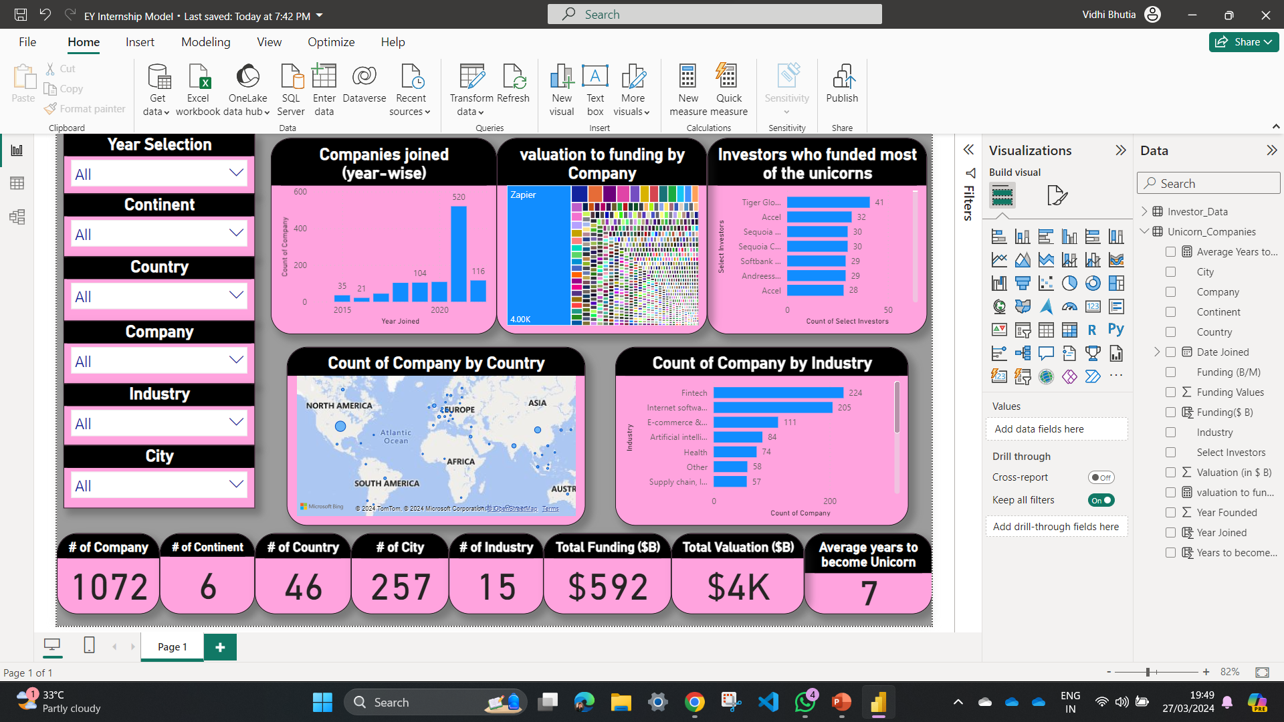
Modelling & Result
On average, it takes 7 years for companies to become unicorns, indicating the substantial time and investment required. These companies have collectively amassed $592 billion in funding and hold a combined valuation of $4000 billion, underscoring their immense economic impact and market significance.

Slide 9
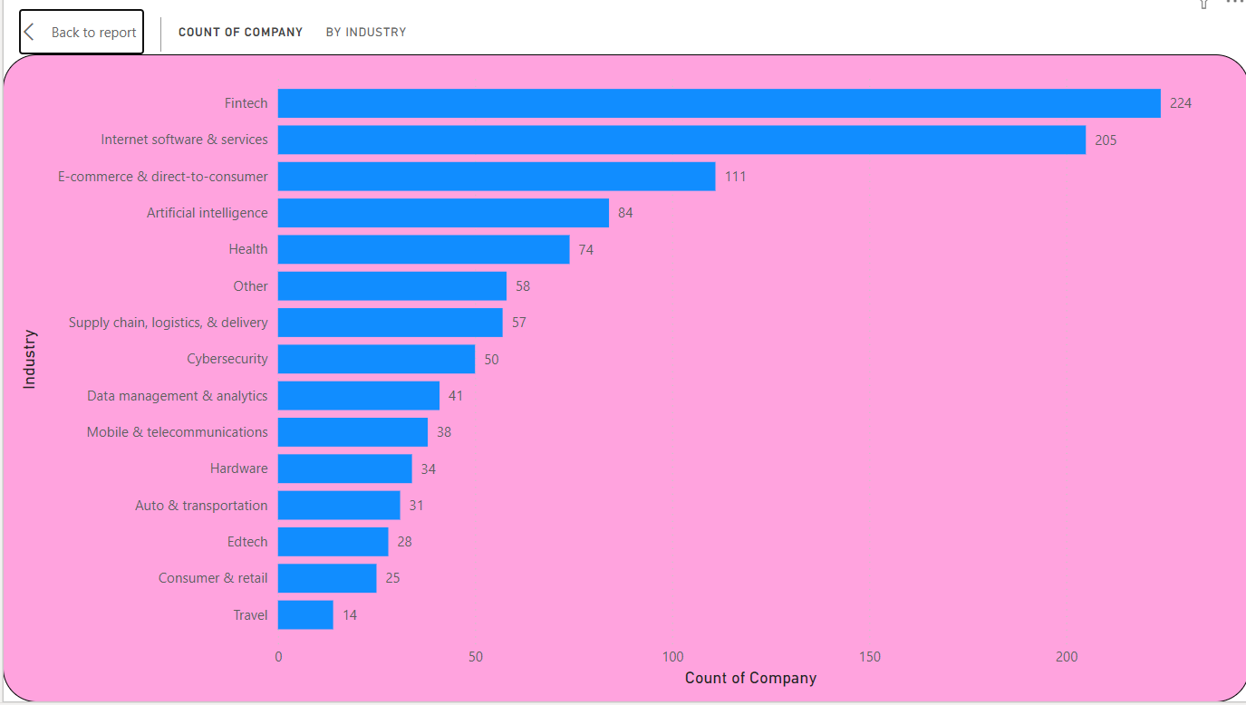
Modelling & Result

Slide 10
Modelling & Result

Slide 11

Conclusion
This project leveraged Microsoft Power BI, particularly utilizing Power Query Editor for effective data cleaning. Through the analysis, it was found that there are a total of 1072 unicorn companies spanning across 6 continents, 46 countries, and 257 cities, representing 15 unique industries. "Tiger Global Management" emerged as the leading investor, followed by "Accel" and "Sequoia Capital". The most prevalent industry among unicorn companies was "Fintech", with North America producing the highest number of unicorn companies. On average, it takes approximately 7 years for a company to achieve unicorn status from its founding date. The total funding raised for these companies amounted to $592 billion, with a combined valuation reaching $4000 billion.

Slide 12


Notes:
Thank You !!

