Slide 1
CloudWise
Explainable Cloud Cost Intelligence & Optimization Platform
AI-Assisted Cloud Cost Anomaly Detection and Resource Optimization
PROJECT TEAM MEMBERS
COURSE & EVALUATION GUIDE
• Pragya Prakash
Register No: 24BML0075
• Vidhi Agarwal
Register No: 24BML0081
Subject: Advanced Cloud Computing
Course Code: BECE355L
Faculty / Evaluator: Prof. Sangeetha N
Implementation Status: Fully Runnable & Verified MVP

Slide 2
AGENDA
Table of Contents
01
Objective
Problem formulation, cloud FinOps motivations, and core platform targets.
02
Proposed Solution
Single-pane CloudWise architecture with simulated AWS data pipeline.
03
Methodology
7-step operational pipeline from telemetry generation to explainable savings.
04
Tech Stack
React 19, FastAPI, SQLite, Scikit-learn, and simulated AWS service concepts.
05
Novelty
Why CloudWise is novel: Explainable recommendations, confidence scores, and risk.
06
Scalability & Future Scope
Evolution path from reproducible MVP to enterprise multi-cloud AWS APIs.
07
Outcomes
Verified achievements: ₹16,310/mo savings, 61 anomalies, 8 recommendations.
08
References
Formal academic citations and official AWS, Scikit-learn, and FastAPI papers.
CloudWise | Advanced Cloud Computing (BECE355L) | Pragya Prakash (24BML0075) & Vidhi Agarwal (24BML0081)
Slide 2 of 16

Slide 3
PROBLEM & GOALS
Problem Statement & Project Objectives
THE PROBLEM IN MODERN CLOUD COMPUTING
CORE OBJECTIVES OF CLOUDWISE
Opaque Cloud Billing: Cloud infrastructure generates massive, continuously changing cost & usage streams. Standard dashboards only report aggregate bills.
Lack of Transparency: Native billing reports fail to explain:
  • Why a sudden cost surge or traffic spike occurred.
  • Which instances are idle or severely oversized.
  • What specific engineering actions can safely lower bills.
  • Exact quantifiable savings in local currency (₹ INR).
1. Real-time Telemetry & Cost Monitoring: Track simulated cloud resources across compute, database, storage, and serverless tiers.
2. Machine Learning Anomaly Detection: Unsupervised detection of unusual daily spend spikes using Scikit-learn's Isolation Forest.
3. Underutilization & Inefficiency Profiling: Transparent FinOps heuristics identifying underused compute (<10% CPU), idle DBs, and cold storage.
4. Actionable Recommendation Generation: Generate concrete, non-destructive rightsizing and migration recommendations.
5. Quantified Savings Estimation: Compute exact monthly and annual savings in Indian Rupees (₹ INR) for every identified waste.
6. Explainable Human-Readable Rationale: Answer WHAT is wrong, WHY it was flagged, WHAT to do, RISK tier, and CONFIDENCE score.
7. Short-Term Predictive Cost Forecasting: Project next 14 days of cloud expenditure using regression modeling to prevent bill shocks.
Cloud Data → Analysis → Intelligence → Recommendation → Savings
CloudWise | Advanced Cloud Computing (BECE355L) | Pragya Prakash (24BML0075) & Vidhi Agarwal (24BML0081)
Slide 3 of 16

Slide 4
SYSTEM ARCHITECTURE
Proposed Solution — High-Level Architecture
"An explainable cloud cost intelligence platform that combines anomaly detection, resource utilization analysis, cost forecasting, and recommendation generation in a single unified dashboard."
LAYER 1: DATA INGESTION
Simulated AWS Telemetry Dataset
• 60-Day Historical Data | 20 Active Resources
• Services: EC2, RDS, S3, Lambda
• Injected Spikes, Underutilization & Traffic Bursts
LAYER 2: PERSISTENCE
SQLite Relational Storage (cloudwise.db)
• Tables: resources, cost_records, usage_records
• 1,200 Cost Records + 1,200 Metric Telemetry Points
• Zero external database dependency, instant processing
LAYER 3: ANALYTICS & ML ENGINE
CloudWise Intelligence Core (Python / Scikit-Learn)
│ ML Anomaly Detection │ Utilization Analysis │ 14-Day Forecasting ││ Isolation Forest │ FinOps Heuristics │ Linear Trend Model │
LAYER 4: EXPLAINABILITY & INSIGHTS
Dynamic Reasoning & Decision Layer
• Evaluates confidence % and risk tier per resource
• Dynamic calculation-backed explanations (No LLM tokens/costs)
• CloudWise Insights Engine generating 4 high-value executive takeaways
LAYER 5: PRESENTATION
Modern SaaS Web Dashboard (React 19 + Recharts + Tailwind CSS)
• Executive Dashboard • Resource Intelligence • Cost Deep-Dive • Anomalies • Recommendations
Note: CloudWise currently operates in Demo Mode using reproducible simulated AWS Cost Explorer/CloudWatch data. Live AWS API integration is planned for future scope.
CloudWise | Advanced Cloud Computing (BECE355L) | Pragya Prakash (24BML0075) & Vidhi Agarwal (24BML0081)
Slide 4 of 16

Slide 5
PROCESSING PIPELINE
Methodology — 7-Step Operational Pipeline
STEP 1: DATA GENERATION
Synthesize 60 days of telemetry across 20 resources (EC2, RDS, S3, Lambda) with seed 42 to ensure reproducible anomalies and idle patterns.
STEP 5: UTILIZATION HEURISTICS
Execute FinOps rules: EC2 CPU < 10%, RDS CPU < 15% & connections < 10, S3 access < 15 requests/day, Lambda burst detection.
STEP 2: DATA STORAGE
Persist schemas in SQLite (`resources`, `cost_records`, `usage_records`) with automated initialization and seeding on startup.
STEP 6: EXPLAINABILITY ENGINE
Derive transparent metrics: Problem, Recommended Action, Estimated Savings (₹), Risk Level, Confidence %, and Reason.
STEP 3: DATA PREPROCESSING
Extract rolling means, standard deviations, and service-level cost aggregations via Pandas and NumPy.
STEP 7: VISUALIZATION DASHBOARD
Render interactive views in React with Recharts (Area, Donut, Stacked, Bar charts), responsive sidebar, and slide-out inspector.
STEP 4: AI / ML DETECTION
Apply Scikit-learn's Isolation Forest (`contamination=0.08`, `n_estimators=40`) to isolate abnormal spend deviations.
CloudWise | Advanced Cloud Computing (BECE355L) | Pragya Prakash (24BML0075) & Vidhi Agarwal (24BML0081)
Slide 5 of 16

Slide 6
TECH STACK
Technology Stack & Architectural Components
FRONTEND
BACKEND
• React 19: Declarative component-based user interface
• Vite 8: High-speed frontend development & bundling
• Tailwind CSS v4: Custom dark-mode glassmorphic design system
• Recharts: Interactive D3-based financial and telemetry charting
• React Router v7: Single-page application client routing
• Python 3.10+: Core algorithmic backend language
• FastAPI: High-performance asynchronous REST API framework
• Uvicorn: Lightning-fast ASGI production web server
• Pydantic v2: Strict schema validation and data contracts
• CORS Middleware: Cross-origin resource sharing for frontend API calls
DATA & MACHINE LEARNING
CLOUD CONCEPTS (SIMULATED)
• Scikit-Learn: Isolation Forest unsupervised anomaly detection & Linear Regression
• Pandas: DataFrame manipulation, rolling statistics, and time-series aggregation
• NumPy: High-performance vector operations and synthetic data generation
• SQLite3: Self-contained serverless relational database engine
• AWS EC2: Elastic Compute Cloud instances (m5, c5, t3, p3 families)
• AWS RDS: Relational Database Service (PostgreSQL/MySQL db classes)
• AWS S3: Simple Storage Service buckets (Standard vs Glacier/IA)
• AWS Lambda: Serverless function invocations and concurrency telemetry
CloudWise | Advanced Cloud Computing (BECE355L) | Pragya Prakash (24BML0075) & Vidhi Agarwal (24BML0081)
Slide 6 of 16

Slide 7
CORE NOVELTY
Novelty & Key Differentiators — The Explainability Layer
TRADITIONAL CLOUD MONITORING VS CLOUDWISE APPROACH
Traditional Approach: Cloud Usage → Passive Billing Dashboard → Manual Human Triage → Opaque Decision (Reactive & Slow)
CloudWise Approach: Cloud Usage → ML Anomaly Detection → Resource Heuristics → Explainable Recommendation → Quantified Savings (Proactive & Automated)
6 KEY PLATFORM DIFFERENTIATORS
ACTUAL SYSTEM RECOMMENDATION OUTPUT
1. Explainable Recommendations: Answers WHAT is wrong, WHY it happened, and WHAT to do.
2. Machine Learning Anomaly Detection: Unsupervised Isolation Forest flags sudden spikes.
3. Deep Resource Intelligence: Combines billing data with CPU, connections, and request metrics.
4. Precise Savings Quantification: Every item is valued in Indian Rupees (₹) monthly & annually.
5. Predictive 14-Day Cost Forecasting: Linear trend projection alerts before monthly budget overruns.
6. Automated Executive Insights: CloudWise Insight engine generates plain-English takeaways.
Flagged Resource: production-api-03 (EC2 m5.large in ap-south-1)
Identified Problem: EC2 instance is underutilized (Average CPU: 5.7%)
Current Cost: ₹7,200 / month (~₹240 / day)
Actionable Advice: Consider downsizing from m5.large to a smaller instance type (t3.medium) or schedule auto-shutdown during off-peak hours.
Potential Savings: ₹3,240 / month (₹38,880 / year)
Risk & Confidence: Risk: Low | Confidence Score: 92%
Why Was It Flagged? "CPU utilization averaged 5.7% over the 60-day observation period, well below the 10% threshold. The instance appears significantly oversized for its workload."
CloudWise | Advanced Cloud Computing (BECE355L) | Pragya Prakash (24BML0075) & Vidhi Agarwal (24BML0081)
Slide 7 of 16

Slide 8
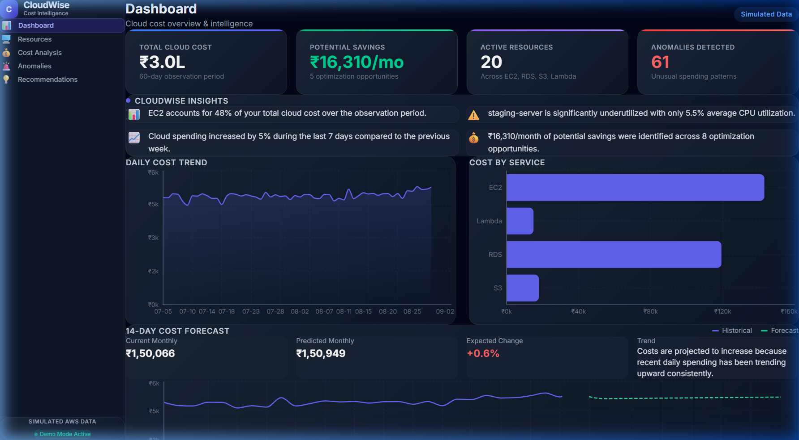
EMPIRICAL RESULTS
Initial Output & Actual System Results
ACTUAL PLATFORM METRICS & KPIS
LIVE RUNNING DASHBOARD SCREENSHOT
Total Simulated Cloud Spend: ₹2,95,141 (~₹3.0 Lakhs across 60 days)
Potential Monthly Savings: ₹16,310 / month (₹1,95,720 / year)
Active Resources Monitored: 20 assets (8 EC2, 4 RDS, 4 S3, 4 Lambda)
Anomalies Flagged: 61 events detected (8 Critical, 2 High)
Optimization Opportunities: 8 active actionable recommendations
Current Monthly Run-Rate: ₹1,50,066 / month
Predicted Monthly Run-Rate: ₹1,50,949 / month (+0.6% drift)
Forecast Prediction Window: 14 days ahead
CloudWise | Advanced Cloud Computing (BECE355L) | Pragya Prakash (24BML0075) & Vidhi Agarwal (24BML0081)
Slide 8 of 16

Slide 9
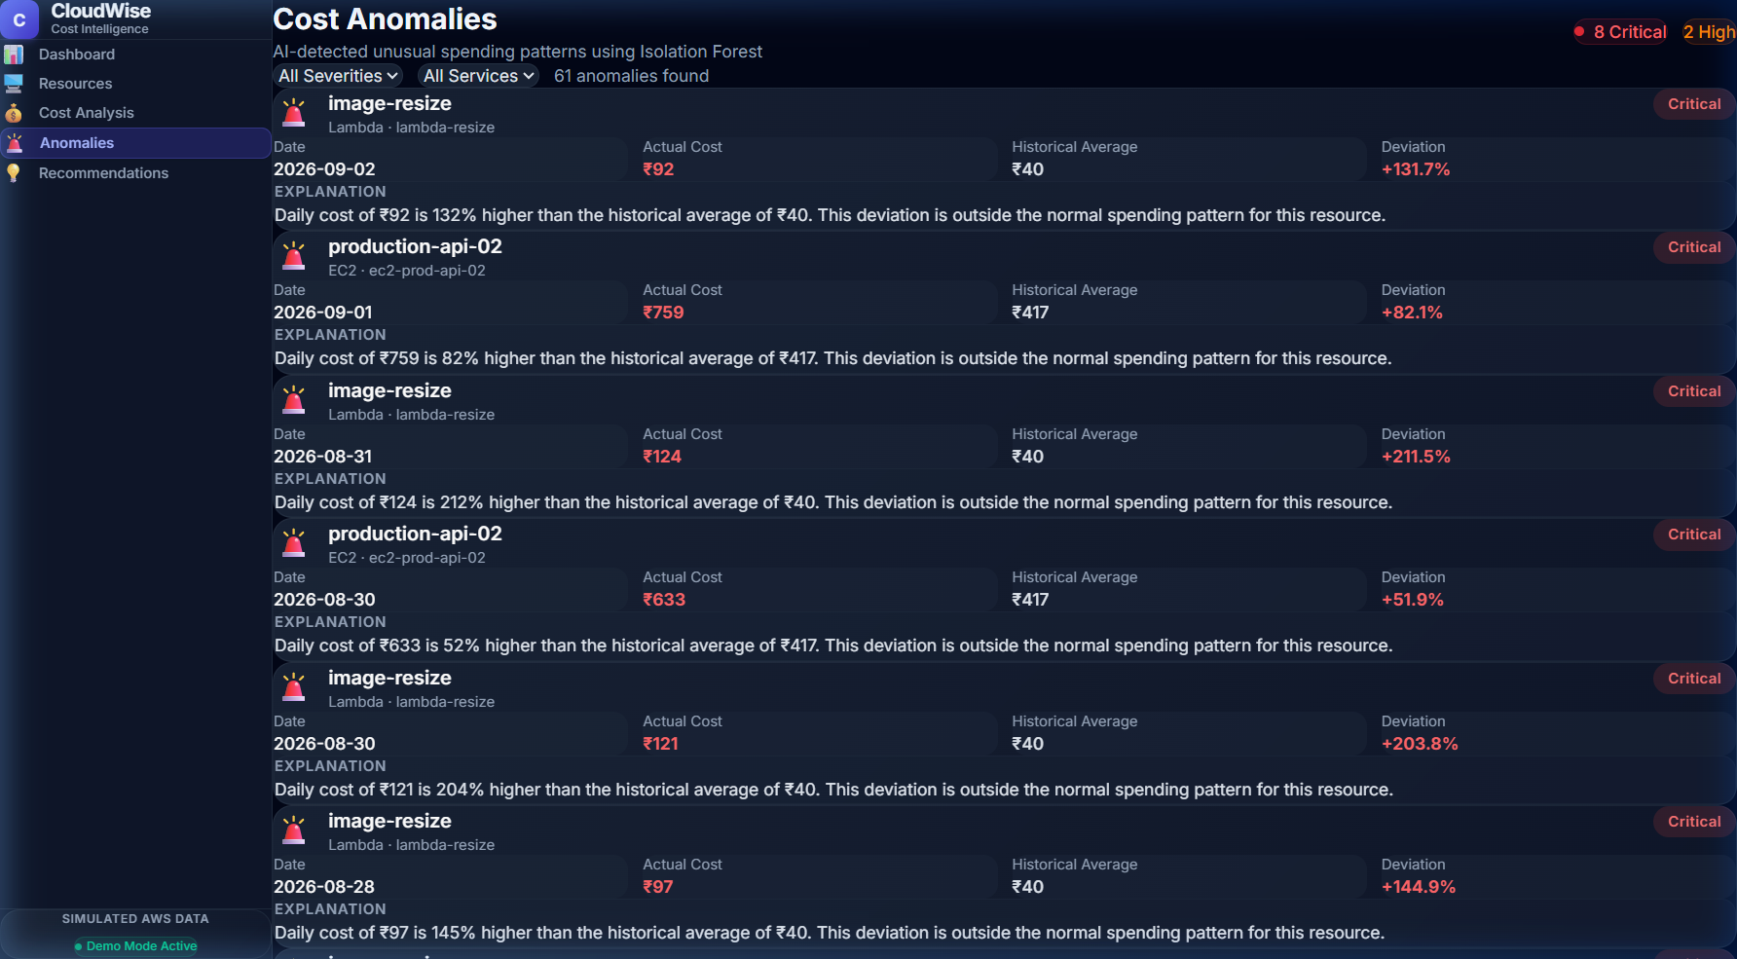
IMPLEMENTATION CODE
Implementation & Program Source Code
CORE BACKEND IMPLEMENTATION (PYTHON / FASTAPI)
LIVE ANOMALY DETECTION OUTPUT
1. Isolation Forest Anomaly Detection (analysis.py):
df["rolling_mean"] = df["daily_cost"].rolling(7, min_periods=1).mean()
features = df[["daily_cost", "rolling_mean"]].values
model = IsolationForest(contamination=0.08, random_state=42, n_estimators=40)
preds = model.fit_predict(features) # -1 flags anomalies
One-Line Explanation: Unsupervised ML model isolates unusual spending deviations based on daily expenditure and 7-day rolling baseline.
2. Underutilization & Dynamic Savings Rule (analysis.py):
if r["service"] == "EC2" and r.get("utilization_status") == "Underutilized":
saving = round(r["monthly_cost"] * 0.45, 0)
confidence = min(95, round(90 + (10 - avg_cpu) * 0.5, 0))
One-Line Explanation: Evaluates observed CPU heuristics against FinOps thresholds and dynamically scales confidence and savings.
3. FastAPI Endpoint Handler (main.py):
@app.get("/api/recommendations")
def recommendations():
return analysis.get_recommendations()
One-Line Explanation: Provides lightning-fast JSON payload serving recommendations directly to the React interface.
CloudWise | Advanced Cloud Computing (BECE355L) | Pragya Prakash (24BML0075) & Vidhi Agarwal (24BML0081)
Slide 9 of 16

Slide 10
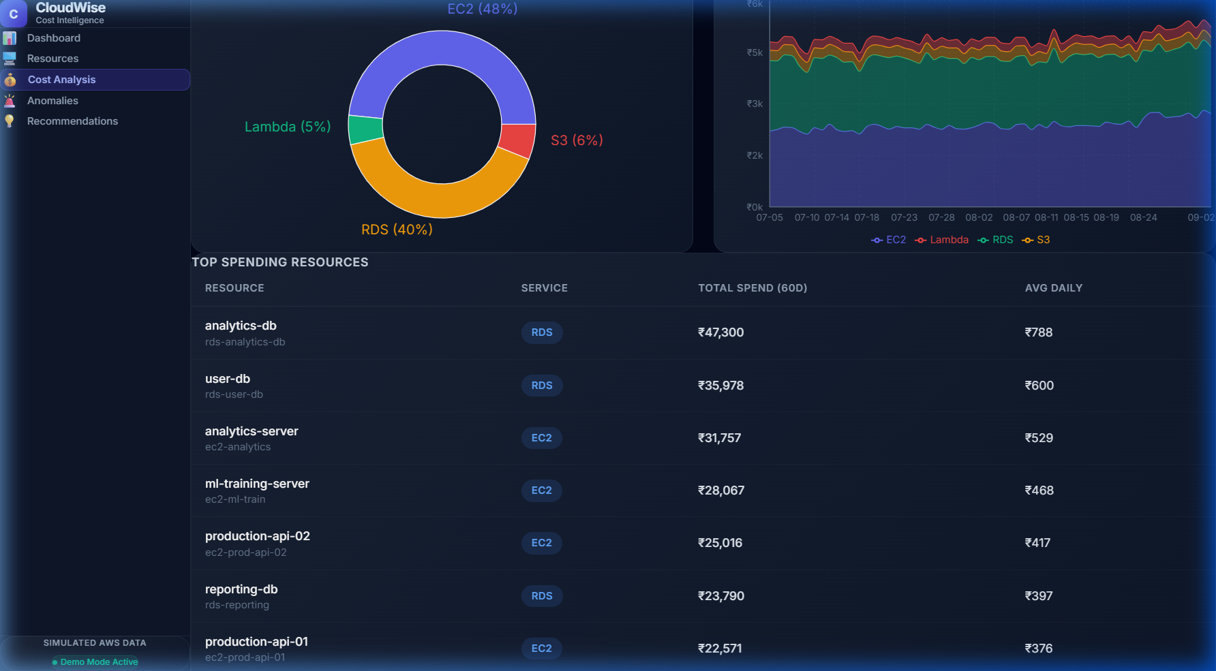
DATA INSIGHTS
Graphs & Empirical Data Analysis
REAL VISUALIZATIONS GENERATED BY CLOUDWISE (RECHARTS / REACT)
EMPIRICAL OBSERVATIONS FROM GENERATED TELEMETRY
• Cost Distribution by Service: EC2 accounts for 48–51% (~₹1.50L) of cloud expenditure, RDS accounts for 40% (~₹1.18L), Lambda accounts for 6% (~₹17k), and S3 represents 3% (~₹10k).
• Daily Spending Trajectory: Daily spend maintains a consistent baseline between ₹4,700–₹5,200/day, with upward spikes occurring in the final 10 days due to injected Lambda traffic bursts and scaling events.
• Identified Inefficiencies: Three EC2 instances (production-api-03, staging-server, dev-server-02) maintain average CPU below 6%, representing ₹6,615/mo in preventable waste.
• 14-Day Linear Forecast: Linear regression indicates a mild upward trend (+0.6% monthly drift), alerting administrators to budget overruns before they materialize.
CloudWise | Advanced Cloud Computing (BECE355L) | Pragya Prakash (24BML0075) & Vidhi Agarwal (24BML0081)
Slide 10 of 16

Slide 11
SYSTEM EVOLUTION
Scalability & Deployment Potential
ARCHITECTURE EVOLUTION: MVP TO PRODUCTION
Current MVP Implementation: Simulated AWS Telemetry → SQLite Relational DB → FastAPI Engine → React Vite SPA (Self-contained, credential-free, fast demo)
Production Enterprise Target: AWS Cost Explorer + CloudWatch Metric Streams + AWS Config → Scalable Ingestion Pipeline (Kafka / Celery) → PostgreSQL / TimescaleDB → CloudWise Analytics Core → React Enterprise Dashboard
INFRASTRUCTURE & DATA SCALABILITY
ENTERPRISE DEPLOYMENT & SECURITY
1. Database Evolution: Transition from SQLite to PostgreSQL / TimescaleDB for multi-year time-series telemetry.
2. Expanded Cloud Services: Broaden monitoring to AWS EKS (Kubernetes), ECS, DynamoDB, NAT Gateways, and CloudFront.
3. Scheduled Data Ingestion: Asynchronous event-driven data ingestion using AWS EventBridge, SQS, and Celery workers.
4. High-Throughput Processing: Distributed ML training and batched anomaly evaluation across millions of metrics.
5. Live AWS Integration: Seamless connection via IAM Cross-Account Roles & AWS Boto3 SDK (no static keys).
6. Multi-Account Management: Centralized FinOps visibility across entire AWS Organizations (Dev, Staging, Prod accounts).
7. Security & Governance: Role-Based Access Control (RBAC), SSO integration, and full audit logging.
8. Cloud-Native Hosting: Containerized Docker deployment on AWS ECS Fargate or AWS App Runner.
CloudWise | Advanced Cloud Computing (BECE355L) | Pragya Prakash (24BML0075) & Vidhi Agarwal (24BML0081)
Slide 11 of 16

Slide 12
FUTURE VISION
Future Scope — Roadmap & Roadmap Distinctions
CURRENT MVP (IMPLEMENTED & CONFIRMED)
FUTURE DEVELOPMENT (PLANNED ENHANCEMENTS)
✓ Simulated AWS Telemetry: 60-day reproducible dataset covering EC2, RDS, S3, and Lambda instances with realistic noise and deliberate spikes.
✓ Unsupervised ML Anomaly Detection: Scikit-learn Isolation Forest flagging 61 cost anomalies with severity tiers (Critical, High, Medium, Low).
✓ Rule-Based FinOps Heuristics: Underutilization rules for compute (<10% CPU), database (<15% CPU, <10 conns), and storage access.
✓ Explainable Recommendation Layer: Dynamic answers for WHAT, WHY, ACTION, RISK, CONFIDENCE %, and SAVINGS in ₹ INR.
✓ 14-Day Cost Forecasting: Lightweight linear regression projecting short-term spending trends and percentage changes.
✓ Glassmorphic React Dashboard: Single-pane SaaS web interface with live Recharts visualizations and slide-out resource inspector.
1. Live AWS Boto3 Integration: Direct credentialed connection to AWS Cost Explorer, CloudWatch Metrics, and AWS Compute Optimizer.
2. Real-time Streaming Alarms: Integration with AWS SNS, Slack Webhooks, and PagerDuty for instantaneous cost spike alerts.
3. Multi-Cloud FinOps Support: Extend intelligence layer to Microsoft Azure (Cost Management) and Google Cloud Platform (Cloud Billing).
4. Advanced Time-Series ML: Evaluate SARIMA, Facebook Prophet, and LSTM neural networks for complex seasonal spending patterns.
5. SHAP Feature Attribution: Integrate SHapley Additive exPlanations for mathematical feature-level explainability in enterprise audits.
6. 1-Click Automated Remediation: Opt-in automated downsizing, schedule stop/start, and lifecycle rule migration with safety rollbacks.
CloudWise | Advanced Cloud Computing (BECE355L) | Pragya Prakash (24BML0075) & Vidhi Agarwal (24BML0081)
Slide 12 of 16

Slide 13
PROJECT ROADMAP
Project Roadmap — 2-Month Execution Timeline
TARGET ACHIEVED: CORE PROJECT IMPLEMENTATION COMPLETED BY END OF MONTH 1
MONTH 1: IMPLEMENTATION & WIND-UP (DONE)
MONTH 2: VALIDATION & ACADEMIC DELIVERABLES
WEEK 1 (Foundation): Architecture design, simulated 60-day AWS dataset generation (EC2, RDS, S3, Lambda), SQLite database schema, and initial FastAPI REST server.
WEEK 2 (Core Intelligence): Cost analysis engine, resource utilization telemetry calculations, and Scikit-learn Isolation Forest ML anomaly model.
WEEK 3 (Explainability & Forecasting): Explainable recommendation engine, dynamic reasoning generator, 14-day linear cost forecasting, and CloudWise insights logic.
WEEK 4 (Final Implementation / Wind-Up): Frontend-backend integration, Recharts visualizations, UI polish, layout bug fixes, endpoint testing, and final MVP completion.
WEEK 5 (Validation & Stress Testing): Model hyperparameter tuning (contamination rates), boundary condition testing, and validation across varying resource loads.
WEEK 6 (Comprehensive Documentation): Preparation of comprehensive project report, research documentation, architectural diagrams, and user guide.
WEEK 7 (Presentation & Viva Rehearsal): Finalization of academic slide deck, live demo preparation, faculty review feedback incorporation, and practice dry runs.
WEEK 8 (Final Evaluation & Submission): Final academic viva defense, project submission, GitHub code archive packaging, and evaluation sign-off.
CloudWise | Advanced Cloud Computing (BECE355L) | Pragya Prakash (24BML0075) & Vidhi Agarwal (24BML0081)
Slide 13 of 16

Slide 14
DELIVERABLES
Project Deliverables & Achieved Outcomes
CURRENTLY ACHIEVED DELIVERABLES (VERIFIED)
FUTURE / EXPECTED OUTCOMES (PLANNED)
✓ Fully Functional FinOps Dashboard: High-performance React 19 web application with dynamic KPIs, dark-mode design system, and zero layout issues.
✓ Reproducible 60-Day AWS Dataset: 20 simulated cloud assets (EC2, RDS, S3, Lambda) with realistic seasonal variance and injected anomalies.
✓ Unsupervised ML Cost Anomaly Detection: Isolation Forest algorithm successfully identifying 61 cost spikes categorized into 4 severity levels.
✓ Transparent Utilization Profiling: Accurate detection of underutilized instances, idle databases, and infrequently accessed storage.
✓ Explainable Recommendation Engine: Every opportunity provides Problem, Action, Confidence %, Risk tier, and human-readable Reason.
✓ Demonstrated Financial Savings: Identified ₹16,310/month (~₹1.95 Lakhs/year) of potential recurring savings across 8 resources.
✓ 14-Day Predictive Spending Forecast: Linear regression model forecasting upcoming expenditure trends (+0.6% monthly drift).
• Live AWS API Integration: Real-time synchronization with AWS Cost Explorer, CloudWatch Metric Streams, and AWS Budgets via IAM.
• Multi-Cloud Support: Unified cost intelligence dashboard bridging AWS, Microsoft Azure, and Google Cloud Platform.
• Automated 1-Click Remediation: Direct execution of recommended downsizing, stopping idle instances, or transitioning S3 storage tiers.
• Enterprise Organization Management: Multi-tenant role-based access control, SSO authentication, and team-level budget alerting.
• Continuous Real-Time Streaming Anomaly Detection: Kafka/Kinesis streaming anomaly detection for instantaneous alerts.
CloudWise | Advanced Cloud Computing (BECE355L) | Pragya Prakash (24BML0075) & Vidhi Agarwal (24BML0081)
Slide 14 of 16

Slide 15
REFERENCES
Academic & Technical References
OFFICIAL DOCUMENTATION & ACADEMIC LITERATURE
1. AWS Cost Management Documentation (2024): Amazon Web Services. 'AWS Cost Explorer and AWS Cost Anomaly Detection User Guide.' AWS Cloud Financial Management Documentation, Seattle, WA.
2. AWS CloudWatch Metrics Reference (2024): Amazon Web Services. 'Amazon CloudWatch Metrics, Dimensions, and Telemetry Reference Guide.' AWS Technical Documentation.
3. Isolation Forest Algorithm: Liu, F. T., Ting, K. M., & Zhou, Z. H. (2008). 'Isolation Forest.' In Proceedings of the Eighth IEEE International Conference on Data Mining (ICDM), pp. 413–422. DOI: 10.1109/ICDM.2008.17.
4. Scikit-Learn Framework: Pedregosa, F., Varoquaux, G., Gramfort, A., Michel, V., Thirion, B., Grisel, O., et al. (2011). 'Scikit-learn: Machine Learning in Python.' Journal of Machine Learning Research (JMLR), 12, pp. 2825–2830.
5. Cloud FinOps Best Practices: Storment, J. R., & Fuller, M. (2023). 'Cloud FinOps: Collaborative, Real-Time Cloud Financial Management.' 2nd Edition, O'Reilly Media, Sebastopol, CA.
6. FastAPI High-Performance Framework: Tiangolo, S. (2023). 'FastAPI: Modern, Fast (High-Performance) Web Framework for Building APIs with Python 3.8+.' https://fastapi.tiangolo.com
7. React User Interface Library: Meta Open Source (2024). 'React: The Library for Web and Native User Interfaces.' https://react.dev
8. Recharts Data Visualization: Recharts Group (2024). 'Recharts: A Composable Charting Library Built on React Components.' https://recharts.org
CloudWise | Advanced Cloud Computing (BECE355L) | Pragya Prakash (24BML0075) & Vidhi Agarwal (24BML0081)
Slide 15 of 16

Slide 16
CONCLUSION
Conclusion & Project Summary
PROJECT SUMMARY & KEY TAKEAWAYS
• Transformation of Cloud Billing: CloudWise demonstrates how raw cloud cost data can be transformed from passive retrospective billing reports into actionable, explainable resource intelligence.
• Bridging AI and FinOps Operations: By coupling unsupervised Isolation Forest anomaly detection with deterministic telemetry heuristics, the system eliminates bill shock without requiring manual threshold configuration.
• Quantifiable Financial Impact: Successfully demonstrated ₹16,310/month (~₹1.95 Lakhs/year) of potential recurring savings across 8 resources, complete with confidence scores and non-destructive recommendations.
• Transparent Explainability: Engineers and executives can confidently make rightsizing decisions because every recommendation answers WHAT is wrong, WHY it was flagged, and WHAT to do.
"From cloud expenditure → to cloud intelligence → to informed optimization."
THANK YOU
Questions & Faculty Discussion | Pragya Prakash (24BML0075) & Vidhi Agarwal (24BML0081) | Guide: Prof. Sangeetha N
CloudWise | Advanced Cloud Computing (BECE355L) | Pragya Prakash (24BML0075) & Vidhi Agarwal (24BML0081)
Slide 16 of 16

