Slide 1

Artificial Intelligence Presentation
Title: Artificial Intelligence In E-Commerce
Submitted By:
Magan Singh(12108313)
Sankit Anand(12106906)
Vidhi Singh(12107831)
Submitted To:
Ankita Wadhawaan

Slide 2
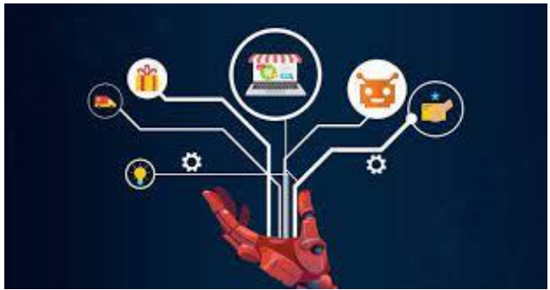
Introduction
When someone says “artificial intelligence,” the first thing that comes to mind might be a vision from movies like Steven Spielberg’s 2001 film A.I. Artificial Intelligence, sci-fi thriller Ex Machina, or 1982 cult classic Blade Runner. But when it comes to the ecommerce sector, it’s less about human-like robotics and more about the learning technologies and algorithms that provide the foundation. AI can help today’s online retailers deliver an optimized customer experience on and off their ecommerce websites by using collected business and customer data to make better business decisions and more accurately predict the future.

Slide 3
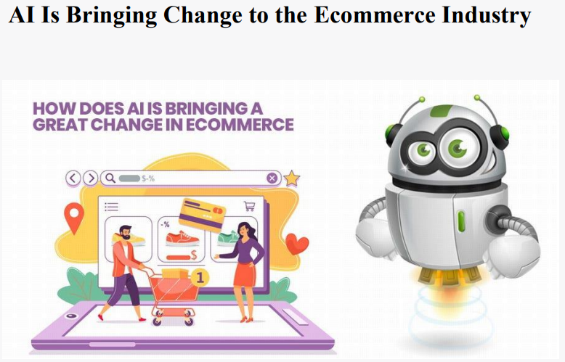
AI In E-commerce
Artificial intelligence isn’t just a novel technology implemented for its “cool factor.” Implementing AI has the potential to impact any number of business functions across your organization. To understand how it could impact your business, it helps to have an understanding of the components of artificial intelligence.
Data mining refers to the gathering of both current and historical data to inform predictions. • Natural language processing focuses on humancomputer interaction and how computers interpret natural human language. • Machine learning concerns using a collection of algorithms to apply past experience or provide examples to solve a problem. Deep learning “involves layering algorithms in an effort to gain greater understanding of the data.”

Slide 4
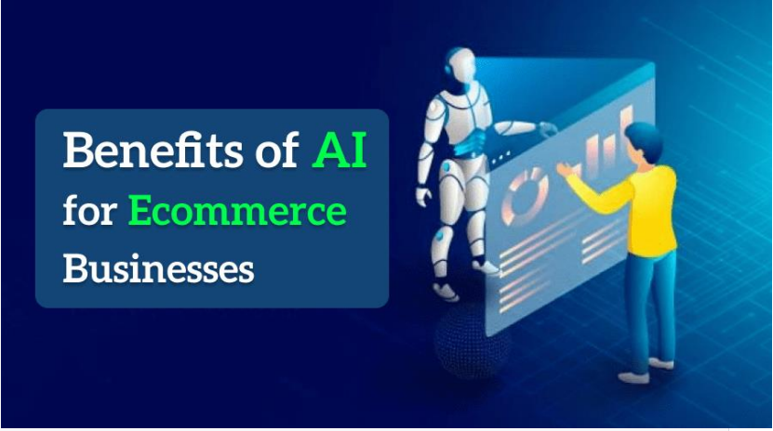
Benefits of Using Artificial Intelligence in Ecommerce Companies
Amazon has long recognized the benefits of artificial intelligence and related technologies. The behemoth ecommerce company uses machine learning to improve product selection and user experience and to optimize logistics. A recent publication from McKinsey & Company and the Retail Industry Leaders Association named seven imperatives for rethinking retail in 2021, and every single one could in some way be supported by some type of AIinformed technology.

Slide 5

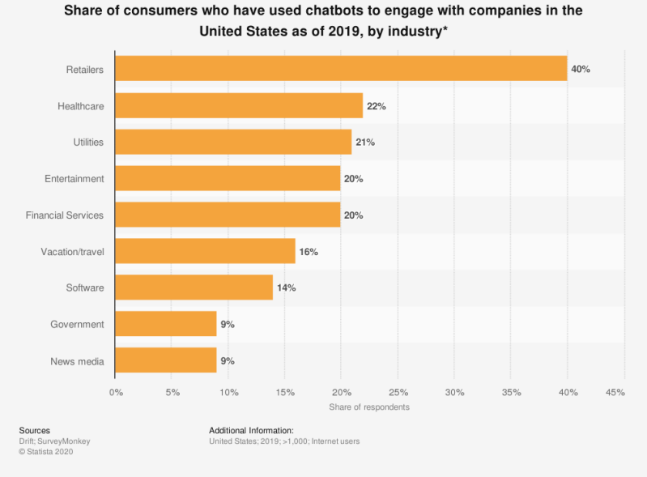

Benefits of Using Artificial Intelligence in Ecommerce Companies
1.More targeted marketing and advertising.
2.Increased customer retention.
3.Seamless automation.
4.Efficient sales process.

Slide 6
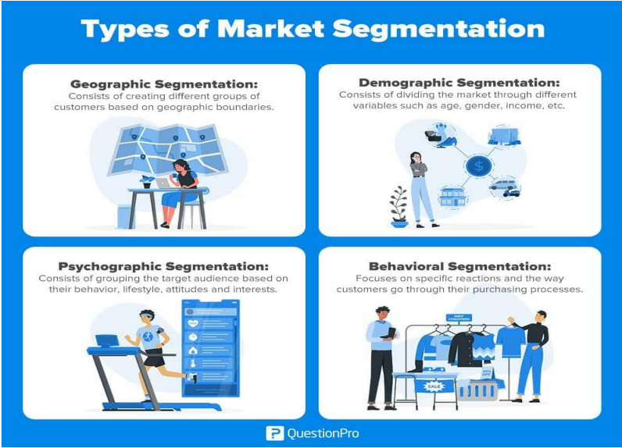
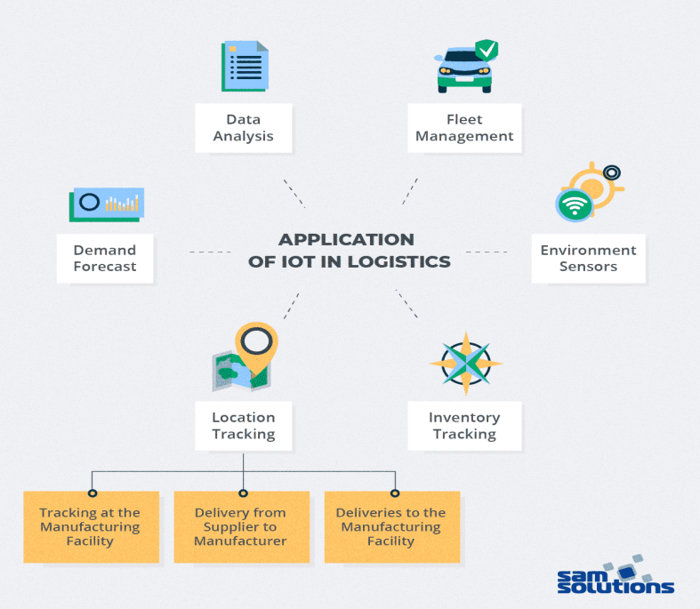
AI Use Cases in Ecommerce
Personalized product recommendations.
Pricing optimization.
Enhanced customer service.
Customer segmentation.
Smart logistics.
Sales and demand forecasting.
Chatbots and Virtual Assistants

Slide 7
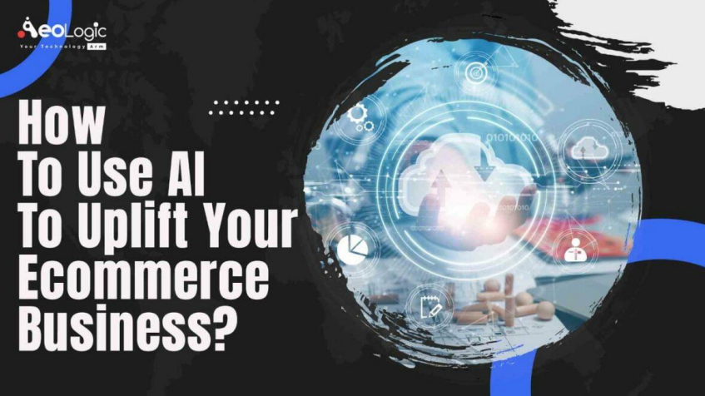
1. Create a strategy.
You have to start somewhere — and your strategy will lay out the path you need to take from there to your AI goal. Don’t just punt this to a newly hired AI expert or your CIO or CTO. Really put some thought into what you want to accomplish with AI. Take a practical approach, and don’t lOMoARcPSD|189 941 16 forget to start small. You can always build on your successes down the road.

Slide 8
2. Find narrow use cases that are relevant to the overall corporate strategy.
The most successful AI use cases live at the intersection of business objectives, data differentiation, and readily available artificial intelligence models. All that to say — you should focus on revenue-generating opportunities where you have a data advantage and in a context appropriate for proven AI technology.
3. Leverage third-party expertise
lOMoARcPSD|189 941 16 Even if you’re an armchair AI aficionado, you’ll want to accept expert assistance on this one. Bring in a tiger team on a project or part-time basis to dig in and help you build a strategic AI roadmap. Those third parties can be helpful in bringing your MVP (minimum viable product) to life as well
4. Build a full-scale solution
Once you’re confident in what your team has produced, it’s time to build the full scale solution. Don’t be surprised if it still takes some iterations before it works like you expect. As you and your team become more comfortable working in the realm of AI, you’ll start to see greater benefit from the projects you implement.

Slide 9
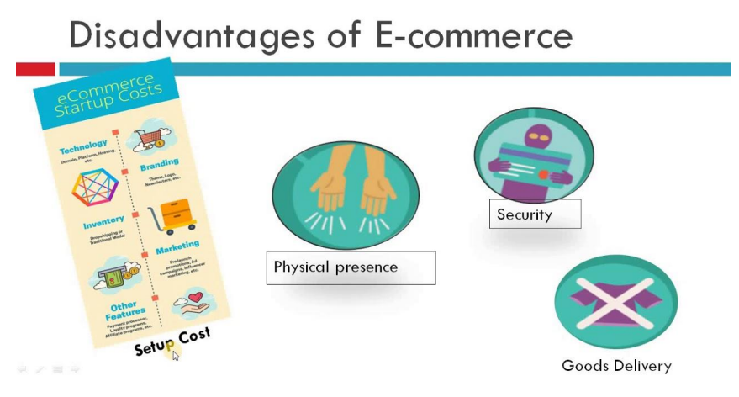
Disadvantages of Artificial Intelligence
1.High costs
2.No creativity
3.Unemployment
4.Make humans lazy
5.No ethics
6.Emotionless
7.No Improvement

Slide 10

METHODOLOGY
1.Data Collection
6.Deployment
2.Data Pre-processing
7.Monitoring and Maintenance
3.Data Analysis
4.Model Building
5.Testing and Validation

Slide 11
CONCLUSION
Tomorrow’s AI sounds like it’s straight from the movies, but there’s plenty of AI technology today that may look less glamorous improving customer experience, increasing conversion rates, and helping to streamline the way the business is run. If you want to deliver the best possible shopping experience on your ecommerce website, look into the various benefits of artificial intelligence and machine lOMoARcPSD|189 941 16 learning. It can help you make better use of your customer and business data to set a plan for your future that will work. As highlighted in this article, artificial intelligence in Ecommerce is playing a leading role in driving innovative solutions and customer experiences. Some the leading use cases of artificial intelligence in Ecommerce is in the area of personalized shopping, product recommendations, and inventory management. As an online retailer, are you considering how to implement a working model of artificial intelligence for your business? Designed for AI in Ecommerce startups, Countants is an established data analytics provider that are enabling online retailers with solutions centred around product analytics and E-commerce KPIs.

Slide 12
REFERENCE
https://scholar.google.com/
https://medium.com/@Countants/how-artificialintelligence-is-transforming-the-e-commerce-industrycountants-scalable-custom-73ae06836d35
https://www.linnworks.com/blog/artificial-intelligencein-ecommerce
4. https://www.bigcommerce.com/articles/ecommerce/ecom merce-ai
5. https://www.luigisbox.com/blog/ecommerce-ai

