Slide 1
TABLEAU • DATA ANALYTICS
Global Fuel Prices
and Taxation Trends
A comparative analysis of petrol prices, crude oil, regional taxation, subsidies and income levels
FUEL PRICE SNAPSHOT
PROJECT PRESENTED BY
Vidhi Sharma
PRICE • TAX • REGION • TIME
en25cs3011043@medicaps.ac.in
Medicaps University | October 2026

Slide 2
PROJECT OVERVIEW
What this project explores
A Tableau dashboard for comparing fuel-price patterns across countries, regions and socio-economic categories.
PROJECT SUMMARY
10
7
Fuel prices are shaped by multiple factors—not only the cost of crude oil, but also taxation, subsidies, policy choices, transport costs and local market conditions.
Countries in price ranking
Regional groups
Top-price comparison
Regional tax comparison
This project uses interactive visual analytics to make those comparisons easier to explore.
3
2
Policy / context lenses
Price series
Tax, subsidy, income
Petrol and Brent crude
MAIN OUTPUT
A multi-view dashboard with a map, trend view, country ranking, regional tax comparison, and subsidy / income breakdowns.
Note: Counts describe the views shown in the current Tableau dashboard. Figures are taken from visible dashboard labels and should be checked against the source data before final submission.

Slide 3
OBJECTIVES
Questions the dashboard is designed to answer
The analysis is descriptive: it compares visible patterns and associations rather than proving cause and effect.
01
Compare countries
02
Compare regions
Identify which countries have the highest displayed average petrol prices.
Explore how average fuel-tax percentages vary by region.
03
Study time trends
04
Explore context
View petrol-price movement over time alongside Brent crude oil.
Compare average petrol prices across subsidy and income categories.
KEY QUESTION
How do displayed fuel prices differ across places and policy categories—and what should we investigate next?

Slide 4
DATA & METHOD
From dataset to interactive dashboard
The workbook’s current views indicate the following fields and analytical steps. Confirm field names and units in the final data source.
FIELDS USED IN THE VIEWS
ANALYTICAL WORKFLOW
Geography
Country, Region
01
Import
Connect Tableau to the source file.
Time
Date / quarter
Prepare
Check data types, missing values, units and dates.
02
Price
Average petrol price (USD/L)
03
Analyze
Aggregate measures and build comparative charts.
Crude oil
Brent crude (USD/bbl)
Tax
Tax as % of fuel price
04
Assemble
Arrange worksheets and add region / income / subsidy filters.
Categories
Income level, subsidy level
05
Validate
Compare displayed figures with the CSV before reporting.

Slide 5
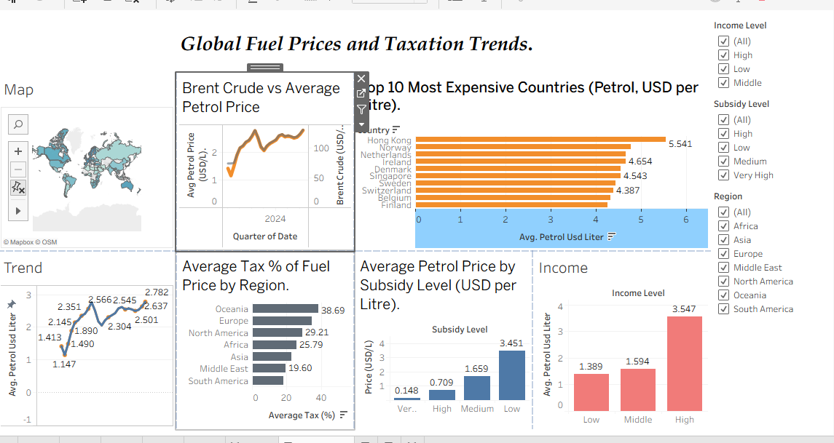
DASHBOARD OVERVIEW
One dashboard, multiple ways to compare
The current workbook brings together geographic, time-series and category comparisons in a single view.
Map
Global distribution
Trend
Petrol vs. crude oil
Ranking
Top-priced countries
Regional bars
Average tax percentage
Category bars
Subsidy and income levels
Current Tableau Desktop view (work in progress)
Interactivity: use the filters to explore how the displayed views change by region, income level and subsidy level.

Slide 6
COUNTRY COMPARISON
Top 10 countries by displayed petrol price
Average petrol price (USD per litre) — values transcribed from the current Tableau view.
Highest displayed average petrol prices
HIGHEST IN THIS VIEW
USD per litre • descending order
Hong Kong
Hong Kong
5.541
5.541 USD/L
Norway
4.654
The next two entries are Norway and the Netherlands.
Netherlands
4.543
Denmark
4.387
Singapore
4.221
HOW TO INTERPRET
Sweden
4.118
These are dashboard averages, not a claim about every fuel station.
Switzerland
3.987
Belgium
3.872
Country ranking does not by itself explain why prices differ.
Finland
3.760
Germany
3.645
Source note: verify against the project CSV before formal submission.

Slide 7
REGIONAL COMPARISON
Average tax as a share of fuel price
Percentages displayed in the current Tableau view; labels are reproduced as shown.
Average tax % of fuel price by region
HIGHEST DISPLAYED TAX SHARE
Average tax share (%)
Oceania
38.69%
Oceania
38.69%
Europe
29.21%
North America
25.79%
LOWEST DISPLAYED TAX SHARE
Africa
19.60%
South America
Asia
19.60%
15.82%
Middle East
19.60%
Check whether regional averages use comparable country coverage and the same period.
South America
15.82%

Slide 8
CATEGORY COMPARISONS
Petrol prices by subsidy and income level
These charts show association between the categories and the displayed average price; they do not establish causation.
Average price by subsidy level
Average price by income level
USD per litre
USD per litre
Very High
0.148
Low
1.389
High
0.709
Middle
1.594
Medium
1.659
Low
3.451
High
3.547
Interpret cautiously: category definitions, country coverage and other policy / market factors may affect these averages.

Slide 9
TIME-SERIES ANALYSIS
Compare petrol prices with Brent crude over time
The workbook uses a dual-axis trend view, so each series has its own scale and unit.
WHAT THE VIEW COMPARES
1 • Match the time period
Check whether dates are monthly, quarterly or yearly.
2 • Respect the two axes
USD/L and USD/bbl are different units and scales.
3 • Look for timing and gaps
Compare direction and turning points; don’t assume causality.
Average petrol price (USD/L)
Brent crude (USD/bbl)
Schematic only: the lines illustrate how to read the dual-axis view; they are not plotted source observations.
For the final report, replace this schematic with a freshly exported chart from the actual Tableau workbook.

Slide 10
SUMMARY OF VISIBLE PATTERNS
What the current dashboard suggests
Interpret these as descriptive observations from the displayed dashboard—not proof of what causes fuel prices to change.
01
Country prices differ widely
02
Tax shares vary by region
Hong Kong is the highest entry in the current top-10 view at 5.541 USD/L.
Oceania is highest at 38.69%, while South America is lowest at 15.82% in the displayed comparison.
03
Category averages diverge
04
Time context matters
The displayed low-subsidy and high-income groups have the highest category averages in their respective charts.
The time-series view should be read alongside crude-oil movement, using each axis’s own units.
RECOMMENDED NEXT CHECKS
Confirm the CSV, filters, aggregation level, data coverage and units before treating displayed values as final results.

Slide 11
CONCLUSION
A useful starting point for fuel-price comparison
The dashboard consolidates several dimensions into one accessible visual analysis.
CONCLUSION
LIMITATIONS TO ACKNOWLEDGE
The project demonstrates how Tableau can bring together geographic patterns, rankings, time trends and category comparisons to explore fuel prices and taxation.
Values are averages and may hide differences within a country.
The result depends on the dataset’s date range and country coverage.
Tax, subsidy and income categories may not be directly comparable.
Interactive filters help users narrow the view and ask more focused questions.
Observed associations do not establish cause and effect.
Next step: validate all displayed figures against the original dataset and publish the final workbook when it is ready.

Slide 12
THANK YOU
Questions & discussion
Global Fuel Prices and Taxation Trends
PROJECT BY
Vidhi Sharma
en25cs3011043@medicaps.ac.in
GITHUB REPOSITORY
[ADD YOUR GITHUB REPOSITORY URL HERE]
TABLEAU PUBLIC DASHBOARD (ADD AFTER PUBLISHING)
[ADD YOUR TABLEAU PUBLIC LINK HERE]
Thank you

