Slide 1



Customer Churn Analysis for Telecom Industry
By Vidhi Gupta | May 2025
by Vidhi Gupta

Slide 2
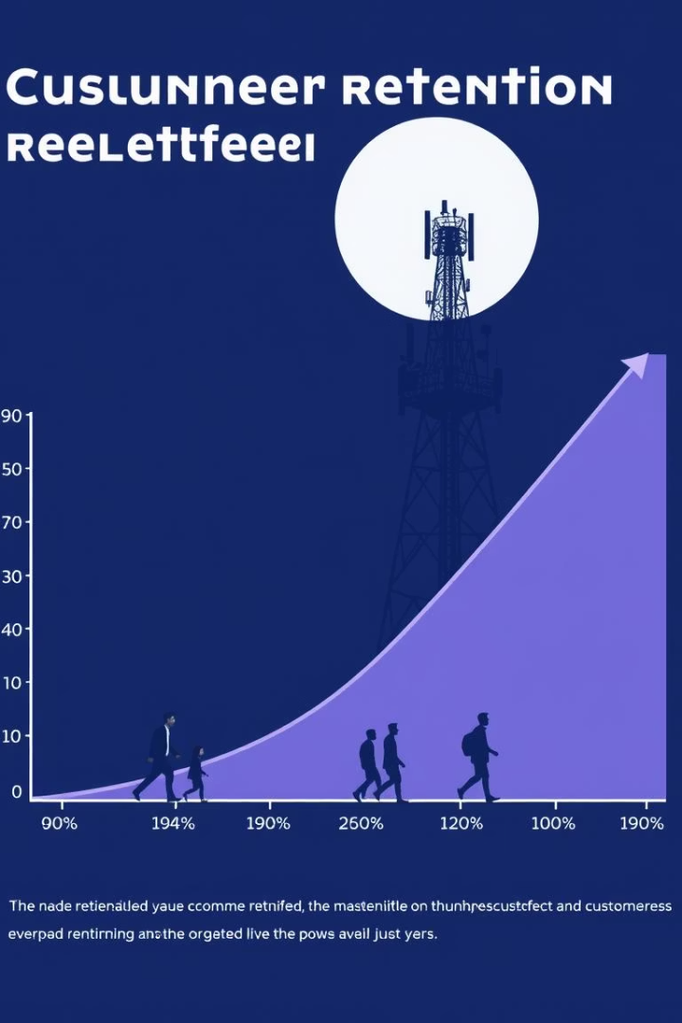



Problem Statement & Objective
Customer churn significantly impacts telecom business revenue. This project aims to predict churn using data analysis and machine learning.
Business Impact
Prediction Goal
Churn directly reduces revenue and growth.
Identify high-risk customers proactively.
Retention Focus
Reduce the overall churn rate.

Slide 3





Tools & Dataset Used
Our analysis utilized key tools and a public dataset to ensure robust insights and predictive power.
Python Ecosystem
Jupyter Notebook
PowerPoint
Interactive development environment.
For clear and concise reporting.
Pandas for data handling
Seaborn for visualization
Scikit-learn for ML models
ELI5 for model insights
Dataset
Telco Customer Churn (Kaggle).

Slide 4






Approach / Steps Taken
Our project followed a structured six-step methodology from raw data to actionable recommendations.
Data Cleaning & Preprocessing
Ensuring data quality and readiness.
Exploratory Data Analysis (EDA)
Discovering patterns and insights.
Model Building
Logistic Regression for prediction.
Model Interpretation
Understanding feature importance using ELI5.
Customer Segmentation
Grouping customers for targeted actions.
Recommendation Generation
Developing strategies to reduce churn.

Slide 5
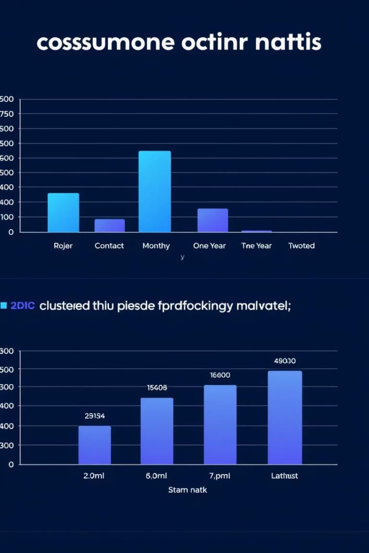
Key Insights
Our analysis revealed critical factors influencing customer churn in the telecom industry.
Contract Type
Month-to-month contracts lead to higher churn. Long-term contracts show lower churn rates.
Monthly Charges
High monthly charges significantly increase the likelihood of churn.
Customer Loyalty
Loyal customers often have long tenure and stable service plans.
Segmentation Value
Segmenting customers allows for more effective and targeted interventions.

Slide 6

Final Recommendations
Based on our insights, we propose targeted strategies to effectively reduce customer churn.
1
Targeted Discounts
Offer incentives to high-risk customers.
2
Long-Term Contracts
Encourage customers to sign up for them.
3
Fiber Support
Improve support for fiber internet users.
4
Re-engagement Campaigns
Reach out to dormant users.

