Slide 1
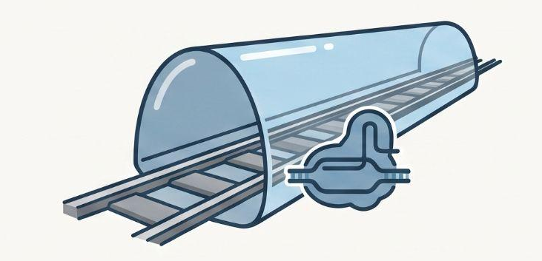
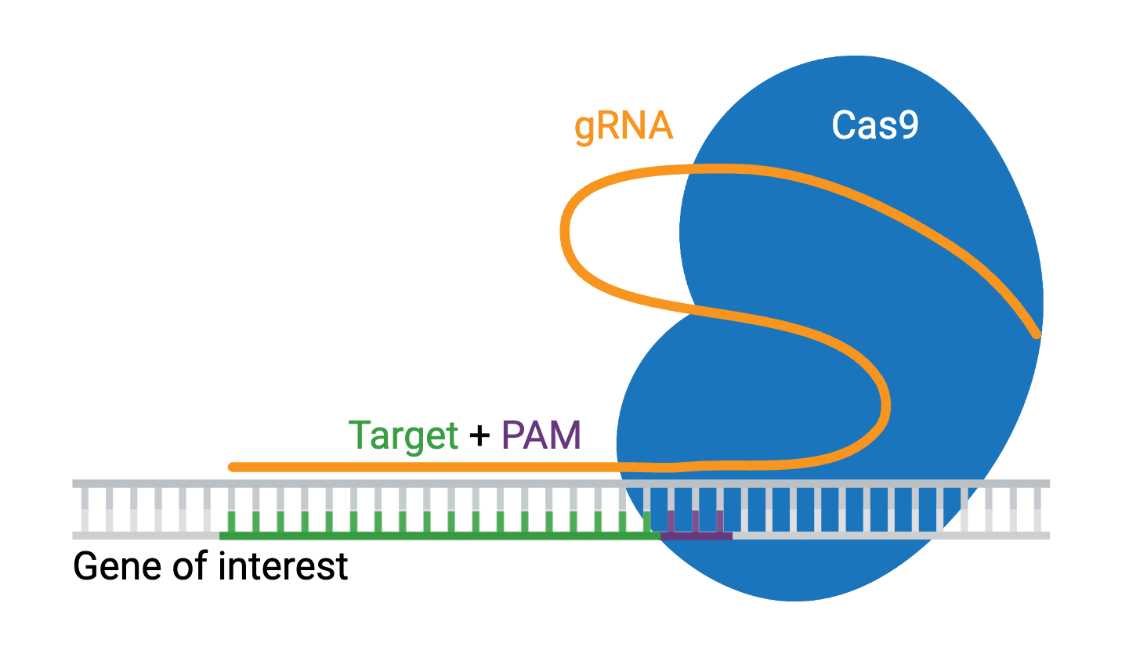
CRISPR GUIDE DESIGN • reAgent HACKATHON 2026
GuideRail
A trustworthy, generative CRISPR sgRNA designer
Sequence quality + chromatin accessibility + auditable validation
Notes:
[Sources]
- README.md — project overview and one-paragraph pitch

Slide 2
THE PROBLEM
A good sequence is not always a good guide
Most design tools score what is encoded in the guide sequence. Cells add a second constraint: whether Cas9 can physically reach the target DNA.
SEQUENCE-ONLY VIEW
CELL-CONTEXT VIEW
Same 20-nt guide
Different accessibility
GC content and learned sequence patterns are fixed. The score cannot see the cell type.
Open chromatin can expose the site; closed chromatin can block it. Accessibility varies by biological condition.
OPEN → reachable
CLOSED → constrained
CELLGUIDE AI
02
Notes:
[Sources]
- README.md — ‘The problem, in plain terms’

Slide 3
THE IDEA
CellGuide treats context as evidence, not decoration
The same guide sequence is evaluated alongside chromatin accessibility, then every conclusion is checked against measured editing outcomes.
02
01
03
Biological context
Guide sequence
Real outcomes
Intrinsic on-target potential
ATAC-seq accessibility asks whether the target site is open in the chosen cells.
Benchmark, critique, revise
A context-aware hypothesis is only useful if the validation loop can reject it.
CELLGUIDE AI
03
Notes:
[Sources]
- README.md — CellGuide’s idea
- README.md — project validation philosophy

Slide 4
ARCHITECTURE
Two workflows share one scoring core and one lab loop
TRACK A
Build + validate
SHARED CORE
CLOSED-LOOP LEARNING
Literature → formula → benchmark → critique → provenance
Agent 3 scoring
Recommend → test → record → update
Sequence efficacy plus accessibility, with assumptions written in SPEC.md
Agent 6 prioritizes the most informative experiment. Agent 8 sends it to Benchling and returns real results.
TRACK B
Score a gene
Gene lookup → candidate guides → prior-report matching
CELLGUIDE AI
04
Notes:
[Sources]
- README.md — ‘How it’s built’
- README.md — Track A, Track B, Agents 6 and 8

Slide 5
VALIDATION JOURNEY
The pipeline improved by finding reasons to distrust itself
ROUND 1
ROUND 2
ROUND 3
The blend underperformed
Naive tests missed the signal
The conditional claim reproduced
A missing-specificity fallback made unknown data look safe. Specificity was removed instead of disguised.
Marginal accessibility was weak, and ATAC replicate sensitivity remained a real warning.
Among above-median sequence guides, accessibility showed significant conditional value.
CELLGUIDE AI
05
Notes:
[Sources]
- README.md — ‘What we’ve actually found so far’, Rounds 1–3

Slide 6
BENCHMARK EVIDENCE
A simple linear blend made prediction worse
Spearman correlation with measured editing efficiency across 199 real guides
THE HONEST VERDICT
0.315 < 0.441
Adding accessibility and an ungrounded specificity term did not create a better universal score. The shipped recommendation therefore falls back to the supported sequence signal.
CELLGUIDE AI
06
Notes:
[Sources]
- README.md — key numbers table
- agent4_benchmarking/output/REPORT.md

Slide 7
CORRECTED RESULT
Accessibility matters conditionally—not as a universal add-on
Testing Ito et al.’s actual interaction claim changes the interpretation: accessibility adds value among guides that already have above-median sequence scores.
ρ = 0.232
p = 0.008
0.741 → 0.862
conditional correlation
statistically significant
gate precision increased
Subset: n = 131 guides with above-median sequence scores. Signal is real, but it is not yet folded into a defensible single score.
CELLGUIDE AI
07
Notes:
[Sources]
- README.md — Round 3 and key numbers table
- agent4_benchmarking/output/INTERACTION_EFFECT_CHECK.md

Slide 8
WHAT WE WILL NOT OVERCLAIM
Three boundaries keep the demo scientifically credible
01
02
03
No specificity claim
ATAC is replicate-sensitive
Track B needs its own validation
Off-target assessment was never grounded in a real data source, so it was removed from the scoring library.
Borderline guides change pass/fail status across the two accessibility measurements.
Azimuth-scored new-gene guides do not inherit the ρ = 0.441 result from Ito’s precomputed scores.
CELLGUIDE AI
08
Notes:
[Sources]
- README.md — Round 2 caveats
- README.md — ‘Careful with these claims on a slide’

Slide 9
PRODUCT WORKFLOW
A gene name becomes a ranked, traceable experiment
Track B is the user-facing path; Agents 6 and 8 extend it into a real learning loop.
INPUT
AGENT 3
AGENT 9
AGENT 6
AGENT 8
Gene symbol
Find + score
Check reports
Choose next test
Sync Benchling
e.g., BCL11A
Real coordinates, sequence and candidate guides
Exact sequence matching after literature search
High potential plus high uncertainty
Send recommendation; retrieve lab result
Wet-lab result returns to update the next recommendation
CELLGUIDE AI
09
Notes:
[Sources]
- README.md — Track B
- README.md — Agents 6 and 8
- README.md — example BCL11A workflow

Slide 10
TRACK C • PROTO DESIGN
Proto turns real guide candidates into a constrained panel
A real genomic candidate pool passes evidence gates before context-specific ranking.
INPUT
HARD GATES
CONTEXT
SELECTION
OUTPUT
Agent 3 pool
Filter evidence
Rank context
Balance genes
Export panel
Real PAM-derived guides
Efficacy, GC, specificity
Paired ATAC advantage
Three guides per target
Ranked CSV + design report
Spacers stay fixed; missing evidence fails visibly
CELLGUIDE AI
10
Notes:
[Sources]
- https://github.com/evo-design/proto-language — Proto framework
- track_c_proto_design/run.py — staged optimization over existing PAM-derived candidates
- track_c_proto_design/design_spec.json — hard gates and three-guides-per-gene panel quota
- track_c_proto_design/README.md — evidence requirements and no-spacer-mutation policy

Slide 11
PARTIAL VIRTUAL TEST • T-CELL
Proto retained five T-cell-open guides
01
02
03
GZMA
GZMB
CD3D
GAGGAACTCCTATAGATTTC ATAC Δ +1.000 Efficacy 0.767
GCAACCAATCCTGCTTCTGC ATAC Δ +1.000 Efficacy 0.883
GAACATAGCACGTTTCTCTC ATAC Δ +1.000 Efficacy 0.883
CELLGUIDE AI
11
Notes:
[Sources]
- papers/ito_2024/table_s2_tcell_vs_k562_panel.csv — published 20-nt guide sequences
- agent4_benchmarking/output/cross_context_panel_results.csv — normalized context accessibility and sequence efficacy
- track_c_proto_design/virtual_test.py — partial hard gates and context-contrast objective
- track_c_proto_design/output/proto_virtual_test_results.json — ranked retrospective results
Retrospective virtual test only; specificity and full genomic provenance were not assessed.

Slide 12
PARTIAL VIRTUAL TEST • K562
Proto ranked K562-open guides
01
02
03
HBE1
TFR2
GATA1
AGTCAGCACCTTCTTGCCAT ATAC Δ +0.768 Efficacy 1.000
CACCGTCCCAGCTGATGAAG ATAC Δ +0.690 Efficacy 0.767
GGTACTGCCCATCTCTACCA ATAC Δ +0.535 Efficacy 0.883
CELLGUIDE AI
12
Notes:
[Sources]
- papers/ito_2024/table_s2_tcell_vs_k562_panel.csv — published 20-nt guide sequences
- agent4_benchmarking/output/cross_context_panel_results.csv — normalized context accessibility and sequence efficacy
- track_c_proto_design/virtual_test.py — partial hard gates and context-contrast objective
- track_c_proto_design/output/proto_virtual_test_results.json — ranked retrospective results
HBB tied GATA1 on the displayed metrics. Retrospective virtual test only; specificity was not assessed.

Slide 13
PROTO VIRTUAL TEST RESULTS
The engine and retrospective virtual test are reproducible
Published guides were filtered by sequence gates, then ranked by context-specific ATAC advantage.
49
9 / 11
2 contexts
repository tests passed
guides passed partial gates
T cell and K562 ranked
EOMES and CD33 failed sequence gates. Full validation still needs guide-level specificity + genomic provenance.
CELLGUIDE AI
13
Notes:
[Sources]
- tests/test_track_c_proto_design.py — virtual-test and Proto constraint tests
- Local repository test run, 2026-08-16 — 49 passed, 1 skipped
- track_c_proto_design/output/proto_virtual_test_results.json — 9 of 11 passed partial sequence gates
- track_c_proto_design/virtual_test.py — hard-gate and ranking implementation
This retrospective result is not a biological recommendation; specificity was not assessed.

Slide 14
WHAT CELLGUIDE PROVES TODAY
Trustworthy guide design starts with a score that can admit when it is wrong.
01
02
03
Validate Azimuth
Model the interaction
Generate paired evidence
Finish the in-context benchmark before transferring claims to new genes.
Replace the naive linear blend with a conditional accessibility formulation.
Test the same guide across biological contexts and feed results back through Benchling.
CellGuide AI • context-aware • evidence-linked • ready to learn from the next experiment
Notes:
[Sources]
- README.md — one-paragraph pitch
- README.md — open validation work and project philosophy

Slide 15
Sponsor tools used
01
02
03
04
Paperclip
Benchling
Claude Agent SDK
Proto
CellGuide AI • context-aware • evidence-linked • ready to learn from the next experiment
Notes:
[Sources]
- README.md — one-paragraph pitch
- README.md — open validation work and project philosophy

