Slide 1
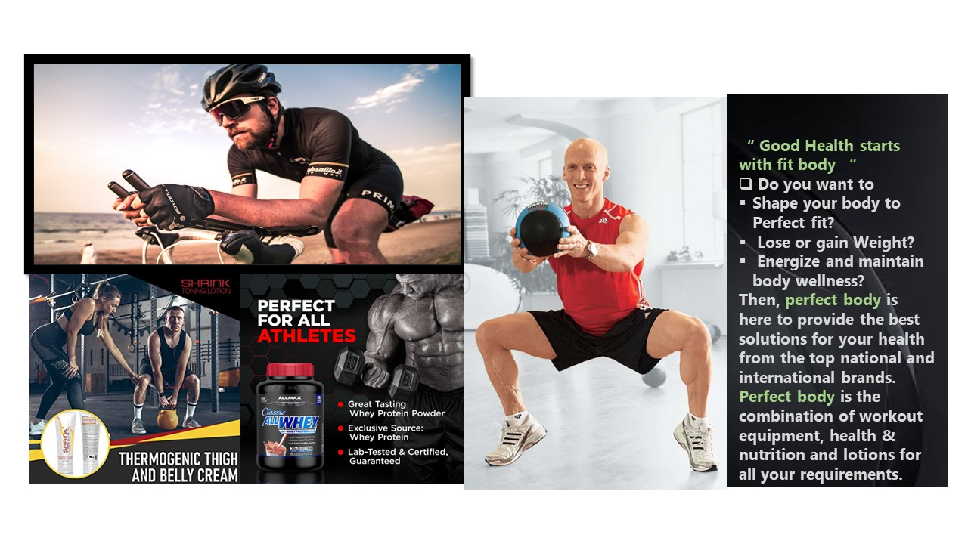

Slide 2
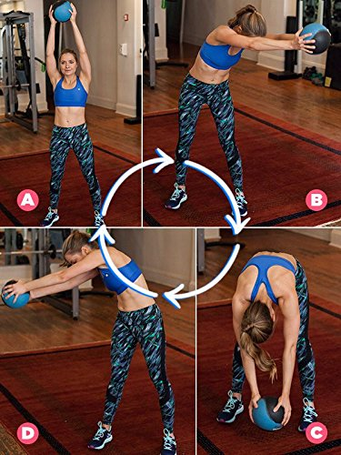
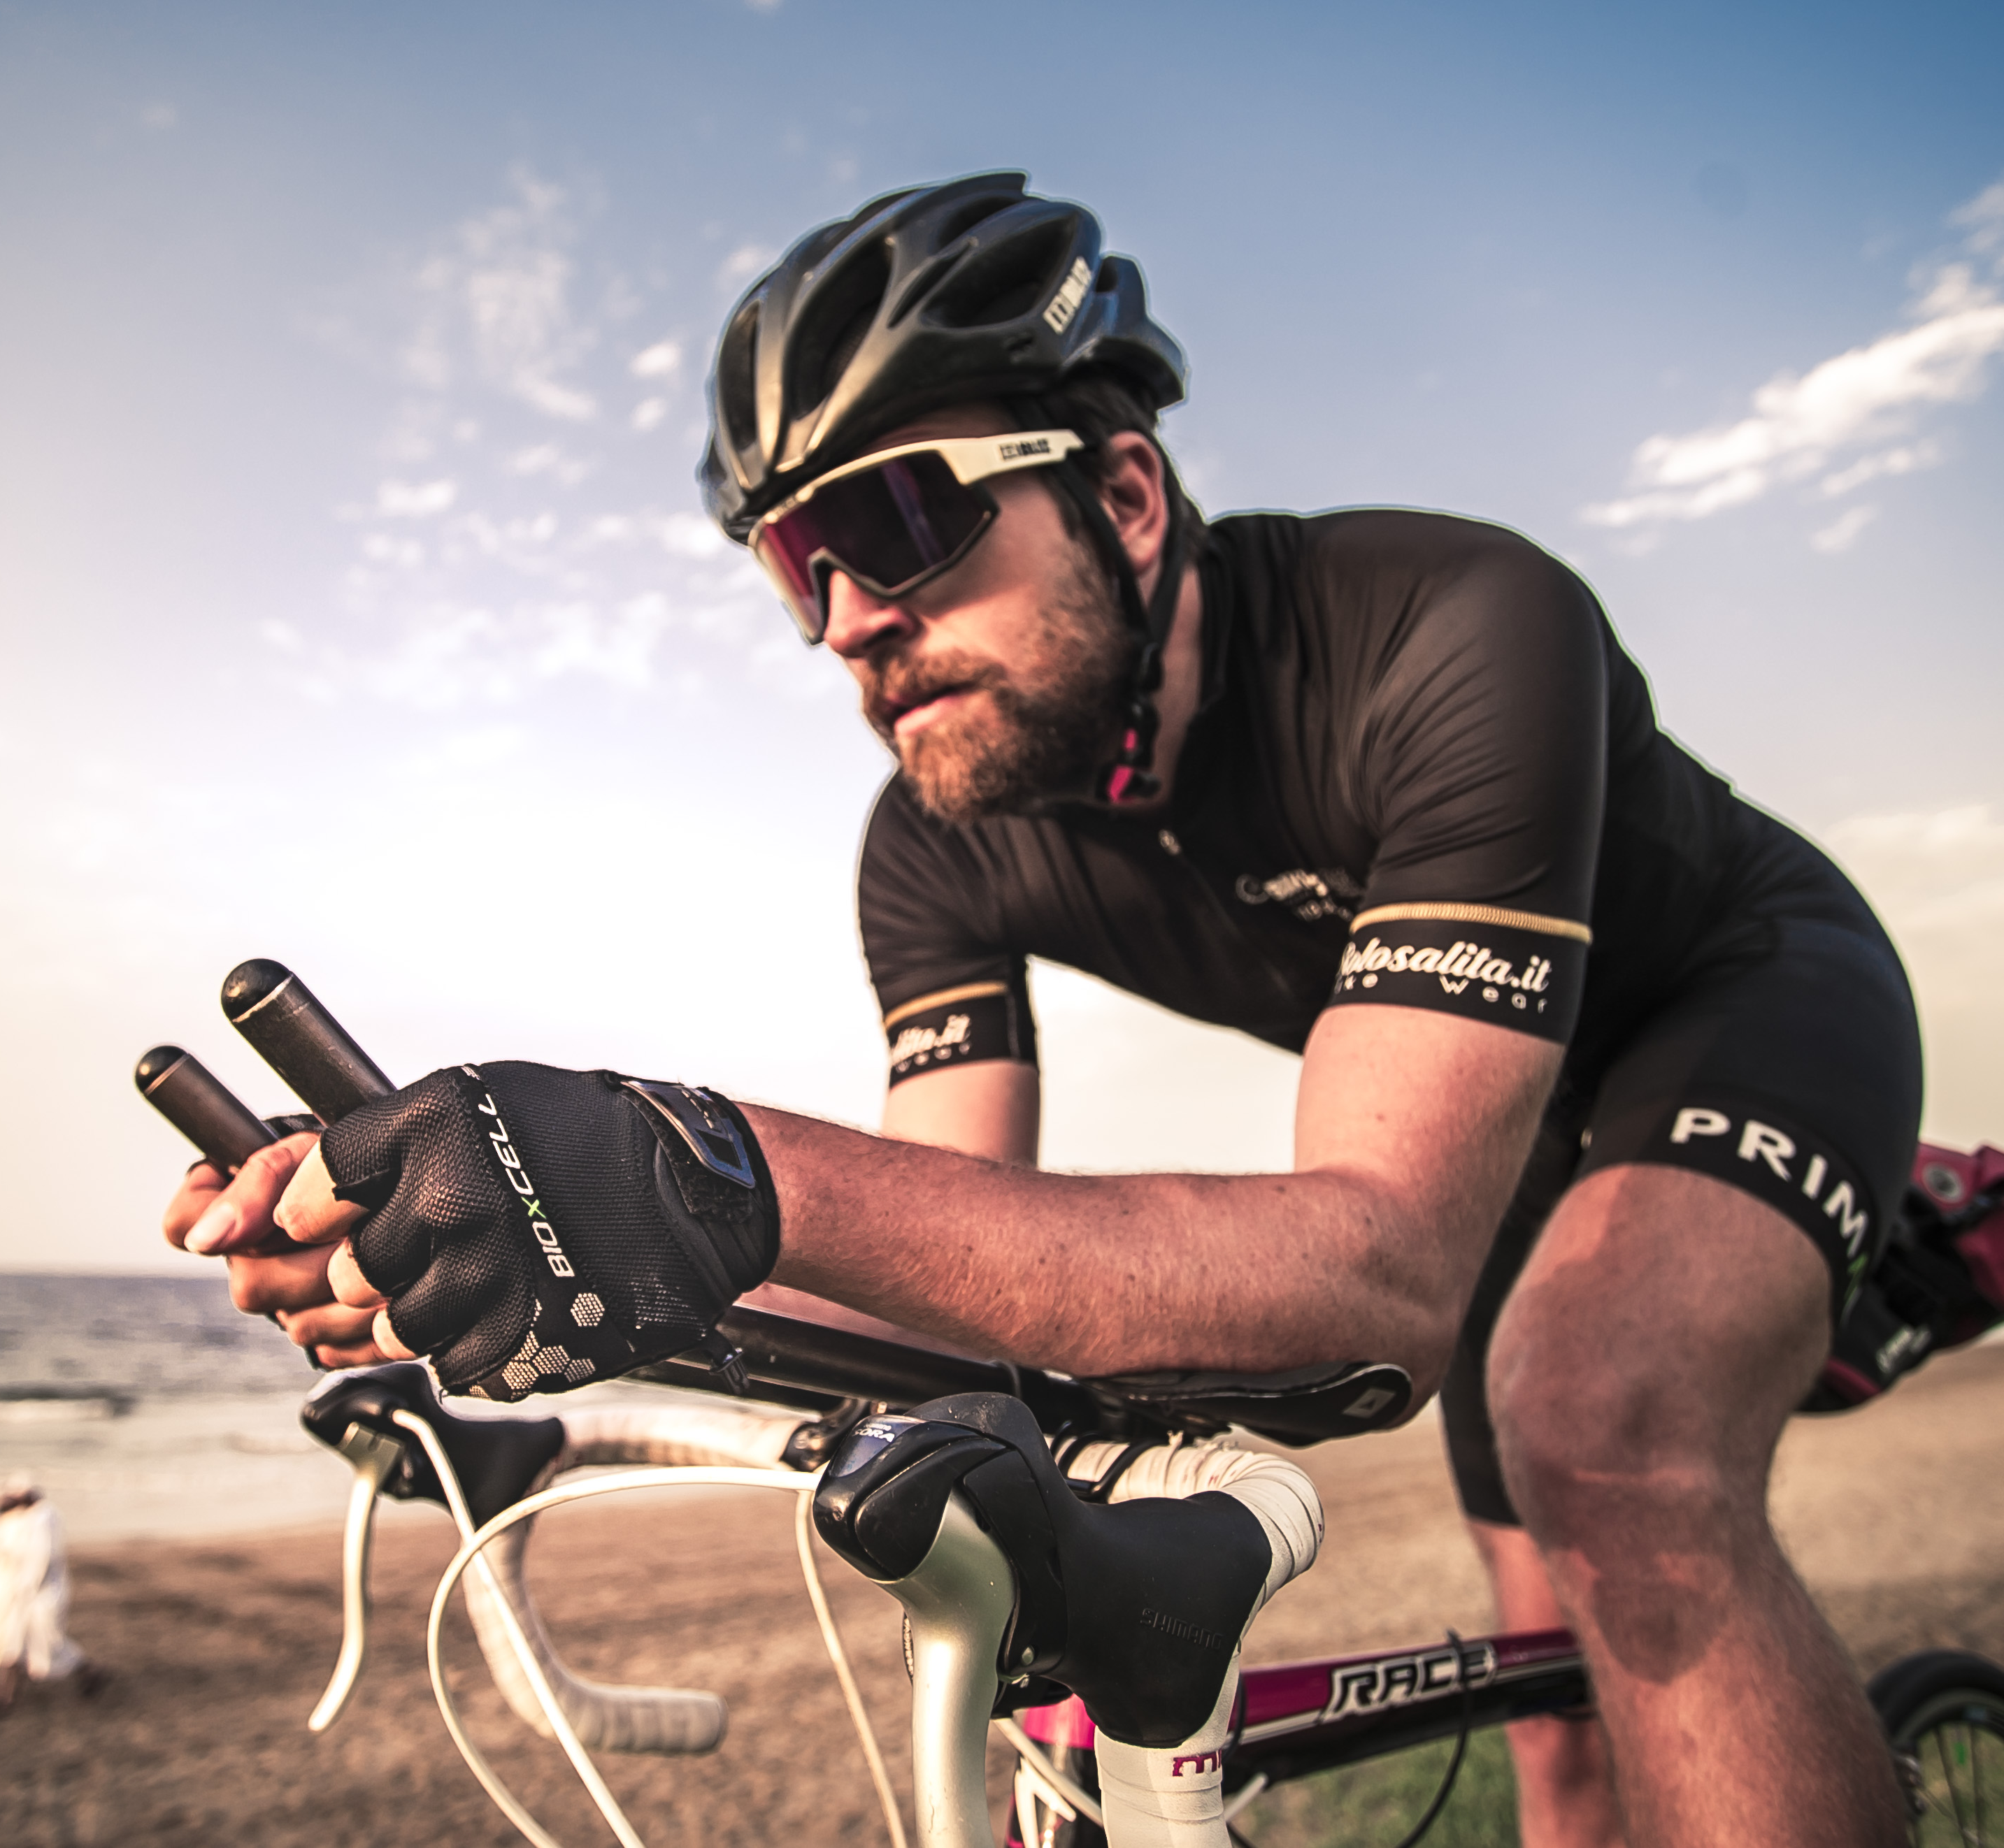
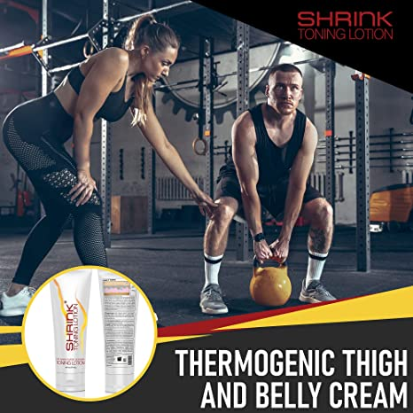
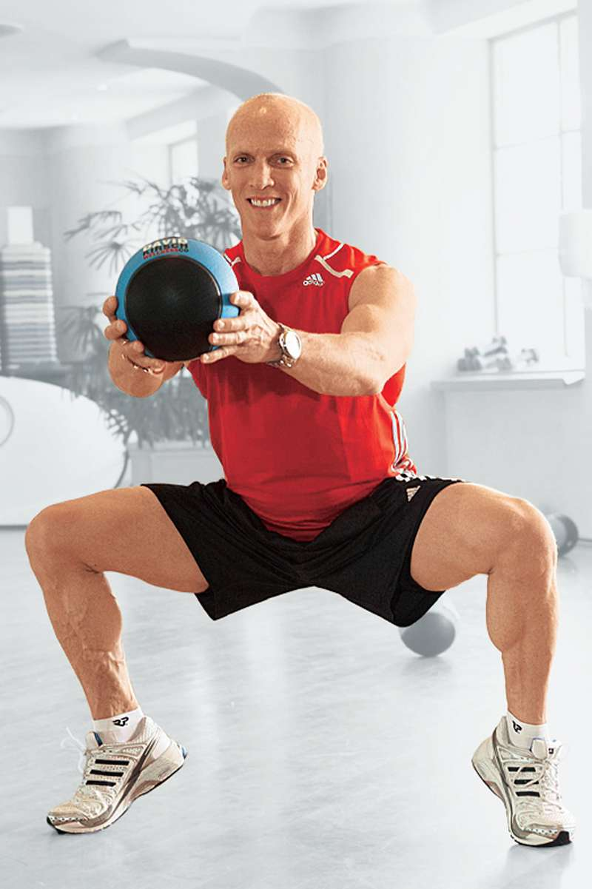
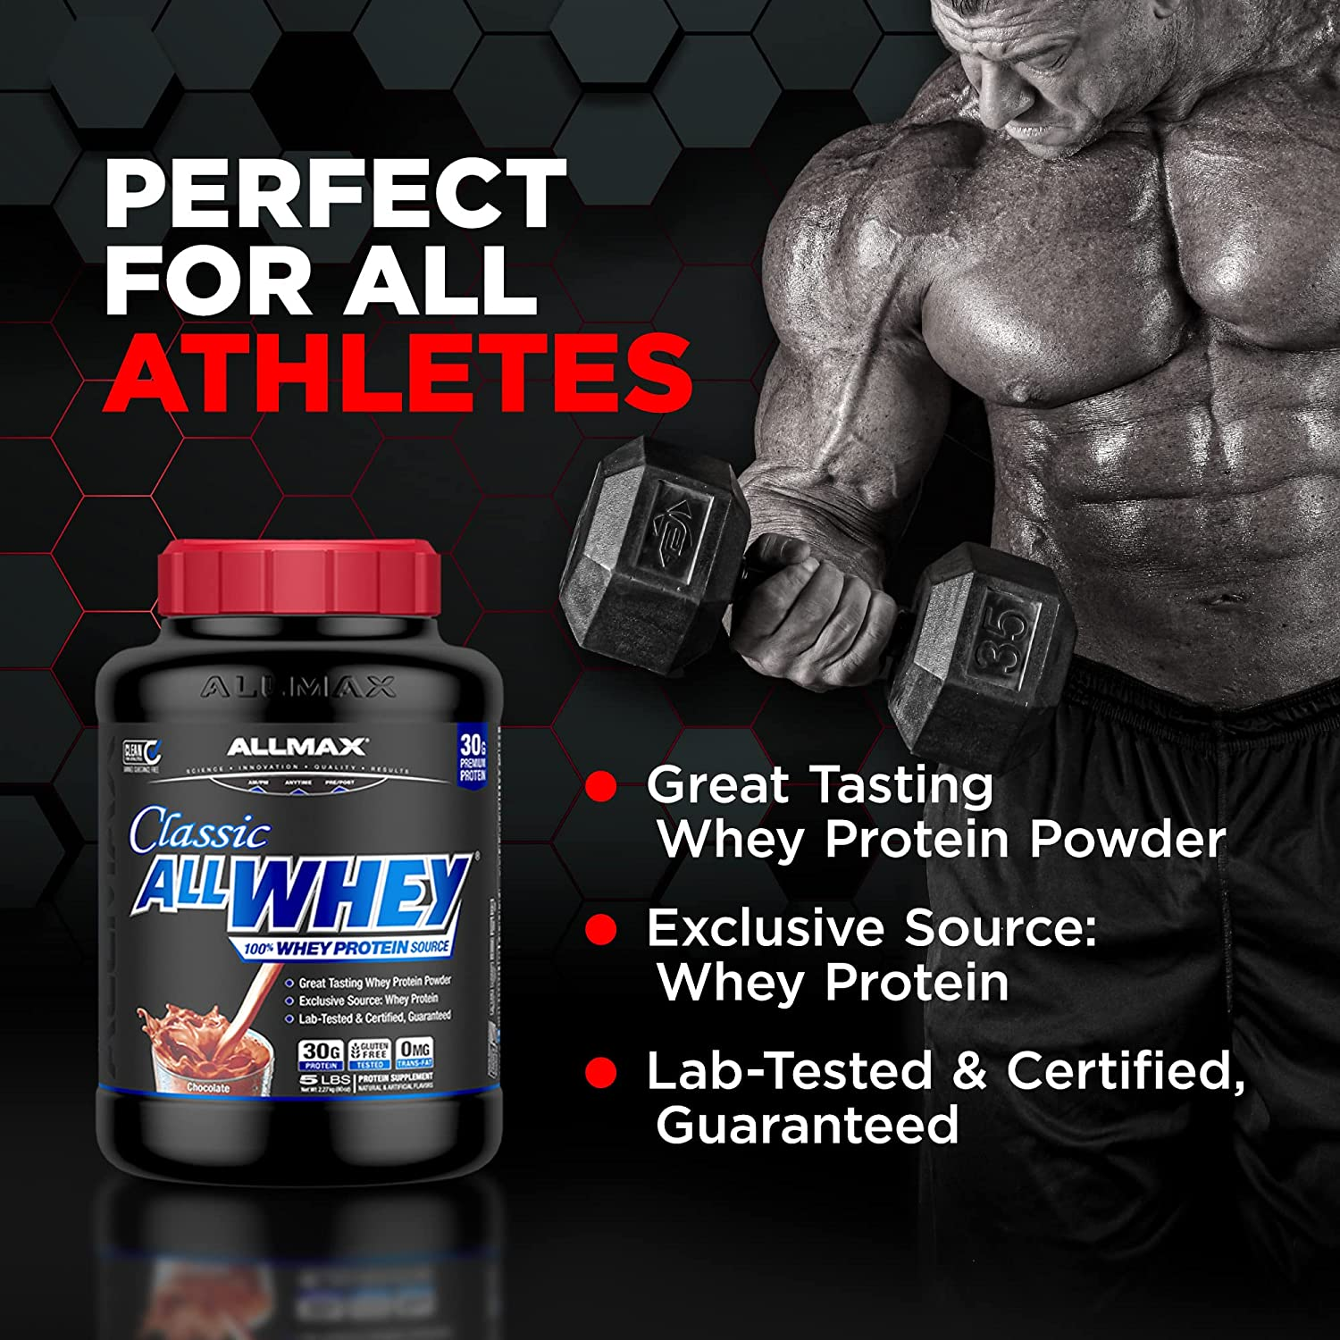

Good Health starts with fit body
Do you want to
... Shape your body to Perfect fit?
... Lose or gain Weight?
... Energize and maintain body wellness?
Then, perfect body is here to provide the best solutions for your health from the top national and international brands.
Perfect body is the combination of workout equipment, health & nutrition and lotions for all your requirements.

Slide 3
Good Health starts with fit body
Do you want to
... Shape your body to Perfect fit?
... Lose or gain Weight?
... Energize and maintain body wellness?
Then, perfect body is here to provide the best solutions for your health from the top national and international brands.
Perfect body is the combination of workout equipment, health & nutrition and lotions for all your requirements.

Slide 4
