Slide 1
Big Data 2 Project
PREPARED BY:
Vidhi Patel (N01426021)
Jinal Patel (N01495566)
GUIDED BY:
Muhammad Rehman Zafar

Slide 2
Cities With Best Life
In order to identify the greatest cities to live, we examined data from a variety of city categories and came up with the findings listed.
What is the best city or country to live in in terms of health, job, work-life balance, and other factors has always been a question for us. We selected the dataset of "best life" cities, which displays the top cities in a variety of categories.
Source: https://www.kaggle.com/datasets/prasertk/cities-with-the-best-worklife-balance-2022

Slide 3
Cities With Best Life
To determine the greatest cities for a lifestyle, we collected data from several cities that included percentages of various categories.
Various categories are as below:
Unemployment
Remote Jobs
Healthcare
Covid Impact
Happiness, Culture & Leisure
Air Quality
Wellness & Fitness

Slide 4

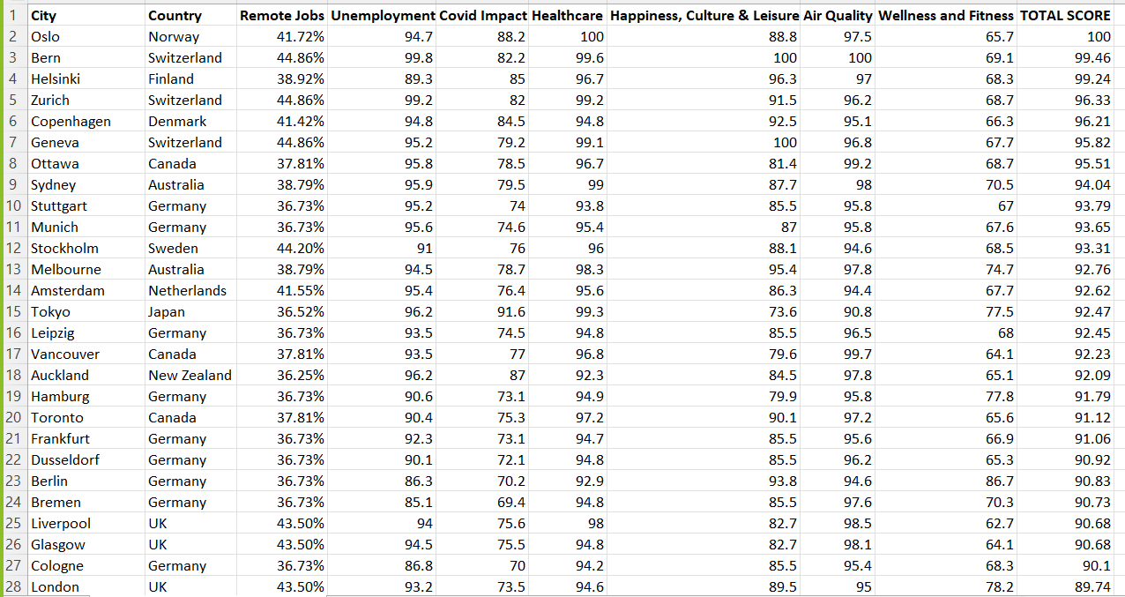
Dataset

Slide 5
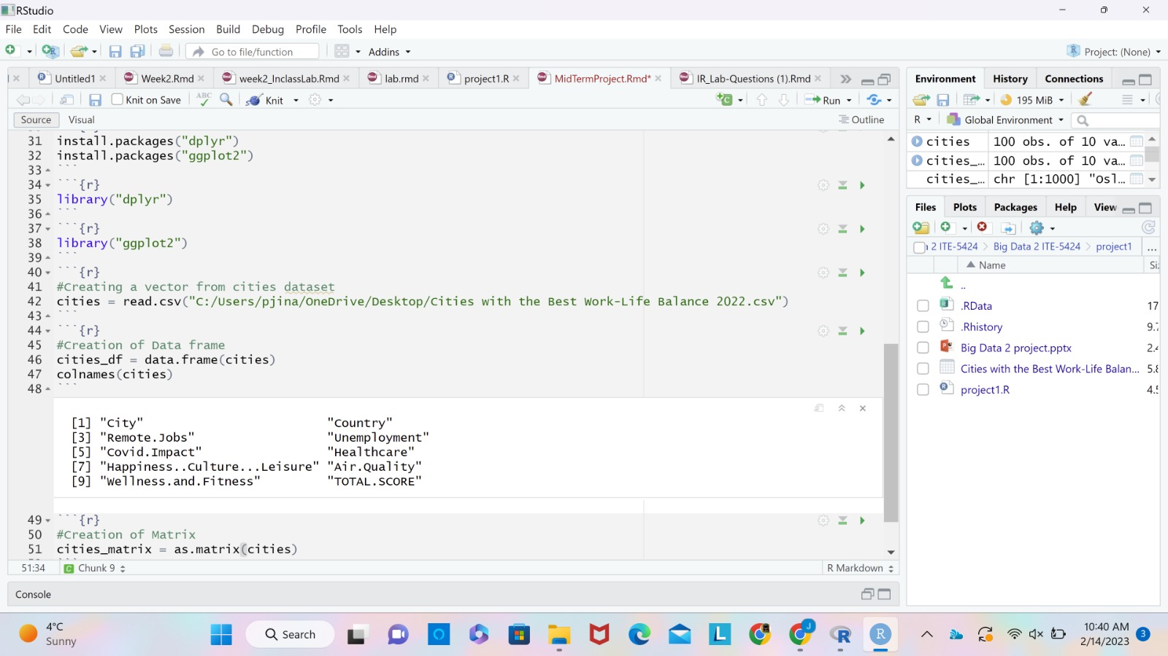
Creation of Vector, Matrix, Data frame

Slide 6
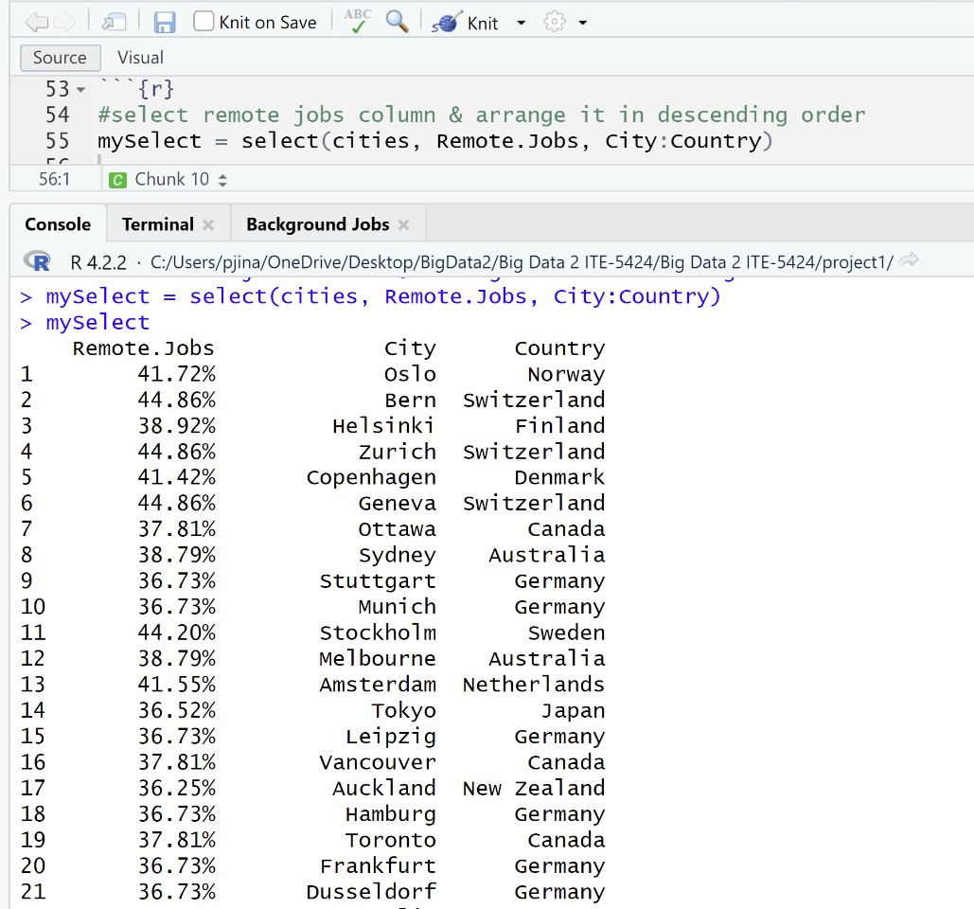
Analysis using DPLYR library
Select
We are determining the percent of remote jobs in each city and nation.
Since more people are gravitating towards remote work after covid, we choose remote jobs.

Slide 7
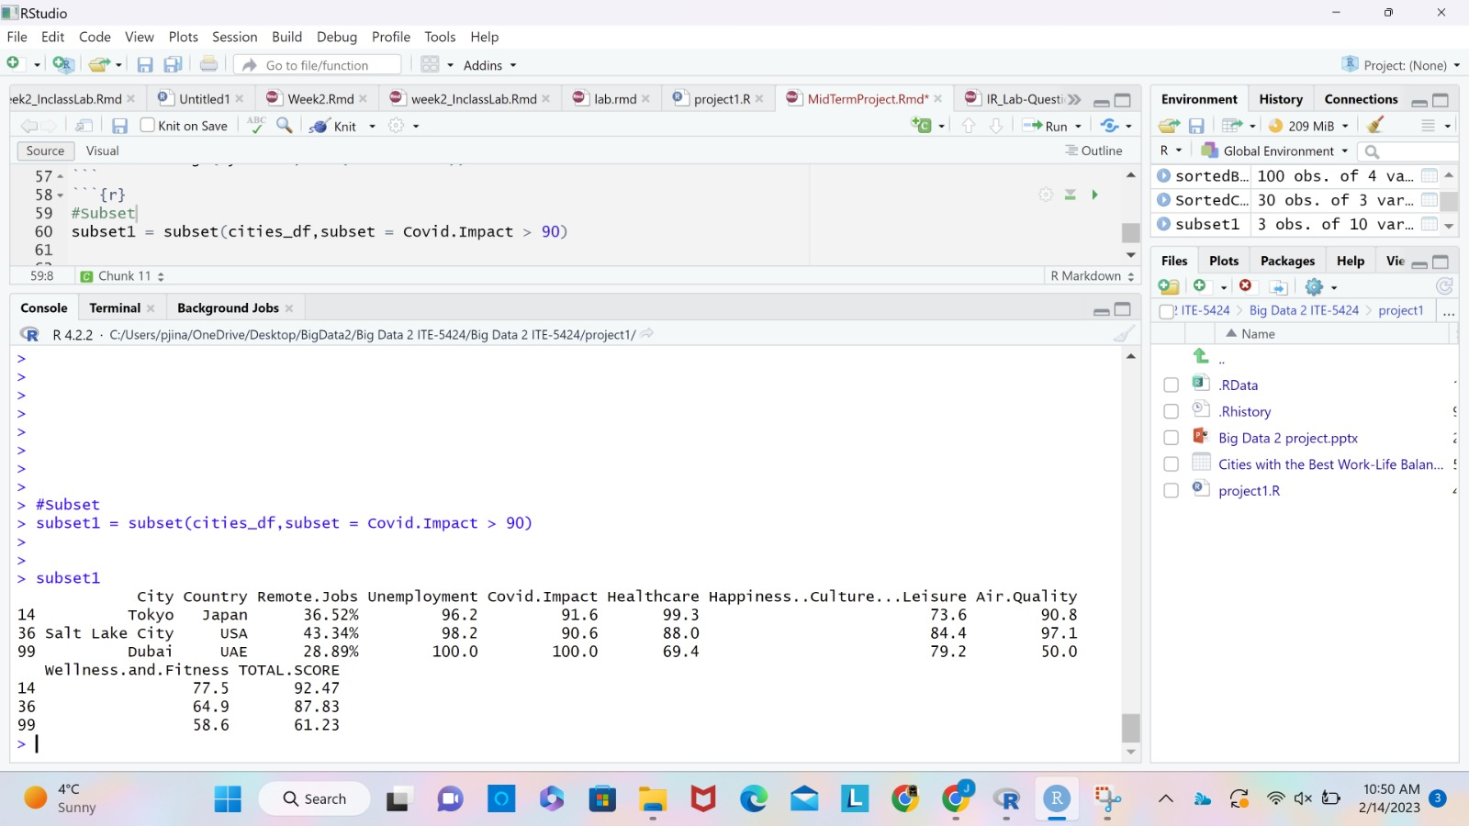
Analysis using DPLYR library
Select using subset
For sub setting we have used column Covid. Impact and displays the cities which have covid impact greater than 90% .
Dubai witnessed the highest covid impact across the globe.

Slide 8
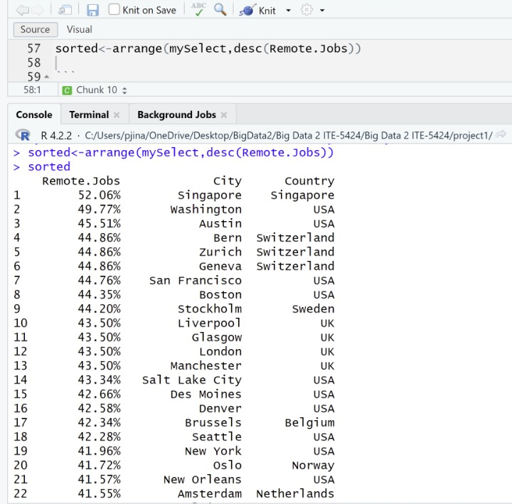
Analysis using DPLYR library
Arrange
We have arranged the previously chosen data in descending order.
According to the data, Singapore has the largest proportion of remote jobs, making it the ideal location for anyone looking to work from home.

Slide 9
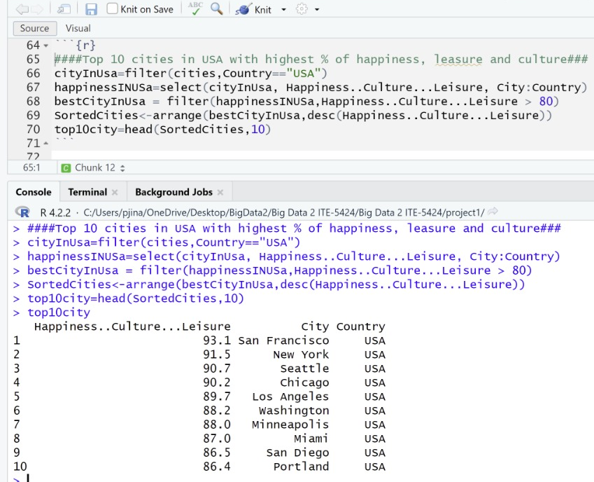
Analysis using DPLYR library
Filter
The American cities have been filtered. The cities with a happiness index greater 80% are shown here.
As a result, San Francisco might be thought of as the perfect place to indulge in cultural and leisure activities.

Slide 10
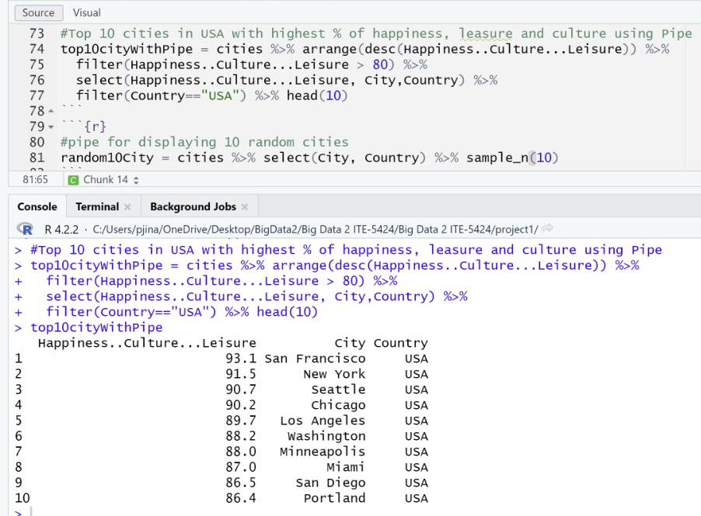
Analysis using DPLYR library
Pipe
As the name implies, a pipe combines various functions for better analysis.
To show off pipe, we used the sample function to display 10 random cities after performing select on the country and city columns.

Slide 11
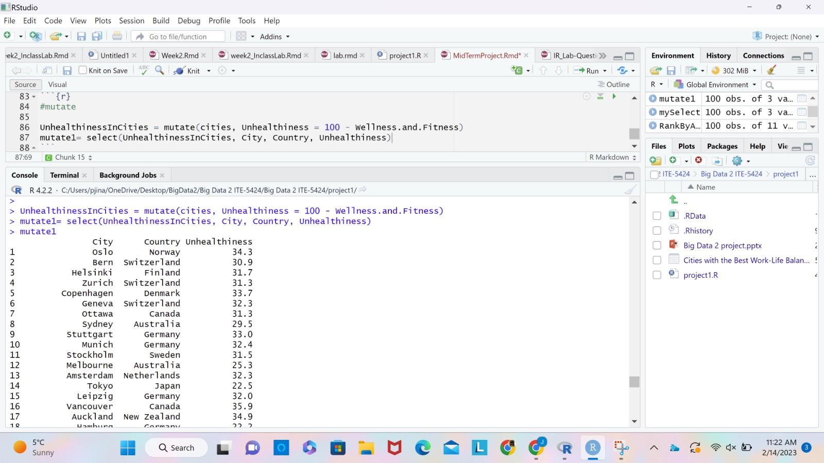
Analysis using DPLYR library
Mutate
To locate the unhealthy areas in several cities, we used mutate.
We have deducted the percentage of the wellness and fitness column from 100 and saved it in the unhelthinessInCIties column in order to implement mutation.
This data's analysis is eye-catching since it shows that even though Oslo has 100% of the necessary healthcare facilities, unhealthiness is still the city's main issue.

Slide 12
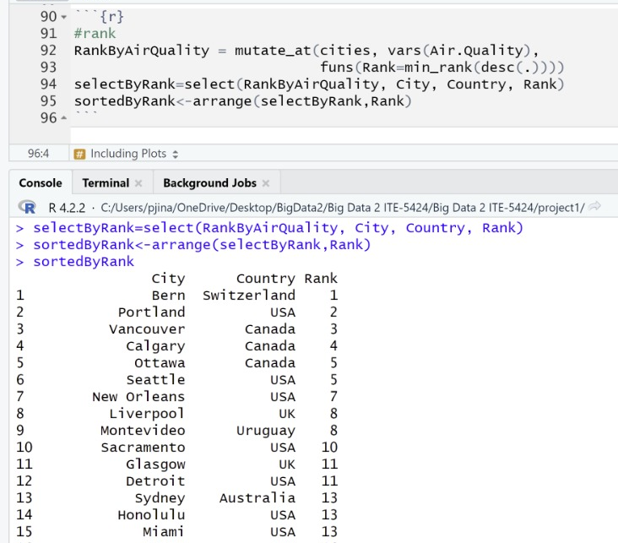
Analysis using DPLYR library
Rank
We used rank to provide a ranking of the various cities' air quality.
The study makes it quite evident that Bern, Switzerland, has the world's best air quality.
Three Canadian cities are among the top 5 for having the cleanest air.

Slide 13
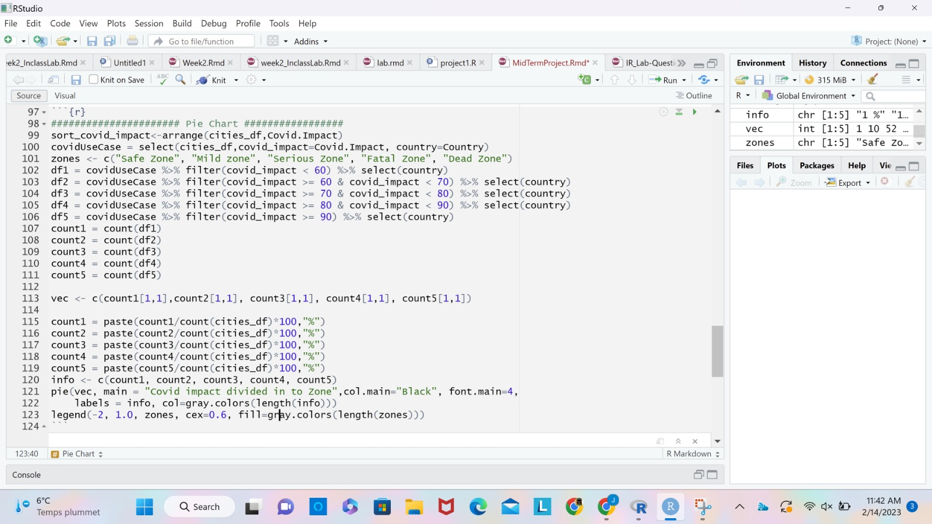
Data Visualization using Pie chart

Slide 14
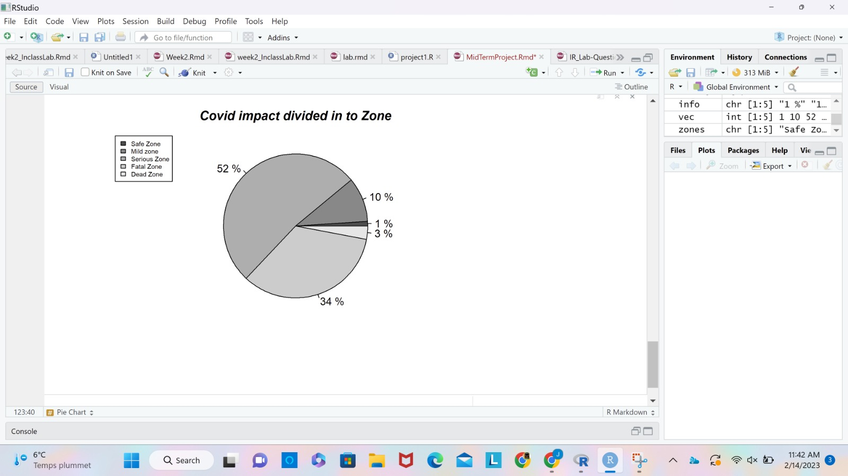
Data Visualization using Pie chart
52% of the cities has the covid impact between 70 to 80 percent which we considered as a Serious Zone.
3% of the cities fall under dead zone where the impact of covid is greater than 90%.

Slide 15
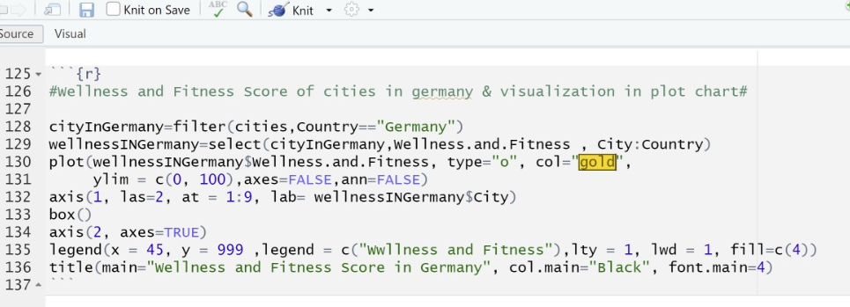
Data Visualization using Plot chart

Slide 16
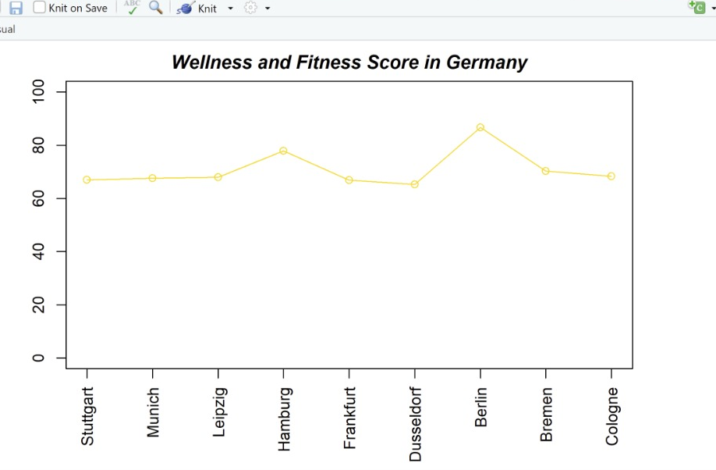
Data Visualization using Plot chart

Slide 17
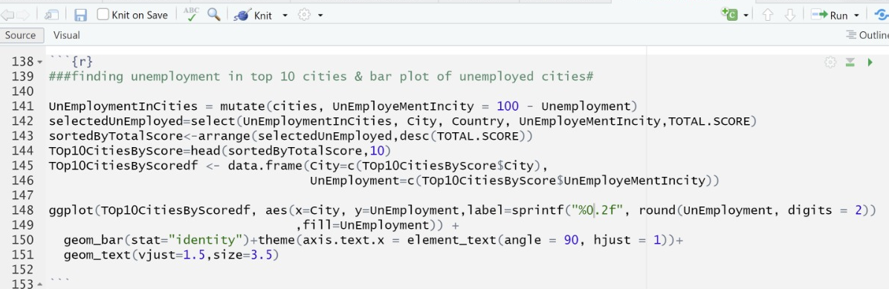
Data Visualization using Bar Plot

Slide 18
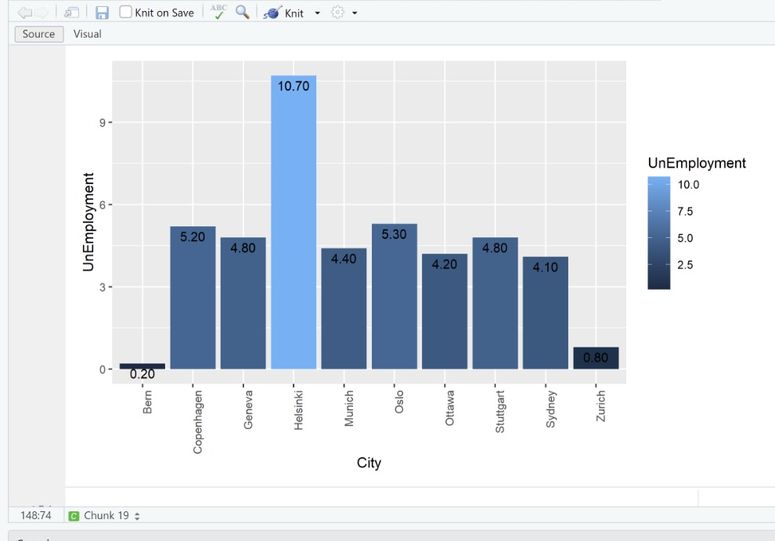
Data Visualization using Bar Plot

Slide 19
Insights of analysis
City with Lowest Inflation rate (0.89%)
Tokyo – Japan
City with amazing Healthcare Facilities
Oslo, Norway
City which was highly impacted due to covid-19
Dubai,UAE
City have highest Air Quality rate of 100%
Bern, Switzerland
Cities with highest Happiness, Culture, Leisure of 100%
Bern and Geneva, Switzerland

Slide 20

Conclusion
People need to identify the ideal city for living based on numerous criteria in today's modern and hectic world.
The results of our analysis enable us to apply the ideas we acquired in big data 2 and demonstrate them in order to obtain some practical solutions and data analytical abilities.

Slide 21


