Slide 1


Sarvajanik Education Society Sarvajanik College of Engineering & Technology, Surat. Master of Computer Applications Academic Year: 2025– 26
A Project On
“FurniZone”
Presented By
Sahil Dharani(ET24MTCA011)
Kishan Pancholi(ET24MTCA036)
Siya Sachan(ET24MTCA058)
Vidhi Sorathia(ET24MTCA065)
M.C.A. II Sem. 3
Under the Guidance of
Prof. Margee

Slide 2
2
Project Abstract
FurniZone is a furniture shopping platform designed to make furniture buying easier, faster, and more user-friendly. It has two main components:
Android Application (Kotlin) – for customers to browse furniture, view offers, add products to the cart, and place orders.
Website Admin Panel (PHP) – for managing products, categories, banners, coupons, and tracking orders/users. Both platforms are connected through APIs, ensuring real-time data synchronization between the admin and the customer app. The project aims to provide a modern, secure, and convenient online furniture shopping experience.

Slide 3
Objective
To create a furniture shopping solution with a mobile app for customers and a web-based admin panel for management.
To enable real-time product and order management through API integration.
To improve customer experience with easy navigation, secure payments, and personalized offers.
To provide administrators with efficient tools for inventory management, order tracking, and sales analysis.
To reduce the time and effort required for both buying and managing furniture products.

Slide 4
System Description (Technologies Used)
Frontend:
Kotlin – for Android app development.
HTML, CSS, JavaScript (Bootstrap) – for website interface.
Backend:
PHP (Core PHP) – for the admin panel and API handling.
Database:
MySQL (via XAMPP) – for storing product, user, and order data during development and testing.
API Integration:
REST APIs to connect the Android app with the PHP backend for real-time updates.
Other Tools:
Payment Gateway API – for secure online payments.
XAMPP – as a local development environment for PHP and MySQL.
Implementing OTP-based phone number verification for user authentication.

Slide 5
1) Android App (Kotlin) – Customer Side
Start ⬇ Home Page → View Categories, Products, Offers, Search, Profile ⬇ Category Page → Product List ⬇ Product Details Page → Add to Cart / Buy Now ⬇ Cart Page → Update Quantity / Remove Item ⬇ Checkout Page → Select Payment Method (Online/Offline) ⬇ Order Confirmation ⬇ Profile Page → View Orders, Edit Profile, Logout

Slide 6
2) Admin Panel (PHP) – Website Side
Admin Login
⬇ Dashboard → Overview of Total Orders & Users ⬇ Manage Categories → Add, Update, Delete Category ⬇ Manage Products → Add Furniture, Update, Delete Product ⬇ Manage Banners → Add, Update, Delete Banner ⬇ Manage Coupons → Add, Update, Delete Coupon ⬇ Order Management → View Orders, Change Status (Pending, Shipped, Delivered) ⬇ User Management → View Registered Users

Slide 7
3) API & Database (XAMPP MySQL)
REST API handles data exchange between Android app & PHP backend.
MySQL database stores all categories, products, orders, users, banners, and coupons.

Slide 8
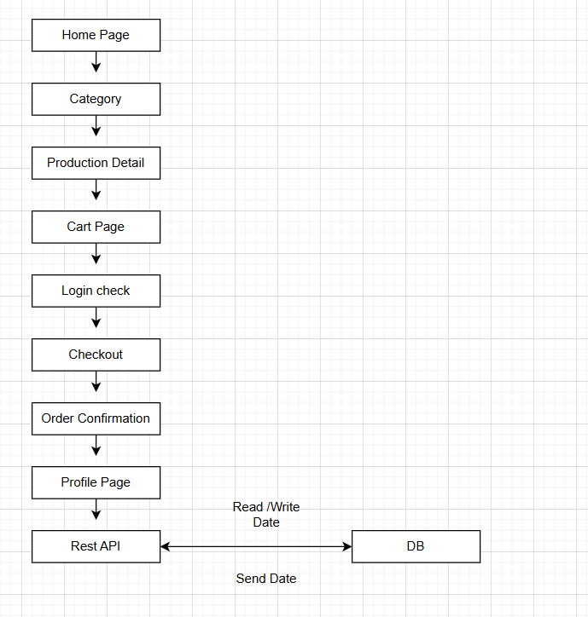
App Flow Chart

Slide 9
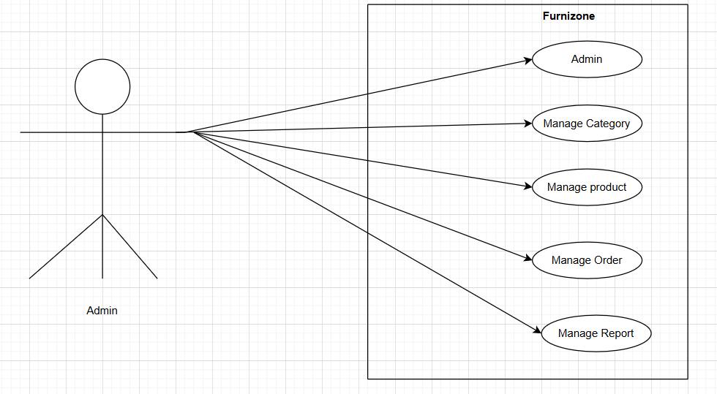
Admin side:
Use case:

Slide 10
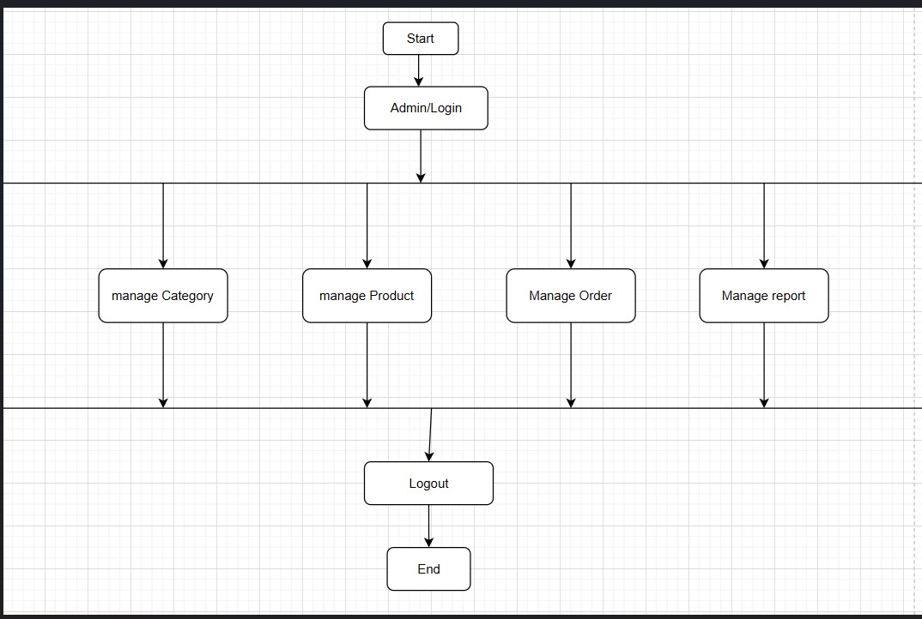
Admin Activity

Slide 11
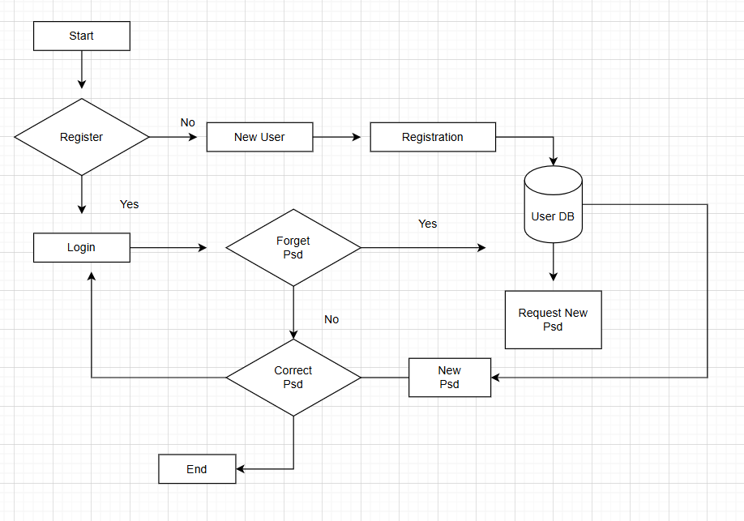
App User Flow Chart

Slide 12
Table Name : tbl_admin
Primary Key : admin_id
Description : This table used for store the admin information
Column name | Data type | Size | Constraint | Description
admin_id | Int | 11 | Primary Key | Used to uniquely identify.
admin_name | Varchar | 100 | Not Null | Specify the name of admin.
admin_email | Varchar | 100 | Not Null | Specify the email of admin.
admin_mobile | Varchar | 100 | Not Null | Specify the mobile number of admin.
admin_password | Varchar | 100 | Not Null | Specify the password of admin.

Slide 13
Table Name : tbl_user Primary Key : user_id Description : This table used for store the user information.
Column name | Data type | Size | Constraint | Description
user_id | Int | 11 | Primary Key | Used to uniquely identify.
user_name | Varchar | 100 | Not Null | Specify the name of user.
user_email | Varchar | 100 | Not Null | Specify the email of user.
user_password | Varchar | 100 | Not Null | Specify the password of user.
user_phone | Varchar | 100 | Not Null | Specify the phone of user.
User_pic | Varchar | 100 | Not Null | Specify the pic of user.

Slide 14
Table Name : tbl_category
Primary Key : cat_id
Description : This table used for store the category.
Column name | Data type | Size | Constraint | Description
cat_id | Int | 11 | Primary Key | Used to uniquely identify.
cat_name | Varchar | 100 | Not Null | Specify the category name of category.
cat_pic1 | Varchar | 500 | Not Null | Specify the pic 1 of category.
cat_pic2 | Varchar | 500 | Not Null | Specify the pic 2 of category.

Slide 15
Table Name : tbl_sub_category
Primary Key : product_id
Description : This table used for store the Product.
Column name | Data type | Size | Constraint | Description
product_id | Int | 11 | Primary Key | Used to uniquely identify.
product_name | Varchar | 100 | Not Null | Specify the Product name.
product_color | Varchar | 255 | Not Null | Specify the Product color.
product_price | Varchar | 255 | Not Null | Specify the Product price.

Slide 16
product_discount | Varchar | 100 | Not Null | Specify the Product discount.
product_description | Varchar | 255 | Not Null | Specify the Product description.
product_dimention | Varchar | 255 | Not Null | Specify the Product dimension.
product_weight | Varchar | 100 | Not Null | Specify the Product weight.
product_primary_material | Varchar | 255 | Not Null | Specify the Product primary material.
product_warranty | Varchar | 255 | Not Null | Specify the Product warranty.
product_rating | Varchar | 100 | Not Null | Specify the product rating.
product_specification | Varchar | 500 | Not Null | Specify the Product specification.
product_pic1 | Varchar | 500 | Not Null | Specify the Product pic1.
product_pic2 | Varchar | 500 | Not Null | Specify the Product pic2.
product_pic3 | Varchar | 500 | Not Null | Specify the Product pic3.
product_pic4 | Varchar | 500 | Not Null | Specify the Product pic4.
cat_id | Varchar | 100 | Not Null | Specify the category id.

Slide 17
Table Name : tbl_banner
Primary Key : ban_id
Description : This table used for store the banner.
Column name | Data type | Size | Constraint | Description
ban_id | Int | 11 | Primary Key | Used to uniquely identify.
ban_title | Varchar | 255 | Not Null | Specify the banner title of banner.
ban_img | Varchar | 500 | Not Null | Specify the banner image of banner
status | Varchar | 500 | Not Null | Specify the status of banner.

Slide 18
Table Name : tbl_coupon
Primary Key : ban_id
Description : This table used for store the coupon.
Column name | Data type | Size | Constraint | Description
coupon_id | Int | 11 | Primary Key | Used to uniquely identify.
coupon_title | Varchar | 255 | Not Null | Specify the coupon title of coupon.
coupon_code | Varchar | 500 | Not Null | Specify the coupon code of coupon.
coupon_description | Varchar | 500 | Not Null | Specify the coupon description of coupon.
coupon_img | Varchar | 500 | Not Null | Specify the coupon image of coupon.
coupon_discount | INT | 100 | Not Null | Specify the coupon discount of coupon.

Slide 19
Table Name : tbl_order
Primary Key : id
Description : This table used for store the order.
Column name | Data type | Size | Constraint | Description
id | Int | 11 | Primary Key | Used to uniquely identify.
uid | Int | 11 | Not Null | Specify the user id of order.
pid | Int | 11 | Not Null | Specify the pid of order.
pname | Varchar | 500 | Not Null | Specify the pname of order.
ppic | Varchar | 500 | Not Null | Specify the ppic of order.
date | Varchar | 300 | Not Null | Specify the date of order.
time | Varchar | 300 | Not Null | Specify the time of order.
amount | Decimal | 10,0 | Not Null | Specify the amount of order.
total_amount | Decimal | 10,0 | Not Null | Specify the total amount of order.
quantity | Int | 11 | Not Null | Specify the quantity of order.
status | Int | 11 | Not Null | Specify the status of order.
is_wishlist | Tinyint | 1 | Not Null | Specify the wishlist of order.
state | Int | 11 | Not Null | Specify the state of order.
address | Varchar | 100 | Not Null | Specify the address of delivery.

Slide 20
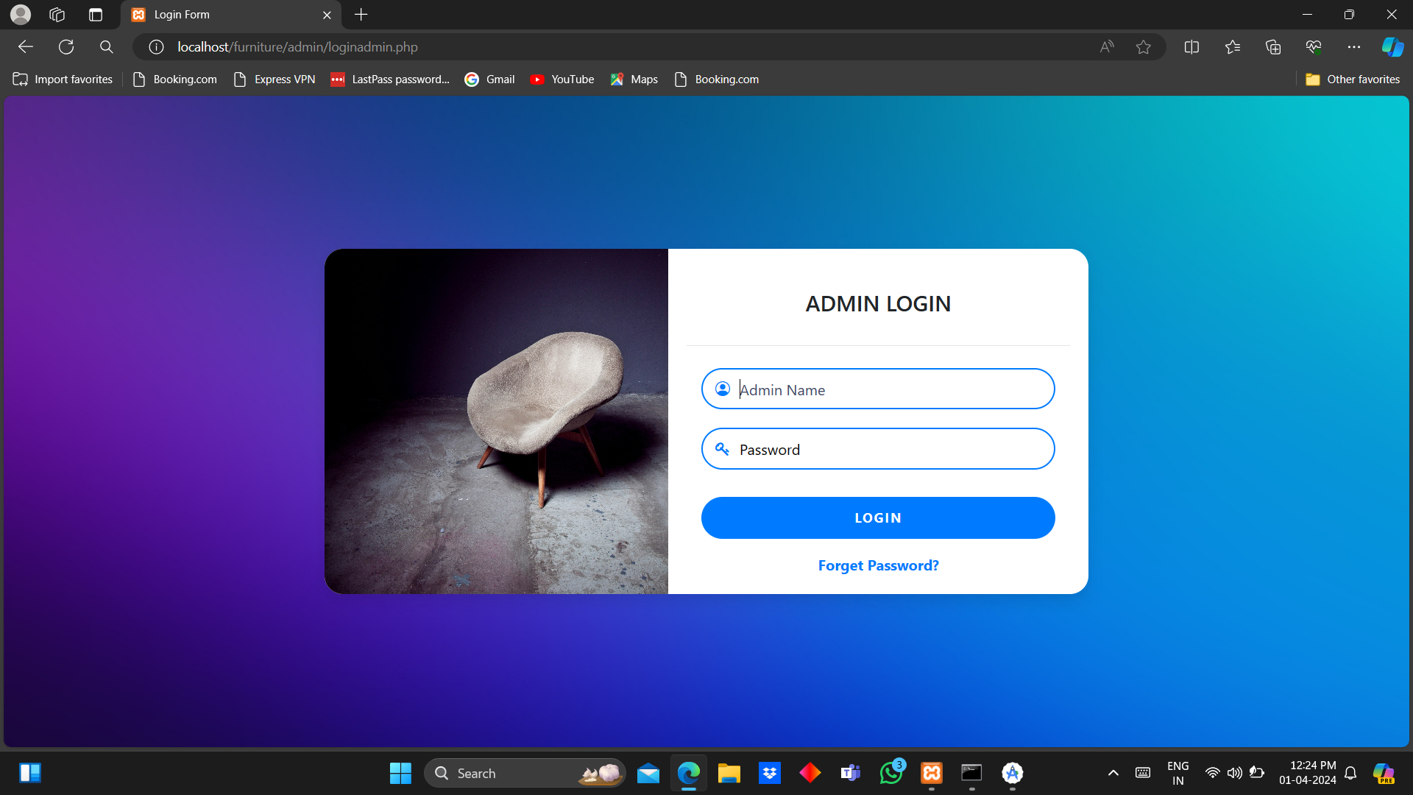
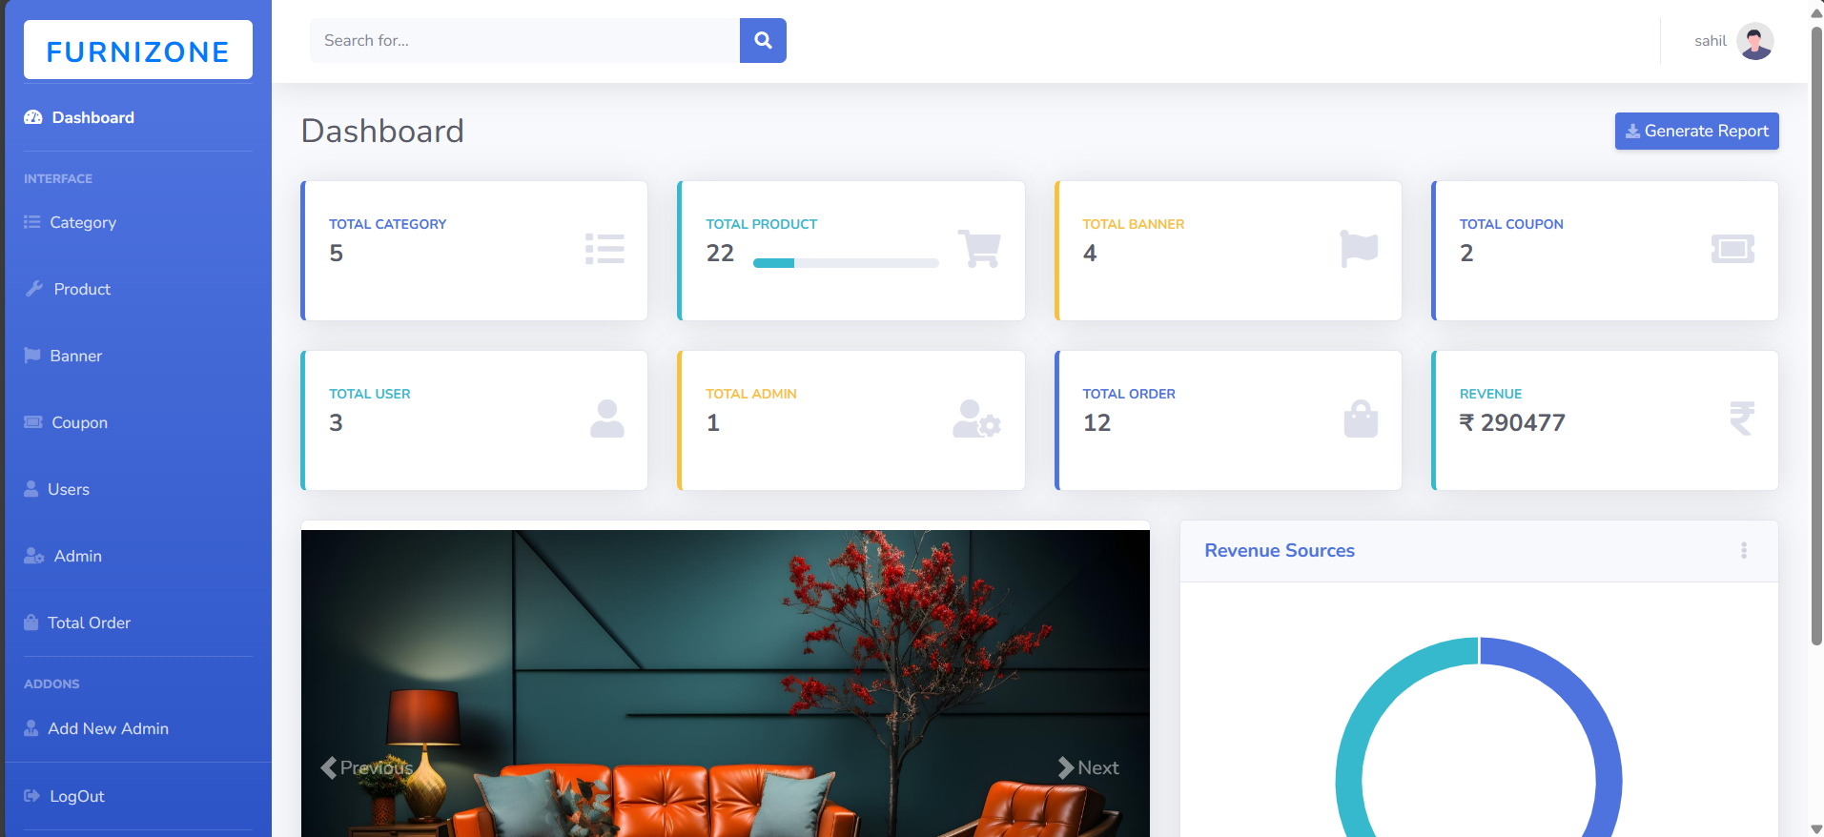
Admin and Dashboard

Slide 21
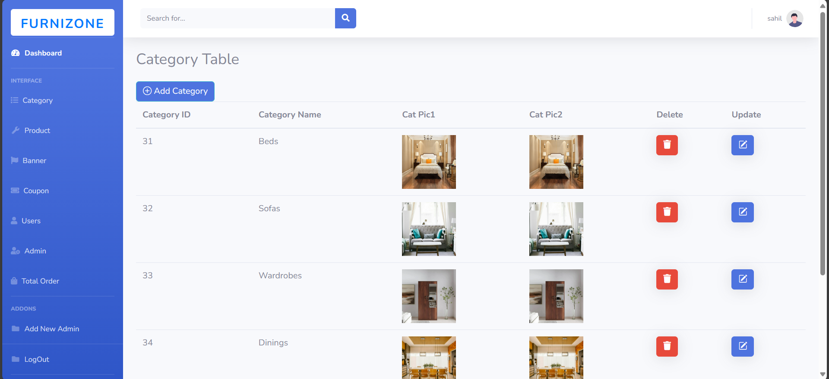
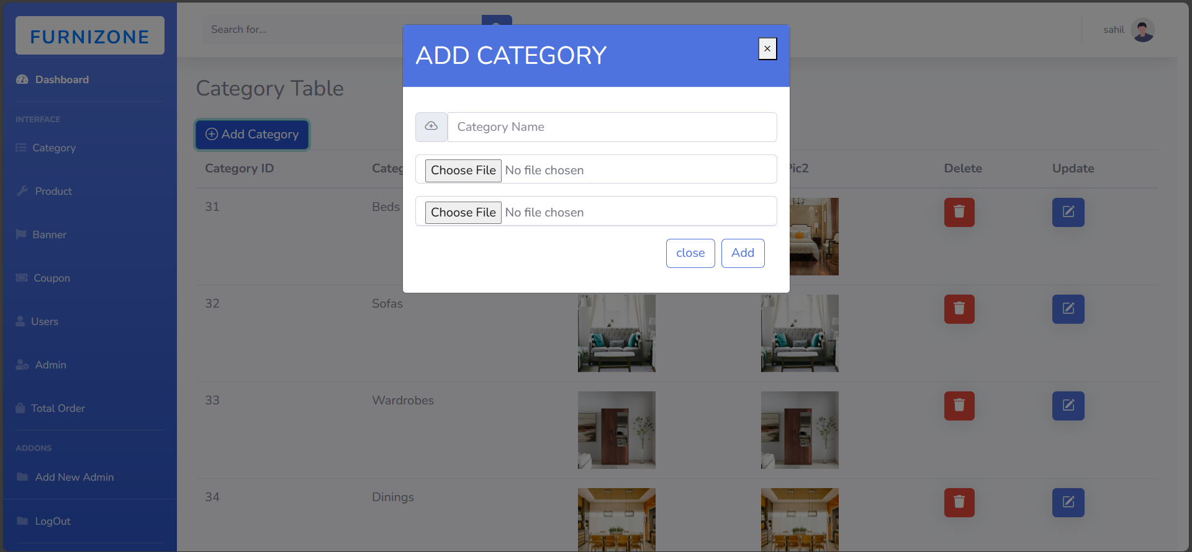
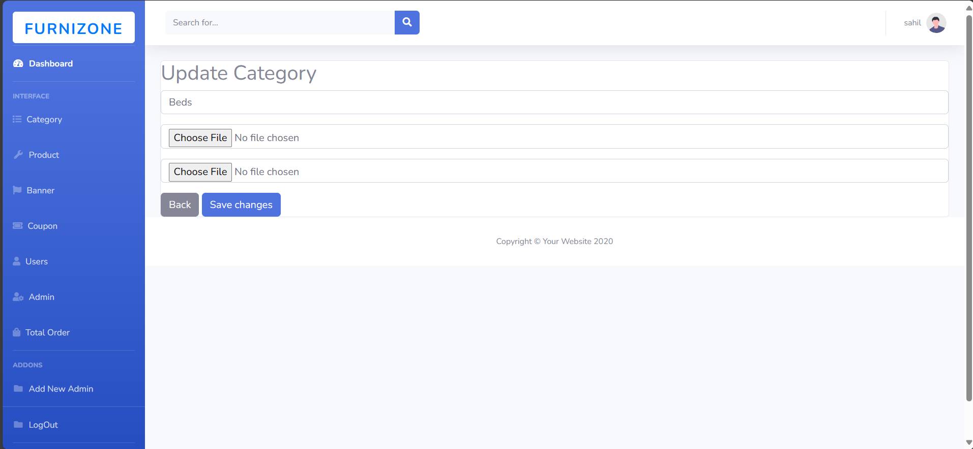
Category

Slide 22
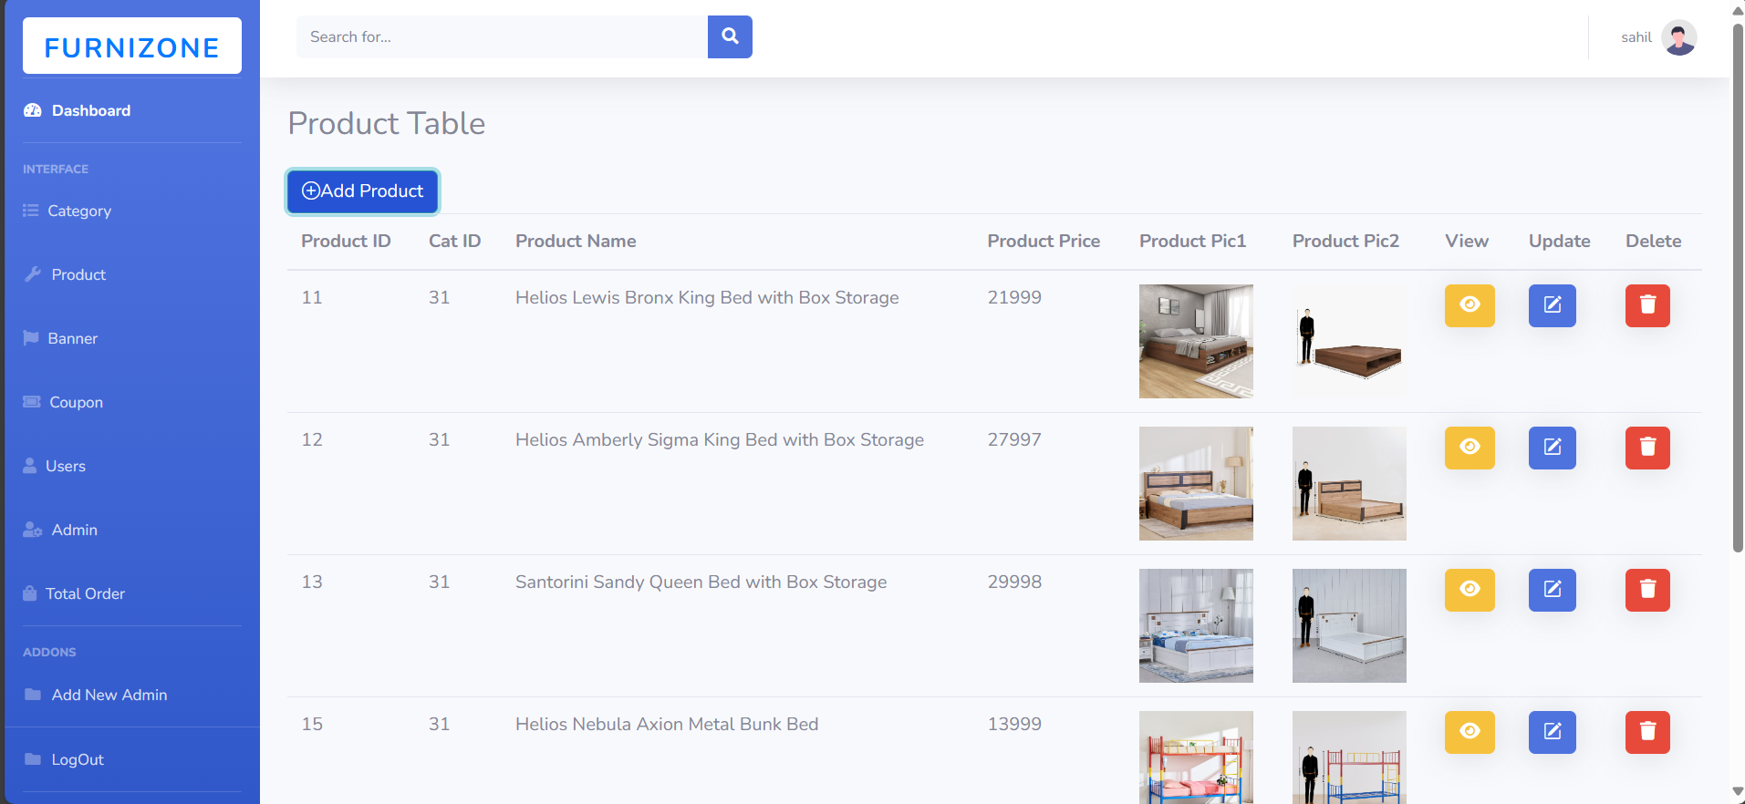
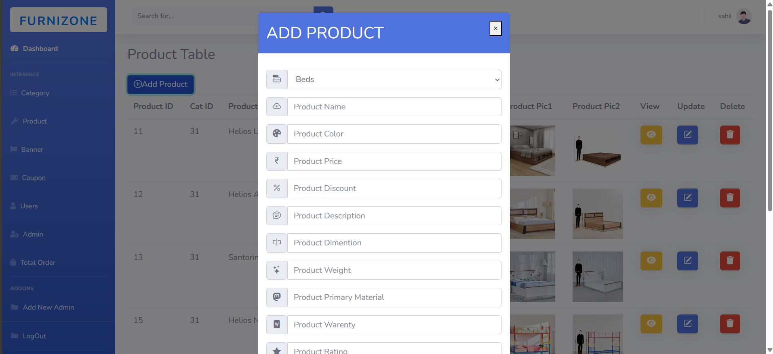
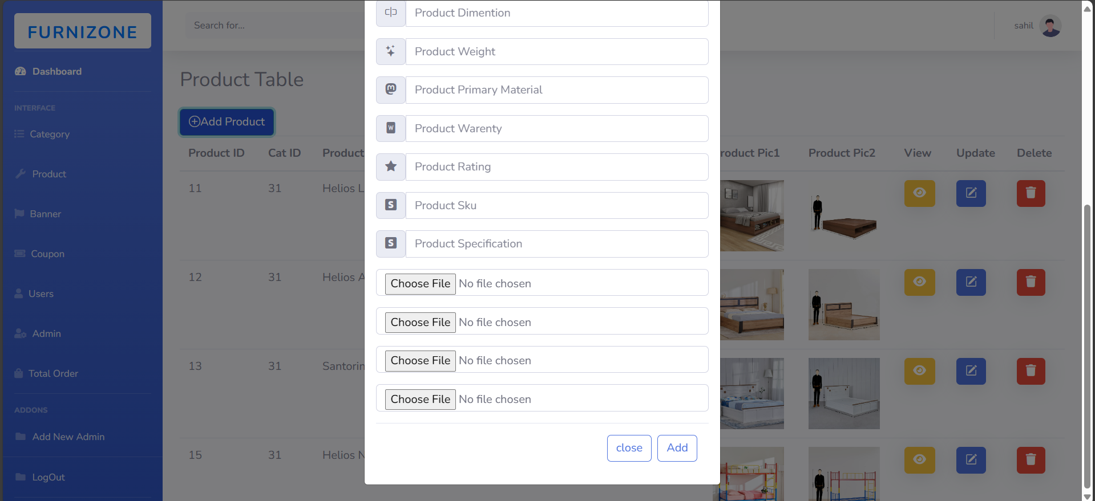
Product

Slide 23
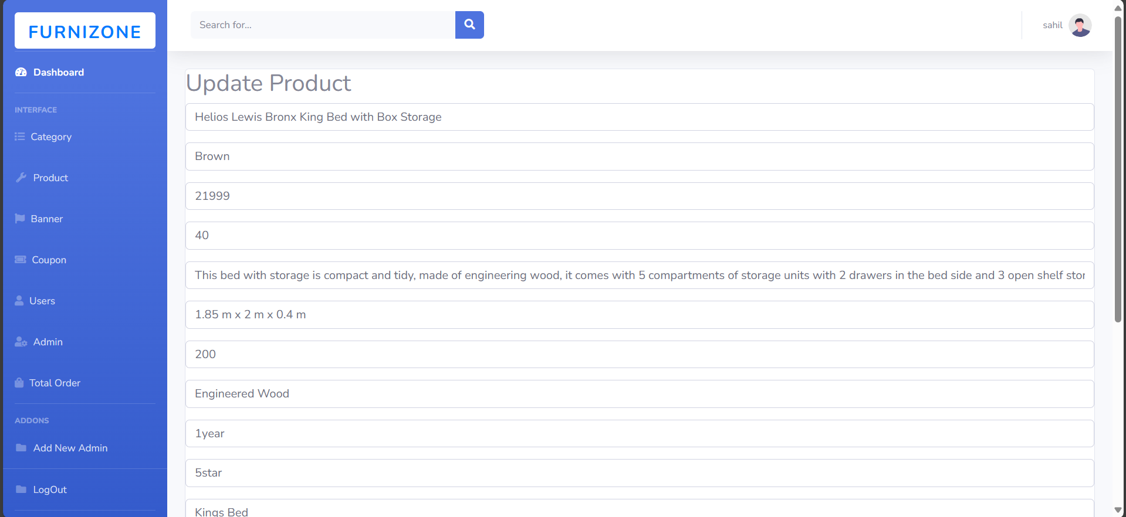
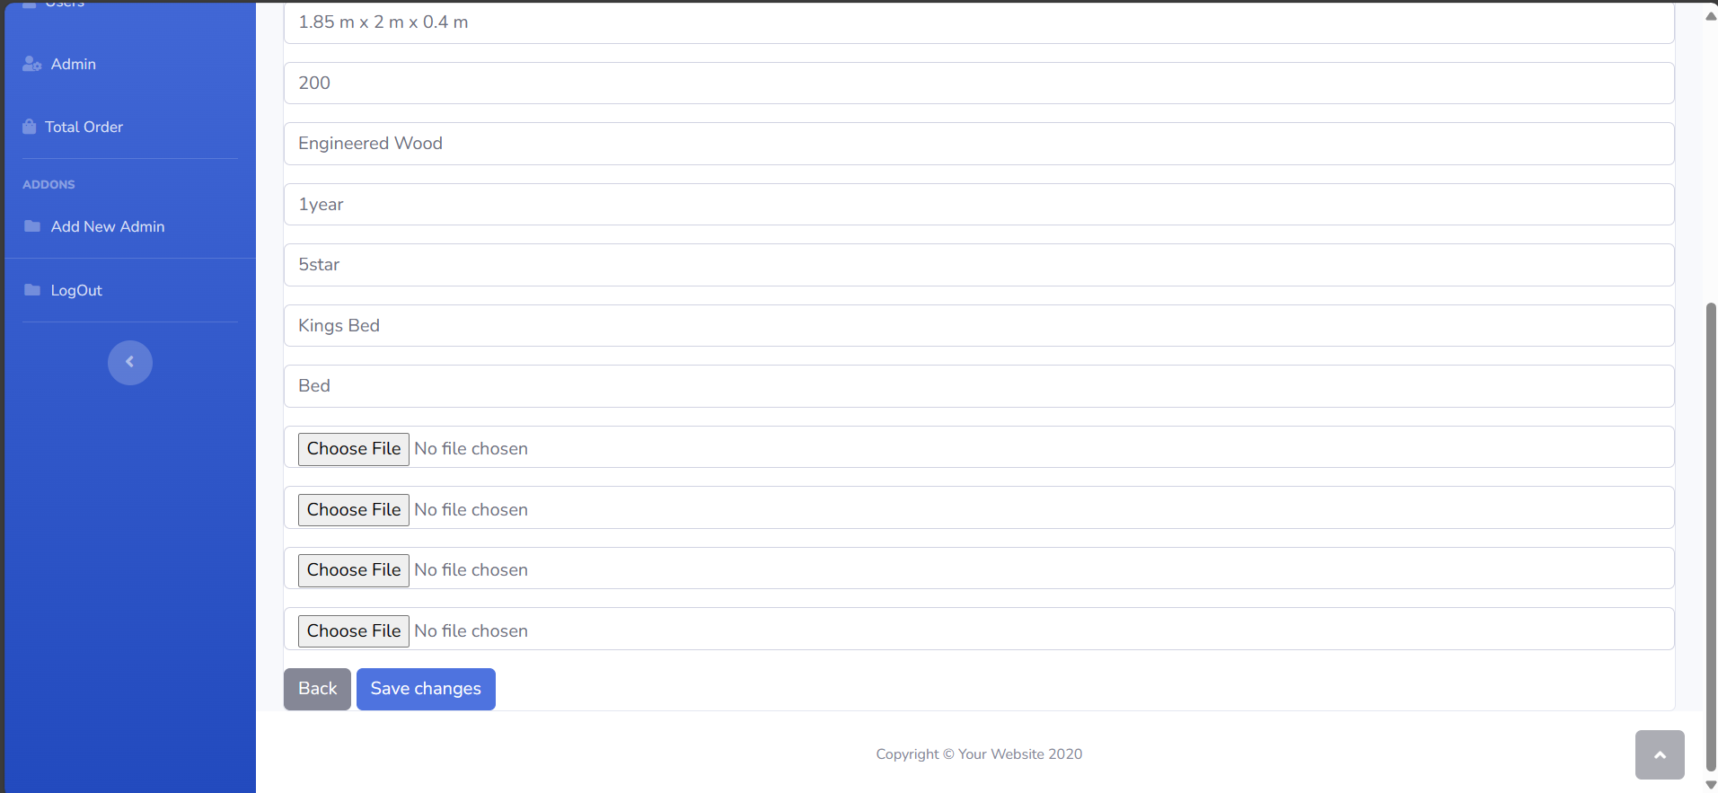
Update Product

Slide 24
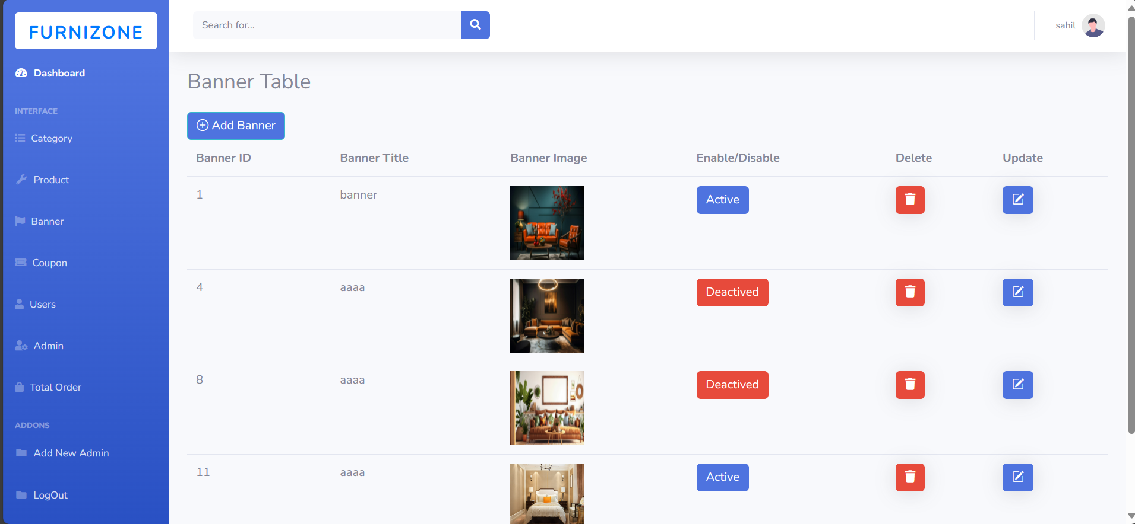
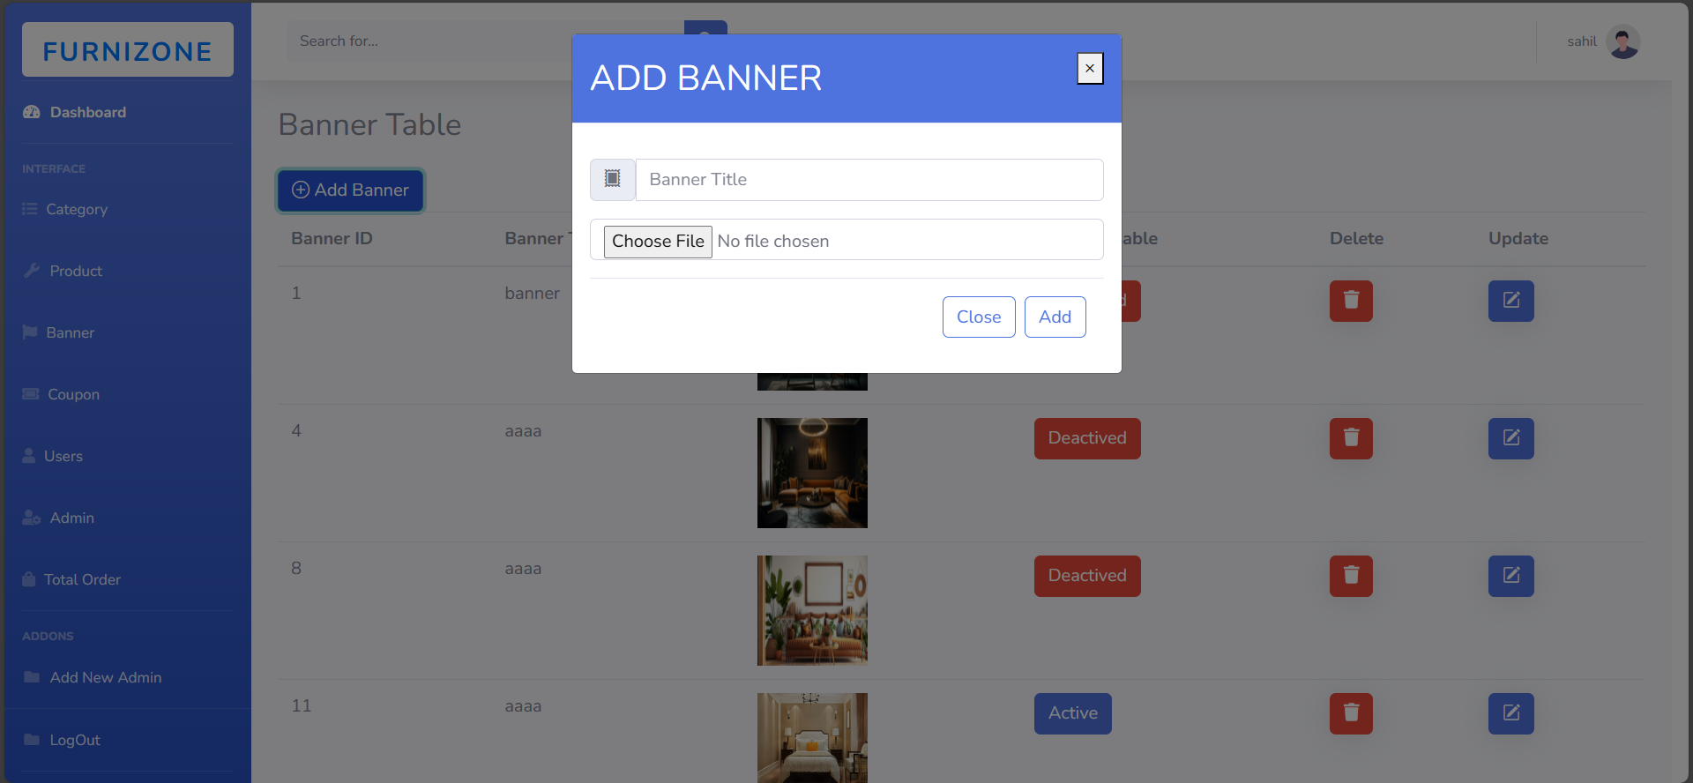
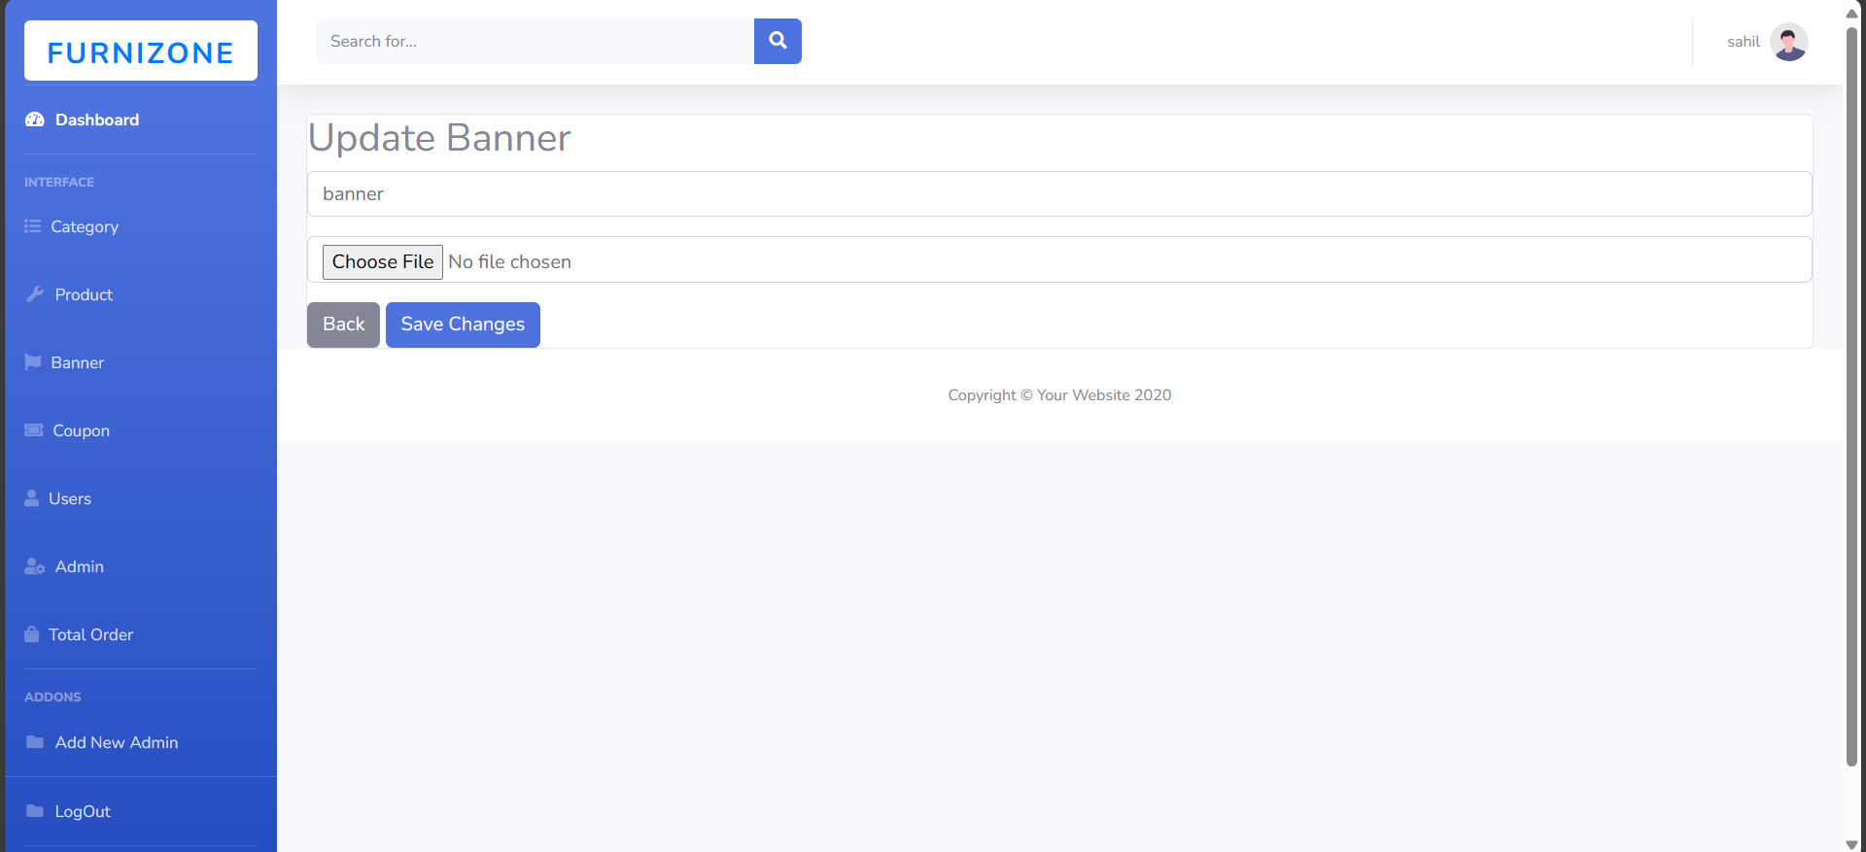
Update Banner
Update Banner
Add Banner
Update Banner

Slide 25
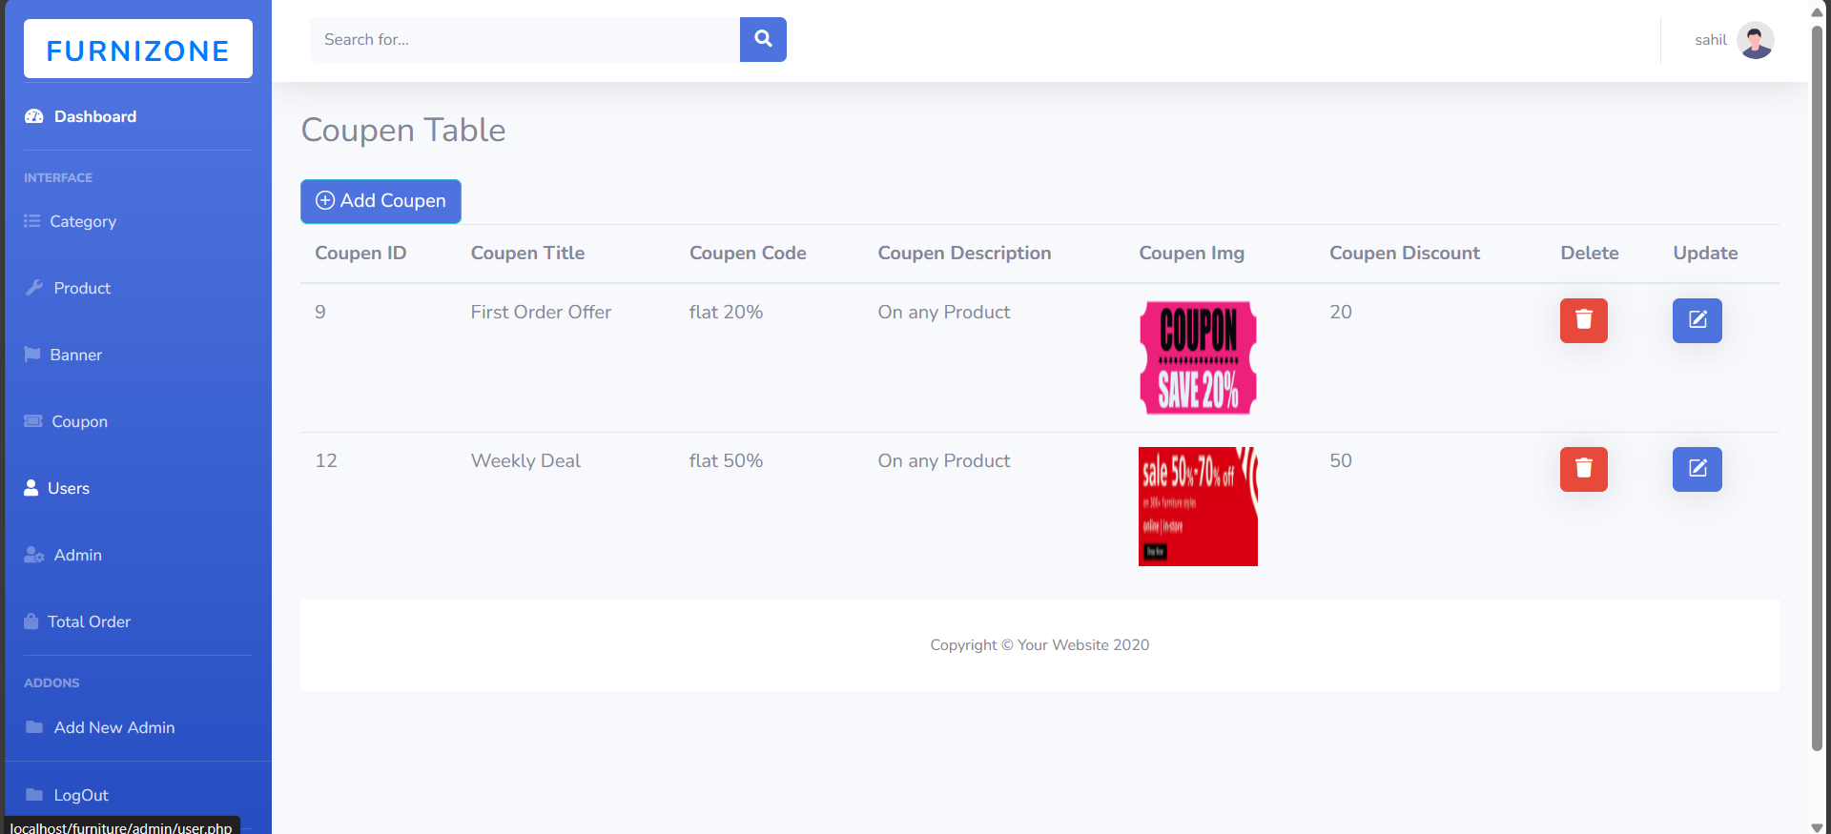
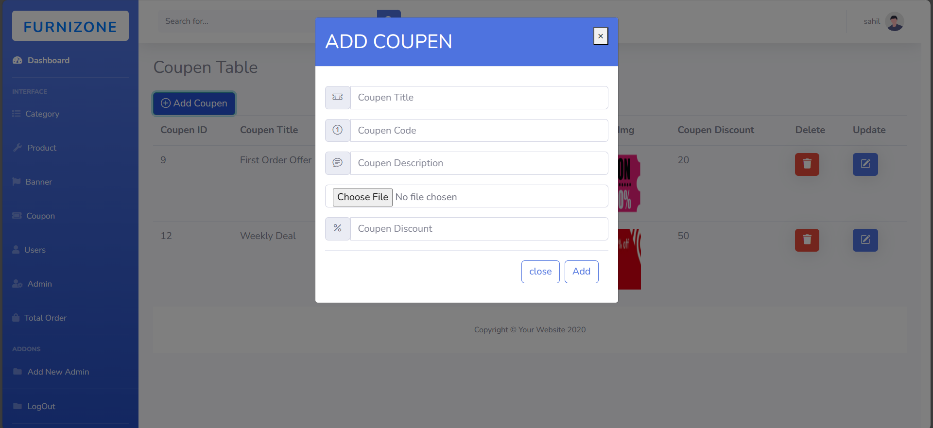
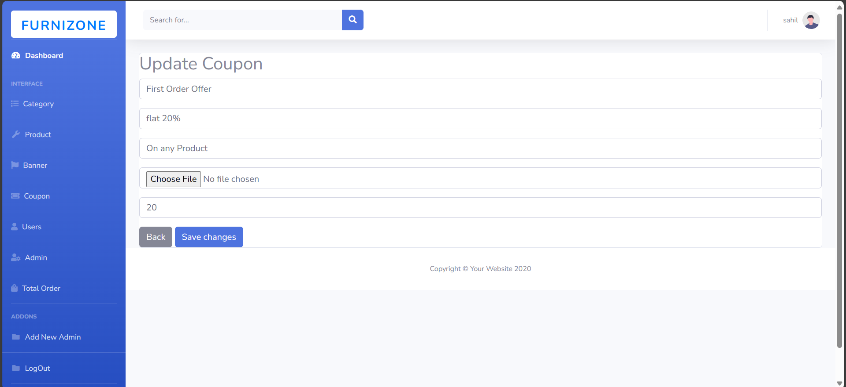
Coupon
Update Coupon
Update Coupon
Update Coupon
Update Coupon
Update Coupon
Add Coupon

Slide 26
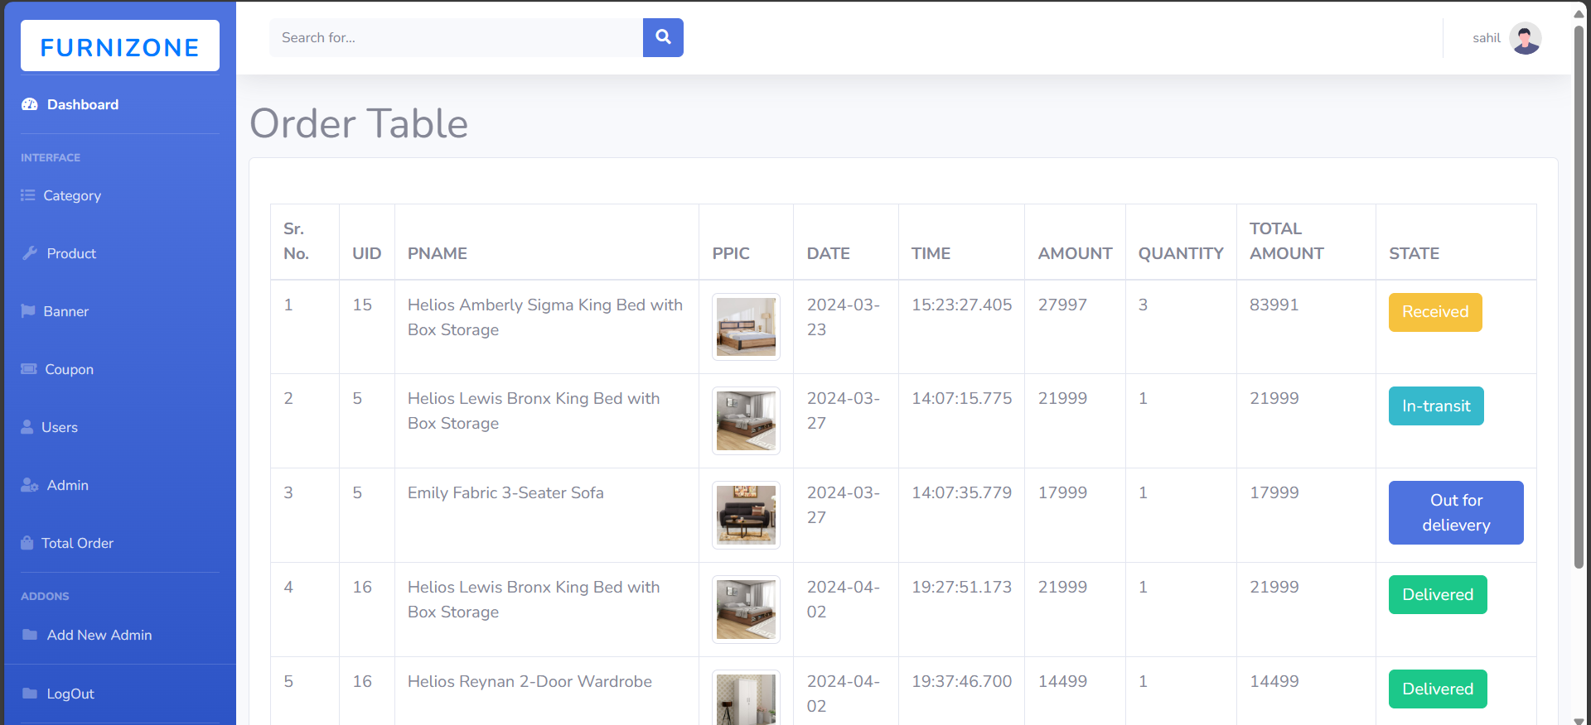
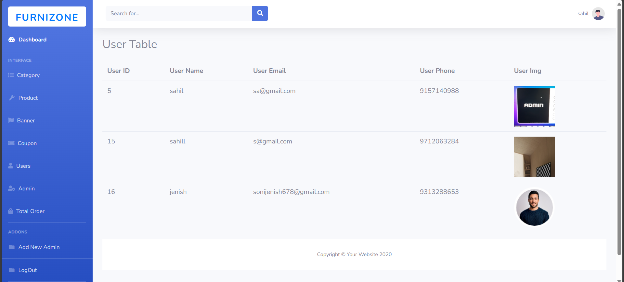
Total order and Total user
Total Order
dfddsdsdTotal User
Total User
Total User
Total Order

Slide 27

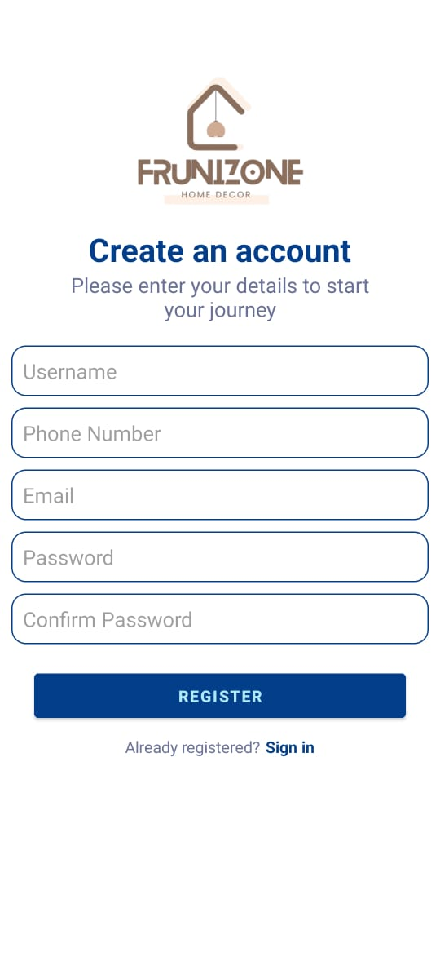
Total
Total User

Slide 28
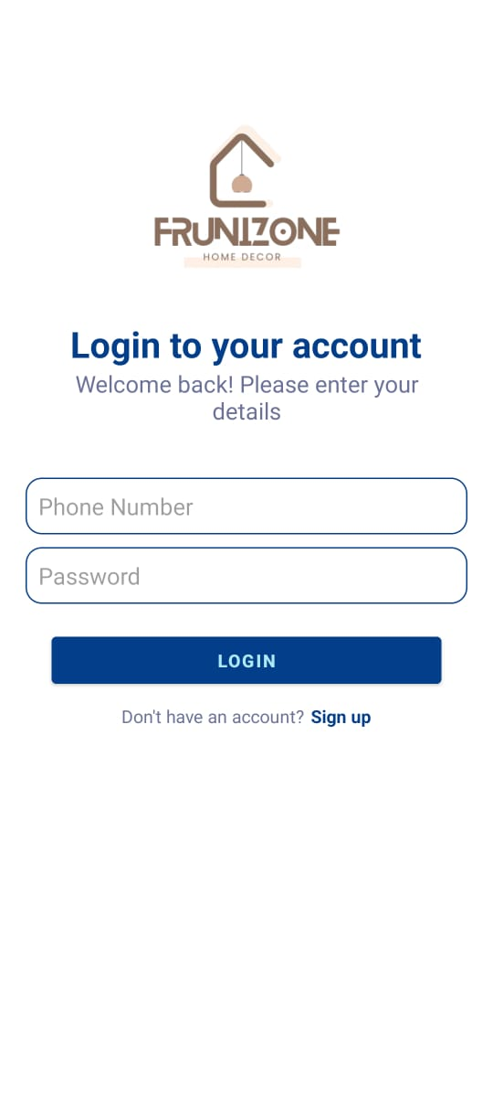
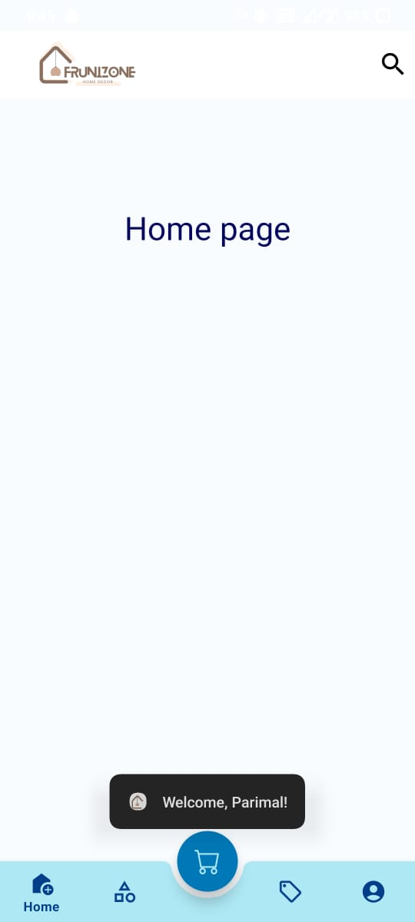
Total
Total User

Slide 29
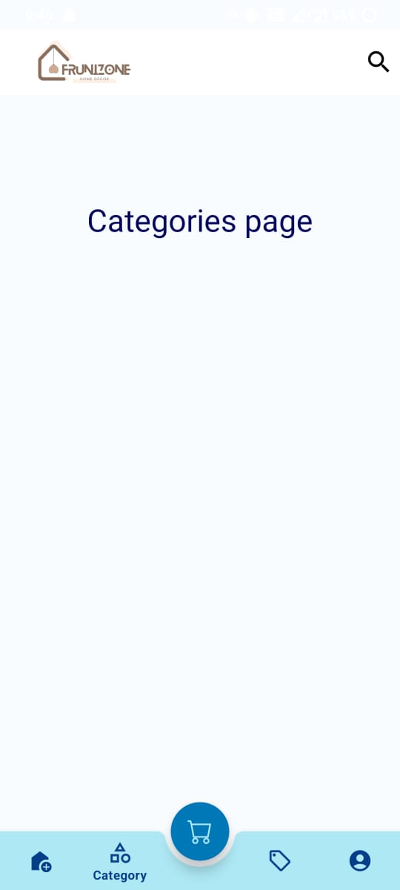
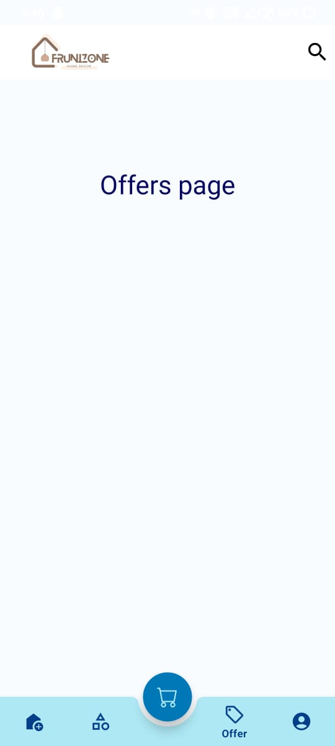
Total
Total User

Slide 30

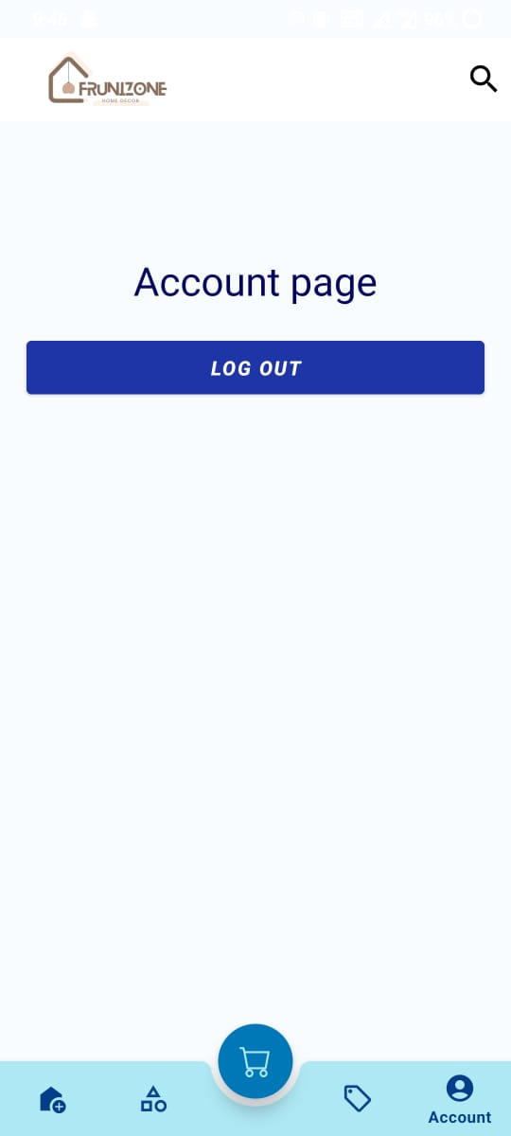
Total
Total User

Slide 31
31
Thank You

