Slide 1



ELITEmart
E-commerce Shopping Application using Flutter
BY-
Vidhi Gandhi 22csu237
Cheshta Taneja 22csu491
Muskan Arora 22csu245

Slide 2
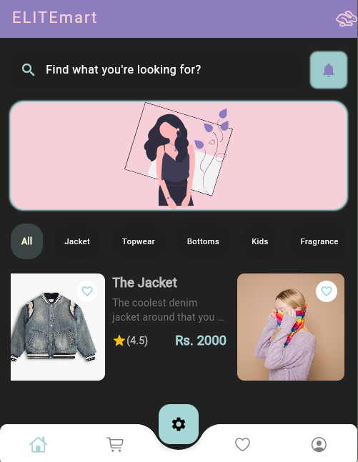
Introduction
The Evolution of Shopping Online
Overview:
A Flutter-based e-commerce app for seamless online shopping.
Problem:
Need for accessible, user-friendly platforms for small businesses.
Solution:
Cross-platform app with intuitive UI, powered by Flutter and Firebase

Slide 3


Project Objectives
Develop a cross-platform e-commerce app using Flutter.
Provide secure user authentication and data management with Firebase.
Ensure intuitive navigation and responsive UI/UX.
Simulate core e-commerce functionalities (cart, orders, payments).
Build a scalable and maintainable solution for small businesses.

Slide 4

Tech Stack
Frontend: Flutter (Dart) for cross-platform UI.
Backend: Firebase (Authentication, Cloud Firestore, Storage).
State Management: Provider for efficient UI updates.
Local Storage: Shared Preferences for user settings.
Tools: VS Code, Android Studio Emulator.

Slide 5

System Architecture
Client: Flutter app (iOS/Android).
Backend: Firebase Authentication for user management.
Database: Cloud Firestore for product and order data.
Storage: Firebase Storage for images and assets.
Data Flow: User → App → Firebase → Firestore.

Slide 6

Key Features
User Authentication: Secure login, signup, and password recovery.
Product Browsing: Grid/list views for products, favorites.
Cart Management: Add/remove items, review cart.
Order Confirmation: Simulated order processing and success screens.
Profile Management: User settings and recovery options.
Change theme according to your preference.

Slide 7
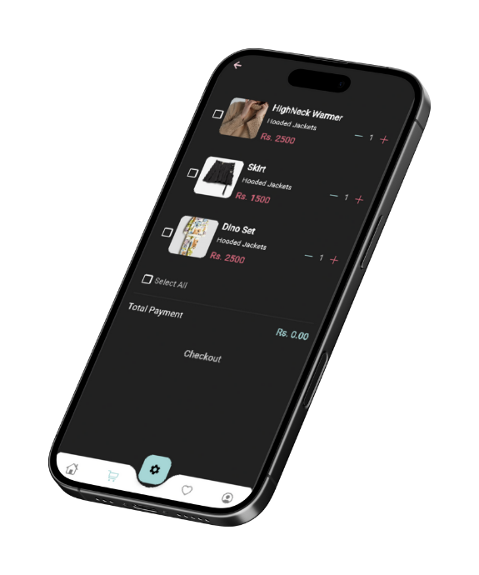
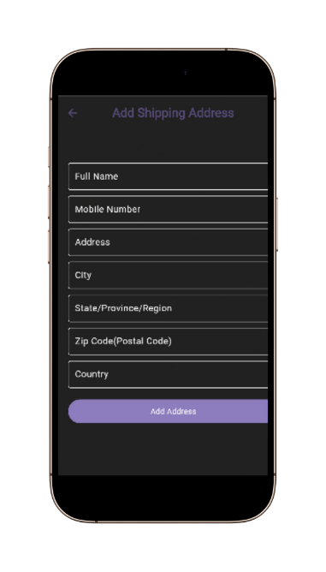
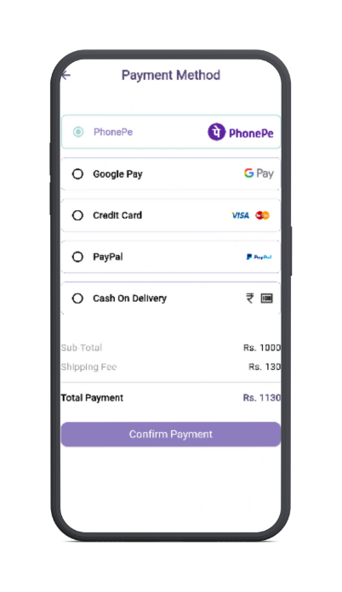
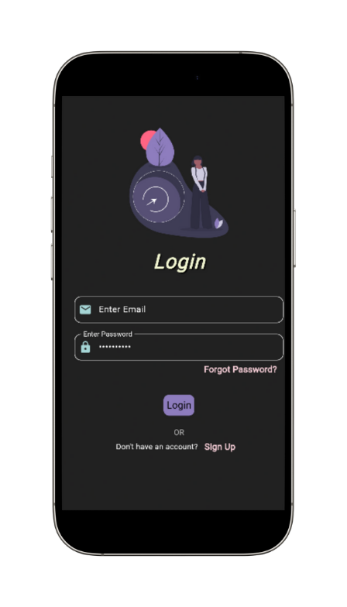
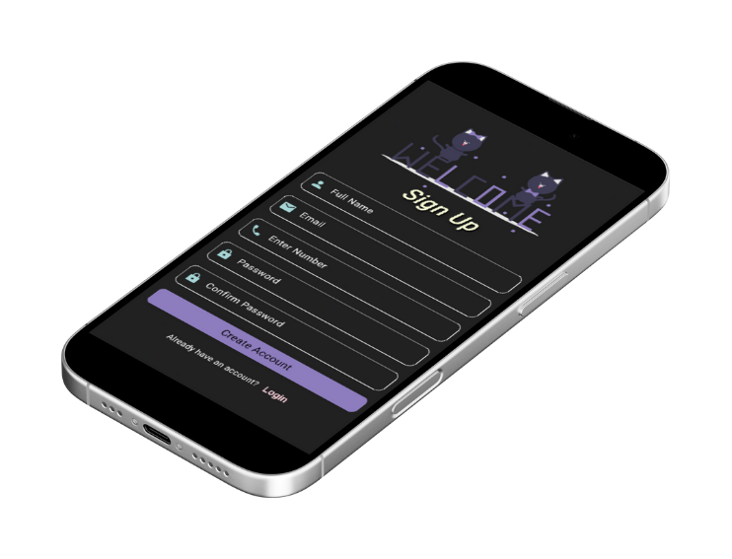

Slide 8

User Interface
Design: Material Design principles for consistency.
Features: Responsive layouts, bottom navigation bar.
Onboarding: Walkthrough screens to reduce user drop-off.
Typography: Clean, readable fonts

Slide 9


Challenges Faced
Overcoming Obstacles
Challenge: State management complexity.
Solution: Adopted Provider for efficient state updates.
Challenge: Data syncing with Firestore.
Solution: Optimized queries and caching.
Challenge: UI responsiveness on varied devices.
Solution: Used Flutter’s responsive widgets.

Slide 10

Future Enhancements
The Evolution of Shopping Online
Integrate real-time payment gateways.
Add user reviews and ratings.
Implement push notifications for order updates.
Develop an admin panel for inventory management.
Enhance personalization with user preferences.
Add Models for try on feature.

Slide 11

Conclusion
Summary: Delivered a functional e-commerce app with Flutter and Firebase.
Impact: Viable solution for small businesses with scalable architecture.
Future: Ready for enhancements like payments and personalization.
Call to Action: “Explore the app’s potential for your business!”

Slide 12
Thank You !

