Slide 1

Project Title -
Seasonal Agriculture Performance Analysis
Prepared by Vidhi Mittal
B.Tech CSE
Echelon Institute of Technology
AICTE STU ID: STU696a56052569d1768576517

Slide 2

PROBLEM STATEMENT
Agricultural activities are influenced by seasonal variations in environmental conditions, farming practices, resource availability and market conditions. Raw agricultural data does not clearly explain these seasonal differences.
This project analyzes the agricultural dataset to identify meaningful seasonal patterns, trends, relationships and variations in yield, production, resource usage, environmental conditions and economic performance.

Slide 3
PROJECT DESCRIPTION
• Analyze 4,000 agricultural farm records covering 28 variables across Kharif, Rabi and Zaid seasons.
• Perform data exploration, missing-value treatment, duplicate removal and basic data-quality checks.
• Compare seasonal yield, production, rainfall, temperature, resource usage, water efficiency, revenue, cost, profit and disease/pest risk.
• Use group-by analysis, cross-tabulation, box plots, bar charts, scatter plots and a correlation matrix to interpret patterns.
• Generate a final season-wise summary table and evidence-based observations for agricultural planning.

Slide 4

WHO ARE THE END USERS?
• Farmers and farm managers — compare seasonal performance and resource usage.
• Agricultural planners and extension teams — understand seasonal patterns and areas needing attention.
• Agribusiness and market stakeholders — examine revenue, cost and profit variation.
• Water/resource management stakeholders — evaluate water use and seasonal water efficiency.
• Data analysts and students — reproduce and extend the analysis using the Jupyter Notebook.

Slide 5

Technology Used
• Python — core analysis language
• Pandas — data loading, cleaning, grouping and aggregation
• NumPy — numerical operations and data handling
• Matplotlib & Seaborn — statistical and analytical visualizations
• Jupyter Notebook / Google Colab — interactive analysis and documentation
• CSV dataset — source agricultural records

Slide 6
RESULTS
4,000
Records
28
Variables
3
Seasons
0
Duplicates
• Missing values detected in Rainfall (48), Soil Moisture (40) and Yield (32).
• Duplicates were checked and removed before analysis; categorical missing values were filled with the mode and numerical missing values with the median.
• No negative values were identified in the numerical columns checked.
• Final analysis produced a season-wise summary covering yield, production, rainfall, temperature, water use, efficiency, revenue, cost, profit and disease/pest risk.

Slide 7
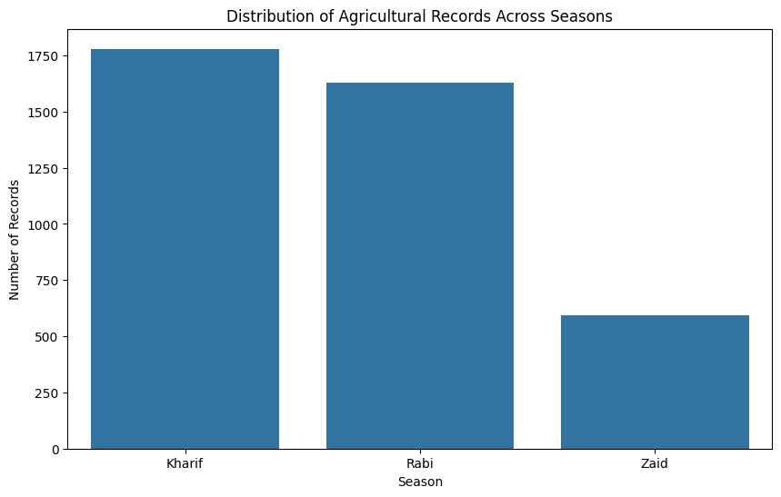
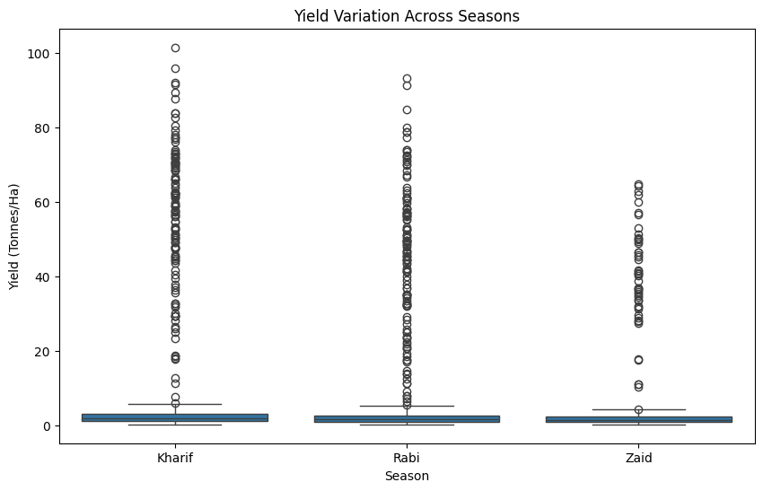
RESULTS
Key result: Kharif recorded the highest average yield (5.63 t/ha), followed by Rabi (5.04 t/ha) and Zaid (4.64 t/ha). Kharif also had the largest number of records in the dataset.

Slide 8
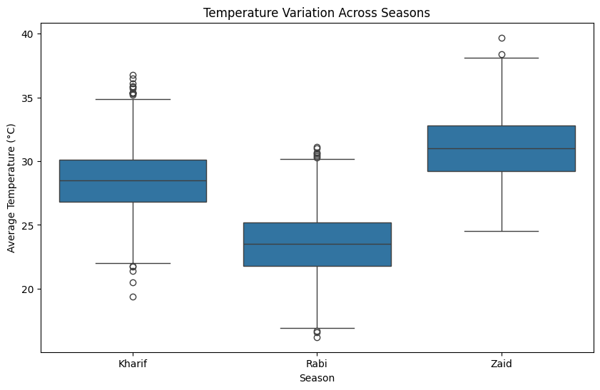
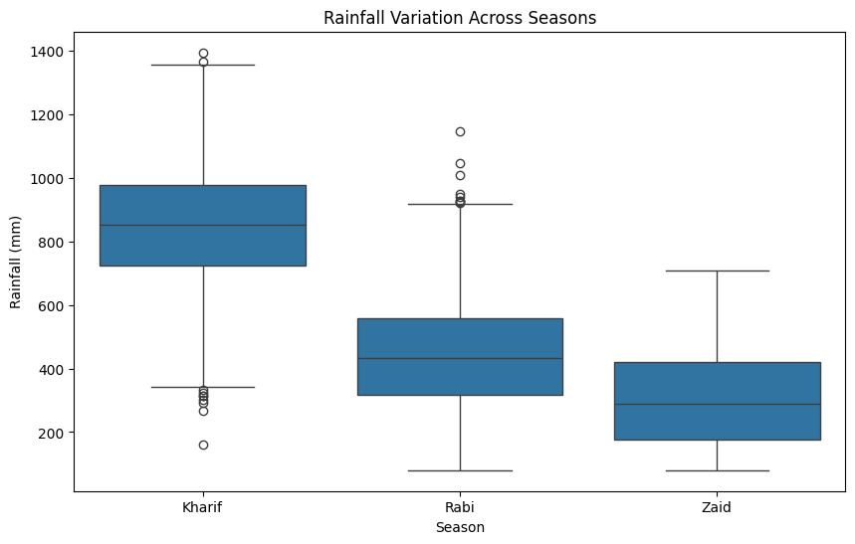
RESULTS
Seasonal environmental averages: Kharif rainfall ≈ 849.20 mm and temperature ≈ 28.45°C; Rabi ≈ 437.62 mm and 23.49°C; Zaid ≈ 304.65 mm and 31.04°C. These differences provide important seasonal context for performance comparisons.

Slide 9
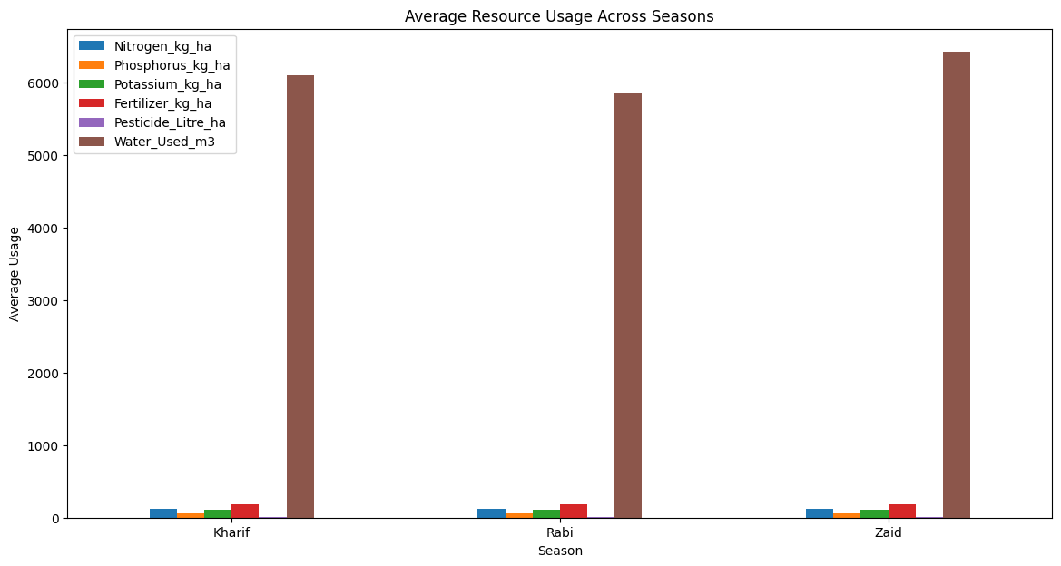
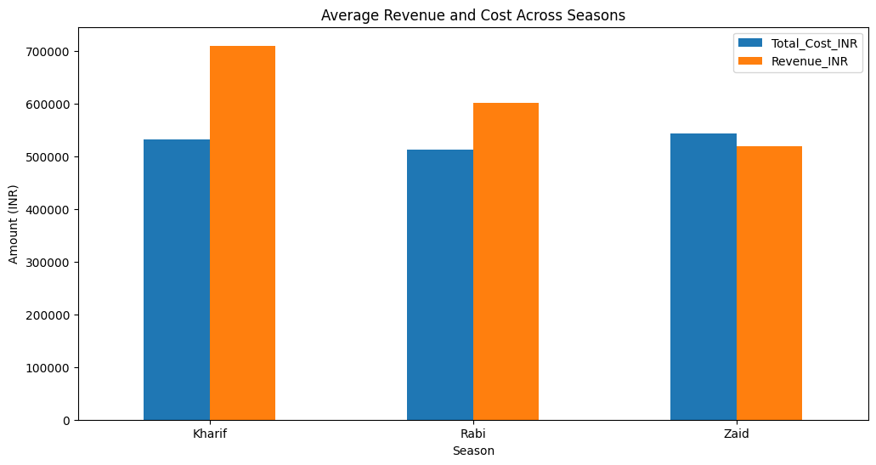
RESULTS
Kharif achieved the highest average water efficiency (5.89 t/1,000 m³), revenue (₹710,719) and profit (₹178,915). Rabi remained profitable (₹87,689), while Zaid showed an average loss of about ₹24,805.

Slide 10
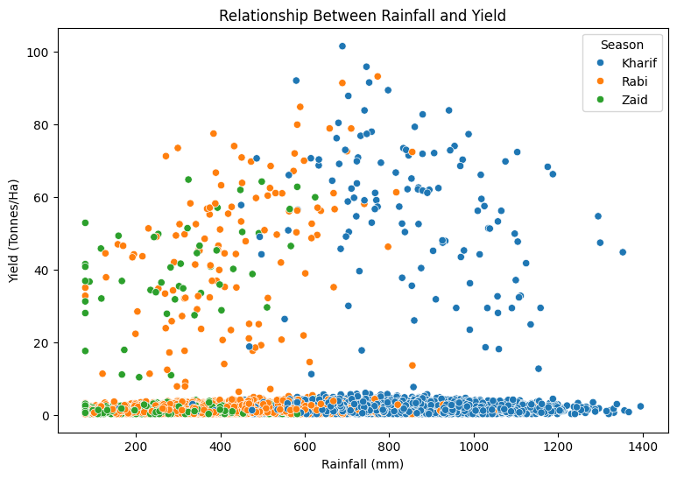
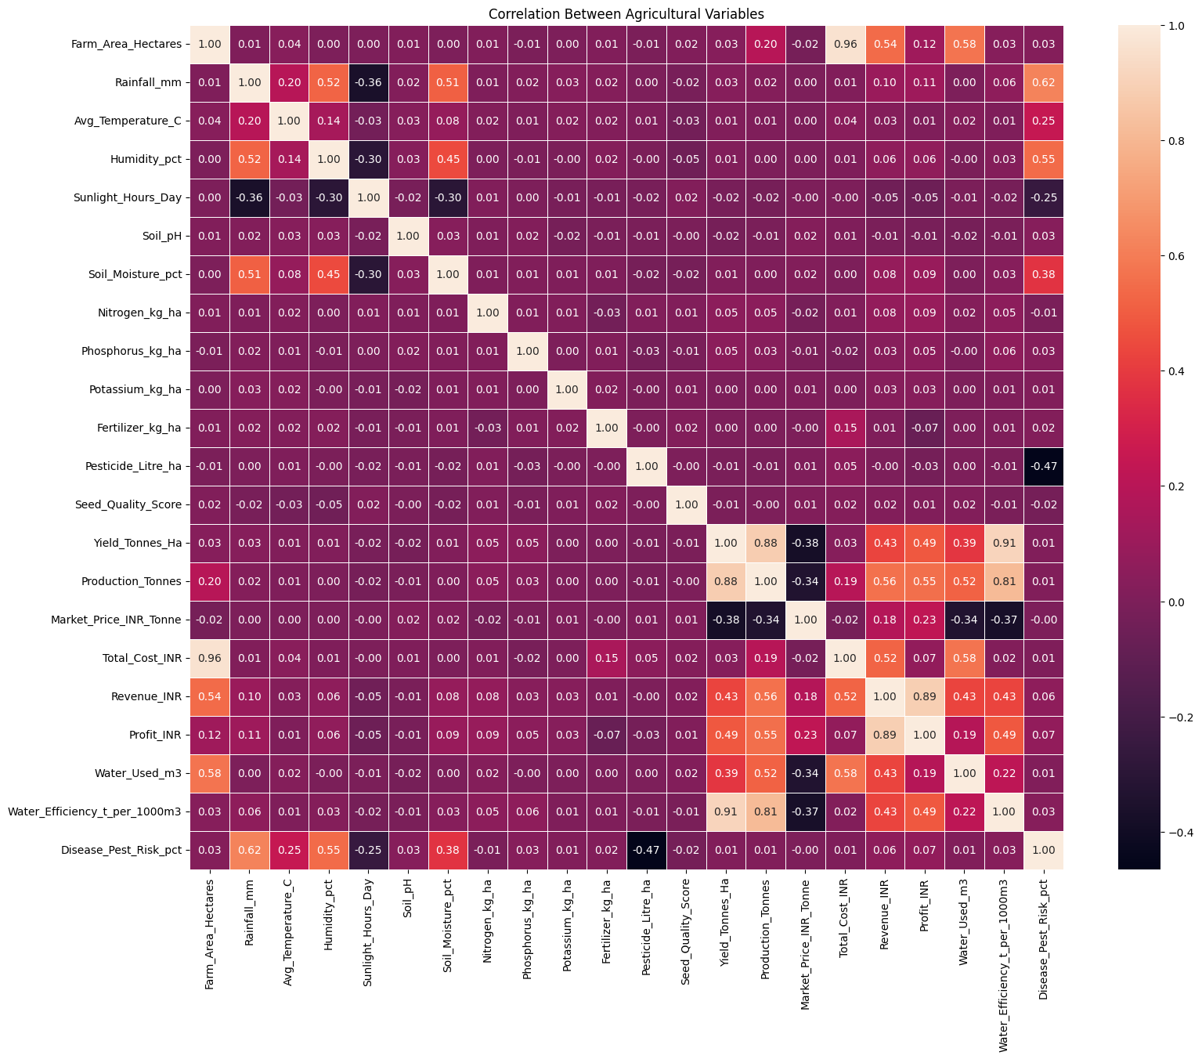
RESULTS
[Add screen shots of your code ]
Correlation analysis showed very weak direct correlations between the tested environmental variables and yield (e.g., rainfall 0.031, humidity 0.012, soil moisture 0.011). The notebook also identified 302 yield outliers using the IQR rule. Highest disease/pest risk was observed in Kharif (54.47%).

Slide 11
Future Scope
• Build an interactive dashboard for season, state, crop and irrigation-level filtering.
• Add predictive models for yield, profit and disease/pest risk forecasting.
• Use time-series data to study multi-year seasonal trends rather than a single dataset snapshot.
• Integrate weather forecasts, soil sensors and real-time market prices for decision support.
• Apply explainable ML to identify the strongest drivers of yield and profitability.
• Extend the system into a practical seasonal planning assistant for farmers and agricultural stakeholders.

Slide 12
GitHub Link
GitHub Repository:
Seasonal Agriculture Performance Analysis
Repository Link:
https://github.com/VidhiiMittal0027/Seasonal-Agriculture-Performance-Analysis
“The repository contains the complete Jupyter Notebook, data analysis workflow, visualizations, seasonal comparisons, correlation analysis, outlier detection, and summary results.”

Slide 13

VOIS Course Completion Certificate
Course Name — Data Visualization

Slide 14
Thank you

