Slide 1
InternImage: Exploring Large-Scale Vision Foundation Models with Deformable Convolutions

Slide 2
Introduction
After the remarkable success of transformers, vision transformers (ViTs) have become a primary choice for research and practice of large scale vision model. ViTs have significantly pushed the boundaries in computer vision tasks, including basic classification, detection and segmentation.
The authors propose that CNN-Based foundation models can also achieve comparable or even better performance than ViTs when equipped with similar operator / architecture level designs, scaling up parameters, and massive data

Slide 3
CNN vs ViT
From the operator level, ViTs have long-range dependencies and adaptive spatial aggregation, thus ViTs can learn more powerful and robust representations than CNNs.
ViTs also contain a series of advanced components that are not included in the standard CNNs, such as layer normalization, feed-forward network and GELU {Gaussian Error Linear Unit}.
Some attempts to introduce longe-range dependencies into CNNs by using dense convoloutions (a variant of skip connection) with very large kernels have been made, but there is still a considerable gap with the state-of-the-art ViTs.

Slide 4
Deformable Convolution (DCN)
Though CNN’s are excellent for visual-recognition tasks but are very limited when it comes to modelling geometric variations or geometric transformations in object scale, pose, viewpoint and part deformation.
The concept of deformable convolution was first introduced in this paper. They introduced a simple, efficient and end-to-end mechanism that makes the CNN capable of learning various geometric transformations according to the given data.
The idea will become more clear in the next slide.

Slide 5
High Level Explanation
In deformable convolutions, in order to factor in the scale of different objects and have different receptive fields according to the scale of the object, 2D offsets are added to the regular grid sampling locations in the standard convolution operation thereby deforming the constant receptive field of the preceding activation unit.
The offsets added are learnable from the preceding feature maps using additional convolutional layers. Thus the deformation applied depends on the input features in a local, dense and adaptive manner.
The added deformable convolutional layers add very small parameters and computation to the existing model and can be trained end-to-end using normal back-propagation.

Slide 6
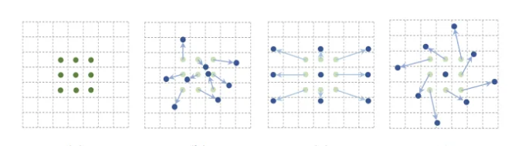
Deformable Convolution in Action

Slide 7
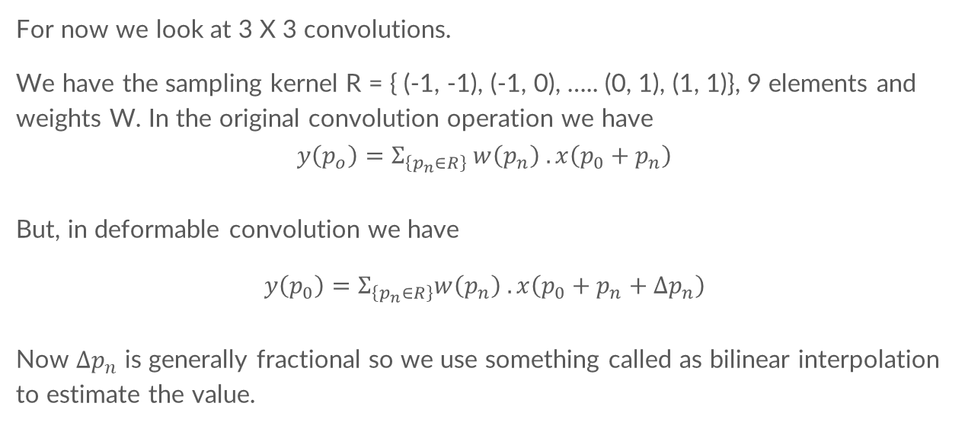
Detailed Explanation
For now we look at 3 X 3 convolutions.
We have the sampling kernel R = { (-1, -1), (-1, 0), ….. (0, 1), (1, 1)}, 9 elements and weights W. In the original convolution operation we have
$$y\left(p_{o}\right)=Σ_{\left\{p_{n}∈R\right\}} w\left(p_{n}\right) . x\left(p_{0}+p_{n}\right)$$
But, in deformable convolution we have
$$y\left(p_{0}\right)=Σ_{\left\{p_{n}∈R\right\}}w\left(p_{n}\right) . x\left(p_{0}+p_{n}+Δp_{n}\right)$$
Now $Δp_{n}$ is generally fractional so we use something called as bilinear interpolation to estimate the value.

Slide 8
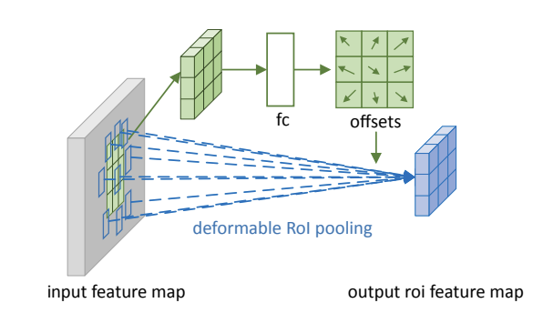
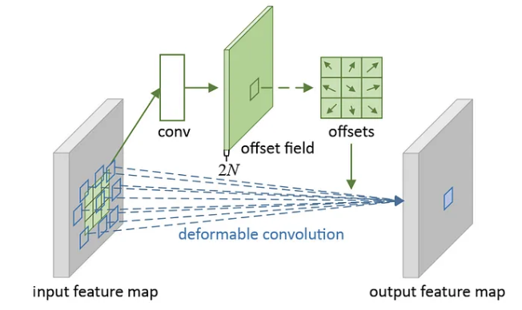

Slide 9
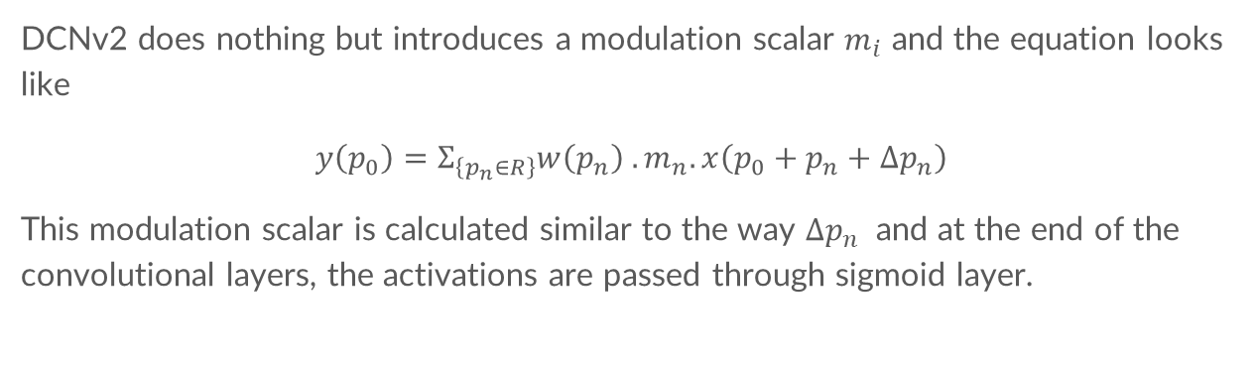
DCNv2
DCNv2 does nothing but introduces a modulation scalar $m_{i}$ and the equation looks like
$$y\left(p_{0}\right)=Σ_{\left\{p_{n}∈R\right\}}w\left(p_{n}\right) . m_{n}. x\left(p_{0}+p_{n}+Δp_{n}\right)$$
This modulation scalar is calculated similar to the way $Δp_{n}$ and at the end of the convolutional layers, the activations are passed through sigmoid layer.

Slide 10
DNCv3
$$y\left(p_{0}\right)=Σ_{\left\{g=1\right\}}^{\left\{G\right\}} Σ_{\left\{k=1\right\}}^{\left\{K\right\}}w_{g} . m_{\left\{g,k\right\}}x_g\left(p_{0}+p_{k}+Δp_{\left\{gk\right\}}\right)$$
1. sharing weights among convolutional neurons
in original DCNv2, we have calculate the offset and modulation scalar for every sampling point. thus memory complexity is linear with the total number of sampling points, which significantly limits the efficiency of the model. So the authors borrow the idea from separable convolution.
2. introducing multi-group mechanism this concept first appeared in Group Convolution and it is widely used in MHSA of
transformers, inspired by this, the authors split the spatial aggregation process into
groups each of which has individual sampling offsets and modulation scale. 3. Normalizing modulation scalars along sampling points the modulation scalars in the original DCNv2 are element-wise normalized by sigmoid. but this could lead to unstable gradients in summation, thus the authors use SoftMax normalization instead of sigmoid.

Slide 11
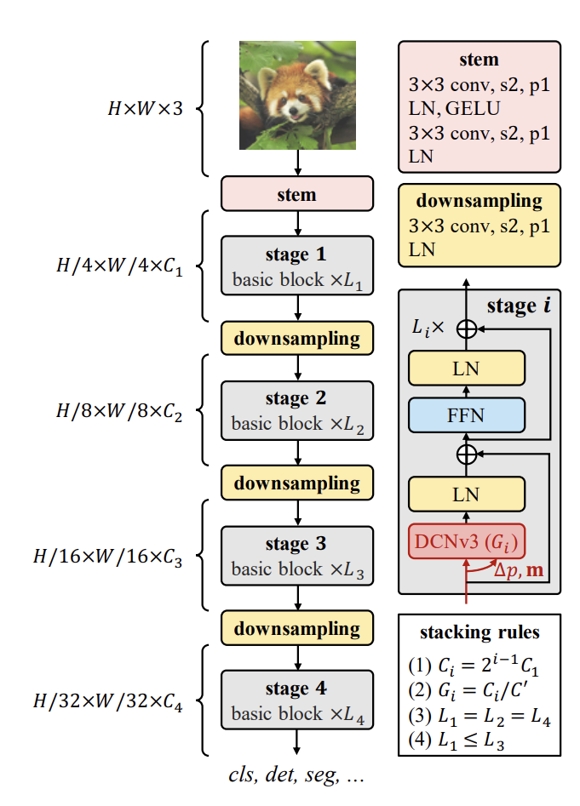
The Architecture
This is the architecture of the Intern-Image model.
The image speaks for itself the complete architecture and the stacking laws.
They have also shared the results in the original paper. There is also some in-depth explanation and their exact training process mentioned in the paper. We encourage you to go through the paper

Slide 12



