Slide 1
Final Presentation
Summer Internship, Multimodal Perception Lab – IIIT Bangalore

Slide 2
Contents
People
Project Overview and Summary
Paper – 1: Multi-Modal Classifiers For Open-Vocabulary Object Detection
Paper – 2: InternImage

Slide 3
People
Prof. Dinesh Babu Jayagopi
Mentor: Ms. Jeba Berlin
Vidhish Trivedi
Deepkumar Patel

Slide 4
Project Overview
The objective of this project is to utilize recorded sessions (video) to predict whether a child has autism or not.
Our initial focus is on training a model capable of detecting objects belonging to child and adult classes within an image.
To accomplish this, we are explored the YOLOv8 framework

Slide 5
Project Overview
We first gathered images (around 250) from the internet for our dataset and annotated them with bounding boxes.
The results obtained from training variations of the YOLOv8 model on this dataset were not good. Our mentor then shared a dataset of short videos from which we extracted 1013 images (710 training, 150 validation, 153 testing).
We trained YOLOv8s model on this new dataset and have made progress in terms of results and predictions that this model makes.

Slide 6
Project Overview
We were instructed by our mentor to now try using the images we collected (from the internet, Data Collection and Training - 1) to test the model which was trained on the larger dataset (from Data Collection and Training - 2).
This led to a decrease in how good the model performed earlier. We suspected that over-fitting might be the reason and looked at how we could make our model generalise better.
We discussed this issue with our professor and came to the conclusion that in some situations when we know beforehand that our model will be used only in specific scenarios (where the model performed relatively well), over-fitting would not be a huge drawback.

Slide 7
Paper – 1: Multi-Modal Classifiers For Open-Vocabulary Object Detection
Summer Internship, Multimodal Perception Lab – IIIT Bangalore

Slide 8
Abstract
Open-Vocabulary Object Detection
Building a model that can detect objects beyond the set of categories seen at training, thus enabling the user to specify categories of interest at inference without the need for model re-training.

Slide 9
Standard Two Stage Object Detector Architecture
Prompt an LLM to generate informative language descriptions for object classes and construct text based classifiers .
Use a visual aggregator on image exemplars, forming vision-based classifiers
Figure out a simple method to fuse information.
Use the fused / multi-modal classifier for object detection

Slide 10
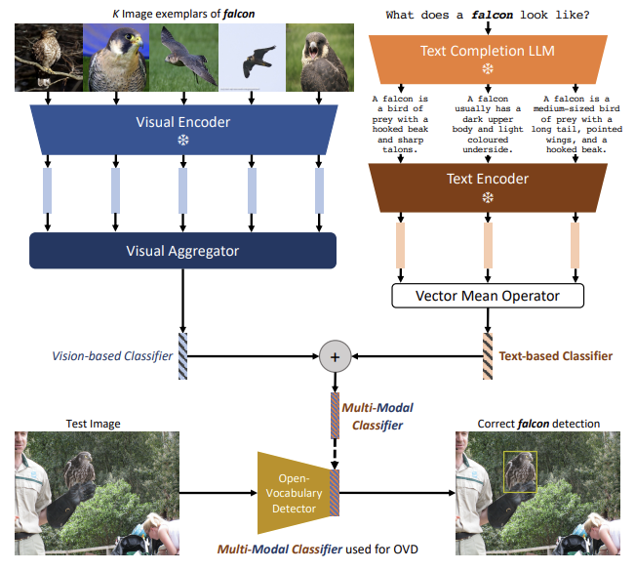
Overview of the architecture of generating text-based, vision-based, or multi- odal classifiers for OVOD

Slide 11
Why not use the just text embeddings and why even go multi-modal ?
Using text can potential lead to ambiguities. Example: “nail” can be either referred to “the hard surface on the tips of the finger” or “a small metal spike with a flat tip hammered into wood to form a joint”.
The class name of interest may be unknown. Assume the vocabulary you use doesn’t contain the word “dugong”, which refers to a herbivorous marine mammal with an adorable, plump appearance, a dolphin tail, round head and downward snout.

Slide 12
Why not use the just text embeddings and why even go multi-modal ?
There are cases where multi-modal is preferable to specify the category of interest. Suppose you are a bug collector, and you want to identify a species of butterfly with a distinctive wing pattern, in this case give a text description may not be enough.
Some more examples:
a. “What does a dalmatian look like?”, using an LLM yields “A dalmatian is typically a large dog with a short coat of black spots on a white background”.
b. the dog breeds “pug” and “bulldog” have similar descriptions, we can generate classifiers from image exemplars.

Slide 13
Related Work
Closed-Vocabulary Object Detection : This is one of the classical computer vision problems. which is finding the class and the bounding box. in CVOD, only objects seen at training time can be detected during inference time, thus termed closed vocabulary
Open-Vocabulary Object Detection: Detecting objects beyond the set of categories seen at training, thus enabling the user to specify categories of interest at inference without the need for model retraining.
The paper mentions that OVOD has seen increased attention and progress primarily driven by the emergence of large-scale vision-language models (VLMs). So what are VLMs?

Slide 14
VLM
VLMs or Visual-Language Models can understand and generate both visual and linguistic information. They are trained on large datasets of image-text pairs, and can be used for a variety of tasks, such as:
Image captioning: generating a natural language description of an image.
Visual question answering: answering questions about an image using natural language.
Text-based image retrieval: finding images that match a given text query.
Visual Dialog: carrying on a conversation about an image.
Some examples are CLIP, VisualBERT, ViLBERT, LaMDA, Gopher
Coming back to OVOD, The paper mentions about other works for OVOD such as: ViLD (Gu et al., 2022), RegionCLIP (Zhong et al, 2022), GLIP and MDETR (Li et al, 2022; Kamath 35 al., 2021), OVR-CNN(Zareian et al., 2021), OWL-ViT (Minderer et al., 2022), OV-DETR (Zang et al., 2022)

Slide 15
Few Shot Learning v/s This Approach
The approach mentioned in the paper is different from few shot learning as follows, in Few Shot Learning we have a few annotated examples to learn from, here we don’t have any annotated examples to learn from instead we try to learn the classifiers.

Slide 16
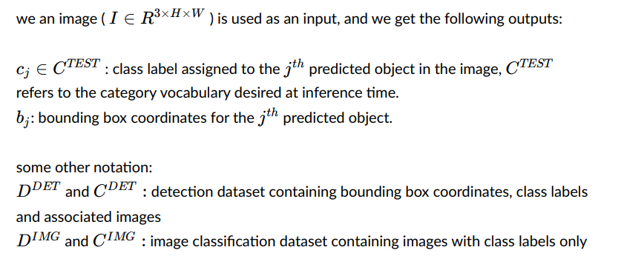
Preliminaries

Slide 17
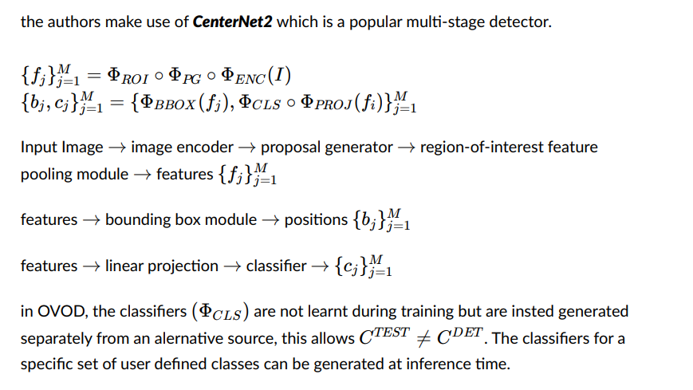
Architecture Overview
Note:
CenterNet2 was introduced in the paper “Probabilistic Two-Stage Detection”

Slide 18
Text-Based Classifiers from Language Descriptions
We use natural language descriptions of categories sourced from a large language model (LLM). Such a design choice gives additional details like visual attributes, leading to increased discriminative information in classifiers. this eliminates lexical confusion {remember the old example “nail”}.

Slide 19
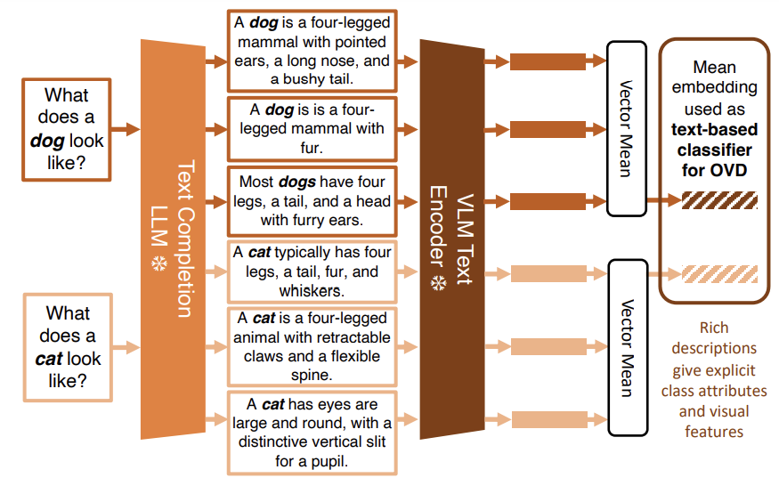

Slide 20
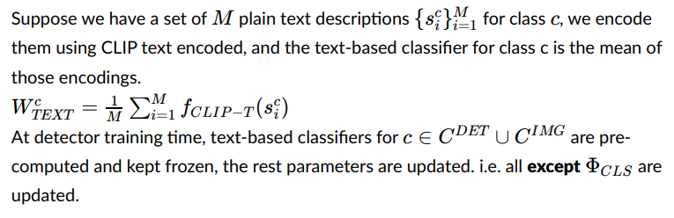
The Mathematical Representation
Note: The authors also tried to use the transformer architecture to aggregate the text embedding from natural language descriptions, but they found that it was not beneficial to OVOD performance over simply using the mean vector.

Slide 21
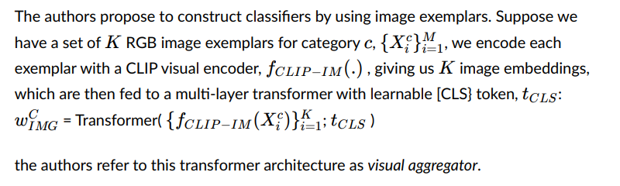
Vision-Based Classifiers from Image Exemplars

Slide 22
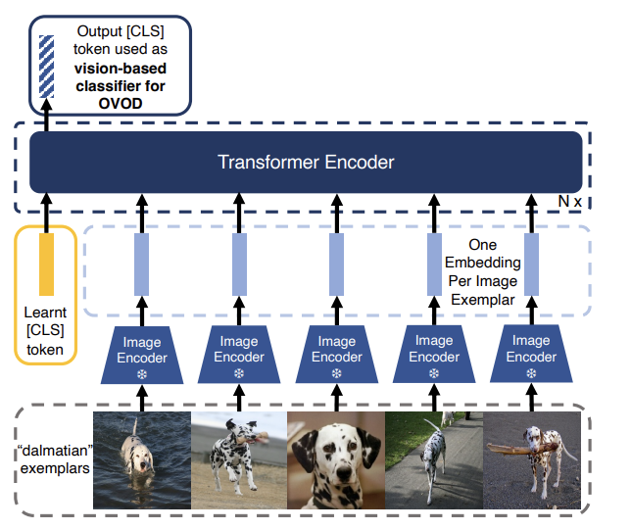
Generating an OVOD vision-based classifier from a set of image exemplars

Slide 23
Training Process
The CLIP image encoder is frozen during training to improve training efficiency and prevent forgetting of the CLIP representation
To provide discriminative vision-based classifiers, contrastive learning is utilised. For a given class, the output embedding from the visual aggregator is trained to minimise similarity with the output embedding from other classes and maximise the similarity with an output embedding from same class. To do this contrastive InfoNCE loss is used.
The visual aggregator is trained offline i.e. it is not updated during detector training
The visual aggregator was trained on ImageNet-21k-P dataset which contains about 11M images across about 11K classes.

Slide 24
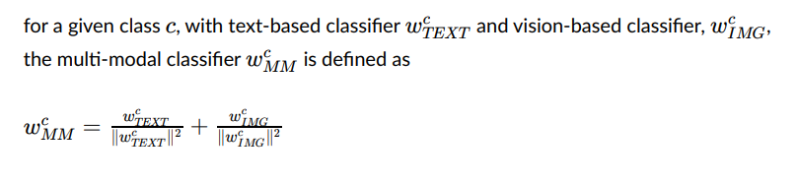
Constructing Classifiers via Multi-Modal Fusion

Slide 25
Results
The authors compared their work with previous work. Using the LVIS Open Vocabulary Benchmark and the results are on the next slide
For more details about the architecture one can read the paper. (Which data, batchsize, how many transformer encoders, which LLM…)
For the paper click here

Slide 26
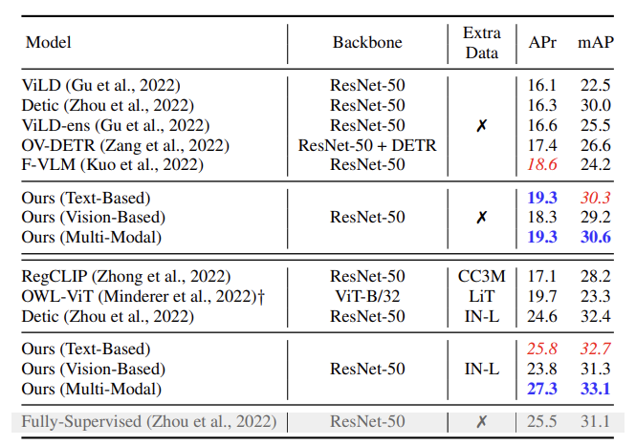
APr - Average Precision Rate
mAP - Mean Average Precision
Basically, higher the value better the performance.

Slide 27
Thank You

Slide 28
Paper – 2: Intern Image
Summer Internship, Multimodal Perception Lab – IIIT Bangalore

Slide 29
InternImage: Exploring Large-Scale Vision Foundation Models with Deformable Convolutions

Slide 30
Introduction
After the remarkable success of transformers, vision transformers (ViTs) have become a primary choice for research and practice of large scale vision model. ViTs have significantly pushed the boundaries in computer vision tasks, including basic classification, detection and segmentation.
The authors propose that CNN-Based foundation models can also achieve comparable or even better performance than ViTs when equipped with similar operator / architecture level designs, scaling up parameters, and massive data

Slide 31
CNN vs ViT
From the operator level, ViTs have long-range dependencies and adaptive spatial aggregation, thus ViTs can learn more powerful and robust representations than CNNs.
ViTs also contain a series of advanced components that are not included in the standard CNNs, such as layer normalization, feed-forward network and GELU {Gaussian Error Linear Unit}.
Some attempts to introduce long-range dependencies into CNNs by using dense convoloutions (a variant of skip connection) with very large kernels have been made, but there is still a considerable gap with the state-of-the-art ViTs.

Slide 32
Deformable Convolution (DCN)
Though CNN’s are excellent for visual-recognition tasks but are very limited when it comes to modelling geometric variations or geometric transformations in object scale, pose, viewpoint and part deformation.
The concept of deformable convolution was first introduced in this paper. They introduced a simple, efficient and end-to-end mechanism that makes the CNN capable of learning various geometric transformations according to the given data.

Slide 33
High Level Explanation
In deformable convolutions, in order to factor in the scale of different objects and have different receptive fields according to the scale of the object, 2D offsets are added to the regular grid sampling locations in the standard convolution operation thereby deforming the constant receptive field of the preceding activation unit.
The offsets added are learnable from the preceding feature maps using additional convolutional layers. Thus the deformation applied depends on the input features in a local, dense and adaptive manner.
The added deformable convolutional layers add very small parameters and computation to the existing model and can be trained end-to-end using normal back-propagation.

Slide 34
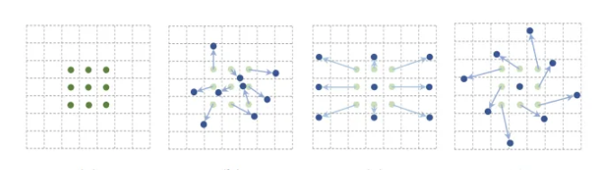
Deformable Convolution in Action

Slide 35
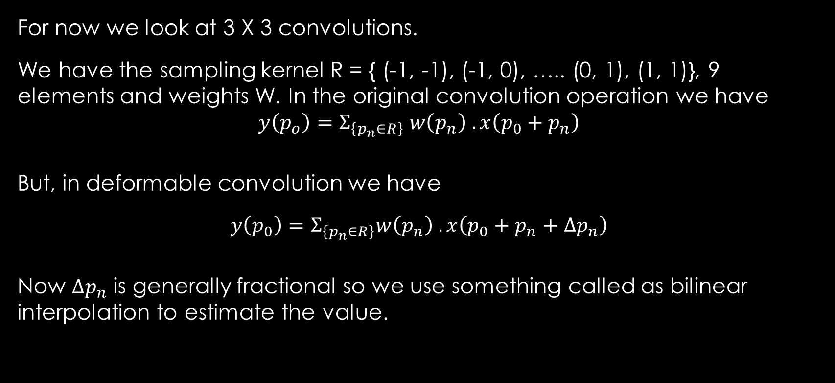
Detailed Explanation
For now we look at 3 X 3 convolutions.
We have the sampling kernel R = { (-1, -1), (-1, 0), ….. (0, 1), (1, 1)}, 9 elements and weights W. In the original convolution operation we have
$$y\left(p_{o}\right)=Σ_{\left\{p_{n}∈R\right\}} w\left(p_{n}\right) . x\left(p_{0}+p_{n}\right)$$
But, in deformable convolution we have
$$y\left(p_{0}\right)=Σ_{\left\{p_{n}∈R\right\}}w\left(p_{n}\right) . x\left(p_{0}+p_{n}+Δp_{n}\right)$$
Now $Δp_{n}$ is generally fractional so we use something called as bilinear interpolation to estimate the value.

Slide 36
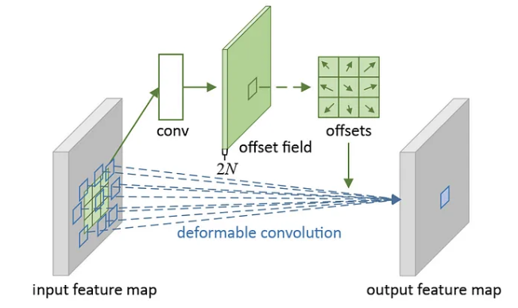
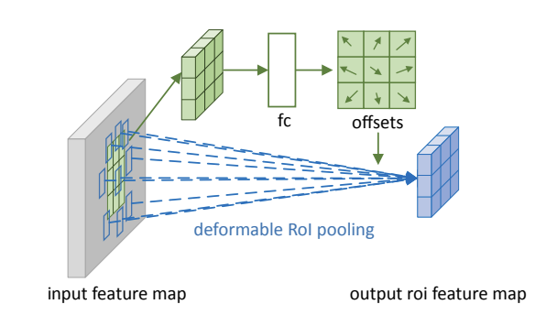

Slide 37
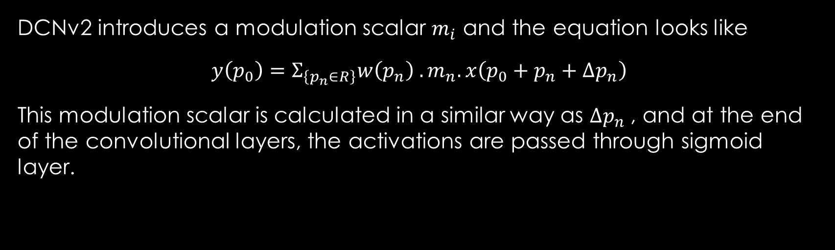
DCNv2
DCNv2 introduces a modulation scalar $m_{i}$ and the equation looks like
$$y\left(p_{0}\right)=Σ_{\left\{p_{n}∈R\right\}}w\left(p_{n}\right) . m_{n}. x\left(p_{0}+p_{n}+Δp_{n}\right)$$
This modulation scalar is calculated in a similar way as $Δp_{n}$, and at the end of the convolutional layers, the activations are passed through sigmoid layer.

Slide 38
DNCv3
$$y\left(p_{0}\right)=Σ_{\left\{g=1\right\}}^{\left\{G\right\}} Σ_{\left\{k=1\right\}}^{\left\{K\right\}}w_{g} . m_{\left\{g,k\right\}}x_g\left(p_{0}+p_{k}+Δp_{\left\{gk\right\}}\right)$$
1. sharing weights among convolutional neurons
in original DCNv2, we have calculate the offset and modulation scalar for every sampling point. thus memory complexity is linear with the total number of sampling points, which significantly limits the efficiency of the model. So the authors borrow the idea from separable convolution.
2. introducing multi-group mechanism this concept first appeared in Group Convolution and it is widely used in MHSA of
transformers, inspired by this, the authors split the spatial aggregation process into
groups each of which has individual sampling offsets and modulation scale. 3. Normalizing modulation scalars along sampling points the modulation scalars in the original DCNv2 are element-wise normalized by sigmoid. but this could lead to unstable gradients in summation, thus the authors use SoftMax normalization instead of sigmoid.

Slide 39
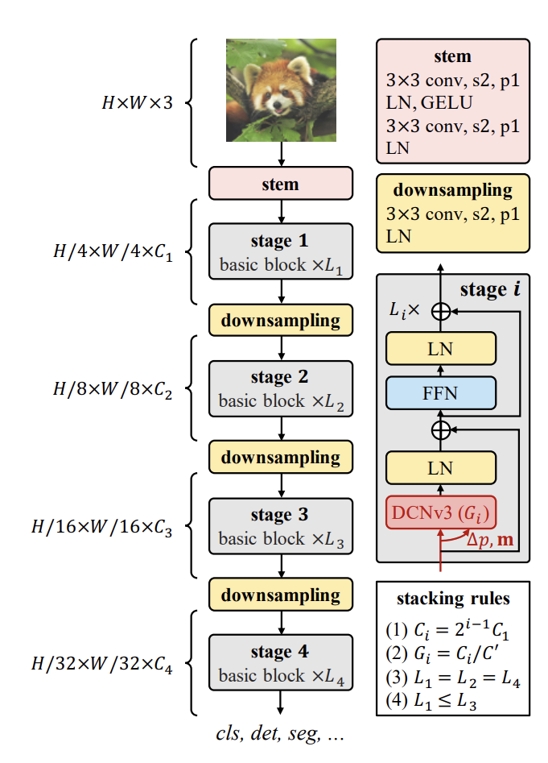
The Architecture
This is the architecture of the Intern-Image model.
The image describes the complete architecture and the stacking laws.

Slide 40
Thank You

