Slide 1
QUALITY ENGINEERING · CASE STUDY
Incremental
shift-left testing
at a European
investment bank
How CI/CD automation cut regression effort, increased delivery cadence, and changed the economics of quality engineering.
Group no- 15
Yash Mishra (202401100200360)
Umesh Singh (202401100200327)
Shubham Singh (202401100200301)
Vidhit Hatwaliya (202401100200346)
Reported case outcomes · European investment banking
Notes:
Introduce this as a reported case study, not an independently audited benchmark. The story is about moving quality activities closer to the commit, building automation incrementally, and turning regression from a release event into a reusable engineering capability.

Slide 2
THE STARTING POINT
2,000+
Manual regression made every release a bottleneck
hours of manual testing effort per release cycle
Regression ran for days and blocked updates.
Coverage was about 40%; critical defects reached production.
Notes:
Start with the constraint the program had to remove. The case study reports more than 2,000 hours of manual testing per release cycle. Regression ran for days, updates were blocked, and coverage was only about 40 percent. The bottleneck was structural, not individual effort.

Slide 3

SYSTEM SCOPE
Three surfaces multiplied the risk
Customer Website
Maintain security and compliance for client access.
Quality had to travel across products, interfaces, and integration boundaries.
Core Trading
OpenAPI Platform
Ensure workflow correctness across order lifecycle.
Verify integration reliability for third parties.
One release could change more than one customer path.
Notes:
The risk was distributed across three surfaces. The core trading application carried the transaction workflows. The customer website carried registration, login, and KYC journeys. The OpenAPI platform exposed contracts to third-party integrations. A quality approach had to cover their shared boundaries, not only one UI.

Slide 4
THE SHIFT-LEFT MODEL
Shift-left moves quality gates toward the commit
Earlier feedback shortens the distance between a change and the evidence needed to promote it.
Before code
In parallel
Clarify acceptance criteria.
Automate regression.
1
2
3
4
On every change
Before promotion
Run unit and API checks.
Require passing gates.
Notes:
Shift-left does not mean testing everything at the earliest possible moment. It means placing the right quality signal near the decision that creates risk. Acceptance criteria become explicit before code. Unit and API checks run on each change. Broader regression runs in parallel, before promotion.

Slide 5




IMPLEMENTATION STRATEGY
Prioritize
Stabilize
1
2
High-risk, high-frequency journeys.
Test data, environments, and selectors.
Incremental automation beats a big-bang rewrite
Automate and measure
Keep judgment human
3
4
One slice, then expand.
Exploratory and regulatory judgment stays human-led.
Case implementation used Selenium with C#/.NET, SpecFlow, REST/OpenAPI testing, and the Page Object Model.
Notes:
The case did not depend on rewriting the entire test estate at once. The practical sequence was to prioritize risky and frequent journeys, stabilize the conditions that make automation reliable, measure one slice, and expand. Exploratory testing and regulatory judgment remained human-led. The implementation used Selenium with C# and .NET, SpecFlow, REST/OpenAPI testing, and the Page Object Model.

Slide 6



REUSABLE COVERAGE
Regression coverage becomes a reusable asset
Trading
Website
OpenAPI
Buy, sell, and limit orders. Pricing, settlement, KYC, AML, and reporting checks.
Registration, login, KYC upload, verification, cross-browser, session, and CSRF checks.
Contract, integration, and load tests against response-time expectations.
Notes:
Automation becomes valuable when the checks can be reused across releases and surfaces. The coverage is not one generic regression pack. It reflects the bank's risk: trading actions and controls, customer website journeys and security checks, and OpenAPI contracts, integrations, and load expectations.

Slide 7

DELIVERY CONTROL
The CI/CD pipeline turns quality into a decision
Commit & PR
Build Artifact
Parallel Tests
Gate Decision
Evidence accumulates through the pipeline until a build either earns promotion or stops.
Notes:
Explain the pipeline as a decision system. The commit and pull request stage checks the change quickly. The build produces an immutable artifact. Test lanes run API, integration, UI, and cross-browser suites in parallel. A critical regression stops promotion. Only then does deployment move through staging toward production with evidence.

Slide 8

OPERATING-MODEL CHANGE
Before versus after: from release event to continuous signal
BEFORE
AFTER
Release event
Continuous signal
Manual and late
Serial regression
Low coverage
Defect leakage
Automated and earlier
Parallel execution
Reusable coverage
Pipeline-integrated
Operating principle: automate repeatable checks; reserve people for judgment and discovery.
Notes:
The operating model changes in more than one dimension. Regression moves earlier, runs in parallel, and becomes reusable evidence inside delivery. That does not remove people from quality. It changes where their time is spent: repeatable checks move to automation, while judgment, discovery, and risk interpretation remain human work.

Slide 9
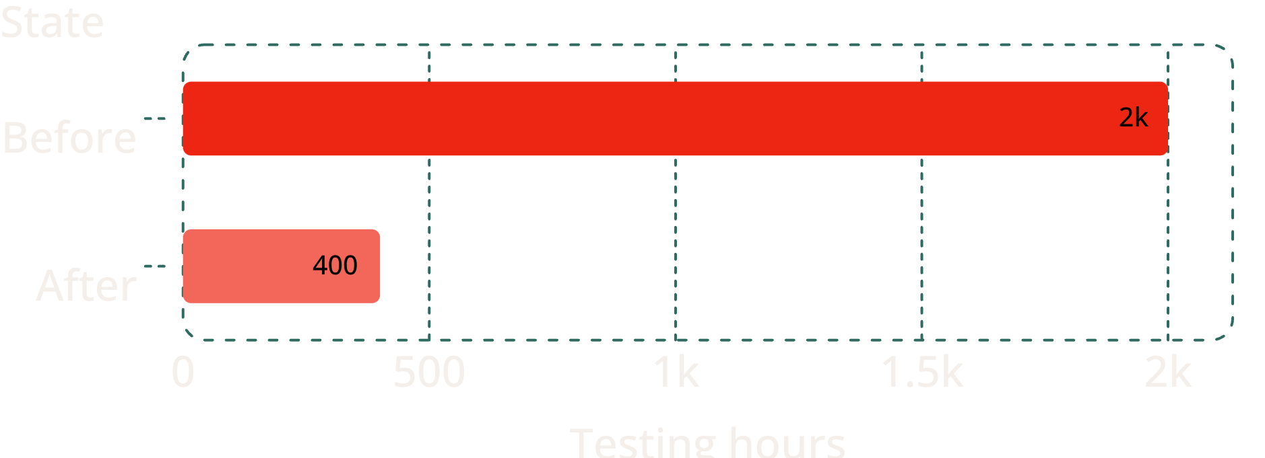
REPORTED OUTCOMES
Reported results: 2,000 hours became 400
The case study reports less effort, broader coverage, and a faster release cadence; vendor-reported outcomes, not independently verified here.
80% reduction
Testing time: from 2,000 to 400 hours
About 40% → 90%+
reported coverage
Testing effort per release cycle
Monthly → bi-weekly
release cadence
Notes:
This is the quantitative headline. The reported testing effort fell from 2,000 to 400 hours, an 80 percent reduction. Reported coverage rose from about 40 percent to more than 90 percent, while the release cadence moved from monthly to bi-weekly. Present these as case-study outcomes, not universal benchmarks.

Slide 10
The financial case is a capacity story
Remove repetitive effort
THE ECONOMIC CASE
Automated regression absorbs repeatable checks once done manually.
$700K+
Release engineering capacity
reported annual savings
Freed time can support exploratory testing, risk analysis, and product learning.
Reduced manual testing created capacity. The value is what that capacity can do next.
Protect the return
ROI depends on test stability, environment cost, and maintenance discipline.
Notes:
Close on the economics without reducing them to a single savings number. The case reports more than 700,000 dollars in annual savings from reduced manual testing. The deeper story is released capacity: people can spend more time on exploration, risk analysis, and product learning. The return holds only when automation remains stable and maintainable.

Slide 11










What makes the model work — and what can break it
Enablers
Challenges
risk-based prioritization
flaky UI tests
stable test data
brittle selectors
deterministic environments
parallel-run cost
ownership
false positives
fast feedback
compliance evidence
Control
quarantine and repair flaky tests; track pass rate, runtime, escaped defects, and change failure rate
Notes:
This is the quantitative headline. The reported testing effort fell from 2,000 to 400 hours, an 80 percent reduction. Reported coverage rose from about 40 percent to more than 90 percent, while the release cadence moved from monthly to bi-weekly. Present these as case-study outcomes, not universal benchmarks.

Slide 12
Key learnings for software engineering teams
01
02
Start with the costliest, most repeated regression paths
Make every pipeline gate explainable and observable
03
04
Scale coverage only after reliability is earned
Measure time, risk, cadence, and economics together
Notes:
This is the quantitative headline. The reported testing effort fell from 2,000 to 400 hours, an 80 percent reduction. Reported coverage rose from about 40 percent to more than 90 percent, while the release cadence moved from monthly to bi-weekly. Present these as case-study outcomes, not universal benchmarks.

Slide 13
The case source is a vendor-published, self-reported account
The institution is not named in the source, so results should be treated as reported outcomes, not independent verification

Slide 14
THANK YOU
Notes:
Introduce this as a reported case study, not an independently audited benchmark. The story is about moving quality activities closer to the commit, building automation incrementally, and turning regression from a release event into a reusable engineering capability.

