Slide 1

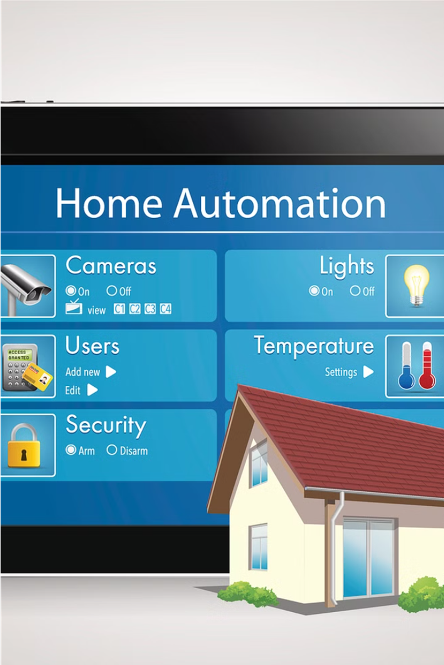
Smart Home Automation System
Revolutionize your living experience with our innovative Smart Home Automation System. Powered by Arduino, NodeMCU ESP8266, and integrated sensors, this cutting-edge solution effortlessly automates your home, putting control at your fingertips.
Vidhiya S B - 210701306
Varusha S - 210701304

Slide 2

Introduction
Our Smart Home Automation System harnesses the power of cutting-edge technologies like Arduino and NodeMCU ESP8266 to bring this vision to life, transforming your living experience through intelligent control and effortless convenience. The goal of this project is to use the ESP8266 Wi-Fi module to create a smart home automation system. The ESP8266 is an excellent option for Internet of Things applications since it is a potent and reasonably priced microcontroller with integrated Wi-Fi. Its adaptability and simplicity of integration with different types of sensors and actuators allow the building of an all-inclusive home automation system.

Slide 3

Objectives
Develop a comprehensive smart home automation system that seamlessly integrates with common household devices and appliances.
Leverage the power of NodeMCU ESP8266 technology to enable remote control and real-time monitoring of the home environment.
Create a user-friendly interface that allows homeowners to effortlessly manage and automate various aspects of their home, such as lighting, temperature, and security.

Slide 4

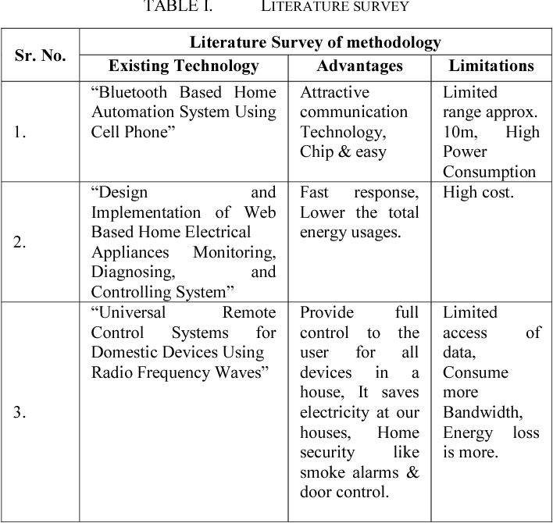
Literature Survey
We've conducted an extensive literature review on smart home automation systems, exploring the latest advancements and key insights from academic and industry research. This has informed the development of our innovative solution, which leverages cutting-edge technologies to deliver unparalleled convenience and control.

Slide 5
Key Challenges
1
Integration Complexity
2
Scalability Concerns
Seamlessly integrating diverse home devices and appliances with varying communication protocols poses a significant technical challenge.
Ensuring the system can accommodate future expansions and a growing number of connected devices requires careful architectural planning.
3
Security and Privacy
4
User-Friendly Interface
Safeguarding the system from cyber threats and protecting user privacy are critical considerations in the design process.
Developing an intuitive and easy-to-use interface that caters to the varying technical abilities of homeowners is a key challenge.

Slide 6
Motivation
Increased Efficiency
Enhanced Convenience
Automating home tasks can significantly improve efficiency, saving time and reducing the burden of manual operations.
Smart home automation puts complete control at your fingertips, allowing you to effortlessly manage your living environment.
Energy Conservation
Improved Security
Intelligent systems can optimize energy usage, leading to lower utility bills and a more sustainable home.
Automated security features, like remote access and motion detection, can provide greater peace of mind and protection.

Slide 7
Existing System
Manual Control
Limited Connectivity
Lack of Automation
High Maintenance
Currently, home automation relies on manual switches and dials to control devices like lights, fans, and appliances. This requires physically going to each device to operate them.
Existing systems often lack the ability to connect and integrate multiple home devices, making it difficult to create a cohesive and streamlined home automation experience.
Homeowners must manually control each device independently, rather than having an automated system that can intelligently manage the home environment based on user preferences and schedules.
Maintaining and troubleshooting a traditional home automation setup can be complex, often requiring professional assistance and specialized knowledge.

Slide 8

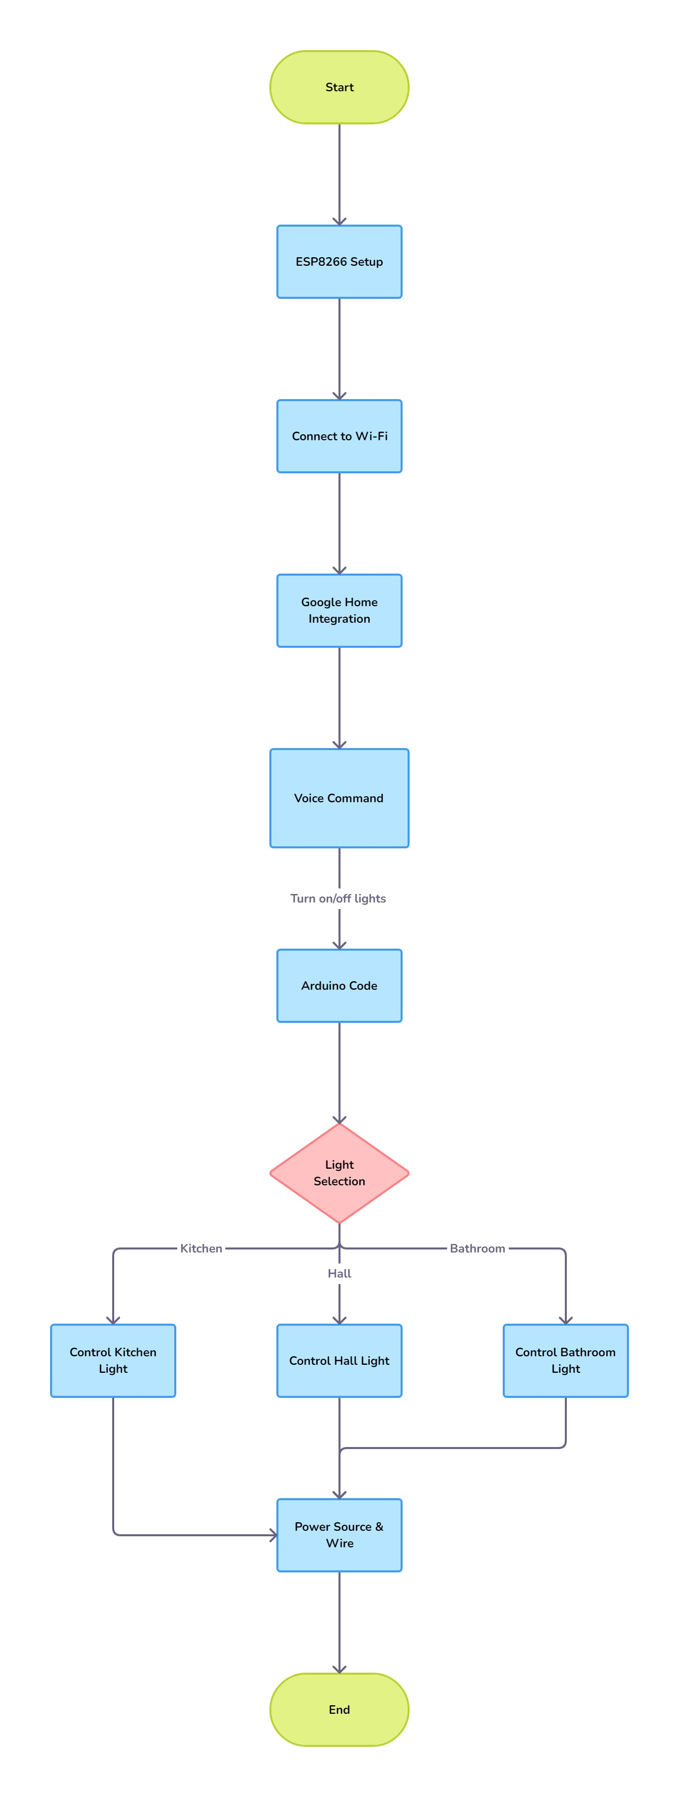
Proposed System
Our cutting-edge Smart Home Automation System harnesses the power of Arduino and NodeMCU ESP8266 to transform your living experience. By seamlessly integrating with existing household devices and appliances, our solution enables effortless remote control and real-time monitoring through a user-friendly interface.
Advantages
Convenience and Control: Smart home systems offer unparalleled convenience by allowing homeowners to control lighting, climate, security, and more from a single device or app, no matter where they are.
Energy Efficiency: These systems improve energy usage by automatically adjusting settings like heating and cooling based on real-time data and user behavior, leading to reduced utility bills and environmental impact.

Slide 9
Components of the System
1
Arduino Board
2
NodeMCU (ESP8266) module
The Arduino microcontroller serves as the brain of the system, processing inputs and controlling outputs.
This Wi-Fi-enabled module provides the connectivity to control the system remotely through a mobile app or web interface.
3
Breadboard and Jumper Wires
4
LED and Relay
These essential components allow for easy prototyping and connections between the various electronic parts.
The LED simulates the home lighting, while the relay acts as the switching mechanism to turn the lights on and off.

Slide 10



System Modules
Microcontroller
Actuators
Connectivity
The heart of the system, the microcontroller like Arduino or NodeMCU ESP8266, processes sensor data and controls connected devices.
Relays, switches, and other actuators connect to and control home appliances, lighting, and other devices based on system commands.
Wi-Fi modules like the NodeMCU ESP8266 enable wireless communication, allowing remote access and control of the system.

Slide 11

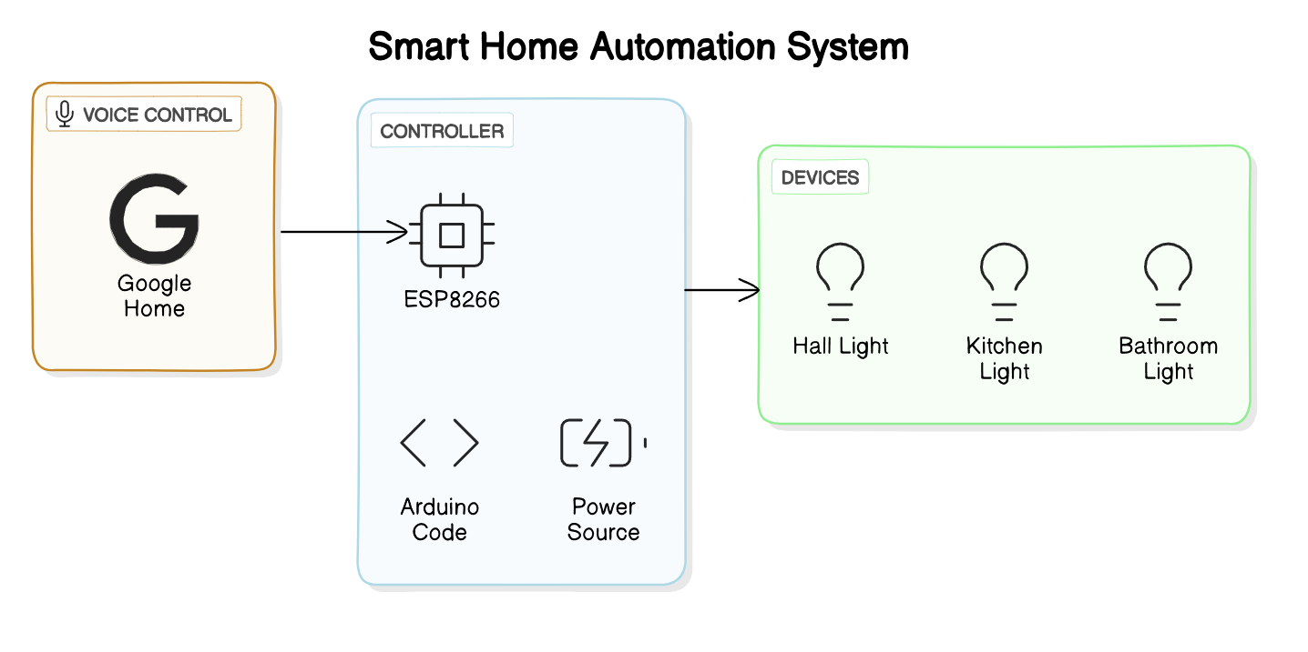




System Architecture
User Interface
1
Mobile app or web dashboard for seamless control
2
Wireless Communication
Wi-Fi connectivity for remote access
Microcontroller
3
Arduino or NodeMCU ESP8266 for processing and control
4
Actuators
Controlling home devices
5
Home Appliances
Lights, fans, and other connected devices

Slide 12
System Architecture
Centralized Control
Wireless Connectivity
Modular Design
The Arduino board serves as the central hub that coordinates and controls all the connected devices in the smart home system.
The NodeMCU module enables wireless communication, allowing users to control the system remotely through a mobile app or web interface.
The system's modular design allows for easy expansion and integration of additional devices, such as sensors and actuators, to enhance the system's capabilities.

Slide 13
Wireless Control of Lights
User Input
The user can control the lights through a mobile app or web interface, sending commands wirelessly to the NodeMCU module.
Arduino Actuation
The Arduino board processes the command and activates the relay to turn the LED lights on or off.
1
2
3
NodeMCU Processing
The NodeMCU receives the user's command and relays the instruction to the Arduino board.

Slide 14
Connecting the Components
Arduino Connections
NodeMCU module Connectivity
The Arduino board is connected to the NodeMCU, relay, and LED using jumper wires on the breadboard.
The NodeMCU is connected to the local Wi-Fi network, enabling remote access and control of the system.
Relay and LED
Breadboard and Wiring
The relay is used to switch the LED on and off, simulating the control of home lighting.
The breadboard and jumper wires provide a flexible platform for prototyping and easy connections between the various components.

Slide 15



Programming the System
Arduino Coding
NodeMCU Connectivity
Mobile App Integration
The Arduino board is programmed to receive commands from the NodeMCU and control the relay to turn the LED lights on and off.
The NodeMCU is programmed to connect to the local Wi-Fi network and communicate with the Arduino board to execute the user's commands.
A mobile app or web interface is developed to provide users with a user-friendly way to control the home lighting remotely.

Slide 16




Demonstration of the System
User Input
Through Home
NodeMCU Transmission
Actuation
Feedback Loop
The user interacts with the mobile app or web interface to send commands to the system.
The user can see the immediate response of the system, with the LED lights changing state based on their input.
The NodeMCU module receives the user's command and relays it to the Arduino board.
The Arduino board processes the command and activates the relay to turn the LED lights on or off.

Slide 17
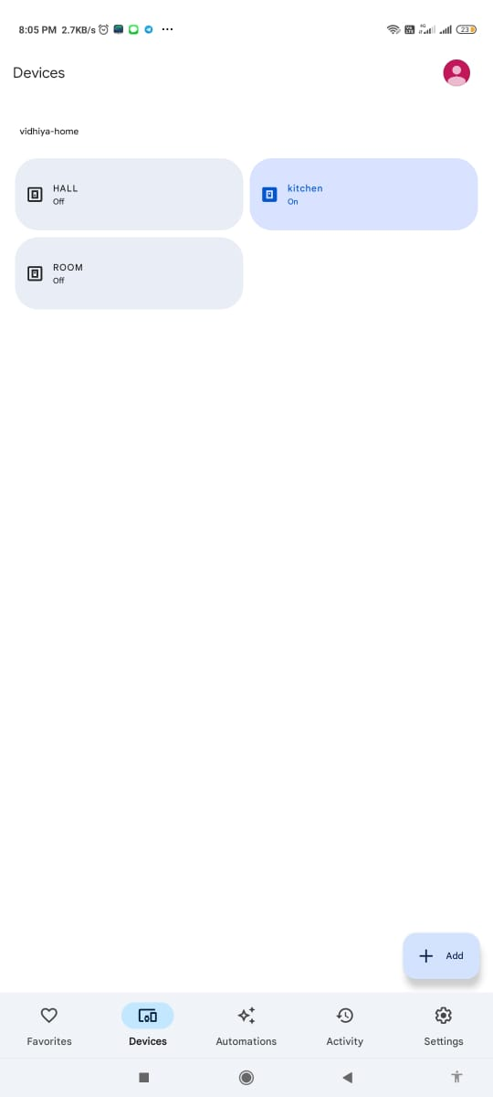
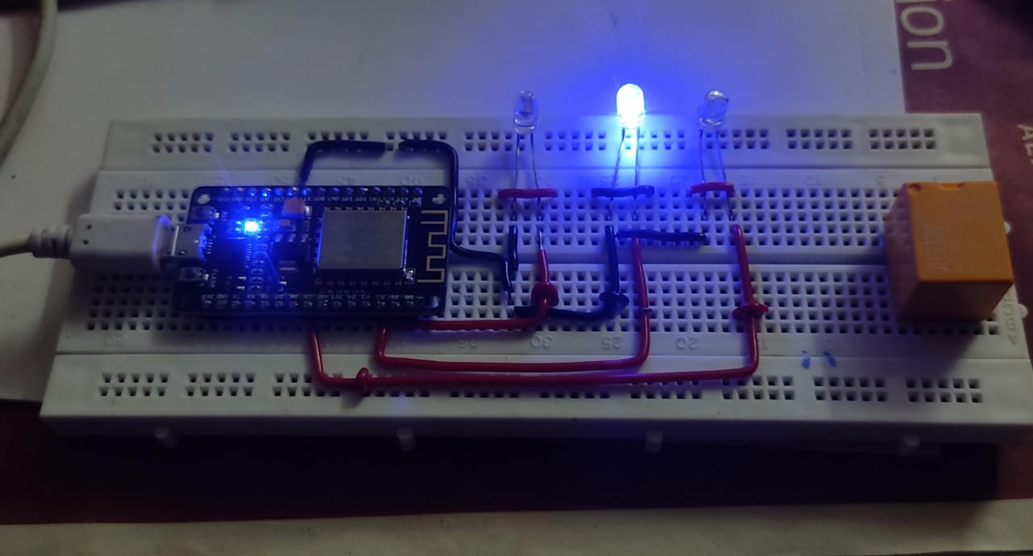
Operating Light using Home App

Slide 18

Conclusion and Future Enhancements
1
Conclusion
2
Future Enhancements
This smart home automation system demonstrates the integration of Arduino, NodeMCU, and IoT devices to wirelessly control home lighting, laying the foundation for a more connected and intelligent living space.
Potential enhancements include integrating additional sensors (e.g., temperature, motion, light) to enable more advanced automation, adding voice control, and connecting the system to a smart home platform for a seamless user experience.

