Slide 1
AI-powered Brand Reputation Monitoring & Improvement Platform
Vidhiya S B 210701306
Vaishnavi C 210701298
Swetha P 210701277

Slide 2
Abstract
An interactive web application to empower brands with sentiment analysis of online conversations. Users (brand representatives) can input text data like social media posts, reviews, or survey responses. The application will categorize the sentiment (positive, negative, neutral) and visualize the results. To leverage the power of AI, the application will go beyond classification by generating actionable suggestions using distilgpt2 from the Hugging Face Transformers library and distilbart-cnn-12-6 from the Hugging Face Transformers library. It corrects the grammar of user-provided prompts to ensure coherence and accuracy in generated responses. . This integration of AI-powered sentiment analysis and suggestions will provide brands with valuable insights to improve brand reputation, customer experience, and marketing strategies.

Slide 3
Existing System
Existing sentiment analysis web apps like Brandwatch and Sprout Social offer social listening and basic sentiment analysis, but lack the actionable suggestions and user-friendly focus of your proposed system. This application can empower brands by not only identifying sentiment (positive, negative, neutral) but also suggesting concrete actions to improve brand reputation, customer experience, and marketing strategies through a user-friendly interface.

Slide 4
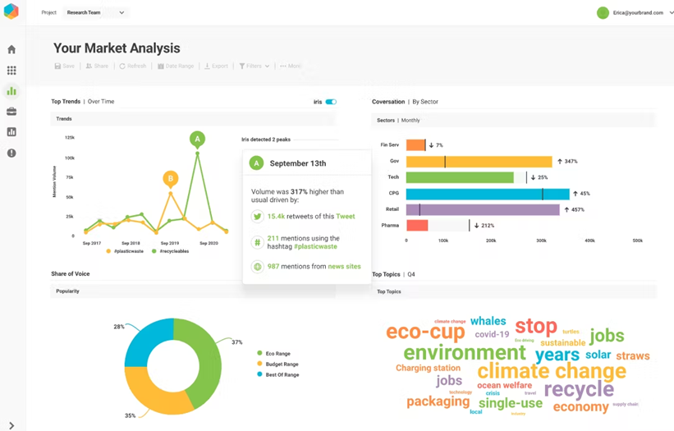
Existing System – Brandwatch Web App

Slide 5
Proposed System
The proposed system harnesses the capabilities of the Natural Language Toolkit (NLTK) for sentiment analysis, enabling the categorization of user-provided text into positive, negative, or neutral sentiments. Complementing this functionality, Streamlit facilitates the creation of an intuitive user interface enriched with visualizations.
The system leverages cutting-edge AI models, including `distilgpt2` for text generation and `distilbart-cnn-12-6` for grammatical correction. These models collaboratively generate actionable suggestions tailored to the sentiment expressed in user feedback. Suggestions may range from expressing gratitude for positive comments to offering solutions for negative feedback and engaging users with neutral sentiment. This seamless integration empowers brands to glean valuable insights from customer feedback and implement targeted strategies to bolster brand reputation and customer satisfaction.

Slide 6
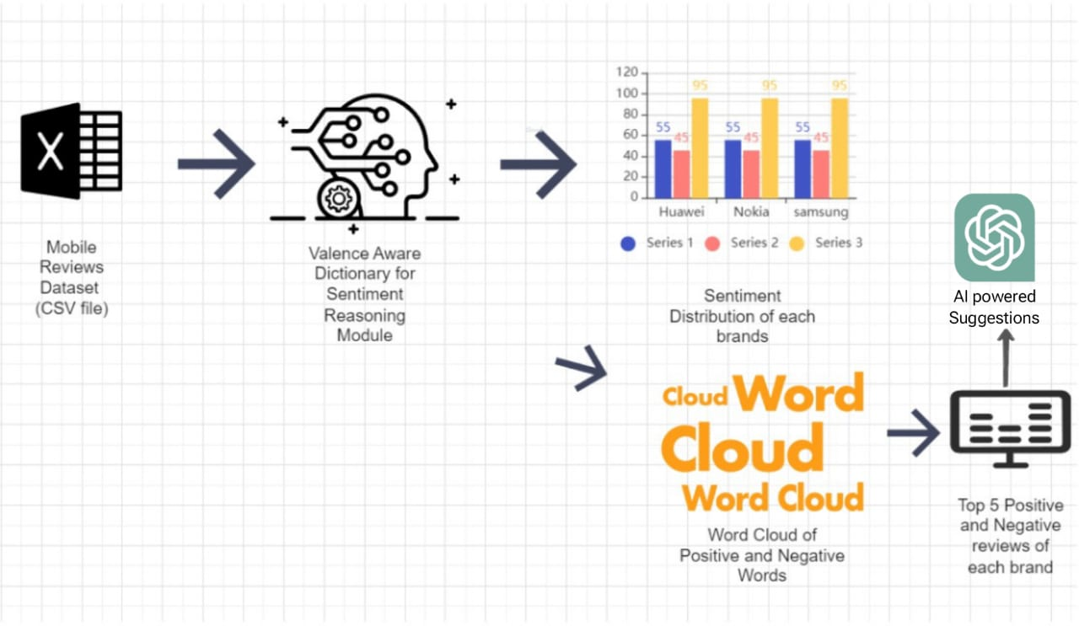
Architecture

Slide 7
Modules
streamlit
numpy
pandas
os
plotly.express
WordCloud

Slide 8
Modules
matplotlib.pyplot as plt
SentimentIntensityAnalyzer from nltk.sentiment.vader
pathlib
textwrap
pipeline, AutoTokenizer, and AutoModelForSeq2SeqLM from transformers
torch

Slide 9
Modules Description
streamlit: A Python library used for creating interactive web applications for machine learning and data science projects.
numpy: A library for numerical computing in Python.
pandas: A powerful data manipulation library for Python.
plotly: A library for creating interactive plots and visualizations.
WordCloud: A library for generating word clouds from text data.
matplotlib: A comprehensive library for creating static, animated, and interactive visualizations in Python.

Slide 10
Module Description
nltk: Natural Language Toolkit, used for natural language processing tasks such as sentiment analysis.
pathlib: A library for handling file system paths.
textwrap: A module for wrapping and formatting text paragraphs.
transformers: A library for state-of-the-art natural language processing using pre-trained models.

Slide 11
Result and Discussion
This application performs sentiment analysis and brand reputation evaluation using user-uploaded review data. It processes the data to categorize reviews into positive and negative sentiments using VADER sentiment analysis, and then generates interactive visualizations such as sentiment distribution pie charts, trend analysis line charts, and histograms of sentiment distribution by brand. The app also creates word clouds to highlight common themes in positive and negative reviews, displays sample reviews, and offers improvement suggestions for brands based on negative reviews, leveraging Hugging Face's text generation and correction models.

Slide 12
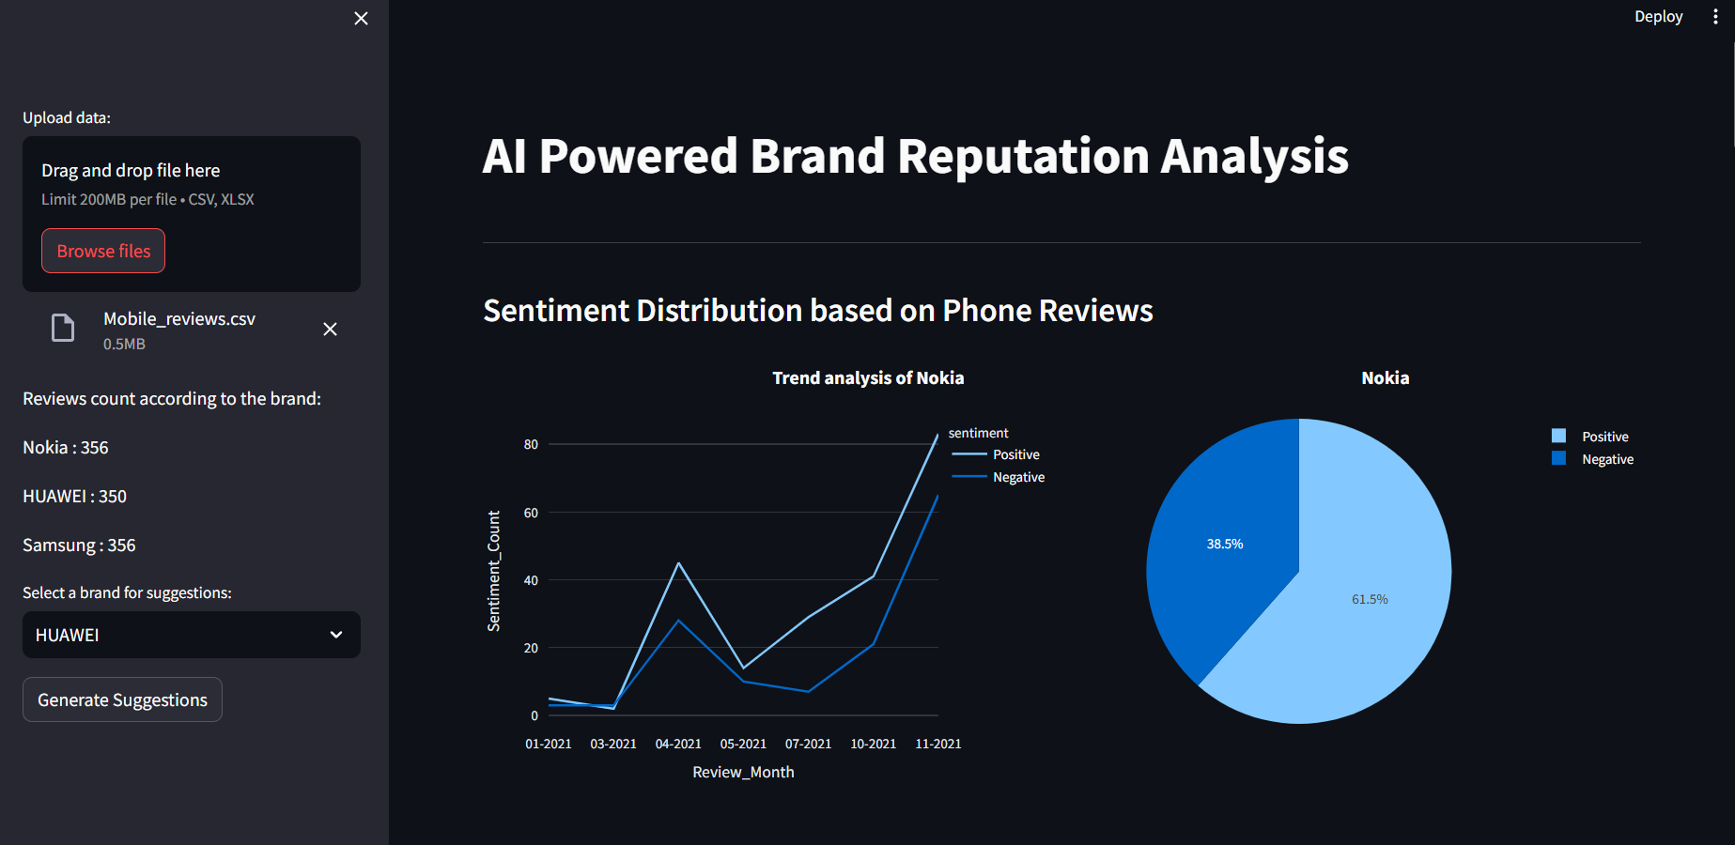
Sentiment Reviews of a brand

Slide 13
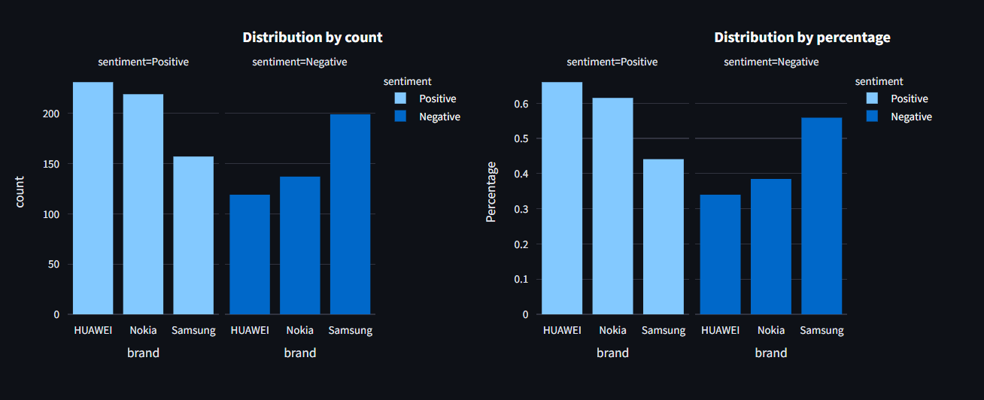
Distribution by count and percentage

Slide 14
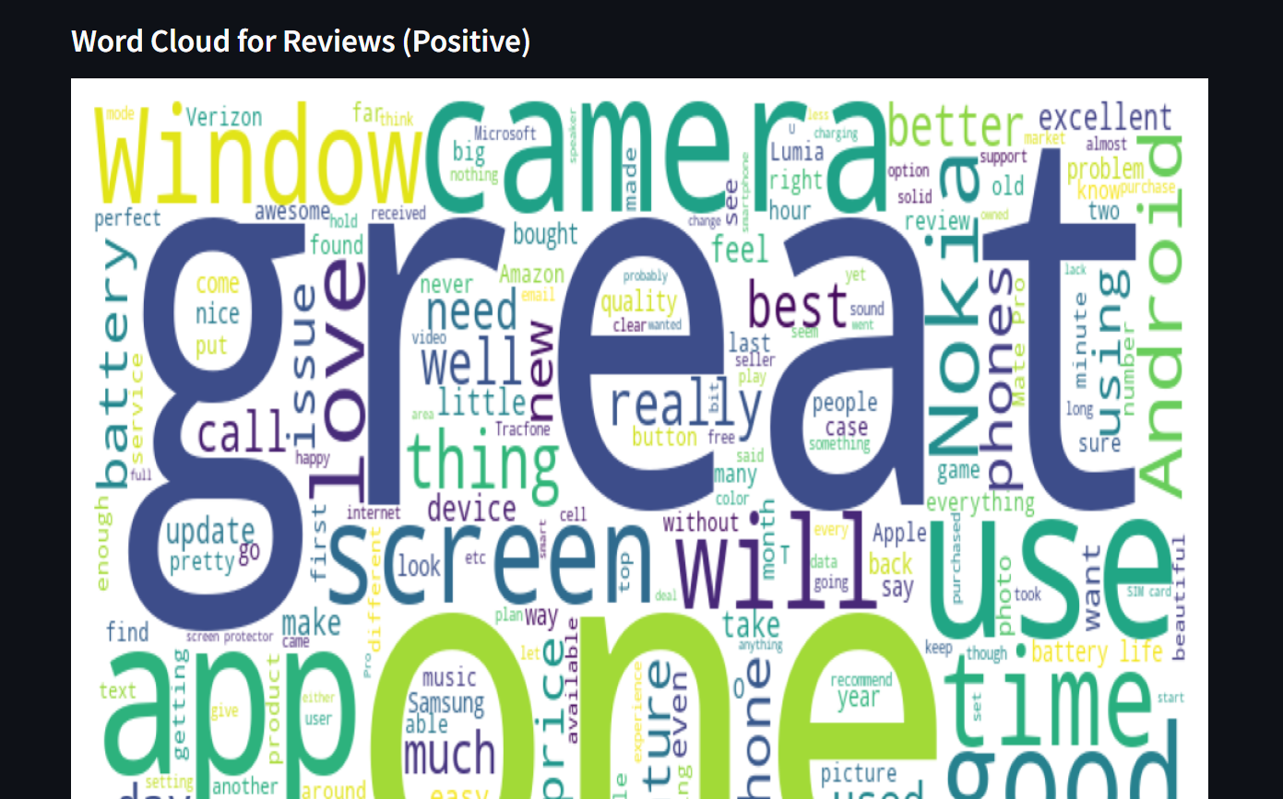
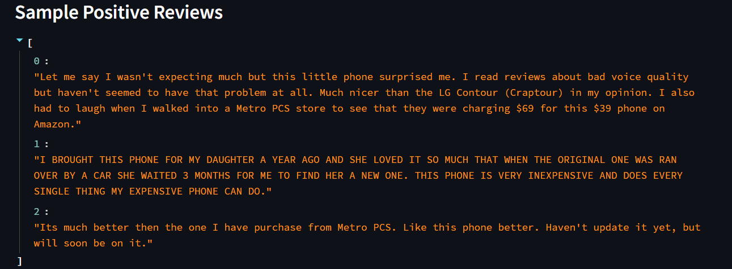
Positive Reviews

Slide 15
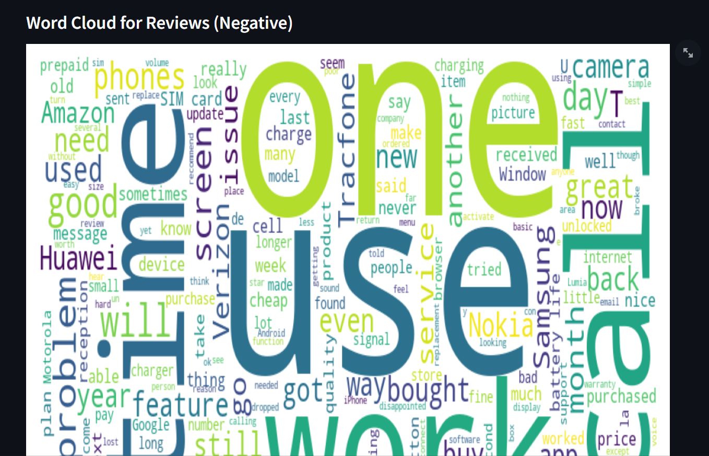
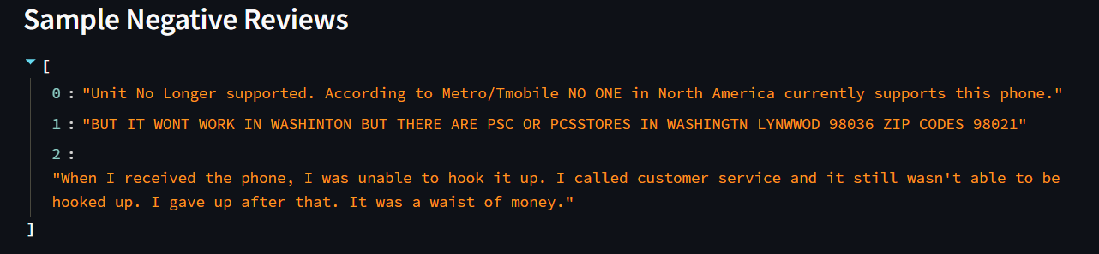
Negative Reviews

Slide 16
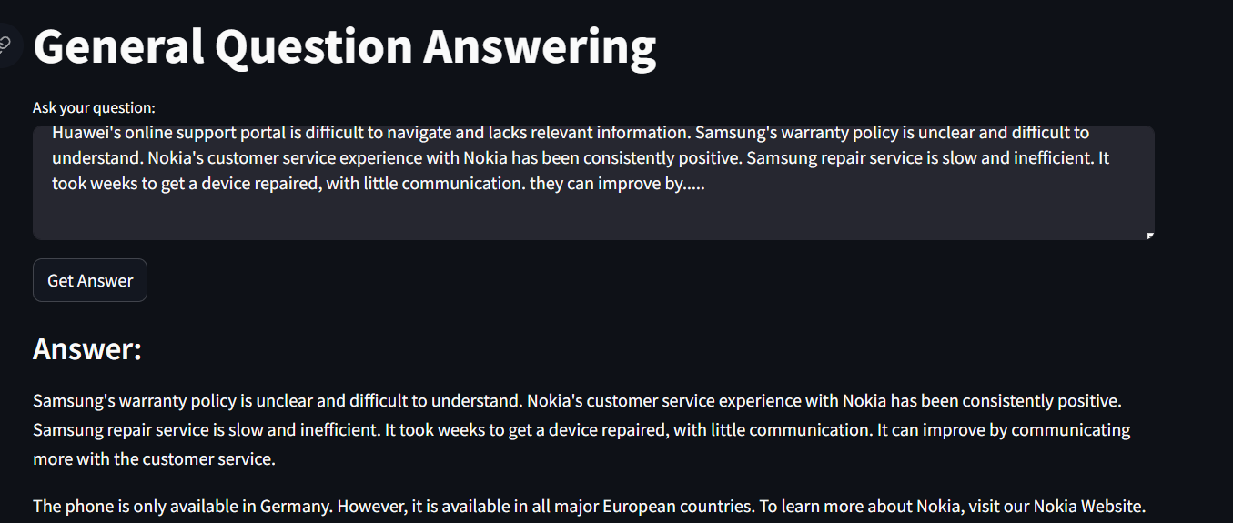
AI Powered Suggestion

Slide 17
Conclusion and future enhancements
In conclusion, this Streamlit application offers a robust solution for sentiment analysis and brand reputation evaluation by leveraging advanced NLP techniques to analyze review data, generate interactive visualizations, and provide actionable insights. Future enhancements could include advanced preprocessing techniques, additional visualizations, real-time data integration, and the use of more sophisticated NLP models like GPT-4. Moreover, incorporating a user feedback loop, optimizing for scalability, offering customization options, and supporting multiple languages would significantly enhance the application's utility, making it a more powerful and flexible tool for businesses aiming to gain deeper insights into customer sentiments and continuously improve their brand reputation.

