Slide 1

Project Title – Seasonal Agriculture Performance Analysis
Name – Vidhya Majee
College Name- Allenhouse Business School
AICTE STU ID- STU6a32bc8af13221781709962

Slide 2

PROBLEM STATEMENT
Agricultural activities are influenced by seasonal variations in environmental conditions, farming practices, resource availability and market conditions. As a result, agricultural performance may differ from one season to another.
However, raw agricultural data does not clearly explain how agricultural performance changes across seasons or what patterns can be observed in different seasonal conditions.
The problem is to analyze the given agricultural dataset and investigate seasonal differences in agricultural performance by identifying meaningful patterns, trends, relationships and variations within the available data.

Slide 3
Project Description
Analyzes 4,000 farm records across 8 Indian states, 8 crops and 3 cropping seasons (Kharif, Rabi, Zaid) to uncover how environmental, resource and economic factors shift across seasons.
Cleans and prepares raw data — season-wise missing value imputation and crop-aware outlier checks — before analysis.
Uses Python (Pandas, Seaborn, SciPy) to compare yield, cost, profit, water use and disease risk across seasons through visual and statistical (ANOVA) methods.
Key finding: profit and financial risk vary far more significantly by season than yield does — Zaid is the smallest, driest and financially riskiest season.
Delivers evidence-based recommendations for season-specific irrigation, pest-budget and crop planning.

Slide 4

WHO ARE THE END USERS?
Agricultural policy planners & government departments designing season-specific support schemes.
Agri-fintech & crop-insurance companies pricing seasonal risk for lending and insurance.
Farmer cooperatives & agri-extension officers advising on irrigation and crop-season choices.
Agri-input companies (fertilizer, pesticide, irrigation equipment) planning seasonal demand.
Researchers & students studying agricultural data analytics.

Slide 5

Technology Used
Python — core language for the analysis
Pandas & NumPy — data cleaning, aggregation and pivoting
Matplotlib & Seaborn — visualizations (boxplots, heatmaps, violin & bar charts)
SciPy (stats) — one-way ANOVA significance testing across seasons
Jupyter Notebook — end-to-end analysis and documentation environment

Slide 6
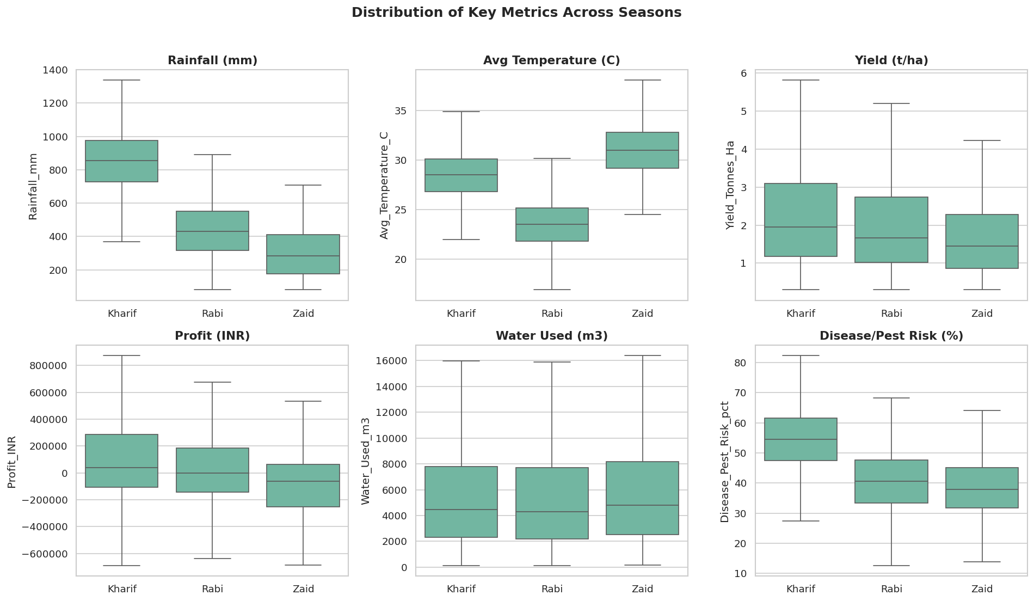
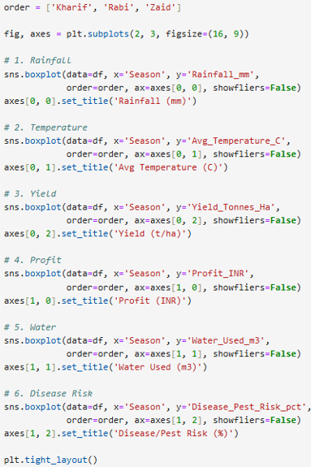
RESULTS
Rainfall, Temperature, Yield, Profit, Water Use & Disease Risk by Season

Slide 7
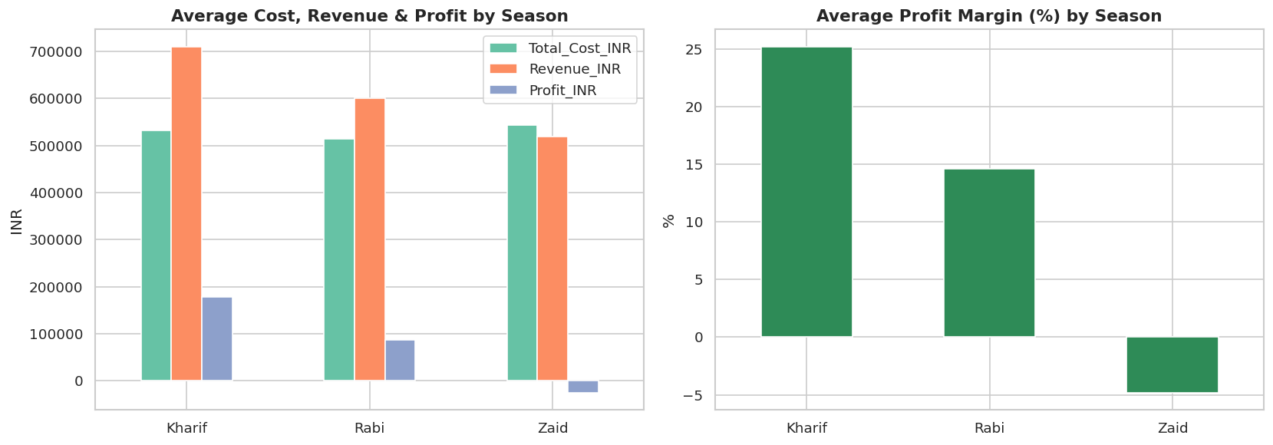
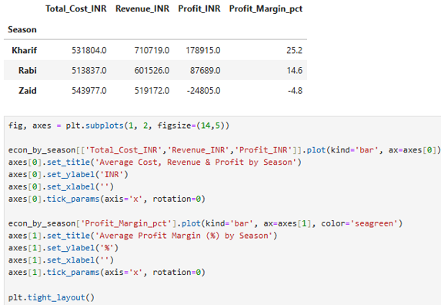
RESULTS
Average Cost, Revenue, Profit & Profit Margin by Season

Slide 8
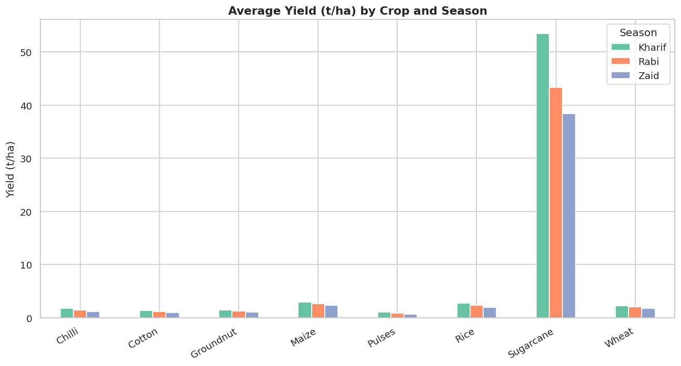
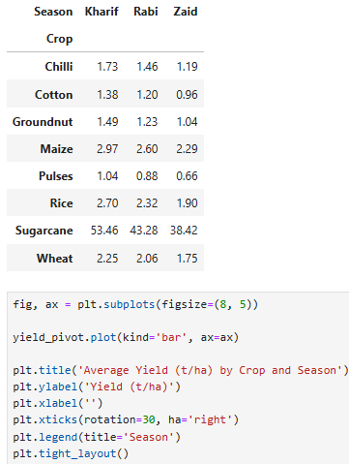
RESULTS
Average Yield (t/ha) by Crop and Season

Slide 9
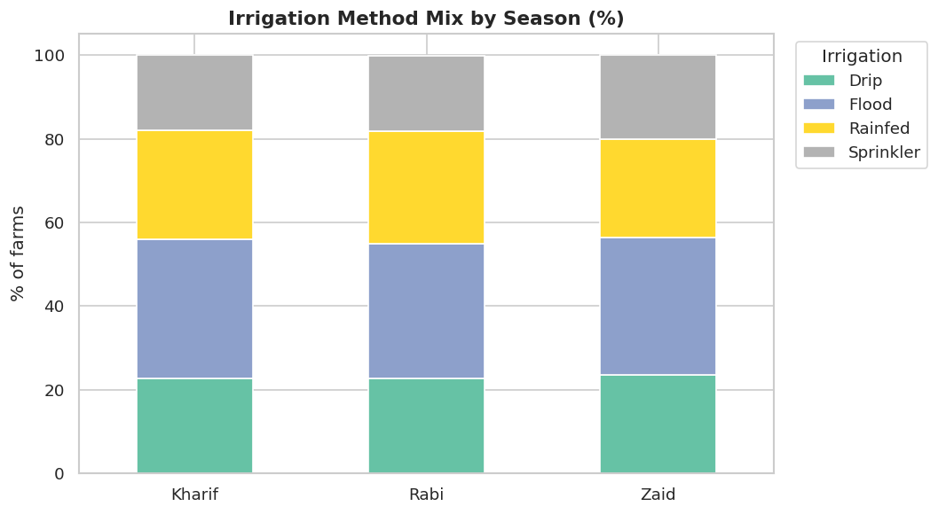
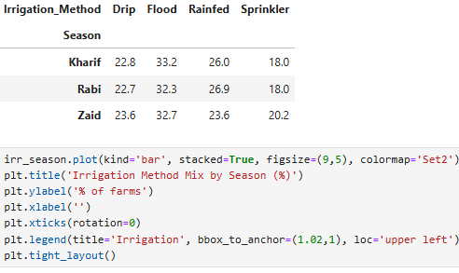
RESULTS
Irrigation Method Mix Is Nearly Uniform Across All Three Seasons

Slide 10
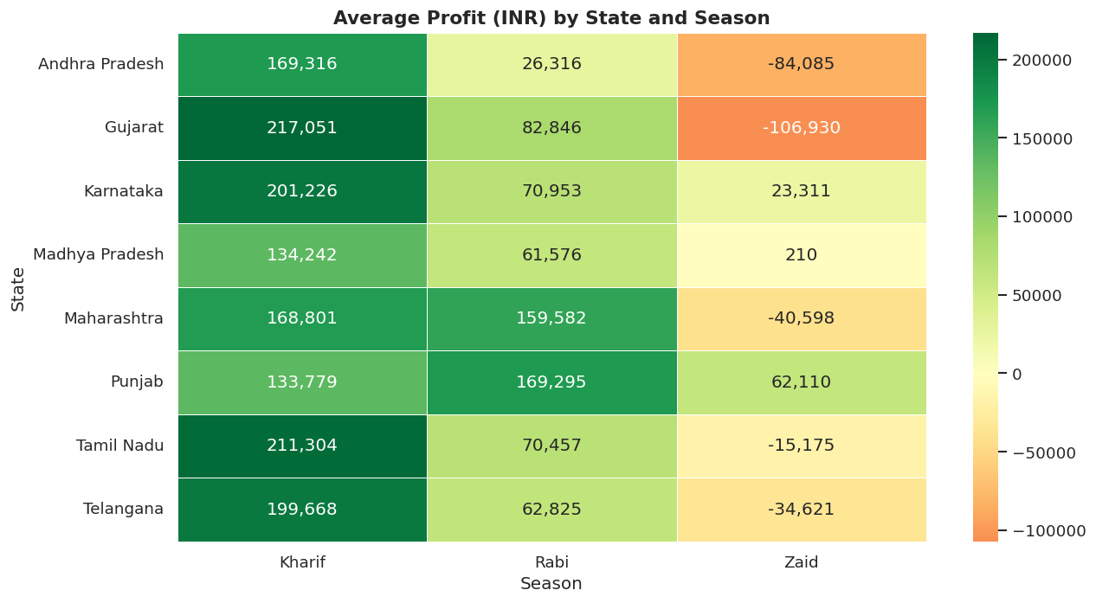
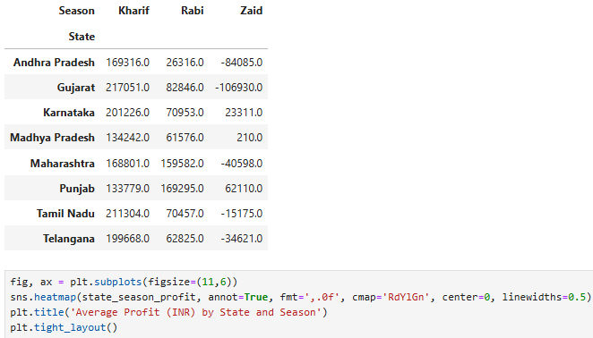
RESULTS
Average Profit (INR) by State and Season

Slide 11
Future scope
Predictive modeling (regression) to forecast seasonal profit or yield from environmental and input variables.
Multi-year time-series data to study year-over-year seasonal trends, not just a single snapshot.
Interactive dashboard (Streamlit / Power BI) for agri-planners to filter dynamically by state, crop and season.
District-level and satellite/weather API data for finer-grained seasonal risk modeling.
An early-warning system for high-risk season-crop-state combinations.
.
.

Slide 12
Github Link
https://github.com/Vidhya-Majee/seasonal-agriculture-performance-analysis
Repository contains the executed Jupyter Notebook, the dataset, and this presentation
.
.

Slide 13

VOIS Course completion certificate - Course name- Data Visualization

Slide 14
Thank you
.
.

