Slide 1
Project 3 | Implementation Presentation
Socratic-OT
Milestone - 1
1
Problem & why direct-answer AI fails
How we are implementing a grounded multimodal Socratic tutor for anatomy and neuroscience in Occupational Therapy
2
What makes this tutor Socratic
Grounded RAG
Image + Text
Tutor-not-Teller
3
Knowledge base and code pipeline
4
Runtime workflow + technical stack
5
Evaluation, roadmap, and team plan
Team
Vidhyadhari Bandaru
Richie Ilavarapu
Socratic-OT | Project 3
1
Notes:
[Sources] User-provided project brief for Project 3 requirements. User-provided PPT draft content used as reference for structure and key claims. Design uses original layout generated for this presentation. [/Sources]

Slide 2
Context
Problem framing: why standard AI is not enough
Why this is a bottleneck course
From QA bot to tutor
• OT students have to master high content density topics i.e. , gross anatomy and neuroscience
• Learning depends on 3D visualization.
• Students often lack 1:1 support outside class
Standard QA bot
Socratic-OT
Direct answer
Staged hinting
Generic response
Grounded retrieval
What goes wrong with normal chatbots
• They often answer too directly
• That reduces guided recall and clinical reasoning practice
• Answers may be ungrounded or overly generic
No short-term memory
Session memory
No mastery check
Assessment summary
Goal: preserve reasoning
Socratic-OT | Project 3
2
Notes:
[Sources] Project brief: standard AI gives answers away too quickly; system should support clinical reasoning. PPT draft reference slide: "Problem Framing and Why Standard AI Is Not Enough." [/Sources]

Slide 3
Requirement
What “Socratic” means in this project
Constraint: no direct definition or final answer in the first two tutor turns.
Leakage = fail
1
2
3
Turn 1
Turn 2
Turn 3+
Broad hint
Stronger clue
Answer if still stuck
Guide recall with location, relation, or concept cues
Add function, insertion, pathway, or contrast clues
Reveal the answer and explain with textbook support
Adaptive conversation strategy
What the manager agent enforces
• Start with context-aware rapport
• Then pivot into the tutoring loop using dialogue-state control
• Smooth social → pedagogical transition
• No answer leakage before the 3rd turn
Socratic-OT | Project 3
3
Notes:
[Sources] Project brief requirement: tutor-not-teller philosophy with no direct answer in first two turns. PPT draft reference slide: “Requirements We Are Targeting.” [/Sources]

Slide 4
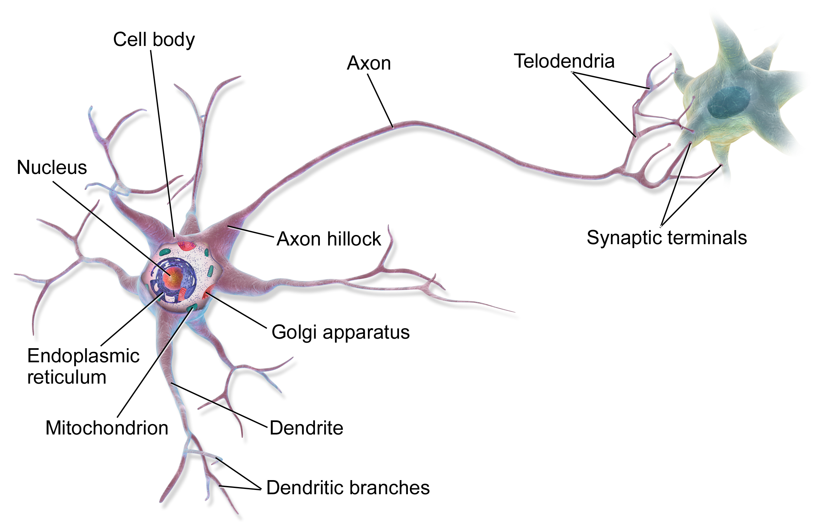
Data
Knowledge base construction: text + image
70
168
6
6
Relevant sections
Retrieval-ready chunks
Labeled diagrams
Metadata records
Text knowledge base
Image knowledge base example
Source: OpenStax Anatomy & Physiology 2e
Extract full textbook text
Detect and isolate section level content
Filter the relevant topics
Clean noise and split sections into chunks
Metadata:
Source id
Chapter
Section title
Topic label
Keyword summary
Chunk text
Image ID
IMG001
Structure
Neuron
Topic
Nervous system
Aliases
nerve cell; neuron structure
Body region
nervous system
Function
basic neural signaling structure
PDF
→
Sections
→
Cleaned text
→
Chunks
Example anatomy asset linked to metadata for multimodal tutoring
Socratic-OT | Project 3
4
Notes:
[Sources] User-provided code files summarized earlier in chat: extraction, filtering, chunking, image download, metadata build, completeness checks. PPT draft reference slide: “Data Plan and Initial Evidence.” [/Sources]

Slide 5
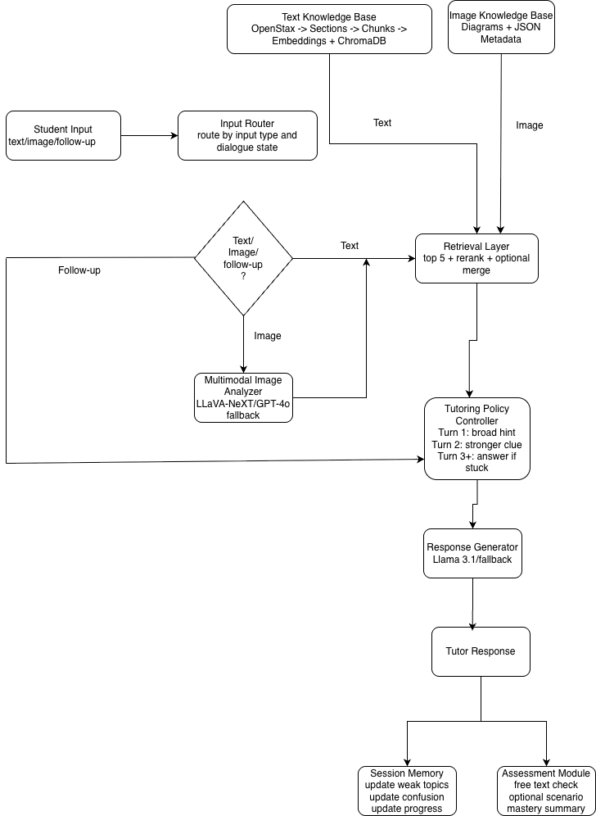
Architecture
Proposed runtime workflow
What happens at runtime
1
Route the input
Text, image, or follow-up
2
Retrieve grounded context
Chunks from ChromaDB + image metadata
3
Apply tutoring policy
Hint → clue → answer if stuck
4
Generate response
Tutor response stays grounded and staged
5
Update session state
Weak topics, confusion, progress, assessment
Socratic-OT | Project 3
5
Notes:
[Sources] User-provided architecture diagram image used on this slide. Project brief and prior analysis: shared grounded retrieval layer, multimodal analyzer, tutoring controller, response generator, memory and assessment. [/Sources]

Slide 6
Implementation
Technical stack and component roles
Orchestration
Dialogue state, tool routing, policy control
Embeddings
Turn chunks into retrieval vectors
LangGraph / LangChain
all-MiniLM-L6-v2
Vector DB
Top-5 retrieval with metadata filtering
Text model
Hinting, clueing, final explanation
ChromaDB
Groq - hostedLlama 3 / GPT-4o-mini fallback
Vision model
Identify structures from uploaded diagrams
Evaluation
Faithfulness and Socratic purity checks
GPT-4o or LLaVA
RAGAS + transcript review
Retrieval settings example: top-5 retrieval → metadata-aware rerank → optional adjacent chunk merge → final 2-3 context units in prompt
Socratic-OT | Project 3
6
Notes:
[Sources] PPT draft reference slide: “Technical Stack.” Project brief explicitly mentions ChromaDB/FAISS and VLM such as GPT-4o or LLaVA; local LLMs like Llama 3/Mistral recommended for cost/privacy tradeoffs. [/Sources]

Slide 7
Implementation
Core Runtime Modules
Retriever
VLM Module
semantic retrieval from ChromaDB
structure/topic inference from uploaded diagrams
Tutoring Controller
Session Memory
masking, escalation, stuck detection
weak-topic and confusion tracking
Text Backend
Assessment Module
grounded hint/clue/explanation generation
mastery summary after explanation
Socratic-OT | Project 3
6
Notes:
[Sources] PPT draft reference slide: “Technical Stack.” Project brief explicitly mentions ChromaDB/FAISS and VLM such as GPT-4o or LLaVA; local LLMs like Llama 3/Mistral recommended for cost/privacy tradeoffs. [/Sources]

Slide 8
Pedagogy
Tutoring loop, memory, and assessment
Example Socratic interaction
Session memory
Tutor turn 1
Weak topics
Repeated confusion
Think about the nerve commonly compressed in the carpal tunnel. Which hand movement becomes harder?
Student
Recent wrong guesses
Progress state
Thumb movement? Maybe opposition?
Tutor turn 2
Good. Now name the nerve that affects thumb opposition and passes through the wrist.
Assessment beyond MCQs
Student
Prompt the student to apply the concept in a clinical scenario, then compare the explanation against the textbook-grounded answer and return a mastery summary.
Median nerve.
No leak
Question
Apply
Mastery summary
Socratic-OT | Project 3
7
Notes:
[Sources] Project brief: interactive memory over ~15 minute sessions, plus synthesis and assessment via free-text clinical reasoning prompts. PPT draft reference slide: “Tutoring Logic, Memory, and Assessment.” [/Sources]

Slide 9
Capability
Multimodal diagram tutoring and transferability
When the student uploads a diagram
Evaluation metrics
Image uploaded
• Groundedness - RAGAS faithfulness
• Socratic purity - No leak before turn 3
• Multimodal accuracy - Blind-test diagrams
VLM identifies likely structure
• Generalizability - Swap vector DB to another subject
Retrieve linked text + metadata
Why the design can generalize
Ask function / insertion / pathway question
Domain-agnostic core
• Same retrieval + policy + memory loop
• Only the vector store and image metadata need to change
• Makes a Physics or Biology variant realistic
Expected behavior example
Student: “What is this muscle?”
Tutor: “Before I name it, what action would you expect from a superficial anterior arm muscle at this location?”
Socratic-OT | Project 3
8
Notes:
[Sources] Project brief task: VLM-based multimodal diagram tutoring using GPT-4o or LLaVA. Project brief evaluation metrics: groundedness, Socratic purity, multimodal performance, generalizability. [/Sources]

Slide 10
Capability
Evaluation Metrics
Metric | Type | Target
Faithfulness (RAGAS) | Quantitative | ≥ 0.90
Answer Relevance | Quantitative | ≥ 0.85
Context Recall | Quantitative | ≥ 0.80
Context Precision | Quantitative | ≥ 0.80
Socratic Purity | Qualitative | 1.0
Structure ID Accuracy | Quantitative | ≥ 0.80
Follow-up Relevance | Human (1–5) | ≥ 4.0
Domain Swap Test | Binary | Pass
Socratic-OT | Project 3
8
Notes:
[Sources] Project brief task: VLM-based multimodal diagram tutoring using GPT-4o or LLaVA. Project brief evaluation metrics: groundedness, Socratic purity, multimodal performance, generalizability. [/Sources]

Slide 11
Plan
Roadmap
Implementation roadmap
Now
Knowledge base
Text chunks + image metadata pipeline
Next
Retrieval layer
Embeddings, ChromaDB, reranking
Then
Tutor policy
Dialogue manager, masking, memory
Final
Evaluation
Transcripts, blind image test, RAGAS
Socratic-OT | Project 3
9
Notes:
[Sources] PPT draft reference slide: “Evaluation Plan and Baseline.” Project brief grading guidance: fit within 10-minute slot and ensure all team members actively participate. [/Sources]

Slide 12
Why this project is worth building
It is not just a chatbot. It is a guided, grounded tutor that turns anatomy content into a reasoning-focused learning experience.
“We are proposing a tutoring system that knows the answer, but chooses to teach instead of tell.”
Grounded
Socratic
Answers come only from approved text and diagrams
Hints first; no direct answer before turn 3
Multimodal
Assessable
Questions?
Supports both text questions and anatomy diagrams
Measures mastery rather than just answer recall
Thank you
Socratic-OT | Project 3
10
Notes:
[Sources] Summary uses only user-provided project brief, draft PPT, architecture diagram, and earlier analysis of uploaded code files. [/Sources]

