Slide 1
SMART PUBLIC RESTROOM
PRESENTED BY
HARISH RAJ N
ANBUSRI G
RAVI SHANKER A
VIDYASAGAR M
YOGESH S

Slide 2
PROBLEM DEFINITION AND DESIGN THINKING
The Problem is to improve the functionality, cleanliness, and overall user experience of public restrooms in urban areas.
Traditional public restrooms often face issues such as lack of cleanliness, maintenance, and security concerns.
To address these problems , a smart public restrooms solution is needed.
Design thinking for a smart public restrooms involves considering user needs, efficiency, and sustainability. Here’s a simplified process.
Empathize
Prototype
Iterate

Slide 3
PROJECT OBJECTIVES
Enhancing cleanliness and sanitation through features like touchless fixtures, automated flusing, soap dispensers, and hand dryers.
Tentative cost INR 1.50 lakh per seat.
Hassle free transportation to predesignated sites for quick installation.
Adequate space for advertisement and revenue generation.
Distinctive & asethetically pleasing designs.
Smart, contemporary and environment friendly features.

Slide 4
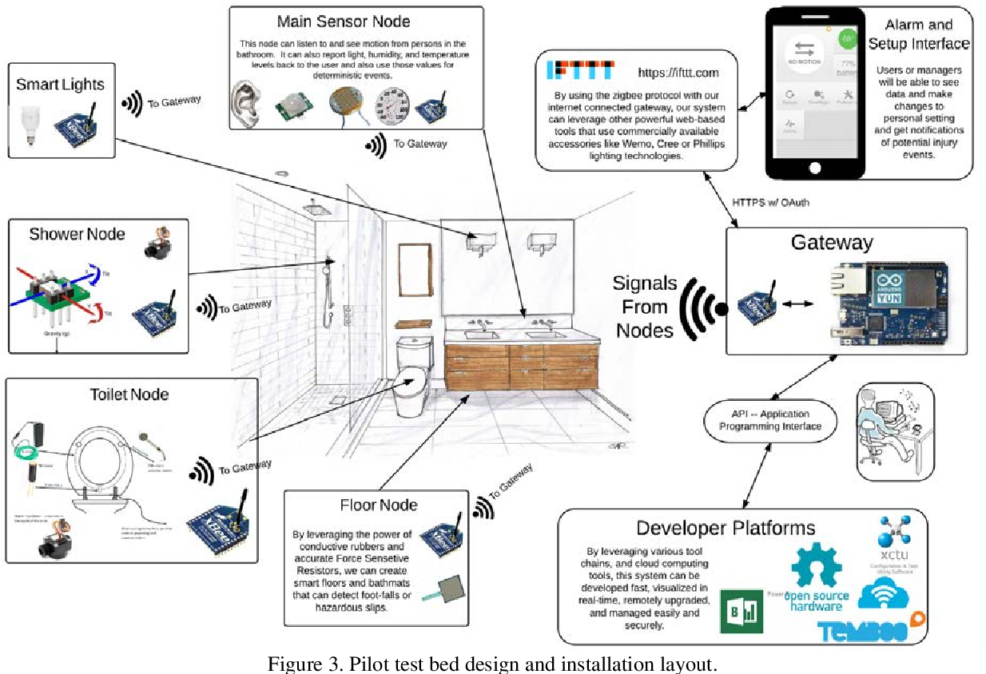
Design For Smart Restroom

Slide 5
IOT DEVICES DESIGNS
Designing smart public restrooms with IOT (Internet Of Things)
devices involves integrating various technologies to enhance user experience, improve cleanliness, and ensure efficient mantenance.
AUTOMATED FLUSH SENSOR: Install sensors on toilets and urinals to automatically flush when a user is done, reducing water wastage and promoting cleanliness.
OCCUPANCY SENSORS: Implement occupancy sensors to monitor restroom usage, helping facility managers track peak hours and ensure timely cleaning.
SMART HANDWASHING STATIONS: Install smart sinks with sensors to dispense soap and water automatically, ensuring that users wash their hands properly.
AIR QUALITY SENSORS: Monitor air quality for temperature, humidity, and odors to ensure comfort and cleanliness. This can trigger ventilation systems as needed.
TOILET HEALTH SENSORS: Install sensors in toilets to detect issues like leaks or clogs, alerting maintenance teams to address problems promptly.

Slide 6
THANK
YOU

