Slide 1
Module 1: Introduction to Secrets Management

Slide 2
What is Secrets Management?
Definition: Secrets management is the practice of securely storing, accessing, and controlling sensitive data such as:
API keys
Database credentials
Certificates
Tokens
Passwords
Key Goals:
Confidentiality: Keep secrets secure
Access Control: Only authorized users/services
Auditing: Know who accessed what and when

Slide 3
Why is it Important?
Common Risks Without Proper Secrets Management:
🔓 Credentials hardcoded in source code
🧑‍💻 Leaked secrets in logs, repos (e.g., GitHub)
🐍 Long-lived tokens in CI/CD pipelines
🕵️‍♂️ Lack of visibility and audit trails
Consequences:
Security breaches and data loss
Compliance violations (e.g., PCI, GDPR)
Damaged reputation and financial loss

Slide 4
Traditional vs. Centralized Secrets Management
Feature | Traditional (Manual) | Centralized (Vault)
Storage | In config files / env vars | Secure secrets store
Access | Broad and static | Fine-grained, dynamic
Rotation | Manual | Automated
Audit | Rare or missing | Built-in audit logs
Bottom Line: Manual approaches are risky, hard to scale, and error-prone.

Slide 5
Where Vault Fits in the Ecosystem
HashiCorp Vault Provides:
🔐 Centralized, encrypted secrets storage
🔑 Fine-grained access policies
🔄 Automated secrets rotation
⚙️ API, CLI, and UI access
🧩 Integration with cloud, CI/CD, and containers
Use with:
Kubernetes / Docker
Jenkins / GitHub Actions
AWS, Azure, GCP
Terraform, Ansible

Slide 6
Real-World Use Cases
App Configuration → Securely inject DB/API credentials at runtime
CI/CD Pipelines → Store build secrets and tokens in Vault
Cloud Infrastructure → Manage dynamic IAM credentials (AWS, GCP)
Database Access → Rotate DB credentials automatically
Multi-tenant SaaS → Isolate secrets per client/namespace

Slide 7
Module 2: Getting Started with Vault

Slide 8
What is HashiCorp Vault?
Definition: HashiCorp Vault is an open-source tool for securely managing secrets, tokens, passwords, and encryption keys.
Key Capabilities:
Secure secret storage
Fine-grained access control
Dynamic secrets (e.g., databases, cloud IAM)
Encryption as a service
Audit logging
Why Vault?
Centralized and consistent way to manage secrets
Avoids hardcoding secrets in code or config files
Supports both human and machine authentication

Slide 9
Core Concepts
Vault: The core service that stores and manages secrets with access control and encryption.
Secrets: Sensitive data like API keys, passwords, certs, or dynamic credentials.
Policies: Rules that define who can access what and how (e.g., read-only vs. full access).
Authentication (Auth) Methods: Used to log in to Vault (e.g., tokens, GitHub, AppRole, LDAP).
Secret Engines: Plugins for storing or generating secrets (e.g., KV, AWS, DB, Transit).

Slide 10
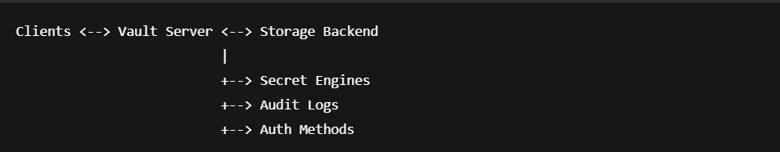
Vault Architecture
Components:
Clients: Apps, scripts, or users that make requests to Vault.
Vault Server: Handles API requests, manages secrets, and applies policies.
Storage Backend: Stores encrypted secrets (e.g., file system, Consul, S3, etc.).
Audit Logs: Logs all requests and responses for accountability.

Slide 11
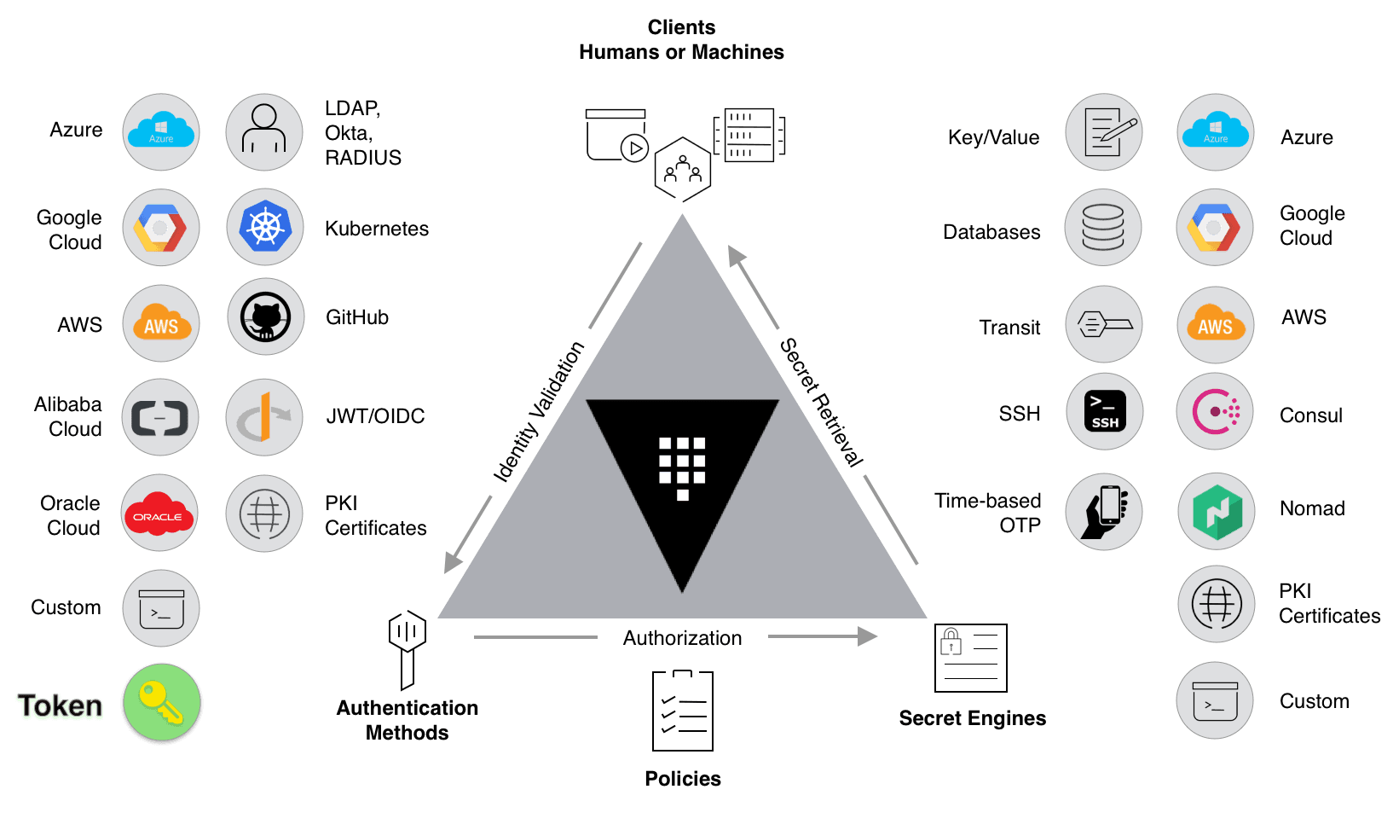

Slide 12
Dev Mode vs. Production Mode
Feature | Dev Mode | Production Mode
Usage | Learning/testing | Real-world deployment
Data Storage | In-memory (ephemeral) | Persistent backend
Security | No security (auto unseal) | Secure with encryption
Auth | Dev token | Proper auth methods
Start Command | vault server -dev | Config file-based start
Note: Dev mode is not secure and should never be used in production.

Slide 13
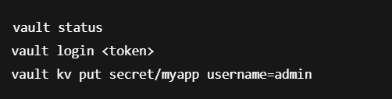
Access Methods
CLI (Command Line Interface): Fast and scriptable. Used with vault commands.
UI (Web Interface): User-friendly graphical interface for browsing secrets and managing settings.
HTTP API: RESTful API for integration with apps and services.

Slide 14
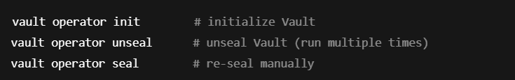
Seal/Unseal and Initialization
Initialization:
First step after installing Vault.
Generates:
Unseal Keys (Shamir’s Secret Sharing)
Initial Root Token
Required to start using Vault securely.
Sealing:
Vault starts in a sealed state — secrets are inaccessible.
Unsealing:
Requires a quorum of unseal keys.
Ensures that no single person can access secrets.

Slide 15
Module 3: Secret Engines

Slide 16
What are Secret Engines?
Definition: Secret engines are Vault components responsible for managing, generating, or storing secrets.
Two Main Types:
🔒 Static Secrets: Stored data (e.g., KV engine)
⚙️ Dynamic Secrets: Generated on demand (e.g., DB, AWS)
Purpose:
Each engine is isolated and enabled at a specific path
Enables fine-grained control and configuration

Slide 17
Enable, Disable, List Secret Engines
Enable a Secret Engine:
vault secrets enable -path=mykv kv-v2
Disable a Secret Engine:
vault secrets disable mykv
List All Enabled Engines:
vault secrets list

Slide 18

Mount Paths and Namespace
Mount Path:
Logical location where a secret engine is enabled e.g., secret/, aws/, database/
Namespaces (Enterprise Feature):
Isolated Vault environments within a single Vault cluster
Each namespace can have its own:
Auth methods
Policies
Secrets engines

Slide 19
Tuning: TTL, Versions, Options
vault secrets tune -default-lease-ttl=1h -max-lease-ttl=24h secret/
Common Options:
default_lease_ttl: Default time a secret is valid
max_lease_ttl: Maximum TTL
max_versions (KV v2 only): Number of versions to retain
Why Tuning Matters:
Controls secret expiration and version history
Helps reduce risk from stale credentials

Slide 20
Secrets Movement
Use Case: When you want to change the path of a secrets engine without losing data.
vault secrets move oldpath/ newpath/
⚠️ Ensure the new path doesn't conflict with another enabled engine.

Slide 21
Common Secret Engines
Secret Engine | Purpose
KV | Key/Value storage of static secrets
AWS | Dynamic AWS IAM credentials
Database | Dynamic DB usernames/passwords
Transit | Encryption as a service
PKI | Issue and manage TLS certificates
SSH | One-time SSH credentials

Slide 22
Module 4: KV Secrets Engine

Slide 23
What is the KV Engine?
KV (Key/Value) Engine Overview:
Used to store static secrets like passwords, API keys, tokens
Secrets are stored as key-value pairs
Supports secret versioning (KV v2)
Use Cases:
App configuration secrets
CI/CD tokens
TLS certs and license keys
Think of it as a secure, version-controlled key-value store.

Slide 24
KV v1 vs. KV v2
Feature | KV v1 | KV v2
Versioning | ❌ No | ✅ Yes
Metadata support | ❌ No | ✅ Yes
Rollback | ❌ No | ✅ Retrieve older versions
API endpoints | /secret/data/ (v2) | /secret/ (v1)
Tip: KV v2 is recommended for most use cases due to versioning support.

Slide 25
Enabling KV Engine
Enable KV v1:
vault secrets enable -path=secret kv
Enable KV v2 (recommended):
vault secrets enable -path=secret kv-v2
Check Current Engines:
vault secrets list

Slide 26
Storing and Retrieving Secrets
Store a Secret (KV v2):
vault kv put secret/myapp username=admin password=pass123
Retrieve a Secret:
vault kv get secret/myapp
Delete a Secret:
vault kv delete secret/myapp
Force Destroy All Versions:
vault kv destroy -mount=secret -versions=1 secret/myapp

Slide 27
KV v2 Features – Versioning, Rollback, Metadata
Versioning:
Automatically tracks changes to secret data
Multiple versions stored securely
Rollback:
vault kv get -version=2 secret/myapp
Metadata Operations:
vault kv metadata get secret/myapp
vault kv metadata delete secret/myapp
Metadata helps manage lifecycle and audit trail of secrets.

Slide 28
Path Conventions and Best Practices
Recommended Path Naming:
Use consistent prefixes: secret/dev/appname, secret/prod/db, etc.
Environment-based separation: secret/dev/, secret/staging/, secret/prod/
Best Practices:
Avoid storing secrets at the root level
Use namespaces or folders to isolate access
Rotate and audit secrets regularly
Use policies to restrict access to specific paths

Slide 29
⚖️ Module 5: Vault Secrets Command

Slide 30
Overview of vault secrets CLI
Purpose: The vault secrets command manages secret engines in Vault.
What You Can Do:
Enable/disable engines
Move engines between paths
Tune engine settings (like TTLs)
List all mounted engines
vault secrets <subcommand> [options]
Common Subcommands:
enable
disable
list
move
tune

Slide 31
vault secrets enable/disable
Enable KV v2 Engine:
vault secrets enable -path=kv kv-v2
Enable AWS Secrets Engine:
vault secrets enable -path=aws aws
Disable a Secret Engine:
vault secrets disable kv

Slide 32
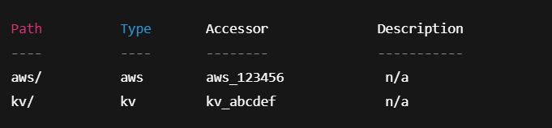
vault secrets list and Interpretation
vault secrets list
Interpreting Fields:
Path: Mount path
Type: Engine type (kv, aws, etc.)
Accessor: Internal ID Vault uses
Description: Optional description
vault secrets list -detailed

Slide 33
vault secrets move, tune Usage
Move a Secrets Engine:
vault secrets move kv/ secrets/
Keeps all secrets and config
Helpful for reorganizing mount paths
Tune Secret Engine Settings:
vault secrets tune -default-lease-ttl=1h -max-lease-ttl=24h kv/
Use Cases for tune:
Expire secrets faster (security)
Comply with org policies (e.g., 24h TTL)
Control version history (e.g., -max-versions=5 for KV v2)

Slide 34
Using with Different Secret Engines
KV Example:
vault secrets enable -path=kv kv-v2
AWS Example:
vault secrets enable -path=aws aws
vault write aws/config/root access_key=... secret_key=...
Database Example:
vault secrets enable database
vault write database/config/mydb ...
Transit Example:
vault secrets enable transit
vault write -f transit/keys/mykey
🔁 All engines share the same CLI interface under vault secrets, but offer engine-specific subcommands under their paths.

Slide 35
🪧 Module 6: Vault CLI Essentials

Slide 36
CLI Setup and Environment Variables
Installing Vault CLI:
Download from: https://developer.hashicorp.com/vault/downloads
Add to your system PATH
Important Environment Variables:
Variable | Purpose
VAULT_ADDR | Sets the Vault server address
VAULT_TOKEN | Authenticates CLI requests
VAULT_NAMESPACE | Used in Enterprise Vault (optional)
export VAULT_ADDR='http://127.0.0.1:8200'

Slide 37
Logging In — vault login, VAULT_TOKEN
Login with Token:
vault login <token>
Or use environment variable:
export VAULT_TOKEN=<token>
Check Current Session:
vault token lookup
📝 Tip: In real-world use, Vault can be integrated with identity providers (e.g., GitHub, LDAP, AWS IAM).

Slide 38
Running Vault Commands
Check Vault Status:
vault status
KV Secrets (v2):
vault kv put secret/app username=admin password=pass123
vault kv get secret/app
vault kv delete secret/app
List Secrets Engines:
vault secrets list
🔍 CLI commands follow this pattern: vault <command> <path> <options>

Slide 39
Authentication — vault auth, List Methods
List Enabled Auth Methods:
vault auth list
Enable a New Auth Method (e.g., GitHub):
vault auth enable github
Disable Auth Method:
vault auth disable github
Auth Method Types:
Token (default)
AppRole
GitHub
LDAP
AWS IAM
🔐 Vault uses pluggable auth methods to verify identity before applying policy.

Slide 40
🛠️ Module 7: Advanced Topics

Slide 41
Vault Authentication Backends
What are Auth Methods? Vault uses auth backends to verify user identity before granting access via policies.
Popular Auth Backends:
Backend | Use Case
userpass | Simple dev/testing
github | Dev teams with GitHub accounts
approle | CI/CD pipelines, apps
ldap | Enterprise user integration
aws | AWS IAM-based login
Example (Enable GitHub Auth):
vault auth enable github
vault write auth/github/config organization=my-org

Slide 42
Policies – Creating, Assigning, Scoping
Vault Policies:
Control who can access what
Use HCL or JSON
Bound to identities via auth methods
Sample Policy (read-only):
path "secret/data/*" {
capabilities = ["read", "list"]
}
Create Policy:
vault policy write readonly readonly.hcl
Assign to User:
Depends on auth backend (e.g., userpass, approle, github)

Slide 43
Dynamic Secrets (DB, AWS, SSH)
What Are Dynamic Secrets?
On-demand credentials generated when accessed
Auto-expire, minimizing exposure
Supported Engines:
🔹 Database (Postgres, MySQL, etc.)
🔹 AWS IAM
🔹 SSH OTP

Slide 44
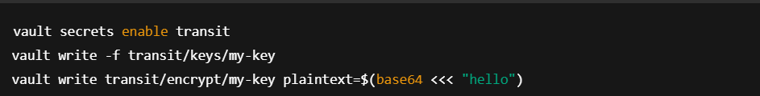
Encryption as a Service (EaaS)
Vault Transit Engine:
Used for data-in-transit encryption
Vault stores keys, not the data
Use Cases:
Tokenization
Secure envelope encryption
Sign/verify payloads

Slide 45
Audit Logs and Access Control
Why Audit Logging?
Track who accessed what and when
Crucial for compliance & security investigations
vault audit enable file file_path=/var/log/vault_audit.log
Audit Log Details:
Timestamp, auth method, token accessor
HTTP method, path, policy matched
📁 Logs are unstructured JSON – use tools like jq for parsing

Slide 46
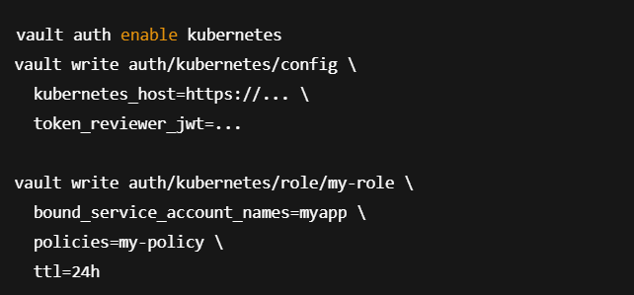
Vault with Docker / Kubernetes
Docker Use Cases:
Local testing with dev mode
Running Vault agent in containers
Vault with Kubernetes:
Inject secrets via Vault Agent Sidecar
Authenticate pods via Kubernetes auth method
K8s Auth Example:
Integrations:
Helm charts available
Sidecar and CSI driver support

