Slide 1
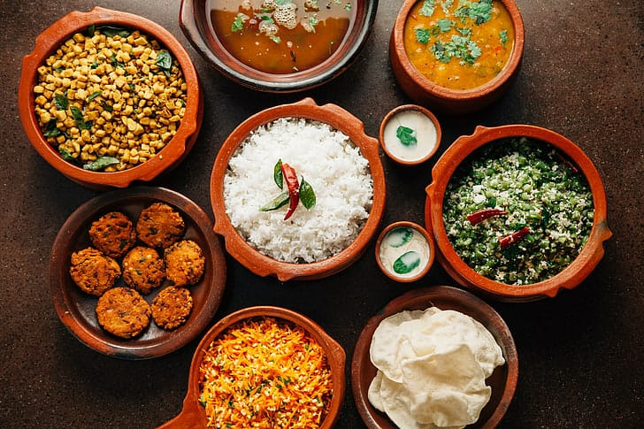
IBM CLOUD COMPUTING
Project Tittle: Personal Blog on IBM Cloud Static Web Apps
Phase 2:Innovation

Slide 2
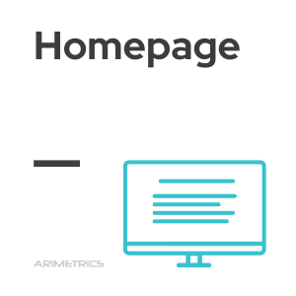
ARCHITECTURE:
FOOD BLOG SITE STRUCTURE:
About
Pages
C
A
T
EG
O
R
I
E
S
News letter
Food items
Dinner Recipes
Sunday Roasts
Easy Baking

Slide 3
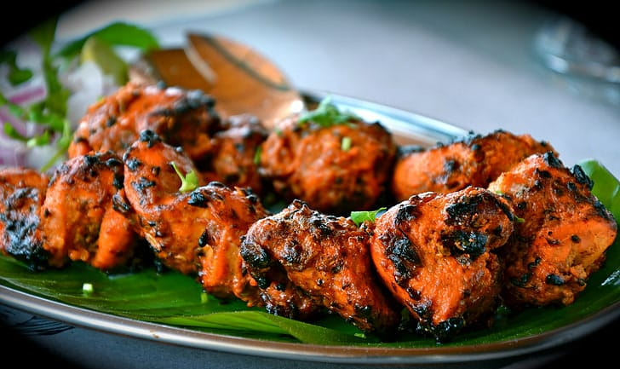
INNOVATION:
My Food Blog innovation:Tamilians and hospitality-Inseparable
Plastic-free and Smart Packing
Drinks that Offer More
Advanced Computerized Technology
Modernization of Old Processing Technique
A focus on Transparency and Trush
The Use of Forward Osmosis
Plant-based,Animal-free Products
Freeze Drying
Alternative Proteins
Personalized Nutrition
Vertical Farming
Blockchain in Agri-Food and Banana Leaves Supply
Secret behind Tranditional Tamil Foods Served on Banana Leaves

Slide 4
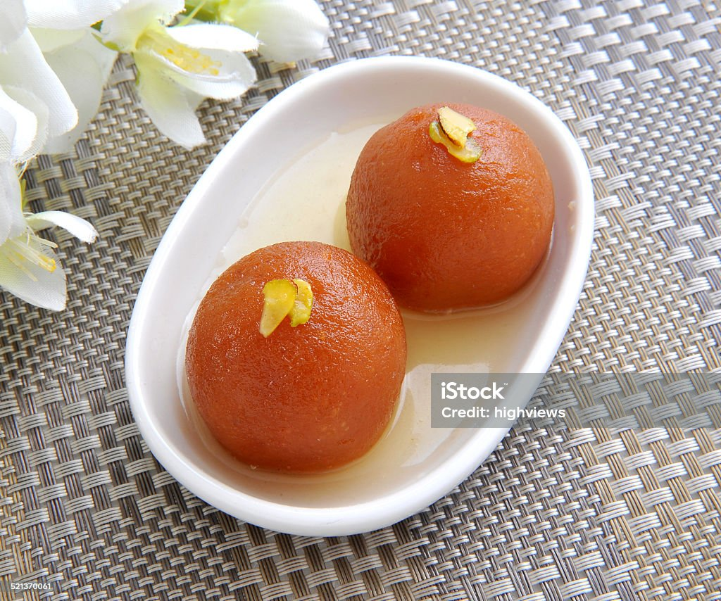
14.Foods are cooked only in manpaanai
15.The Resurrection of the QR code in food packing
16.A Return to old food processing Technique
Some Traditional Foods:
Uttapam-the fluffy pancake
Chicken chettinad
Banana Bonda
Idiyappam paaya
Paniyaram
Rava vadai
Sukku m,alli coffee
Prawns Kuzhambu

Slide 5
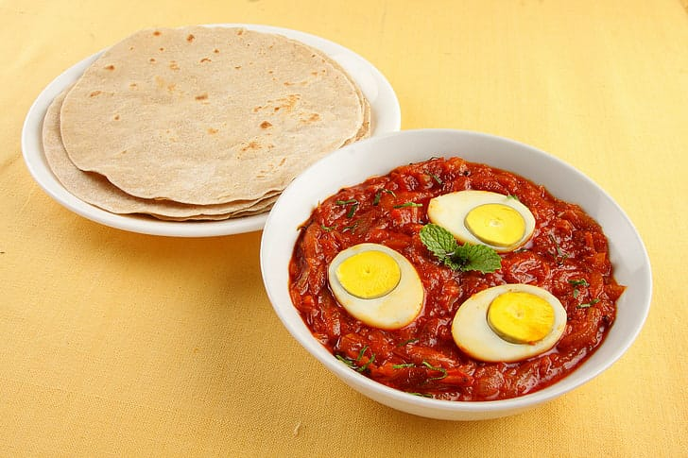
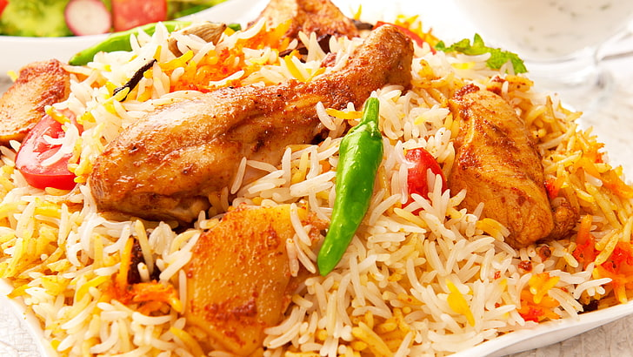
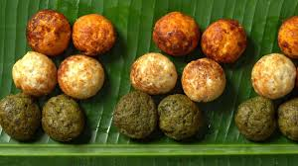
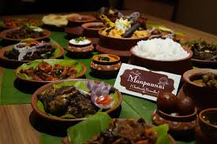
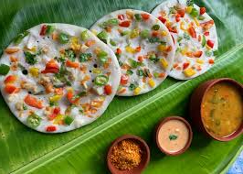
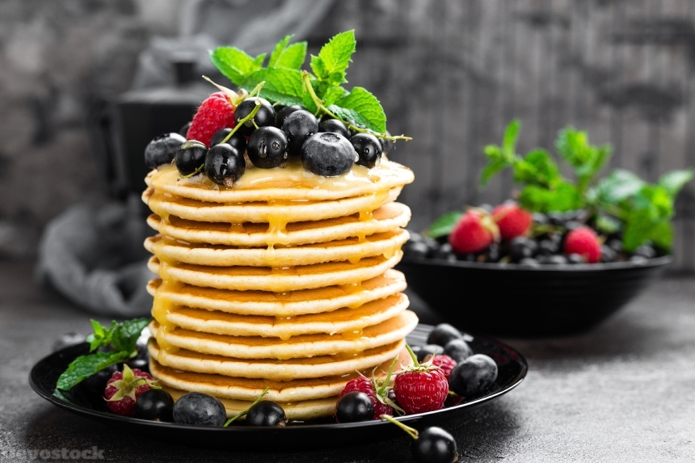
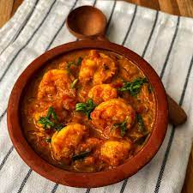
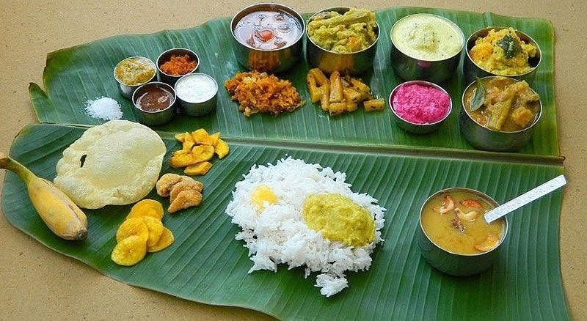
THANK YOU

