Slide 1

The Smart City Sentinel: A Modular PCB for Environmental Monitoring
This presentation explores the design and development of a modular PCB for intelligent environmental monitoring, focusing on its key components, power management, and data communication protocols.

Slide 2
Problem Statement: The Smart City Sentinel
Design and develop a modular PCB using the open-source software KiCad within the next 4 hours to serve as the backbone of an advanced central monitoring system for urban environmental surveillance. This Smart City Environmental Sentinel must seamlessly integrate sensor interfacing, power management, and real-time data transmission within a scalable and efficient architecture while adhering to strict power and connectivity constraints. The PCB must feature correctly mapped communication protocols for all sensor modules and actuators, along with a robust power management unit that includes battery monitoring, recharging capabilities, and an integrated solar panel interface. The design should ensure scalability and modularity, allowing for future enhancements with minimal redesign, using only standard electronic components readily available in any electronics lab.

Slide 3
Bill of Materials: Essential Components
Component
Description
Specification
ESP32-S3 Dev Module
Microcontroller
Dual-Core 32-bit processor, Wi-Fi/Bluetooth, 8MB Flash, 4MB SRAM
MQ-135 Gas Sensor
Multi-Gas Sensor
Voltage: 5V, Current Consumption: 150mA, Detection Gases: CO₂, NH₃, NOx, Benzene, Alcohol, Smoke, Output Type: Analog
Sound Sensor Module
Noise Detection
Voltage: 3.3V / 5V, Current Consumption: 4mA, Output: Digital (high/low) + Analog, Frequency Range: 50Hz – 10kHz
OLED Display
Data Visualization
Voltage: 3.3V / 5V, Current Consumption: 20mA, Interface: I2C (SDA, SCL), Resolution: 128×64 pixels
BME280 Environmental Sensor
Temperature, Humidity, and Pressure
Voltage: 3.3V, Current Consumption: 0.7mA (active), Measurement Parameters: Temperature, Humidity, Pressure, Interface: I2C / SPI, Accuracy: Temperature: ±1°C, Humidity: ±3% RH, Pressure: ±1 hPa
Solar Panel
Power Source
Output Voltage: 5V, Output Current: 1A (depending on model)
Rechargeable Module (TP4056)
Battery Charging
Input Voltage: 4.5V – 5.5V, Output Voltage: 4.2V, Charging Current: 1A
IR Flame Sensor
Fire Detection
Voltage: 5V, Current Consumption: 20mA, Detection Range: 0.5m – 1m (depending on model)
Battery 3.7v 2500mAh 18560
Power Backup
Nominal Voltage: 3.7V, Capacity: 2500mAh
Voltage Booster
Boosting Battery Voltage
Input Voltage: 3.3V – 5V, Output Voltage: 5V, Output Current: 1A (depending on model)
Dust Sensor
Air Quality Monitoring
Voltage: 5V, Current Consumption: 90mA, Particle Size Detection: PM2.5 and PM10, Output Type: Analog
Hall Effect Sensor
Magnetic Field Detection
Voltage: 3.3V / 5V, Current Consumption: 8mA, Sensitivity: Detects magnetic fields (Gauss units), Output Type: Digital
MAX471 Current and Voltage Sensor
Power Monitoring
Voltage: 3V – 36V, Current Measurement Range: 0A – 3A, Output: Analog
Water Flow Sensor
Water Usage Monitoring
Voltage: 5V, Current Consumption: 15mA, Flow Rate Measurement: 1L/min – 30L/min, Output: Pulse signal
DHT11 Temperature and Humidity Sensor
Ambient Conditions Monitoring
Voltage: 3.3V / 5V, Current Consumption: 2.5mA, Measurement Range: Temperature: 0°C – 50°C (±2°C), Humidity: 20% – 90% RH (±5% RH), Output Type: Digital
Soil Moisture Sensor
Water Level Detection
Voltage: 3.3V / 5V, Current Consumption: 35mA, Output: Analog
Relay Module (1 channel)
Control of External Devices
Voltage: 5V, Current Consumption: 70mA (per active relay), Switching Voltage: 250V AC / 30V DC, Output: Normally Open (NO) / Normally Closed (NC)
Rain Sensor
Precipitation Detection
Voltage: 3.3V / 5V, Current Consumption: 20mA, Output: Digital + Analog
RTC DS3231 module
Real-Time Clock
Voltage: 3.3V / 5V, Current Consumption: 0.1mA (sleep mode), 2mA (active), Timekeeping Accuracy: ±2ppm

Slide 4
Power Management: Balancing Energy Consumption
Battery Backup
Voltage Regulation
The Smart City Sentinel utilizes a 3.7V 2500mAh battery to provide continuous operation during power outages. The TP4056 module efficiently charges the battery using a solar panel or external power source.
The system uses a voltage booster to convert the 3.7V battery output to 5V, providing a stable power supply for all components. Additionally, a 3.3V regulator powers the ESP32-S3 and other low-voltage components.

Slide 5
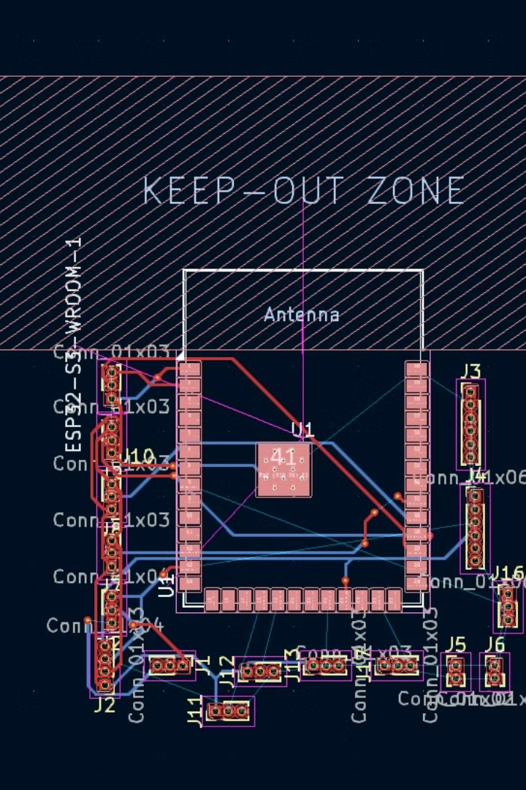




Sensor Interfacing: Gathering Environmental Data
MQ-135 gas sensor provides analog readings for CO₂, NH₃, NOx, Benzene, Alcohol, and Smoke detection.
The Sound Sensor module captures noise levels, offering both digital and analog outputs for analysis.
BME280 sensor acquires data for temperature, humidity, and pressure via I2C communication.
The Dust Sensor measures PM2.5 and PM10 particulate matter, providing analog readings for air quality monitoring.

Slide 6





Communication Protocols: Data Transmission and Control
I2C (Inter-Integrated Circuit)
The I2C protocol facilitates communication between the ESP32-S3 and sensors like BME280, OLED, and RTC DS3231.
Wi-Fi/Bluetooth
The ESP32-S3 enables wireless data transmission to a central monitoring system via Wi-Fi or Bluetooth.
Analog (ADC)
Analog sensors like MQ-135, Sound Sensor, and Dust Sensor provide analog readings to the ESP32-S3's ADC pins.
Digital (GPIO)
Digital sensors like Hall Effect Sensor, IR Flame Sensor, Water Flow Sensor, and DHT11 utilize dedicated digital GPIO pins on the ESP32-S3.

Slide 7
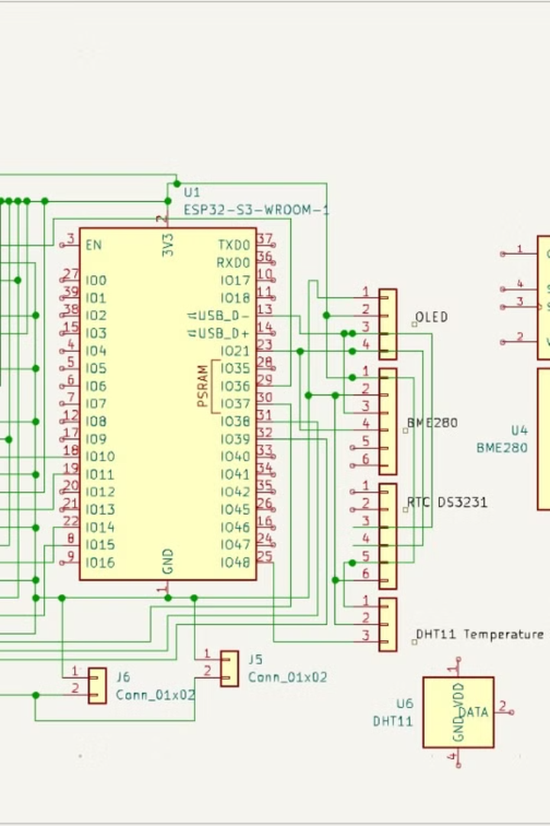
Smart Data Logging and Communication
1
Data is sampled at defined intervals, balancing real-time monitoring with battery conservation.
2
The ESP32-S3 processes sensor data and transmits it in batches to a central monitoring system via Wi-Fi/Bluetooth.
3
The OLED display is updated only when necessary, minimizing power consumption and maximizing battery life.

Slide 8
Key Takeaways and Future Enhancements
Key Takeaways
Future Enhancements
This Smart City Sentinel project effectively demonstrates the feasibility of building a modular and scalable PCB for intelligent environmental monitoring. The design prioritizes energy efficiency, scalability, and data accuracy.
Future enhancements include integrating additional sensors for comprehensive data collection, developing a web-based interface for data visualization and analysis, and incorporating machine learning algorithms for predictive analytics.

Slide 9
