Slide 1
DATA STORY · CUSTOMER INSIGHT
Customer Behaviour
Analysis
From raw shopping data to an analysis-ready table.
Notes:
Introduce the work as a transformation: raw customer shopping records become a consistent table that can support SQL analysis and Power BI reporting.

Slide 2
THE WORKFLOW
From raw shopping data to an analysis-ready table
Prepare, validate, and load customer shopping behaviour data for SQL analysis and Power BI reporting.
01
02
03
04
05
Profile
Clean
Engineer
Validate
Publish
Understand records, types, distributions, and completeness.
Make fields consistent and usable.
Add useful customer-ready attributes.
Remove redundancy and check the result.
Load the processed data to PostgreSQL.
02
Notes:
The workflow moves left to right: profile the dataset, clean the fields, engineer useful attributes, validate the result, then publish it to PostgreSQL.

Slide 3




SOURCE DATA
The dataset captures the full shopping journey
3,900
Demographics
Purchases
Age, gender, and location.
Category, amount, season, and ratings.
customer records
Across demographics, products, purchases, preferences, and shopping patterns.
Fulfilment
Patterns
Shipping, discounts, and subscriptions.
Purchase history and frequency.
18 original columns
03
Notes:
The source contains 3,900 customer records and 18 original columns. Together they cover the full shopping journey, from who the customer is to what they bought, how they received it, and how often they return.

Slide 4
DATA PROFILING
Profiling found one focused data-quality issue
37
Pandas inspection
Focused repair
The issue was isolated to one field rather than spread across the dataset.
Initial exploration used inspection and summary methods to understand records, types, distributions, and completeness.
missing values in Review Rating
Other columns were complete.
04
Notes:
Profiling used Pandas inspection and summary methods. The main finding was precise: 37 missing values appeared in Review Rating, while other columns were complete.

Slide 5
CLEANING
Cleaning made the data consistent and usable
01
02
03
Repair ratings
Standardise names
Clarify amount
Filled missing ratings with the median for the corresponding product category.
Converted column names to lowercase with underscores.
Renamed purchase_amount_(usd) to purchase_amount.
One focused issue repaired · fields aligned for downstream analysis
05
Notes:
Cleaning addressed the missing ratings with a category-level median, then made the schema easier to work with by standardising names and simplifying purchase_amount_(usd) to purchase_amount.

Slide 6
FEATURE ENGINEERING
Feature engineering added customer-ready segments
NEW ATTRIBUTE
NEW ATTRIBUTE
Age groups
Purchase frequency
Four quantile-based groups translate a continuous field into customer-ready segments.
Frequency labels became numeric day intervals, from weekly to annually.
Young Adult
Adult
Middle-aged
Senior
A consistent interval supports sorting, filtering, and comparison.
06
Notes:
Feature engineering adds two customer-ready views: four quantile-based age groups and purchase_frequency_days, which converts labels ranging from weekly to annually into numeric intervals.

Slide 7



VALIDATION
Validation removed redundancy before loading
Redundant field removed
Duplicate check passed
discount_applied and promo_code_used matched for every record, so the redundant field was removed.
Duplicate-row checks returned zero duplicates.
Types confirmed
Data types were checked across integer, floating-point, text, and categorical fields.
07
Notes:
Validation reduced ambiguity before the data reached PostgreSQL. One field was redundant, duplicate rows were absent, and the remaining fields were checked across integer, floating-point, text, and categorical types.

Slide 8

PUBLISHING LAYER
Supabase PostgreSQL became the analysis layer
Connected the processed DataFrame using SQLAlchemy and psycopg2.
SSL-enabled connectivity tested successfully
PostgreSQL 17.11
08
Notes:
The processed DataFrame connected to Supabase PostgreSQL through SQLAlchemy and psycopg2. SSL-enabled connectivity was tested successfully against PostgreSQL 17.11, establishing the database as the analysis layer.

Slide 9
LOAD COMPLETE
3,900 processed records are ready for SQL analysis
19
3,900
final columns
Cleaned originals plus age_group and purchase_frequency_days.
processed records
Loaded into a customer table with Pandas to_sql.
promo_code_used removed
09
Notes:
The final load contains all 3,900 processed records. The customer table has 19 columns: cleaned originals, age_group, and purchase_frequency_days, with promo_code_used removed.

Slide 10
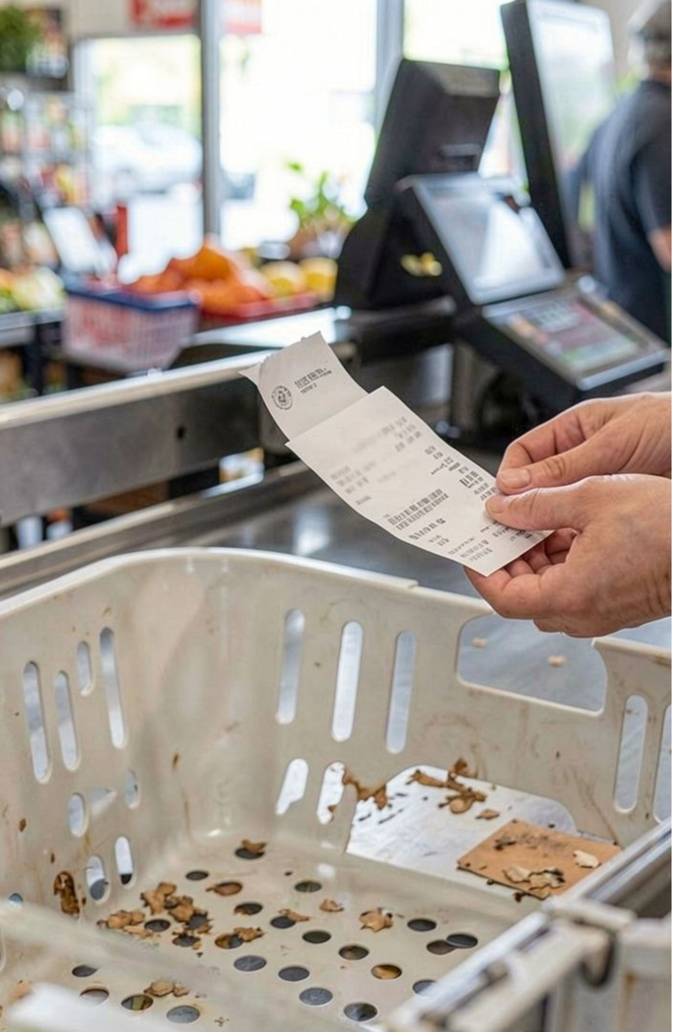
WHAT THE TABLE ENABLES
The table supports practical customer questions
01
Compare revenue
By gender, shipping type, subscription status, and age group.
02
Find product signals
High-rated products, discount-heavy products, and top products within each category.
03
Segment loyalty
New, returning, and loyal customers, then repeat-buyer subscription patterns.
10
Notes:
Close on the practical use of the table. It supports revenue comparisons, product discovery, and customer segmentation, including repeat-buyer subscription patterns.

