Slide 1

Code Refactoring and Bug Fixing
B. Vidhyalakshmi
27th February 2024

Slide 2
ABOUT ME :
I am an undergraduate student in second year, studying Artificial Intelligence and Data Science at SRM Easwari Engineering College.
My academic pursuits reflect a keen interest in AI, data science, machine learning, deep learning, and related fields.
LinkedIn Profile: www.linkedin.com/in/b-vidhyalakshmi
Github Profile:
Vidhyalakshmib1305 (github.com)

Slide 3
SCENARIO:
A team of enthusiastic data scientists embarked on a mission to develop a Note Taking Application using Python, Flask, and HTML. However, their lack of experience in backend development has led to challenges in making the application fully functional. Recognizing your proficiency in backend development, you have been tasked with fixing the broken code and ensuring the application works seamlessly.
MORE DETAILS:
The application's home route contains a text field and a button. Users can add a note, and all the notes should be displayed as an unordered list below the text field on the same page.

Slide 4
AGENDA:
Refactor the existing codebase and ensure the proper functioning of the Note Taking Application.
Fix the already existing codebase and make the application work as intended.

Slide 5
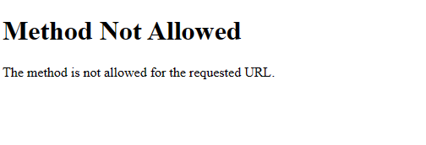
BUGS, RESULTS OF THE BUGS AND ITS CORRECTION
BUG 1:
Method Representation in Function Route Definition in app.py
Initially, the route in app.py is restricted to only accept POST requests with methods=["POST"].
The HTML form in home.html defaults to using GET requests, resulting in a mismatch between the expected (POST) and actual (GET) HTTP methods for form submission

Slide 6
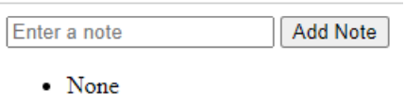
CORRECTION REQUIRED:
We need to change the methods as methods=[“GET” , “POST”]
Modify the route definition in app.py to accept both GET and POST requests using methods=['GET', 'POST'].
Ensure the HTML form in home.html submits data using either GET or POST method by specifying method="POST" in the <form> tag

Slide 7
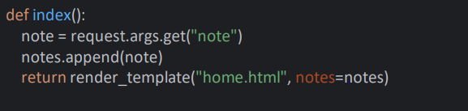
BUG 2:
Request Method Representation in index Function Route Definition in app.py.
The index function route in app.py only accommodates POST requests, limiting its ability to process data solely from form submissions.
The use of request.args.get("note") is incorrect for retrieving form data via POST requests as it extracts data from query parameters, not form fields.

Slide 8
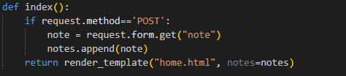
CORRECTION REQUIRED:
We need to change Request Method in Route Function Definition in app.py.
By adjusting the route function in app.py to handle both GET and POST requests, it becomes more versatile in processing form submissions.
Changing request.args.get('note') to request.form.get('note') ensures that the correct method is used to retrieve form data from POST requests, leading to proper handling and storage of notes.

Slide 9
BUG 3:
Missing type attribute in Submit button
The submit button in home.html lacks the type attribute, which could lead to inconsistent behavior across different browsers.
2. Without the type="submit" attribute, the button might not behave as expected when clicked, especially in forms with multiple buttons.

Slide 10
CORRECTION REQUIRED:
We need to add type = ‘submit’ in button tag in home.html.
Adding the type="submit" attribute to the button tag ensures that it behaves as a submit button, triggering form submission upon click.
With the addition of type="submit", the button consistently performs its intended action across various browsers, improving the overall user experience and form functionality.

Slide 11
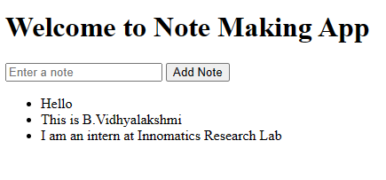
FINAL REQUIRED OUTPUT SCREEN
Thus the existing codebase is fixed and and made the application to work as intended successfully.

Slide 12
CONCLUSION
Through collaborative efforts, the Note Taking Application underwent significant refinement to overcome issues concerning HTTP methods, form submission, and HTML attribute specification.
By systematically identifying and rectifying these bugs, the application now seamlessly facilitates note-taking, with users able to add and view notes dynamically on a single page.
This success underscores the vital role of teamwork and specialized expertise in achieving optimal functionality in application development.

Slide 13

THANK YOU

