Slide 1
Job Acceptance Prediction System
G.vidhya

Slide 2
Problem Statement
High offer rejection impacting recruitment efficiency
No predictive system to estimate acceptance probability
Need for data-driven hiring to reduce cost and time

Slide 3
Objectives
Predict candidate job offer acceptance using Machine Learning
Identify key factors influencing acceptance decisions
Enable data-driven hiring to improve placement success

Slide 4
Dataset Overview
Contains candidate academic, technical skill, experience, and salary-related features
Includes both numerical and categorical variables
Target variable: Job Acceptance Status (0 = Not Placed, 1 = Placed)
The dataset was preprocessed through data cleaning, encoding, and feature engineering before model development.

Slide 5
Data Cleaning
Handled missing values using appropriate imputation techniques.
Removed duplicate records to ensure data consistency.
Encoded categorical variables into numerical format for model compatibility.
Treated outliers where necessary to improve model stability.
Verified data types and ensured the dataset was ready for EDA and machine learning.

Slide 6
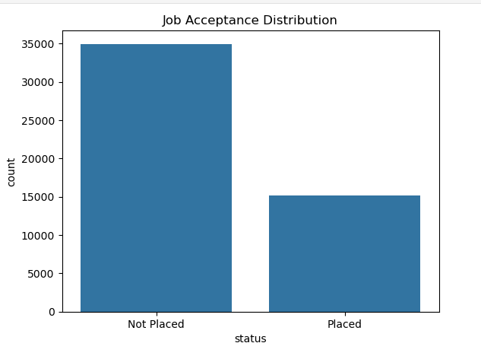
Job Acceptance Distribution

Slide 7
Distribution
From the target distribution plot I observed that the dataset is moderately imbalanced
This indicates that accuracy alone may not be a reliable evaluation metric. Therefore, I plan to use precision, recall, F1-score
possibly apply techniques like class weighting or SMOTE to handle imbalance.
I ensure balancing is done after train-test split to avoid data leakage.

Slide 8
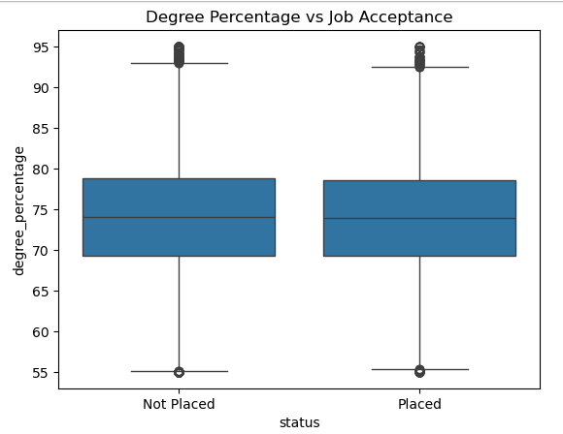
Academic Performance vs Job Acceptance

Slide 9
Academic Performance
Median degree percentage is almost the same for placed and not placed (~73–74%).
Academic marks alone do not strongly differentiate placement outcomes.
Skills, interview performance, and experience play a more critical role.
Outliers exist in both categories, showing marks are not the deciding factor.

Slide 10
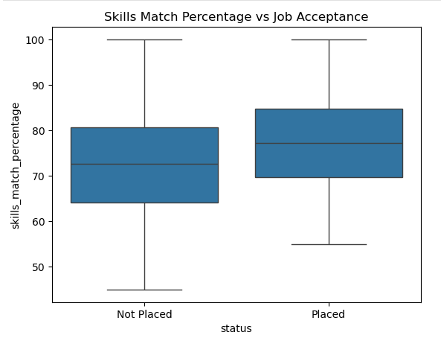
Skills Match vs Job Acceptance

Slide 11
Skill Match
Skills match percentage is a strong differentiating factor for job acceptance.
The entire box of “Placed” is shifted upward.
This indicates a positive relationship between skills match and placement.

Slide 12
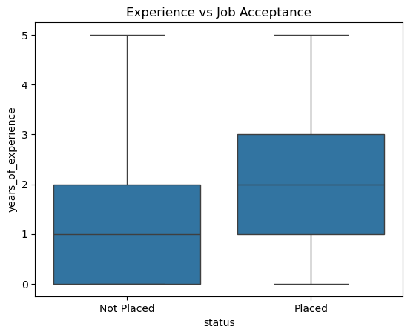
Experience vs Job Acceptance

Slide 13
Experience
Candidates with higher years of experience have a greater probability of job acceptance.
Experience is a strong differentiating feature,.
Experience positively influences placement chances.
This is a strong signal.
Experience → Visible upward shift → Stronger predictor

Slide 14
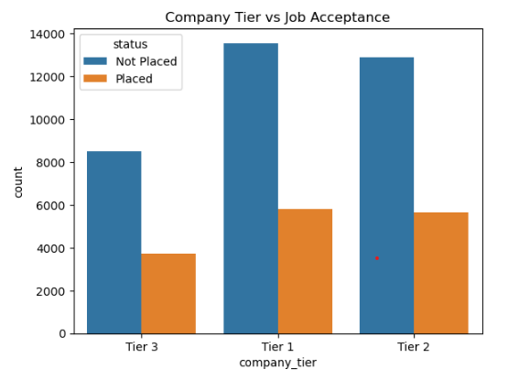
Company Tier vs Acceptance Rate
Company Tier

Slide 15
Company tier does NOT strongly influence placement probability.
The analysis reveals that Tier 1 companies have the highest number of placements, followed by Tier 2 and Tier 3 companies. However, absolute counts alone do not fully represent acceptance likelihood.

Slide 16
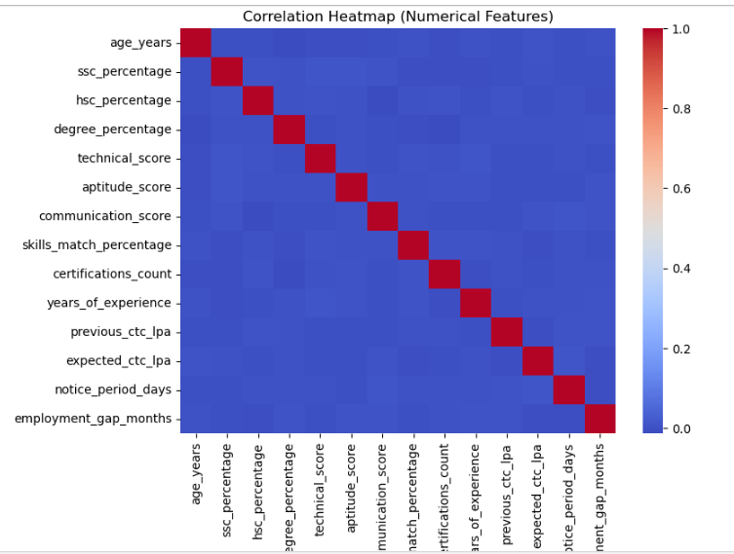
Correlation Heatmap

Slide 17
Correlation
Most numerical features show low to moderate correlation.
Academic, skills, and interview features behave independently.
Independent features help the model capture diverse candidate attributes effectively.

Slide 18
Model Comparison
Multiple classification models were trained and evaluated.
Performance was compared using Accuracy, Precision, Recall, F1-Score, and ROC AUC.
Random Forest outperformed other models with the highest overall performance.
The final model was selected based on better generalization and stability.

Slide 19
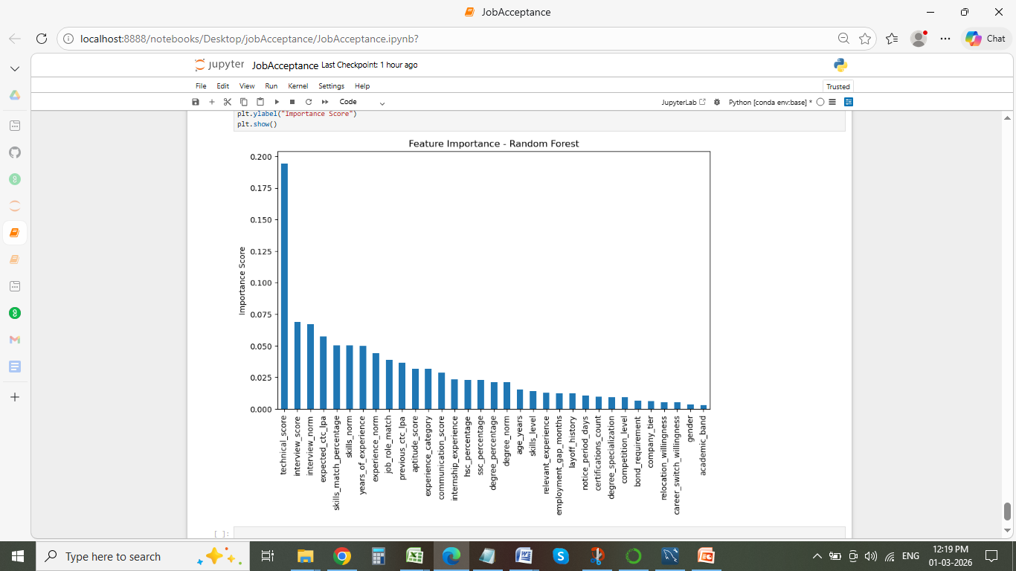
Feature Importance

Slide 20
Feature Importance
Shows how much each feature contributes to prediction.
Higher importance score = stronger influence on decision.
Removing low-importance features reduces model complexity.
Improves model speed and reduces overfitting.

Slide 21
Feature Selection Analysis
Feature selection was performed using an importance cutoff of 0.01. The reduced model achieved:
Accuracy: 87.91%
ROC AUC: 0.9488
Compared to the full model:
Accuracy: 88.63%
ROC AUC: 0.9551
Since the full model demonstrated slightly better performance, it was selected as the final production model.

Slide 22
Analytical Insights
Technical skills, interview performance, and skills match are the strongest drivers of job acceptance.
Experience level significantly increases placement probability, especially for senior candidates.
Academic scores and certifications alone do not strongly differentiate placed vs not placed candidates.
The model shows clear probability separation, confirming strong predictive performance (ROC AUC ~0.95).

Slide 23
Risk Segmentation
High Acceptance Probability (≥ 75%) – Strong likelihood of offer acceptance
Medium Probability (40% – 75%) – Requires follow-up and engagement
High Drop Risk (< 40%) – Needs proactive HR intervention

Slide 24
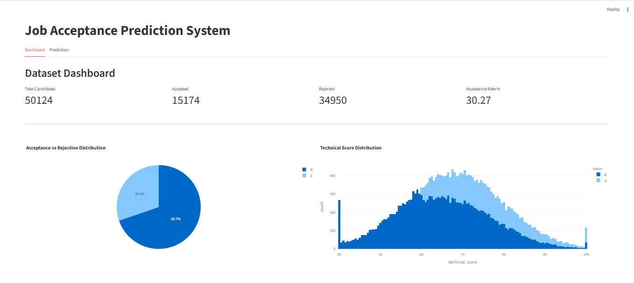
Streamlit Dahboard

Slide 25
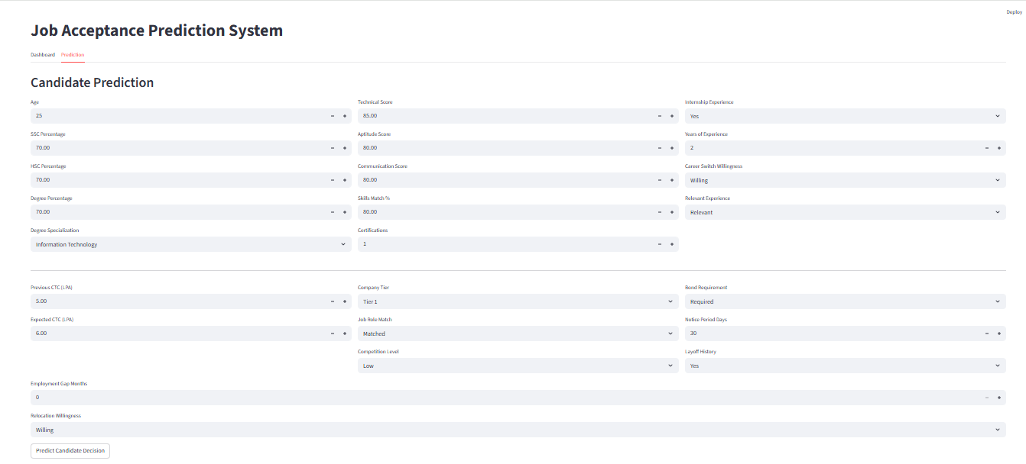
Prediction Page

Slide 26
Business Recommendations
Predict acceptance probability before offer release.
Optimize interview and selection strategy.
Reduce offer dropout rate.
Improve recruitment ROI.

Slide 27
Conclusion
Built a high-performance model to predict job offer acceptance.
Identified skills, experience, and salary alignment as key drivers.
Enabled data-driven hiring to reduce offer dropouts and improve recruitment efficiency.

Slide 28
Thank you

