Slide 1
Online Food Delivery Analysis
Python + SQL + Power BI
G.Vidhya

Slide 2
Tools & Technologies
Python (Pandas, NumPy, Matplotlib)
SQL (Data extraction & queries)
Power BI (Dashboard)
Excel (Initial review)

Slide 3
Problem Statement
Online food delivery platforms generate large volumes of data
Business needs insights to:
  Improve delivery efficiency
  Reduce cancellations
  Increase revenue and profit
This project analyzes order, delivery, and revenue data to support business decisions

Slide 4
Objectives
Analyze order and revenue trends
Measure delivery performance
Identify cancellation patterns
Evaluate customer and restaurant ratings
Build an interactive dashboard for KPIs

Slide 5
Data Cleaning & Preprocessing
Handling missing values using mean, median, or mode
Correcting invalid values (ratings > 5, negative profit margin)
Standardizing categorical values
Ensuring logical consistency(cancelled orders vs ratings)
Removing or capping outliers (delivery time, order value)
        The data is right-skewed, but does not contain extreme statistical outlier

Slide 6
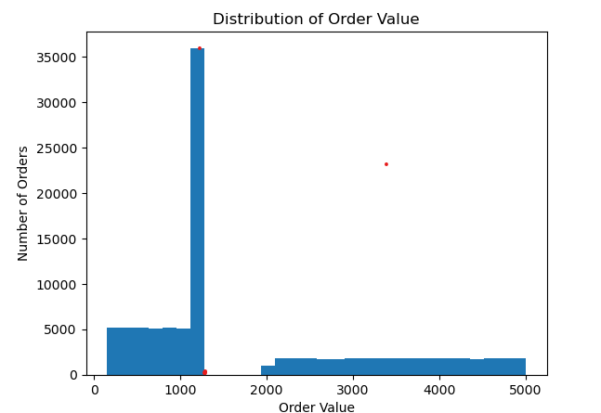
Distribution of order values and delivery time
Order value vs Orders

Slide 7
large number of orders are concentrated in 1000-1200 price range
This is the most common order value range
Orders between ₹100 – ₹1000 are low to medium value orders. Daily regular users ordering small meals or snacks
Long tail from ₹2000 to ₹5000
Fewer bars, but spread over a wide range
This is called a right tail.
Shape of the distribution is Right-skewed
Because of this skewness:
Mean (average) order value will be higher
Median is a better representative value

Slide 8
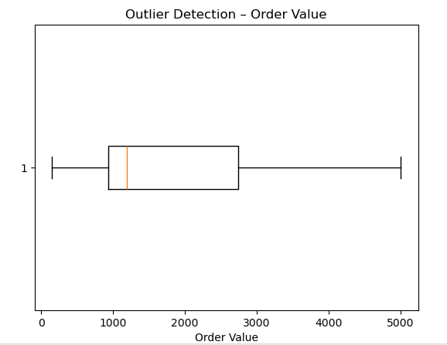

Slide 9
There is no statistical outliers were detected using the IQR method, indicating that high-value orders are a normal part of the business rather than anomalies.

Slide 10
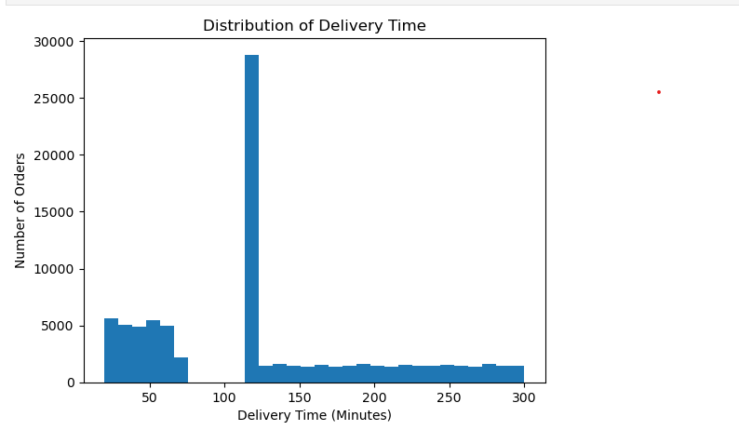
Delivery time

Slide 11
The delivery time distribution is highly right-skewed, with a significant concentration of orders around 110-120 minutes. While most deliveries occur within a reasonable time frame, a long right tail indicates delayed deliveries that may impact customer satisfaction.

Slide 12
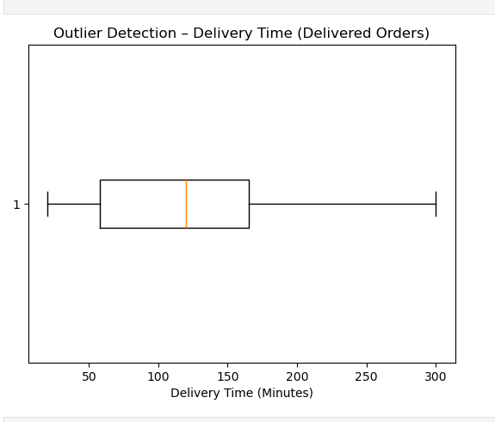

Slide 13
The boxplot of delivery time for delivered orders shows a wide spread with a median of approximately 110 minutes. The interquartile range lies between roughly 50 and 160 minutes. No significant outliers were detected using the IQR method, indicating that long delivery times are part of the normal operational range rather than data anomalies.

Slide 14
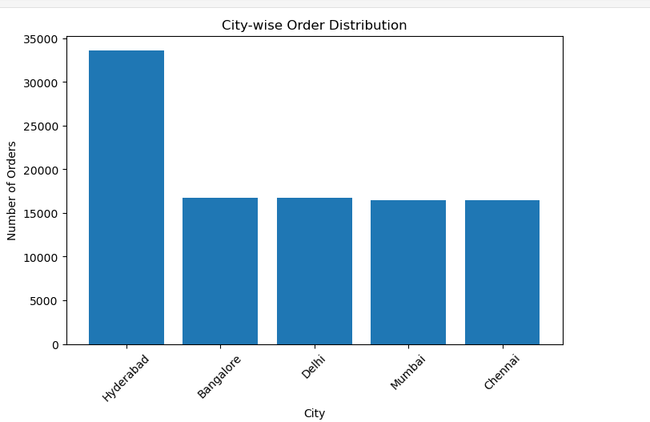
City-wise order analysis

Slide 15
City Wise Order
Hyderabad has the highest number of orders among all cities.
Bangalore, Delhi, Mumbai, and Chennai have similar order counts.
This shows that demand is balanced across these metro cities.
Hyderabad is a key market for the platform.
Focusing on Hyderabad can help improve customer engagement and revenue growth.

Slide 16
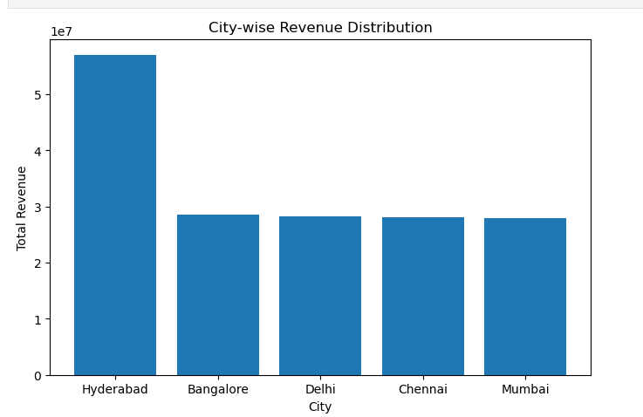
City wise revenue

Slide 17
City wise revenue
Hyderabad generates the highest total revenue among all cities.
Revenue from Hyderabad is significantly higher than other cities.
Bangalore is the second-highest revenue–generating city.
Delhi, Chennai, and Mumbai show similar revenue levels.

Slide 18
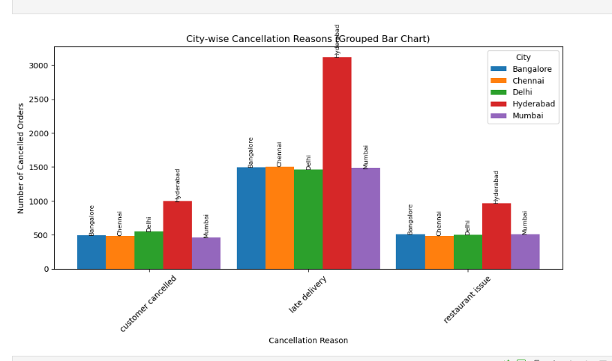
City wise cancel reason

Slide 19
City wise cancel reason
Hyderabad shows higher cancellation counts compared to other cities.
Cancellation patterns are similar across metros, indicating operational issues rather than location-specific problems.
Late delivery is the most common cancellation reason across all cities.

Slide 20
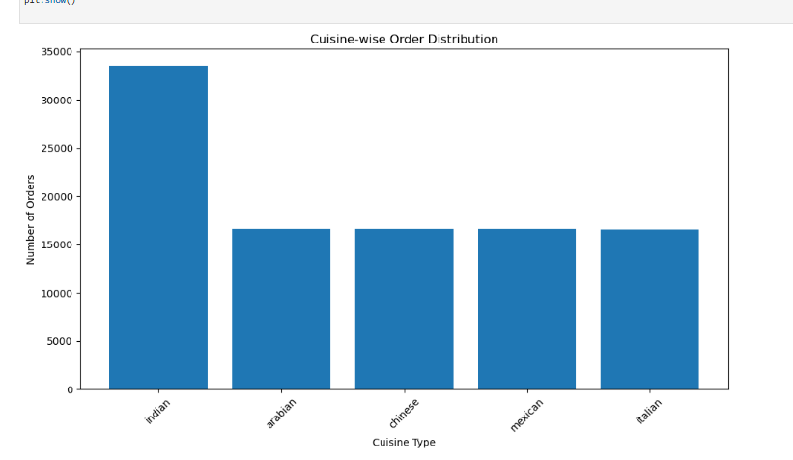
Cuisine wise analysis

Slide 21
Cuisine wise analysis
Indian cuisine has the highest number of orders.
Other cuisines show almost similar order counts.
This indicates a strong customer preference for Indian food.
Demand for non-Indian cuisines is evenly distributed.
Indian cuisine plays a major role in total order volume.
Promoting Indian cuisine can further increase engagement and revenue.

Slide 22
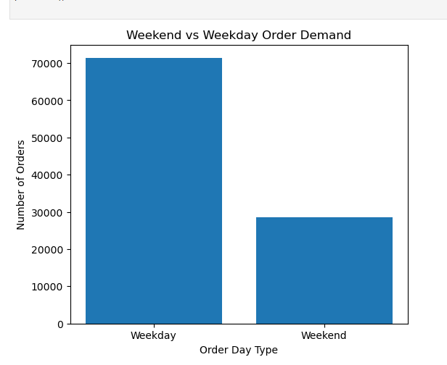
Weekday vs weekend analysis

Slide 23
Weekday vs weekend analysis
Weekday orders are higher than weekend orders.
Customers place more food orders on weekdays.
This suggests orders are driven by workdays, office meals, and routine schedules.
Weekend demand is lower in comparison.
Weekday demand represents the core business volume for the platform.
Strategies like office lunch deals and weekday subscriptions can increase revenue further

Slide 24
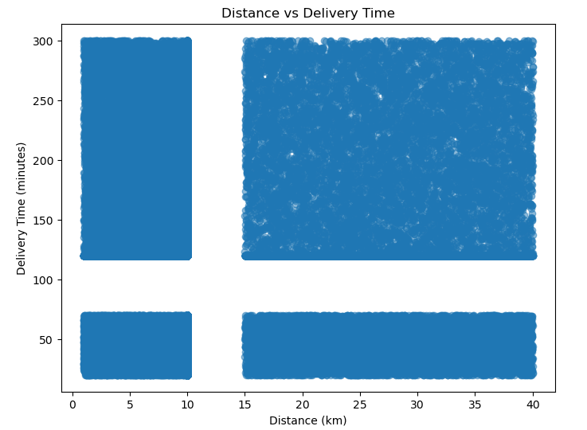
Distance vs delivery delay relationship

Slide 25
Delivery time generally increases as distance increases.
Short-distance orders are delivered faster.
Long-distance orders show higher delivery times.
Some long-distance orders are delivered quickly, indicating efficient routing.
A few points with very high delivery time indicate possible delays or outliers.

Slide 26
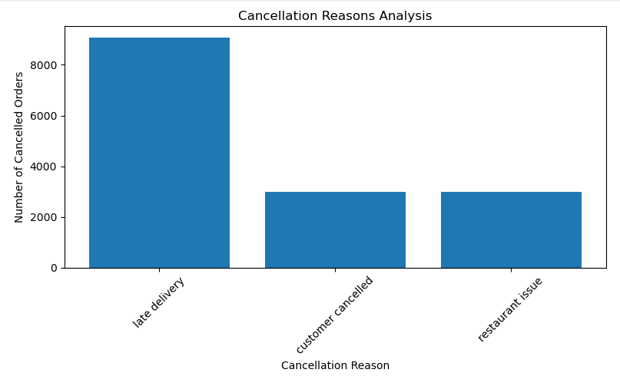
Cancellation reasons analysis

Slide 27
Cancellation reasons analysis
Late delivery is the top cancellation reason.
It accounts for the highest number of cancelled orders.
All other cancellation reasons occur in almost equal numbers.
This indicates that delivery delays are the primary operational issue.
Improving delivery speed can significantly reduce cancellations

Slide 28
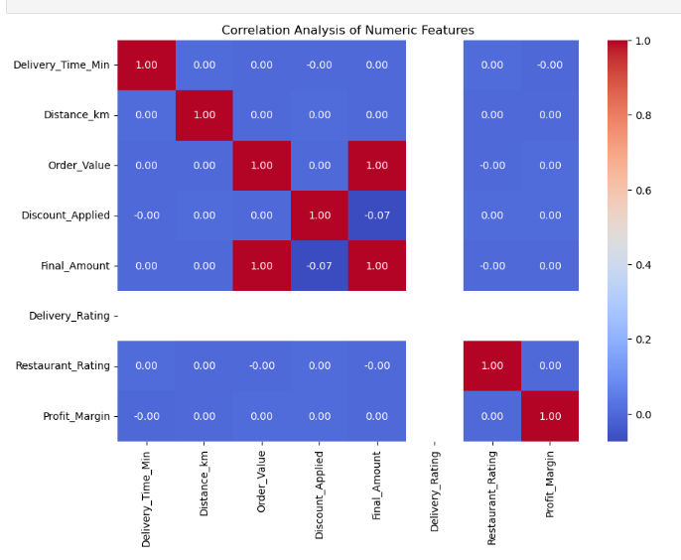
Correlation analysis among numeric features

Slide 29
Correlation
Order value and Final amount are perfectly correlated(1)
Discount applied has very week relationship with Final amount(-0.07)
Delivery time and Distance have almost no correlation with other variables
Rating are not strongly related to numeric values
Profit margin has no strong correlation with other variables.

Slide 30
Data Storage (MySQL)
Cleaned data can be stored in MySQL
Data inserted using SQLAlchemy

Slide 31
Analyst Tasks
Customer & Order Analysis
Revenue & Profit Analysis
Delivery Performance
Restaurant Performance
Operational Insights

Slide 32
DASHBOARD - POWER-BI
Total Orders
Total Revenue
Average Order Value
Average Delivery Time
Cancellation Rate
Average Delivery Rating
Profit Margin %

Slide 33
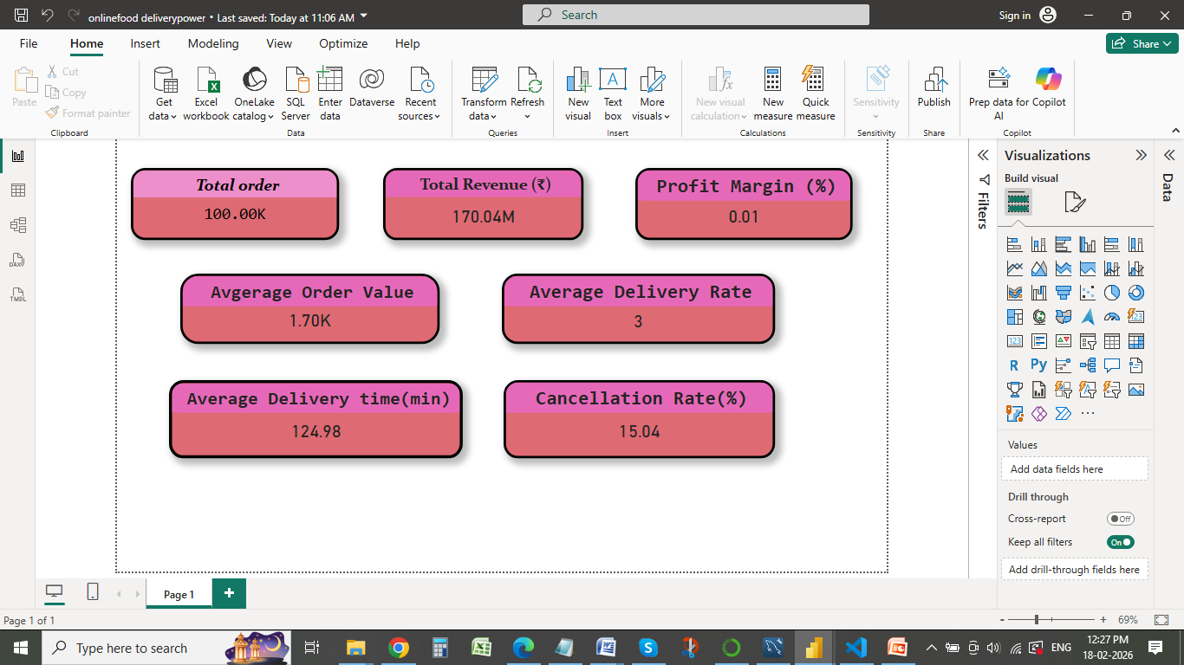
PowerBI Dashboard

Slide 34
KeyInsights
Most common order value range 1000-1200
Commonly 100–110 minutes delivery time
Delayed deliveries that may impact customer satisfaction.
Hyderabad has the highest number of orders among all cities.
This suggests orders are driven by workdays, office meals, and routine schedules.
Hyderabad generates the highest total revenue among all cities
Late delivery is the most common cancellation reason across all cities.
Indian cuisine has the highest number of orders.
Weekday orders are higher than weekend orders.
Zero-Discount Orders Are Slightly More Profitable

Slide 35
Business Recommandations
Focusing on Hyderabad can help improve customer engagement and revenue growth
Strategies like office lunch deals and weekday subscriptions can increase revenue further
Reduce the Delivery delay for that add more delivery partners
Make Campion and advertisement in all cities
Handel the peek hour order properly
Increasing so offers can increase the orders

Slide 36
Thank you

