Slide 1

APRIL 30, 2019​
Irony Detection on Online Social Media
--
A team has no name
RAHUL PANDEY,
ARJUN MS,
VIDHYASRI
GANAPATHI

Slide 2
Outline
Introduction
Related work
Resources
Data Analysis
Approach
Error Analysis
Results
Discussions
Conclusions

Slide 3
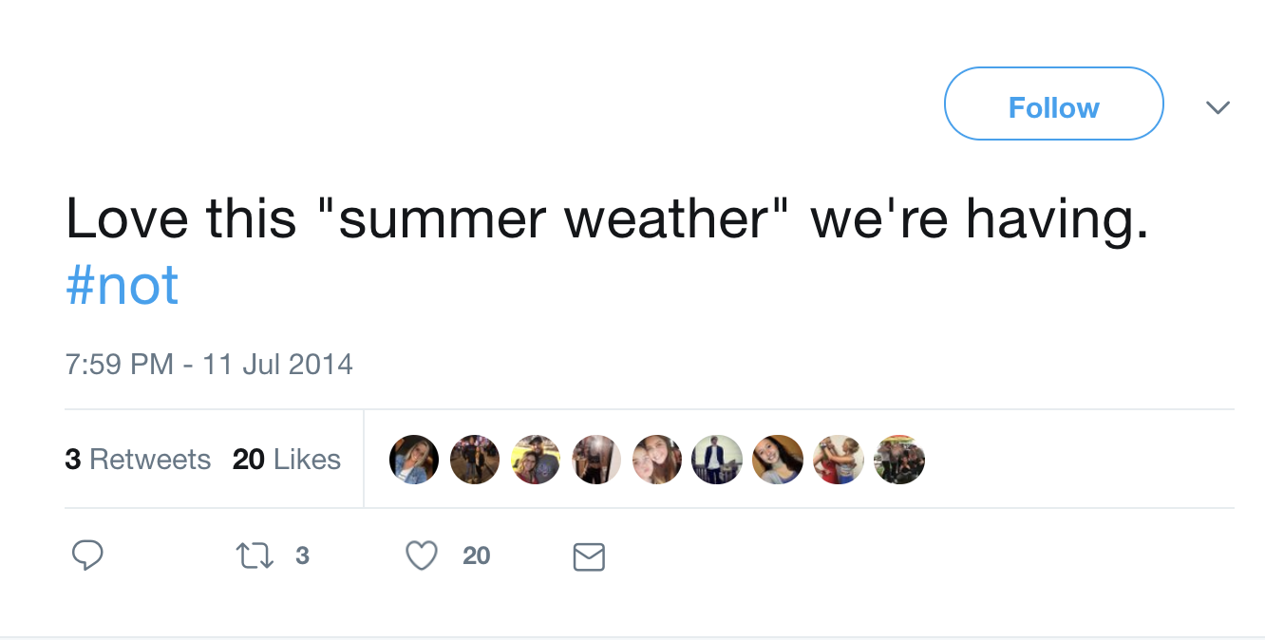
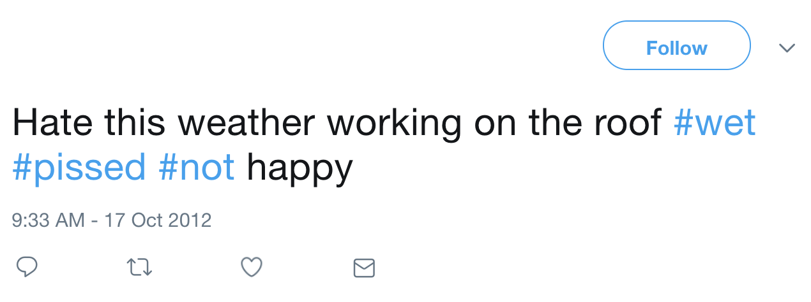
Introduction
IRONIC
The evolved language allows users to mock anything in a subtle and abstract manner by using sarcasm and irony.
Irony detection has a large potential for various applications in the domain of text mining such as author profiling, detecting online harassment, and sentiment analysis.
We are proposing two classification model.
The first model will classify whether a comment/tweet is ironic or not.
While the second model will classify the given input to the 3 irony types (i.e. verbal irony, situational irony, or dramatic irony)
NOT IRONIC
Notes:
With increasing usage of social media, the language has been evolving in accordance.
The evolved language also allowed users to mock anything in a subtle and abstract manner by using sarcasm and irony. Due to its nature, irony has important implications for NLP tasks, which aim to understand and produce human language. In fact, automatic Irony detection has a large potential for various applications in the domain of text mining such as author profiling, detecting online harassment, and sentiment analysis.

Slide 4
Related Work
Existing methods to detect irony are mainly based on rules or machine learning techniques.
Deep learning techniques (CNN-LSTM model) are successfully applied to classify the ironic and non-ironic tweets.
The state of art results:
Task A: F1 score of 0.705 and accuracy of 73.5%
Task B: F1 score was 0.507 and accuracy of 73.2%
Notes:
Previous work on irony detection mostly applied supervised machine learning mainly exploiting lexical features. Existing methods to detect irony are mainly based on rules or machine learning techniques. These methods cannot detect contextual irony.
Traditional machine learning based methods like SVM are also effective, but they heavily depend on the text processing done prior to the modelling. Recently, deep learning techniques like CNN-LSTM model are successfully applied to classify the ironic and non-ironic tweets.
The state of the art result for both classifications are 73.5% accuracy for Task A and 73.2% accuracy for Task B
For the binary classification, they have built a constrained (i.e. only the provided training data were used) system and yielded an F1 score of 70.5%. Their architecture consists of densely connected LSTMs based on (pre-trained) word embeddings. For multiclass classification, they used a slightly altered (i.e. ensemble LR models and concatenated word embeddings instead of averaged) model.

Slide 5
Resources
Dataset overview:
Training Data: Twitter data provided by the Sem-Eval 2018 Task 3.
Test Data: 2015 Reddit Comment dataset, acquired from Kaggle competition.
Overall distribution of the training data:
Class | Sub Class | # Instances
Ironic | Verbal irony by means of a polarity contrast | 1728
 | Other types of verbal irony | 267
 | Situational irony | 401
Not Ironic | Not ironic | 2396
Notes:
We have used Twitter data provided by the SemEval 2018 Task 3 for building the training model and also validating that with the gold standard test-set. Once we have built a robust training model, we will use this model to evaluate 2015 Reddit Comment dataset, which we have acquired from Kaggle competition2.

Slide 6
Data Analysis
Determination of Key Important factors for models:
Generated the Bag of Words model using TF-IDF
Used recursive feature elimination to determine the important features in the model
Inferences – Presence of Stop Words and unigram Models.
Retweets and Mentions:
The original dataset had the redundant retweets removed.
Notes:
Before the models were implemented we performed a certain analysis which might felt will be very critical in terms of the O/P of the models.
We wanted to see the factors(here the words present in the tweets) which were responsible for the model performance. We generated the bag of word model by taking the TF-IDF anf applied scikit-learn’s recursive feature elimination(RFE) for determining the most important features in the model.
RFE – it select features by recursively considering smaller and smaller sets of features. It is given with the initial set of features along with importance of each features. Then the least important features are pruned from current set of features. That procedure is recursively repeated on the pruned set until the desired result is obtained.
Two Inferences- Stop words were identified to be the most important features (but we can't remove the stop words. Eg: #not) and all of them were
Unigrams except a few.

Slide 7
Base Approach
Base model: Bag of Words features for input tweets
Machine learning model used: SVM, Logistic Regression, KNN and Descision Tree classifier.
Data preprocessing:
replacing all URLs with “_url_”,
replacing mentions(@user_name) by “_mentions_”,
replacing numbers with “_num_”, etc.

Slide 8
Contd..
Task 1 (Whether the tweets was Ironic or not):
A bag of words model has been developed using TF-IDF vectorizer
Simple models like SVM, KNN, Decision trees, and Logistic Regression were implemented. The kernel of the SVM was set to linear and the K value for KNN was 1.
Of all the models, SVM performed the best.
S: No | Model | Accuracy
1 | SVM | 63.26 %
2 | Logistic Regression | 62.12 %
3 | K nearest neighbors | 53.69 %
4 | Decision Tree Classifier | 56.63 %
Notes:
As a baseline solution, a bag of words model has been developed. This has been developed using scikit-learn's TF-IDF vectorizer. The TF-IDF vectorizer converts the tweets into one hot encoded vectors with penalized weights. Simple models like SVM, KNN, Decision trees, and Logistic Regression were implemented using the training set. The kernel of the SVM was set to linear and the K value for KNN was 1 so as to be simple. Once the model has been trained we had tested it against the gold standard test data to determine the performance. No cross-validation or parametric tuning was performed to maintain simplicity.

Slide 9
Contd..
Task 2 (Categorizing ironic tweets):
A TF-IDF has been developed and the simple models have been applied. The accuracy of the different models was as follows
SVM outperformed all the basic simple classifiers.
S: No | Model | Accuracy
1 | SVM | 64.92 %
2 | Logistic Regression | 62.62 %
3 | K nearest neighbors | 57.90 %
4 | Decision Tree Classifier | 51.40 %

Slide 10
Contd..
The confusion matrix of base models for both Task A and Task B:
Task A:
Task B:
Confusion matrix | Ironic | Not Ironic
Ironic | 330 | 140
Not Ironic | 148 | 163
Confusion matrix | 1 | 2 | 3 | 4
1 | 379 | 91 | 2 | 1
2 | 68 | 94 | 2 | 0
3 | 58 | 16 | 11 | 0
4 | 55 | 6 | 1 | 0
Notes:
TASK A: There are an equal number of type 1 and type 2 errors. These can say that the model is still yet to be improved
TASK B: The model fails to capture any element from 3 or 4 (due to its linear boundary) yet it outperforms the other classifier. Also, we may even infer that the test set might contain a very high number of type 1 (verbal irony).

Slide 11
Contd..
The error analysis for the baseline:
Most of the word appears only once in the tweet.
Frequency vector doesn’t give enough information to capture the intent of the tweet whether it is ironic or not.
Contracted Words were not expanded
Hash tags had multiple words which were not separated.
Based on this analysis, we have proposed our new approach that will build up on our baseline and will try to improve by tackling all our error analysis.
Notes:
1. vocabulary size of the dataset is 11,372 in our 3834 tweet training document, which is very less to cover the semantics of each vocab. That means, most of the word appears only once in the tweet so their frequency vector doesn’t give enough information to capture the intent of the tweet whether it is ironic or not.

Slide 12
Proposed Approach - 1
The steps involved in this approach are:
Created a contraction dict to expand all the contracting words (Eg: I’ve, You’d, We’ll, etc)
Created a regex to expand the hashtags if there is change of case (Eg: #SoCute -> so cute)
Used two pre-trained word embeddings (trained on very large corpus to bring domain knowledge) to represent word – GloVe and Word2Vec.
Trained different classifier for training the data.
Task A (using Word2Vec) Task A(Using GloVe):
Classifier | Accuracy
SVM | 54.84%
LR | 62.88%
GBM | 62.62%
LGBM | 65.43%
Classifier | Accuracy
SVM | 67.73%
LR | 68.88%
GBM | 66.58%
LGBM | 65.43%
Notes:
More than 4% increase in our performance for task A with Logistic Regression model on GloVe Twitter embedding features with expanded hashtags and contracting words.

Slide 13
Contd..
Task B:
Accuracy using the Word2vec embeddings and GloVe as the features for the task-B.
Result: Low performance with task B, because of data imbalance in the training with respect to different classes.
Word2Vec: GloVe:
Classifier | Accuracy
SVM | 60.20%
LR | 59.56%
GBM | 61.73%
LGBM | 59.94%
Classifier | Accuracy
SVM | 62.76%
LR | 62.50%
GBM | 62.76%
LGBM | 62.76%

Slide 14
Contd..
The confusion matrix of best performing models for both Task A and Task B:
Task A:
Task B:
Confusion matrix | Ironic | Not Ironic
Ironic | 295 | 178
Not Ironic | 66 | 245
Confusion matrix | 1 | 2 | 3 | 4
1 | 379 | 91 | 2 | 1
2 | 68 | 94 | 2 | 0
3 | 58 | 16 | 11 | 0
4 | 55 | 6 | 1 | 0

Slide 15
Error Analysis:
Comparative Analysis of test data between baseline approach and proposed approach 1.
Total test data: 784
Total miss by our baseline bow SVM: 276 (35.2%)
Total miss by our new proposed approach (178+66 ): 244 (31.12%)
Percentage decrease of error = (35.2%-31.12%) 4.08%
Total data that is recalled from the base model: 132
That explains out of 784 tweets in test data, 132 tweets that were misclassified in the baseline approach were classified correctly in our proposed approach.
Total new data miss that was classified correctly by the base model: 100
That explains that 100 new tweets were misclassified by proposed approach were predicted correctly with our baseline approach.
Total common data, which were classified incorrectly by both model: 144
That explains that 144 tweet data in test set are misclassified in both the baseline and proposed approach.

Slide 16
Contd..
Some observation based on the statistics:
Use of #NOT at the end of the sentence.
If the word has 'not' in the middle of the sentence
Original | Predicted | Tweet
ironic | not_ironic | Since the tribunal was established 14 years ago, no complaint against the intelligence services has ever been upheld. #trustthesystem #not
ironic | not_ironic | You decide to go on vacation without me sleep? Reaaaal nice. #considerate #not 😒💤
Original | Predicted | Tweet
not_ironic | ironic | @terry_legg @SR_Duncan @KateOnTheGo It wasn't for one person. It was a business expense.
not_ironic | ironic | At least I don't have to clean the floor

Slide 17
Contd..
If the tweets has sarcasm expressed through images.
Inference: The structure of the tweet should also be considered rather than just that the words present in them.
Original | Predicted | Tweet
ironic | not_ironic | I may or may not have put @robertashton1 at the top of @swarm_tweets tree soon as he likes Christmas time... #Sarcasm http://t.co/OMOURvLfzt
ironic | not_ironic | clashupdate #not http://t.co/1bFOsIwnI5
Notes:
1. If the tweets has sarcasm expressed through images. These images are present when we tried to open the URLs. So, this results in ironic tweets being classified as non-ironic

Slide 18
Proposed Approach – 2
Two different models:
Model 1(Improved embeddings model):
Improvised the model embeddings by using a weighted average, calculated using the TFIDF weights
This served as the feature set with powerful classifiers such as Logistic regression(LR), LightGBM, Support Vector Machines (SVM), etc.
Model 2(CNN for text classification)
The CNN for text was implemented using tensorflow framework and 3 parallel convolution layers ,1 fully connected , 1 droput layer and 1 softmax
A Strong classifier with such as LR, SVM was also used as classifier instead of the softmax by using the trained weights in the last layer as the features

Slide 19
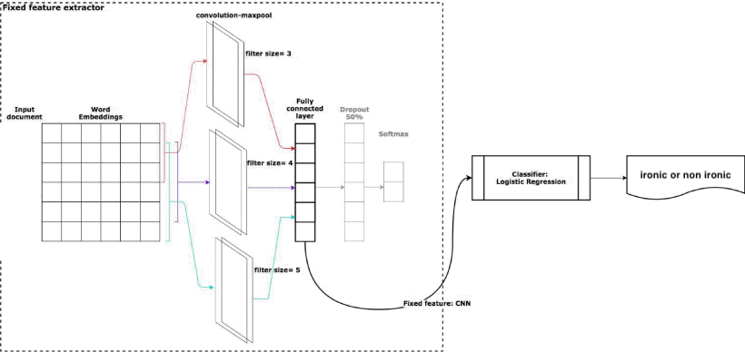
Proposed Approach – 2: CNN architecture

Slide 20
Proposed approach -2 Results
Using the improvised embeddings, the accuracy are as follows:
Using the CNN for text classification, the accuracy are as follows:
Classifier | Accuracy
SVM | 60.69%
LR | 61.24%
LGBM | 59.94%
Classifier | Accuracy
CNN with soft max | 35.71%
CNN with LR | 38.76%
CNN with SVM | 37.37%

Slide 21
Overall Results
Approach | Task | Features | Classifier | Accuracy
baseline | A | tf-idf | Support Vector Machine | 63.26 %
baseline | B | tf-idf | Support Vector Machine | 64.92%
P. App. 1 | A | word2vec | Light Gradient Boosting | 65.43%
P. App. 1 | B | word2vec | Gradient Boosting | 61.73%
P. App. 1 | A | GloVe | Logistic Regression | 68.88%
P. App. 1 | B | GloVe | SVM/GBM/LGBM | 62.76%
P. App. 2 | A | tf-idf + GloVe | Logistic Regression | 61.24%
P. App. 2 | A | CNN | Logistic Regression | 38.76%
Gold Standard | A | Dense LSTM | Softmax | 73.5%
Gold Standard | B | Dense LSTM | Softmax | 73.2%

Slide 22
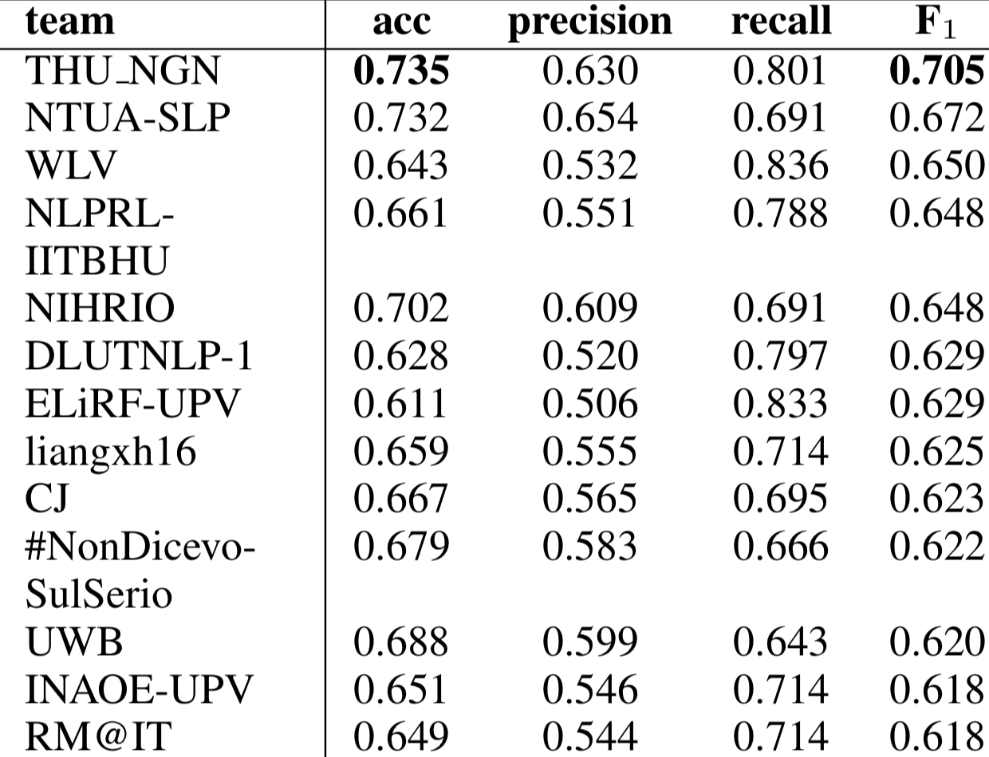
Comparison with other model – TASK A
OUR PROPOSED. | 0.688 0.579 0.788 0.668

Slide 23
Analysis of Reddit Comments

Slide 24
Reddit Comments Dataset
Reddit dataset present in Kaggle was around 31.1 GB in size stored in SQLite database
It had around 7 billion comments from different users
We have randomly chosen 20,000 comments to analyze the irony
The new dataset had 20,000 rows and 20 columns
We used the best model(LR- GLoVe embeddings) to see if the comments were sarcastic or not

Slide 25
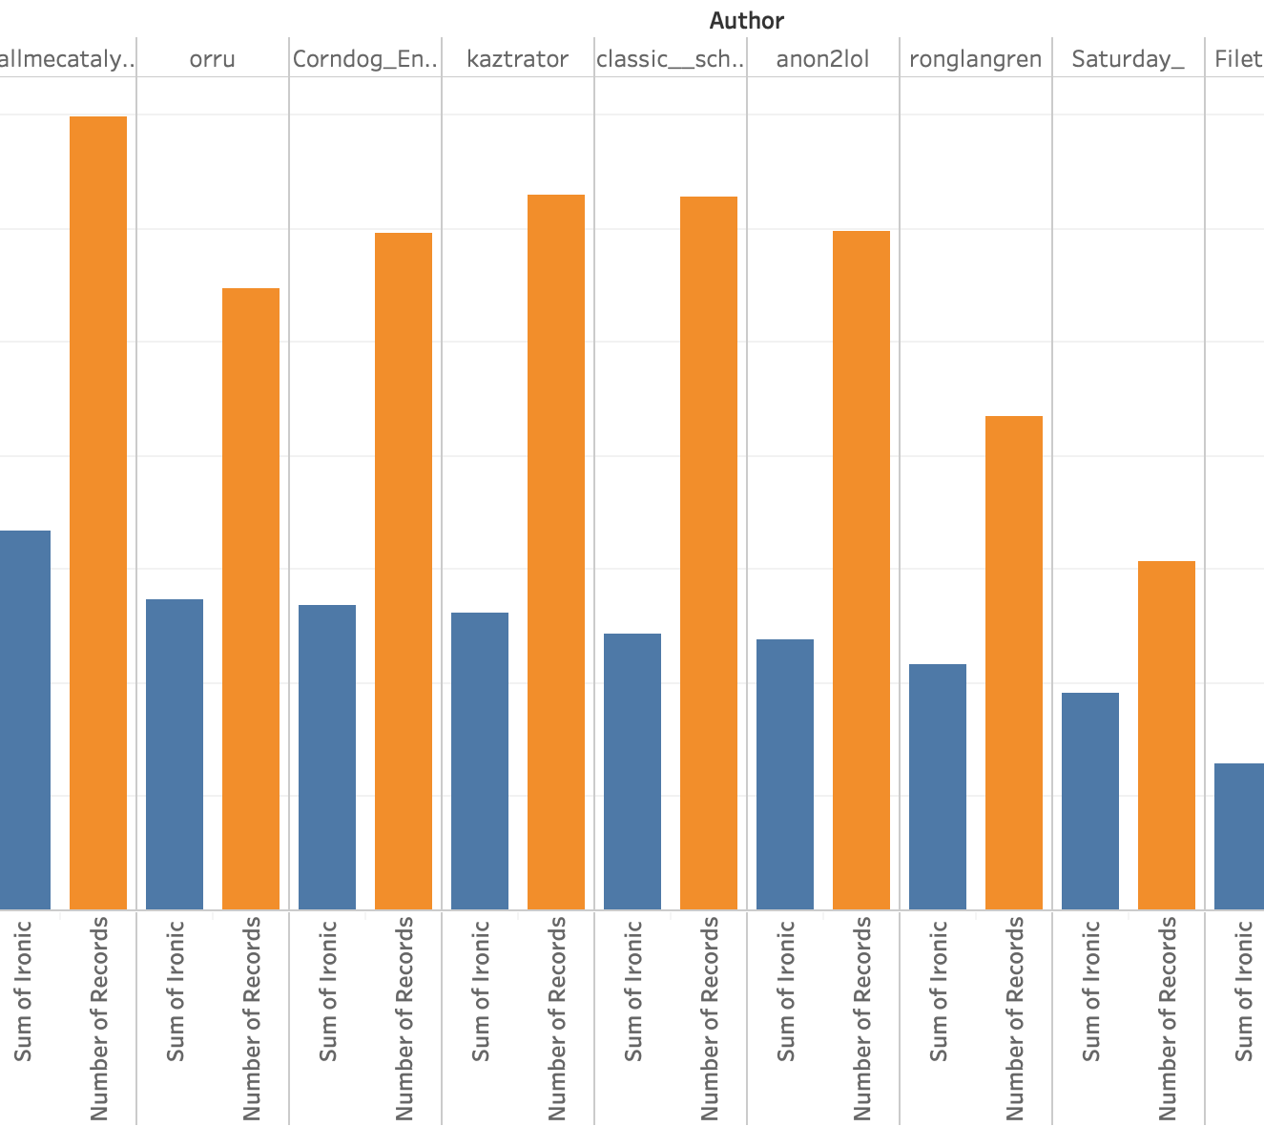
Number of ironic/ Non ironic comments given by top reddit users

Slide 26
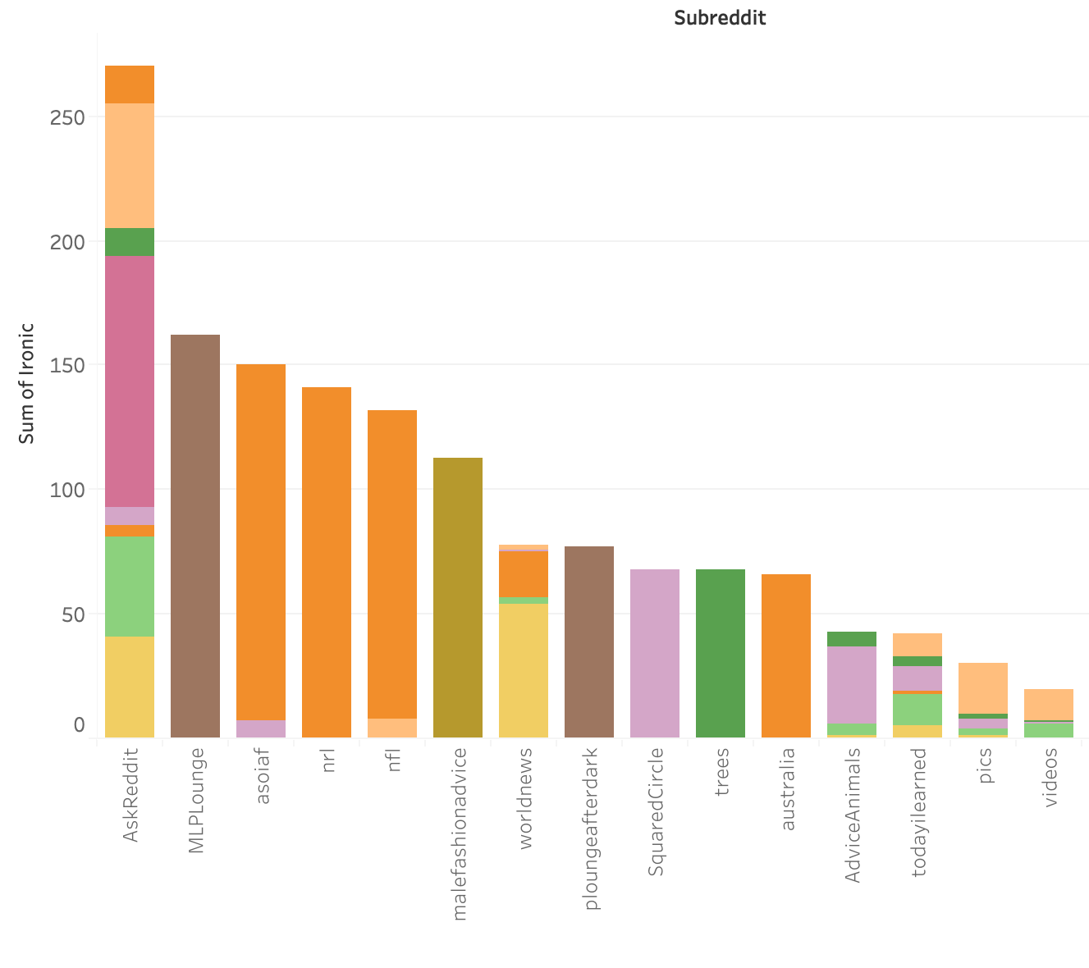
Number of ironic comments given by most saracastic users in each section

Slide 27
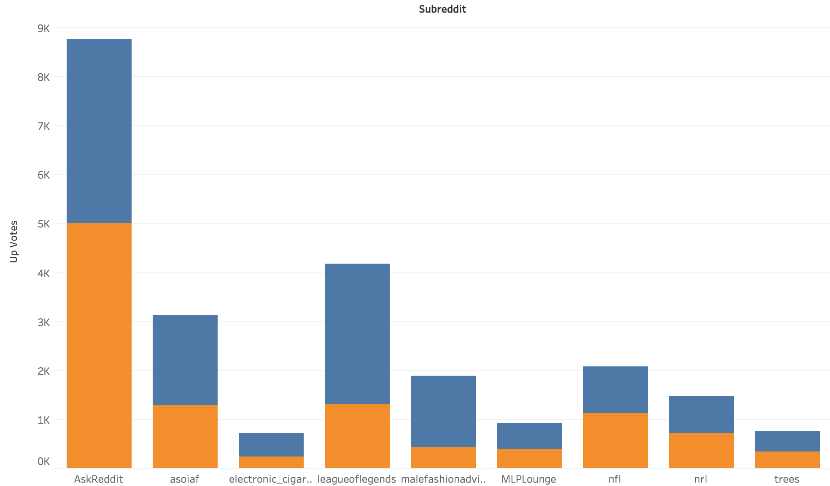
Total upvotes in each subreddit classified by ironic/non ironic

Slide 28
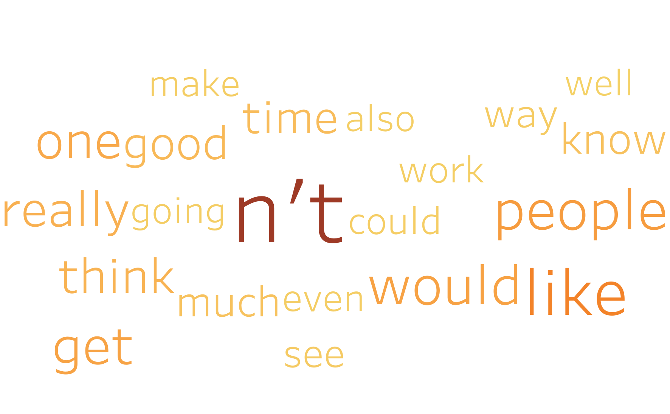
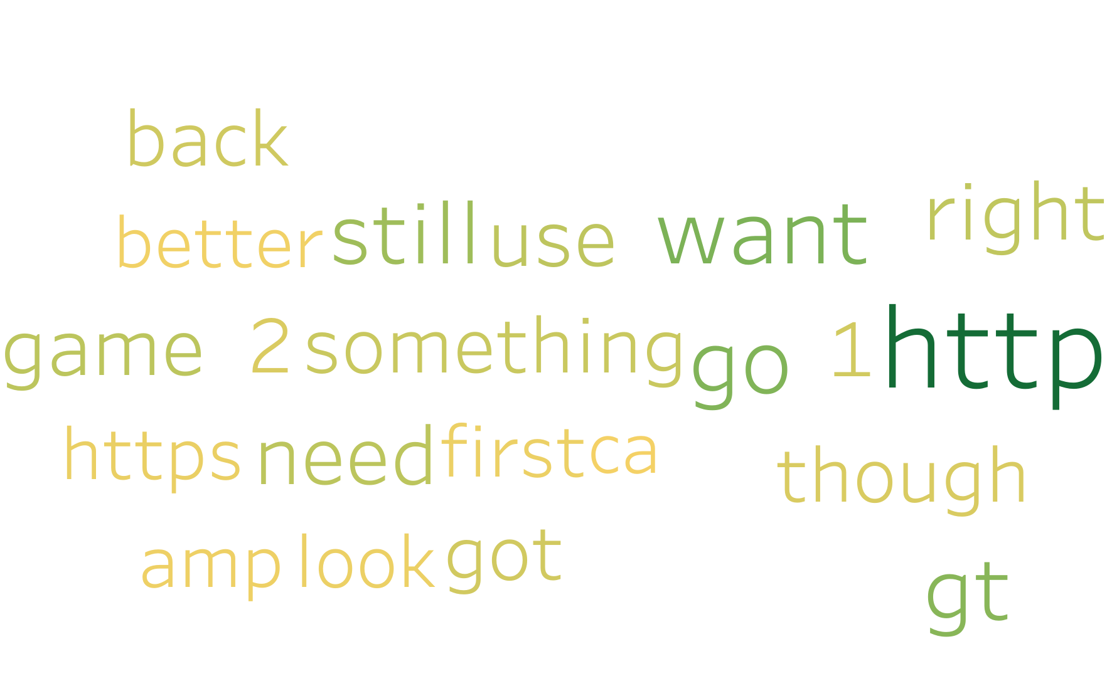
Word Cloud for Ironic vs non ironic reddit comments
IRONIC
NON IRONIC

Slide 29
Conclusions
LR with GLoVE embeddings performed the best in Task A with classification accuracy of 68.88% and F-1 score of 65%
SVM with GLoVE performed the best for Task B with the Classification accuracy of 62% and F-1 score of 61%
Embedded model performed better than the regular Bag of Words models
The simple models performed much better than complex models

Slide 30
Future Works
More powerful sequential models like Bi-directional LSTM –CNN
Include more deep hidden layers and more units
Using embedding specific for irony and sarcasm (none present till now)

Slide 31




Slide 32


