Slide 1
Life Cycle Assessment of Cyclopentanone production from Olive Kernels
Vidianos Giannitsis, Nikos Stavrou

Slide 2
Goal
The goal of this study is to assess the environmental impact of Cyclopentanone production from Olive Kernel. Cyclopentanone is a chemical used widely in pharmaeceuticals and its production from renewables and especially so waste, is interesting to compare with the production from petroleum sources.

Slide 3
Process for comparison
The conventional production process for cyclopentanone is based on the heating of an aquatic solution of adipic acid with Ba(OH)2. The mixture slowly distills to cyclopentanone ¹. Adipic acid however uses benzene as its precursor which is very toxic for both human and environment. For this reason, we would like to replace this process with a different process and see how the two compare.

Slide 4
Impacts assessed
The carbon footprint of the process will be studied as it is generally considered an important metric. Besides that, the petrelaic process uses benzene, therefore, human toxicity should probably be included to show the adverse impact of that material, while the olive kernel process uses a lot of water, therefore water usage is a metric that is quite important to show the adverse impact of that process. Lastly, the energy demand of the two processes is very important to assess.
If the approach was cradle-to-gate (starting from the cultivation of the olives), the assessment of eutrophication and land use would be more important. Now however, these will be rather low in our process.

Slide 5
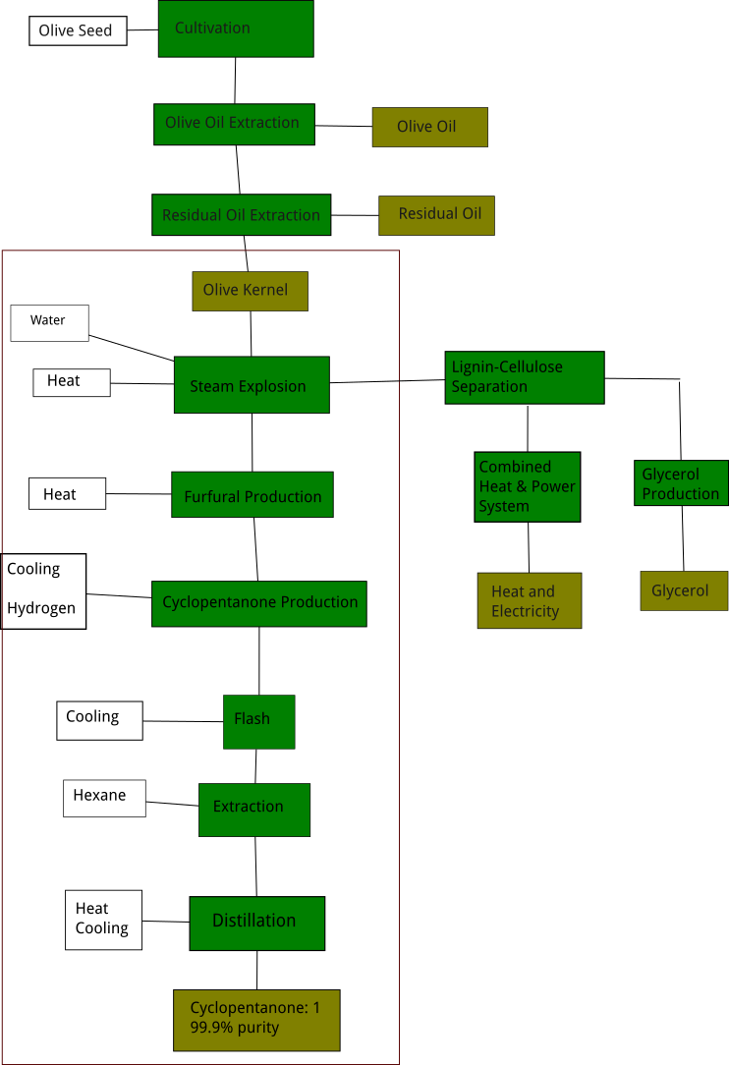
System Boundaries and Functional Unit
The functional unit that was selected is 1 kg of cyclopentanone. Since we are comparing 2 production methods of the same material, it was assumed that a more intricate functional unit was not necessary.

Slide 6
Life Cycle Inventory
Stages | Materials | Input (kg/fu) | Output (kg/fu)
Steam Explosion | Olive Kernels | 11.7
 | Xylose |  | 2.03
 | Solids (co-prod) |  | 6.18
 | Steam (co-prod) |  | 5.70
 | CO₂ eq |  | 0.018
 | Water | 5.85
 | CO₂ |  | 2.76
 | NO₂ |  | 0.048
Furfural Production | Xylose | 2.03
 | Furfural |  | 2.03
 | CO₂ eq |  | 8.84E-5
Cyclopentanone Production | Hydrogen | 0.082
 | Furfural | 2.03
 | Cyclopentanone |  | 2.11
Flash | Water (Cooling) | 5
 | Cyclopentanone | 2.11 | 2.11
 | Hydrogen |  | 0.027
Stages | Materials | Input (kg/fu) | Output (kg/fu)
Extraction | Hexane | 0.044
 | Cyclopentanone | 2.11 | 1.21
 | COD |  | 0.076
Distillation | Water (Cooling) | 9
 | Cyclopentanone | 1.21 | 1
 | CO₂ eq |  | 0.01
 | COD |  | 3.54
 | Furfural (co-prod) |  | 0.00167

Slide 7
Assumptions
To model this process in CCalc, some assumptions were necessary, which are listed below:
For cooling needs, tap water is used and no additional energy requirements are listed.
For furfural production, catalytic amount of sulfuric acid is used, which isn't included in the LCI
The waste streams containing organic compounds are assessed cumulatively as Chemical Oxygen Demand, which in CCalc is reflected only in the eutrophication impact.
The vapor stream of the Flash is considered pure enough in hydrogen to be a co-product and not a waste material
The electricity requirements of the pumps is negligible, while other electricity needs of the factory were not assessed due to difficulty in finding them.
Olive kernel was modelled as residual wood chopping.
Heat was modelled as Heat at cogen 1400 kWh, wood as in the original aspen, heat was produced from lignin.

Slide 8
Allocations
Besides the final product of cyclopentanone, some other streams were considered co-product streams and should somehow be included in the impact assessment. These streams are: The solid stream of steam explosion, which contains cellulose and lignin, the hydrogen rich stream of the flash and the furfural rich stream of the distillation process.
For the first stream, it is hard to assess the economic value of the three components of the kernel (hemicellulose, cellulose and lignin) to do economic allocation and energy allocation isn't very useful, therefore, the allocation methodology followed is mass allocation. The other two streams are very low in quantity and therefore impacts should be allocated to them with mass allocation.

Slide 9
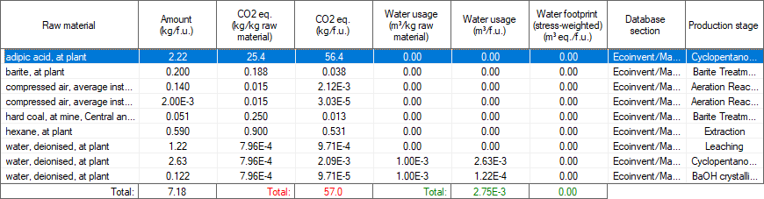
Conventional Process LCI
For modelling cyclopentanone production in CCalc, Ba(OH)2 was not found in the ecoinvent database, so its production from the mineral barite was modelled based on a patent describing the process ².
Energy data: 2 MJ/f.u. heat (modelled as heavy fuel oil), 2.2 MJ/f.u. electricity (electricity mix, Greece), 0.92 MJ/f.u. cooling (water)
Emissions: 0.075 kg CO2/f.u., 0.048 kg SO2/f.u., 2.1 kg COD/f.u.

Slide 10
Life Cycle Impact Assessment of our process
Impact Category | Assessment
carbon footprint | 0.370
water usage | 0.020
energy demand | 34.1
eutrophication | 0.017
human toxicity | 0.380

Slide 11
Uncertainty in input variables
However, these results have a high amount of uncertainty because much of the LCI was built on assumptions and old data. The biggest factors of uncertainty are:
The olive kernel is highly uncertain because data for the steam explosion was taken from old literature. Furthermore, an assumption was made that all the hemicellulosic sugars are xylose making the yield a bit better than it should be.
The water used for steam explosion is based on a process on a much smaller scale and a linear scale-up was assumed. In reality, the analogy of olive kernel to water might be different.
The amount of hexane selected for extraction was arbitrarily calculated in Aspen Plus and gives decent results, but is not necessarily optimal.
Similarly, the distillation columns are potentially not optimally designed and seeing how changes in them will affect the LCIA is interesting.
Lastly, we assume that the hydrogen needed has uncertainty. This is the least uncertain as it was modelled based on recent data. However, decreasing the amount of grey hydrogen shows the effect that using more green hydrogen technologies could have.

Slide 12
Input Range studied
By controlling these 6 design variables we can see how the process changes. To find the sensitivity of the process in each of these variables, we selected 5 values for each of the variables and ran the LCIA varying each one independently. Some of them, also directly cause changes to other parameters, so those were changed as well.
Olive Kernel | Water | Hexane | Heating | Cooling | Hydrogen
6 | 3 | 0.02 | 1.5 | 0.5 | 0.04
8 | 4 | 0.03 | 2 | 1 | 0.06
10 | 5 | 0.04 | 2.5 | 1.5 | 0.07
14 | 7 | 0.08 | 3.5 | 2.5 | 0.09
16 | 8 | 0.1 | 5 | 4 | 0.1

Slide 13
Results of the uncertainty quantification
We noticed that the input variables we are controlling are linearly related with the output variables (impacts). Since the relation is linear, performing sensitivity analysis of the process is very easy as the sensitivity to each parameter is simply its coefficient in the linear relation. This relation can also give us the minimum and maximum we can expect in each impact.
Impact | Minimum | Maximum
Carbon Footprint | 0.185 | 0.527
Water Usage | 0.0097 | 0.0329
Energy Demand | 17.389 | 49.426
Eutrophication Potential | 0.0119 | 0.0235
Human Toxicity | 0.196 | 0.562

Slide 14
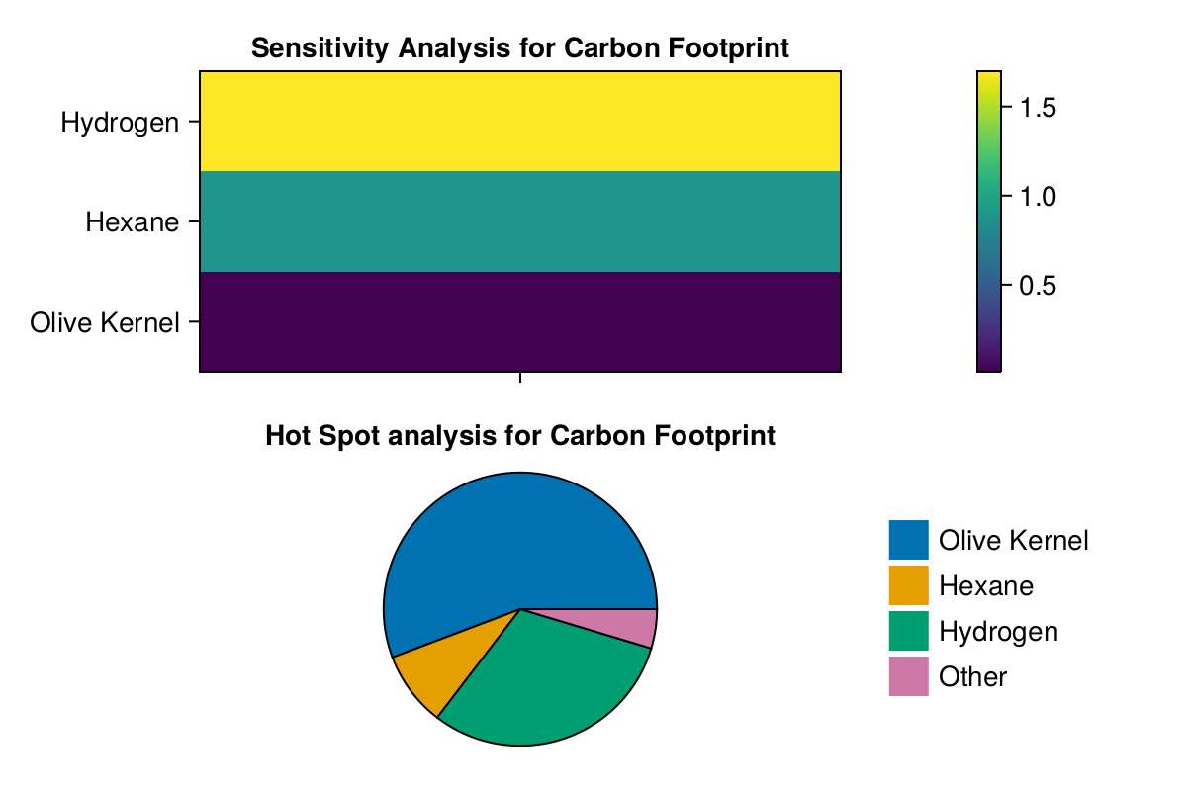
Sensitivity and Hot Spot Analysis for Carbon Footprint

Slide 15
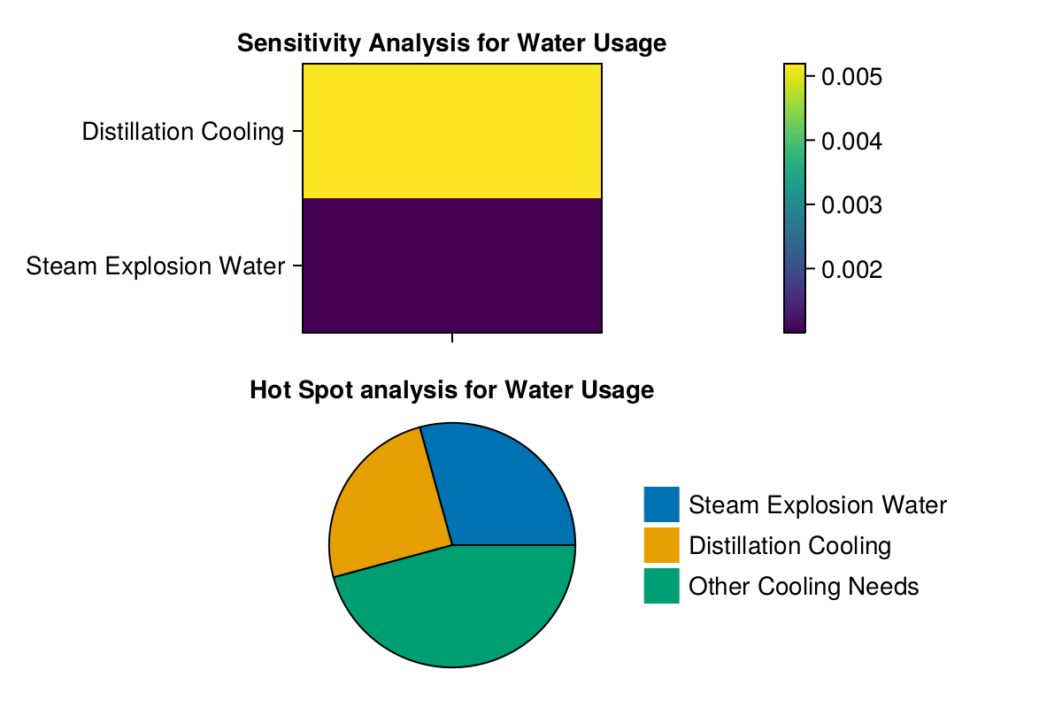
Sensitivity and Hot Spot analysis for Water Usage

Slide 16
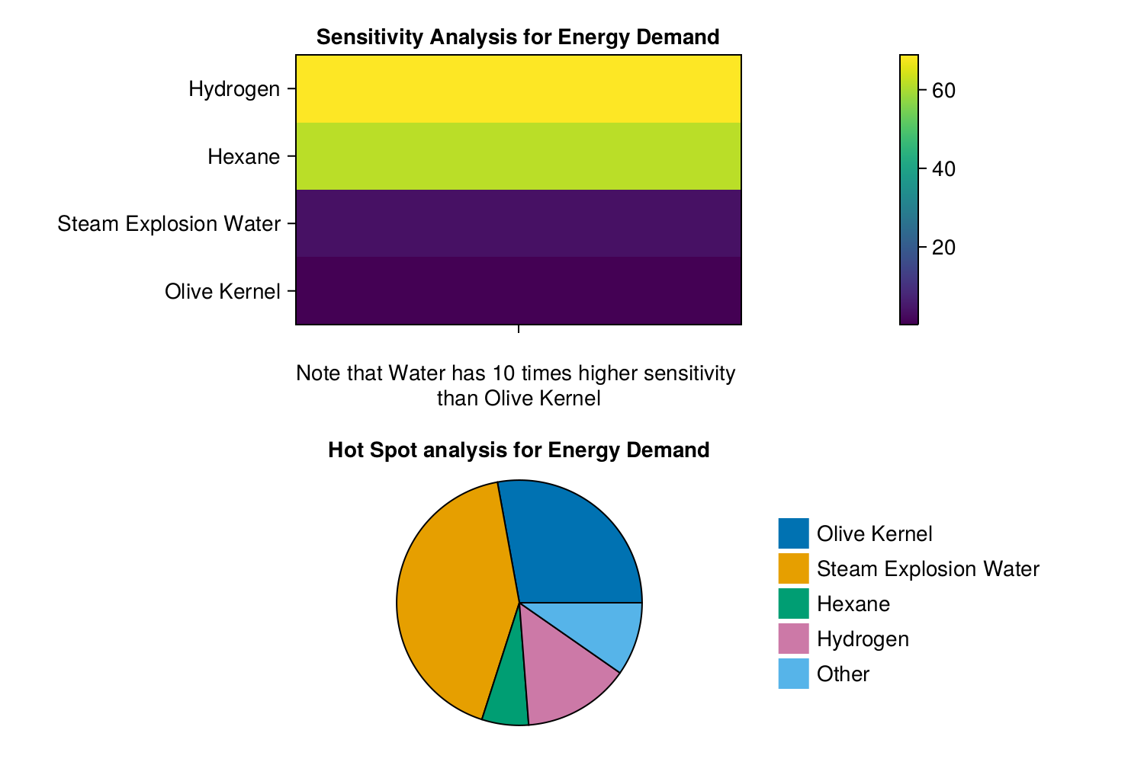
Sensitivity and Hot Spot analysis for Energy Demand

Slide 17
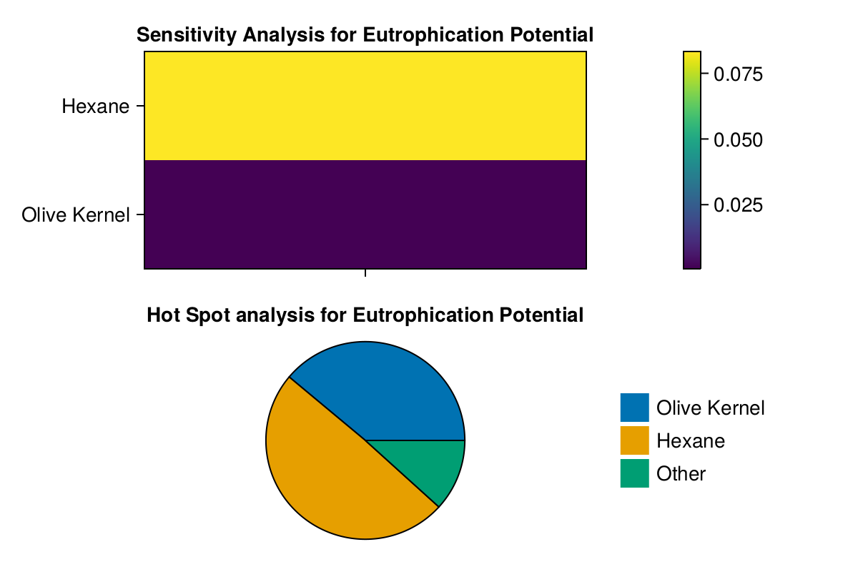
Sensitivity and Hot Spot analysis for Eutrophication Potential

Slide 18
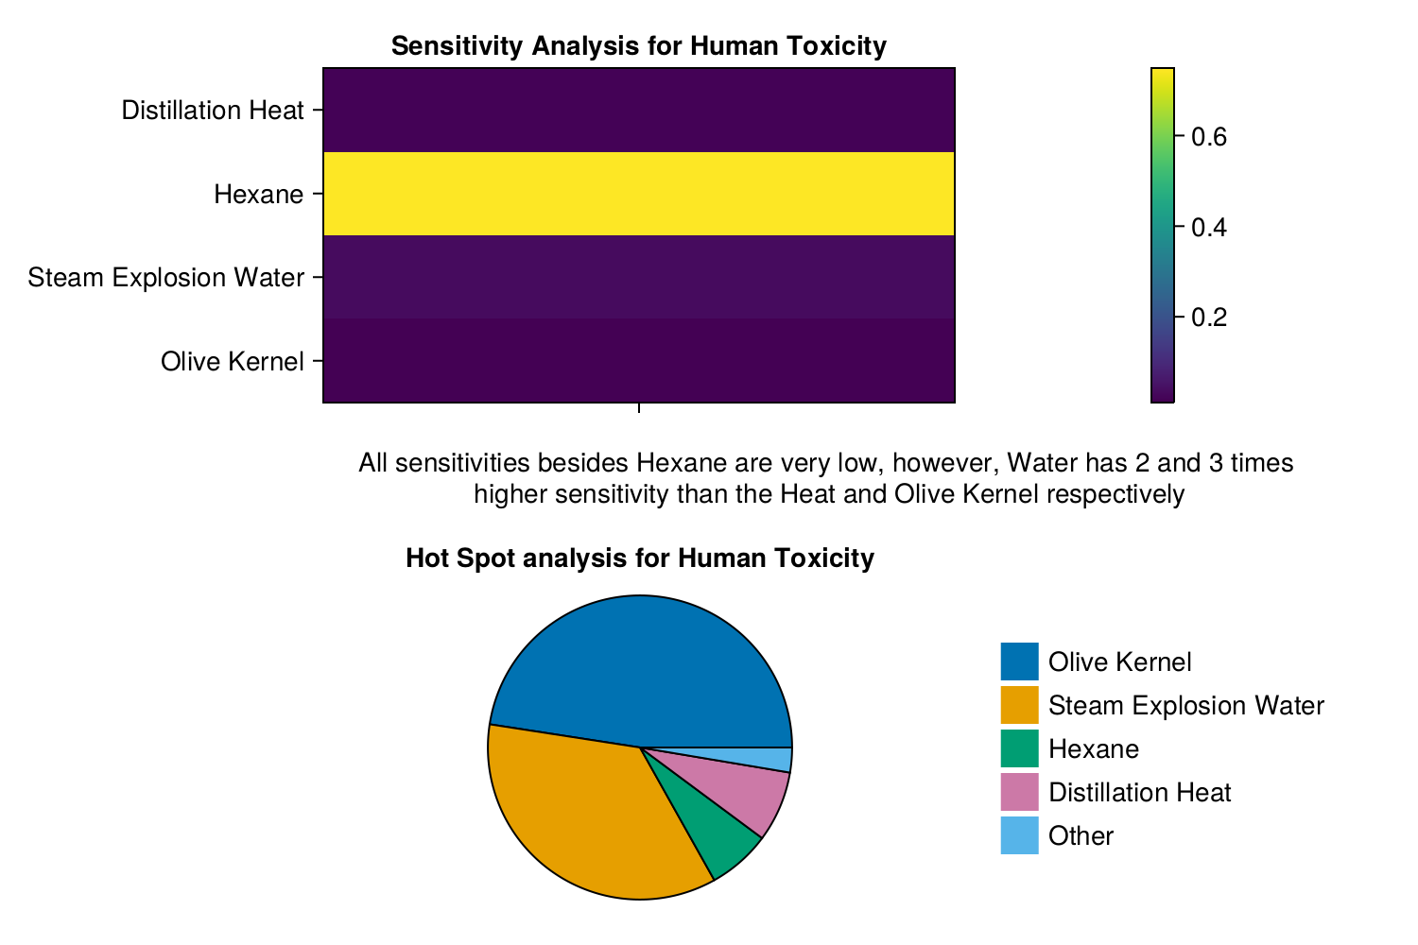
Sensitivity and Hot Spot analysis for Human Toxicity

Slide 19
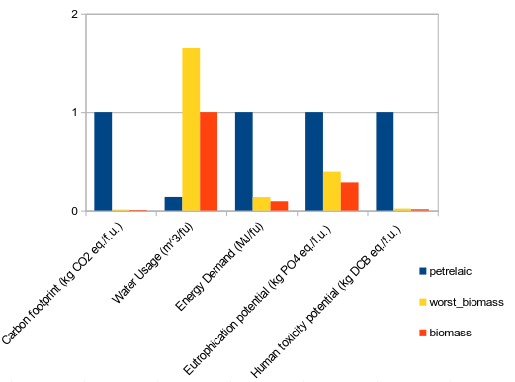
Comparison with the conventional process

Slide 20
Water Reuse Prospects
To improve the large water usage of the process, we can look into water reuse prospects, such as integrating the distillation columns with a refrigerator cycle, which will reuse the water needed for the cooling, thus lowering the water needs of the process.
This could make the process worse in other aspects, but is something worth looking into

Slide 21
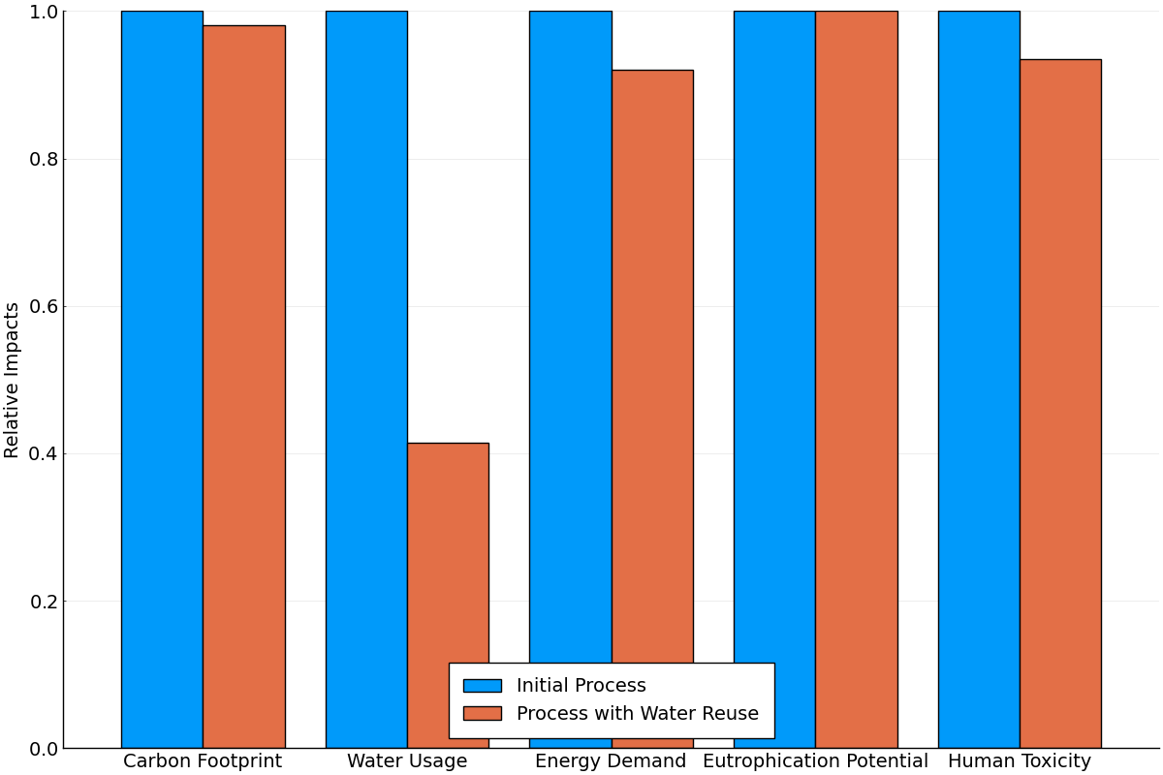
LCIA with water reuse

Slide 22
Conclusions on water reuse
The biggest problem of the process is water usage. The proposed scenario brings water usage to 40% of its original value, which is a significant improvement, without it increasing the other impacts of the process.
What this does affect significantly however is the economics of the process. Electricity is energy of higher quality compared to heat, indicating that this is potentially more taxing energetically. Moreover, an investment on some expensive equipment, such as the compressor of the cycle is necessary. To fully assess if this is worth, a techno-economic analysis would be necessary.

Slide 23
Other reuse possibilities
The above process shows that it has potential as it doesn’t make the process significantly worse in any factor. For this reason, we considered other possibilities of water reuse. The other important cooling need is the cooling after the reactors. This has a wider range (30-160 C), so it’s harder to integrate.
A first thought was to integrate it in the above cycle. For this to be done, the use of Chloromethane (CH3-Cl) is necessary, which is hazardous for both human and environment and for this reason, this wasn’t considered optimal.
Another thought was to create a different cycle. This exacerbates the economic problems of the problem by needing more electricity and a second compressor. Furthermore, it still can’t use water for the cooling, but R-134, which may affect other impacts as well. This means that despite lowering water usage even further, it’s even more likely to make the process worth.

Slide 24
The role of Olive Kernel in improving the process
The second most important parameter is decreasing the amount of olive kernel necessary for the process as it will help in almost all impacts. It is the hot spot of the carbon footprint and human toxicity and plays a role in energy demand and eutrophication potential of the process. The process is not so sensitive to this change as it is to others, but the extraction of xylose from the kernel is highly inefficient so we believe that this variable has the largest range for improvement.

Slide 25
The role of Steam
Decreasing the amount of steam needed for the steam explosion is also very impactful. This will be decreased by decreasing the olive kernel, but if we can find that less water than what was initially assumed (half of the kernel's mass) can be used, this will significantly improve the energy demand of the process (as it is sensitive to it and it is the hot spot of the process), it will improve the human toxicity of the process decently and also lower water usage, albeit it not being the most impactful parameter for this.

Slide 26
The role of Hydrogen
Using less hydrogen is the other parameter that can significantly affect the system. It plays a very significant role in the carbon footprint of the process and is the parameter to which the system is the most sensitive to. Decreasing the amount of hydrogen used is rather hard, but replacing the gray hydrogen with something like green hydrogen has the potential of improving the process.

Slide 27
The role of Hexane and Distillation Column Design
Hexane is a parameter to which the system is very sensitive, showing that if we wrongly underestimated its value, we have wrongly assessed the process as much more environmentally friendly than it is. However, for improving the process, there is a very narrow range to which hexane can help, as the amount used is already very low. It is the hot spot in eutrophication, but its impact is low to begin with.
The distillation column design doesn’t seem to significantly impact the process, meaning that even if the columns can be designed better, it will not affect the environmental impact of the process significantly. It will help in decreasing the water usage, but not by a large margin.

Slide 28
Bibliography
1. Thorpe, J. F., and G. A. R. Kon. “CYCLOPENTANONE.” Organic Syntheses 5 (1925): 37. https://doi.org/10.15227/orgsyn.005.0037.
2. Rohrborn, Hans-Joachim. Process for producing barium hydroxide. United States US4060585A, filed February 20, 1976, and issued November 29, 1977. https://patents.google.com/patent/US4060585A/en.

Slide 29
Thank you for your time

