Slide 1
Life Cycle Impact Assessment of Cyclopentanone Production from a biomass and a petrelaic route
Vidianos Giannitsis, Nikos Stavrou

Slide 2
Life Cycle Inventory of Cyclopentanone Production (gate to gate)
Stages | Materials | Input (kg/fu) | Output (kg/fu)
Steam Explosion | Olive Kernels | 11.7
 | Xylose |  | 2.03
 | Solids (co-prod) |  | 6.18
 | Steam (co-prod) |  | 5.70
 | CO₂ eq |  | 0.018
 | Water | 5.85
 | CO₂ |  | 2.76
 | NO₂ |  | 0.048
Furfural Production | Xylose | 2.03
 | Furfural |  | 2.03
 | CO₂ eq |  | 8.84E-5
Cyclopentanone Production | Hydrogen | 0.082
 | Furfural | 2.03
 | Cyclopentanone |  | 2.11
Flash | Water (Cooling) | 5
 | Cyclopentanone | 2.11 | 2.11
 | Hydrogen |  | 0.027
Stages | Materials | Input (kg/fu) | Output (kg/fu)
Extraction | Hexane | 0.044
 | Cyclopentanone | 2.11 | 1.21
 | COD |  | 0.076
Distillation | Water (Cooling) | 9
 | Cyclopentanone | 1.21 | 1
 | CO₂ eq |  | 0.01
 | COD |  | 3.54
 | Furfural (co-prod) |  | 0.00167

Slide 3
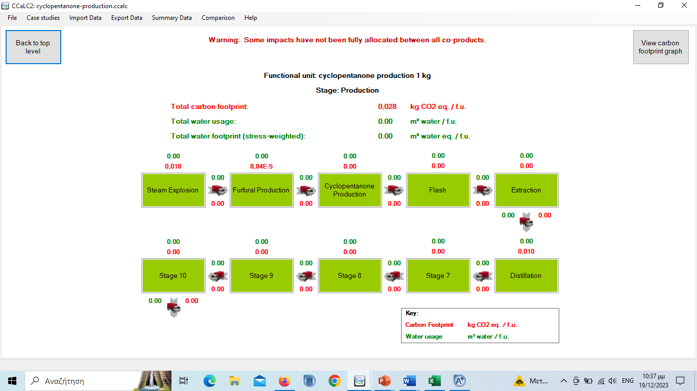
Cyclopentanone Production in CCaLC

Slide 4
Assumptions for Cyclopentanone Production from Olive Kernels
For the cooling needs it is assumed that regural water is used with no additional energy requirements
Furfural Production: Xylose Acid Catalysis Furfural. The acid used is in catalytic amount and wasn’t included in the LCI
The waste streams of the Extraction and Distillation stages are assessed cumulatively as Chemical Oxygen Demand
The “waste” stream of the Flash stage is considered pure enough in hydrogen to be modeled as a co-product.
The electricity needed for the pumps is negligible. The electricity needed for the stirring of the CSTRs and other potential needs of the factory were not assessed.
Olive kernel was modelled as residual wood chopping.
Heat was modelled as Heat at cogen 1400 kWh, wood as in the original aspen process heat was produced from lignin in a CHP cycle.

Slide 5
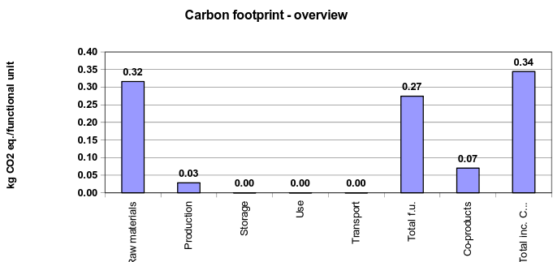
Carbon Footprint of the process I

Slide 6
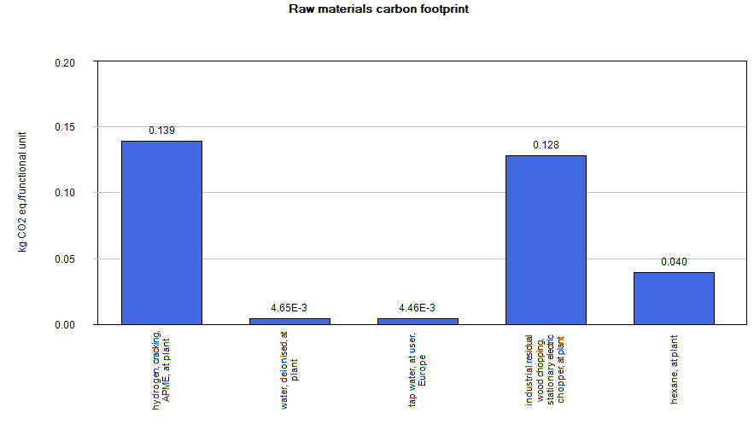
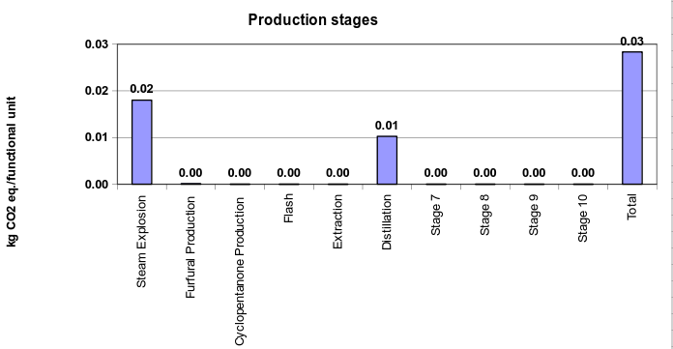
Carbon Footprint of the process II

Slide 7
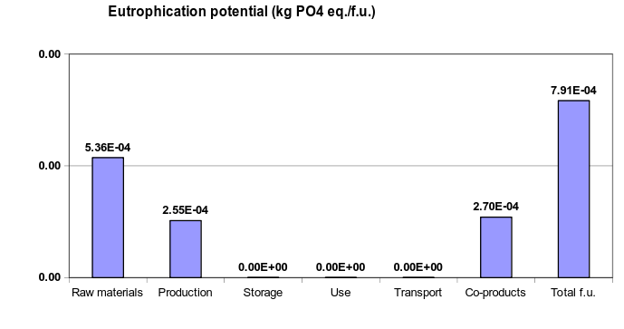
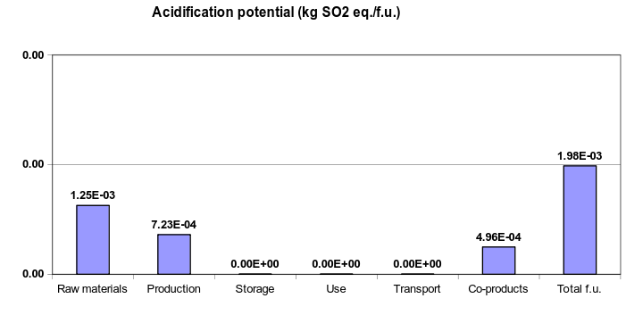
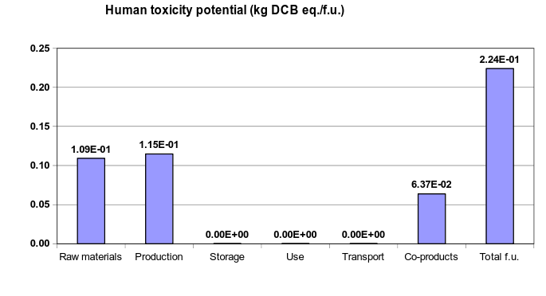
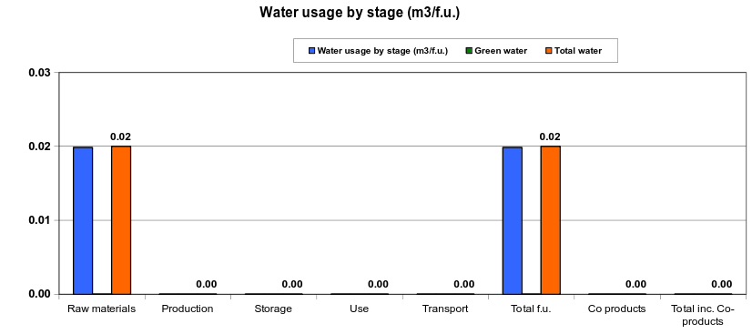
Other Impacts

Slide 8
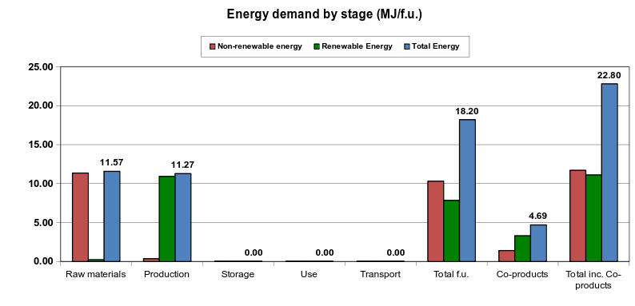
Energy Demand

Slide 9
Process for comparison
We compared our process with a conventional cyclopentanone production process [1], based on petrelaic feedstock and more specifically on the conversion of adipic acid to cyclopentanone when heated with Ba(OH)2 in the mixture.

Slide 10
Ba(OH)2 Production
Barium hydroxide does not exist in the database used. To assess the environmental impact of the process, data for this is necessary. For this reason, the process was modelled based on a patent describing the production process of barium hydroxide from barite mineral [2].

Slide 11
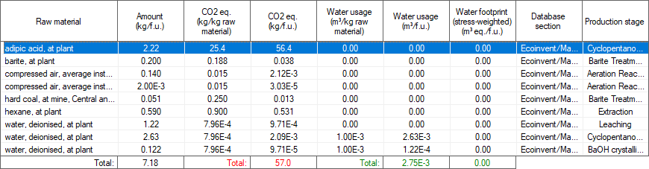
LCI of the process
Energy data: 2 MJ/f.u. heat (modelled as heavy fuel oil), 2.2 MJ/f.u. electricity (electricity mix, Greece), 0.92 MJ/f.u. cooling (water)
Emissions: 0.075 kg CO2/f.u., 0.048 kg SO2/f.u., 2.1 kg COD/f.u.

Slide 12
Comparative LCIA

Slide 13
Conclusion
The conventional process has a very a bad environmental impact due to the existence of adipic acid, whose precursor is benzene. Our proposed process has a much lower environmental impact in every factor besides water usage. Another factor that may affect our process is that it uses the waste material of olive processing and as such, in a cradle to gate approach, it might have an adverse impact in land use. However, this was not assessed at all in our study.

Slide 14
Bibliography
[1] Thorpe, J. F., and G. A. R. Kon. “CYCLOPENTANONE.” Organic Syntheses 5 (1925): 37. https://doi.org/10.15227/orgsyn.005.0037.
[2] Rohrborn, Hans-Joachim. Process for producing barium hydroxide. United States US4060585A, filed February 20, 1976, and issued November 29, 1977. https://patents.google.com/patent/US4060585A/en.

Slide 15
Thank you for your attention

