Slide 1
Life Cycle Analysis of Cyclopentanone Production by Olive Kernel Goal, Scope and LCI
Vidianos Giannitsis, Nikos Stavrou

Slide 2
Goal of the Study
The goal of this study is to assess the environmental impact of Cyclopentanone production from Olive Kernel. Cyclopentanone is a chemical used widely in pharmaeceuticals and its production from renewables and especially so waste, is interesting to compare with the production from petroleum sources.

Slide 3
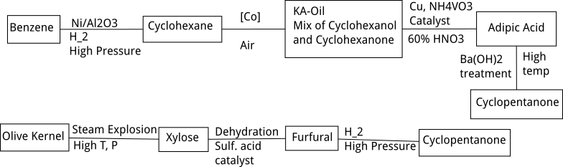
Flow diagrams of the two processes
The petrelaic processes starts from Benzene, which is very hazardous and is generally avoided and uses many metallic catalysts as well as acid and alkaline treatments.
The olive kernel approach doesn’t avoid high pressures or the acid treatment, but uses a renewable feedstock doesn’t have something as hazardous as benzene and has less steps.

Slide 4
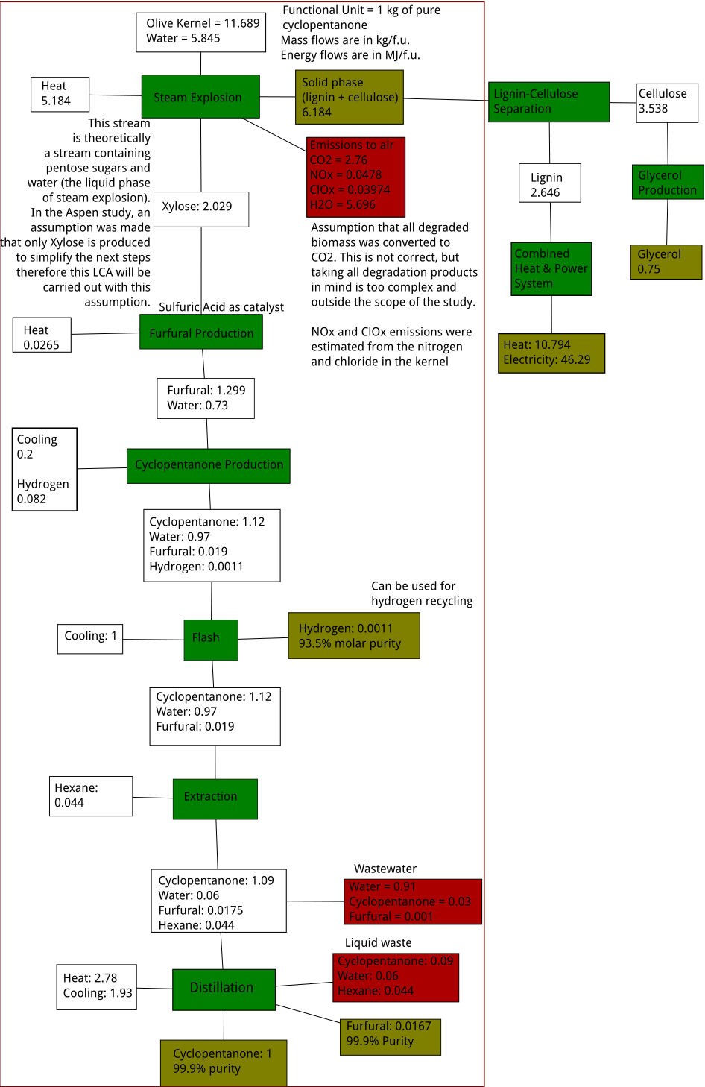
Scope and Life Cycle Inventory
Environmental Impacts: The carbon footprint of the process will be studied as it is generally considered an important metric. Besides that, the petrelaic process uses benzene, therefore, human toxicity should probably be included to show the adverse impact of that material, while the olive kernel process uses a lot of water, therefore water usage is a metric that is quite important to show the adverse impact of that process. Furthermore, other impacts may be included if they are considered important.

Slide 5
Allocation Methodologies
The products produced from cellulose and lignin can be disaggregated from our study as they are not deeply connected with our process.
The other “co-products” are the furfural and hydrogen that didn’t react in the process and are in very small amounts. Their impact can be done with mass allocation as their amount is fairly small.

Slide 6
Thank you for your time!

