Slide 1
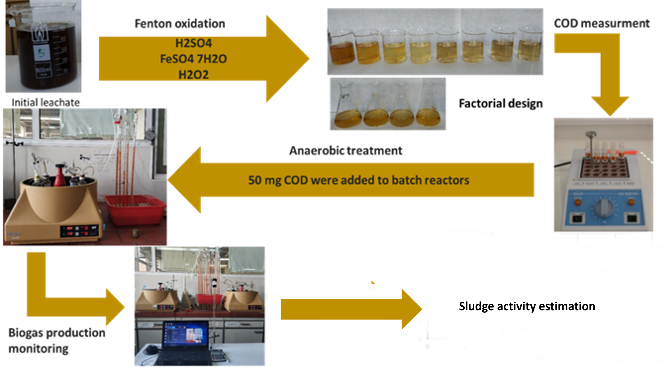



LEACHATE DETOXIFICATION USING FENTON REAGENTS AND STUDY OF ITS BIODEGRADABILITY THROUGH ANAEROBIC DIGESTION
D. Theodosi-Palimeri¹, L. Maragoudaki¹, A. G. Vlyssides ¹, A. A. Vlysidis^{1,2,}
¹ School of Chemical Engineering, National Technical University of Athens, Athens, 15780, Greece
² School of Chemical and Environmental Engineering, Technical University of Crete, Chania, 73100, Greece
SUMMARY
The leachate produced from municipal solid waste contains high concentrations of BOD and COD, as well as high content of ammonia and heavy metals. This pollutant load must be reduced before its rejection to the environment.
Fenton process is proposed for leachate detoxification and aims not only to minimize the organic load as much as possible but also to make the leachate bio-digestible for anaerobic microorganisms in order to maximize biogas production.
The implementation of the regression analysis computes the parameters of linear model for efficiency of COD reduction:
.
The prediction expression after regression analysis for sludge activity becomes:
,
where X1 is H₂SO₄, X2 FeSO₄, and X3 H₂O₂
Larger sludge granules are observed after feeding with the pretreated leachate (Figure 2A), with 26.3% of the TSS appearing at the highest velocity. On the contrary, after treatment with untreated leachate (Figure 2B), the majority of TSS (26.2%) appears in the 7th velocity. Large granules indicate more active sludge, while the iron added during oxidation contributes on sludge granulation [4].
Table 1. Experimental results from chemical oxidation and anaerobic treatment.
Runs | H₂SO₄ (mL/L) | FeSO₄*7H₂O (g/L) | H₂O₂ 50% v/v (mL/L) | pH | sCOD (mg/L) | Efficiency%* | Normalized Activity**
1 | 2,22 | 0,5 | 0,4 | 7,57 | 9151 | 11,8 | 0,378
2 | 2,22 | 0,5 | 1,2 | 7,51 | 8258,5 | 20,4 | 0,439
3 | 2,22 | 1,5 | 0,4 | 7 | 7428,5 | 28,4 | 0,872
4 | 2,22 | 1,5 | 1,2 | 6,98 | 7895,5 | 23,9 | 0,264
5 | 2,58 | 0,5 | 0,4 | 3,42 | 5467,5 | 47,3 | 0,288
6 | 2,58 | 0,5 | 1,2 | 3,36 | 7605 | 26,7 | 0,241
7 | 2,58 | 1,5 | 0,4 | 3,07 | 6536,5 | 37,0 | 0,111
8 | 2,58 | 1,5 | 1,2 | 2,98 | 5945 | 42,7 | 0,207
9 | 2,4 | 1 | 0,8 | 6,06 | 7864,25 | 24,2 | 0,228
10 | 2,4 | 1 | 0,8 | 5,96 | 7926,5 | 23,6 | 0,273
11 | 2,4 | 1 | 0,8 | 5,7 | 7895,375 | 23,9 | 0,279
12 | 2,4 | 1 | 0,8 | 6,1 | 7833,125 | 24,5 | 0,256
Untreated leachate | - | - | - | 7,8 | 10375 | - | 0,194
METHODS
The effect of Fenton reagents on both organic load reduction and biodegratability was quantified and performed by 2³ factorial experimental design.
For each experiment, a portion of 500 mL of leachate oxidized using Fenton reagents. The oxidation was carried out at room temperature, under stirring for one hour. As Fenton’s reagents were used H₂SO₄ conc. for pH adjustment, ferrous salt FeSO₄·7H₂O and hydrogen peroxide 50% v/v. The reagents were added at various concentrations in each experiment indicated by the experimental design. After oxidation, the samples were filtered and the liquid supernatants were analysed in terms of COD.
For the anaerobic treatment, 13 batch reactors based on Hungate's Technique were set up [1] and used to determine the sludge activity and consequently the biodegratability of each pretreated run as well as initial leachate. All batch reactors were placed in a water bath which was set at 35 ⁰C and 195 rpm, and inoculated with 100 ml of anaerobic sludge (4,7g VSS). Each reactor was charged with acetic acid three times to achieve the maximum activity of sludge [2]. After that, an appropriate amount of pretreated wastewater (50 mg COD) was added to each reactor. Biogas production was measured using the liquid displacement technique. Calculation of sludge activity was based on the slope of cumulative gas production versus time divided by grams of VSS. Figure 1 shows the whole process.
Granulometric analysis was performed according to Andras E. et al [3]. The sample was taken from a batch reactor which was fed with the untreated leachate and then with the pretreated leachate from run 8. The procedure was repeated 3 times for both substrates.
** normalized activity = sludge activity after feeding with leachate/sludge activity after feeding with acetic acid
A
B
Figure 2. Granulometric analysis of sludge after feeding with A) pretreated leachate of 8th run. B) untreated leachate.
CONCLUSIONS
In the design area, the most important factor for COD reduction is H₂SO₄, however it has a negative effect on sludge activity. Low pH seems to inhibit anaerobic microorganisms. The interaction of the three factors is also statistically important, and plays a positive role in the rate of biogas production, sludge activity and leachate biodegradability.
Chemical oxidation with Fenton reagents is fairly efficient on leachate detoxification.
REFERENCES
Miller, T. L., & Wolin, M. J. (1974). Applied Microbiology, 27(5): 985–987.
Jigura R. M., Kamusoko R. (2017). Biofuel Research Journal. 4(2): 573-586.
Andras E., Kennedy K. J., Richardson D. A. (1989). Environ. Technol. Lett., 10(5): 463-470
Vlyssides A., Barampouti, E. M., & Mai, S. (2009). Chemical Engineering Journal, 146(1): 49–56
Figure 1. Schematic representa bntal methodology.
RESULTS
The results of the factorial experiments are shown in Table 1. Maximum efficiency % is 47,3% in the run 5, where H₂SO₄ is at the highest level (low pH) while FeSO₄ and H₂O₂ are at the minimum level.
The highest normalized activity is in the run 3 where H₂SO₄ and H₂O₂ are 2.22mL/L and 0.4 mL/L respectively, and FeSO₄ is 1.5 g/L.
Acknowledgements
This research is co-financed by Greece and the European Union (European Social Fund-ESF) through the Operational Programme «Human Resources Development, Education and Lifelong Learning» in the context of the project “Strengthening Human Resources Research Potential via Doctorate Research” (MIS-5000432), implemented by the State Scholarships Foundation (ΙΚΥ).

