Slide 1
Vidya G S
Plant Disease Detection

Slide 2
Plant Disease Detection
Our project focuses on the development of a system for Plant Disease Detection using advanced image processing and machine learning techniques.

Slide 3


AGENDA
This project aims to develop a Convolutional Neural Network (CNN) model for Plant Disease Detection, achieving an impressive 92% validation accuracy, showcasing the potential of deep learning in agriculture.
3/21/2024 Annual Review

Slide 4

PROBLEM STATEMENT
In agriculture, the inefficient detection of plant diseases is a critical issue, leading to reduced crop yields and economic losses. Implementing Convolutional Neural Networks (CNNs) offers a promising solution. CNNs are adept at image recognition tasks, enabling accurate classification of plant images based on disease symptoms. This provides farmers with a fast, automated, and accurate tool for timely interventions, minimizing crop losses and improving economic outcomes.

Slide 5

PROJECT OVERVIEW
This project highlights the successful implementation of a Convolutional Neural Network (CNN) model for plant disease detection, achieving a high validation accuracy of 92%. The use of deep learning in agriculture presents a valuable tool for timely and accurate identification of diseased plants, contributing to improved crop yields and agricultural practices.

Slide 6

WHO ARE THE END USERS?
This project has significant social impact, benefiting farmers, agricultural experts, and the broader agricultural community. By offering a fast and accurate tool for plant disease detection, it enables timely interventions to prevent crop losses, enhances disease monitoring, and contributes to improved food security and sustainable agriculture practices.

Slide 7

YOUR SOLUTION AND ITS VALUE PROPOSITION
The methodology used in this project utilizes a Convolutional Neural Network (CNN) trained on labeled plant images to achieve a high validation accuracy of 92% for disease detection. This deep learning approach offers a fast, automated, and accurate tool for identifying diseased plants, enabling timely interventions to prevent crop losses and improve agricultural practices.

Slide 8

THE WOW IN YOUR SOLUTION
The adoption of Convolutional Neural Networks (CNNs) for plant disease detection is justified by their unique ability to analyze visual data and extract intricate features from plant images. This method's automatic learning and adaptation to complex patterns enable a high validation accuracy of 92%, providing a fast, automated, and accurate solution for addressing the challenges in agriculture. This approach represents a cutting-edge application of artificial intelligence in agriculture, offering a fast and accurate solution for identifying diseased plants.
3/21/2024 Annual Review
8

Slide 9
MODELLING
Teams cam add wireframes
The project leverages Python along with frameworks such as TensorFlow and Keras, along with modules like NumPy, Matplotlib, and possibly Scikit-learn, for implementing the Convolutional Neural Network (CNN) model for plant disease detection.
9

Slide 10
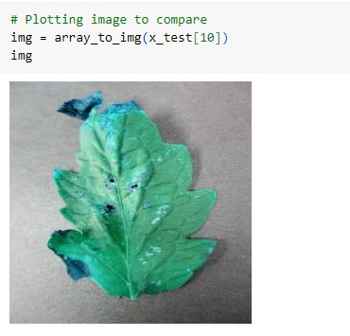

RESULTS
AFTER PREDICTION
10

