Slide 1

Power BI Dashboard Overview
A snapshot of key KPIs and analysis

Slide 2
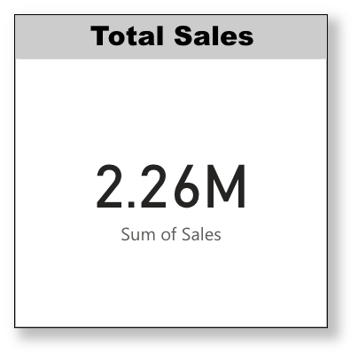

Total Sales
This slide displays the total sales figure.

Slide 3
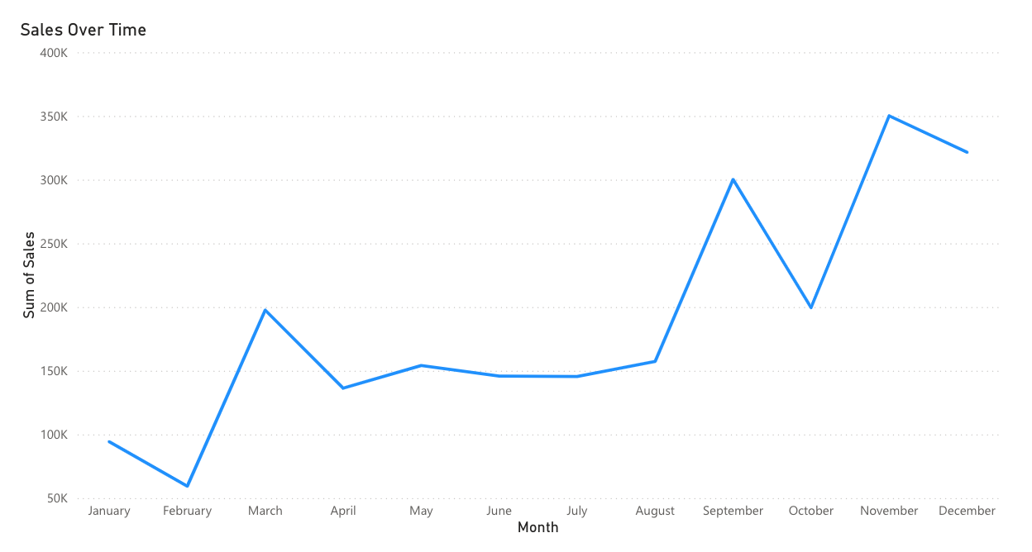
Sales Over Time
This line chart visualizes the sales trend over time, showing growth or decline.

Slide 4
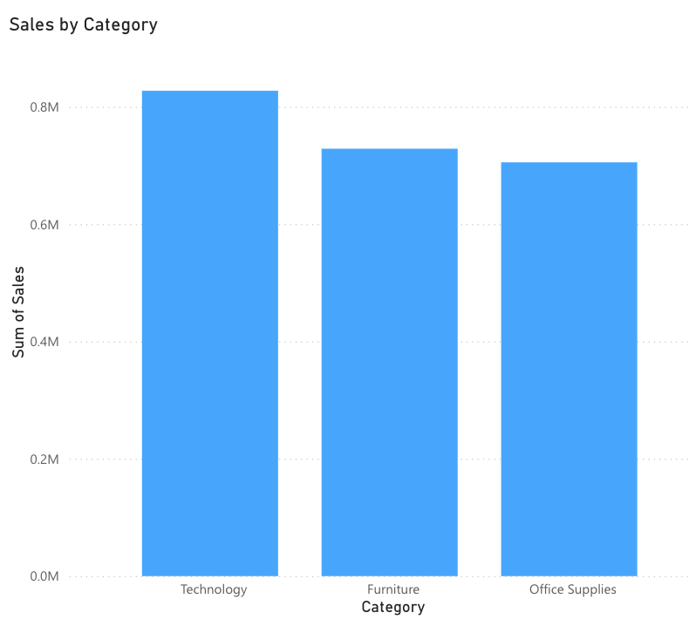
Sales by Category
This bar chart compares sales across different product categories.

Slide 5
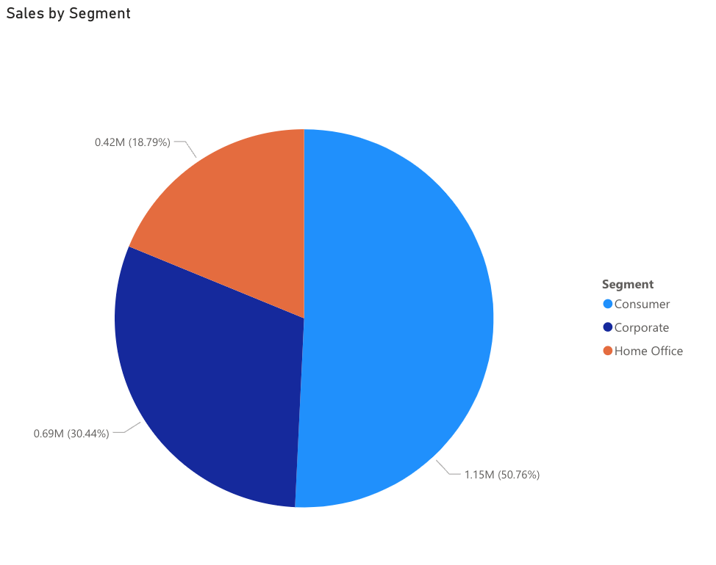
Sales by Region
This pie chart breaks down the sales performance in different segments.

Slide 6
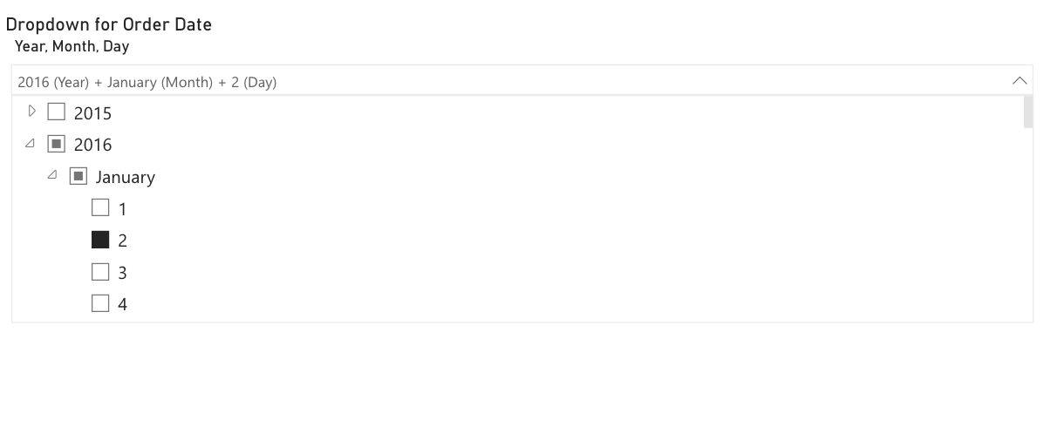
Order Date Slicer
The slicer allows users to filter data based on order date, providing flexibility in analysis.

Slide 7

Conclusion
This dashboard offers an interactive and comprehensive view of sales data, helping to make data-driven business decisions.

