Slide 1
Team Recommendation System
By Vidish Joshi
AU1841019

Slide 2
A pool of candidates with multiple features/skills to form teams out of..
What do we have?

Slide 3
Candidates and their skills

Slide 4
Candidates
Skill A: Intelligence
Skill B: Tech. proficiency
Skill C: Communication skills
Skill D: Past performance
Candidates are measured on 4 the basis of pre-decided skills.
We create a dataset containing the values for these skills for each candidate.

Slide 5


Procedure
We first gather the dataset for the candidates based on the number of skills to consider and rank them.
We input this collected data into our system.
The system will compute the data and assign each candidate to a team
Our aim is to form as balanced teams as possible.

Slide 6
How to form teams?

Slide 7

We use “K-means clustering algorithm” to group candidates with similar qualities together.

Slide 8
How does this work?
Firstly it clusters/groups candidates
With the help of the mentioned algorithm, we can put candidates with similar qualities/capabilities together into what are known as “clusters.”
….then it creates teams from clusters
Now each group has similar candidates.
We pick candidates from each of these groups and form a team. Thus we will have a balanced team.

Slide 9
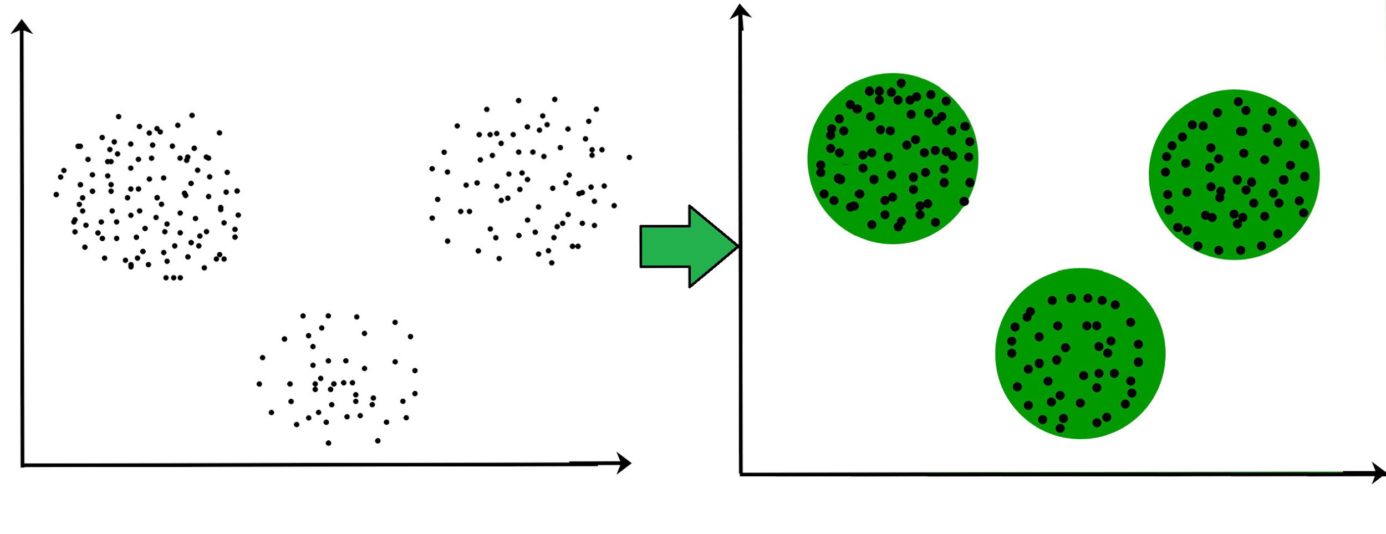
Suppose we want to make team of K members, we would first form K clusters and divide the candidates into them.
Then we take a member from each cluster and form a team of K members.

Slide 10
Assumtions and Drawbacks
In this implementation, we assume that it is possible to divide the available pool of candidates into exact teams of size K.
Also, often the number of candidates in a cluster are different than the other. So it is not necessarily possible to form all the teams where each candidate is from different cluster. However, there are ways through which we can find the best possible solution that can be produced by this approach.

Slide 11
Conclusion
Through this algorithm, as is the aim of the exercise, we get recommendation for balanced teams for the available candidates with different skill sets.

