Slide 1


| Tech Management, SRI-B
CLAWS
CLASH OF THE
RVCE_Pirates
Income proof for India's invisible workforce.
Fathima Imran
M. Shashwati Rao
Vidisha Dewan
Tanisha Bhide

Slide 2
Idea
Problem Statement
Why this theme — Productivity + GenAI Research India's 450 million informal workers are productive — they earn, they pay bills, they transfer money via UPI every month. But that productivity is invisible to the financial system. GenAI can now read those digital breadcrumbs and turn them into structured proof.
What problem are you solving Informal workers (gig workers, freelancers, street vendors, domestic workers) can't access loans or credit because they have no payslips or bank salary credits. Their income exists — it just lives in UPI screenshots, rent receipts, and utility bills that no bank will accept.
Who faces it — Persona Ravi, 34, delivery partner in Bengaluru. Earns ₹18,000/month across PhonePe payments from 3 different employers. Needs a ₹50,000 loan for his daughter's school fees. Gets rejected — "no proof of income."
Why it matters 450M informal workers = 80% of India's workforce. Less than 5% have access to formal credit. This isn't a niche problem — it's the biggest financial exclusion gap in the world's 5th largest economy.
The insight They already have proof. It's just not in a format banks recognise. KamaaiProof converts their existing digital payment trail into a verifiable Work Passport — using Groq Vision + LLaMA 4 + OpenClaw to extract, score, and certify income consistency.

Slide 3
Idea
Current Solution & Gaps
Existing Solutions
CIBIL / credit bureaus — only work if you have formal salary credits into a bank account
NBFC manual underwriting — loan officer visits home, takes 2–3 weeks, still rejects most
Account aggregator (AA) framework — exists but requires bank account + consent flow, excludes cash/UPI-heavy workers
Aadhaar-based eKYC — proves identity, not income
What's Missing / Broken
No solution reads UPI screenshots, rent receipts, or utility bills as income proof
All existing tools require a formal bank salary credit — the exact thing informal workers don't have
Account aggregator needs the payer to also be a registered entity — doesn't work for individual-to-individual payments
Manual processes are slow, biased, and don't scale
The Opportunity
450M informal workers, <5% have formal credit access
UPI hit 18 billion transactions in March 2026 — most of that is informal economy money moving around with zero financial record attached
RBI's push for financial inclusion + OCEN (Open Credit Enablement Network) creates a policy tailwind — they need exactly this kind of income signal layer
First mover to create a portable, verifiable, AI-generated income passport for informal workers owns the trust layer between this workforce and formal credit

Slide 4
Idea
Your Solutions
What We Built
KamaaiProof is an AI-powered income verification engine. A worker uploads their UPI screenshots, utility bills, and rent receipts. The system reads them using Groq Vision + LLaMA 4 Scout + Openclaw, extracts structured financial data, scores income consistency over 6 months, and generates a signed Work Passport PDF that an MFI or lender can actually trust.
Core Ideas Explained
Vision-First Extraction — The image goes directly to LLaMA 4 Scout which identifies the document type (GPay, PhonePe, BHIM, electricity bill, rent receipt) and extracts fields in one shot. Handles handwritten receipts, blurry screenshots, mixed languages.
Consistency Scoring — Not just "did they earn money" but "did they earn consistently." A 6-month rolling window scores coverage (70 points) and income stability (30 points). A gig worker with ₹15k every month scores higher than someone with one ₹90k spike
Privacy-First Pipeline — PII (names, UPI IDs, phone numbers, account numbers) is masked before anything is stored or indexed. The Work Passport shows financial behaviour, not personal data.
Work Passport PDF — A structured, dated, scored document a loan officer can read in 30 seconds. Consistency score, monthly income breakdown, months covered, flags for anomalies.

Slide 5
Idea
Your Solutions
Key Features
Multi-format Document Upload Drop any mix of UPI screenshots (GPay, PhonePe, BHIM), electricity bills, water bills, rent receipts — jpeg, png, pdf. No fixed template, no "please upload in this exact format." The system figures it out.
Automatic Document Classification LLaMA 4 Scout looks at the image and identifies what it is before extracting anything. A GPay screenshot gets parsed differently from a TNEB electricity bill. No manual tagging required from the worker — they just upload what they have.
6-Month Income Consistency Score (0–100) Two-part score — 70 points for how many of the last 6 months have income evidence, 30 points for how stable that income is month-to-month. A score of 85+ means consistent, reliable income. This single number is what an MFI loan officer needs to make a decision in under a minute.
Privacy-First Data Pipeline Names, phone numbers, UPI IDs, bank account numbers, IFSC codes are all stripped and masked before any data is stored or processed. The Work Passport proves income behaviour without exposing personal identity — important for a population that is already financially vulnerable.
Instant Work Passport PDF Generated entirely client-side using React PDF — no server roundtrip for the PDF. Contains consistency score (colour-coded), monthly income breakdown, documents submitted, flags for anomalies, and a disclaimer footer for loan officers. Download in one click.
Role-Based Access Control (RBAC) Workers see their full transaction breakdown. MFI officers and lenders see only the summary — score, income range, months covered. Sensitive transaction details never leave the worker's view unless they choose to share.
Demo Override Mode For presentations and testing, filenames matching the override registry return pre-validated deterministic output — guaranteed clean score, correct amounts, correct dates — even without a live Groq API call. Lets you demo confidently without depending on network or API availability on stage.

Slide 6
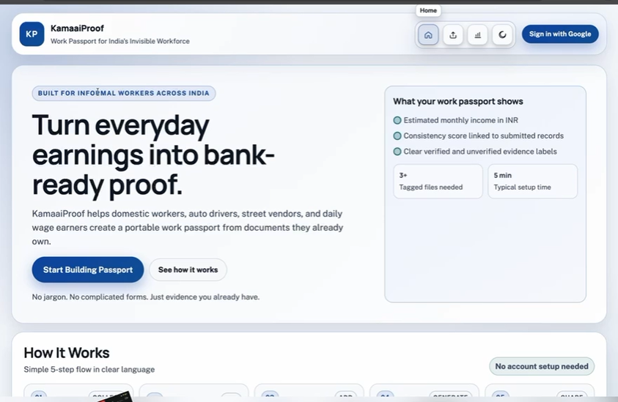
Idea
Demo/Product Walkthrough
Screen 1 : Landing / Login
Key Moment : User signs up or logs in via Supabase Auth

Slide 7
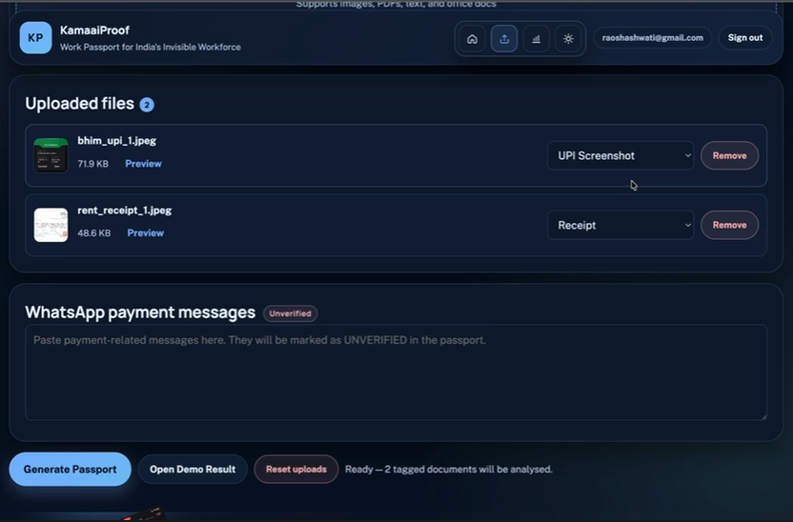
Idea
Demo/Product Walkthrough
Screen 2 : Upload Document
Key Moment : User uploads a photo/scan of an informal financial doc (rent receipt, payslip, etc.)

Slide 8
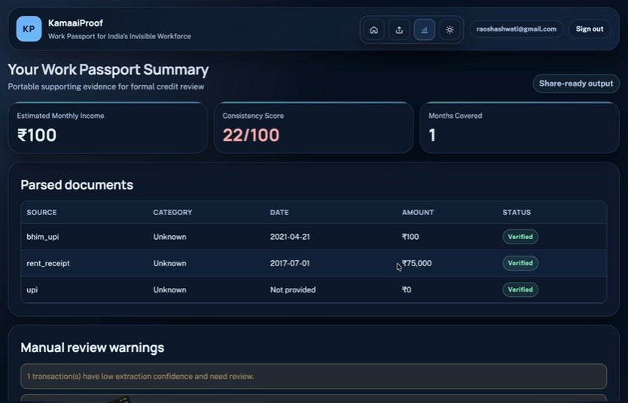
Idea
Demo/Product Walkthrough
Screen 3 : Score / Summary
Key Moment : Document trust score is shown with breakdown

Slide 9
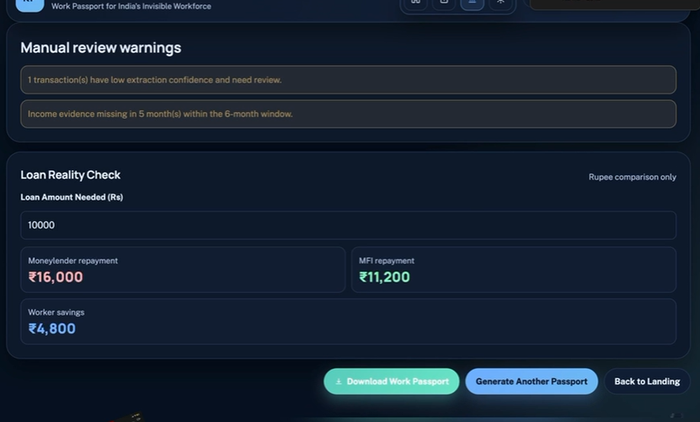
Idea
Demo/Product Walkthrough
Screen 4 : Loan Reality check
Key Moment : This page shows the monthly savings and provides a loan trusteeship to the bank

Slide 10
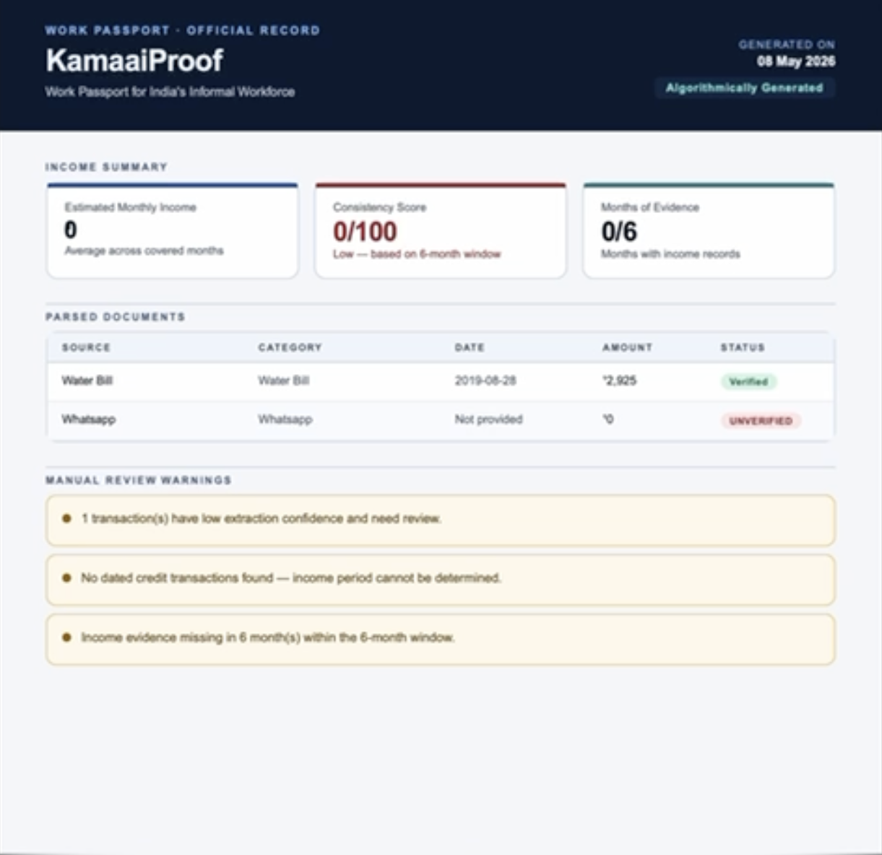
Idea
Demo/Product Walkthrough
Screen 5 : Income passport
Key Moment : a tamper-proof Work Passport that turns informal income records into a trusted, shareable proof of livelihood.

Slide 11
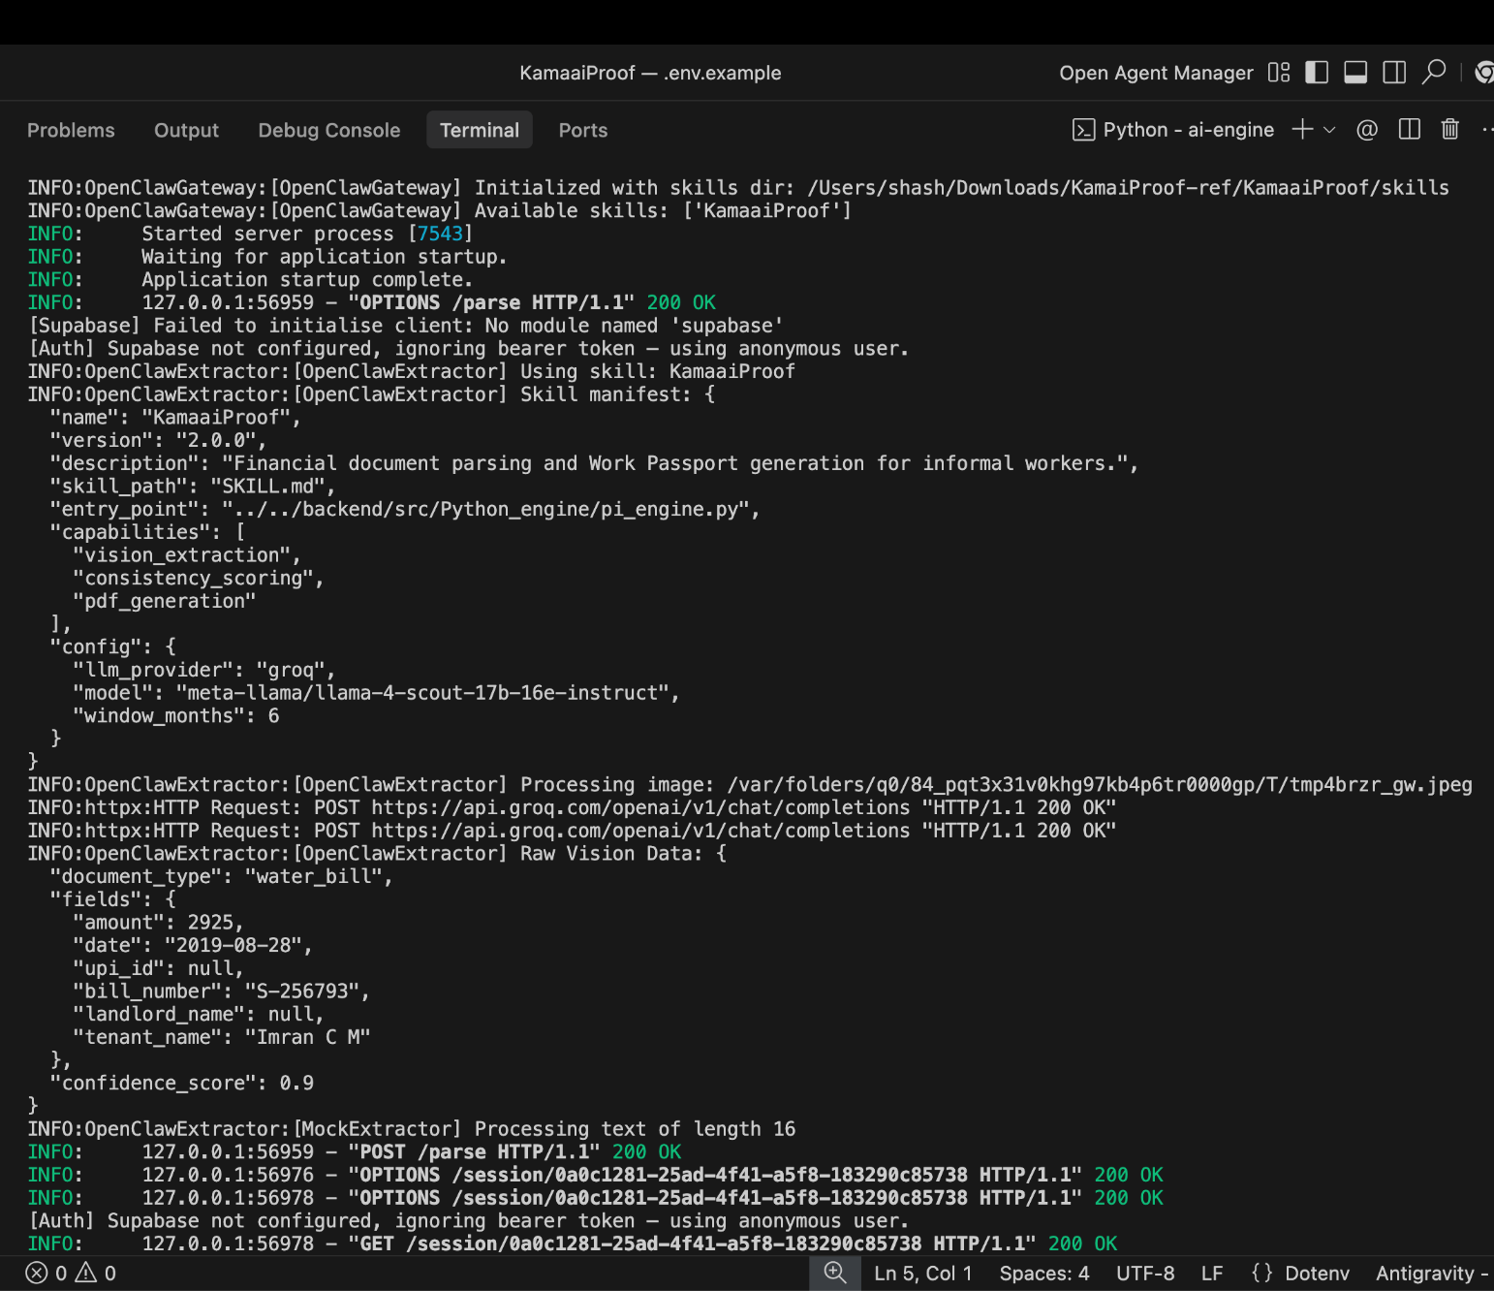
Idea
Demo/Product Walkthrough
Screen 6 : OpenClaw
Key Moment : OpenClaw orchestration

Slide 12
Idea
Tech & Architecture
Tech Stack: AI usage( model, APIs, Framework): OpenClaw AI Framework · Groq LLM API · Firebase · jsPDF · React.js AI Usage:
Model | Groq (LLaMA 3)
Task | Multimodal document parsing - extracts dates, amounts, frequency from UPI screenshots and bills
Framework | OpenClaw Pi Engine - agent loop that routes input, calls Groq, returns structured JSON
System Flow: User uploads documents → OpenClaw skill triggered → Groq API parses images → Structured JSON extracted → Consistency scoring (6-month window) → PDF Work Passport generated → Returned to user

Slide 13
Idea
Impact & Use cases
Real life scenarios:
Meena - Domestic Worker, Bengaluru Cleans 4 houses/month, ₹12,000 income, 11 years consistent work. No payslips. Without KamaaiProof: moneylender at 60% p.a. With KamaaiProof: MFI loan at 24%. Saves ₹4,800 in 6 months.
Lakshmi - SHG Leader, Rural Karnataka Manages 15 women in her group. Manually compiling income proof for each member takes weeks, error-prone. With KamaaiProof: generates verified passports for all 15 in one afternoon. Group access to formal credit increases 40%.
Ravi - MFI Field Officer, Tier-2 City Reviews 20 loan applications/week, 80% rejected due to missing income proof. Manual verification takes 2 hours per applicant. With KamaaiProof: qualified applicants arrive with structured, verifiable PDFs. Approval cycle cuts from 14 days to 3 days.
Govind - Auto Driver, Mumbai Gig worker, irregular income but consistent over 6 months. No formal records. Wants ₹50,000 for vehicle repair. KamaaiProof aggregates his UPI records into proof. First time accessing formal credit instead of borrowing from loan sharks.
Scale Potential
1 Agent : 20 Workers - single OpenClaw instance on SHG leader's device handles batch document processing
10,000+ Profiles - targeted dataset for initial AI training and accuracy benchmarking
Existing SHG & MFI Networks - leveraging 6.9M SHGs and 900K+ Anganwadi workers for distribution, no new infrastructure required
B2B2C Model - MFIs pay per qualified application, KamaaiProof scales with their pipeline growth

Slide 14
Idea
Differentiation
MOAT 1: Worker Data Ownership
The worker's score or profile is controlled by every product available on the market, including CIBIL, e-Shram, Tala, and Kaleidofin. This is reversed by KamaaiProof; the employee owns the PDF, takes it to any lender, and switches lenders without re-verification. Meena owns the data asset, not the platform. Because employees have no need to use a black-box scoring system once they have their own passport, this is both operationally irreplaceable and lawfully defendable under DPDP. User autonomy includes switching costs.
MOAT 2: Hyperlocal Income Intelligence
India's informal income patterns, such as UPI transaction signatures, domestic worker salary benchmarks, gig worker seasonality, and SHG lending cycles, are all learned by KamaaiProof. This corpus, which is incorporated into the vector database and scoring system, is very difficult to duplicate and has no use outside of India. This is difficult for a global fintech to port. The entire training dataset and MFI cooperation network would have to be rebuilt by an Indian rival. Our model gets increasingly precise and region-specific the longer we run it.

Slide 15
Idea
Demo Link
GitHub Repo : https://github.com/Vidisha231106/KamaaiProof Demo Link : https://drive.google.com/file/d/15u-VTZ2A4oxDs_xcZyafK1uI7GySnwwg/view?usp=sharing

Slide 16
Idea
OpenClaw Integration: Why It Matters
Sovereign AI on Device
The whole parsing, scoring, and PDF generating pipeline of KamaaiProof operates locally on the SHG leader's device, making it a modular OpenClaw talent. No lock-in among vendors no reliance on the cloud, and no data leaving the user's hardware. This is both cost-effective at scale and privacy-by-design.
Plug-and-Play Modularity
Because of OpenClaw's architecture, KamaaiProof may be implemented as a skill on any agent instance, be it embedded in a larger workflow, operating on a Mac mini in a microfinance office, or a Raspberry Pi in a hamlet. Infinite deployment contexts with a single codebase. MFIs adopt our expertise rather than our platform.
Competitive Insulation
By adhering to OpenClaw's ecosystem, we avoid competing with closed platforms for market share. We are expanding an open-source agent framework that is already used by more than fifteen different skills. We benefit from network effects, which make KamaaiProof a more natural and reliable component as OpenClaw adoption increases.

