Slide 1
Lloyds Banking Group: Data Analysis
Presenters: Hassan, Shubham, Tiancheng, Vidit
Teaching Assistant: Joshua Ramini

Slide 2
Methodology
Data source and exploration
Data Visualization
Insights
Future Scope
Questions

Slide 3


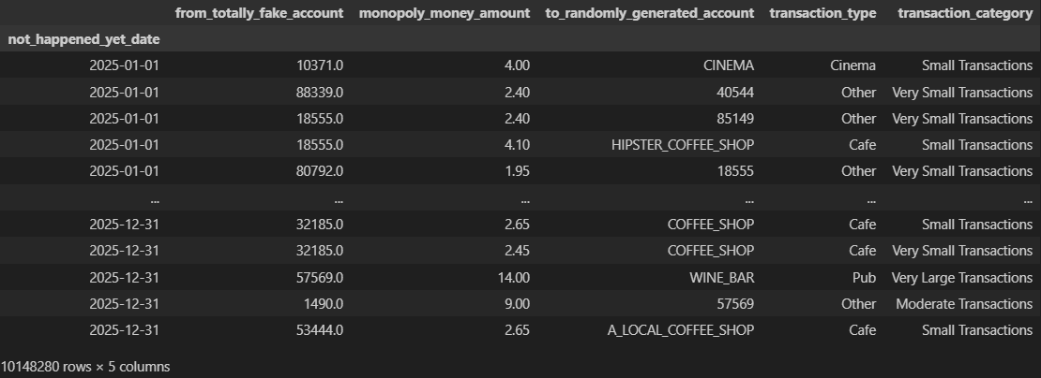
Feature Engineering
Transaction_type
Transaction_category

Slide 4
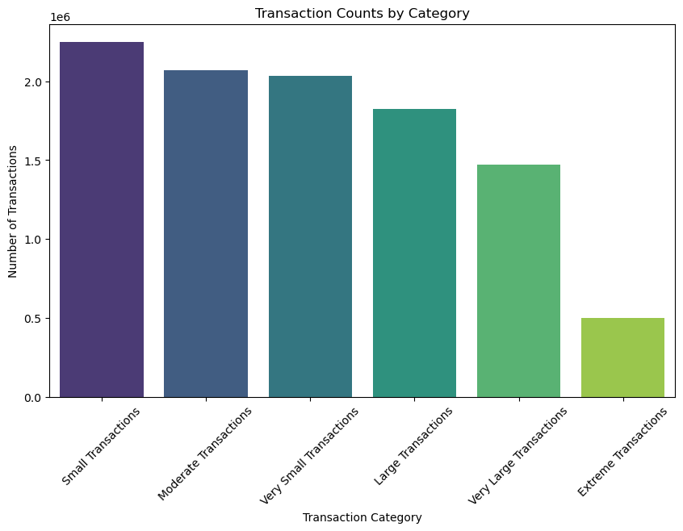
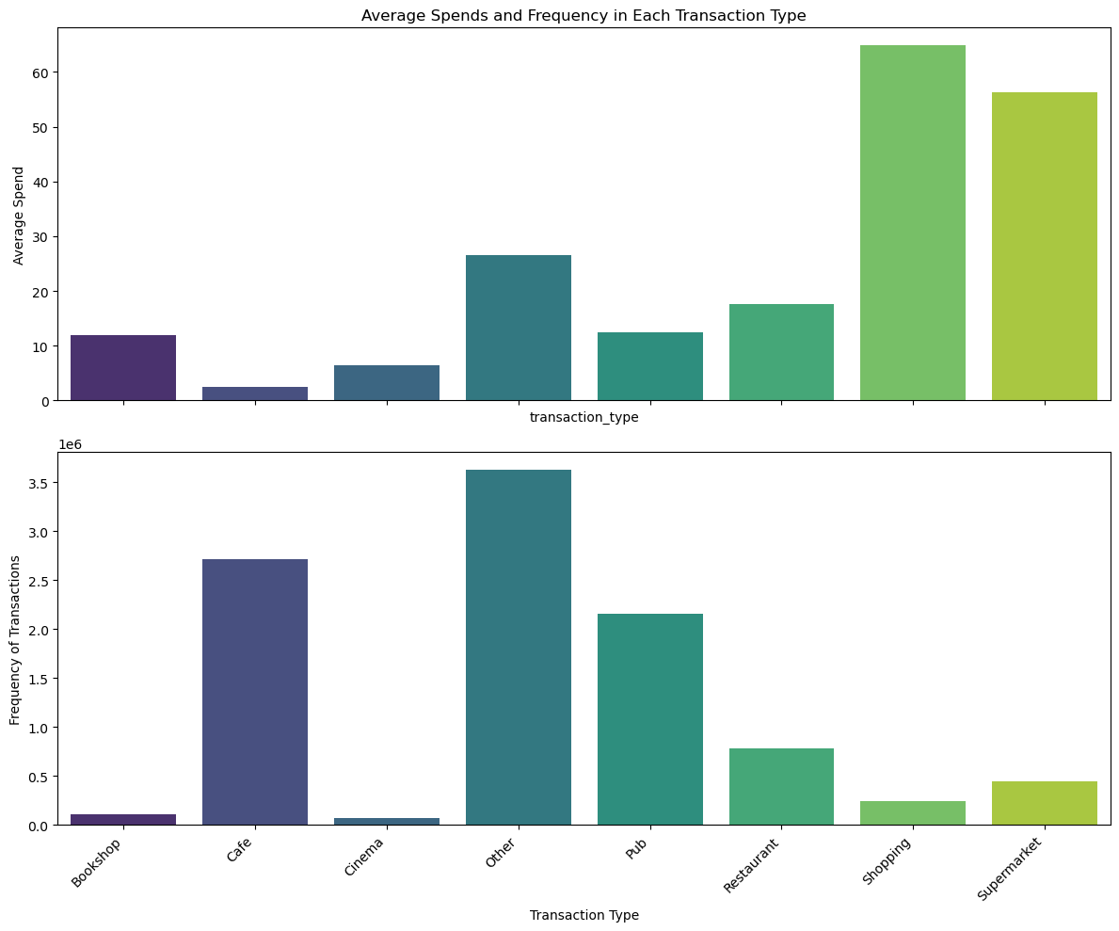

Slide 5
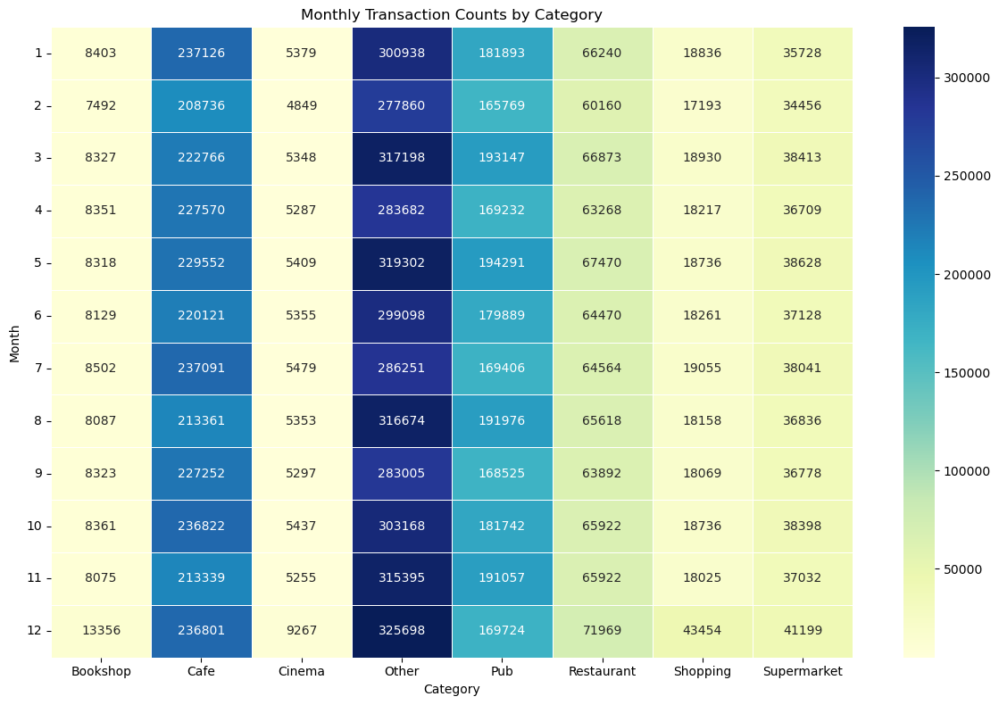
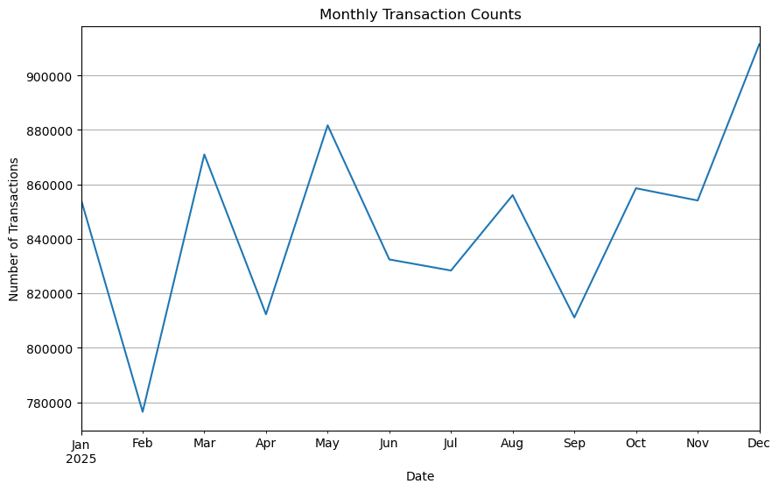

Slide 6
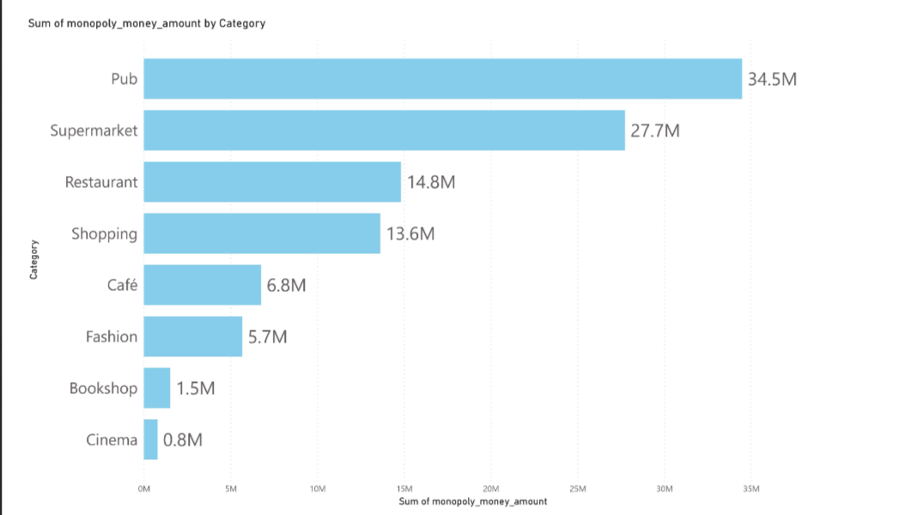
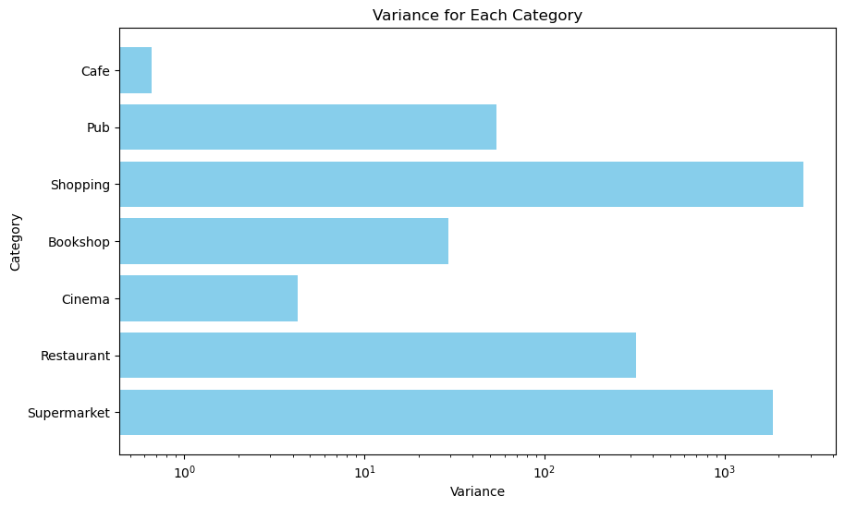

Slide 7
Future Scope
RFM Analysis
Merchants and Individuals
Loyalty Schemes
Future Dataset/ New Features
Timestamp and Balances
Target Individuals for Loans, Savings/Investment schemes
Help Businesses with Data insights [Staffing, Opening hours]

Slide 8
Questions
What sort of threshold needs to be passed to make an assumption of a customer’s characteristics? (Age)
Exploring the ‘other’ category in detail to see what it is comprised of?
Questions from the audience!

Slide 9
Thank You!

Slide 10
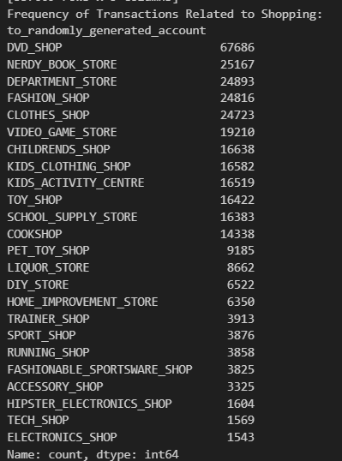
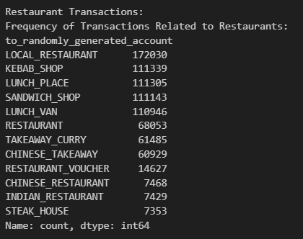
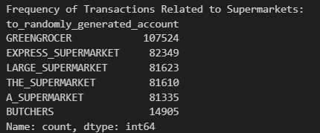

Slide 11
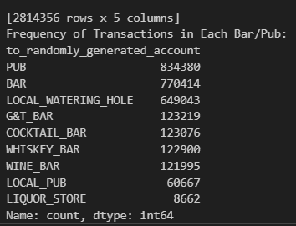
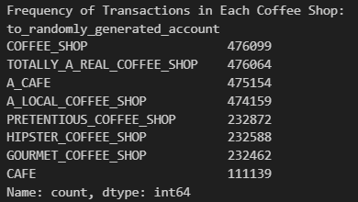

Slide 12
