Slide 1
Homework 3 German Credit Dataset
Vidit Kalani / Abraham Shoun
MSCS 5610 Data Mining
Vidit Kalani / Abraham Shoun
MSCS 5610 Data Mining
Final Project
Spring 2018
Prof. Dr. Praveen Madiraju

Slide 2
Vidit Kalani / Abraham Shoun
MSCS 5610 Data Mining
These are my of the features for study in German Credit dataset
SavingsAccountBonds.lt.100,
SavingsAccountBonds.100.to.500,
SavingsAccountBonds.500.to.1000,
SavingsAccountBonds.gt.1000,
SavingsAccountBonds.Unknown,
EmploymentDuration.lt.1,
EmploymentDuration.1.to.4,
EmploymentDuration.4.to.7,
EmploymentDuration.gt.7,
EmploymentDuration.Unemployed,
Personal.Male.Divorced.Seperated,
Personal.Female.NotSingle,
Personal.Male.Single,
Personal.Male.Married.Widowed,
Personal.Female.Single,
Property.RealEstate,
Property.Insurance,
Property.CarOther,
Property.Unknown,
Housing.Rent,
Housing.Own,
Housing.ForFree
Duration,
Amount,
InstallmentRatePercentage,
Age,
NumberExistingCredits,
NumberPeopleMaintenance,
Telephone,
ForeignWorker,
Class,
CheckingAccountStatus.lt.0,
CheckingAccountStatus.0.to.200,
CheckingAccountStatus.gt.200,
CheckingAccountStatus.none,
CreditHistory.NoCredit.AllPaid,
CreditHistory.ThisBank.AllPaid,
CreditHistory.PaidDuly,
CreditHistory.Delay,
CreditHistory.Critical,

Slide 3
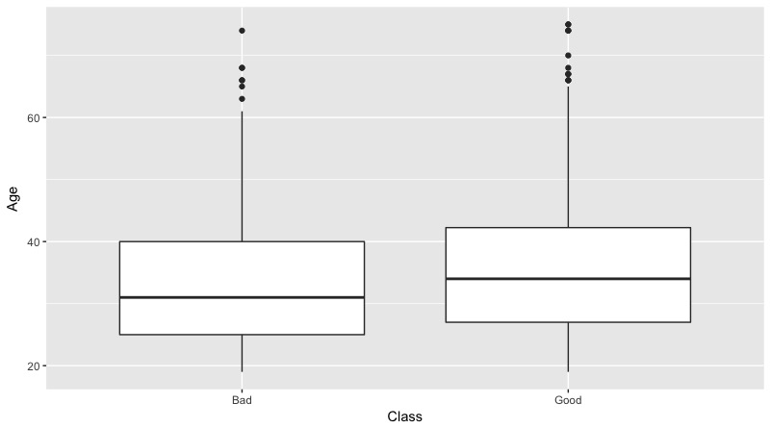
Vidit Kalani / Abraham Shoun
MSCS 5610 Data Mining

Slide 4
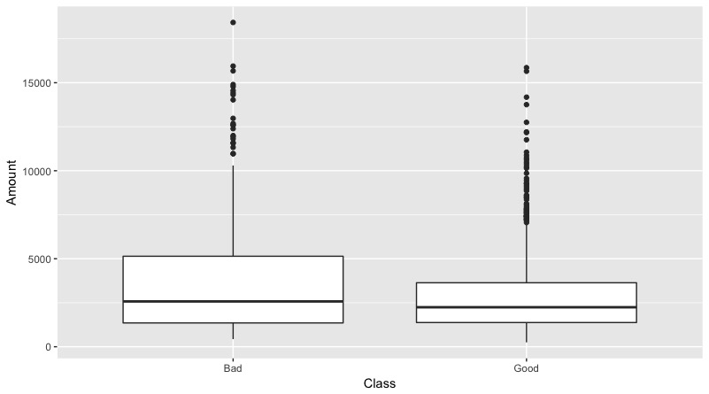
Vidit Kalani / Abraham Shoun
MSCS 5610 Data Mining

Slide 5
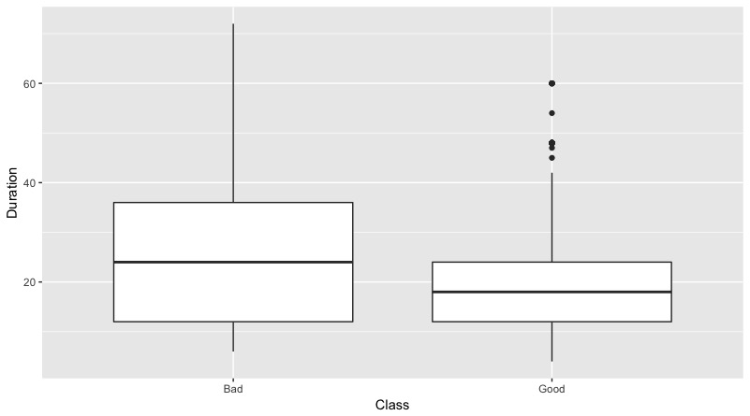
Vidit Kalani / Abraham Shoun
MSCS 5610 Data Mining

Slide 6
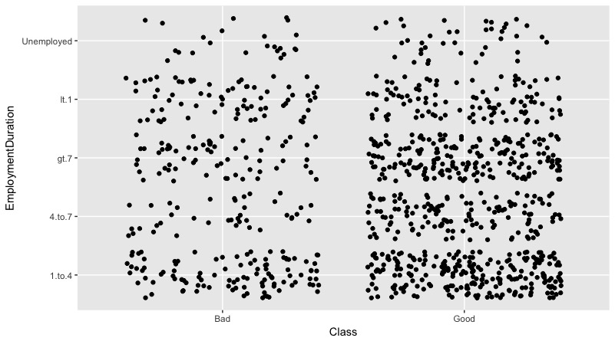
Vidit Kalani / Abraham Shoun
MSCS 5610 Data Mining

Slide 7
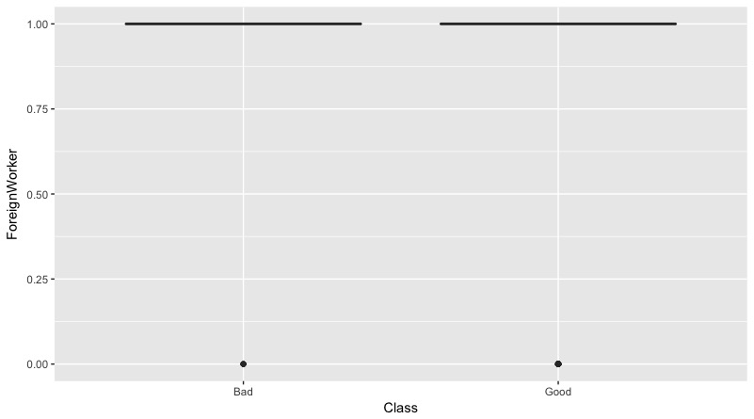
Vidit Kalani / Abraham Shoun
MSCS 5610 Data Mining

Slide 8
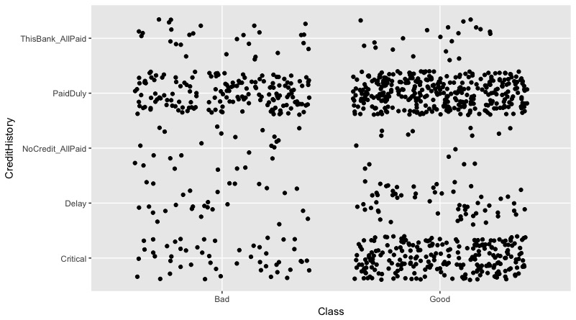
Vidit Kalani / Abraham Shoun
MSCS 5610 Data Mining

Slide 9
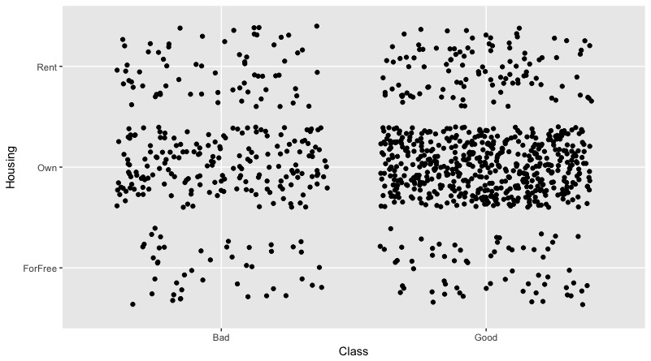
Vidit Kalani / Abraham Shoun
MSCS 5610 Data Mining

Slide 10
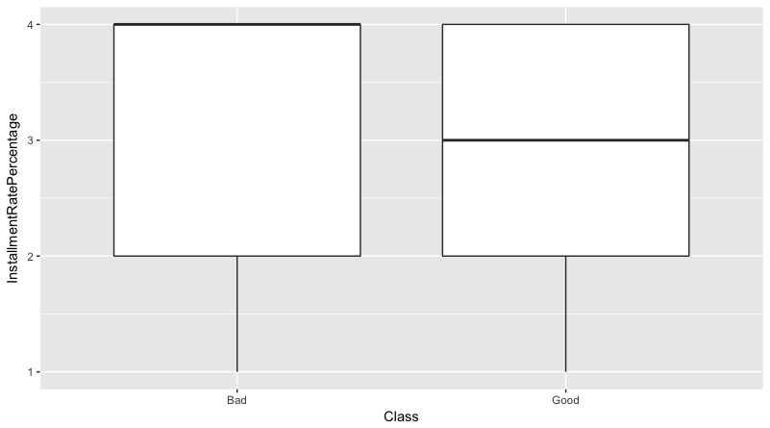
Vidit Kalani / Abraham Shoun
MSCS 5610 Data Mining

Slide 11
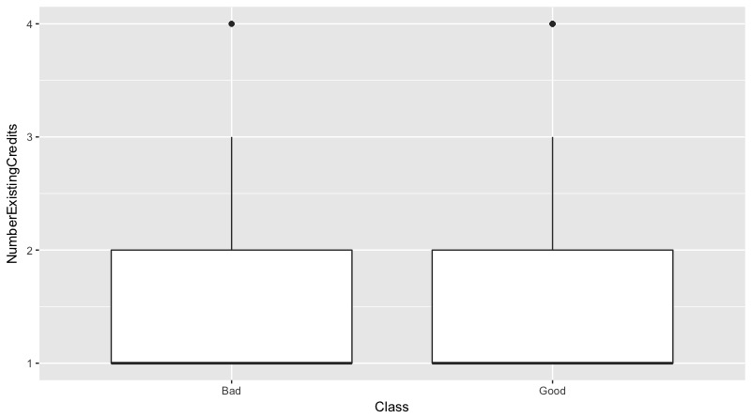
Vidit Kalani Abraham Shoun
MSCS 5610 Data Mining

Slide 12
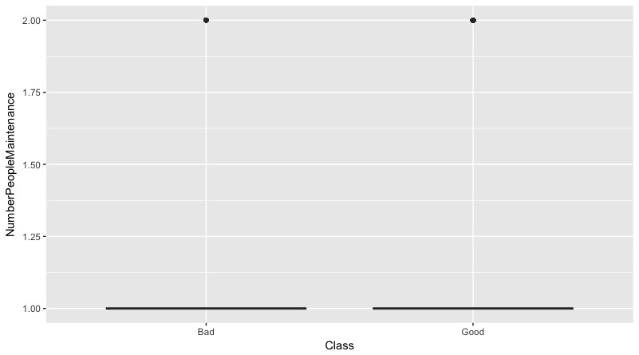
Vidit Kalani / Abraham Shoun
MSCS 5610 Data Mining

Slide 13
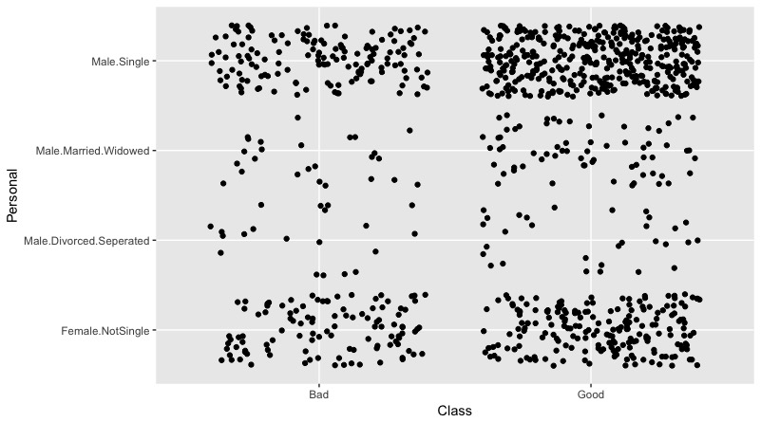
Vidit Kalani / Abraham Shoun
MSCS 5610 Data Mining

Slide 14
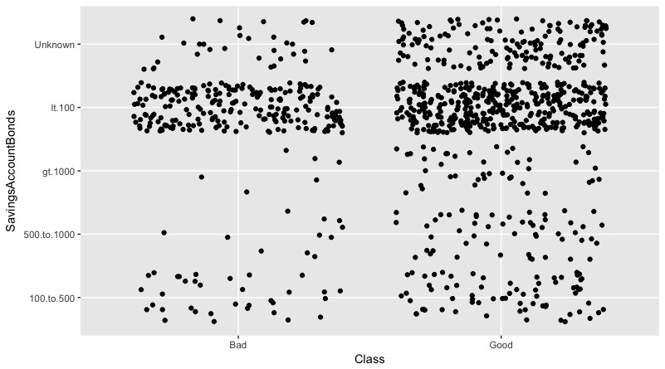
Vidit Kalani / Abraham Shoun
MSCS 5610 Data Mining

Slide 15
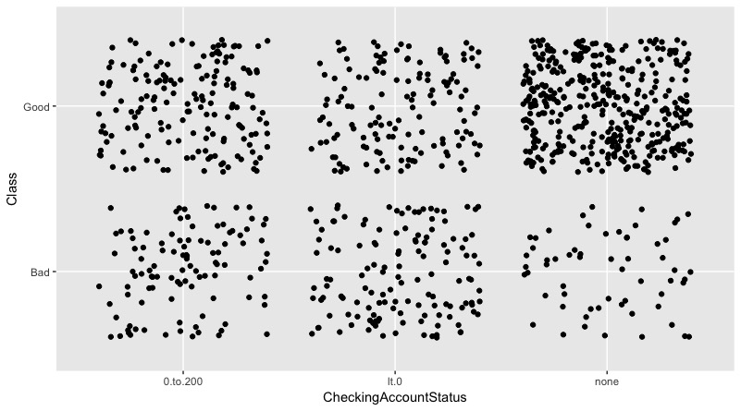
Vidit Kalani / Abraham Shoun
MSCS 5610 Data Mining

Slide 16
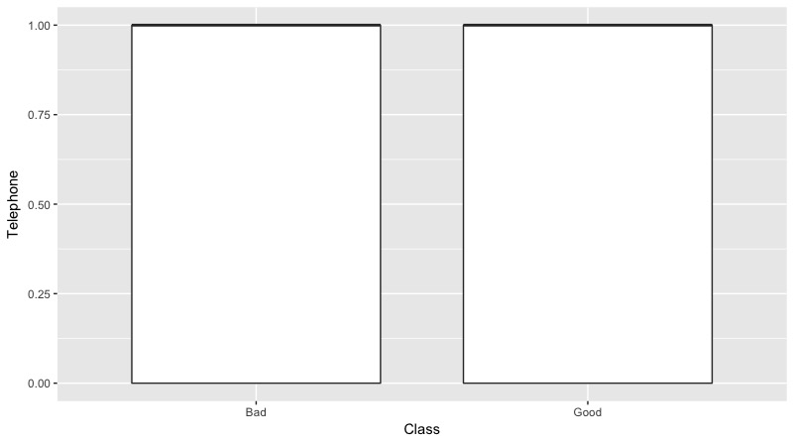
Vidit Kalani / Abraham Shoun
MSCS 5610 Data Mining

Slide 17
Vidit Kalani / Abraham Shoun
MSCS 5610 Data Mining
Round: 1
Features | Accuracies
Duration | 0.725
Amount | 0.69
InstallmentRatePercentage | 0.7
Age | 0.685
NumberExistingCredits | 0.7
NumberPeopleMaintenance | 0.7
Telephone | 0.7
ForeignWorker | 0.7
CheckingAccountStatus | 0.665
CreditHistory | 0.7
SavingsAccountBonds | 0.7
EmploymentDuratio | 0.7
Personal | 0.7
Property | 0.7
Housing | 0.7

Slide 18
Vidit Kalani / Abraham Shoun
MSCS 5610 Data Mining
Round: 2
Features | Accuracies
Duration + Amount | 0.70
Duration + InstallmentRatePercentage | 0.715
Duration + Age | 0.715
Duration + NumberExistingCredits | 0.725
Duration + NumberPeopleMaintenance | 0.735
Duration + Telephone | 0.725
Duration + ForeignWorker | 0.72
Duration + CheckingAccountStatus | 0.71
Duration + CreditHistory | 0.71
Duration + SavingsAccountBonds | 0.72
Duration + EmploymentDuratio | 0.73
Duration + Personal | 0.73
Duration + Property | 0.70
Duration + Housing | 0.7

Slide 19
Vidit Kalani / Abraham Shoun
MSCS 5610 Data Mining
Round: 3
Features | Accuracies
Duration + NumberPeopleMaintenance + Amount | 0.71
Duration + NumberPeopleMaintenance + InstallmentRatePercentage | 0.715
Duration + NumberPeopleMaintenance + Age | 0.73
Duration + NumberPeopleMaintenance + NumberExistingCredits | 0.74
Duration + NumberPeopleMaintenance + Telephone | 0.725
Duration + NumberPeopleMaintenance + ForeignWorker | 0.74
Duration + NumberPeopleMaintenance + CheckingAccountStatus | 0.71
Duration + NumberPeopleMaintenance + CreditHistory | 0.735
Duration + NumberPeopleMaintenance + SavingsAccountBonds | 0.73
Duration + NumberPeopleMaintenance + EmploymentDuratio | 0.715
Duration + NumberPeopleMaintenance + Personal | 0.715
Duration + NumberPeopleMaintenance + Property | 0.71
Duration + NumberPeopleMaintenance + Housing | 0.765

Slide 20
Vidit Kalani / Abraham Shoun
MSCS 5610 Data Mining
Round: 4
Features | Accuracies
Duration + NumberPeopleMaintenance + Housing +Amount | 0.72
Duration + NumberPeopleMaintenance + Housing + InstallmentRatePercentage | 0.75
Duration + NumberPeopleMaintenance + Housing + Age | 0.735
Duration + NumberPeopleMaintenance + Housing + NumberExistingCredits | 0.73
Duration + NumberPeopleMaintenance + Housing + Telephone | 0.775
Duration + NumberPeopleMaintenance + Housing + ForeignWorker | 0.76
Duration + NumberPeopleMaintenance +Housing + CheckingAccountStatus | 0.71
Duration + NumberPeopleMaintenance + Housing + CreditHistory | 0.735
Duration + NumberPeopleMaintenance + Housing + SavingsAccountBonds | 0.735
Duration + NumberPeopleMaintenance + Housing + EmploymentDuratio | 0.72
Duration + NumberPeopleMaintenance + Housing + Personal | 0.72
Duration + NumberPeopleMaintenance + Housing + Property | 0.73

Slide 21
Vidit Kalani / Abraham Shoun
MSCS 5610 Data Mining
Round: 5
Features | Accuracies
Duration + NumberPeopleMaintenance + Housing + Telephone + Amount | 0.735
Duration + NumberPeopleMaintenance + Housing + Telephone + InstallmentRatePercentage | 0.71
Duration + NumberPeopleMaintenance + Housing + Telephone + Age | 0.775
Duration + NumberPeopleMaintenance + Housing + Telephone + NumberExistingCredits | 0.73
Duration + NumberPeopleMaintenance + Housing + Telephone + ForeignWorker | 0.74
Duration + NumberPeopleMaintenance +Housing + Telephone + CheckingAccountStatus | 0.665
Duration + NumberPeopleMaintenance + Housing + Telephone + CreditHistory | 0.705
Duration + NumberPeopleMaintenance + Housing + Telephone + SavingsAccountBonds | 0.735
Duration + NumberPeopleMaintenance + Housing + Telephone + EmploymentDuratio | 0.705
Duration + NumberPeopleMaintenance + Housing +Telephone + Personal | 0.74
Duration + NumberPeopleMaintenance + Housing + Telephone + Property | 0.695

Slide 22
Vidit Kalani / Abraham Shoun
MSCS 5610 Data Mining
Round 1:- Duration feature is best accuracy.
Round 2:- Duration + NumberPeopleMaintenance features are best accuracy.
Round 3:- Duration + NumberPeopleMaintenance + Housing features are best accuracy.
Round 4:- Duration + NumberPeopleMaintenance + Housing + Telephone features are best accuracy.
Round 5:- Duration + NumberPeopleMaintenance + Housing + Telephone + Age features are best accuracy.
But I noticed that after Round 4 the some features accuracy going down compare to first 3 rounds.
And In Round 5 only one feature’s accuracy is going up compare to first 4 rounds.

