Slide 1
German Credit Worthiness
Shoun Abraham and Vidit Kalani

Slide 2
Introduction
Credit agencies use credit worthiness to determine interest rates
Possibility a borrower may default on debt
US: Equifax, Experian, TransUnion
Is it possible to predict credit worthiness based on information about the borrower?
Goal: Create a model to predict credit worthiness based on important factors of the borrower.
Learn more about the factors that impact credit worthiness

Slide 3
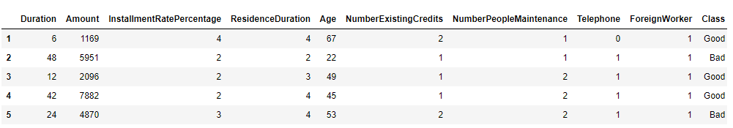
DataSet
German Credit Dataset
Contains information about 1000 German citizens
Information about personal history, employment history, property information, and credit history (62 attributes)
Credit worthiness is classified as either good or bad

Slide 4
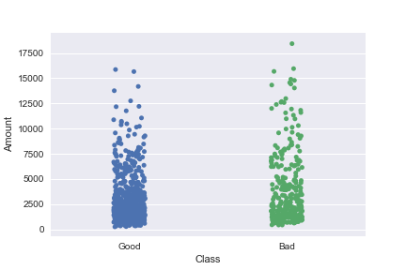
Models/Methods
PCA Analysis: reduce dimensionality
Our dataset contains too many factors, we want to use kNN on the important factors
kNN recommender / classification algorithm: model creation
Linear regression: model creation

Slide 5
Future Work
Test models against a testing subset of our dataset
Compare accuracy of different models
Research more about current credit worthiness prediction methods
Obtain more domain information about credit rating

