Slide 1
Dynamic Pricing Strategies for Fitness Classes based on Demand, Time, and Location
Leveraging Predictive Analytics & Elasticity to Maximize Yield
Kanani Vidita
Professional Certificate Program in AI and Data Science

Slide 2
The Business Problem
The Static Pricing Trap: Our current "Fixed-Price" model treats every hour, location, and activity as identical units of value.
The "Value Leak": High-demand Yoga and Strength classes hit 100% occupancy months in advance, yet are priced the same as 10% empty mid-day sessions.
The Objective: Capture the "Convenience Premium" during peak hours.
  Incentivize attendance to fill "Empty Mats" during off-peak slumps.
  Transition from a volume-centric to a yield-centric model.

Slide 3
Data Foundation (The EDA Phase)
Dataset Merging: Successfully merged the April–May and June 2018 dataset without data loss.
Quality Assurance: Identified and handled overbooking anomalies (where bookings exceeded capacity).
  Handled negative pricing outliers and standardized currency to INR.
  Validated that no missing values remained in core columns (Price, Number Booked, Capacity).
Feature Engineering: Created the Occupancy_Rate metric and extracted temporal features (Hour, Day, Month) to enable demand-side analysis. Extracted ActivityName from ActivitySiteID and handled missing values.

Slide 4
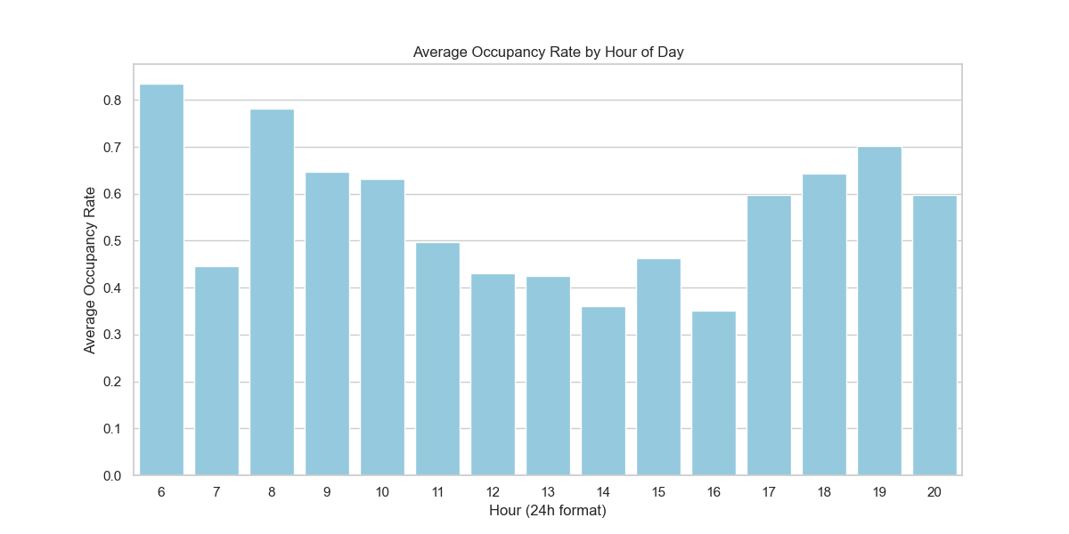
The "Double Peak" Phenomenon
Attendance surges significantly between 06:00–09:00 and 17:00–20:00.

Slide 5
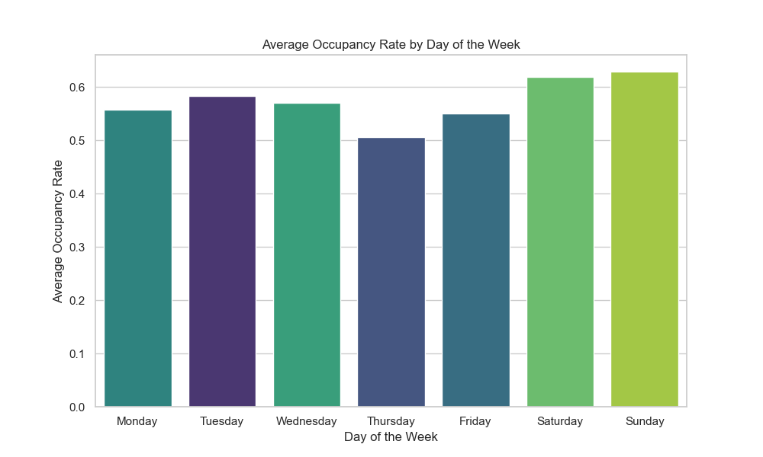
Weekend vs. Weekday
Weekend (Saturday/Sunday) shows higher professional-class engagement, while weekdays show a more distributed, lower-intensity booking pattern.

Slide 6
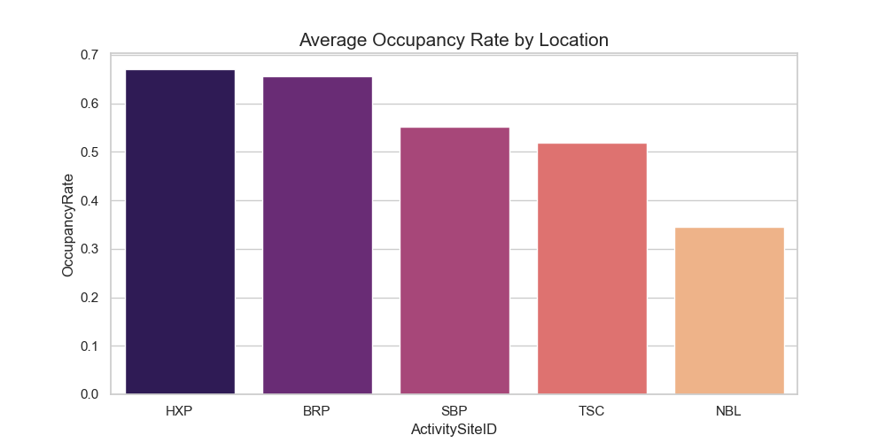
Site Variance

Slide 7
Consumer Behavior (Price Elasticity)
The Metric: Calculated Price Elasticity of -0.3235 via Log-Log Regression.
The Insight: Our member base is "Price Inelastic." A price increase does not trigger a proportional drop in bookings because the value of the specific time slot/trainer outweighs the cost.
Strategic "Green Light": This statistical coefficient justifies surge pricing during "Power Hours" without risking significant churn or brand fatigue.

Slide 8
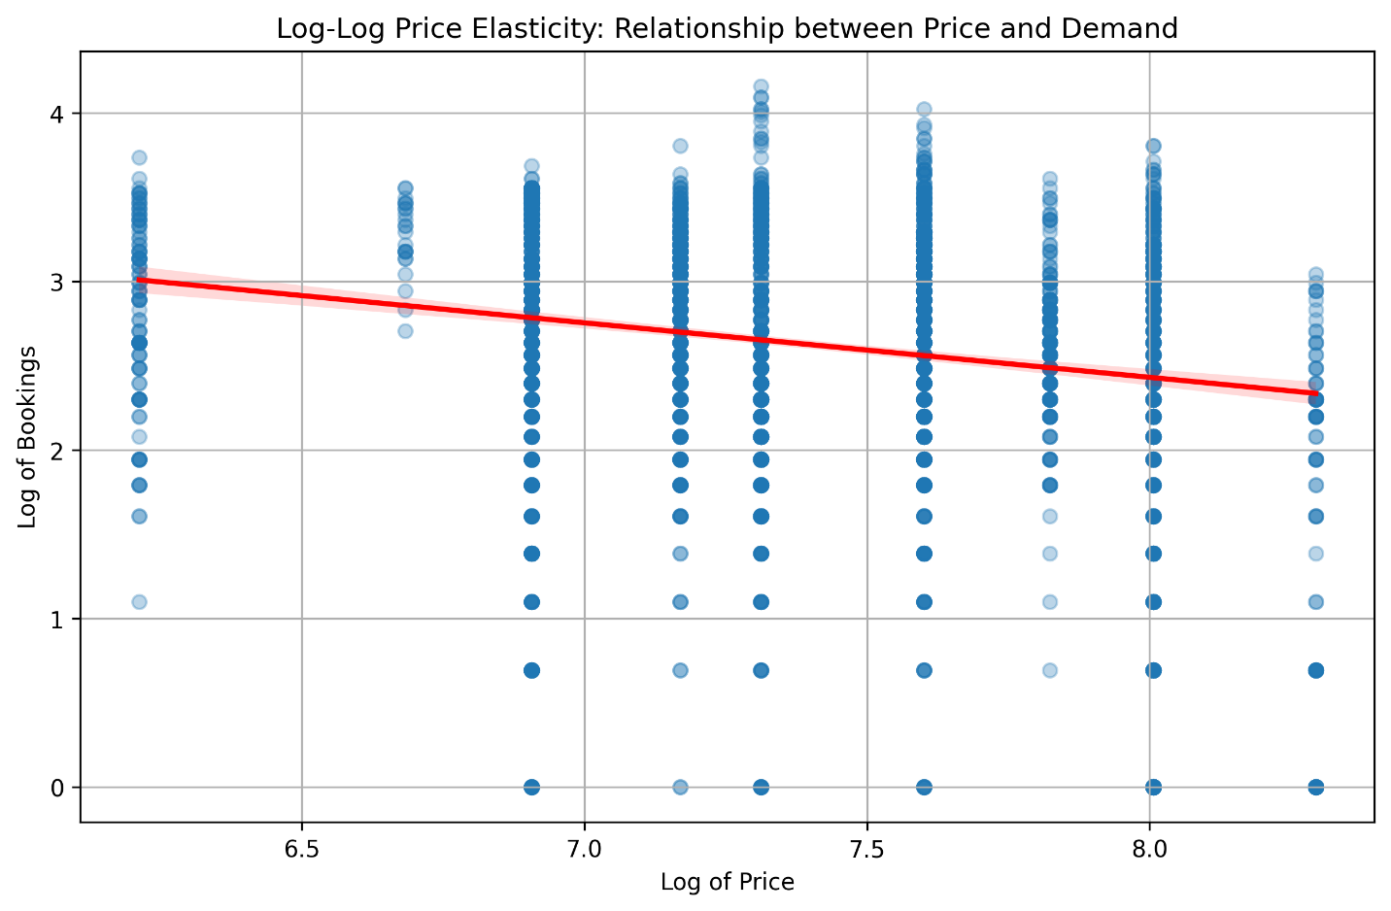
Price Elasticity

Slide 9
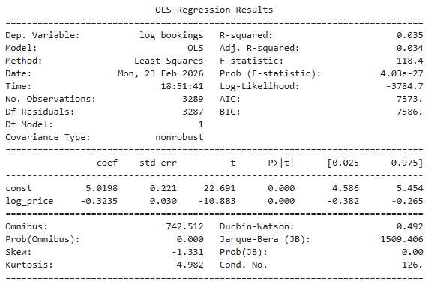
OLS Regression Result

Slide 10
Model Validation & Statistical Interpretation
Metric | Value | Interpretation
MSE | 0.5848 | Represents the variance in predictions. The moderate error confirms high 'noise' in individual booking behaviors.
R² Score | 0.0348 | Price explains 3.48% of booking variance. This confirms price is a secondary driver compared to time/activity.
Adjusted R² Score | 0.0345 | Confirms the model is not over fitted and the single-variable approach is stable.

Slide 11
Strategic Conclusion:
Insight on Negative Price Elasticity (-0.3235)
Finding: The elasticity is -0.3235, confirming that demand is Inelastic. However, to capture the remaining 96.5% of demand variance, we must integrate Time-Series Forecasting (Prophet) to account for seasonality and schedule-based patterns.
Business Meaning: Customers at Cult.fit are more focused on their health goals and schedules than on price. A 10% increase in price only reduces bookings by about 3.2%.
Pricing Action: We have significant Pricing Power. During high-demand periods, we can implement "Surge Pricing" to maximize revenue without fear of losing our core customer base. The revenue gained from the higher price per head will far outweigh the minor loss in total participants.

Slide 12
Strategic Conclusion:
Insight on Small R² Value (0.035)
Finding: The R² of 0.035 indicates that Price alone explains only 3.5% of why people book a class
Why?: Booking behavior is dominated by "External Factors" like time, location, day rather than cost.
Strategic Implication : Since price isn't the primary driver, we must use forecasting to identify the "Non-Price" drivers (like time, day, and seasonality). By knowing when demand is naturally high due to these factors, we can strategically apply our pricing model to the right slots.

Slide 13
Predictive Intelligence (Forecasting)
The Model: Implementation of Prophet for Time-Series Forecasting.
The Benefit: Moves from reactive pricing to proactive yield management.
The Logic: The model identifies seasonality (e.g., mid-week Tuesday/Wednesday highs) and holiday dips.
Automation Rule: If the Prophet forecast predicts >85% occupancy for a future slot, the +15% Surge Multiplier is automatically queued.

Slide 14
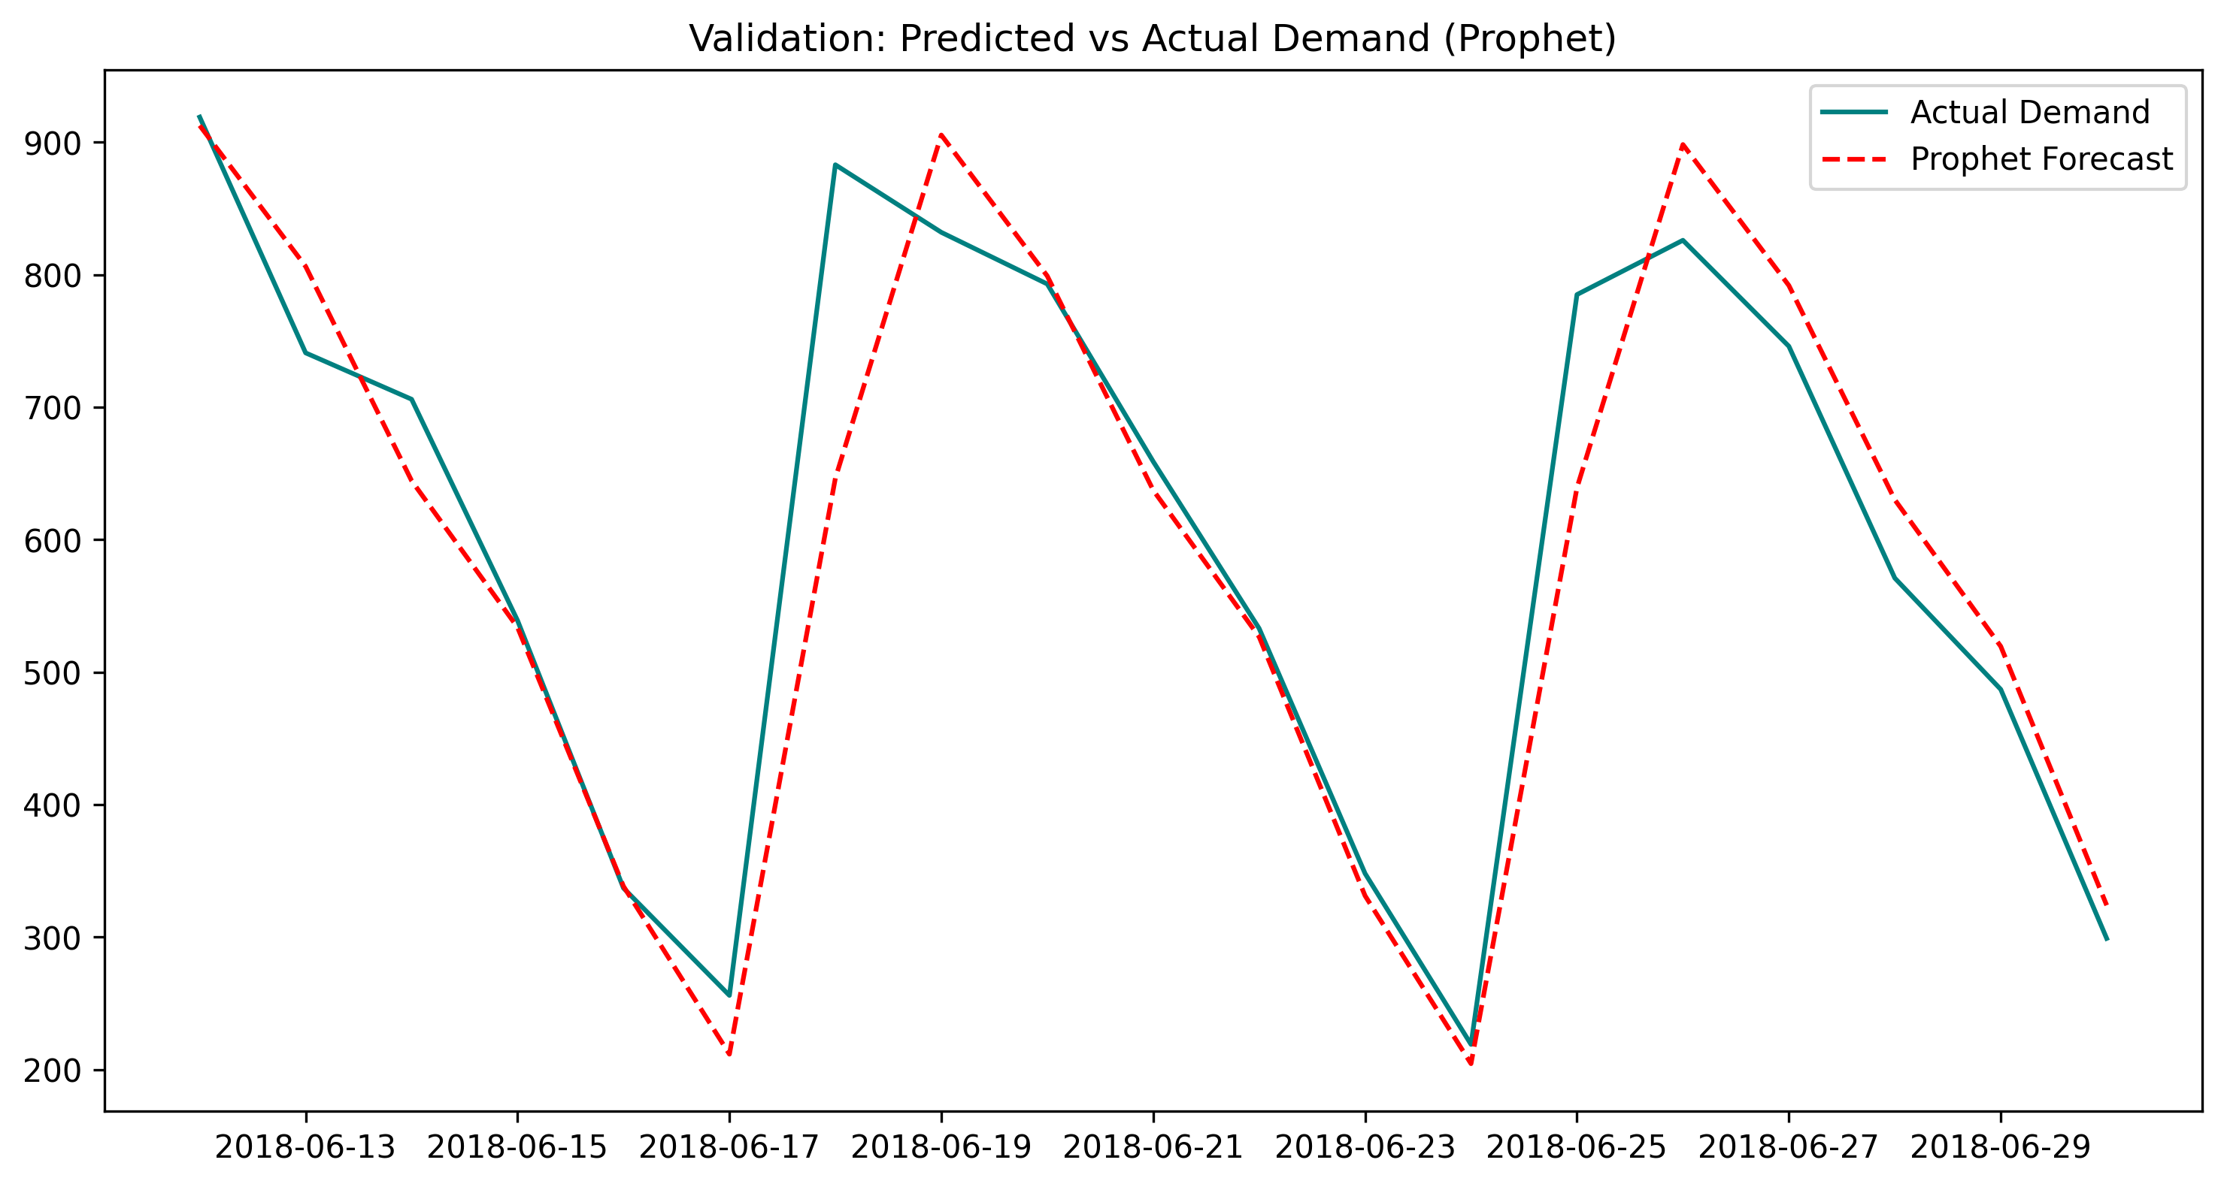
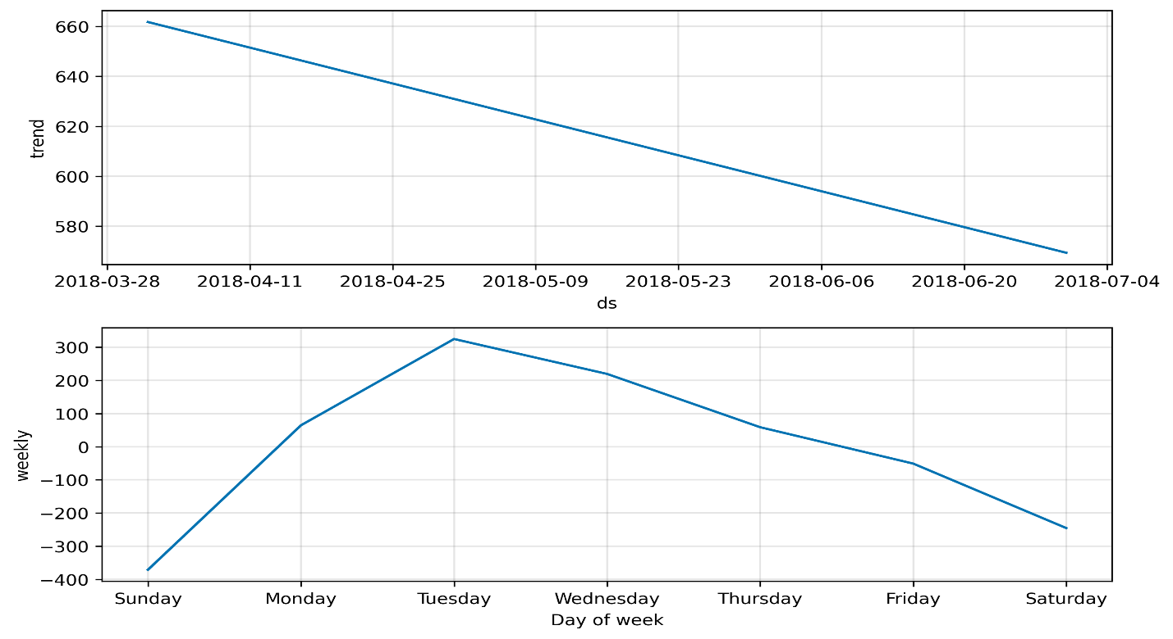
Prophet Forecast

Slide 15
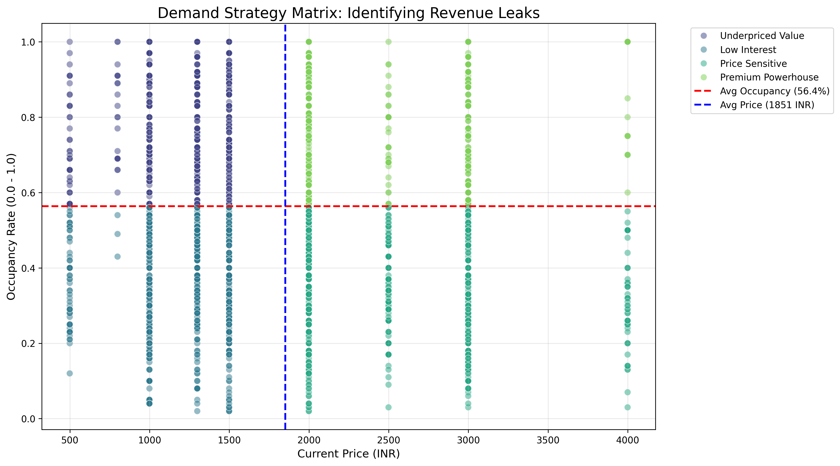
Demand Strategy Matrix

Slide 16
The "Triple-Factor" Pricing Algorithm
Our pricing engine doesn't guess; it calculates a Price Adjustment Factor across three dimensions:
Elasticity Factor: Baseline sensitivity derived from historical response.
Temporal Factor: Time-of-day multipliers based on the "Double Peak" data.
Inventory Factor: Real-time triggers that adjust as the final 5–10 mats in a class remain.
The Result: A fluid price that reflects the true market value of a workout slot in real-time.

Slide 17
Segment-Based Action Rules
Segment | Logic | Action Rule
Premium Powerhouse | High Occupancy / High Price | Maintenance: Maintain current price or apply +5% "Premium Guard" surge.
Underpriced Value | High Occupancy / Low Price | Surge: Apply +15% Surge Multiplier. Target for immediate yield growth.
Price Sensitive | Low Occupancy / High Price | Re-evaluation: Monitor for 2 weeks; if occupancy remains <30%, apply -5% correction.
Low Interest | Low Occupancy / Low Price | Incentivize: Apply -10% "Fill-the-Room" Discount to cover variable costs.

Slide 18
Prophet model’s performance
Metric | Value | Interpretation
R² Score | 0.8848 | High Predictive Power: The model successfully explains 88.48% of the variance in booking demand. This confirms that temporal seasonality (Time/Day) is the primary driver of attendance.
MAE | 49.48 | Average Accuracy: On average, the model's prediction deviates by approximately 49 bookings. This represents a high level of precision for high-volume fitness center operations.
MSE | 5593.60 | Error Variance: This metric reflects the penalty for larger outliers. The result indicates that while some extreme demand spikes exist, the model remains stable for general forecasting.

Slide 19
Financial Impact (The Bottom Line)
Model Strength: The underlying model maintains R² Score of 0.88. 88% of the variation in bookings is explained by our key features: Price, Time, Site, and Activity.
Projected Revenue Lift: 6.91% increase in total revenue.
Total Value Creation: Approximately 6.86 Million INR.
Operational Efficiency: Predicted 12% increase in off-peak occupancy.
  Reduction in the "Occupancy Variance" between peak and off-peak sessions.
Top revenue engines. Contributors: HXP Site , Studio Cyc, and Body Combat identified as the primary revenue engines.

Slide 20
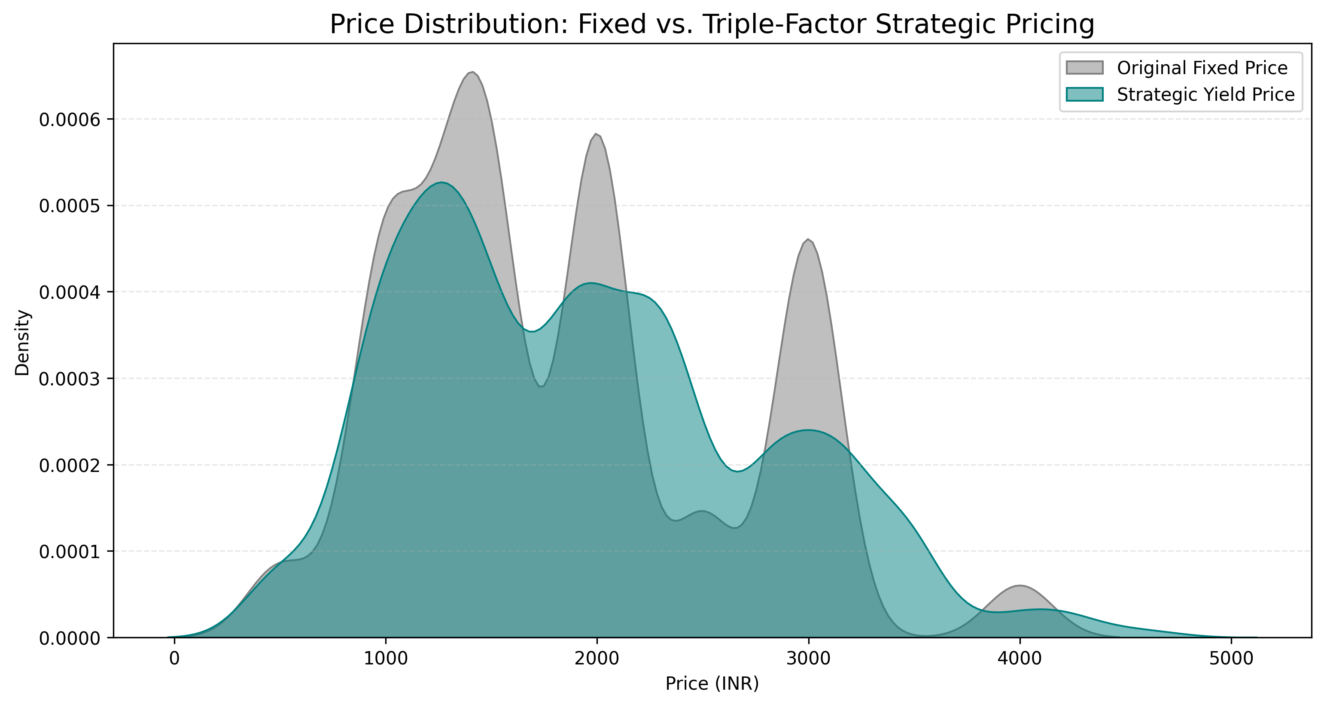
Price Distribution: Fixed vs Triple Factor Pricing

Slide 21
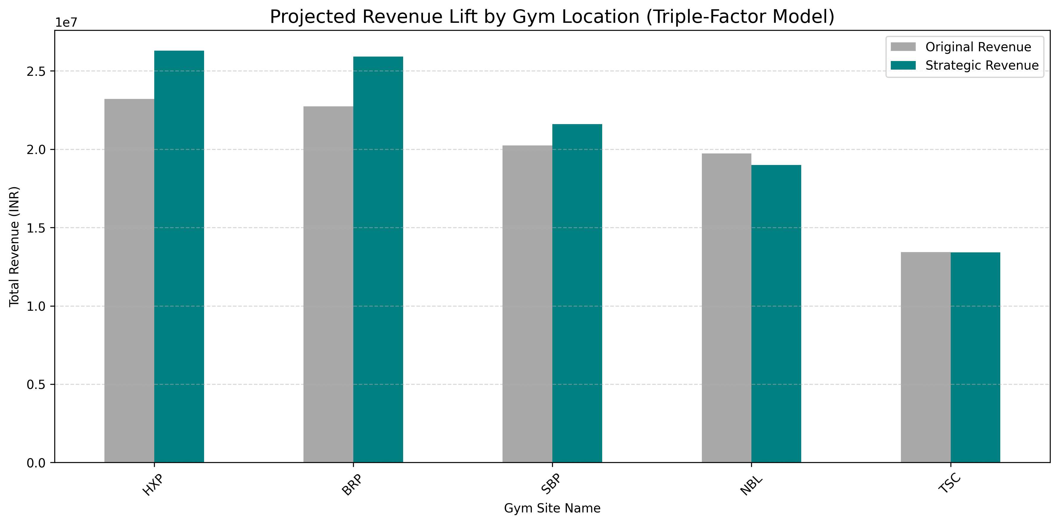
Projected Revenue Lift by Gym Location(Triple-Factor Model)

Slide 22
BUSINESS RECOMMENDATIONS
Targeted Pilot Rollout: Begin with the "Underpriced Value" segment. Specifically, apply the +15% surge to Yoga and HRX classes during the 7 AM and 6 PM slots where occupancy is consistently >95%.
Dynamic UI/UX Integration: Implement "Urgency Cues" in the Cult.fit app. Displaying messages like "Only 3 mats left at this price!" leverages loss aversion to accelerate bookings.
The "Freelancer" Discount: Use the "Fill-the-Room" (-10%) discount specifically for mid-day slots (11 AM – 3 PM) to attract students and remote workers who have flexible schedules but higher price sensitivity.
Site-Specific Sensitivity: Don't apply a blanket city-wide surge. Use the site-specific coefficients discovered in EDA to ensure pricing reflects the local competition and neighborhood demographics.

Slide 23
Conclusion & Next Steps
Summary: We are evolving from a "Volume-centric" business to a "Yield-centric" powerhouse.
Scalability: The Prophet + Elasticity framework is modular and ready for site-specific expansion across all Cult.fit locations.
Final Word: "Data-driven pricing isn't just about charging more; it's about finding the right price for the right customer at the right time."

Slide 24
THANK YOU

