Slide 1
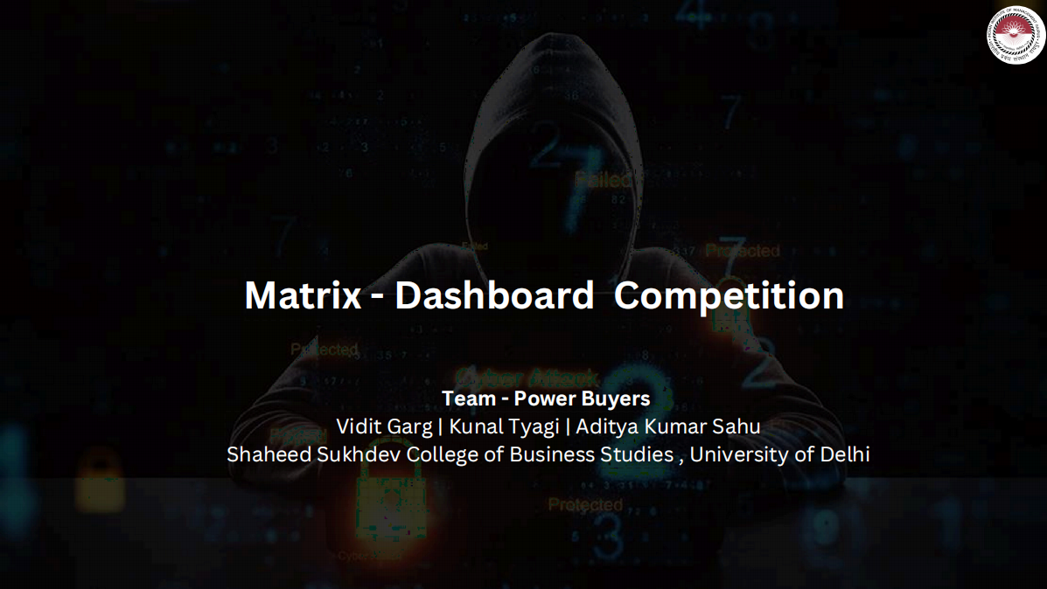
5555555555555555555555555555555555555555555555555555555555555555555555

Slide 2
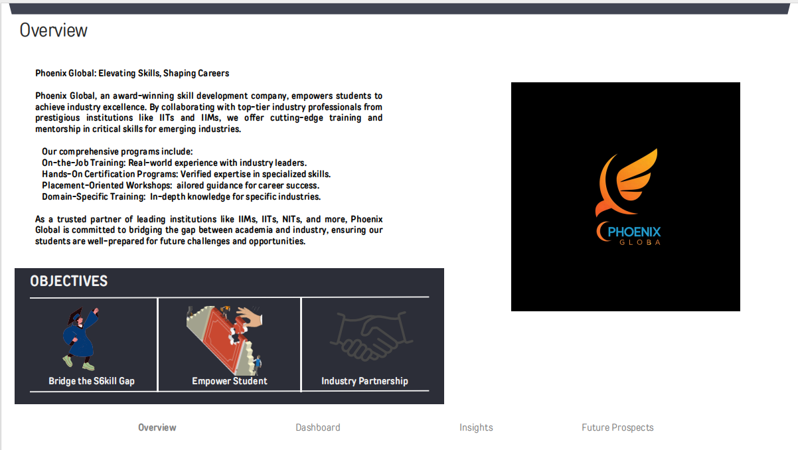

Slide 3
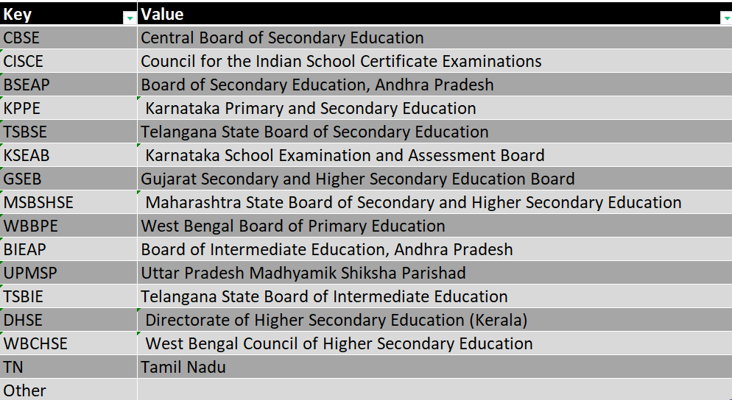
Data Dictionary
BSE
Board Of Secondary Education
All the Data with some errors

Slide 4
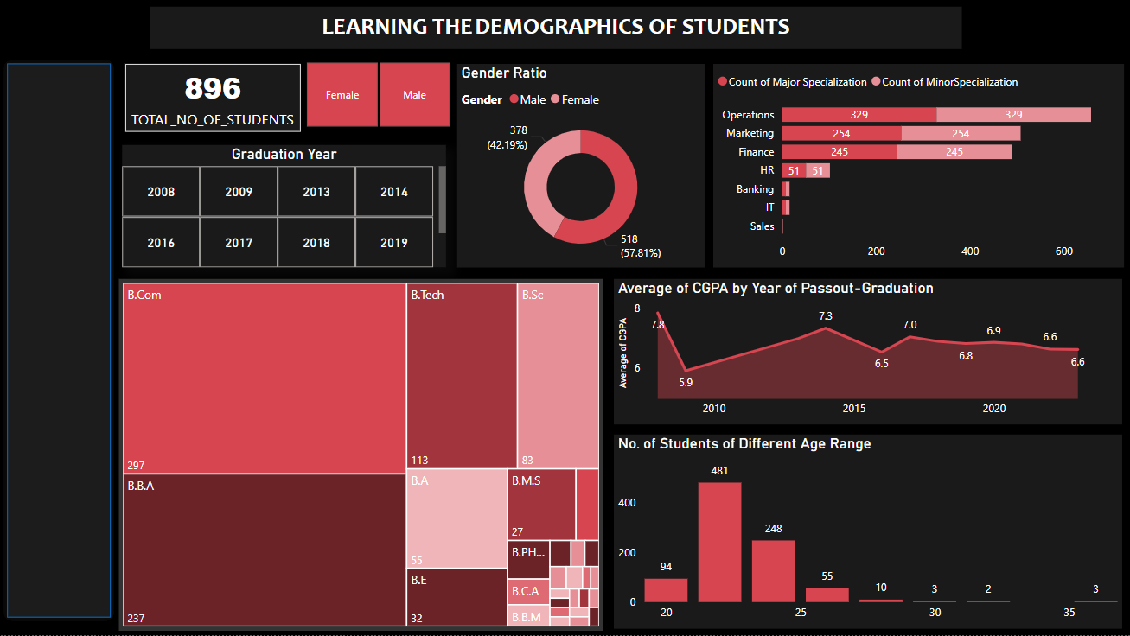

Dashboard – Part 1
C
L
I
C
K
H
E
R
E
DATASET
FOR
Overview
Dashboard

Slide 5
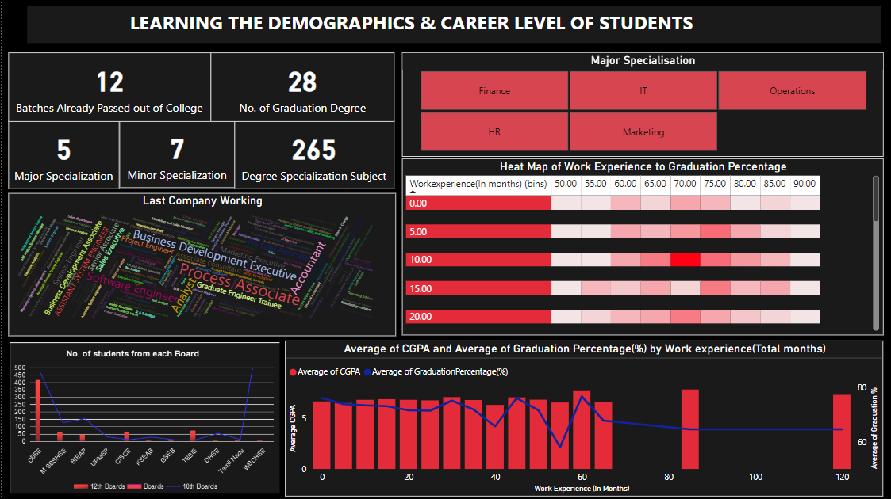
Dashboard – Part 2
Overview
Dashboard

Slide 6
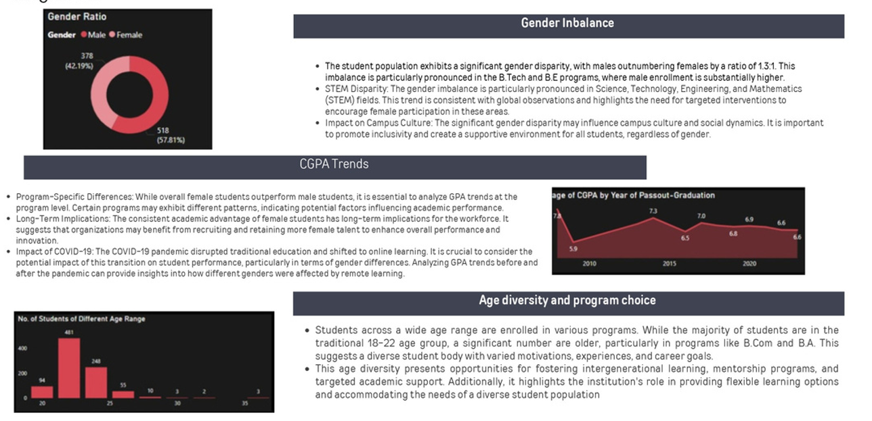
INSIGHTS
Gender Imbalance
Overview
Dashboard
Insights

Slide 7
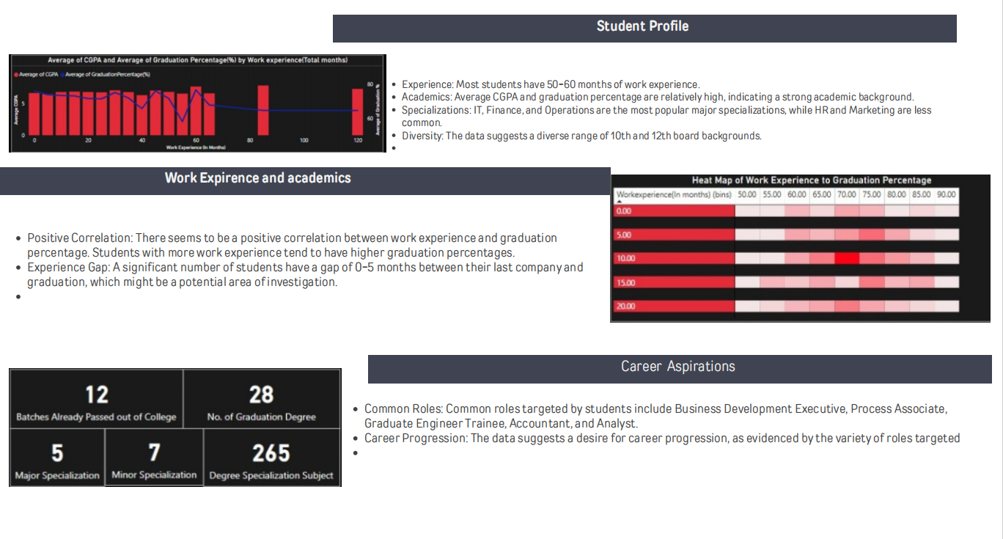
INSIGHTS
Overview
Insights

Slide 8
Future Roadmap/Prospects
Empowering Learning: Mini-Courses on Emerging Technology Trends
Blending the Best: Transitioning to a Hybrid Learning Model
Collaboration with Targeted Institutes
Introducing mini-courses on the latest technology trends to bridge the gap in understanding modern innovations and staying industry-readywith our long form courses to have organic Promotion without expending very much on Marketing
Our audience is mainly from Finance and IT courses, we can partnership mainly with colleges providing these courses to create our niche more strong and could gain trust
To enhance the effectiveness of our learning experience and ensure every student’s needs are met, we are evolving into a hybrid model. This approach will combine the flexibility of online education with the interactive benefits of in-person sessions.
Four Online Classes: Convenient, accessible, and technology-driven for uninterrupted learning.
Two Offline Classes: In-person interactions focused on doubt-clearing, collaborative activities, and hands-on learning.
Workshops in Companies
Market Research and In-depth Analysis
Providing Career Development Workshops to the working Professionals which will increase our revenue as well as helps us in our Promotion
We can further use Google analytics and market research, to develop effective strategies.
Studying competitors will offer insights into successful industry trends
Diversify into Targeted Schools
Our Audience is mainly of CBSE, ICSE, Maharashtra Board, where we will provide our courses on personality Development and other holistic development courses
Source(s):byungwan,colleendilen
Insights
Future Prospects
Overview Data Dictionary Dashboard Performance Analysis Top 3 Video Short Form Content Long Form Content Insights

Slide 9
THANK YOU !

