Slide 1



AZKEN OPERAATIO’2025
START-OP-SPHERE
Optimizing Inventory Planning Management
TEAM STRATEGY_CREATORS
DHANRAJ SONI | VIDIT GARG | KRISH GUPTA
SHAHEED SUKHDEV COLLEGE OF BUSINESS STUDIES, UNIVERRSITY OF DELHI

Slide 2























INDUSTRY & COMPANY ANALYSIS
Mapping the Market: Unveiling Industry Trends & Company Positioning
INDUSTRY ANALYSIS
COMPANY ANALYSIS
MARKET SIZE
PESTLE ANANLYSIS
pioneers compostable, plastic-free packaging, offering eco-friendly bags, films, and bio-based additives that align with EPR regulations and SUP bans, driving a greener future.
20
15
10
5
0
70+ countries ban single-use plastics (India, EU, US). While green laws boost demand, high compliance costs & trade barriers raise procurement risks.
5.4
3.1
PRODUCTS OFFERING
Sustainable Packaging & Waste Management Soln.
Focus: Everyday consumer & industrial packaging needs with a strong emphasis on sustainability.
Advanced Bio-Based Materials & Industrial Films
Focus: Next-gen sustainable materials for industrial applications, packaging, and coatings.
Sustainable packaging costs significantly more than plastic, making Businesses struggle to balance affordability.
Key Certifications…
ISO 17088 Certified & CIPET Tested –
Quality assurance across all products
Plastic-Free & Compostable – 100% biodegradable materials
Regulatory Compliance – Supports EPR guidelines & single-use plastic bans
(in USD billion) 2024 2032 Valued at $ 3.1billion in 2024,
projected to reach $5.4 billion
by 2032.
73% of consumers prefer eco-packaging,
boosts premium sales. Yet, 30-40% higher costs lowers the sale in low-income markets.
Growing at 7.09% (2024-2032)
_{CAGR} with a potential boost from
government policies.
AI-driven forecasting cuts waste, and smart packaging (QR codes, sensors) improves transparency & efficiency.
Source: whatpackaging.co
Key metrics…
Supplier MOQ is 500 kg per order; ordering costs, ₹5000 (≤2t) and ₹8000 (>2t).
Competition in the Market
Operational Excellence
Jindal Poly Films
Uflex Limited
EU mandates 50% plastic recycling by 2025. Greenwashing fines rise, punishing false sustainability claims.
The Industry demands the efficiency in all, to achieve the Largest Market Share
50 tonnes/month production, scalable to 250 t/month.
Essel Propack Ltd.
Customer Intimacy
Bio-packaging cuts CO₂ by 60%, yet bio- plastics use 3x more water. Refill & reuse models grow rapidly.
Products have a 2-year shelf life
and 5% holding costs.
Ester Industries
Product
Customers are willing to pay a 10-20% premium
TCPL Packaging Ltd.
Leadership
Value Discipline Framework
Direct Competitors Indirect Competitors
INDUSTRY & COMPANY ANALYSIS
SAFE FRAMEWORK & SEGMENTATON
SMART SUPPLIER DASHBOARDS
RISK MITIGATION & IMPACT
APPENDIX
1

Slide 3













SAFE Model: Smart, Agile, and Future-Ready Stock Planning
Predict, Procure, and Store Smarter : The Future of Inventory
THE SAFE FRAMEWORK
SMART SEGMENTATION
Why Does Phitons Need Segmentation?
Why only 3 segments ?
Why Phitons Needs a New Inventory Model?
We introduce SAFE – a custom-built inventory framework to
solve issues, optimizing inventory for types of customers.
Bulk orders tie up working capital, while small orders create uncertainty.
Optimal balance between simplicity & efficiency
Each group has unique
demand patterns.
Allows for tailored
stock allocation strategies.
Overstocking causing waste & capital lock-in
Smart Forecasting
Agile Procurement
Some buyers get too much stock,
while others face shortages.
One approach cannot optimize stock for all the types of consumers.
Demand Volatility
Supplier Constraints
Managing Inefficiency
AI-driven prediction using: Historical sales data Regulatory impact
modeling (plastic bans).
Market trends (Google searches, shifts).
JIT model: Orders only when needed.
MOQ pooling with firms to reduce bulk order.
Multiple suppliers to prevent stock delays.
Stockouts leading to lost revenue
CONSUMER SEGMENTATION FOR PHITONS
MOQ constraints leading to inefficient bulk purchases.
Agile Procurement
Green Automation
Enterprise Clients
(Bulk Buyers)
SMEs & Startups (Medium Buyers)
R&D/Trial Orders
(New Customers)
Total Financial Impact (Savings Due to SAFE Model)
Large FMCG /Retail
/ Industrial firms.
Monthly orders:
10+ tonnes.
More Predictable
demand.
Orders: 500 kg - 5 tonnes / month.
Highly pricing - sensitivity .
Demand is not
stable due to growth.
Small batch
purchases (100-500 kg) per month.
Used to test products before larger orders.
Impact
10
5
0
Before SAFE After SAFE
Dynamically allocates inventory based on consumer type.
Stock segmentation prevents waste & ensures priority fulfillment.
RFID & IoT-based tracking for real-time stock visibility.
Blockchain for supplier coordination & auto-replenishment.
Ensures financial viability while reducing waste.
INDUSTRY & COMPANY ANALYSIS
SAFE FRAMEWORK & SEGMENTATON
SMART SUPPLIER DASHBOARDS
RISK MITIGATION & IMPACT
APPENDIX
2

Slide 4






















Right Stock for the Right Customer – Precision Inventory Allocation
Custom Solutions for Enterprise, SMEs & Trial Orders – Maximizing Inventory Efficiency
SEGMENTED SOLUTIONS FOR EACH CONSUMER TYPE
IMPACT
COST SAVINGS AND FINANCIALS
ENTERPRISE CLIENTS
SMES & STARTUPS
Needs consistent, guaranteed supply to maintain production.
Problem
5.18 Cr
Current
3.02 Cr
After
Problem
Unexpected Last Minute Orders cause stockouts & disrupt inventory cycles |  |  | Phitons holds too much stock, leading to over- purchasing & capital lock-in.
Unsegmented inventory leads to
stockout, causing reputation risk.
How?
Dedicated Stock Buffers (10-20% reserved inventory) to ensure more availability.
AI-Based Just-in-Time (JIT) Inventory for SMEs
Stockouts Cut by 58% (₹70L recovered)
Inventory Wastage Reduced by 47% (₹70L
saved)
Holding & Procurement Costs Optimized (₹76L
saved)
Break-even in Less Than 3 Months!
AI Prediction for SMEs
Priority Order
Slots
Recurring SME customers are given guaranteed inventory access
Dynamic MOQ Adaptation
Solution
Quarterly Procurement Contracts
with AI-based auto-replenishment.
Dynamic Reallocation: If enterprises’
demand drops, stock is shifted to SMEs.
Analyse past orders & trends of SMEs as their demand is more fluctuating
AI groups multiple SME orders together to reduce MOQ burden
Supporting Evidence: Used by FMCG giants (Nestlé, HUL) for stable B2B demand management.
Safe Model alone saved Rs
2.85 Cr
Segments added Rs 31L more in savings
Total Costs Savings is Rs 2.16
Crores
A THREE- PART STRATEGY FOR TRIAL ORDERS
Key Challenges of Managing Trial Orders
Dedicated Trial Inventory Pool → Set aside 5-7% of total stock for R&D buyers, separate from core inventory.
Expiry-Based Stock Rotation (FIFO & FEFO) → Ensure older stock is used first for trial orders, minimizing waste.
Dynamic Discounting
System → If trial
orders don’t convert, unsold stock is repurposed for SMEs at a discount.
Disrupts SME & Enterprise Stock Planning
High Waste Probability
Short Shelf Life Impact
The SAFE Model & Segmentation combined result in a ₹2.16 Cr annual cost saving—a 42% efficiency boost for Phitons.
INDUSTRY & COMPANY ANALYSIS
SAFE FRAMEWORK & SEGMENTATON
SMART SUPPLIER DASHBOARDS
RISK MITIGATION & IMPACT
APPENDIX
3

Slide 5
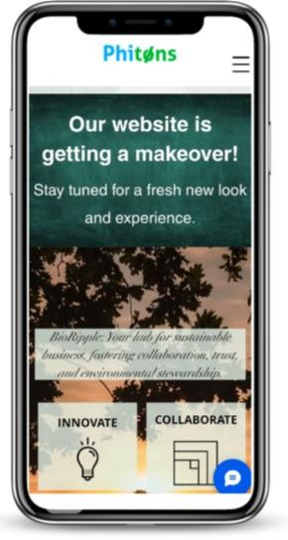

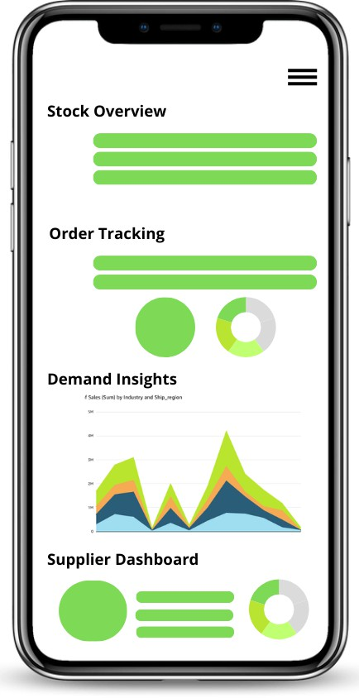
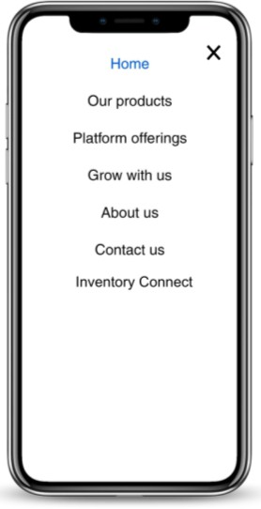



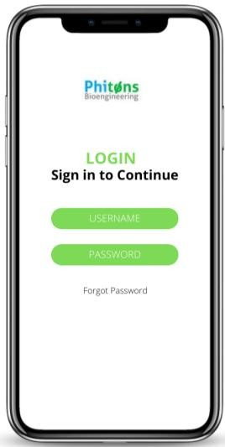









Real-Time Inventory Insights: Track, Manage, Optimize
Mapping the Inventory: Provide real-time data for smarter procurement and seamless inventory control.
Click on the three horizontal lines (☰) at the top-right corner of the website to open the navigation menu.
Click on the three horizontal lines (☰) at the top-right corner and select "Raw Materials" or "Final Products" to view inventory details.
Displays real-time data on stock levels, including available, in- transit, and low-stock items.
Monitors incoming and outgoing shipments, including estimated arrival times and supplier details.
Analyzes product demand trends, sales forecasts, and reorder recommendations.
Provides suppliers with access to order history, fulfillment status, and performance metrics.
From the menu, click on "Inventory Connect"
to proceed to the supplier login page.
Benefits for Suppliers
"Inventory Connect"
Enter your assigned credentials (Username & Password) and click Login to access the complete inventory details.
Track stock, shipments, and orders instantly to avoid delays and shortages.
Use demand forecasts to plan better, reduce waste, and improve cash flow.
Minimize lead times, prevent miscommunication, and ensure seamless supply chain coordination.
Effortlessly track stock, orders, and shipments with Inventory Connect. Gain real-time insights, ensure optimal availability, and make data-driven decisions—all from a secure, streamlined dashboard.
INDUSTRY & COMPANY ANALYSIS
SAFE FRAMEWORK & SEGMENTATON
SMART SUPPLIER DASHBOARDS
RISK MITIGATION & IMPACT
APPENDIX
4

Slide 6







RISK MITIGATION
Sustainable Strategies to tackle unanticipated risks due to Volatile Demands
RISKS
EXPLANATION
MITIGATION
High
4
2
Inaccurate AI-Based Demand Forecasting
AI predictions may not always align with sudden demand shifts, leading to overstocking or stockouts.
Combine AI forecasts with manual market adjustments, using real-time supplier and customer data for accuracy.
1
Low Probability of Risk
3
1
Increased Supplier Dependence on Our System
Suppliers may become overly dependent on the portal, leading to operational disruptions if the system faces downtime.
Maintain backup systems, offline inventory reports, and emergency procurement protocols to ensure continuity.
2
3
Supply Chain Disruptions Leading to Stockouts
JIT minimizes excess inventory, but if suppliers delay deliveries, Phitons may face stockouts.
Diversify suppliers to reduce dependency on a single source. Maintain a strategic safety stock for high-demand SKUs.
Supplier May Overprice Due to Inventory Stockouts
When inventory levels drop critically low, suppliers may exploit the urgency by increasing prices, leading to higher procurement costs
Pre-negotiated contracts prevent sudden cost spikes, diversifying suppliers ensures competitive pricing.
4
Low
Impact
High
Solutions
1
2
AI-Powered Demand Forecasting
3
IMPACT
ASSESSMENT…
Supplier Inventory Portal
MOQ Optimization & Dynamic Order Planning
Key
Benefits
Real-time stock visibility, tracks in-transit inventory, reduces supplier uncertainty.
Predicts demand shifts, cuts excess inventory by 25%, and reduces stockouts by 40%.
Speeds up order fulfillment by 30%, lowers wastage–15% and improves cash flow
Impact Weightage
INDUSTRY & COMPANY ANALYSIS
SAFE FRAMEWORK & SEGMENTATON
SMART SUPPLIER DASHBOARDS
RISK MITIGATION & IMPACT
APPENDIX
5

Slide 7
APPENDIX!

Slide 8

APPENDIX (1/4)
Calculations for the Solutions provided
Additional Proof: Real-World Examples of Similar 3-Group Segmentation
Amazon B2B Inventory: Splits inventory handling into Bulk Buyers, SMBs, and Small Test Orders for efficiency.
Tesla’s Supply Chain Strategy: Focuses on Fleet Buyers (big companies), Individual Buyers (mid-size), and R&D (new markets)—same logic as Phitons.
FMCG Companies (HUL, Nestlé): Follow a 3-tiered inventory model to optimize supply chain efficiency.
Why 3 Segments Work Best for Phitons?
Different Inventory Needs: Large enterprises need bulk stock buffers to meet consistent orders. SMEs order unpredictably, so JIT works best.
R&D/Trial buyers need smaller experimental stock, which shouldn't mix
with regular inventory.
Optimized Inventory Strategy: If we combine SMEs and Trial Buyers (2 groups only) → Trial orders would disrupt inventory meant for SMEs. If we add a fourth group (Splitting SMEs) → Adds unnecessary complexity without improving stock planning significantly.
Why Are SMEs & Startups Different from Enterprises? SMEs are high-growth, high-uncertainty customers for Phitons: Smaller, irregular orders (500 kg – 5 tonnes per month).
More price-sensitive than large enterprises.
Highly reactive to market trends → Orders increase/decrease
based on their customers' needs.
Cash flow constraints → They prefer on-demand inventory rather
than bulk commitments
Simplicity in Operations = Fewer Errors: Too many categories make AI- driven stock planning harder → leading to inefficiencies in ordering & allocation. Three clear groups keep operations agile and manageable
Conclusion: 3 is the most efficient number for inventory segmentation—simple enough for implementation, yet detailed enough to capture distinct customer behaviors.
INDUSTRY & COMPANY ANALYSIS
SAFE FRAMEWORK & SEGMENTATON
SMART SUPPLIER DASHBOARDS
RISK MITIGATION & IMPACT
APPENDIX
6

Slide 9
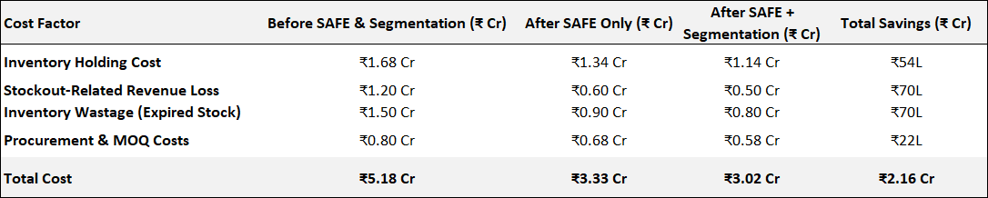
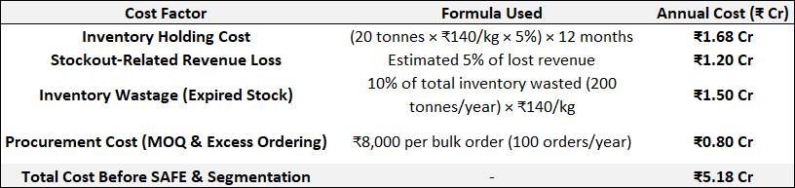
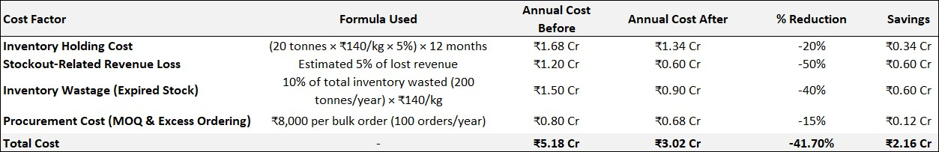
APPENDIX (2/4)
Calculations for the Solutions provided
Cost Comparison Before and After SAFE & Segmentation Implementation
Calculations of the above…
Calculations of the above…
INDUSTRY & COMPANY ANALYSIS
SAFE FRAMEWORK & SEGMENTATON
SMART SUPPLIER DASHBOARDS
RISK MITIGATION & IMPACT
APPENDIX
7

Slide 10
APPENDIX (3/4)
Calculations for the Solutions provided
Feasibility – Why AI JIT for SMEs is Practical?
Concern | Solution & Justification | Proof & Case Study
"AI forecasting might be inaccurate for SMEs since they don’t order consistently." | AI tracks not just historical sales but also external signals (Google trends, regulatory news, seasonal factors). | Amazon’s SME supply chain model uses AI-based demand tracking to serve 3M+ small businesses worldwide.
"Won’t JIT create stock shortages for SMEs?" | No, because Phitons pre-allocates stock for high-frequency SME buyers based on past trends. | Used by Tesla’s supplier management system to reduce waste while ensuring stock availability.
Feasibility & Supporting Evidence FOR TRIAL ORDERS
Concern | Solution & Justification | Real-World Example
"Will a separate trial inventory create inefficiencies?" | No, because it’s only 5-7% of total stock and dynamically adjusted based on demand. | Tesla uses dedicated inventory for new market testing before mass production.
"Will SMEs actually buy discounted trial stock?" | Yes, because SMEs prefer lower-cost raw materials and often look for deals. | Amazon’s warehouse strategy repurposes unsold stock for small business buyers at a discount.
"Is it costly to implement AI for this system?" | No, because AI-driven discounting and rotation pays for itself in 3-4 months with the cost savings. | McKinsey reports that AI-driven inventory rotation reduces waste by 15-20%.
INDUSTRY & COMPANY ANALYSIS
SAFE FRAMEWORK & SEGMENTATON
SMART SUPPLIER DASHBOARDS
RISK MITIGATION & IMPACT
APPENDIX
8

Slide 11
APPENDIX (4/4)
Calculations for the Solutions provided
Feasibility & Supporting Evidence FOR ENTERPRISES
Concern | Solution & Justification | Real-World Example
"Will reserving buffer stock increase holding costs?" | No, because buffer stock is dynamically adjusted every quarter based on demand. | Amazon ensures 20% inventory buffer for key enterprise customers while maintaining JIT supply.
"Will quarterly contracts restrict supplier flexibility?" | No, because AI predicts demand shifts, allowing Phitons to phase out contracts smoothly. | Used by Unilever to reduce raw material stockouts in FMCG manufacturing.
"What happens if enterprises cancel bulk orders?" | AI immediately redirects excess stock to SMEs, preventing losses. | Tesla repurposes unsold parts for different vehicle models to avoid overstocking.
Sources…
https://www.netstock.com/blog/the-ultimate-list-of-inventory-management-statistics/
https://www.supplychainbrain.com/articles/36071-overproduction-waste-account-for-163-
billion-in-annual-inventory-losses
https://www.netstock.com/blog/the-ultimate-list-of-inventory-management-statistics/
https://www.bcg.com/publications/2014/supply-chain-management-retail-demand- forecasting-the-key-to-better-supply-chain-performance
https://www.bloomberg.com/news/newsletters/2022-11-10/supply-chain-latest-inventory- waste-totals-163-billion-a-year
https://www.mckinsey.com/industries/retail/our-insights/beating-the-shrink-on-grocery- shelves
https://www.logisticsbureau.com/7-mini-case-studies-successful-supply-chain-cost-
reduction-and-management/
https://www.dhl.com/discover/en-global/logistics-advice/sustainability-and-green-
logistics/reduce-wastage-along-your-supply-chain
https://www.slimstock.com/blog/how-to-solve-wastage-problems/
https://www.ascm.org/ascm-insights/a-forward-thinking-approach-to-backorders/
https://www.pival.com/reduce-inventory-waste-supply-chain/
INDUSTRY & COMPANY ANALYSIS
SAFE FRAMEWORK & SEGMENTATON
SMART SUPPLIER DASHBOARDS
RISK MITIGATION & IMPACT
APPENDIX
9

Slide 12
THANK YOU!

