Slide 1

First-Aid Assistance based on Image Processing Using TensorFlow

Slide 2
Team Members
Student ID | Name | Roles/Responsibility
700757653 | Viditha Avuthu | Algorithm Development
700756645 | Rathna Sahithi Nalluri | Presentation and Documentation
700756585 | Jhansi Veluvolu | Testing
700758331 | Anjana Devi Gorantla | Gathering Requirements

Slide 3
Abstract
Motivation
Introduction
Related Work
Data Description
Proposed System
System Architecture
Proposed Methodology
Results
Conclusion/Summary
References
Contents

Slide 4
Traditional methods of injury detection often rely on subjective human assessment, leading to delays in diagnosis and treatment. Timely recognition of injuries is crucial for initiating appropriate interventions and minimizing adverse consequences. Moreover, accurate classification of injuries enables healthcare providers to tailor treatment strategies according to the specific injury type, optimizing therapeutic outcomes. However, recent advancements in deep learning, particularly in the realm of image classification using convolutional neural networks (CNNs), offer promising avenues for efficient and accurate injury identification. This paper presents a comprehensive study on injury identification and treatment based on image classification using CNNs. Our research explores various architectures, training strategies, and optimization techniques to enhance the performance and reliability of injury identification systems.
Abstract

Slide 5
Injury identification and treatment stems from several key factors that underscore the importance of prompt and accurate diagnosis, followed by appropriate intervention.
These factors include: ensuring the well-being and health outcomes of patients, early identification and intervention can help prevent such complications, customize treatment plans and interventions, early intervention may also prevent the progression of injuries to more severe stages, which typically require more extensive and costly treatments, and many more.
Motivation

Slide 6
Introduction
Injury identification and treatment are pivotal aspects of healthcare, where accurate and prompt diagnosis significantly influences patient outcomes and recovery trajectories. Traditional methods of injury assessment rely heavily on clinical expertise and diagnostic tools, often requiring time-consuming manual analysis and subjective interpretation. However, the emergence of Convolutional Neural Networks (CNNs) and their applications in medical image classification have revolutionized the landscape of injury diagnostics

Slide 7
Introduction
The first section discusses the imperative nature of precise injury identification and its profound impact on treatment planning and patient care followed by surveys relevant previous studies, theories, and findings related to the research topic to understand the existing knowledge base, identifies gaps or controversies in the literature, and justifies the need for the current study.
Next we are going to discuss research design, procedures, and techniques employed to address the research questions or objectives along with the workflow of the system and architecture of the CNN.

Slide 8
Objectives

Slide 9
Automated Recognition of Medical Emergencies
Identification of Critical Conditions
Guided First Aid Instructions
Integration with Emergency Services
Accessibility and User-Friendly Interface

Slide 10
Related Work

Slide 11
Title: Software Development for First Aid Decision Support System
Description: The authors presented an approach to deal with modeling a decision support system framework to introduce an application for decisions in medical knowledge system analysis. A decision support framework, known as First Aid Decision Support System (FADSS), was designed and implemented to assess experimental cases exerting danger to the general population, offering advanced conditions for testing abilities in research and arranging an emergency treatment through the graphical user interface (UI). The application takes into account the actual evaluation of first aid’s standard parameters, which focus on the ultimate objectives of recognizing the case of first aid and providing an appropriate proposal for treatment.
Literature Survey-1

Slide 12
Title: A Novel Method for Robots to Provide First Aid to Injured People Inside the Mines Using GIS Technology
Description: A new methodology proposed for managing robots inside the mines using an electronic system designed for driving robots to injured people in seas, mines or wells who can not be reached by human force and also explains the concept of managing and remote-controlling the process of searching and helping the injured. The robot’s tasks are to take a sample of the blood of the injured person, examine it, and measure the percentage of oxygen underground and send it to the user who directs the robot to pump a specific percentage of oxygen to the injured person. The robot is equipped with headphones to communicate with the injured and the user can direct the camera of the robot and take x-rays from the injured.
Literature Survey-2

Slide 13
Title: Artificial Intelligence Technology-Based Medical Information Processing and Emergency First Aid Nursing Management
Description: This study will use the artificial intelligence algorithm to optimize medical information processing and emergency first aid nursing management processes, in order to improve the efficiency of the emergency department and first aid efficiency. The successful rescue rates of hemorrhagic shock, coma, dyspnea, and more than three organs injury were 96.7%, 92.5%, 93.7%, and 87.2%, respectively, after the emergency first aid nursing mode was used in the hospital emergency center.
Literature Survey-3

Slide 14
Data Description

Slide 15
To diagnose the disease, data was gathered from the Internet. Images of various injuries have been collected, belonging to 16 different classes, consisting of 100 images of every injury for training and 30 images for testing for every injury. All the images from the internet from scratch. All images are stored in jpeg, jpg, and png format.
Collection of Data

Slide 16
Convolutional neural networks are employed in the second procedure to categorize the provided image into one of the existing classes.
Classification
of Data

Slide 17
Proposed System

Slide 18
In this project, we implemented deep learning algorithms for the precise detection of mild ailments. .
Main functionality is first aid assistant; if an image or text of an injury is provided as input, then our system will display the appropriate video to perform first aid
CNNs are the chosen network architecture for detecting and recognizing objects in deep learning
Transfer learning is used in this model to classify using a previously trained model.

Slide 19
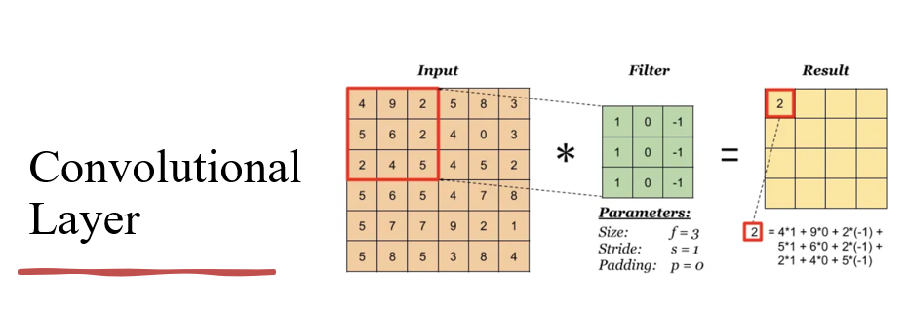
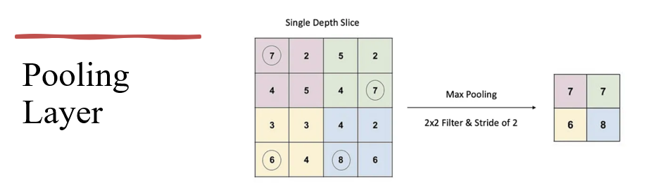

Slide 20
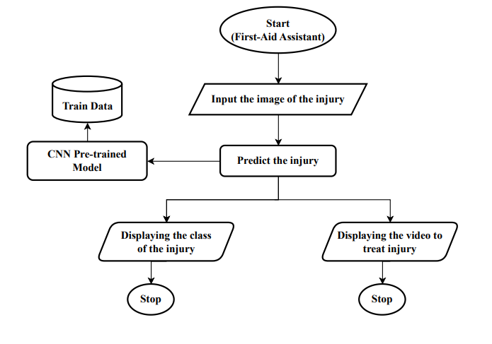
Proposed System Architecture

Slide 21
Proposed Methodology
Importing Modules
Importing Data
Preprocessing Data
Defining Layers
Creating Checkpoints
Training and Testing the Model
Saving the Model
Loading the Model
Plotting the Results
Creating the Interface
Predicting Classes for new images

Slide 22
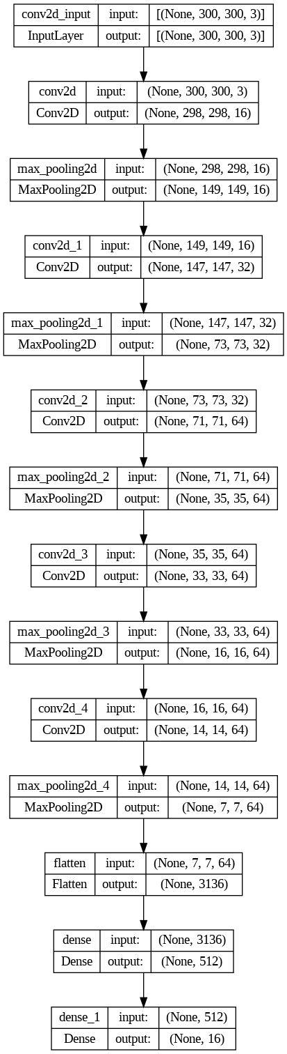
Model Architecture

Slide 23
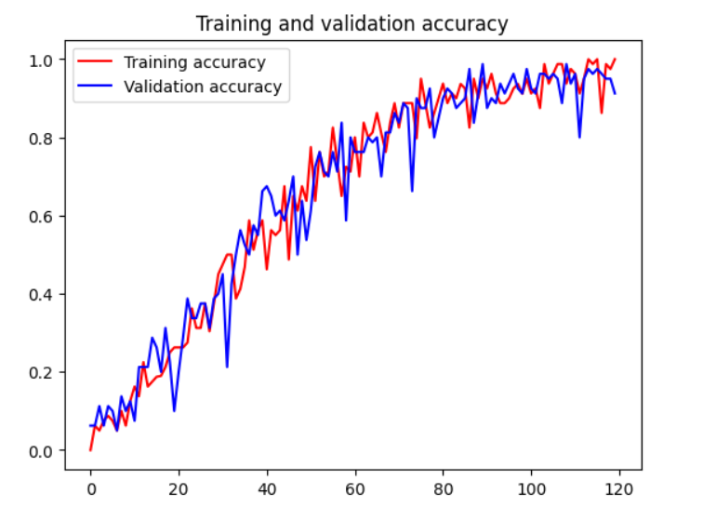
Results
The training and validation accuracy for classifying injuries using the training data acquired by the CNN model topped out at 95.3%.

Slide 24

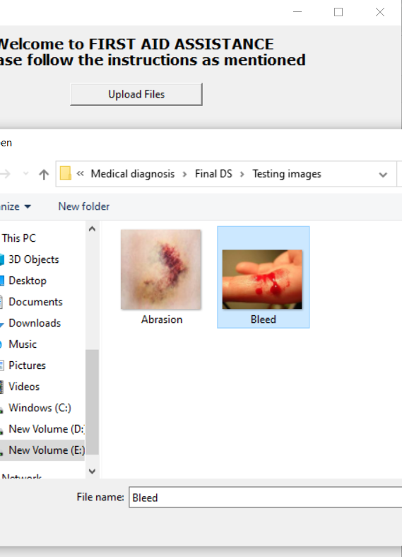
Screen Shots of the Execution

Slide 25
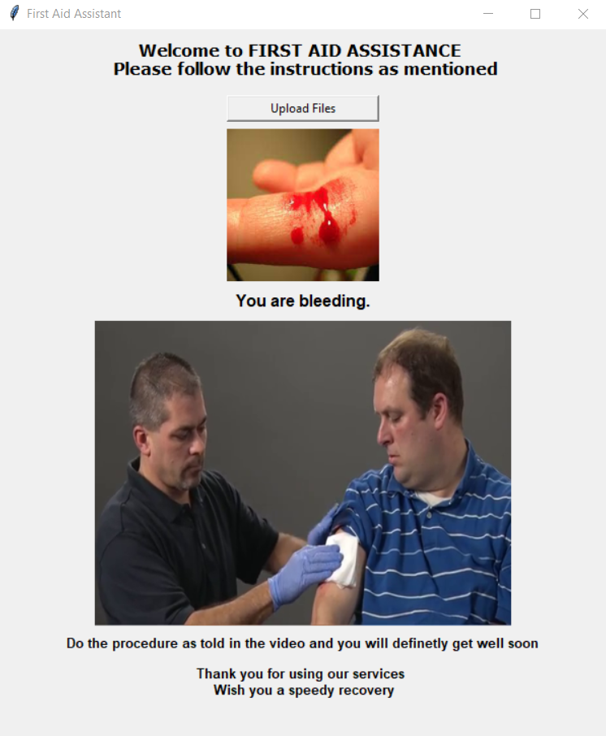
Output

Slide 26
The results of this study are the application of deep learning algorithms in the prediction and treatment of injuries. To our best understanding, the model built according to the proposed method exhibits better accuracy. We have created a feature to aid people in reducing discomfort from joint and muscle injuries.
Conclusion

Slide 27
References
[1] Ahmed Shihab Ahmed ,Hussein Ali Salah, Jalal Q.Jameel "Software Development for First Aid Decision Support System" in Iraqi Journal of Science, 2020, Vol. 61, No. 1, pp: 202-214, DOI: 10.24996/ijs.2020.61.1.23.
[2] Eman Galaleldin Ahmed Kalil "A Novel Method for Robots to Provide First Aid to Injured People Inside the Mines Using GIS Technology" in IJCSNS International Journal of Computer Science and Network Security, VOL.23 No.8, August 2023, DOI: 10.22937/IJCSNS.2023.23.8.1.
[3] Qing Liu, Liping Yang, and Qingrong Peng "Artificial Intelligence Technology-Based Medical Information Processing and Emergency First Aid Nursing Management" in Comput Math Methods Med. 2022; 2022: 8677118, DOI: 10.1155/2022/8677118.

Slide 28
Thank You

