Slide 1
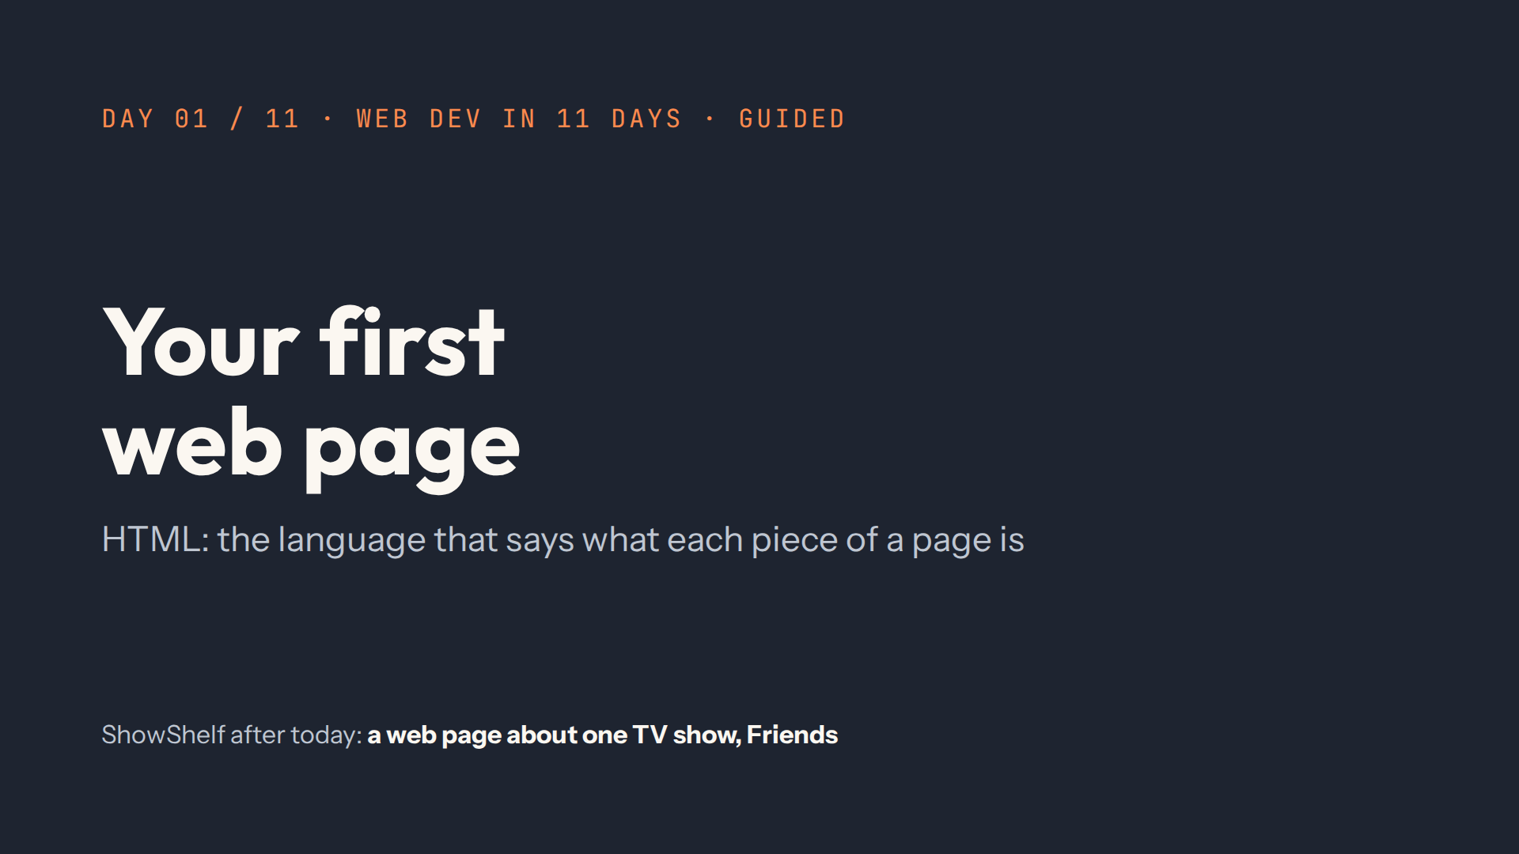
Notes:
Script 0:00 and 0:05. Welcome, then the warm-up from quiz.md. Open #/day/11 in the Lab to show the finished site, then come back to #/day/1.

Slide 2
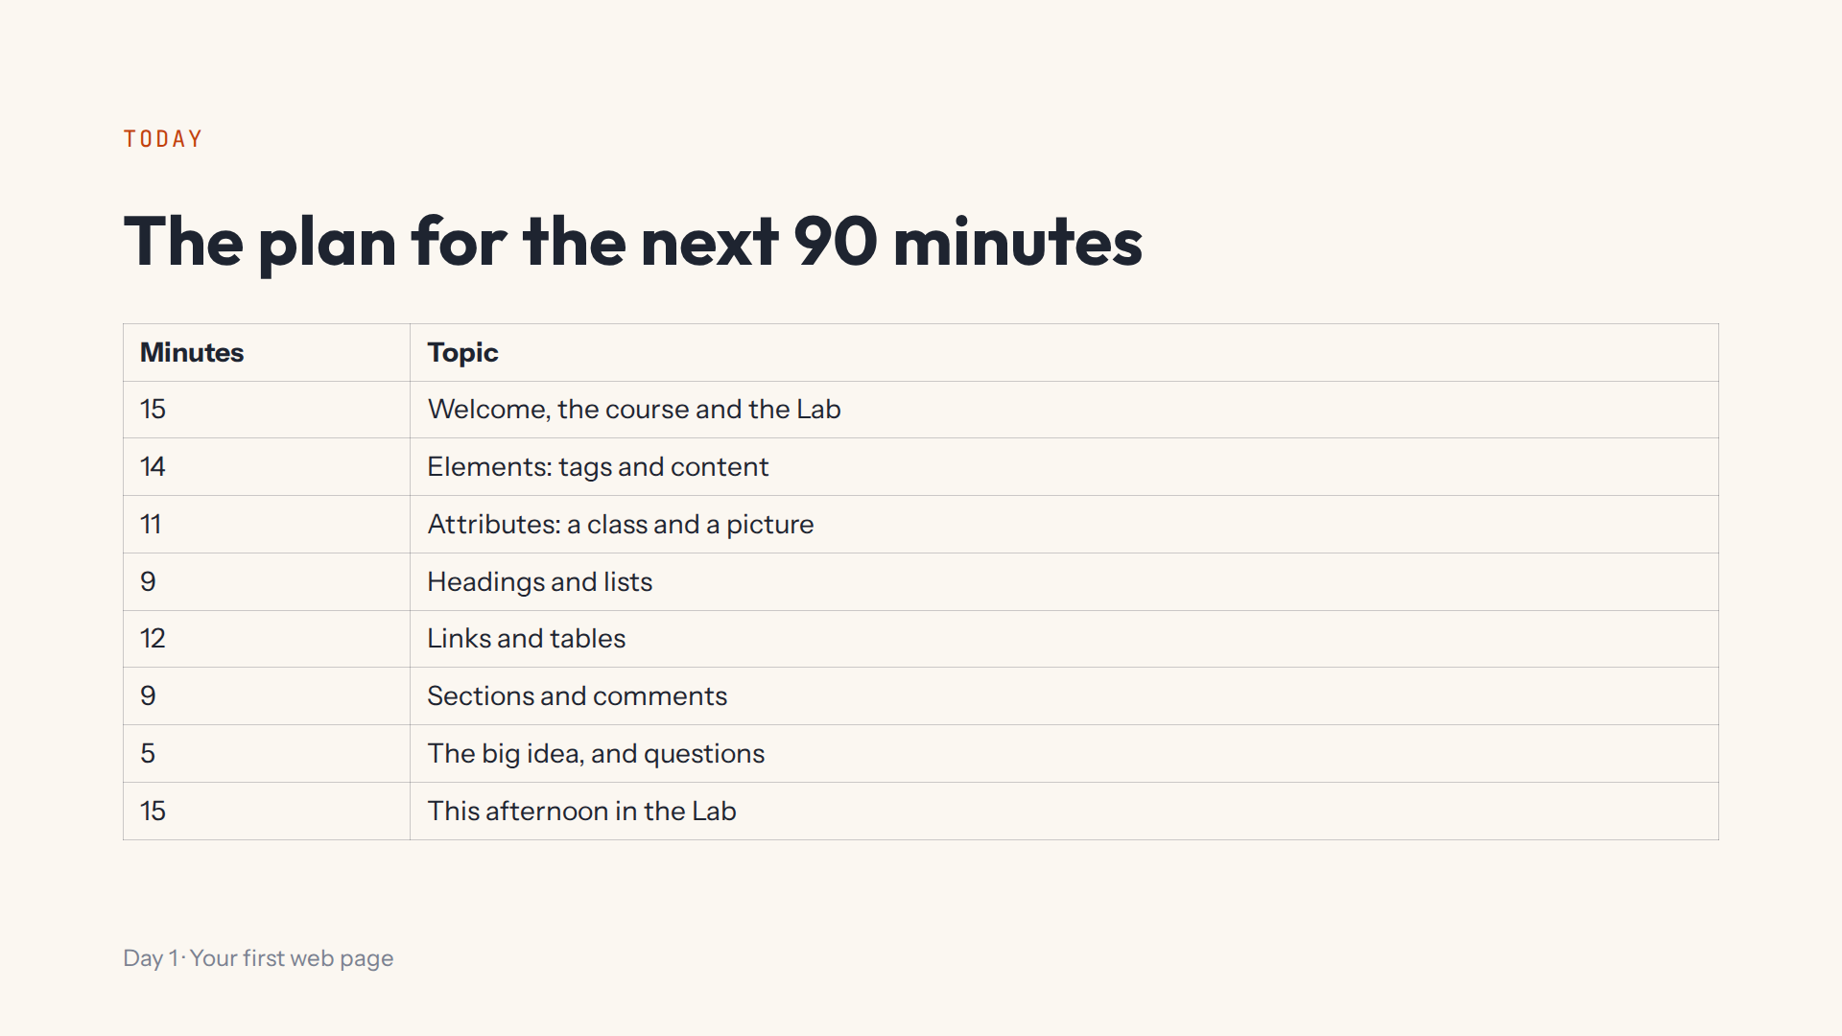

Slide 3
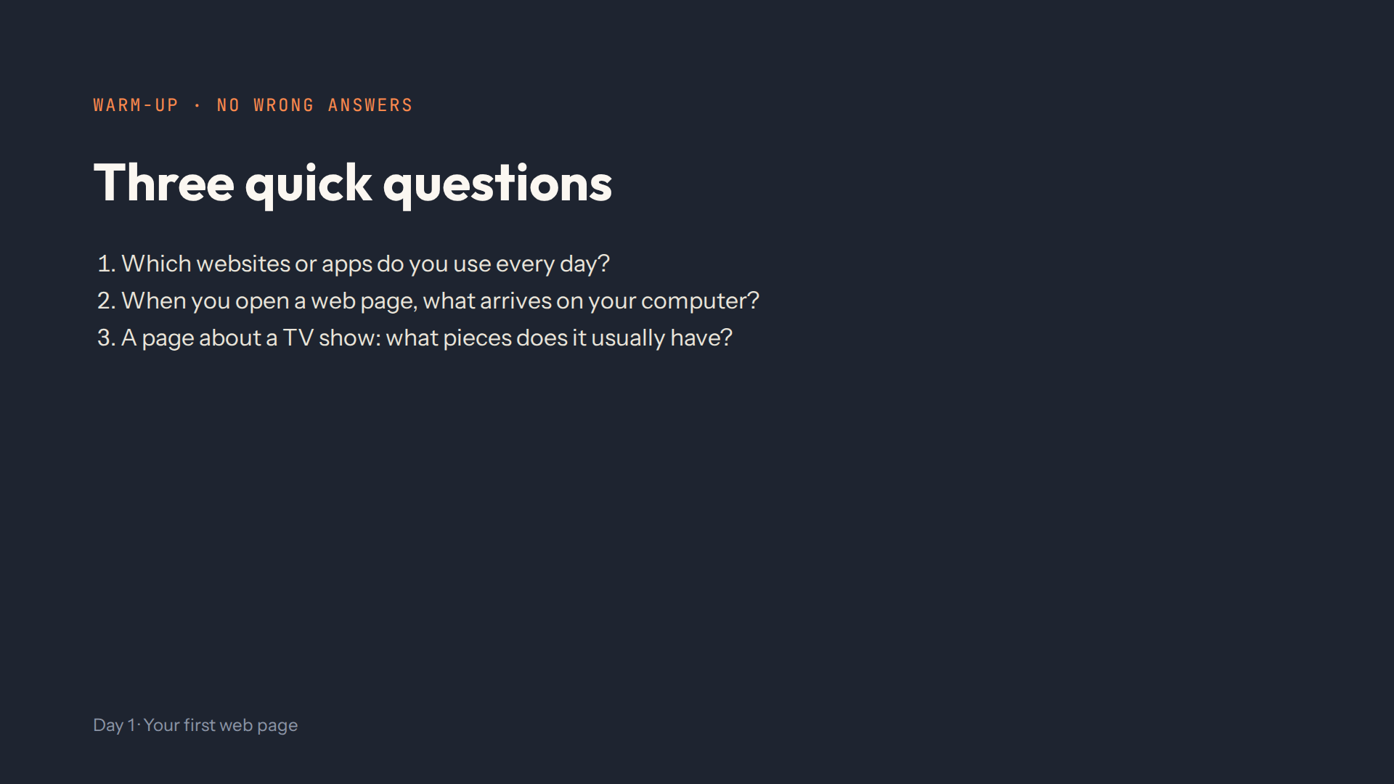
Notes:
Script 0:00. Answers and what to listen for are in quiz.md. Note who has seen code before: they can help neighbours this afternoon.

Slide 4
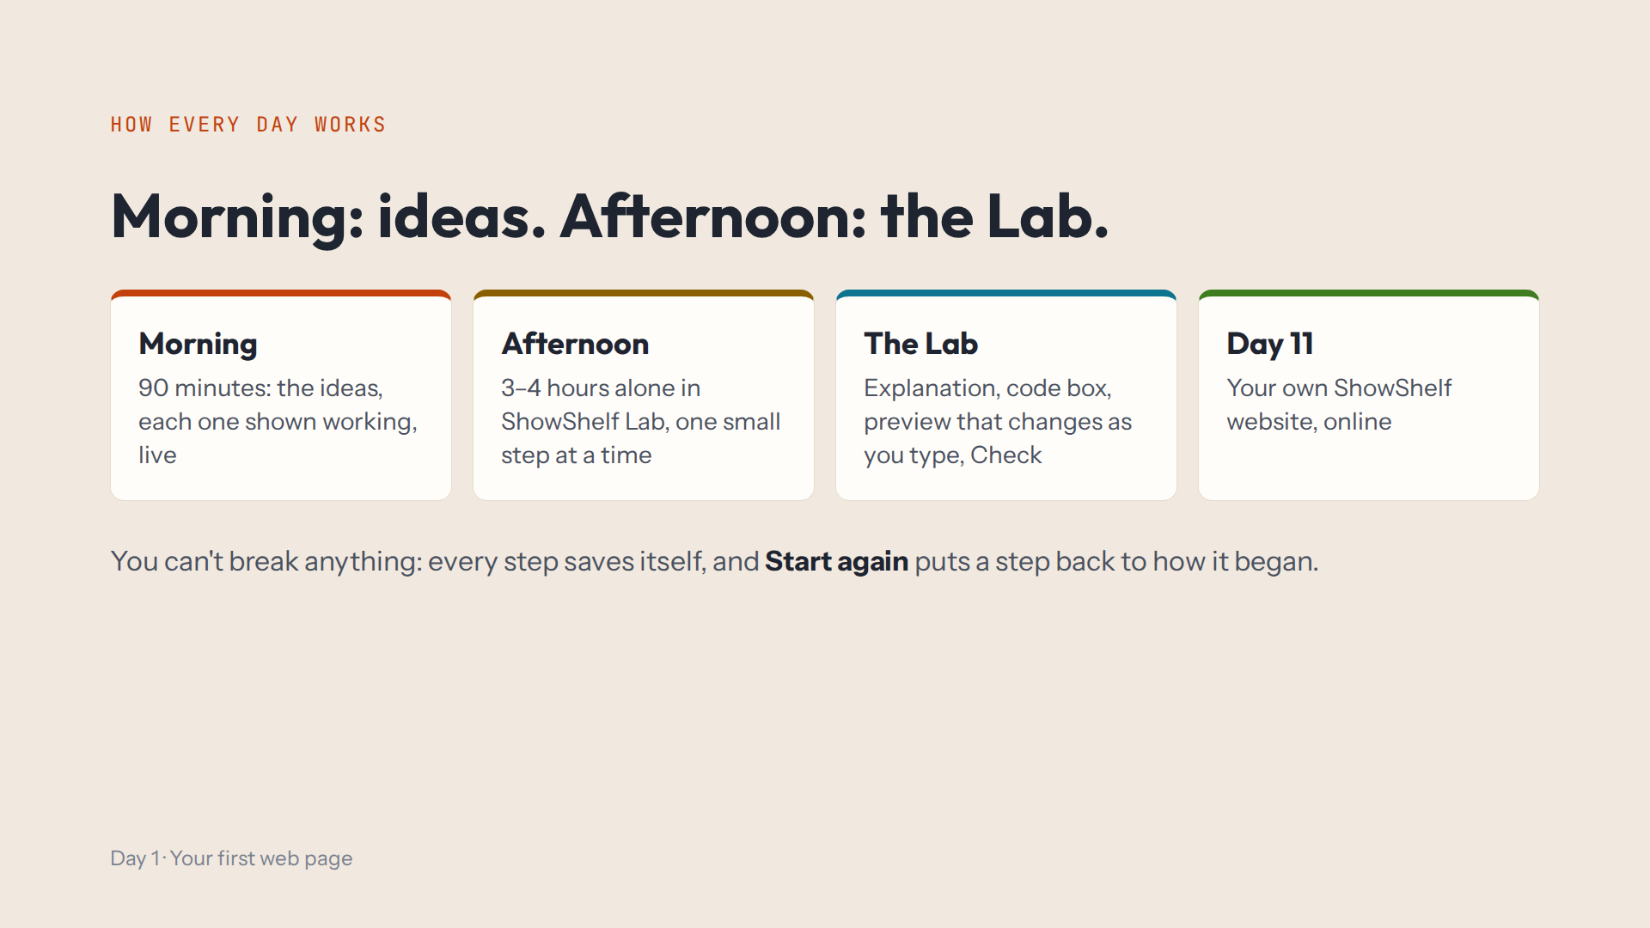
Notes:
Script 0:05. Show Day 11's overview first: the finished ShowShelf, a TV-show website with My List. Then the daily rhythm and the four parts of a Lab step.

Slide 5
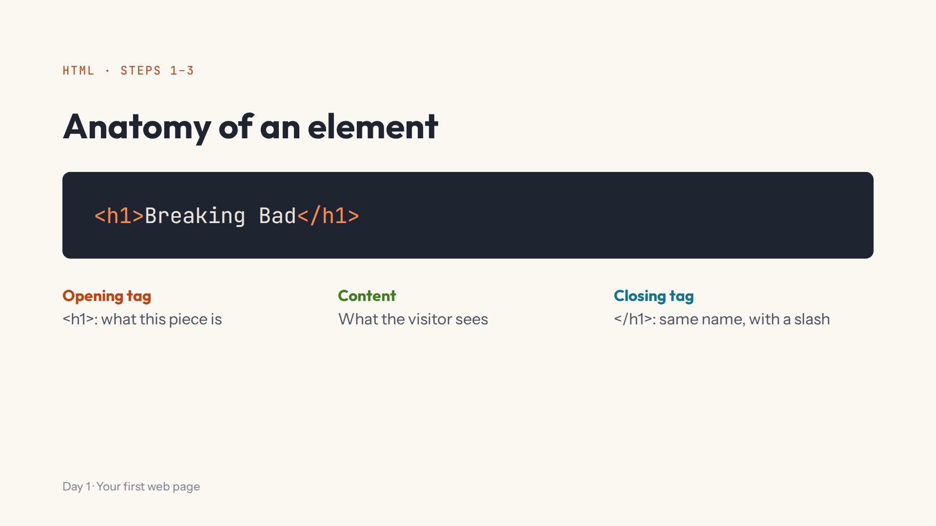
Notes:
Script 0:15. Type in step 1's code box (it starts empty). Then delete the slash on purpose: HTML doesn't complain, it guesses. Put it back.

Slide 6
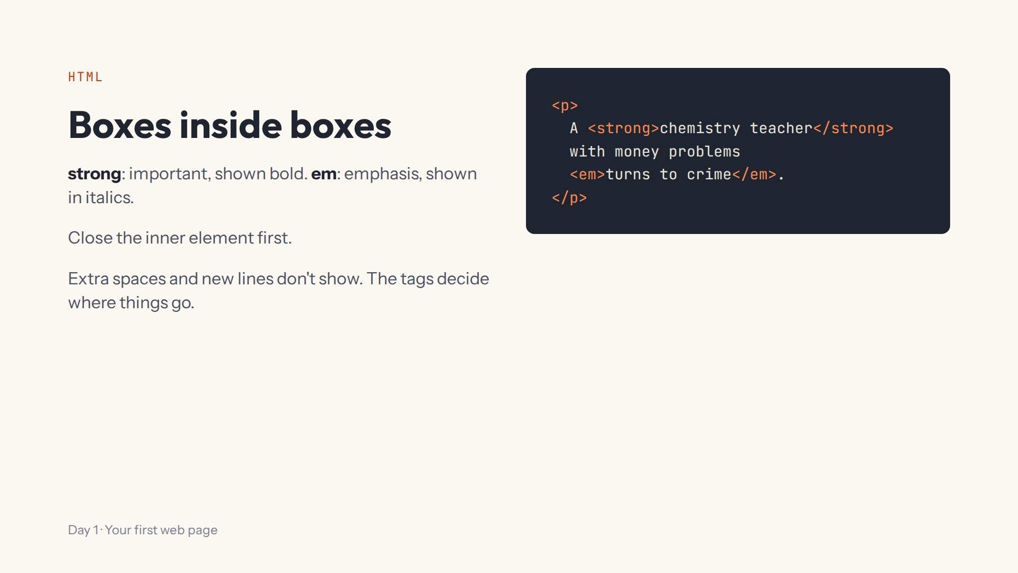
Notes:
Script 0:15, items 4 and 5. Press Enter in the middle of the sentence: the page doesn't change. Ask: which closes first, the em or the p?

Slide 7
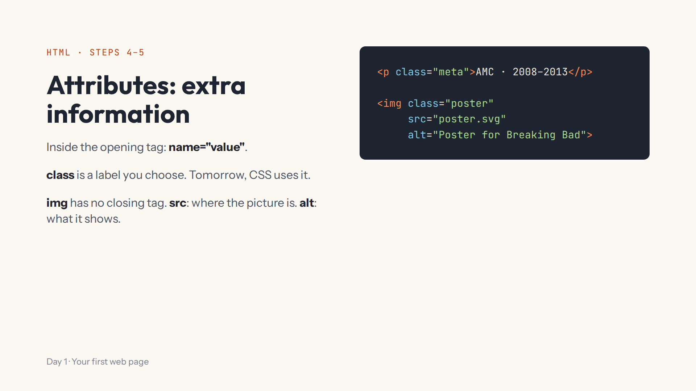
Notes:
Script 0:29. Mistake on purpose: delete the closing quote of class="meta" and the text vanishes. In the Lab a missing picture shows the ShowShelf poster, so the alt text is not visible there. Ask: opening or closing tag for attributes?

Slide 8
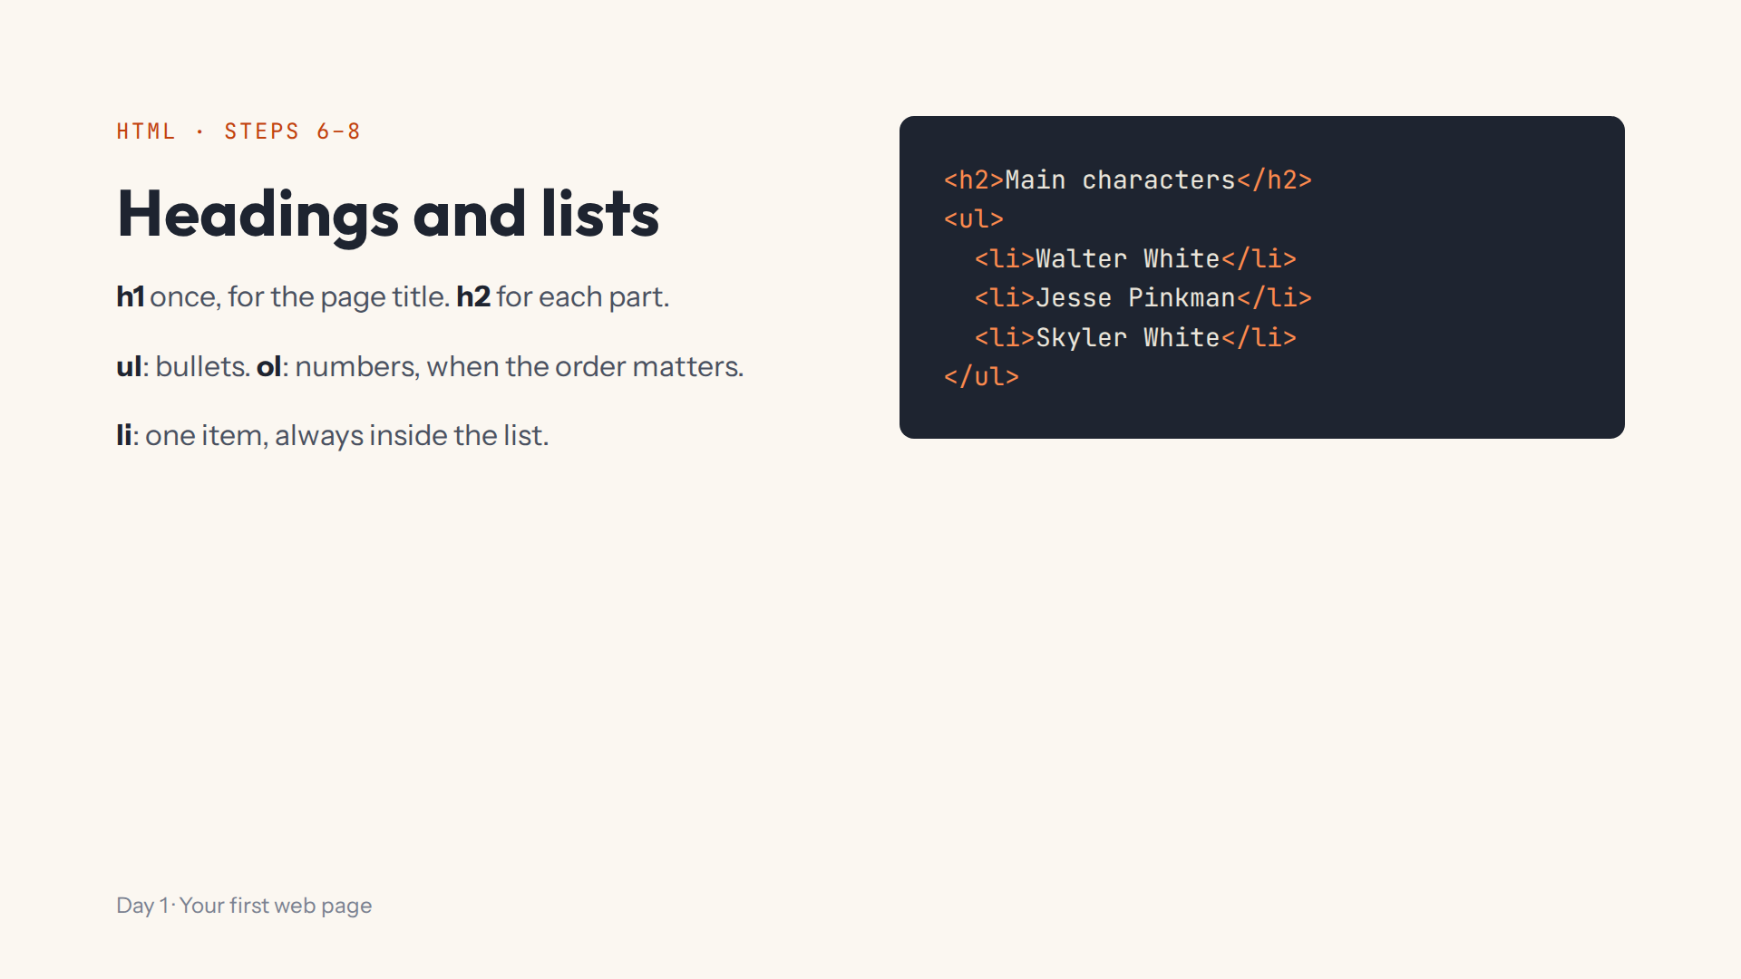
Notes:
Script 0:40. Point at the indenting: two spaces, the Tab key. Then change ul to ol in both tags: numbers appear. Ask: your top three shows, ul or ol?

Slide 9
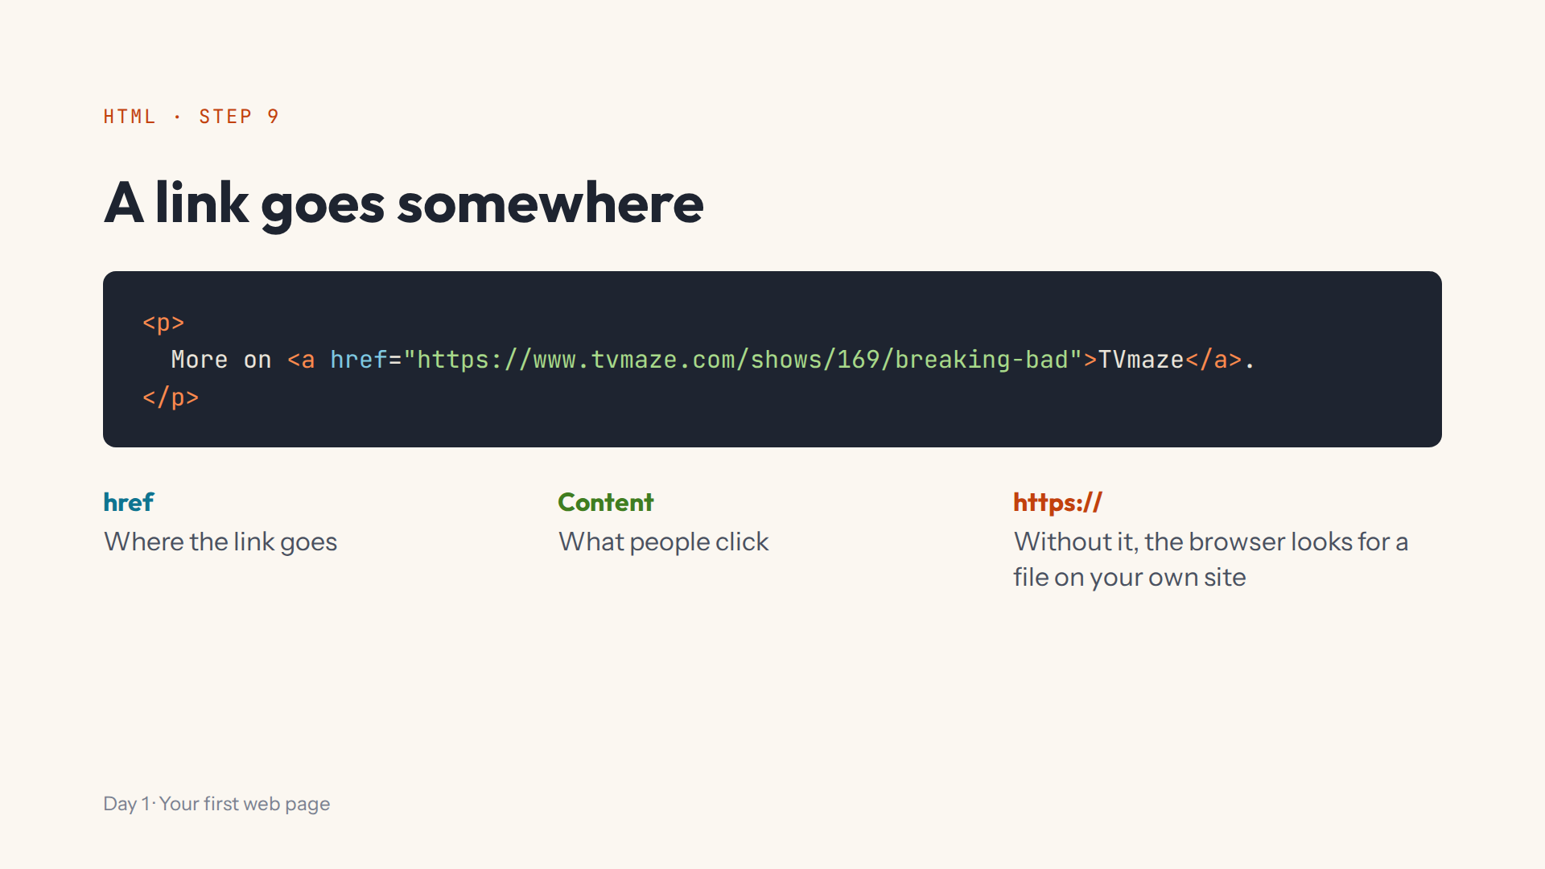
Notes:
Script 0:49. Click the link in the preview: it opens in a new tab. Then remove https:// on purpose and click again: the Lab shows a notice instead.

Slide 10
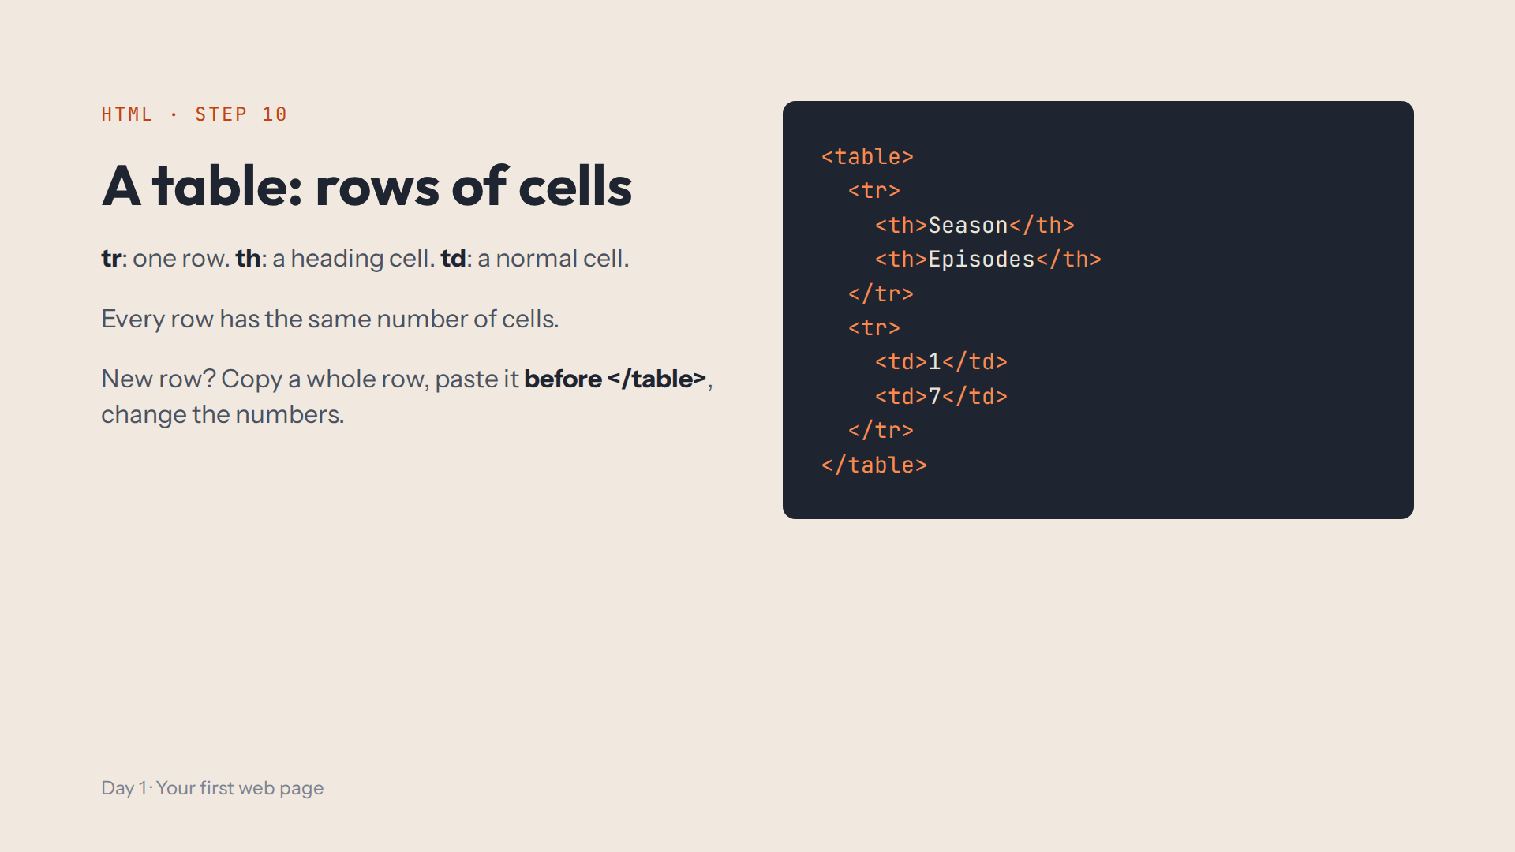
Notes:
Script 0:49, items 3 and 4. Add season 2 (13 episodes) by copy, paste, change. Ask: before or after </table>? Step 10 this afternoon is exactly this, for Friends.

Slide 11
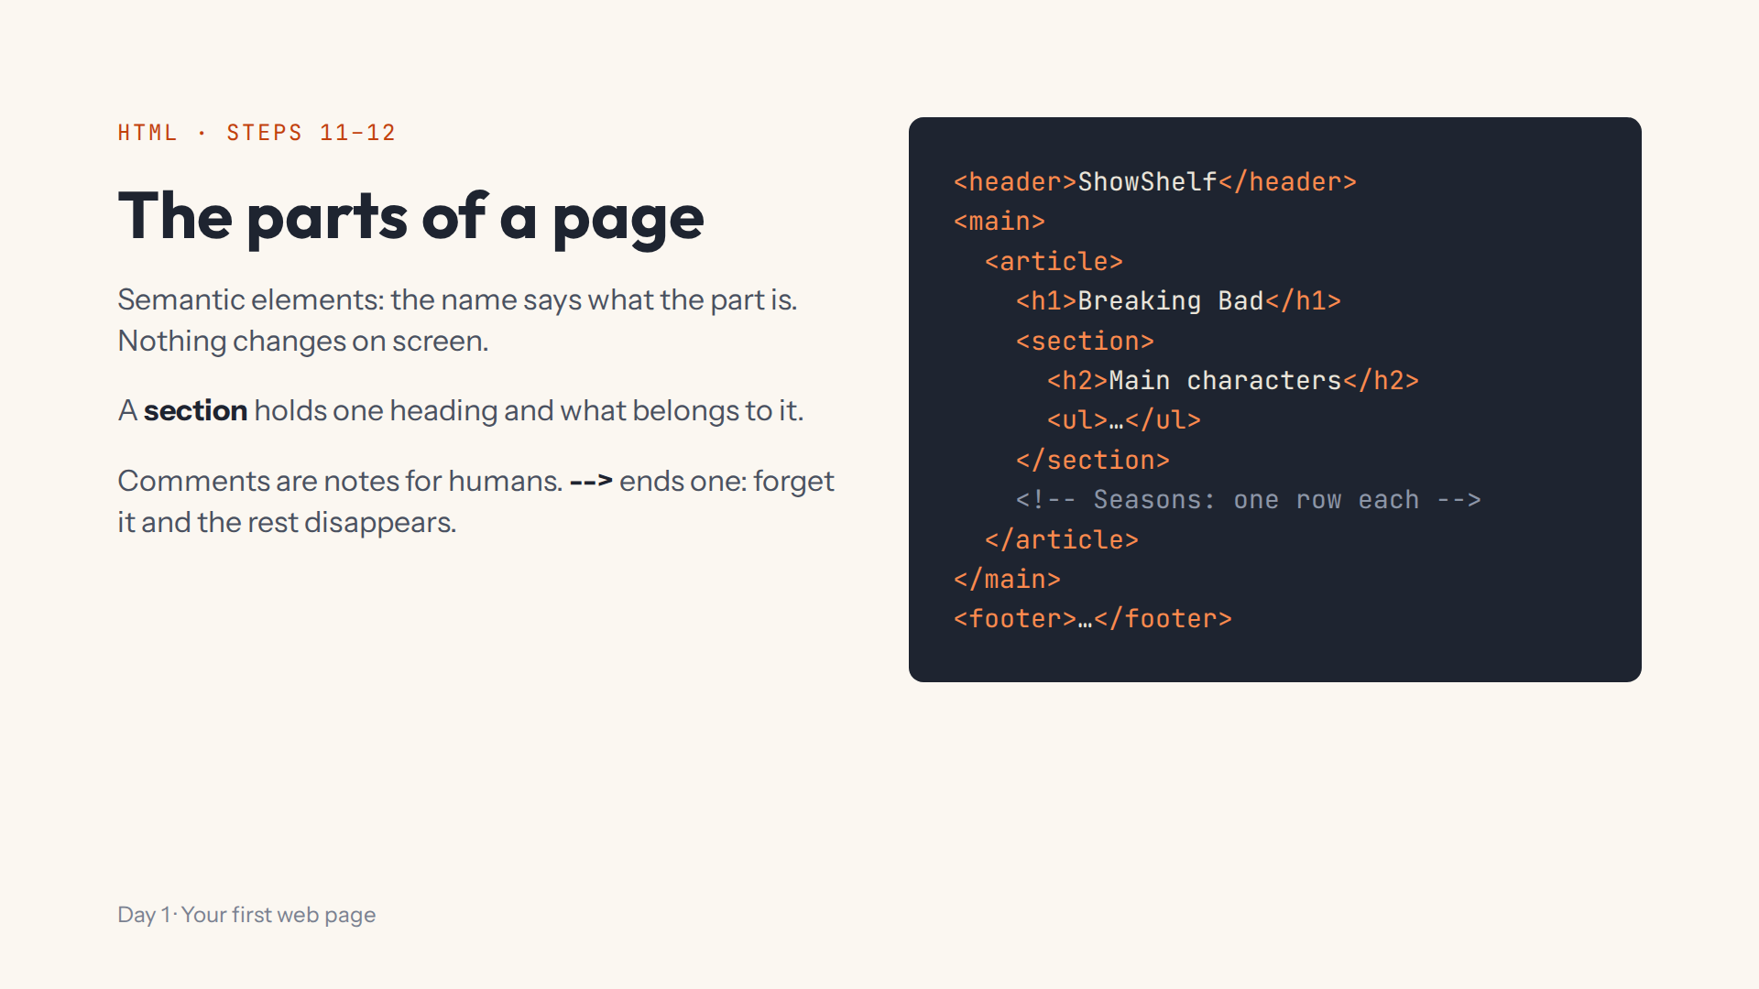
Notes:
Script 1:01. Click the show.html (whole page) tab first: header, main, article, footer are already there. Mistake on purpose: a comment without --> swallows the rest of the page.

Slide 12
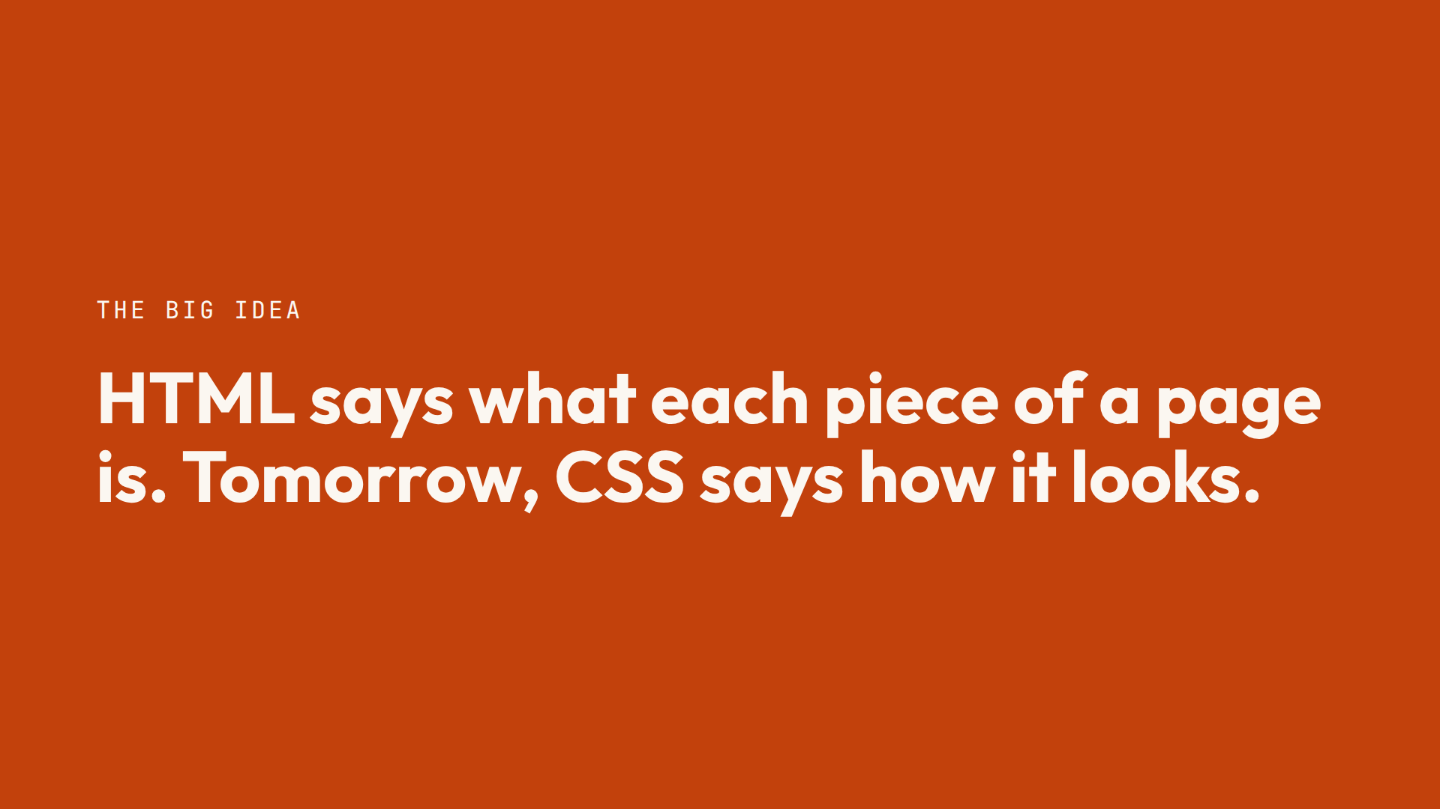

Slide 13
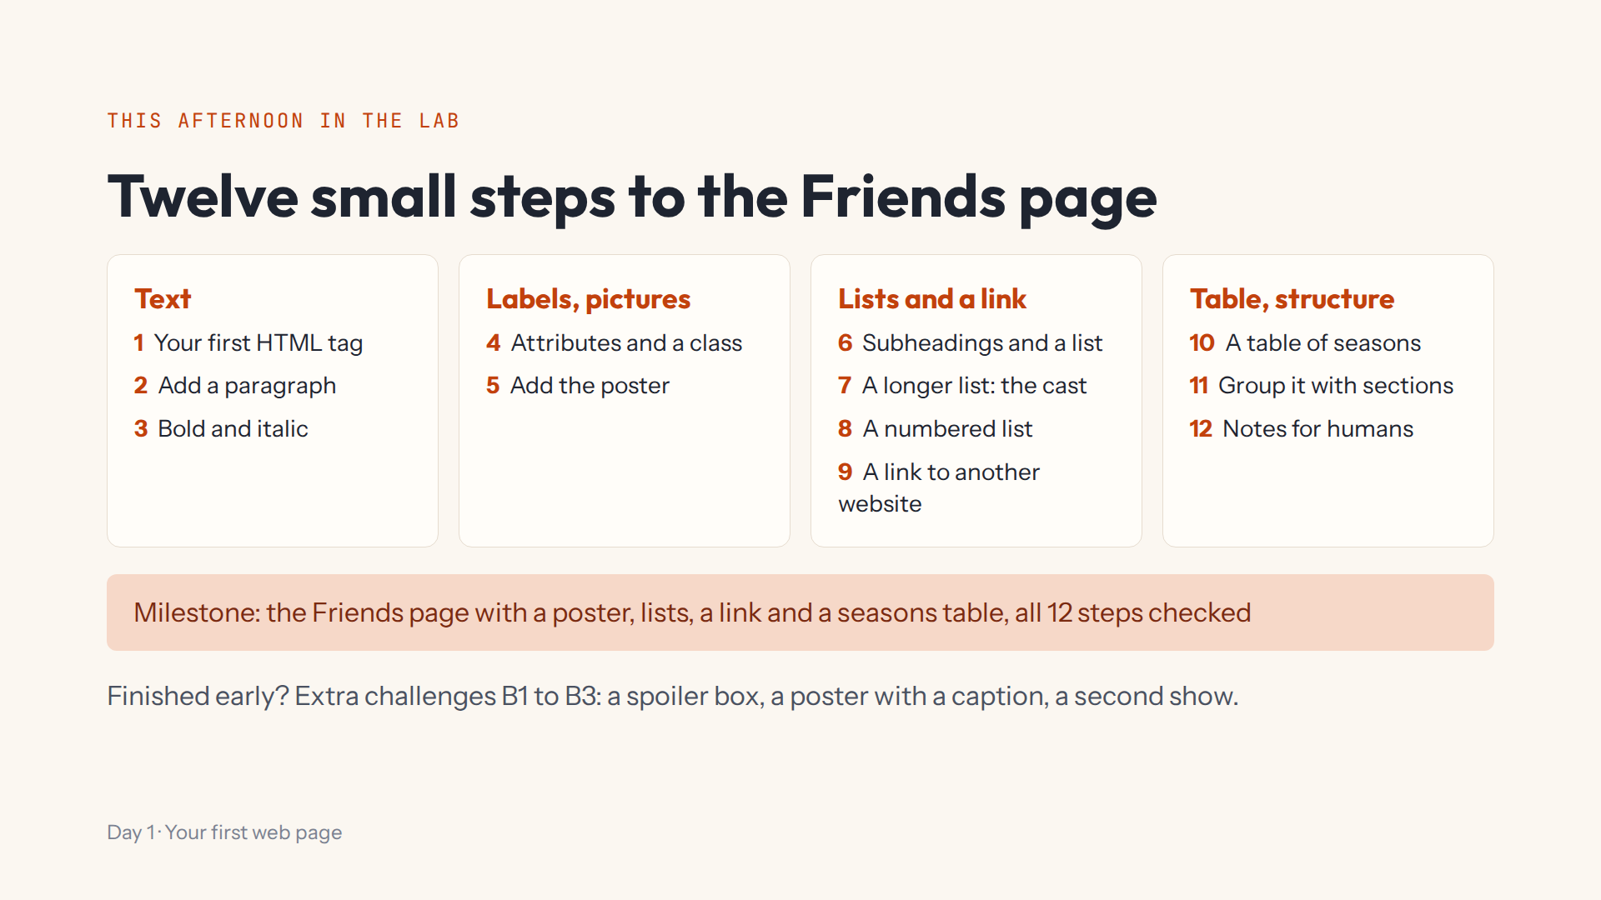
Notes:
Script 1:15. Open #/day/1, read the step list together, then do step 1 together (Start again first, to clear the demo). Show Hint, Answer, the Console and Help > Save progress to a file. Extra challenges: a spoiler box, a captioned poster, a second show.

Slide 14
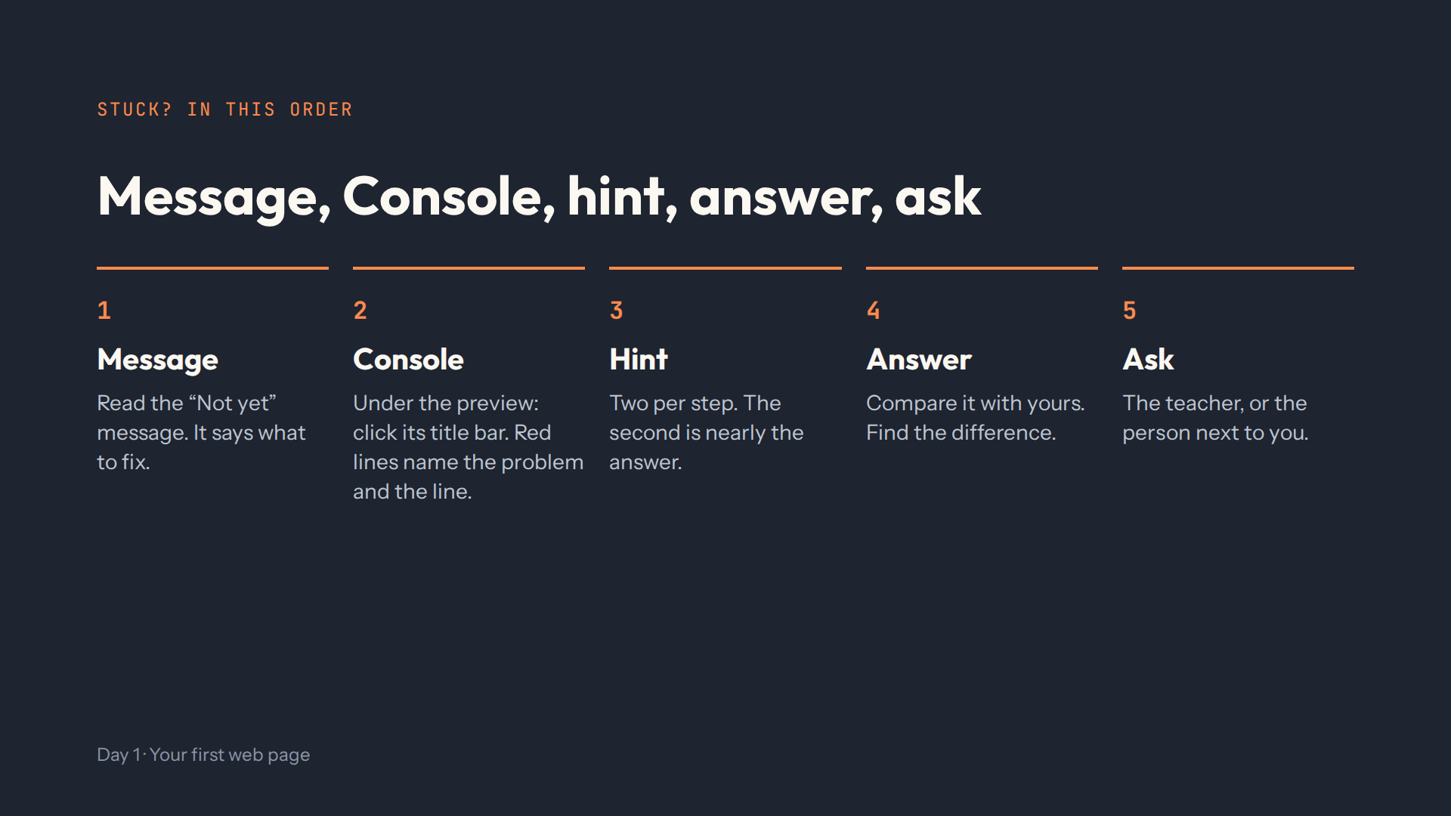
Notes:
Script 1:15, item 3. This order works every day of the course. Introduce the afternoon teacher here.

Slide 15
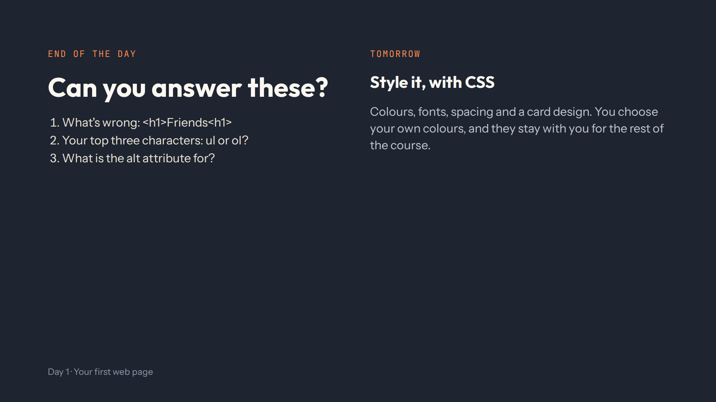
Notes:
For the afternoon teacher, last 10 minutes. Answers: the closing tag needs a slash, </h1>. ol, because the order matters, with li items. alt describes the picture for screen readers and when it can't load. Full check in quiz.md.

