Slide 1
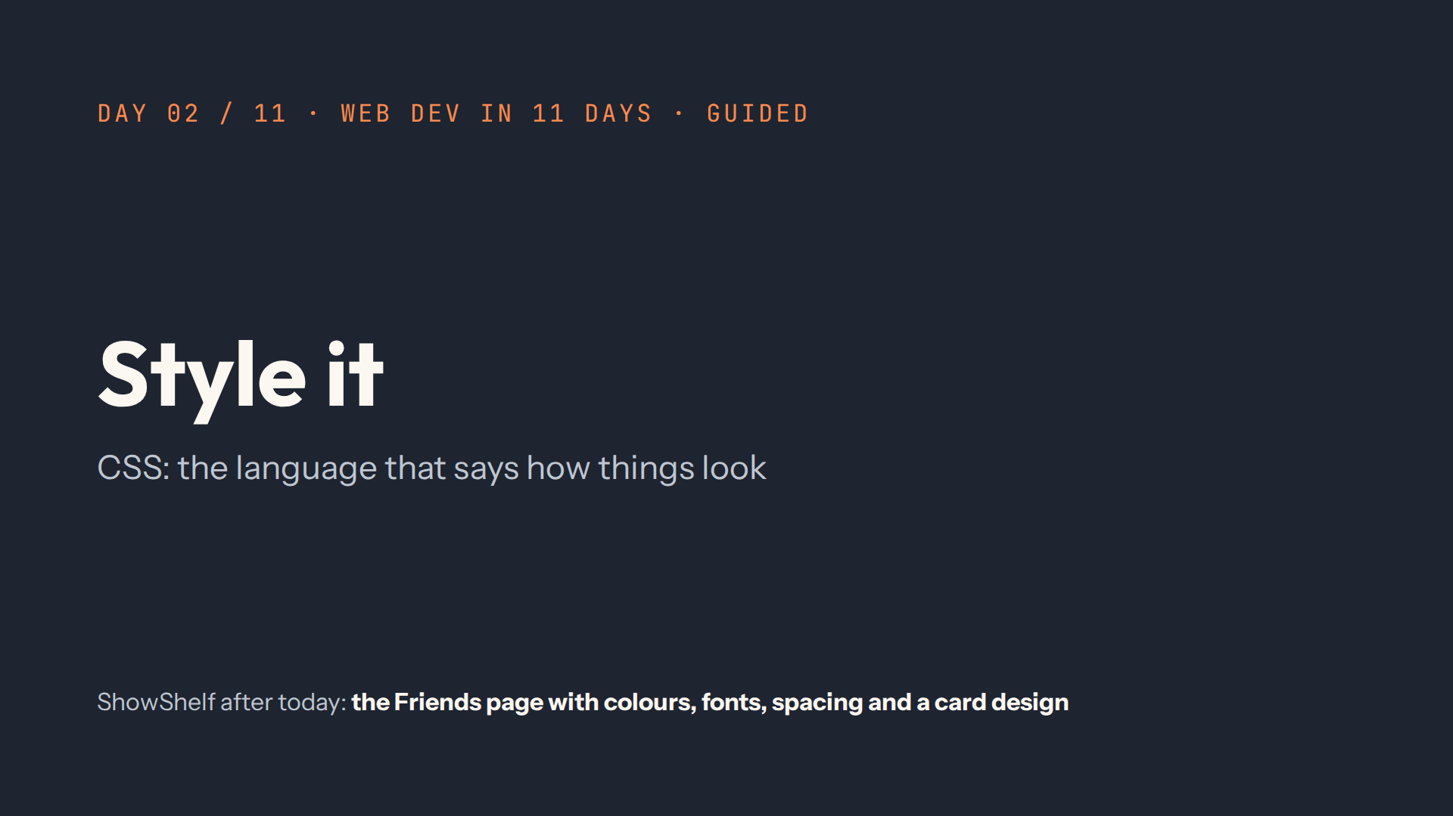
Notes:
Script 0:00. Recap from quiz.md first. Then show yesterday's page at #/day/1: it works, but it looks plain.

Slide 2
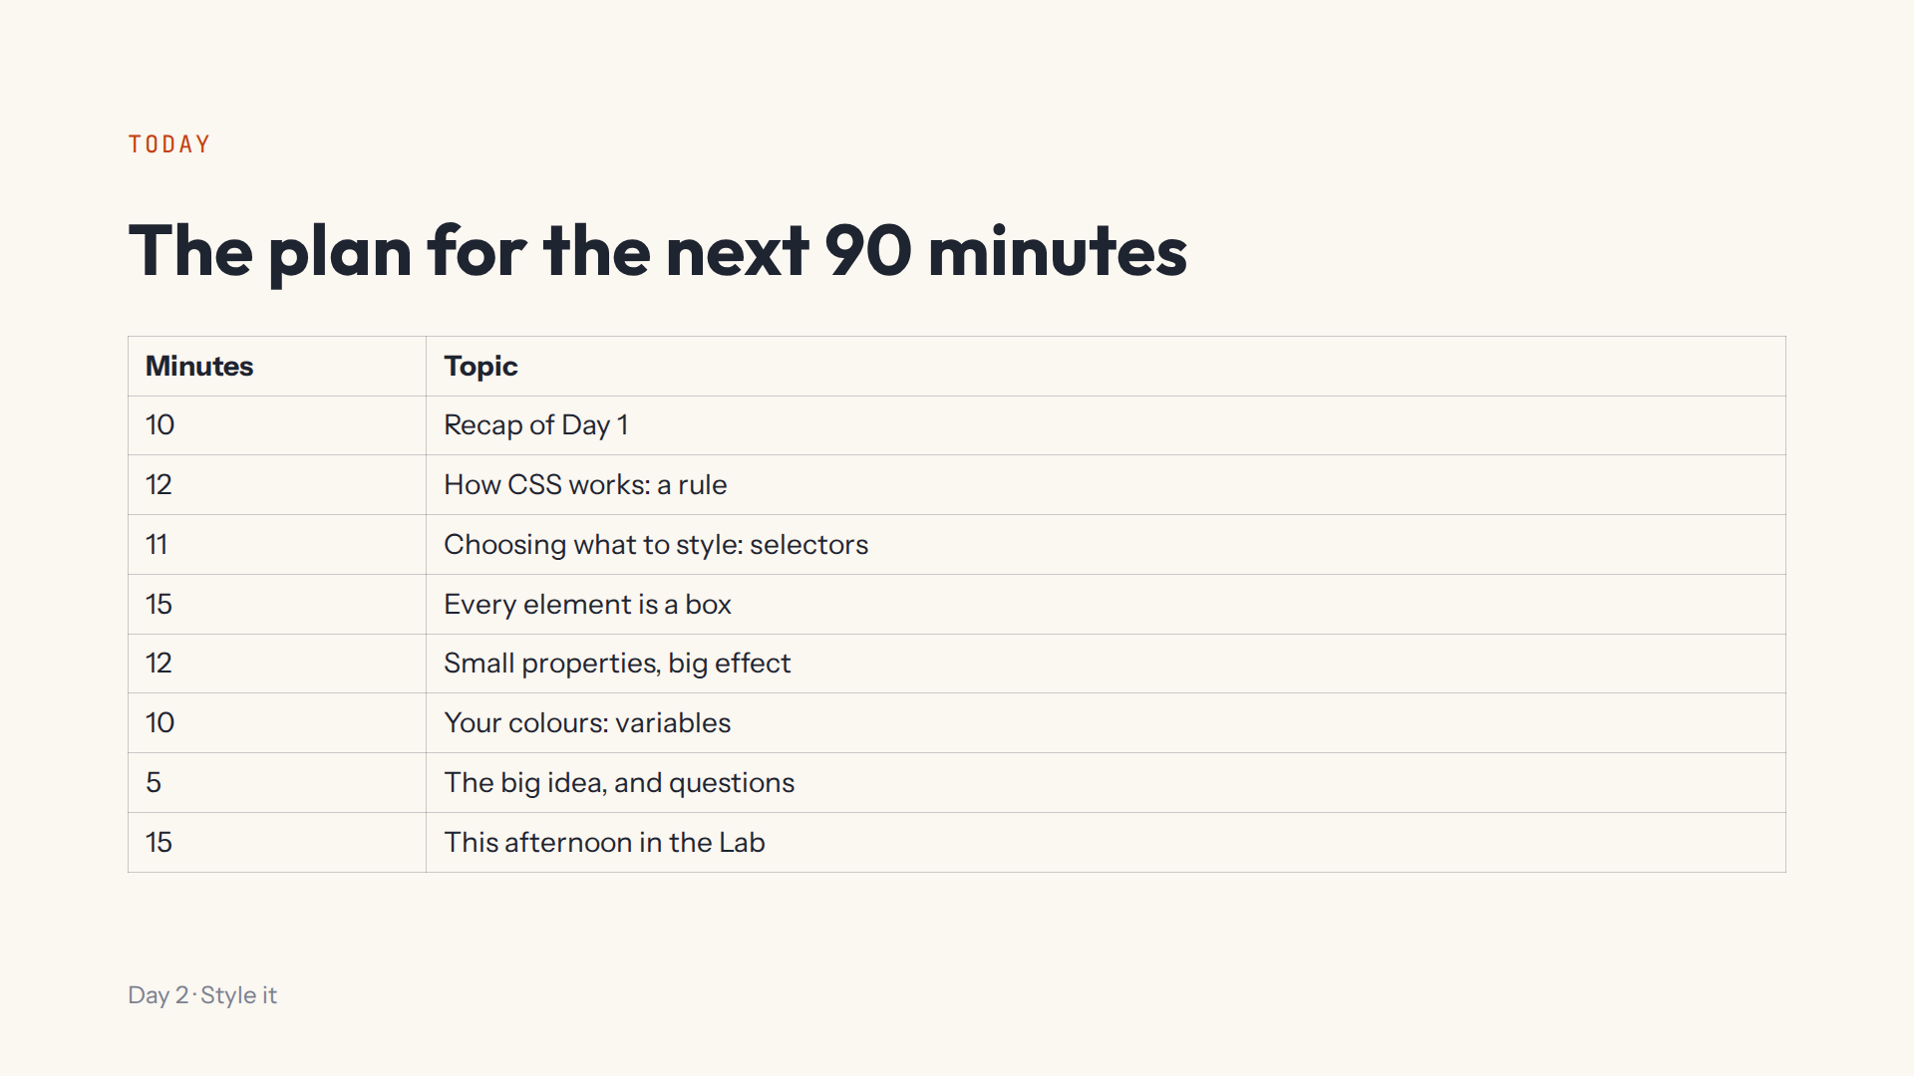

Slide 3
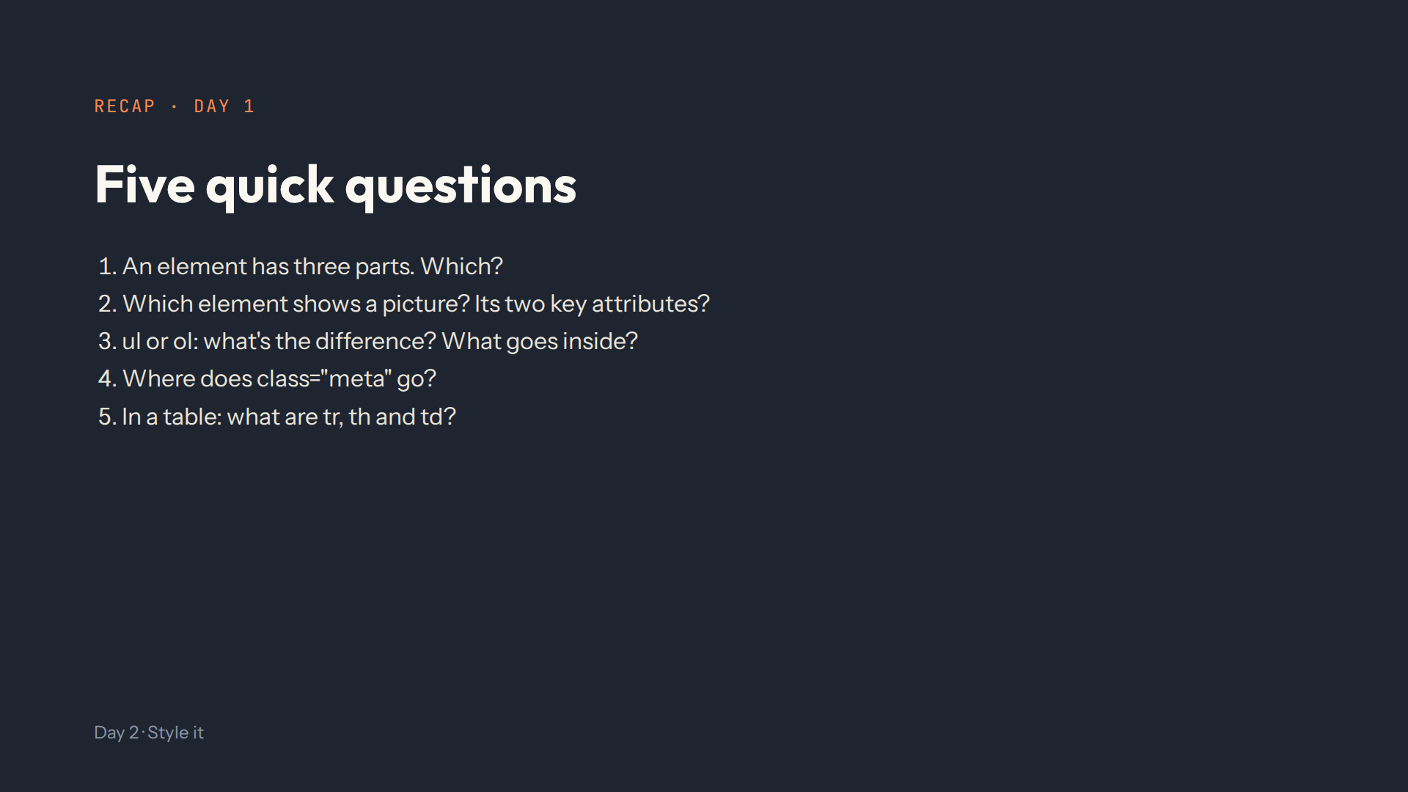
Notes:
Script 0:00. Answers: opening tag, content, closing tag. img, with src and alt. Bullets or numbers, li items inside. In the opening tag. Row, heading cell, normal cell.

Slide 4
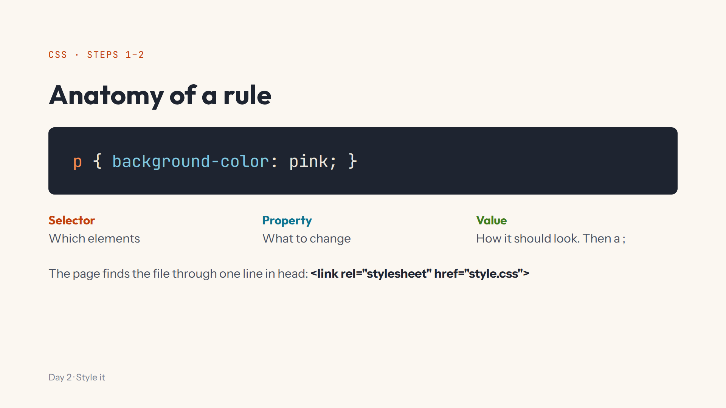
Notes:
Script 0:10. Type p { background-color: pink; } in step 1's code box: ugly on purpose, to prove the file is connected. Mistake on purpose: background-colour, CSS skips it silently.

Slide 5
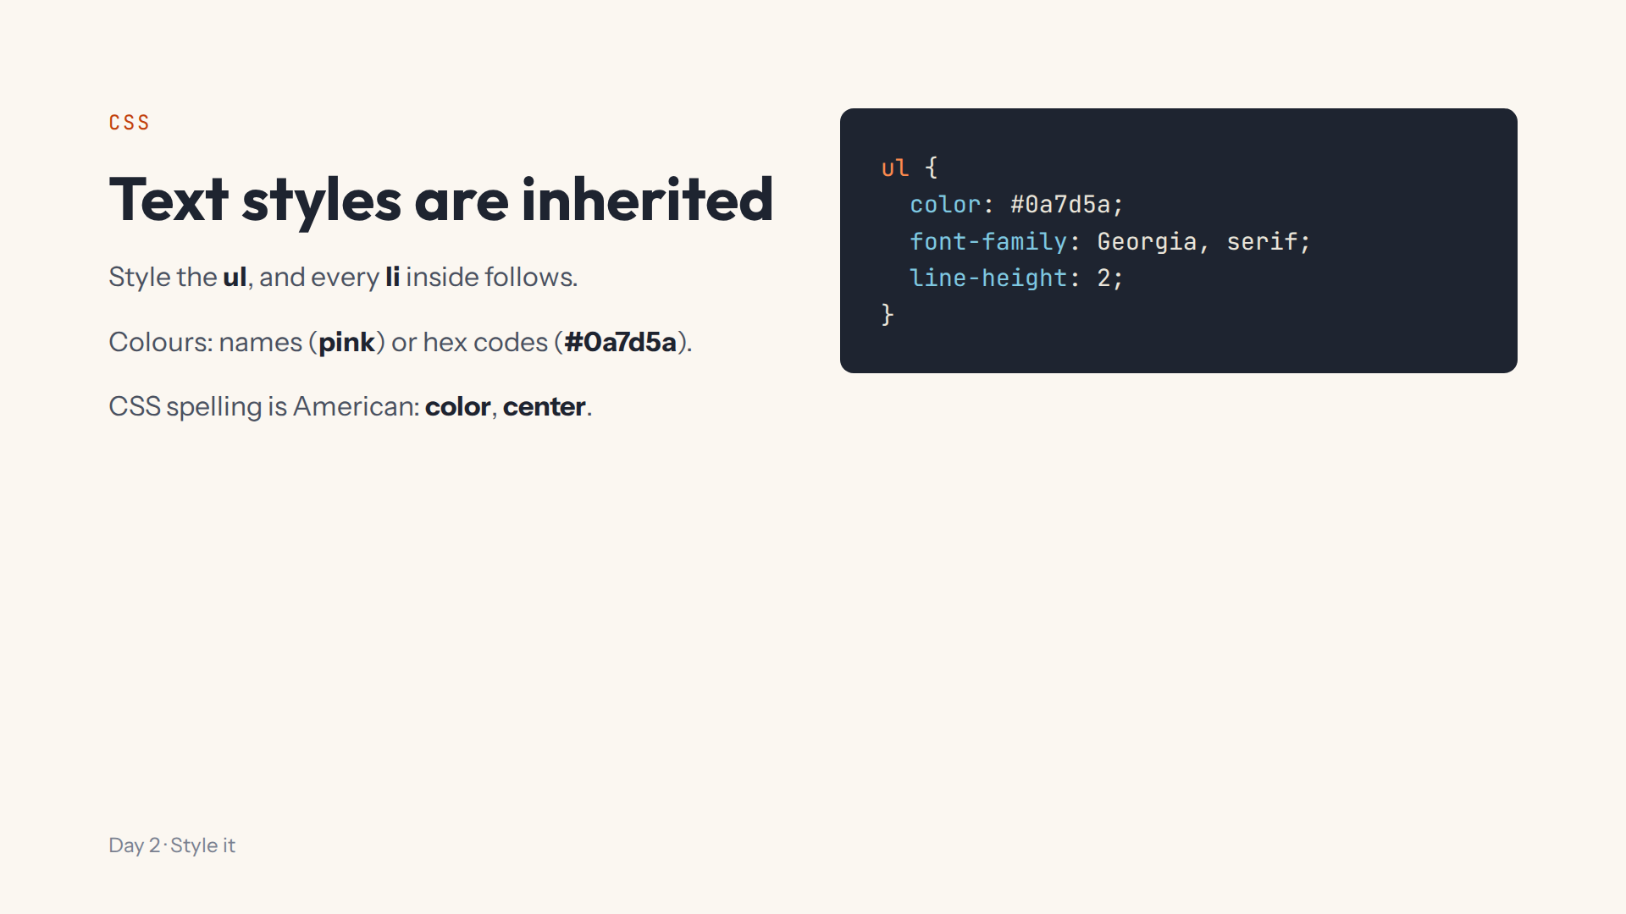
Notes:
Script 0:10, items 5 and 6. Switch pink to a hex code first. Then the ul rule: all the list items change. This afternoon they style body, and the whole page follows.

Slide 6
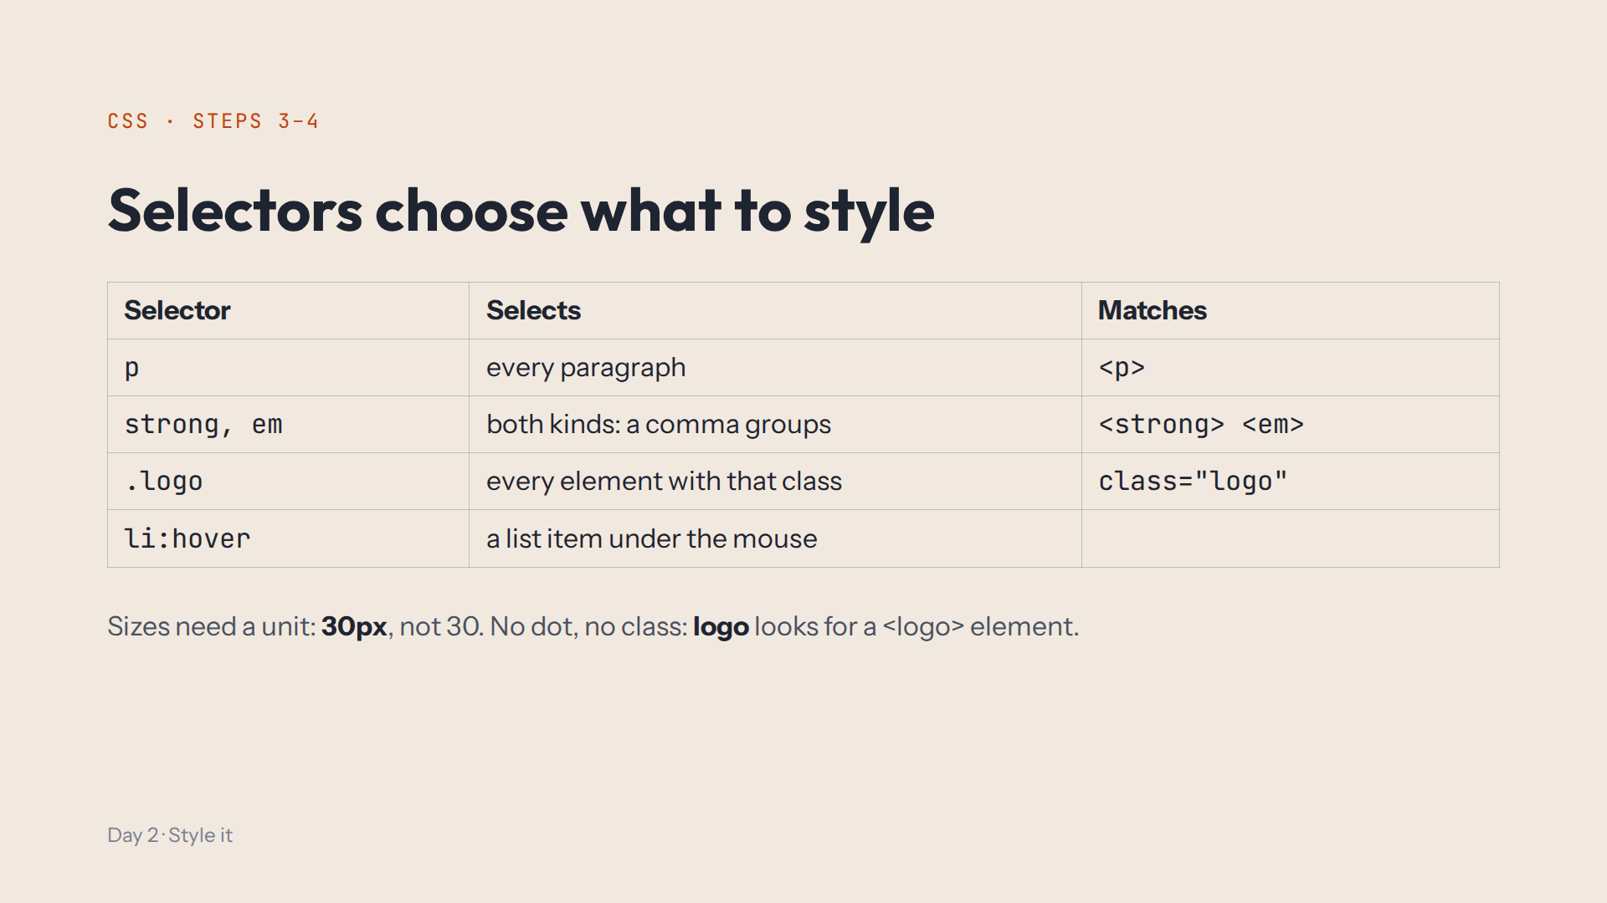
Notes:
Script 0:22. Type strong, em { color: crimson; } then .logo { color: crimson; }. Mistake on purpose: remove the dot. Then font-size: 30; does nothing until you add px.

Slide 7
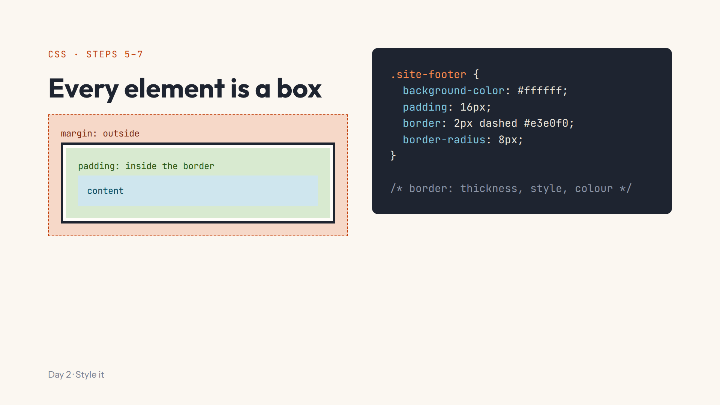
Notes:
Script 0:33. Draw the four layers on the board too. Type the footer rule one line at a time. Mistake on purpose: remove dashed, the border disappears. Ask: did padding grow inside or outside the line?

Slide 8
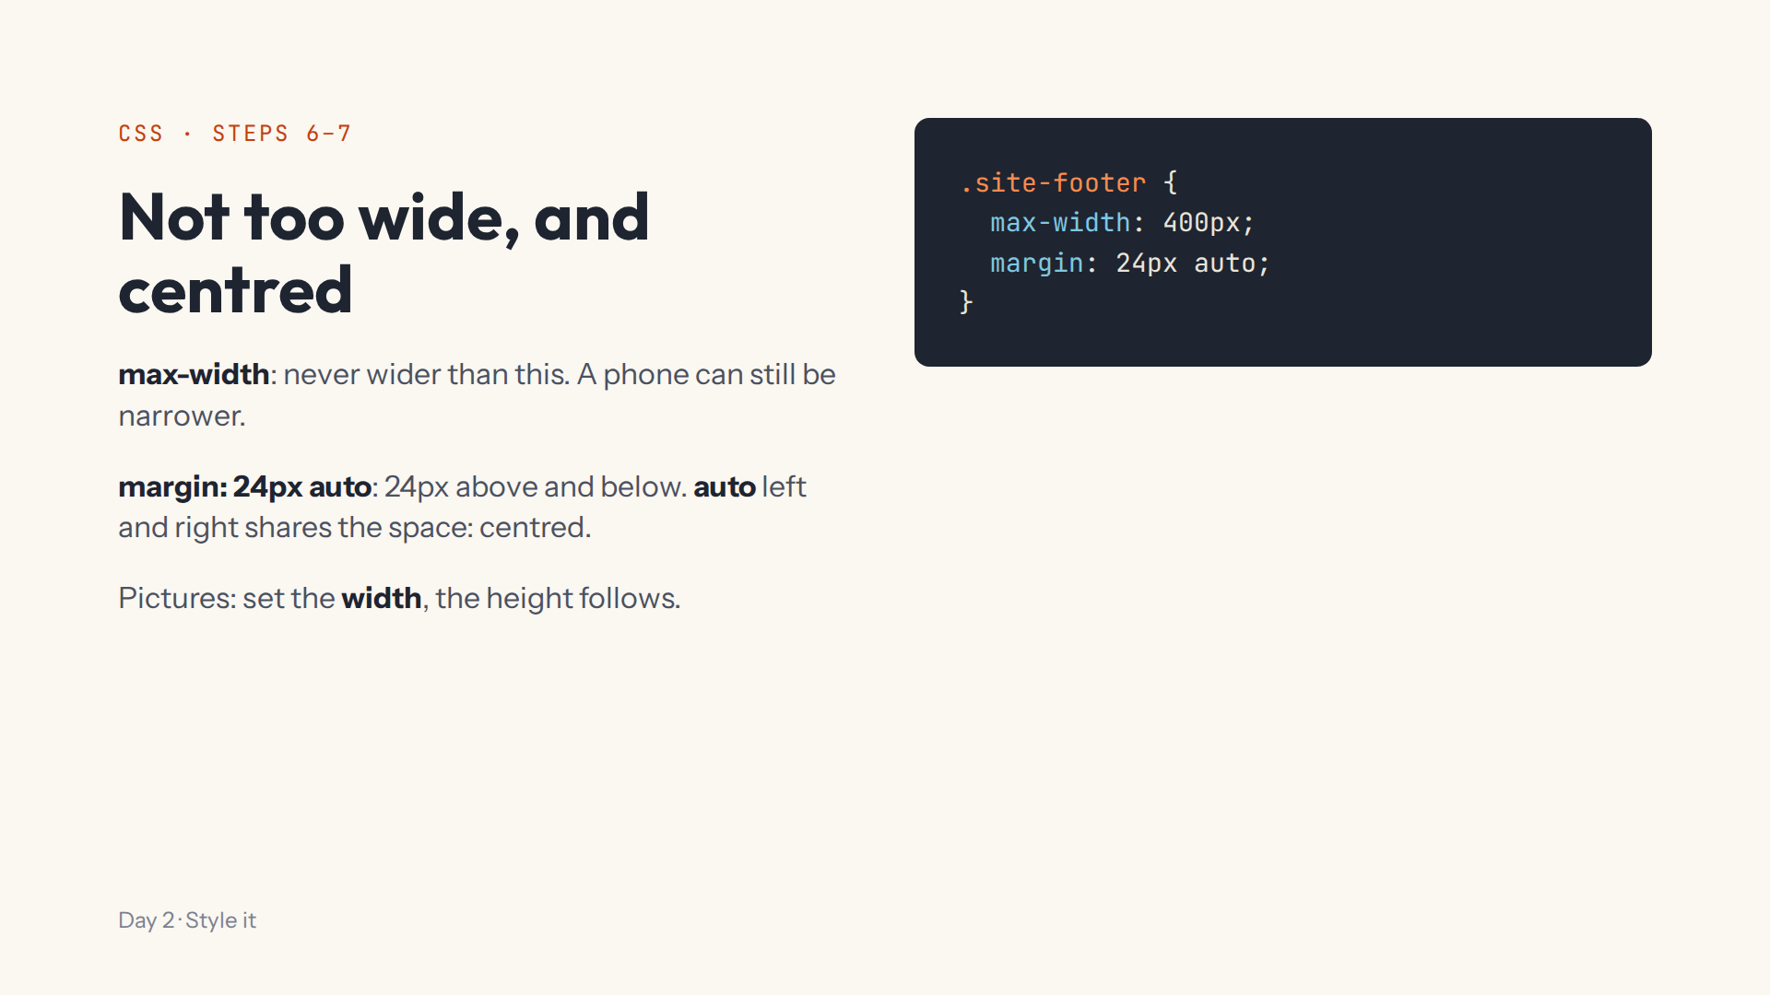
Notes:
Script 0:33, items 4 and 5. Press Bigger above the preview to see the centring on a wide screen. The preview itself is narrow.

Slide 9
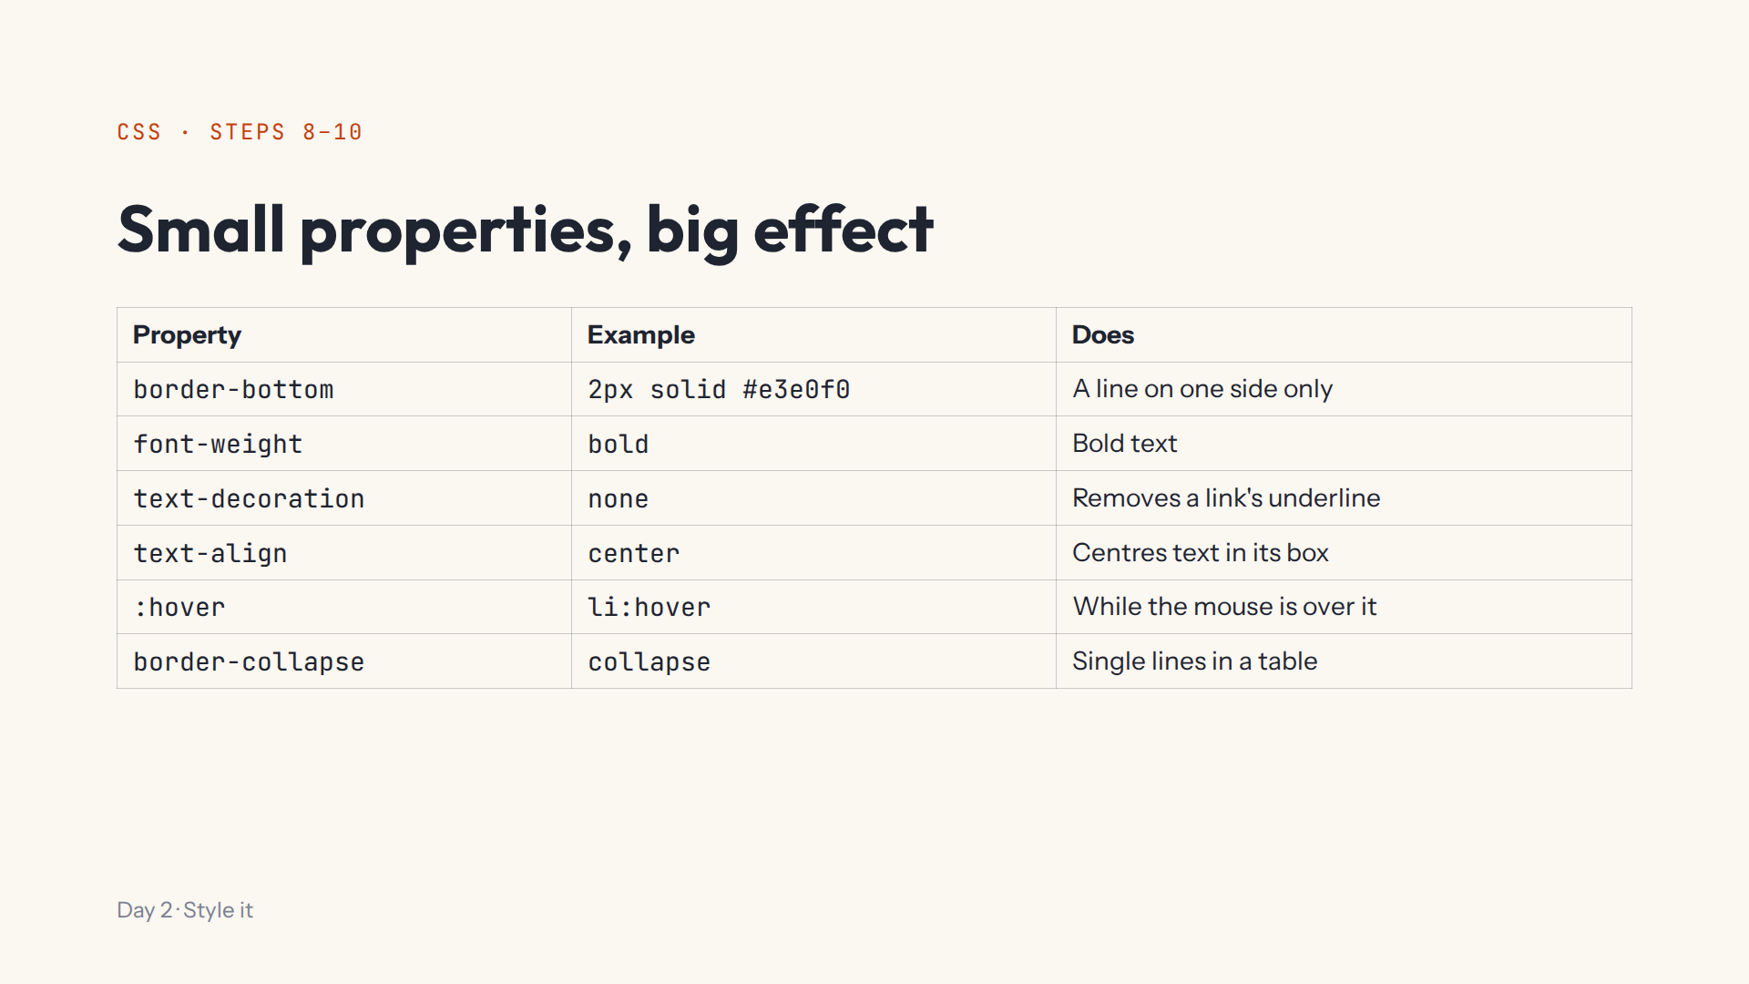
Notes:
Script 0:48. Demo h2 with border-bottom and text-align, then li:hover with a lavender background. Mistake on purpose: li :hover with a space. Tables are explained in step 10.

Slide 10
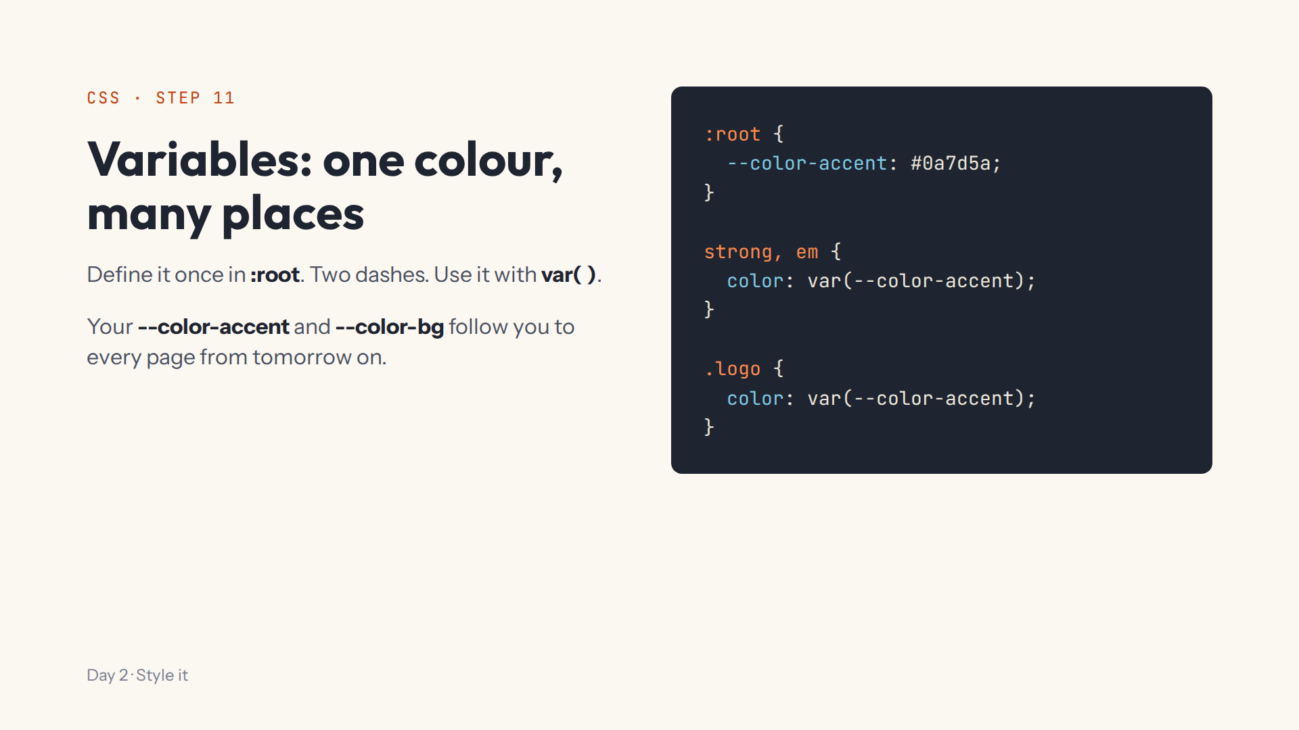
Notes:
Script 1:00. Change the variable once and both rules change. Mistake on purpose: one dash. Stress the exact names and a light --color-bg: the Lab carries them into Day 3 onwards.

Slide 11
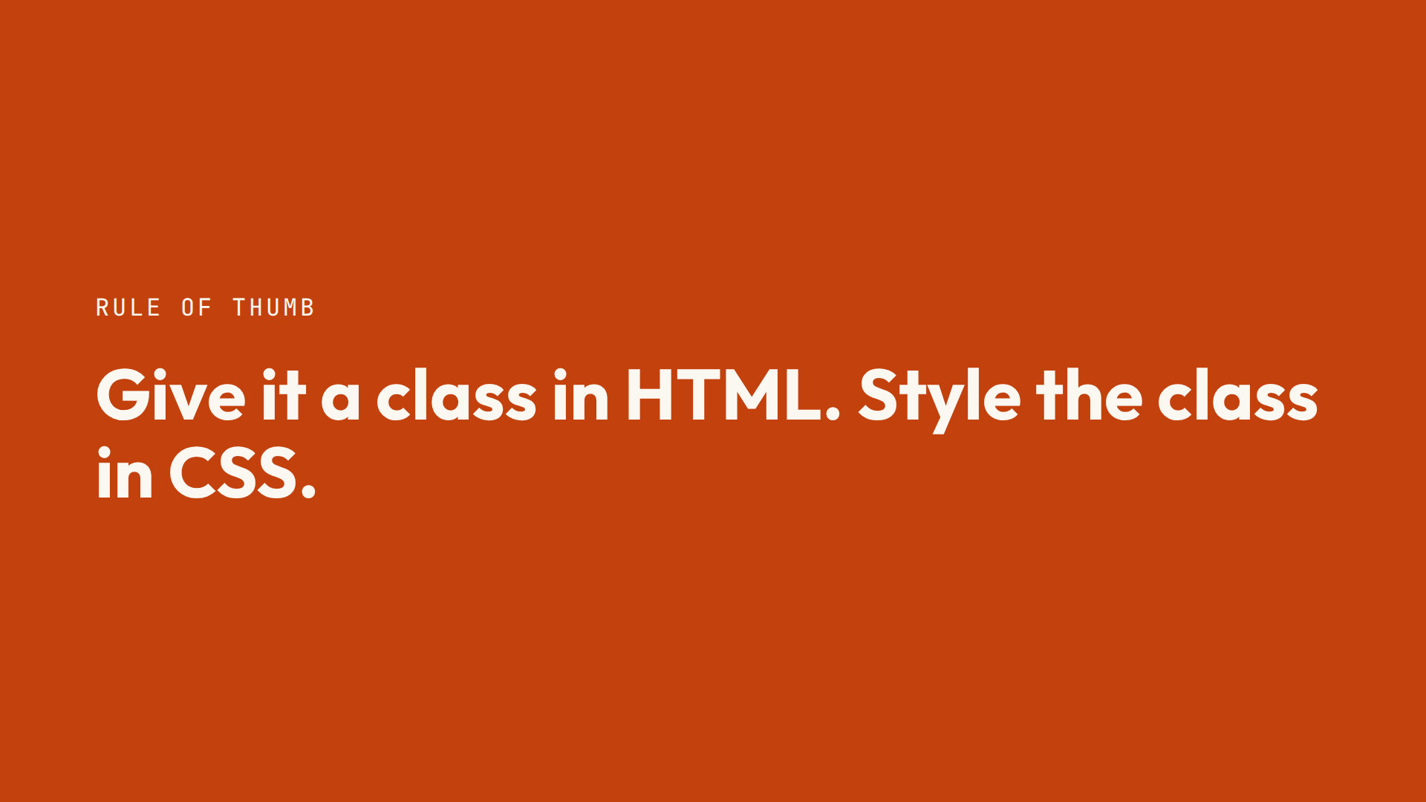

Slide 12
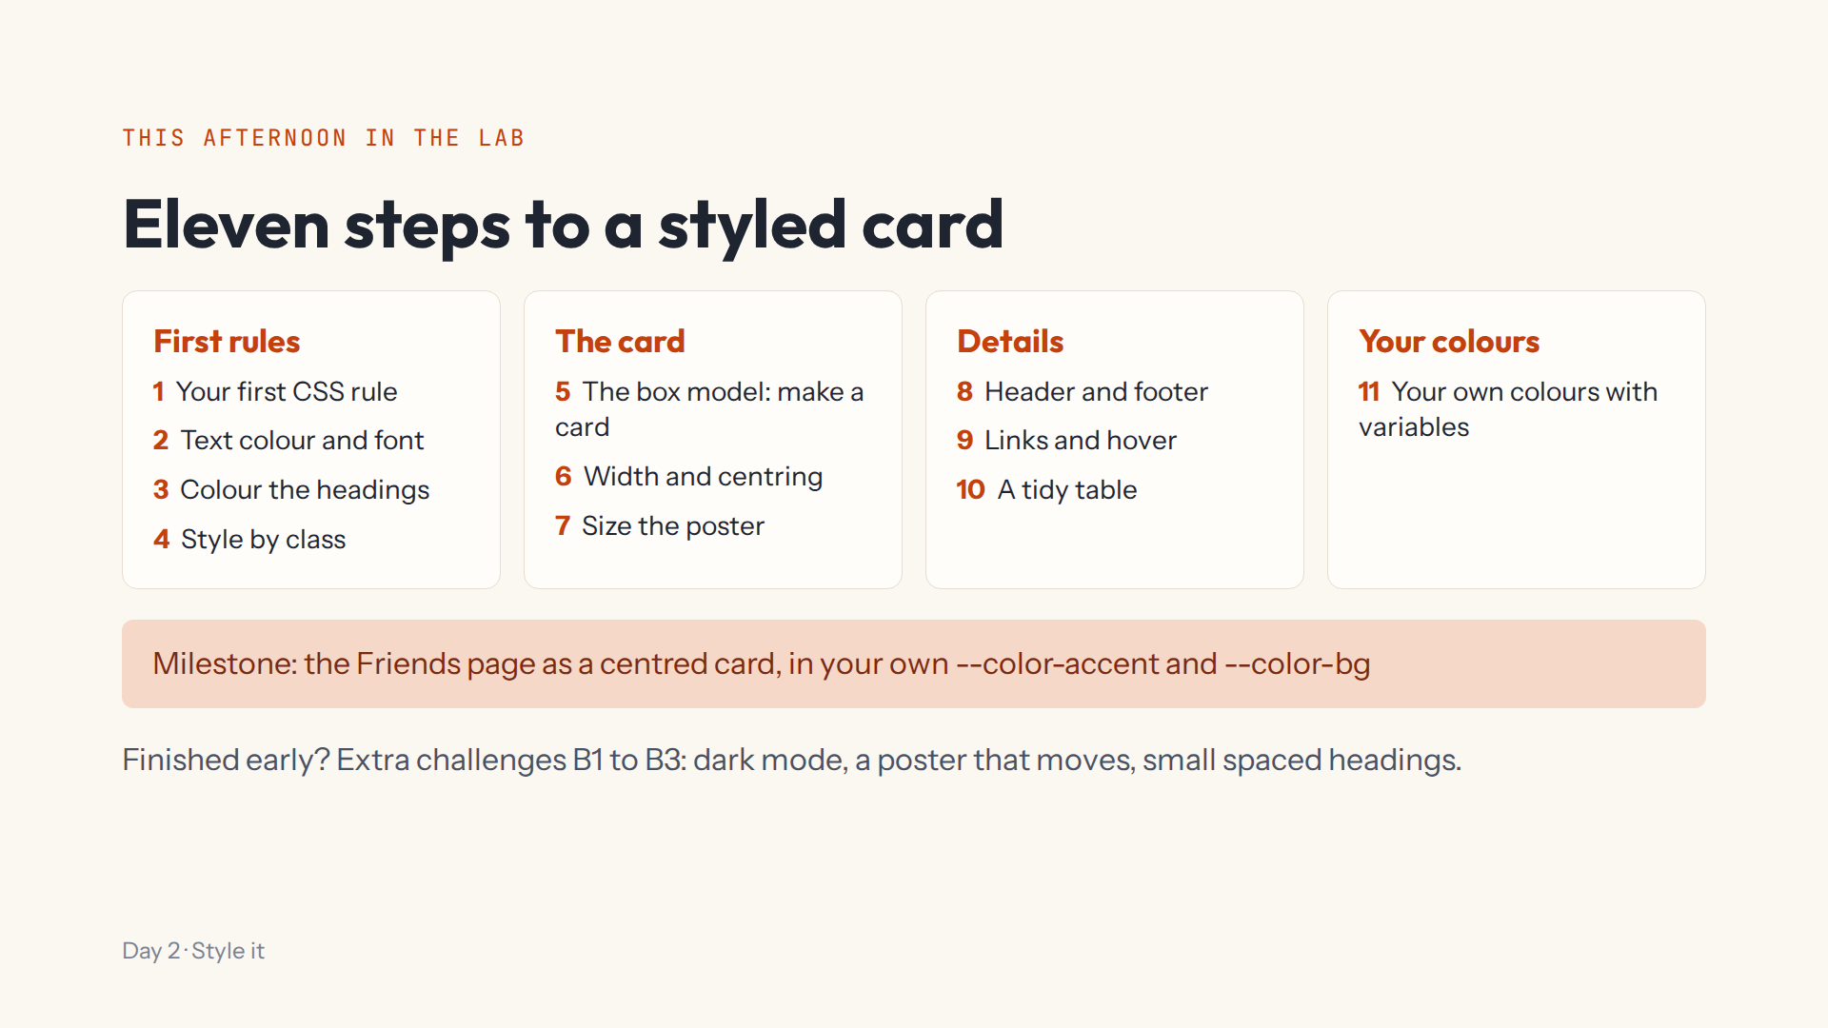
Notes:
Script 1:15. Open #/day/2, read the list, do step 1 together (Start again first). Show Hint, Answer, the Console, Bigger and the whole page tab. Progress saves itself; Help > Save progress to a file for another computer.

Slide 13
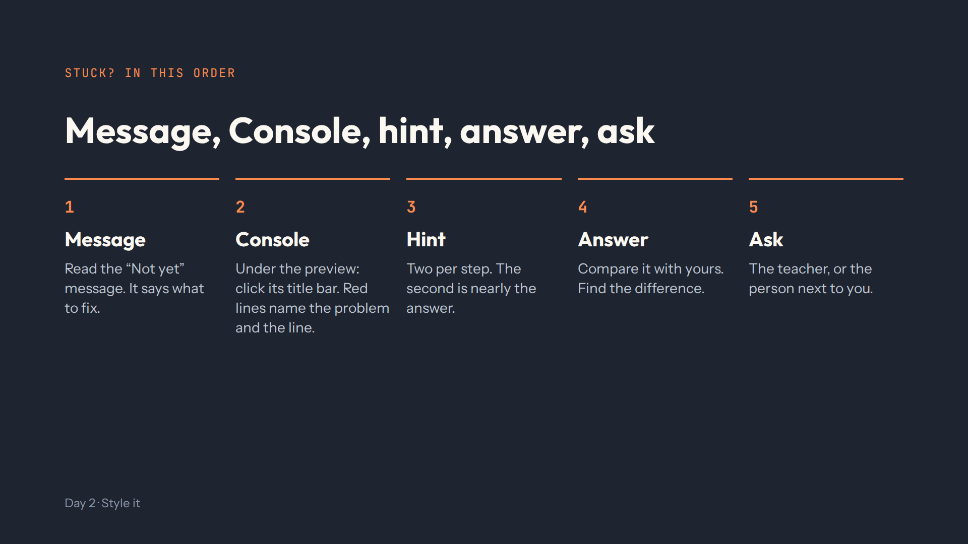
Notes:
Script 1:15. Today the Not yet message does most of the work: CSS skips what it can't read without an error.

Slide 14
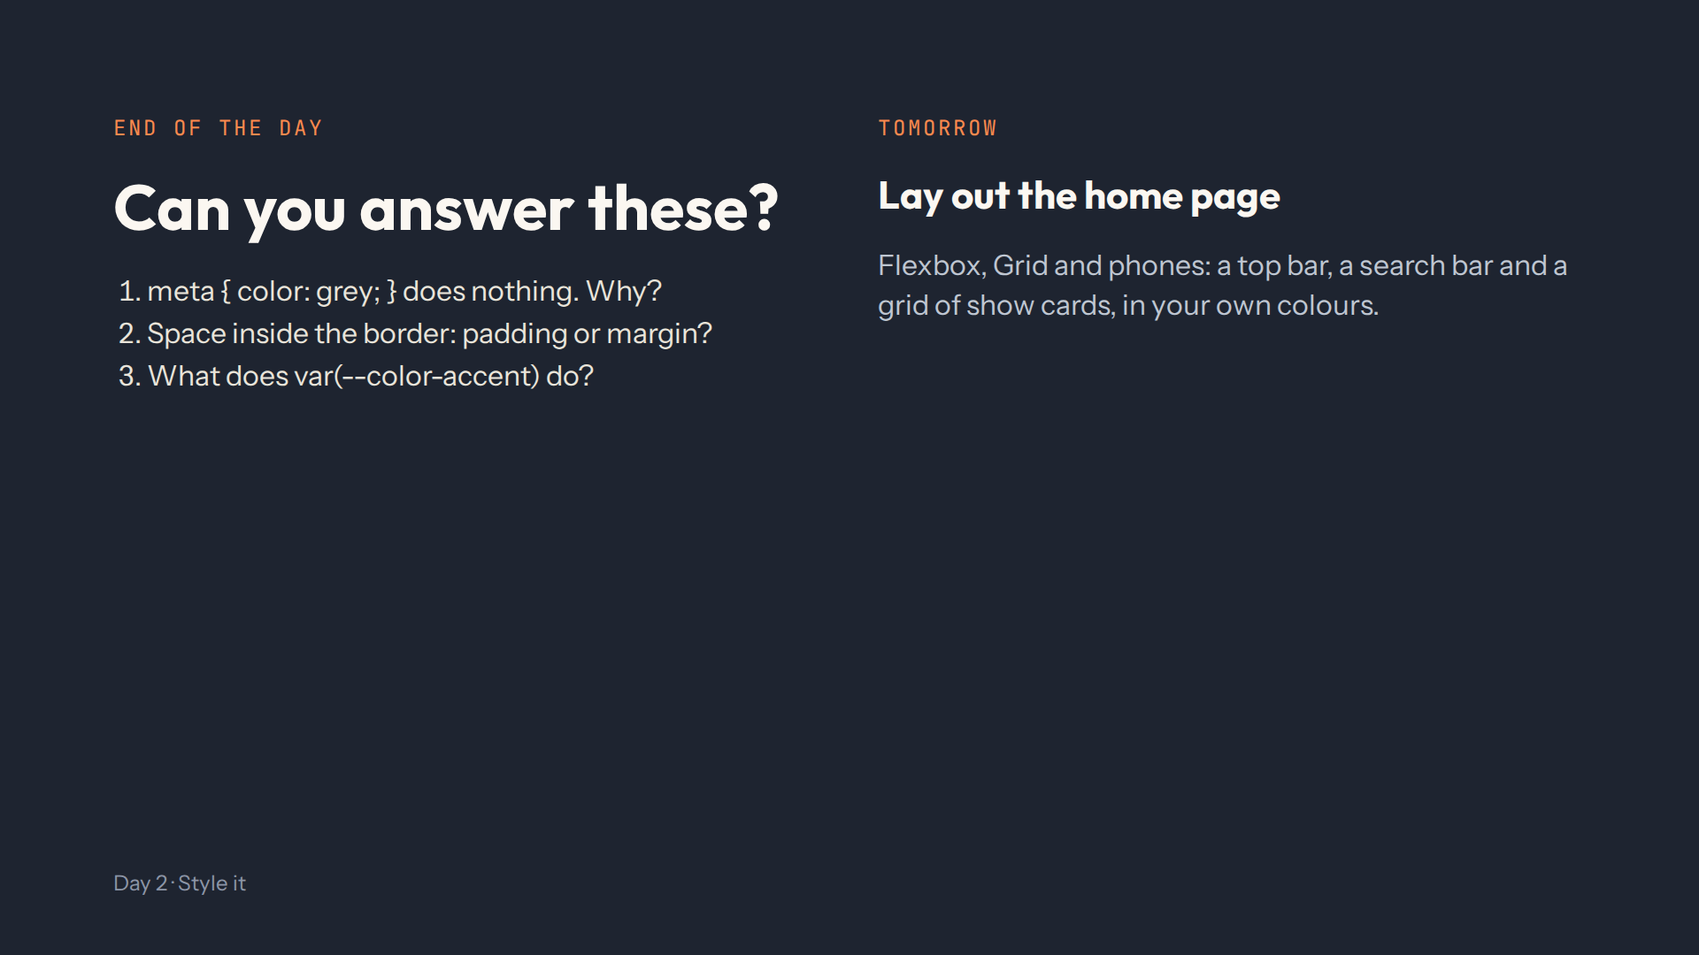
Notes:
For the afternoon teacher. Answers: the class selector needs a dot, .meta. Padding. It uses the colour stored in --color-accent; the names must match because later days use them. Full check in quiz.md.

