Slide 1
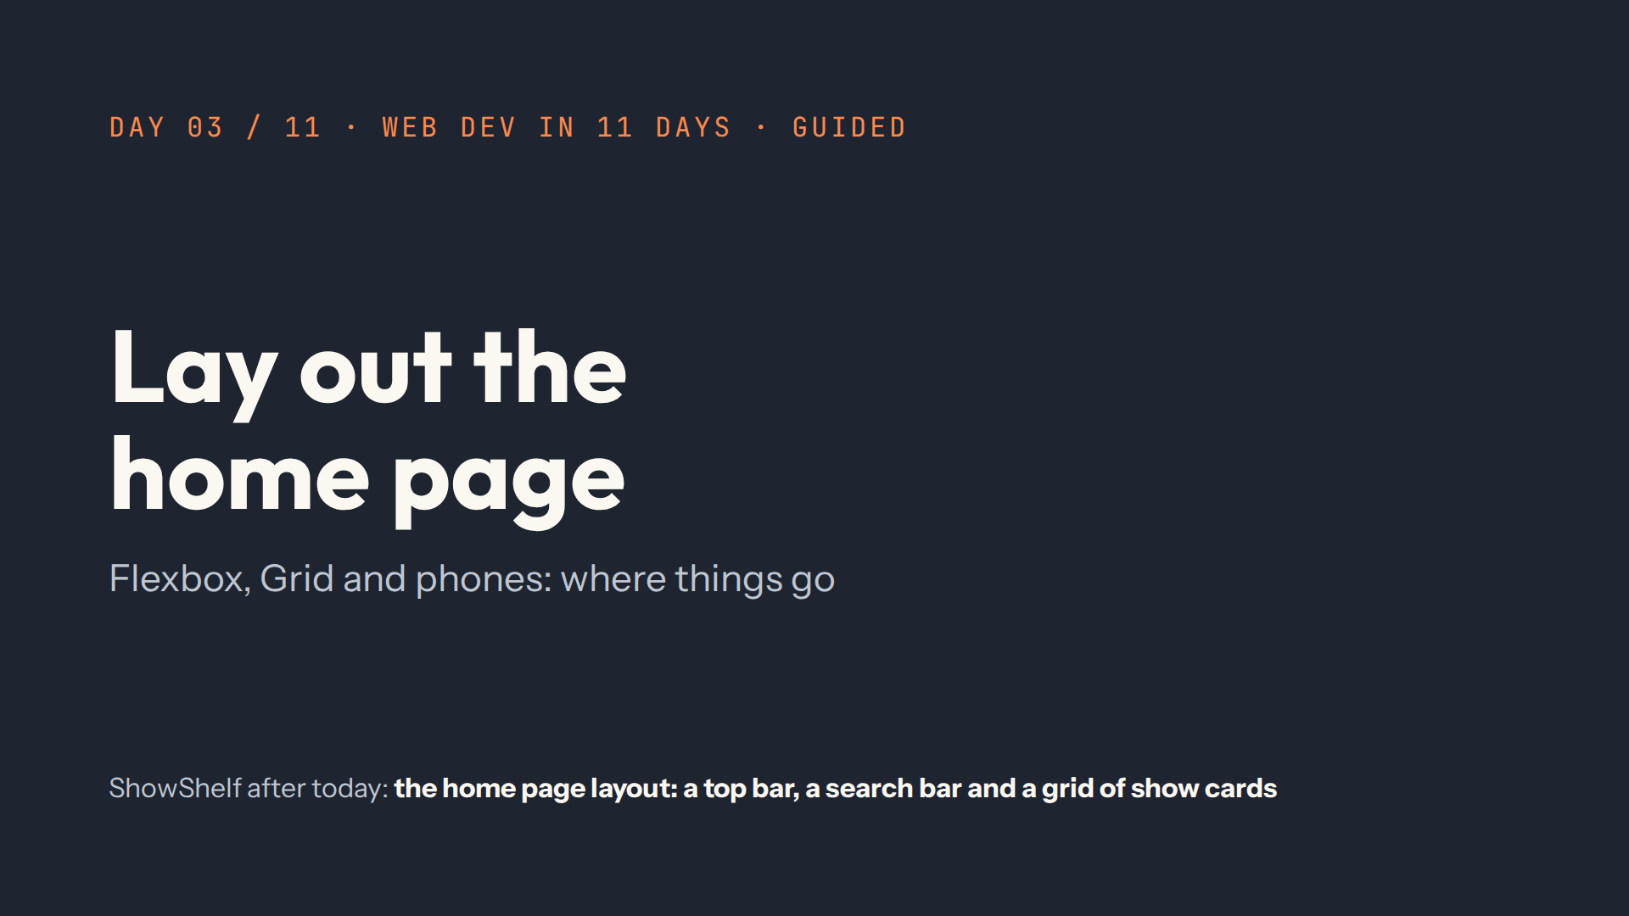
Notes:
Script 0:00. Recap from quiz.md first. Then open #/day/3 and point at the finished home page on the right.

Slide 2
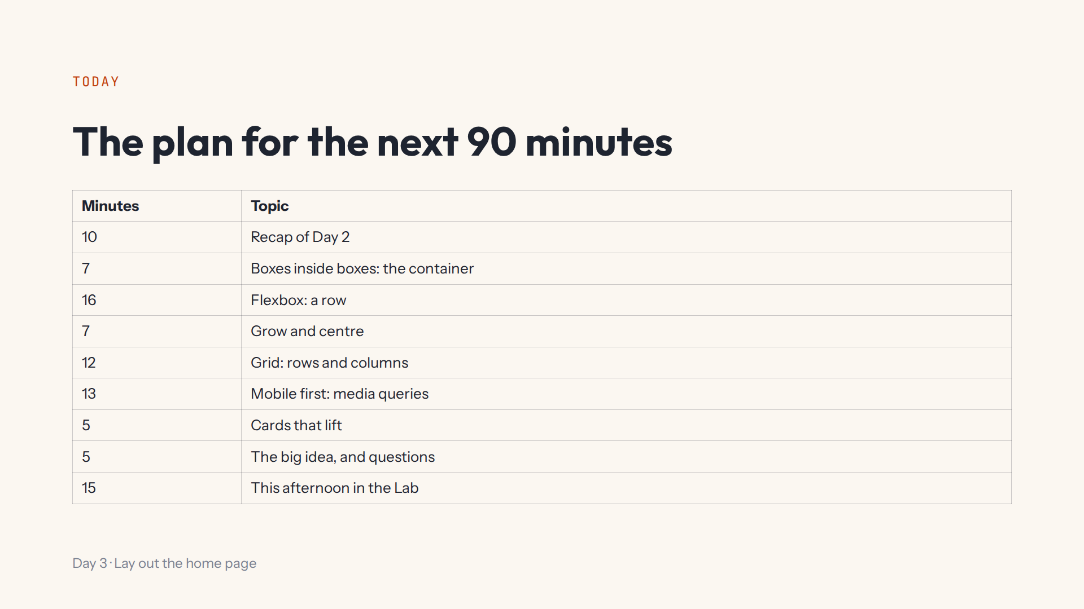

Slide 3
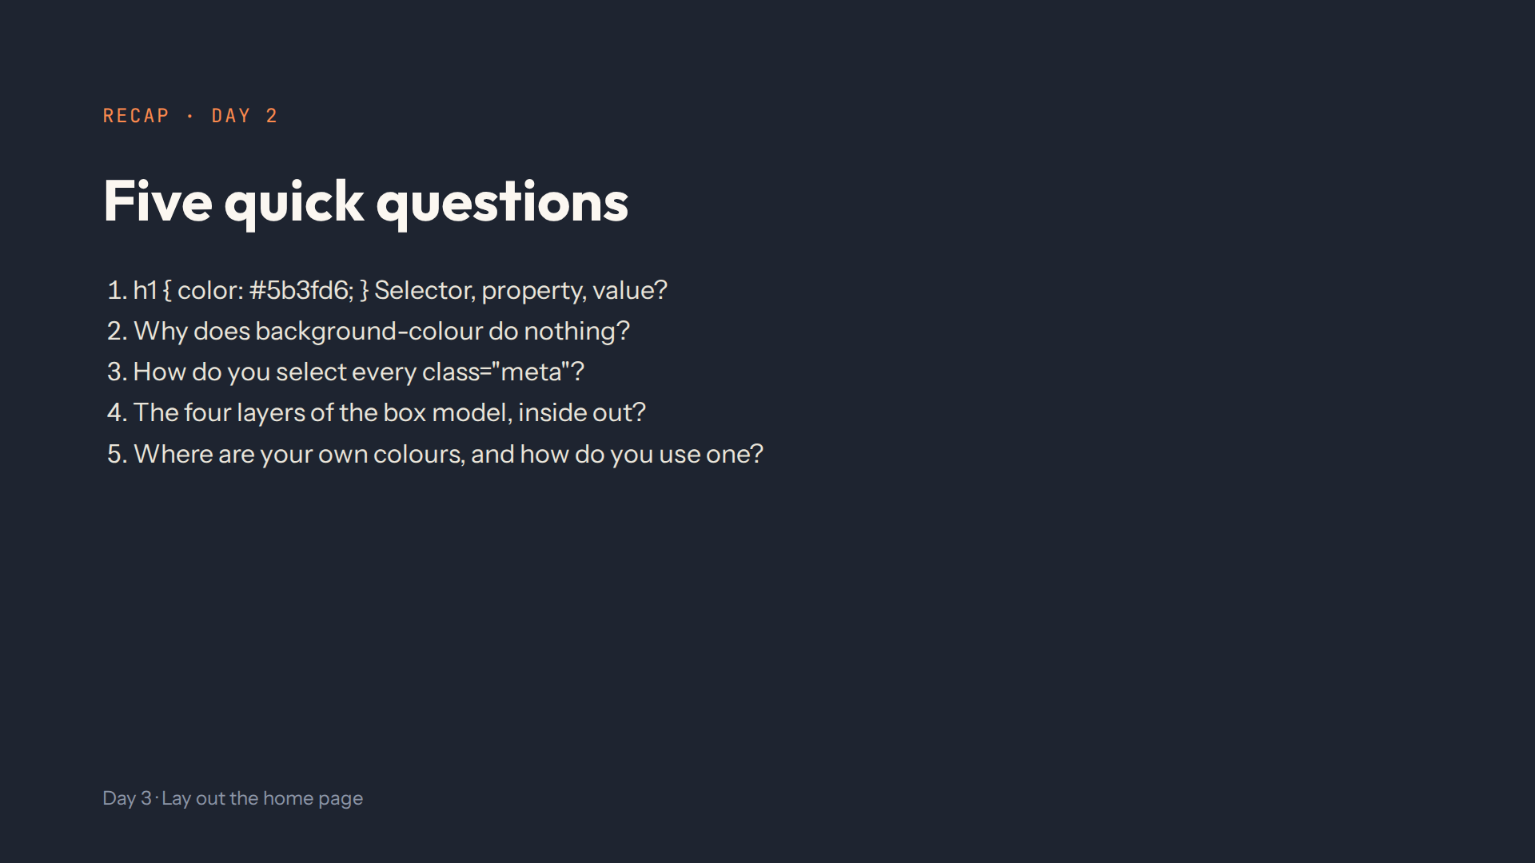
Notes:
Script 0:00. Answers: h1, color, #5b3fd6. American spelling: background-color. With a dot: .meta. Content, padding, border, margin. In :root, used with var(--color-accent).

Slide 4
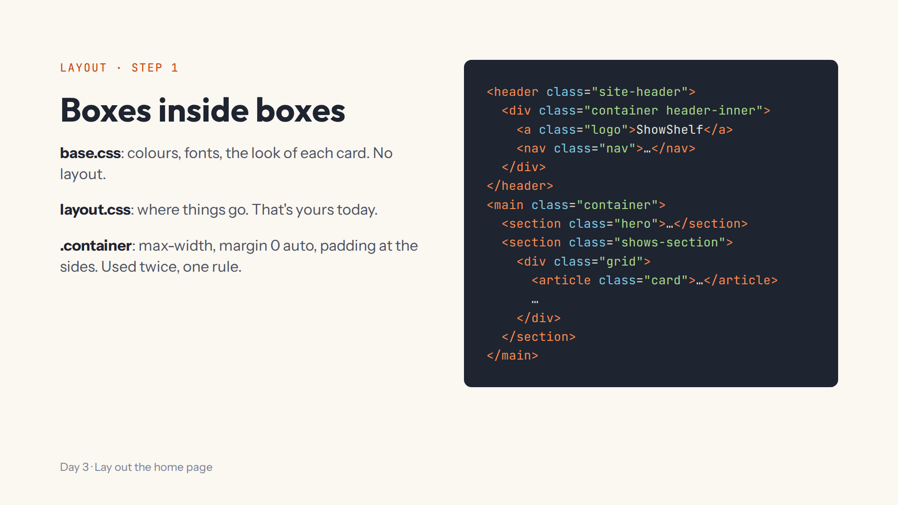
Notes:
Script 0:10. Open the index.html (whole page) tab and draw these boxes on the board, outside in. Press Bigger once: the preview is narrow, like a phone.

Slide 5
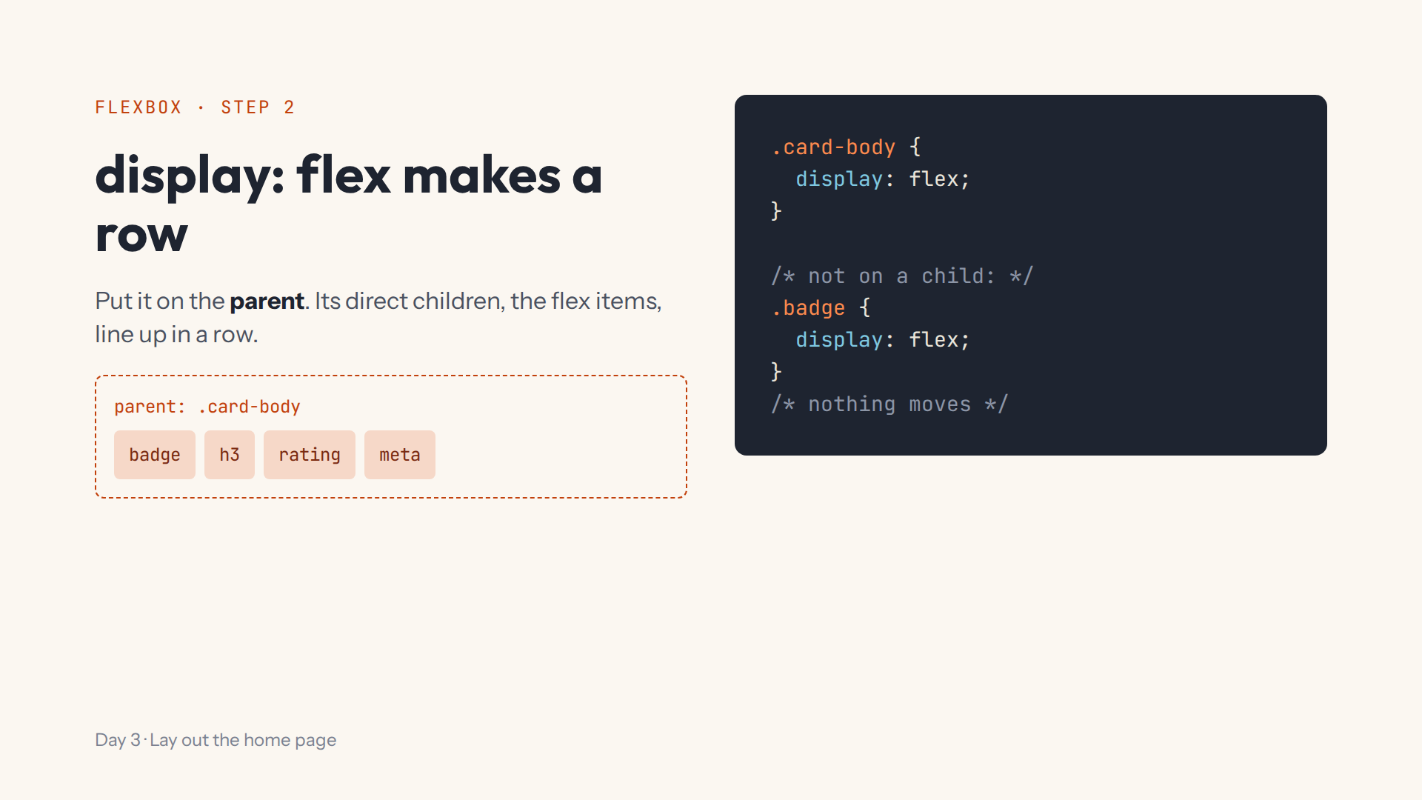
Notes:
Script 0:17. Type the .card-body rule in step 1's box, then scroll the preview to the first card's text: its four parts line up. Mistake on purpose: display flex on .badge, a child. The parent decides.

Slide 6
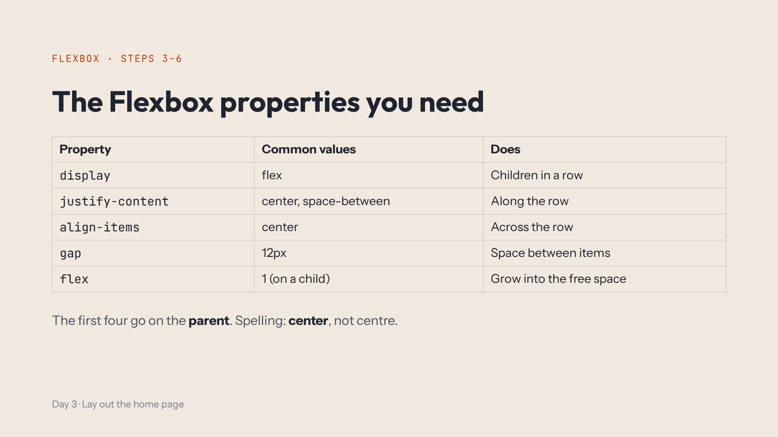
Notes:
Script 0:17, items 3 to 5. Add justify-content, align-items and gap to .card-body one at a time; let the class predict each. Mistake on purpose: align-items: centre.

Slide 7
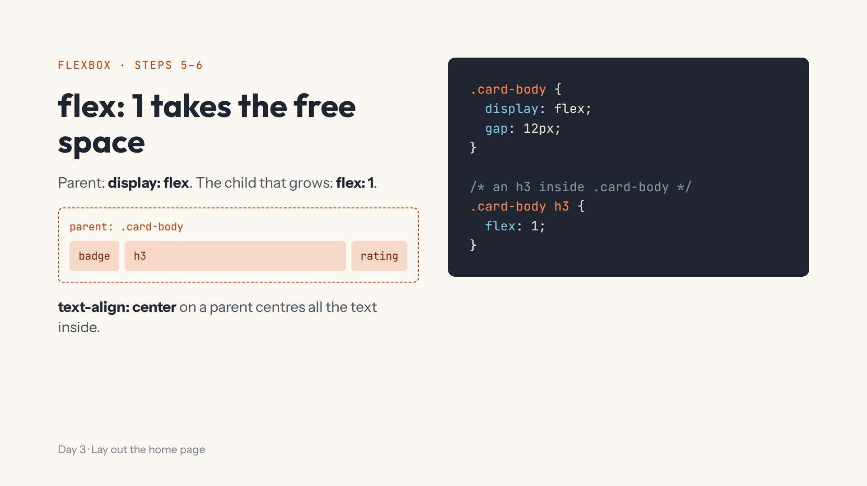
Notes:
Script 0:33. A space in a selector means inside. In step 6 the same idea makes the search input stretch next to its button. Then text-align center on .shows-section, and delete it.

Slide 8
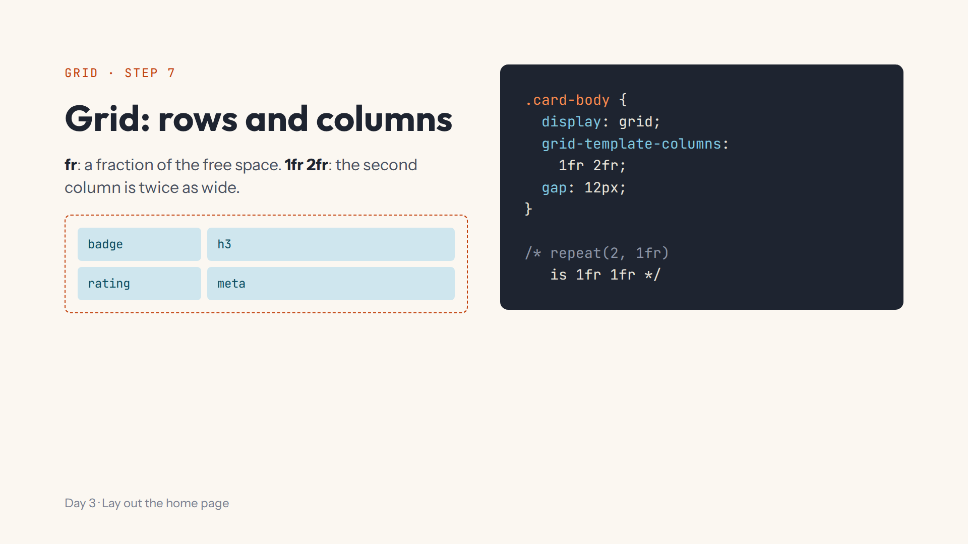
Notes:
Script 0:40. Change the demo from flex to grid. Try 1fr 1fr, 1fr 2fr, repeat(2, 1fr). Mistake on purpose: repeat(2 1fr) without the comma. Ask: top bar, Flexbox or Grid? The cards?

Slide 9
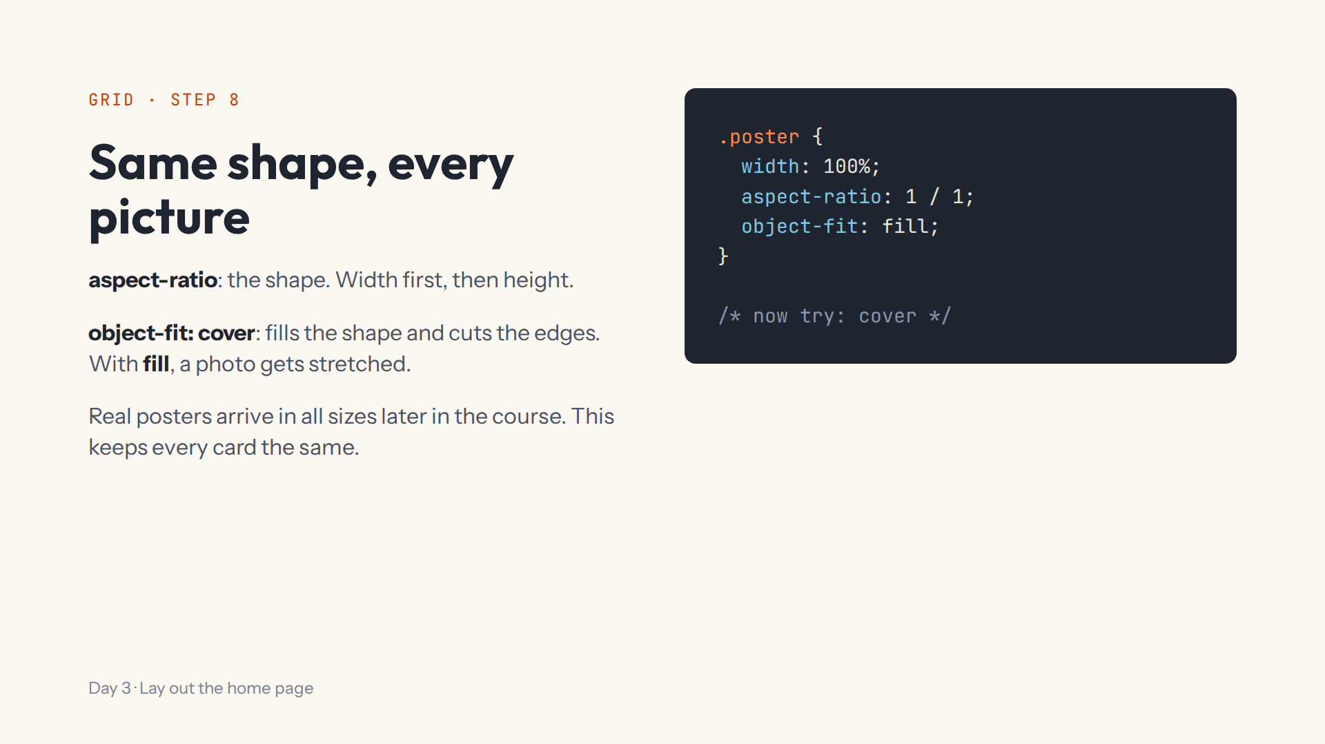
Notes:
Script 0:40, item 4. A square on purpose. With fill, the placeholder poster leaves grey bands; with cover it fills the square and loses its top and bottom. Then delete the demo rules.

Slide 10
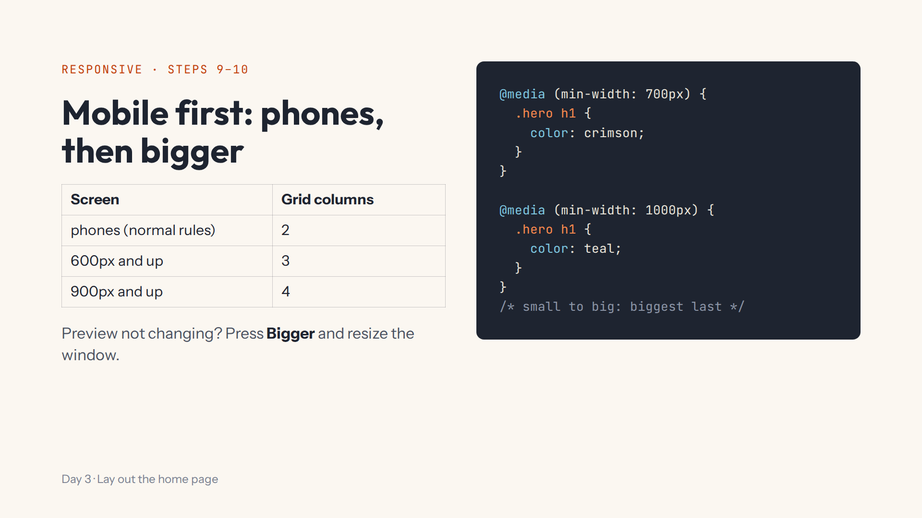
Notes:
Script 0:52. The demo changes a colour, the afternoon changes the columns. Press Bigger and drag the window edge. Swap the two queries to show the later one wins. Mistake on purpose: no round brackets.

Slide 11
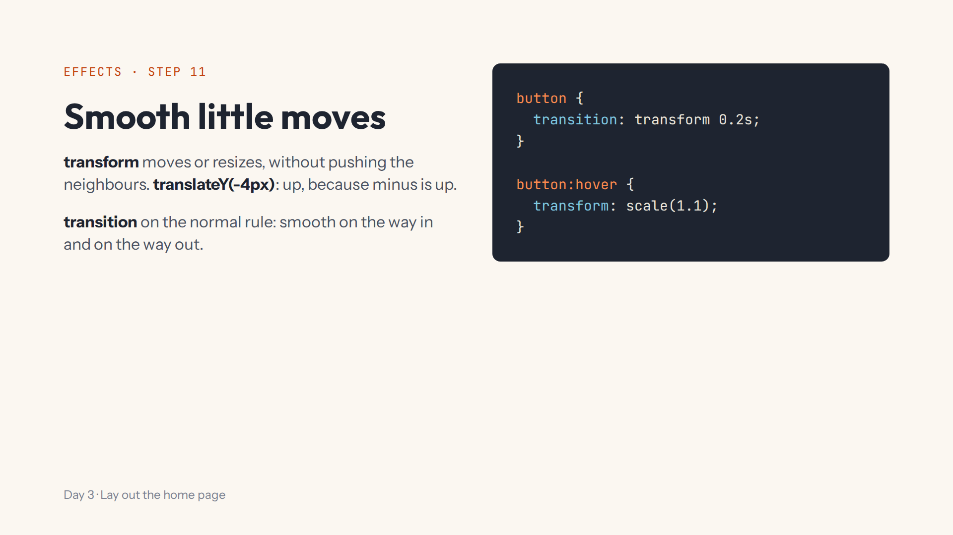
Notes:
Script 1:05. Hover the Search button in the preview: it grows smoothly. In step 11 the cards lift with translateY and a box-shadow.

Slide 12
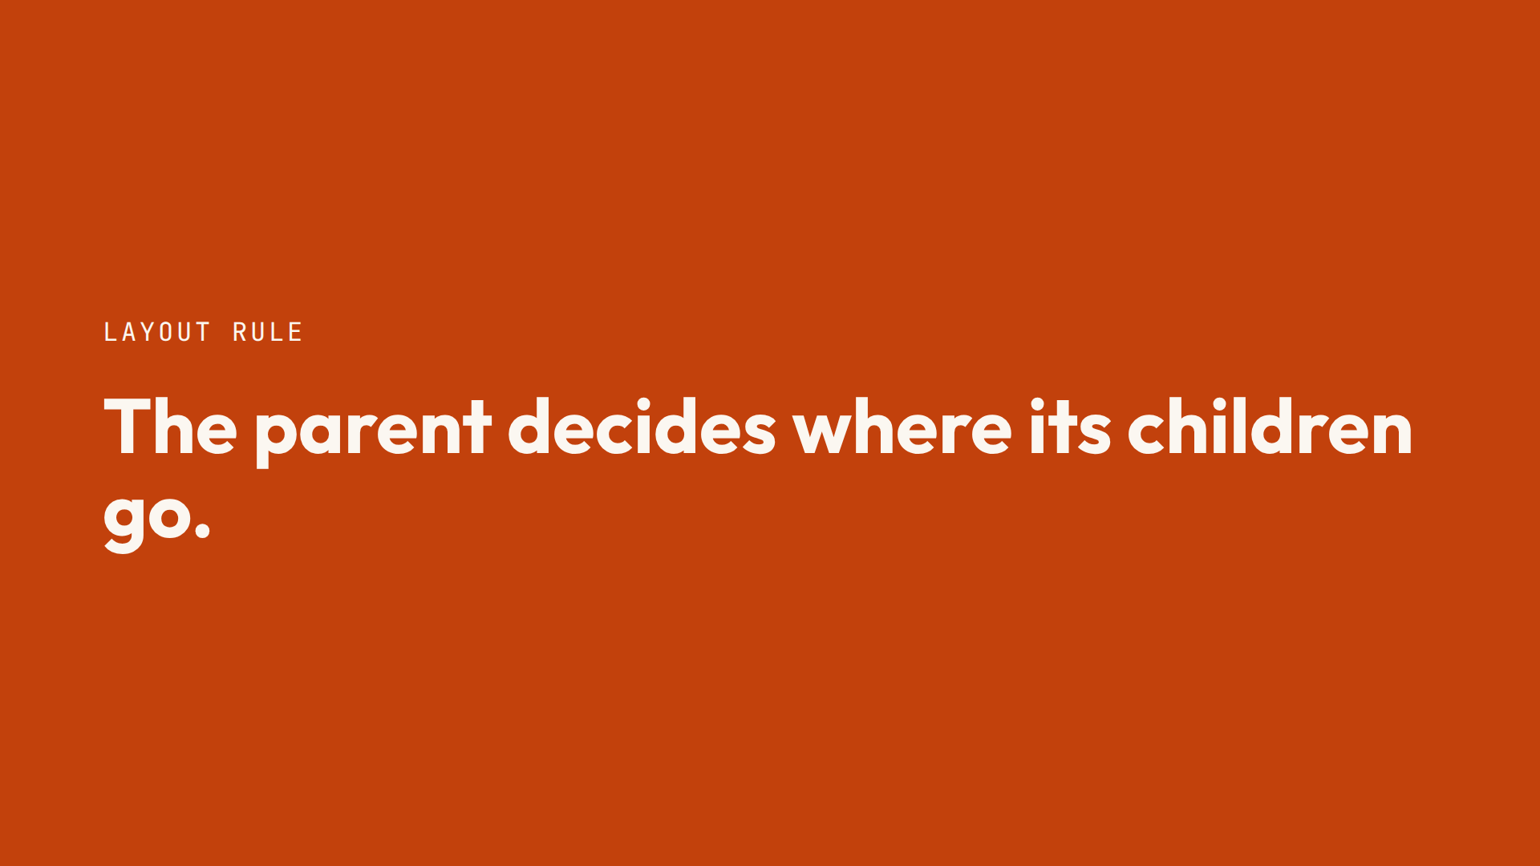

Slide 13
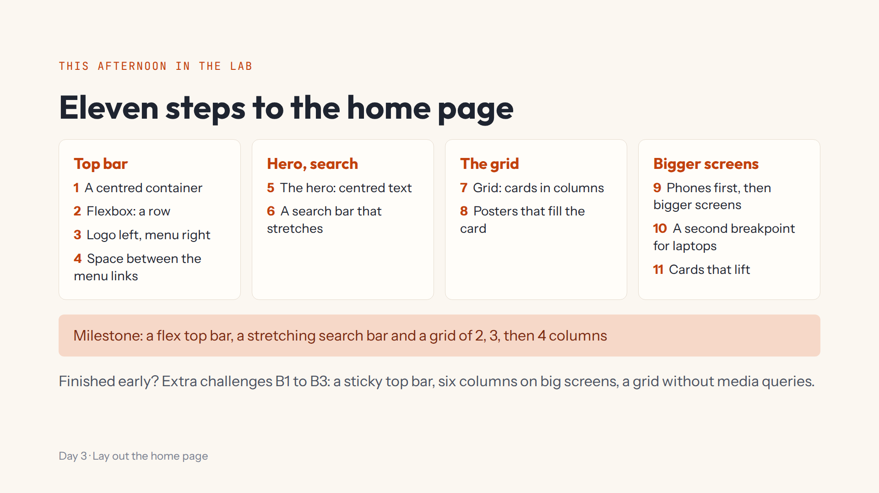
Notes:
Script 1:15. Open #/day/3, read the list, do step 1 together (Start again first), then press Bigger. Show Hint, Answer, the Console and the base.css tab. Progress saves itself; Help > Save progress to a file for another computer.

Slide 14
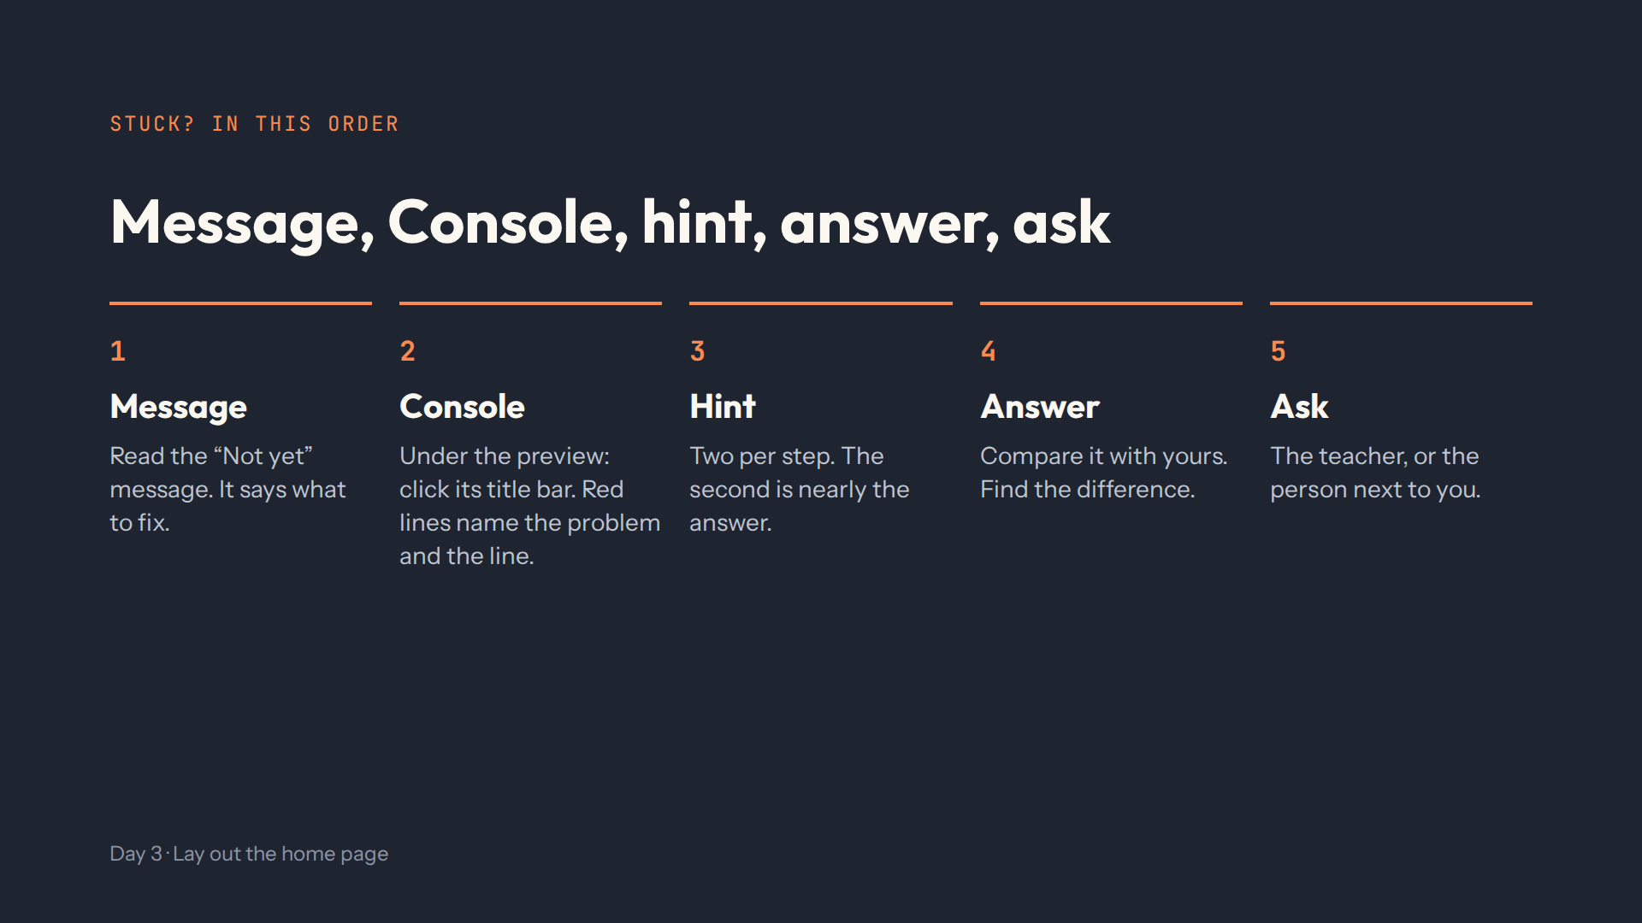
Notes:
Script 1:15. For steps 9 and 10, add one more thing before asking: press Bigger.

Slide 15
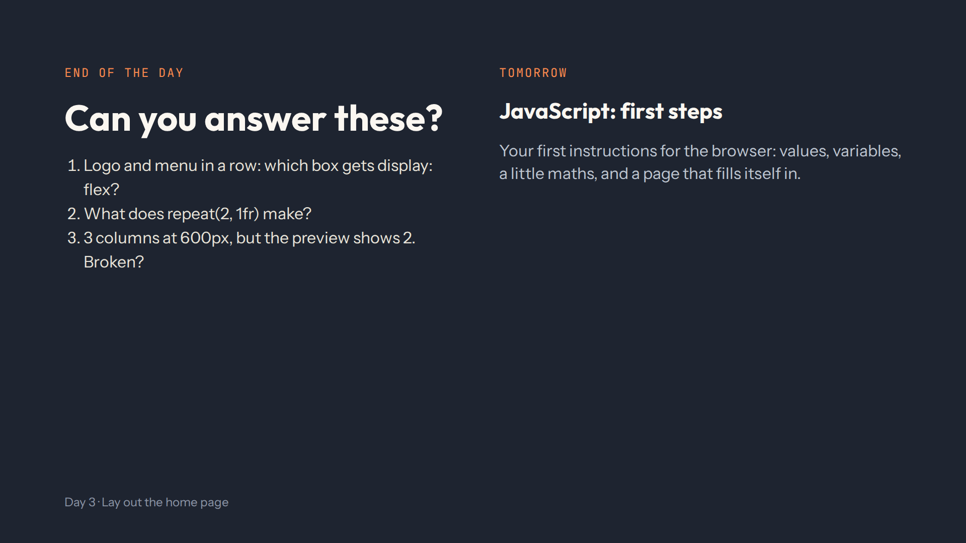
Notes:
For the afternoon teacher. Answers: .header-inner, the parent. Two equal columns. Not broken: the preview is narrower than 600px, press Bigger. Full check in quiz.md.

