Slide 1
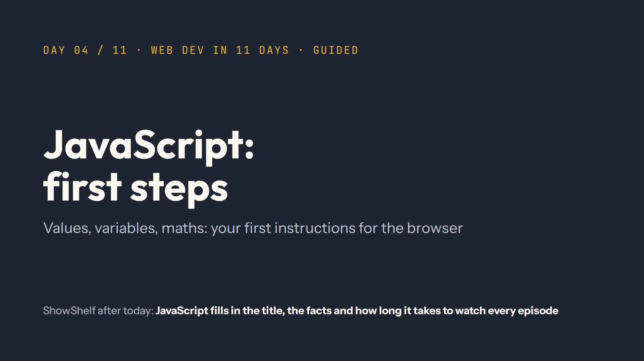
Notes:
Script 0:00. Say it out loud: today is the day most people find hardest at first. That's normal. It clicks with practice. Then the recap from quiz.md.

Slide 2
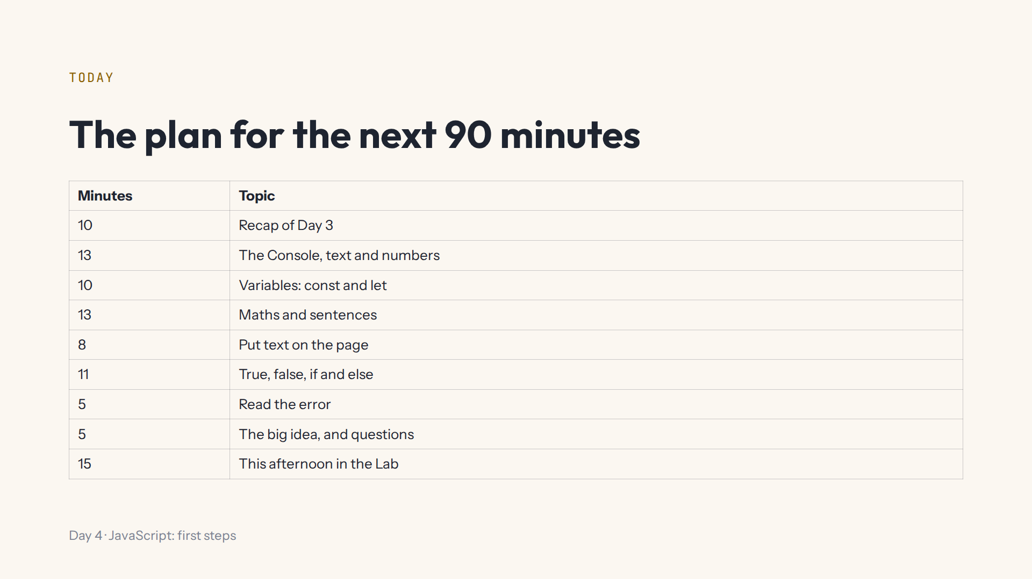

Slide 3
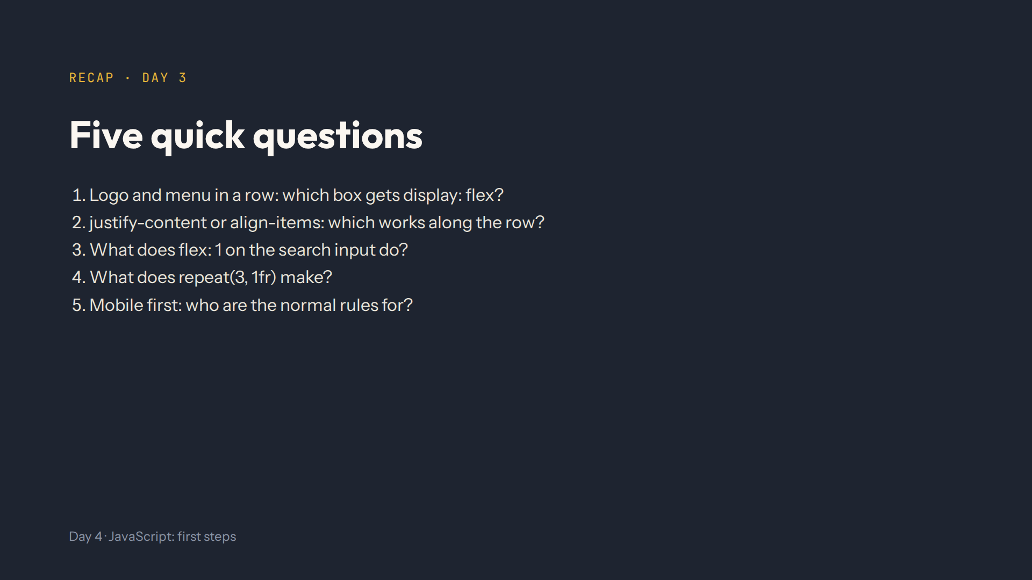
Notes:
Script 0:00. Answers: .header-inner, the parent. justify-content along, align-items across. It grows into the free space. Three equal columns. Phones; media queries add bigger screens, biggest last.

Slide 4
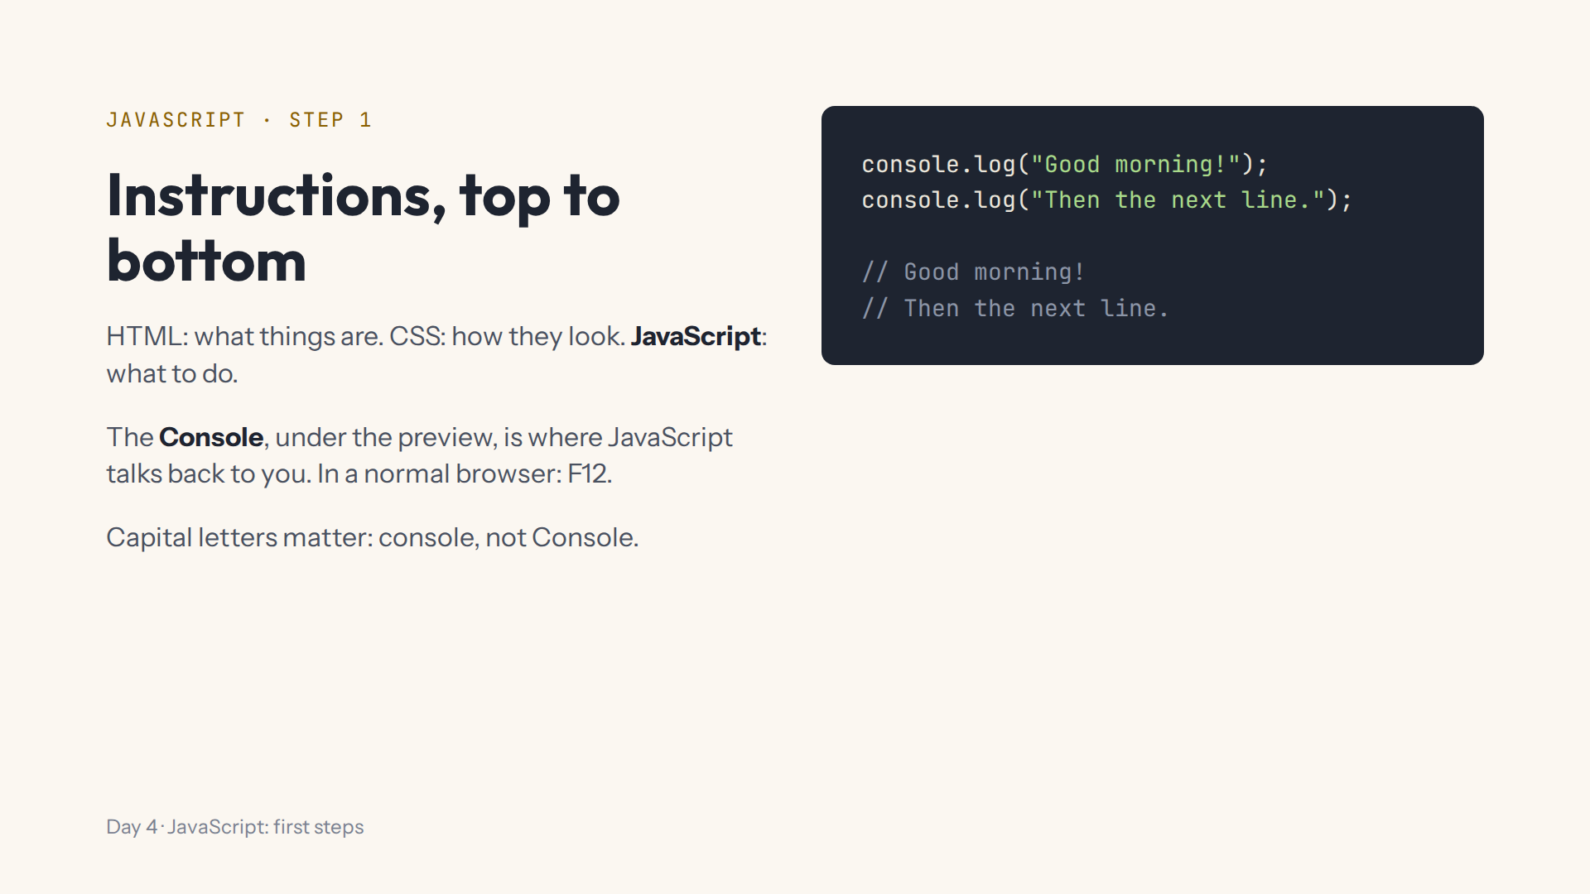
Notes:
Script 0:10. Type in step 1's code box and point at the Console. Swap the two lines: the order follows the code. Mistake on purpose: Console.log with a capital C, then read the red line and the grey note aloud.

Slide 5
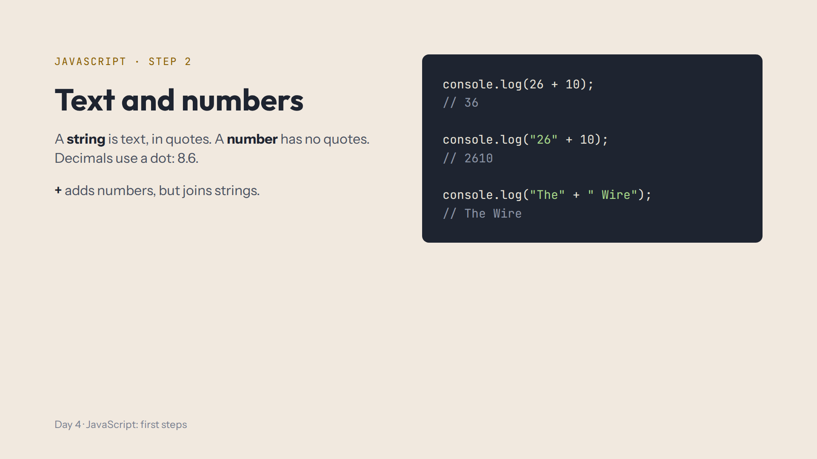
Notes:
Script 0:10, items 3 and 4. Let the class predict each line before you type it. 26 and 10 are the episodes of Dark and Band of Brothers. Mistake on purpose: console.log(Hello) without quotes.

Slide 6
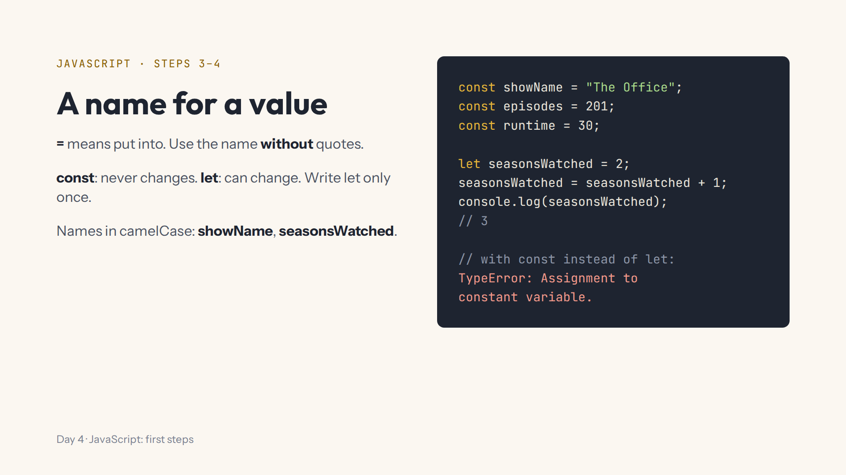
Notes:
Script 0:23. Mistake on purpose: console.log("showName") prints the word. Then change let to const and read the error. Ask: the app's name, const or let? Episodes watched?

Slide 7
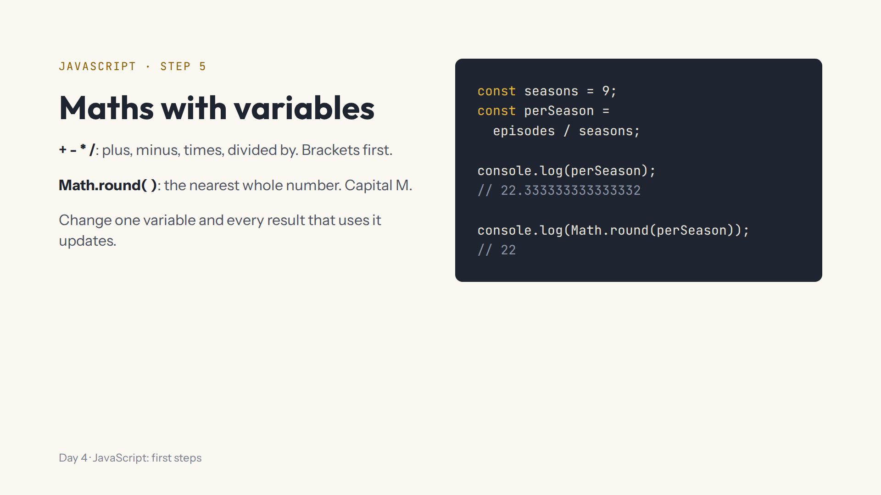
Notes:
Script 0:33. The Office: 201 episodes over 9 seasons. Then Math.round(perSeason) * runtime gives 660 minutes. Mistake on purpose: math.round with a small m.

Slide 8
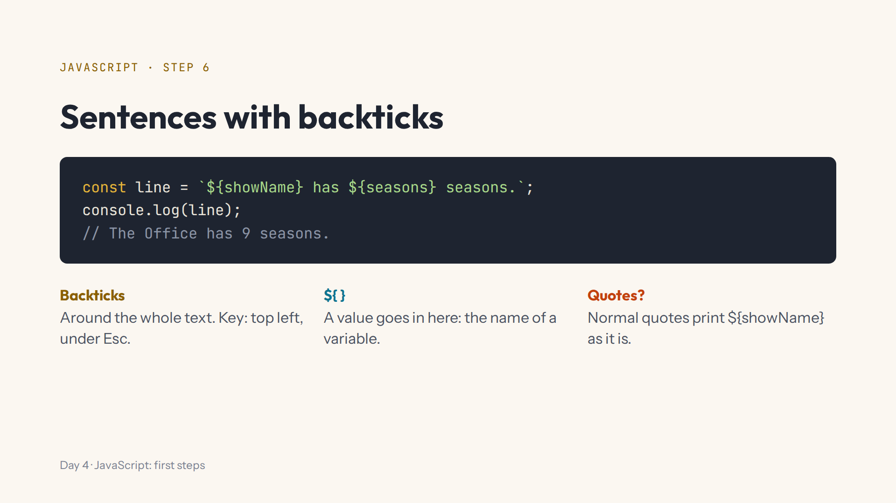
Notes:
Script 0:33, items 4 and 5. Show the backtick key on your keyboard. Mistake on purpose: swap the backticks for normal quotes.

Slide 9
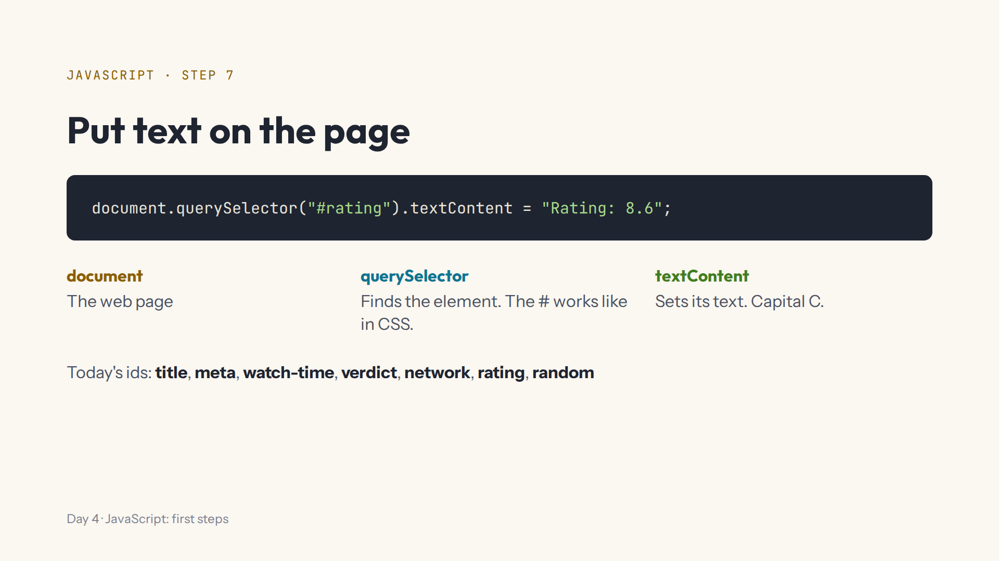
Notes:
Script 0:46. Show the ids in the show.html (whole page) tab first. Then fill #rating and #random. Mistake on purpose: querySelector("rating") without the #, and read the red error.

Slide 10
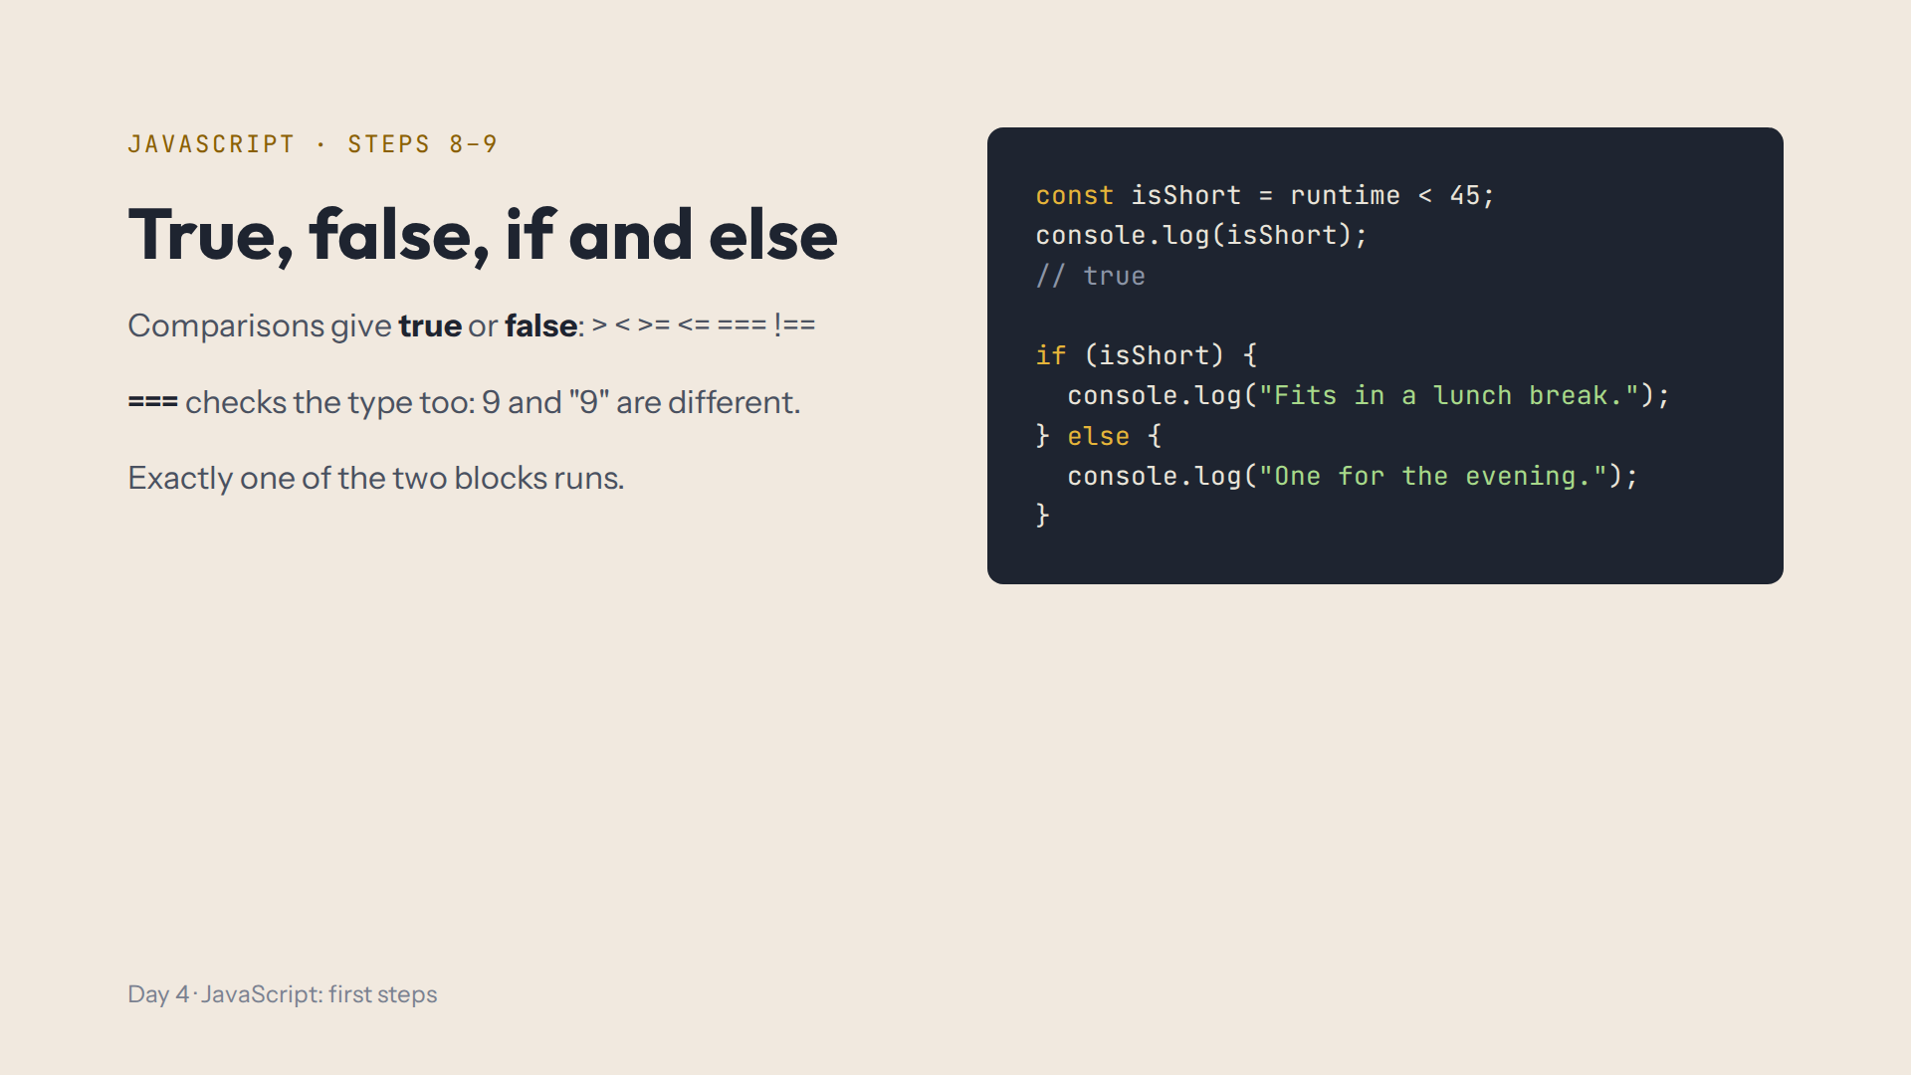
Notes:
Script 0:54. Predict first. Change runtime to 60 and the other message appears; change it back. Mistake on purpose: delete the } before else, which leads into the next slide.

Slide 11
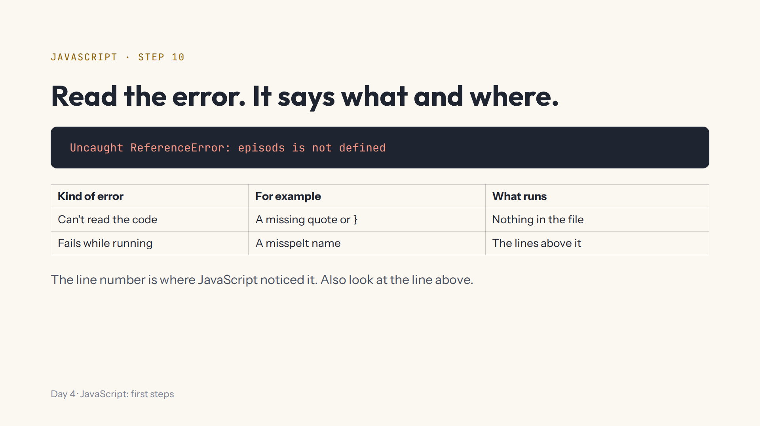
Notes:
Script 1:05. With the } still missing, show that the whole page went back to grey notes. Fix it. Then console.log(episods): only that line fails. Read every red message aloud.

Slide 12
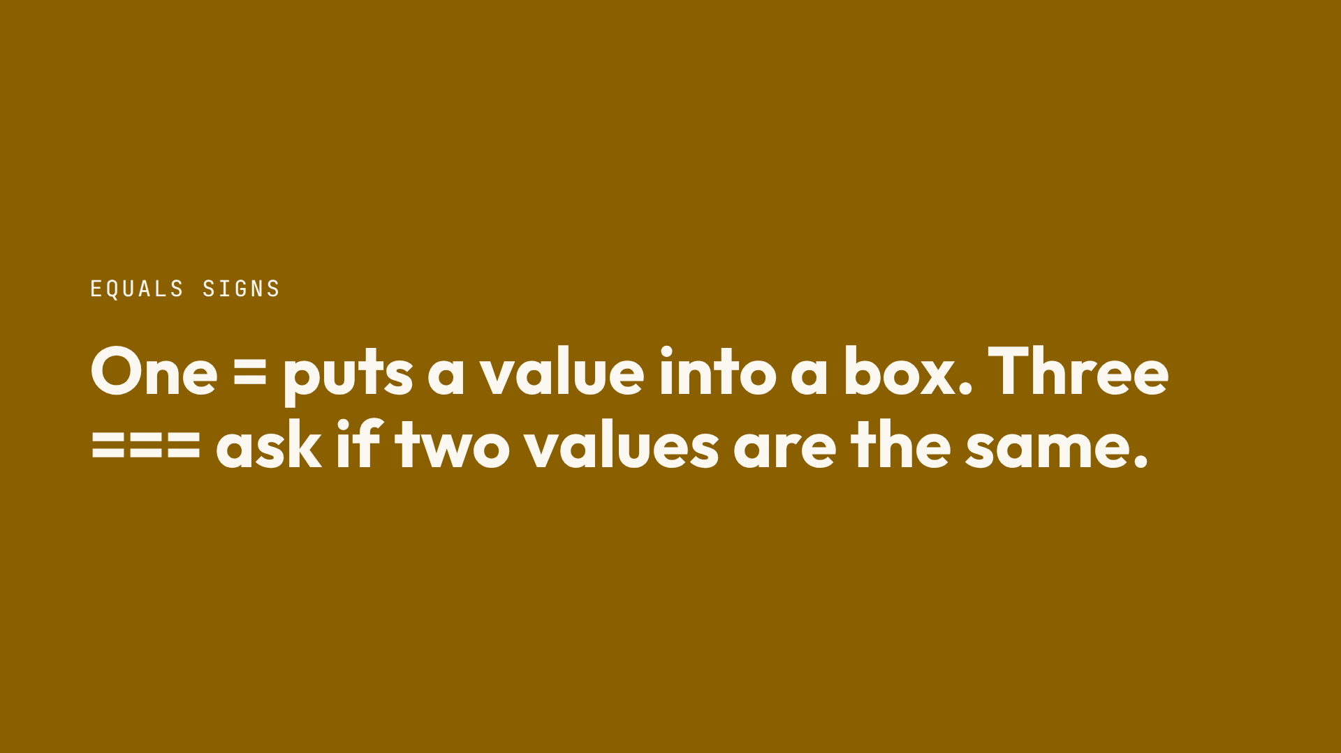

Slide 13
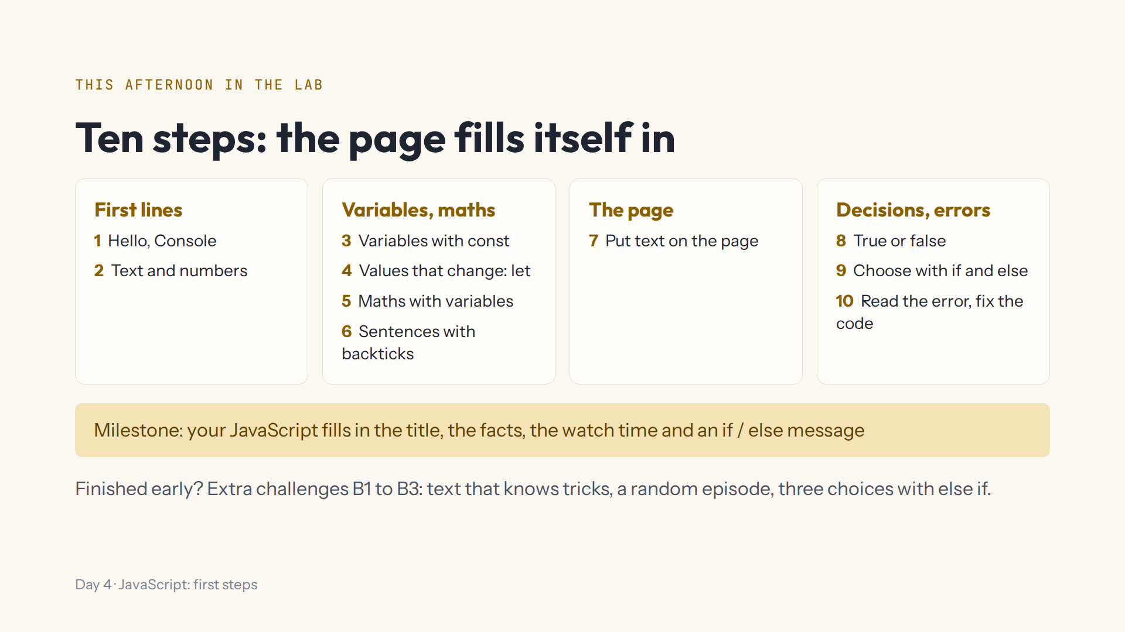
Notes:
Script 1:15. Open #/day/4, read the list, do step 1 together (Start again first). Show the Console, Hint, Answer, Run again and the whole page tab. Progress saves itself; Help > Save progress to a file for another computer.

Slide 14
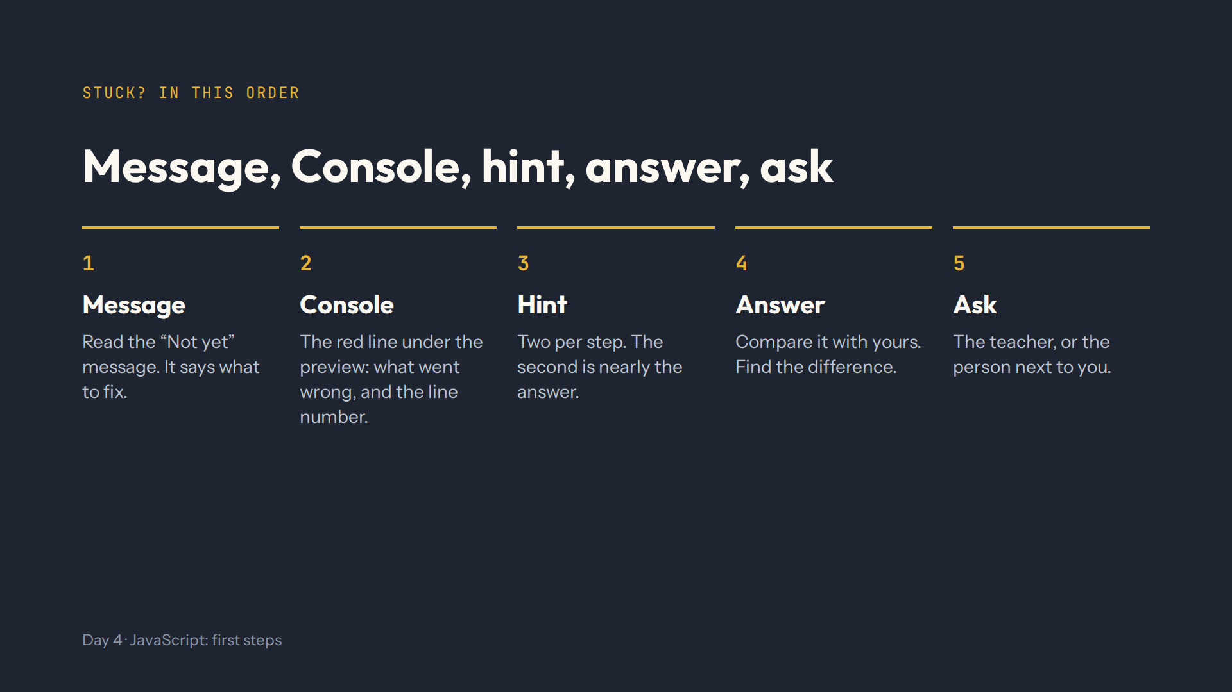
Notes:
Script 1:15. From today the Console is the most important helper. Read the red line and the grey note under it before opening a hint.

Slide 15
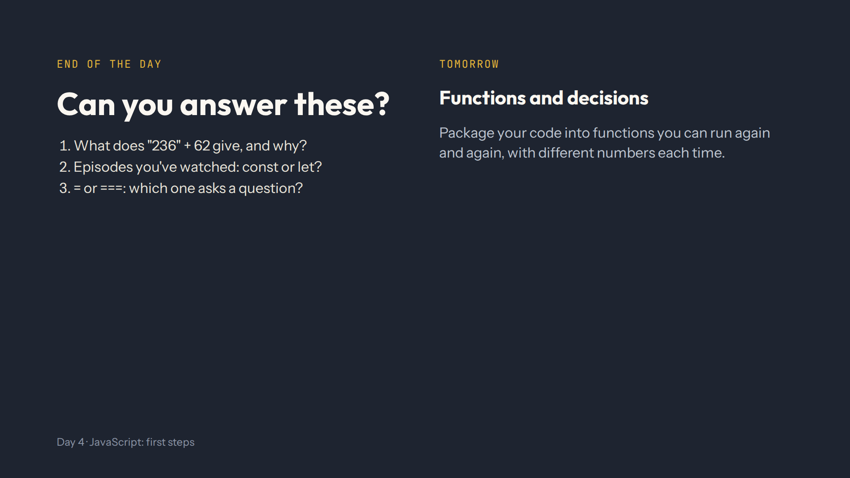
Notes:
For the afternoon teacher. Answers: 23662, because "236" is a string and + joins. let, because it changes. === asks; = puts a value in. Full check in quiz.md.

