Slide 1
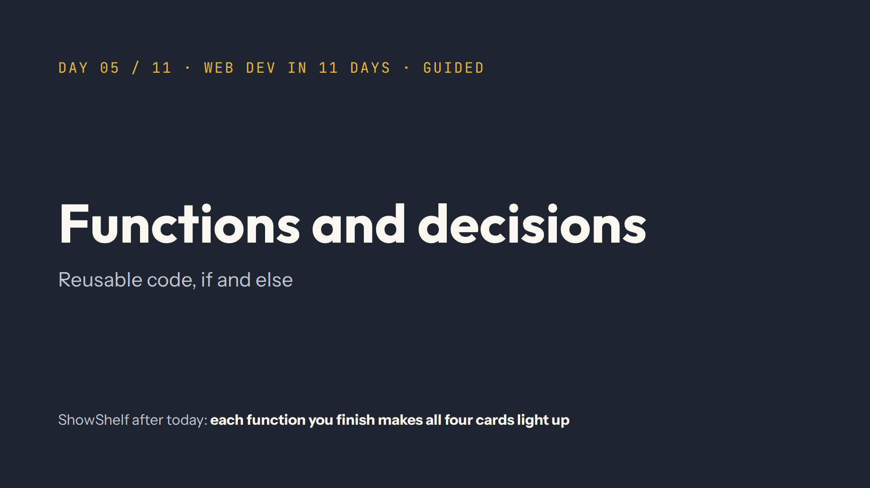
Notes:
Script: Mindset. One idea matters more than all the others today: return. Spend your time there.

Slide 2
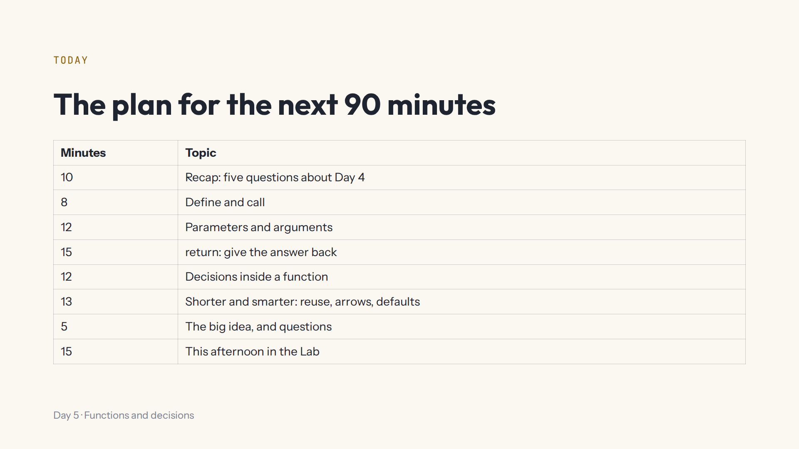
Notes:
Lab open on the projector at #/day/5. After each demo, press Start again in that step.

Slide 3
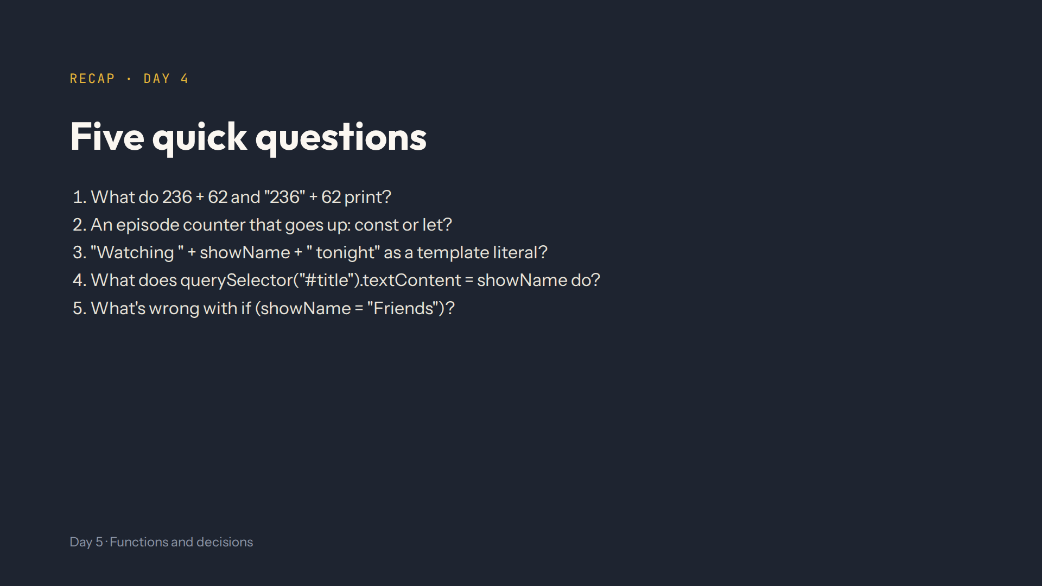
Notes:
Script 0:00. Answers: 298 and 23662. let, a const can't change. `Watching ${showName} tonight`. Finds id="title" and puts the value of showName in it. One = puts a value in; use === to compare.

Slide 4
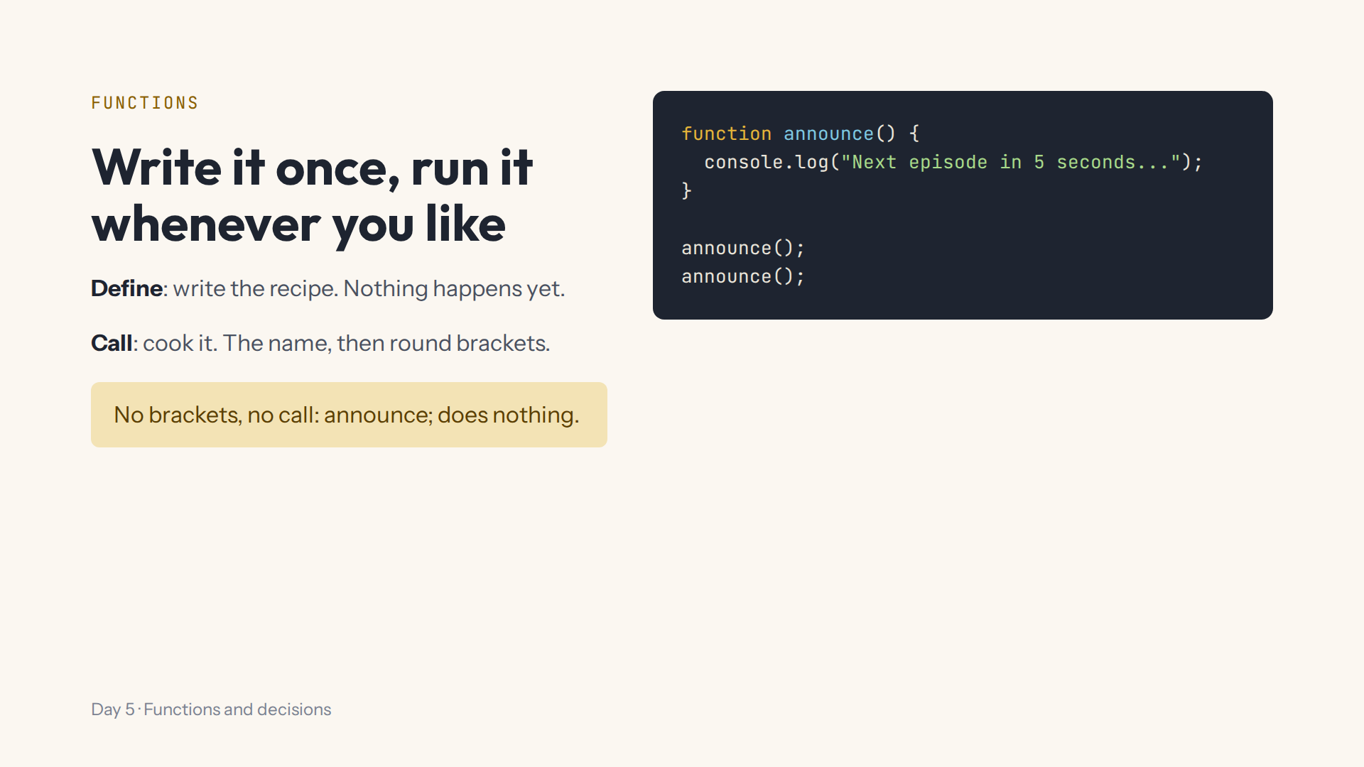
Notes:
Script 0:10. Demo in step 1's code box. Point at the grey notes on the cards first: each one is a function they write this afternoon. Delete the calls: nothing prints. Then announce; without brackets.

Slide 5
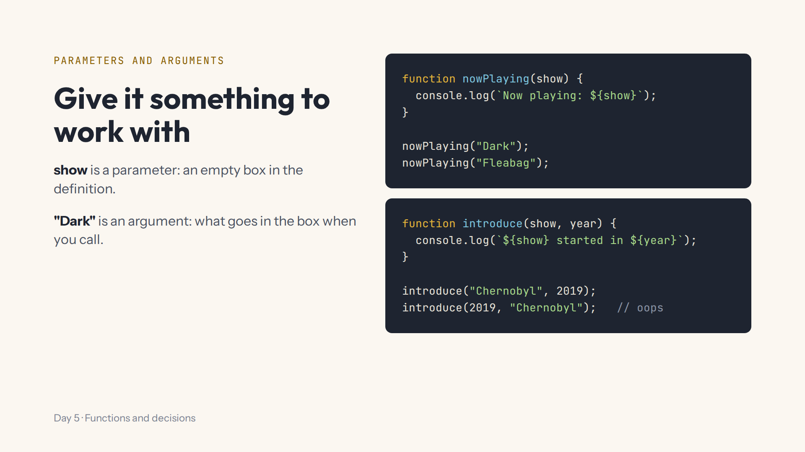
Notes:
Script 0:18, Lab steps 2 and 3. Ask what nowPlaying() prints with no argument: undefined, no value yet. The order of the arguments decides which box they go in. Then open the page.js tab and find the line that calls watchTime.

Slide 6
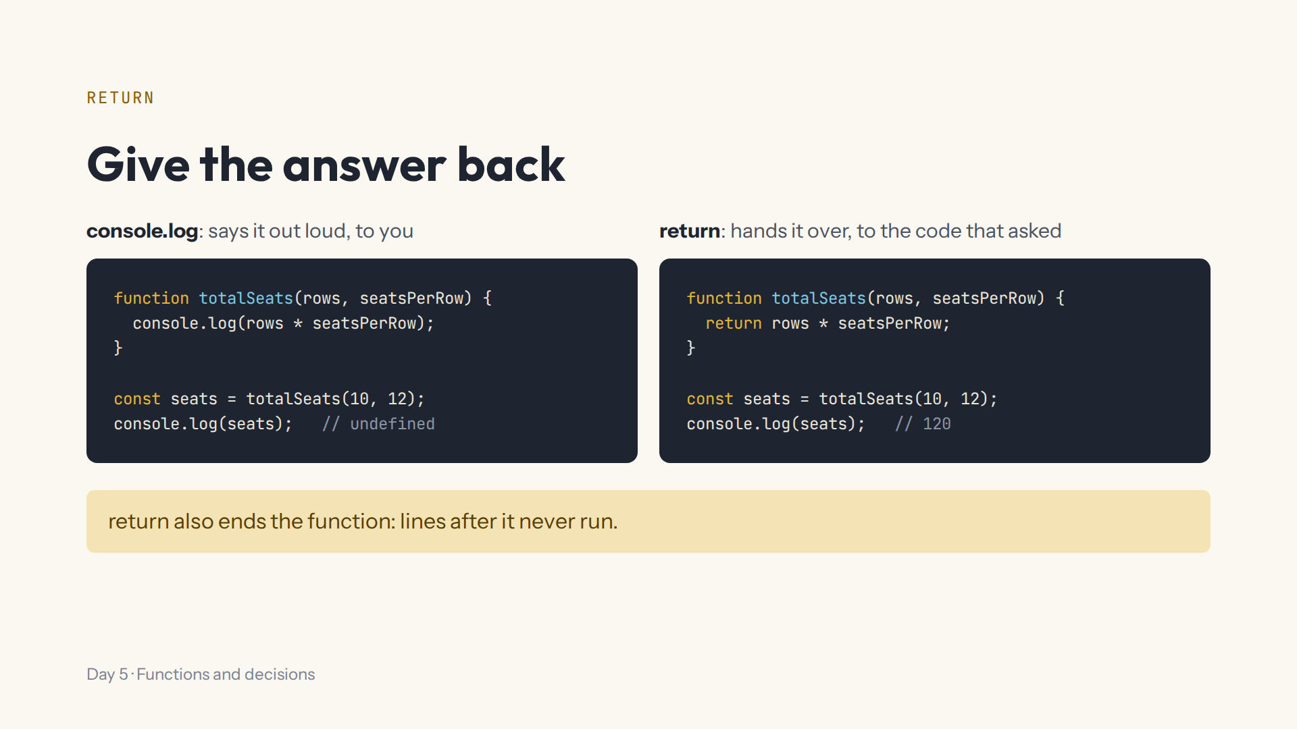
Notes:
Script 0:30, Lab step 4. The step 4 box starts with watchTime logging, and the cards say undefined hours. Ask why before you type. Don't fix watchTime yourself: that's their task. Ask: who needs the answer, you or page.js?

Slide 7
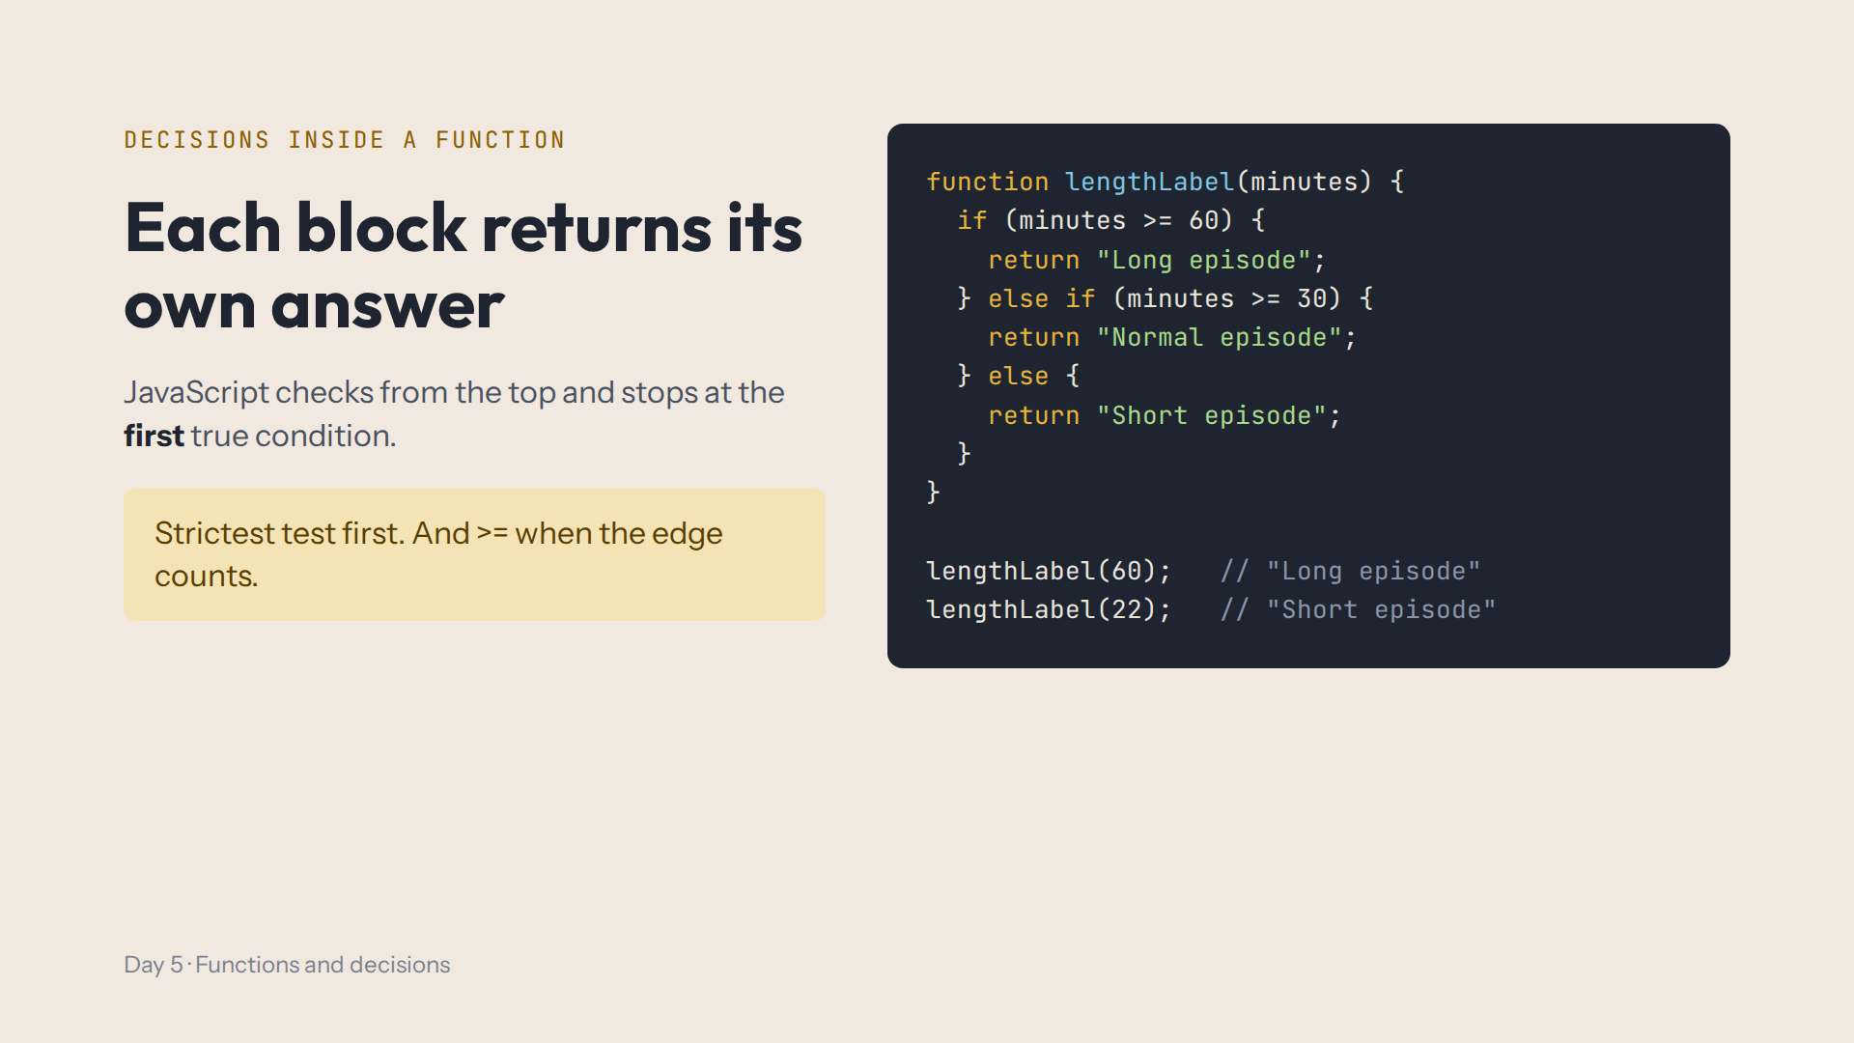
Notes:
Script 0:45, Lab step 5. Mistake on purpose: swap the first two conditions, and lengthLabel(60) says Normal episode. Ask what > instead of >= does with exactly 60.

Slide 8
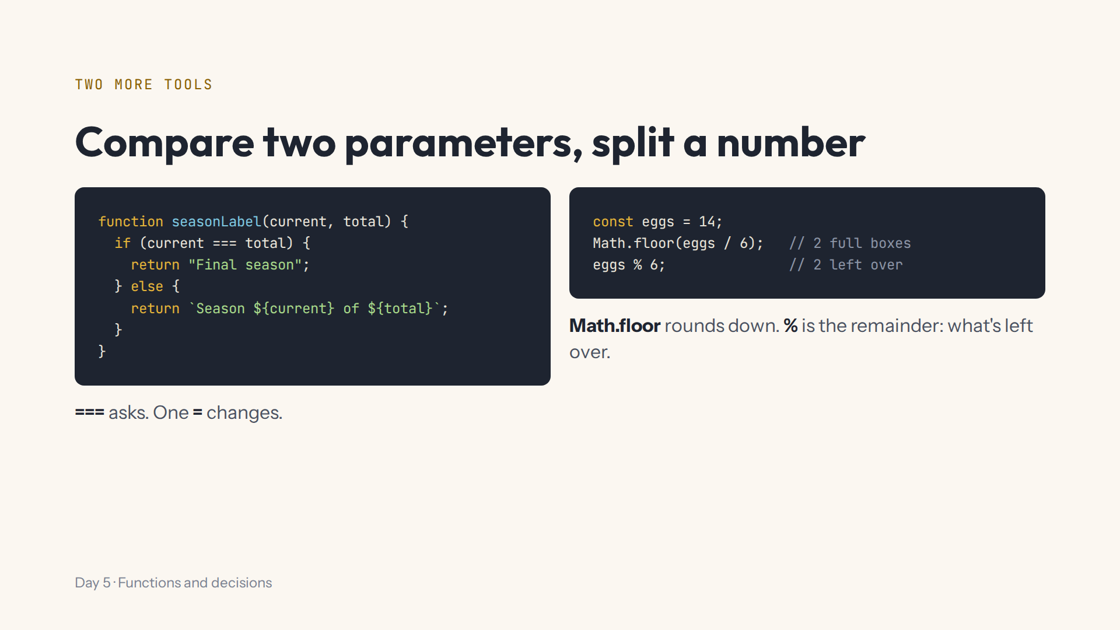
Notes:
Script 0:45, Lab steps 6 and 7. This afternoon they split minutes into hours and the rest the same way. If % is confusing, use a clock: 90 minutes is 1 hour and 30 left over.

Slide 9
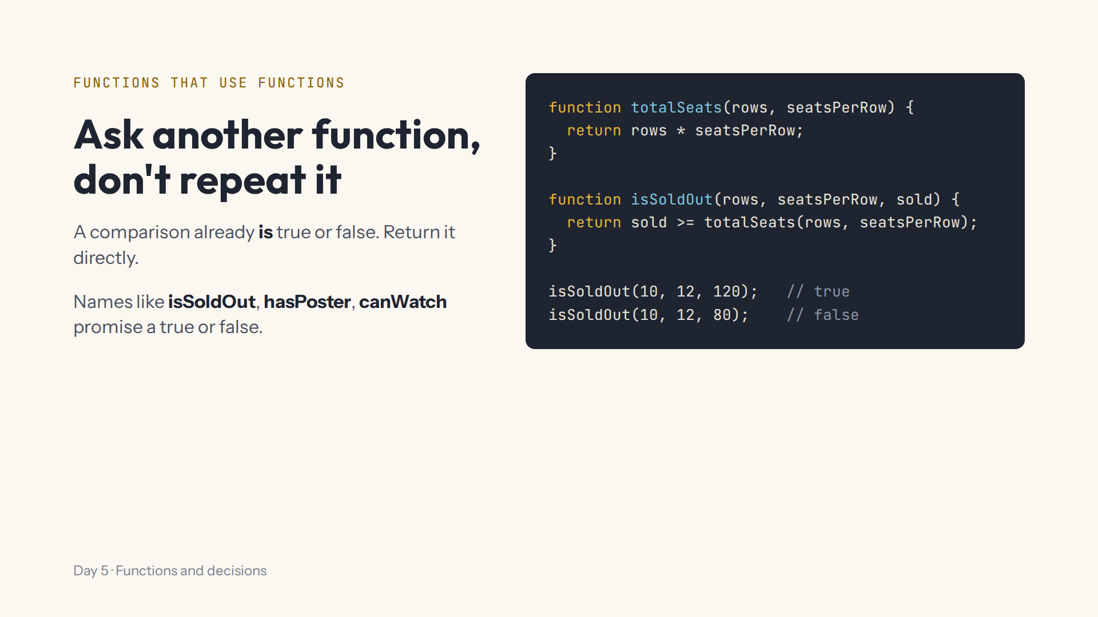
Notes:
Script 0:57, Lab step 8. If the seat rules change, you fix one function and both are right. Watch for the strings "true" and "false" instead of booleans.

Slide 10
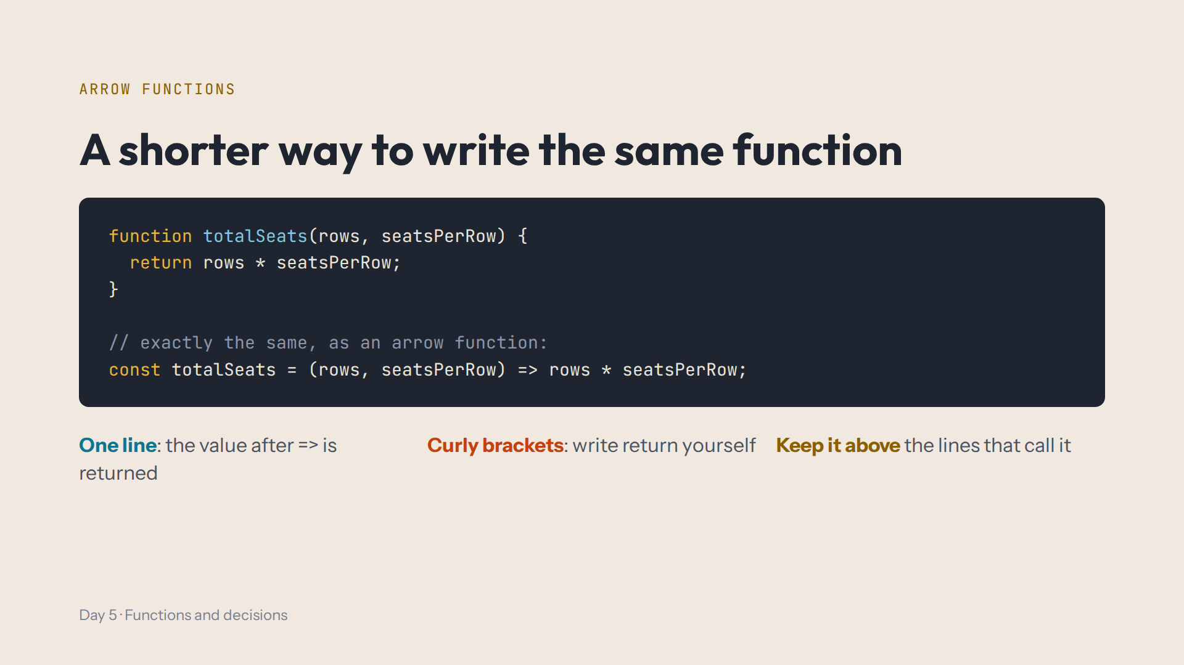
Notes:
Script 0:57, Lab step 9. Mistake on purpose: keep both versions and read the red error, already declared. Then delete the old function block. Two functions can't share a name.

Slide 11
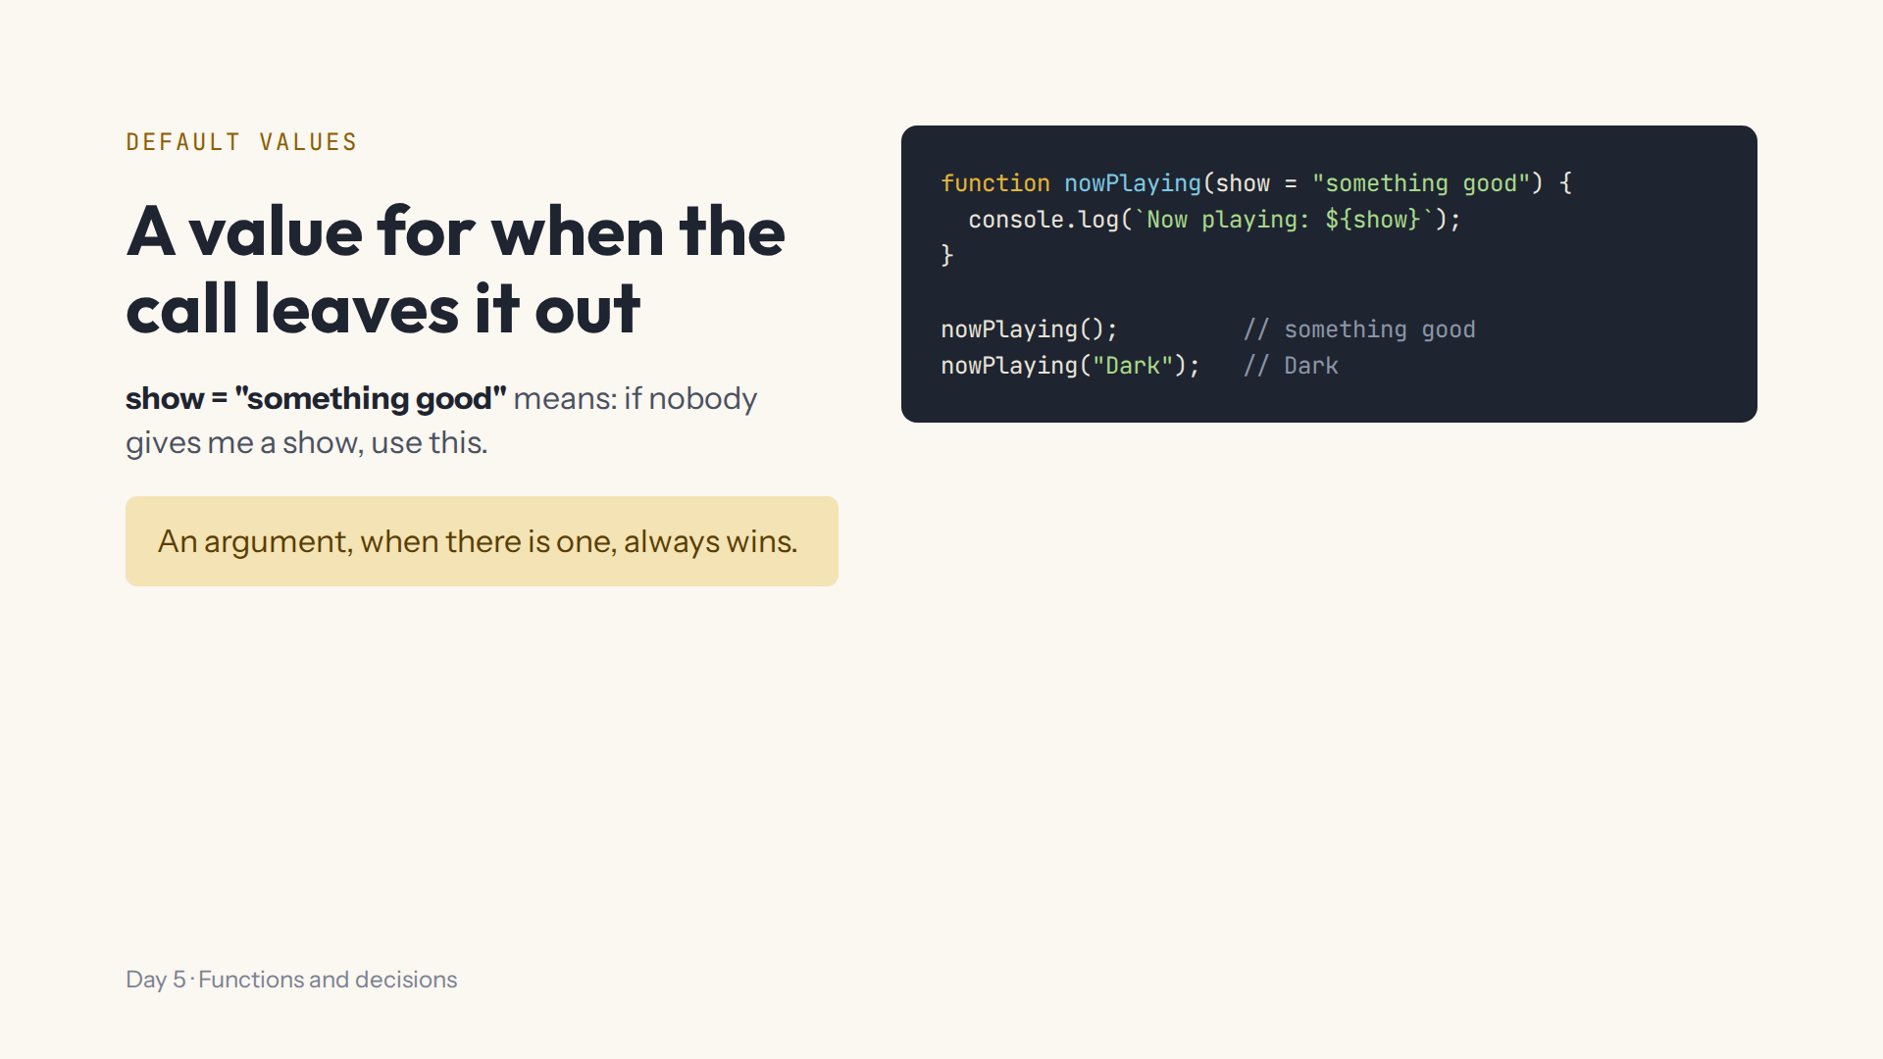
Notes:
Script 0:57, Lab step 10. This afternoon: one small function for 1 episode and 236 episodes. Watch for word == "episode" or word: "episode" in the brackets.

Slide 12
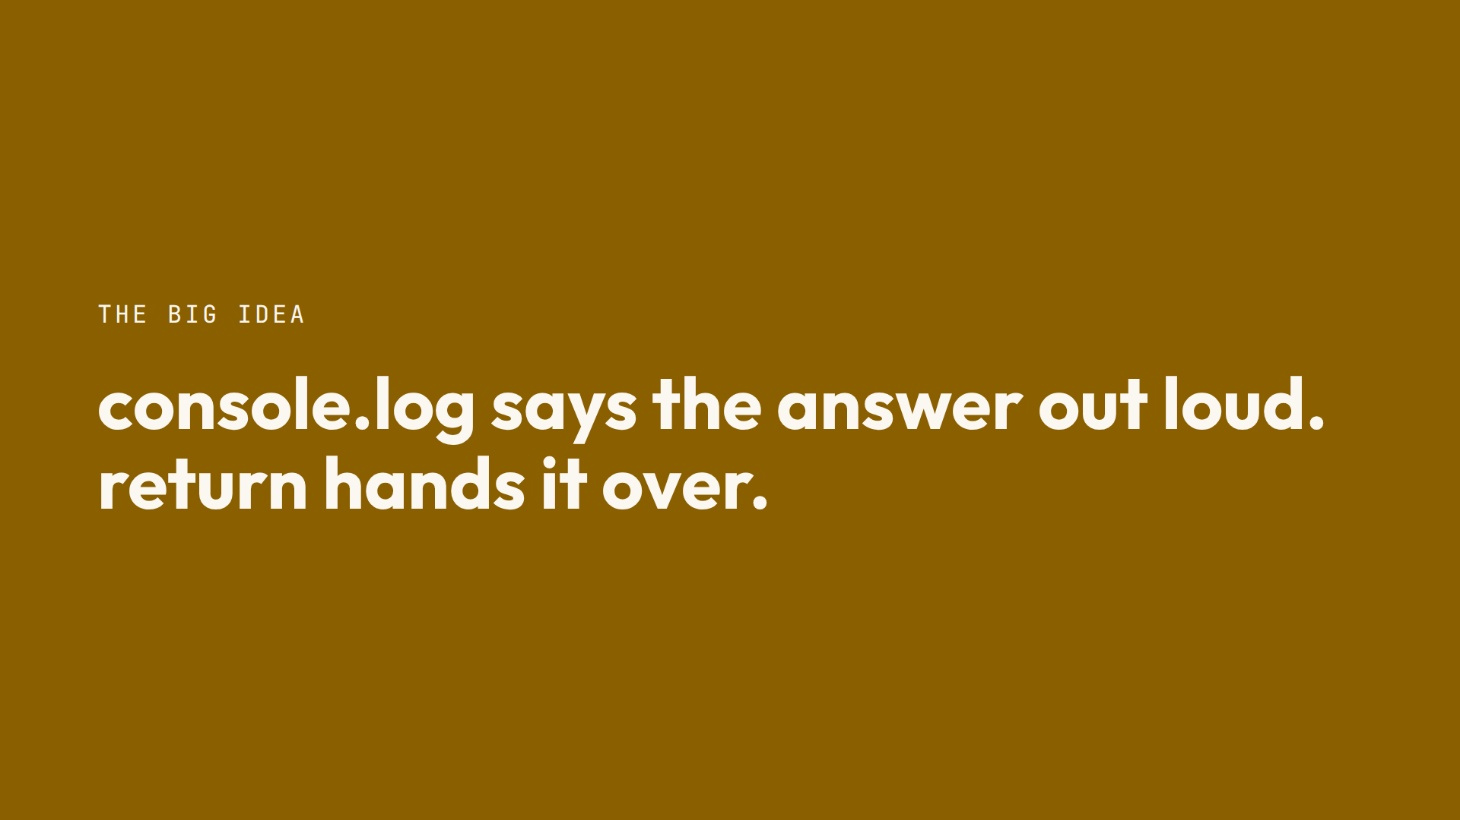
Notes:
Script 1:10. Ask the class to say it back in their own words, then take questions.

Slide 13
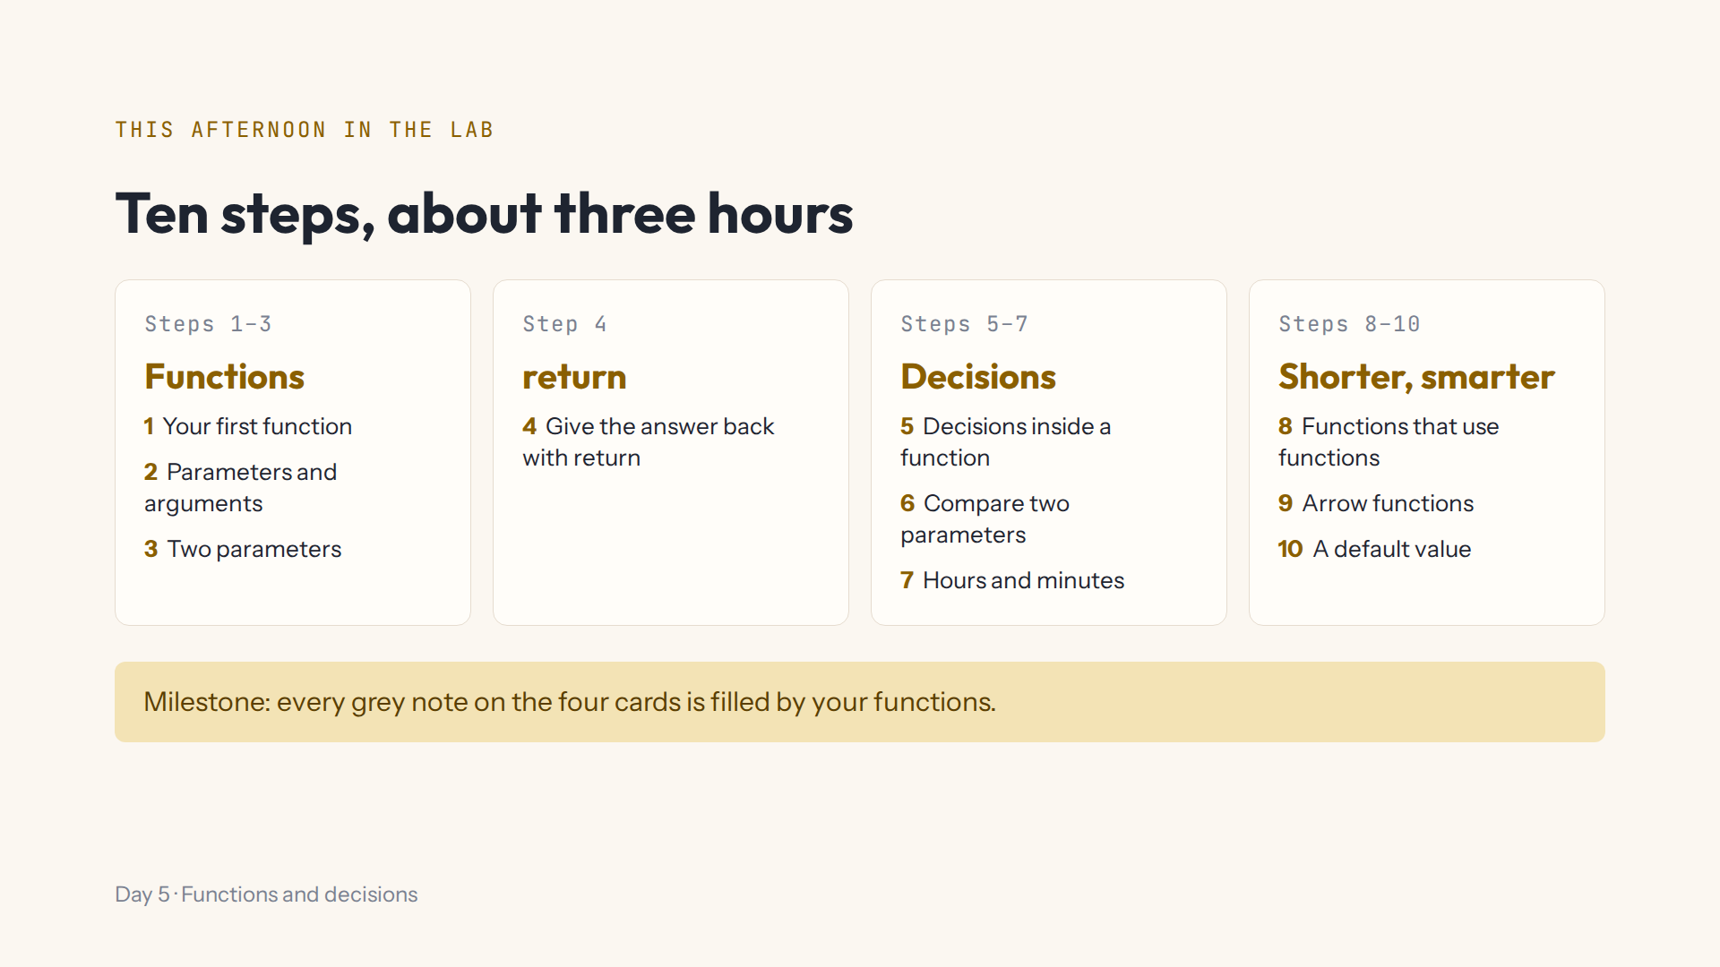
Notes:
Script 1:15. Open #/day/5, read the step list together, then do step 1 together. Show Hint, Answer, the Console and Check. Progress saves by itself; Help, Save progress to a file to change computers.

Slide 14
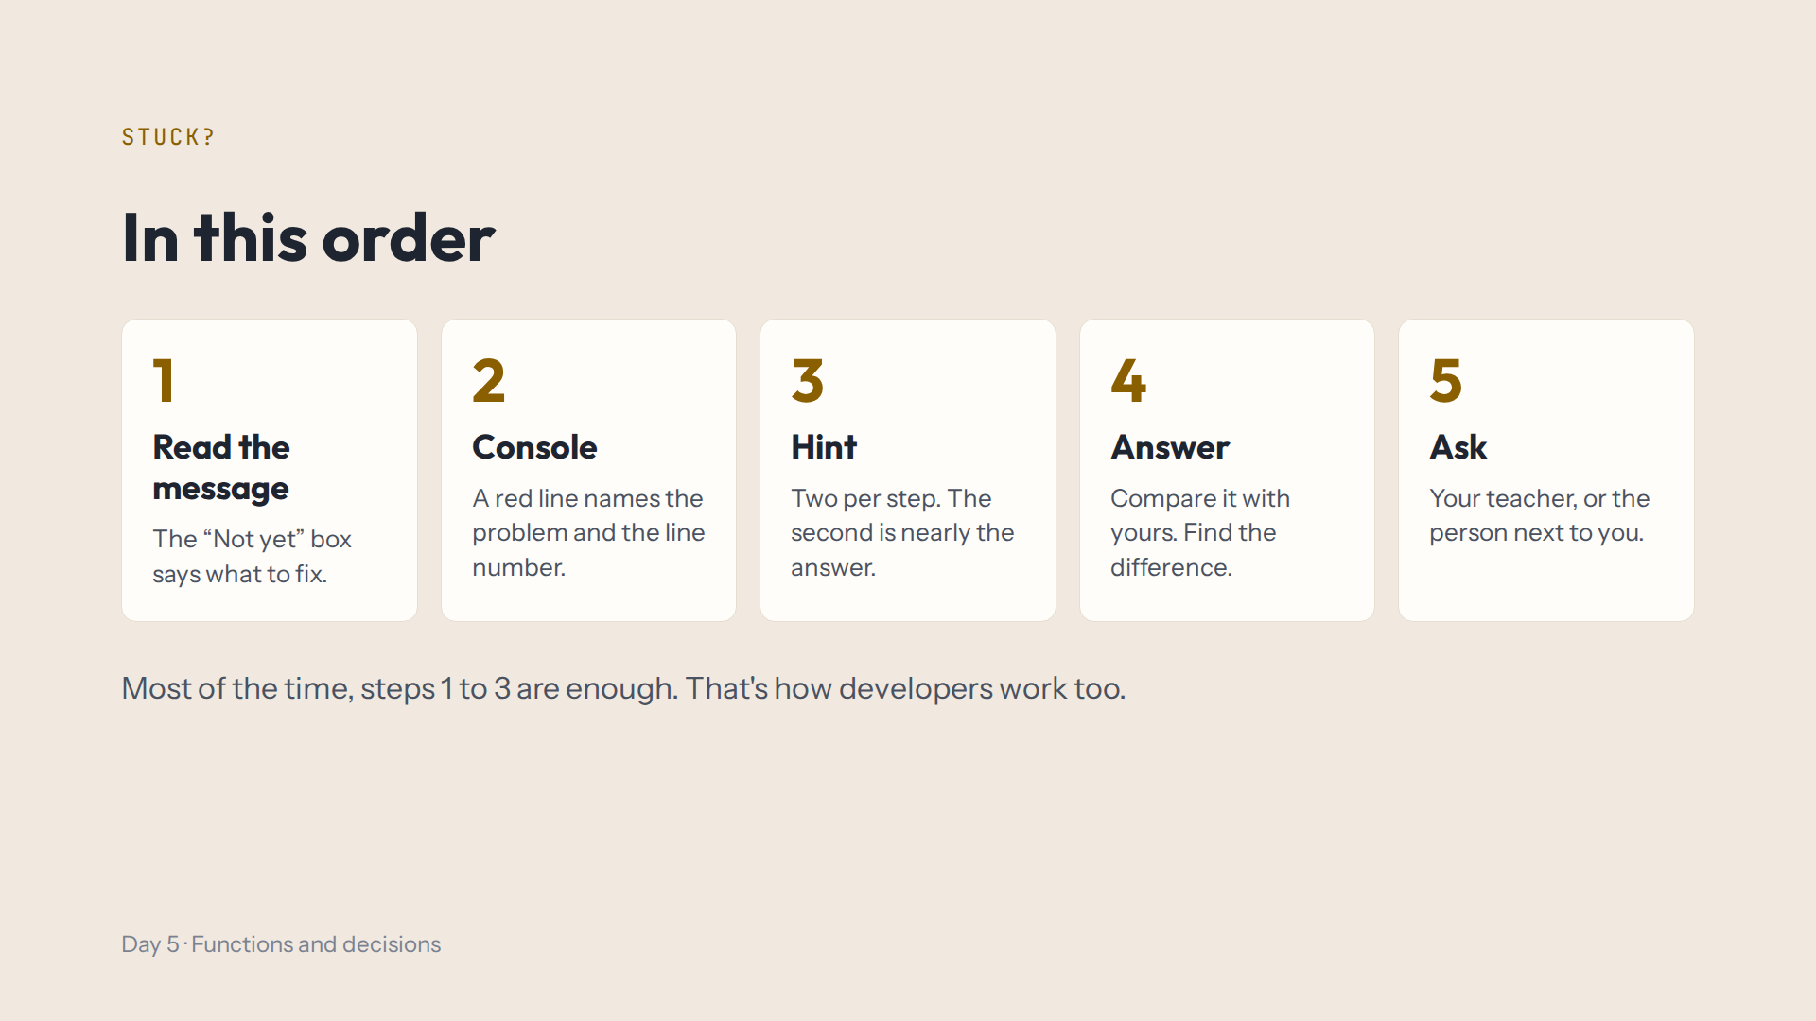
Notes:
Script 1:15. Read it together. Today most red errors are a missing } or a name typed two ways. The second hint is nearly the answer; the Answer button is fine after that.

Slide 15
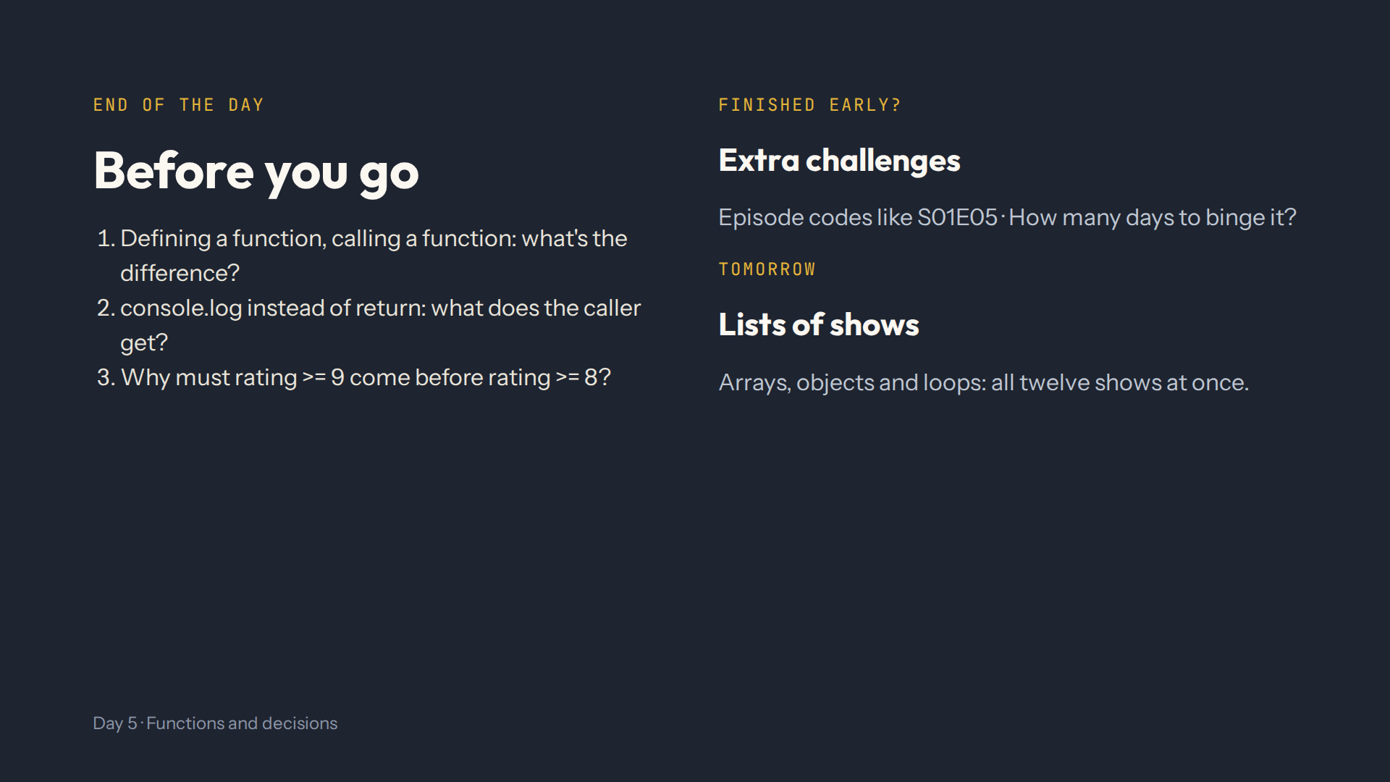
Notes:
For the afternoon teacher at the end of the day. Answers in quiz.md, End-of-day check. Ask them to show you the four cards with every grey note filled.

