Slide 1
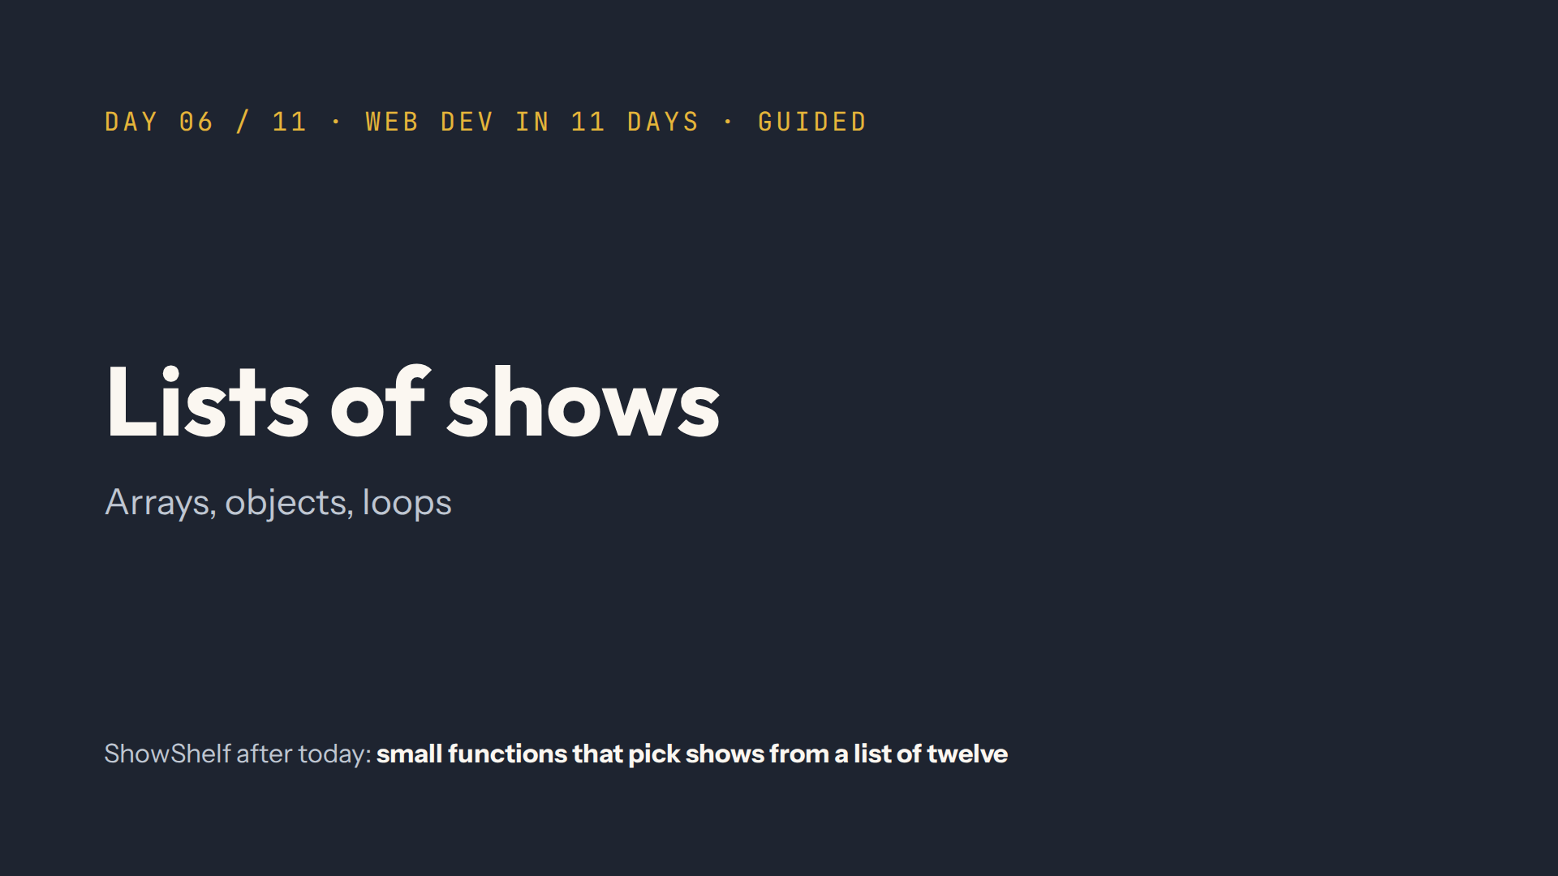
Notes:
Script: Mindset. Every idea today answers one question: how do I get this out of a list? Keep coming back to the twelve shows in data.js.

Slide 2
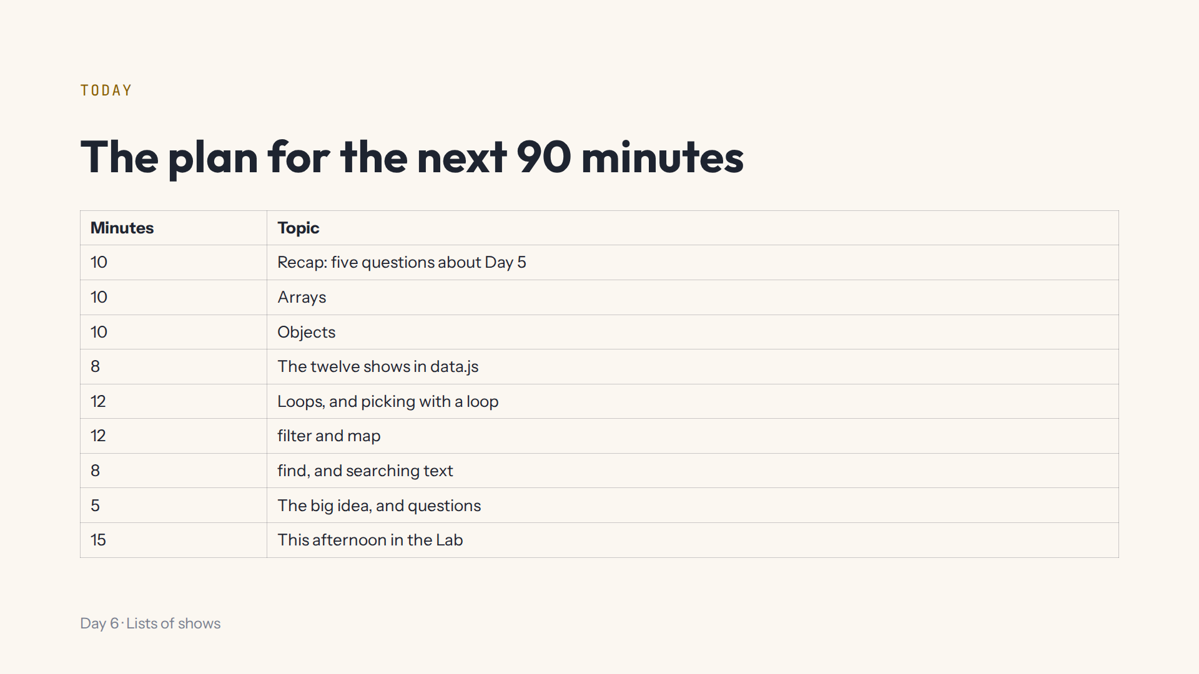
Notes:
Lab open on the projector at #/day/6, Console panel open. After each demo, press Start again in that step.

Slide 3
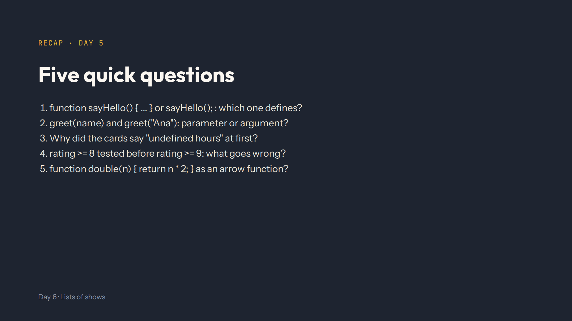
Notes:
Script 0:00. Answers: the first defines, the second calls. name is the parameter, "Ana" the argument. console.log instead of return, so page.js got undefined. 9.5 is also >= 8, so it says Good: strictest test first. const double = (n) => n * 2;

Slide 4
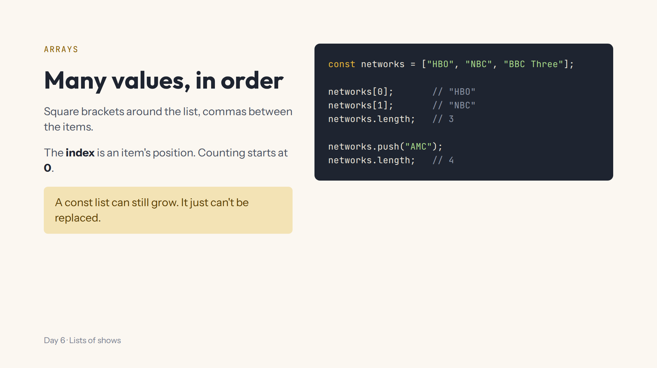
Notes:
Script 0:10, Lab step 1. Ask what networks[1] is before you run it. Show networks[3] before the push: undefined. Everyone forgets the 0 at least once this week.

Slide 5
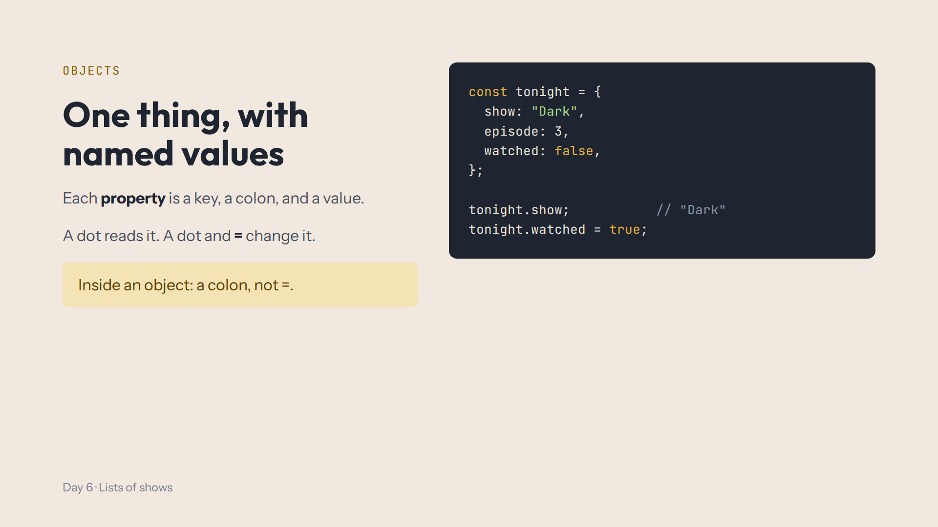
Notes:
Script 0:20, Lab step 2. Mistake on purpose: show = "Dark" inside the object. Read the syntax error together, then fix it with a colon.

Slide 6
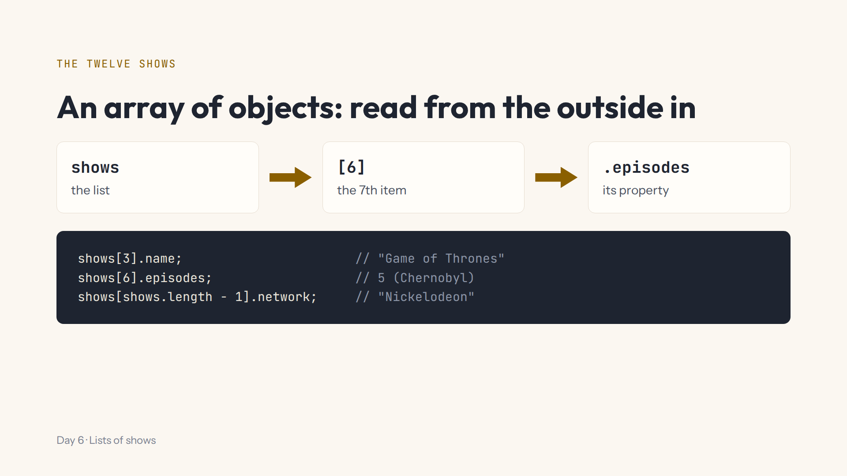
Notes:
Script 0:30, Lab step 3. Open the data.js tab first and read one show's keys aloud. Ask why length - 1. Mistake on purpose: shows[12].name gives Cannot read properties of undefined.

Slide 7
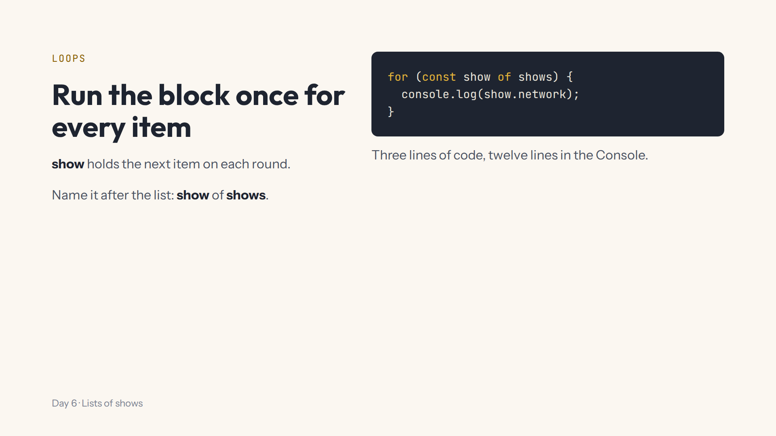
Notes:
Script 0:38, Lab step 4. Read the for line aloud as a sentence: for each show of the shows list, run the block.

Slide 8
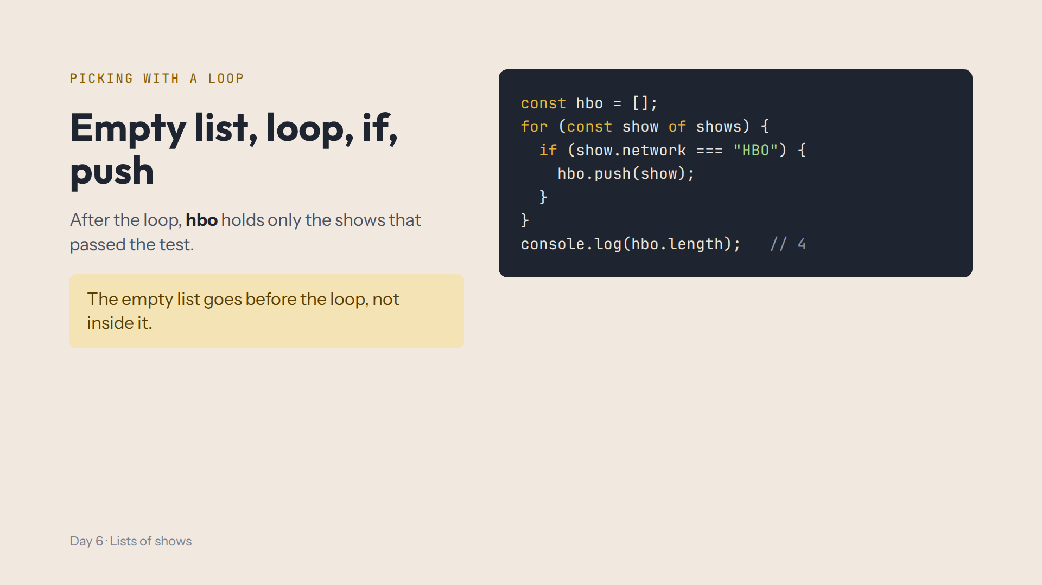
Notes:
Script 0:38, Lab step 5. Ask which four: Game of Thrones, Chernobyl, The Wire, Band of Brothers. Mistake on purpose: move const hbo = [] inside the loop, and the answer becomes 0. Point at the indentation: blocks inside blocks.

Slide 9
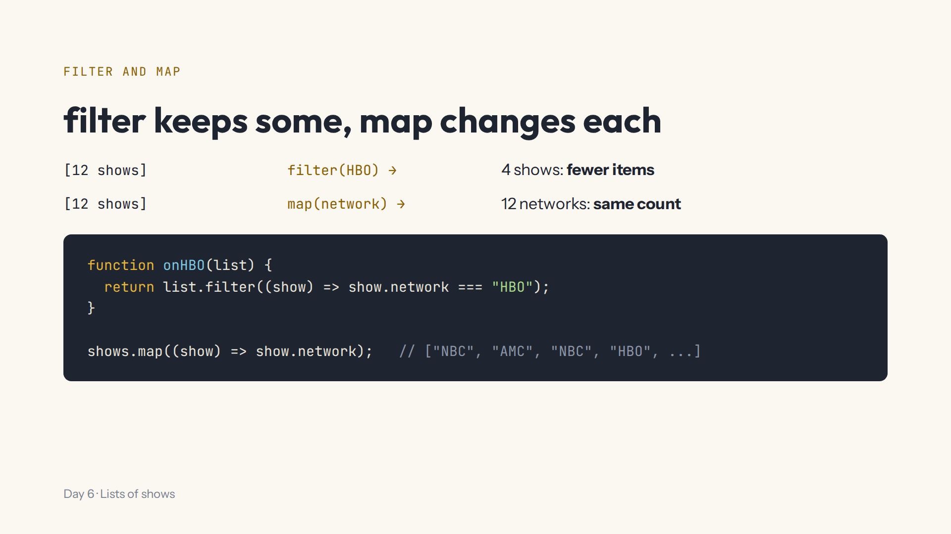
Notes:
Script 0:50, Lab steps 6 and 7. Inside the function use the parameter list, never shows. Mistake on purpose: curly brackets after the arrow without return, and the result is empty.

Slide 10
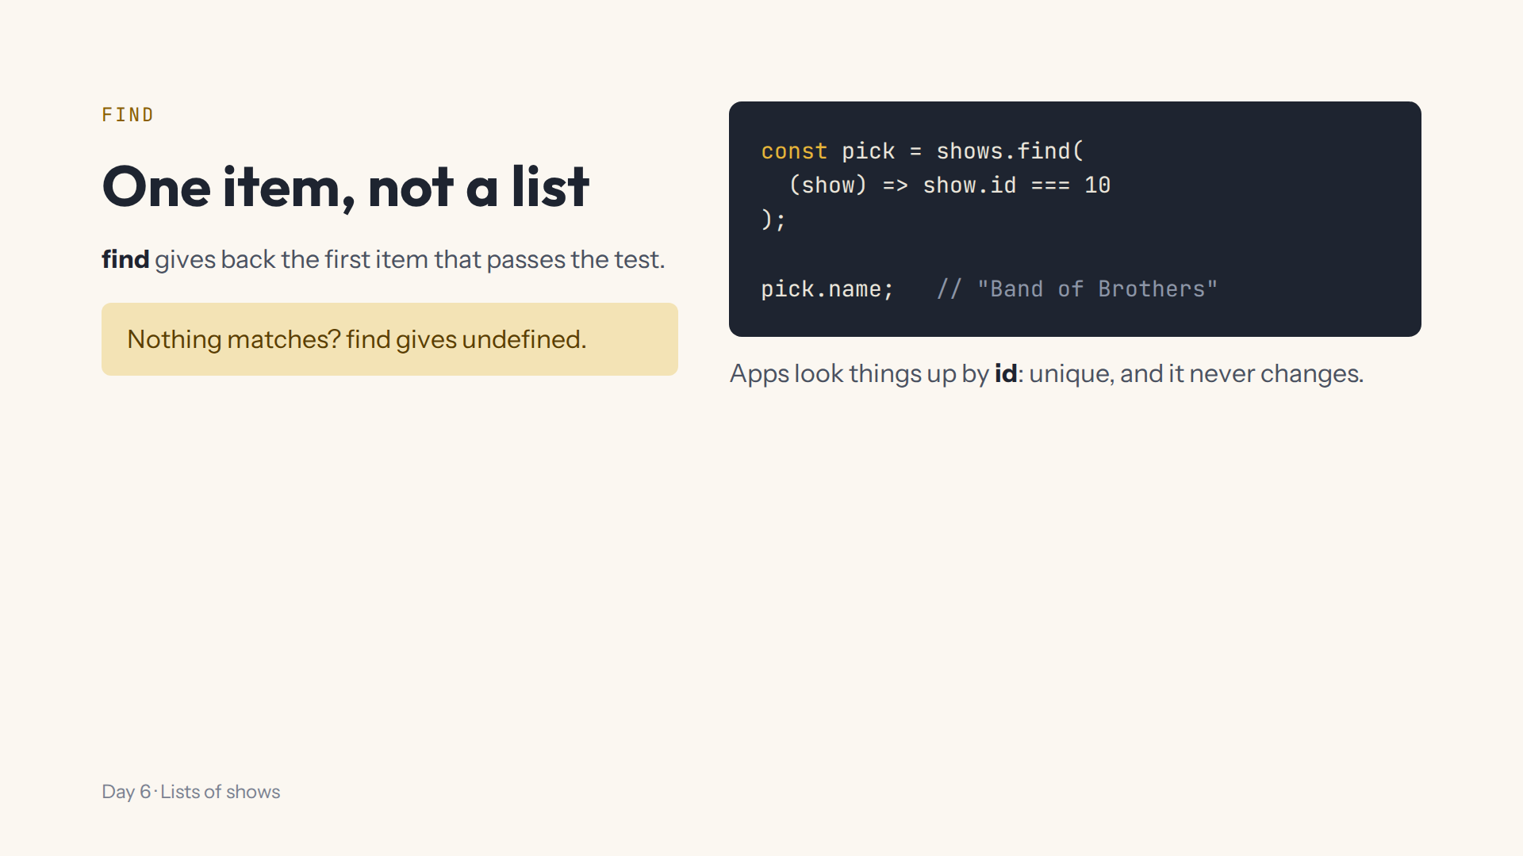
Notes:
Script 1:02, Lab step 8. Mistake on purpose: show.id = 10 with one equals sign always gives the first show. Three equals signs ask.

Slide 11
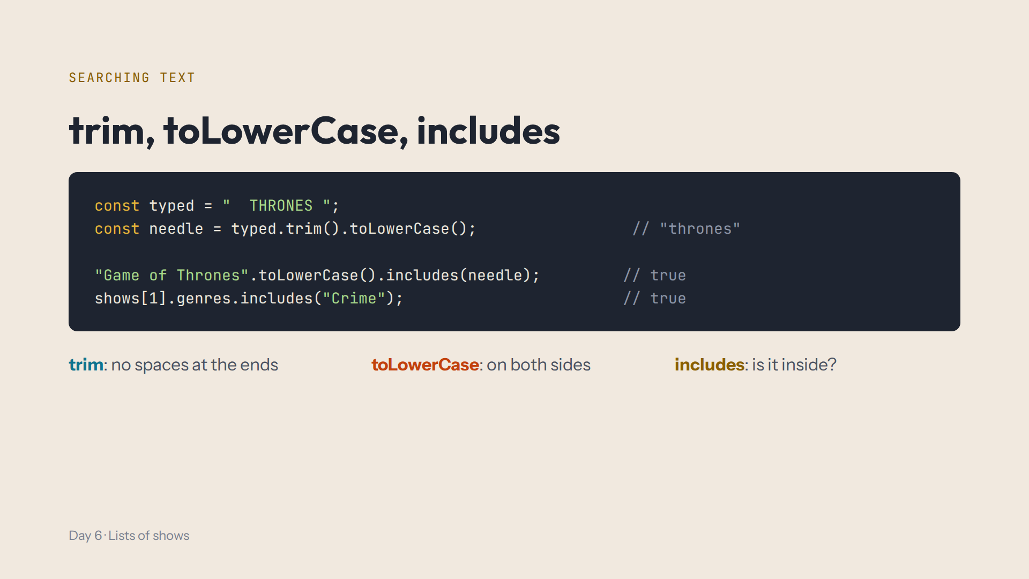
Notes:
Script 1:02, Lab steps 9 and 10. Methods can be chained: each one works on the result of the one before. Arrays have includes too: is this genre in the list? Capital letters matter there.

Slide 12

Notes:
Script 1:10. With these three you can ask almost anything of a list. Take questions.

Slide 13
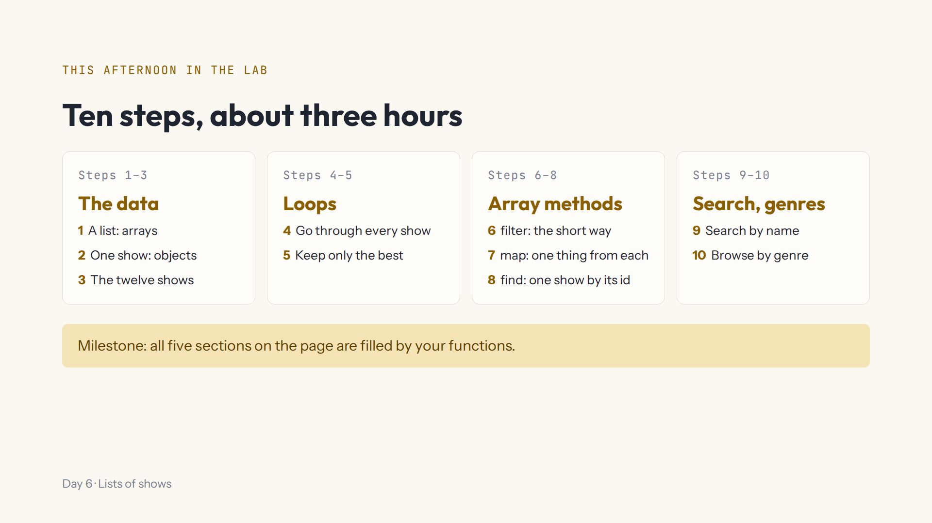
Notes:
Script 1:15. Open #/day/6, read the step list together, then do step 1 together. Show the data.js tab, Hint, Answer, the Console and Check. Progress saves by itself; Help, Save progress to a file to change computers.

Slide 14
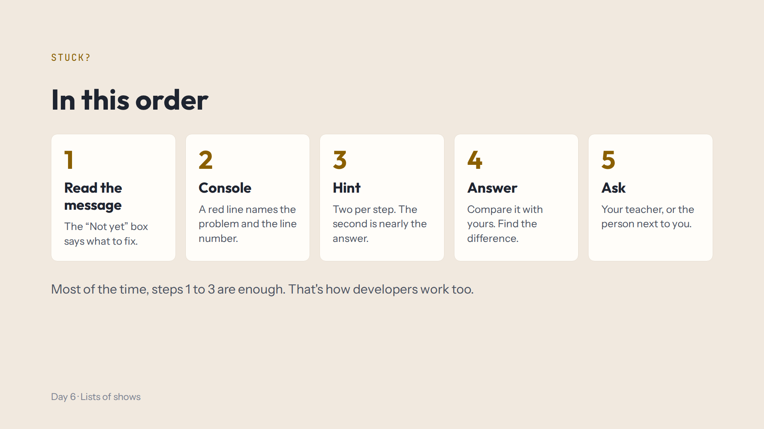
Notes:
Script 1:15. Today the Console is your best friend: log the thing you're looking at. undefined usually means a wrong index or a misspelt key.

Slide 15
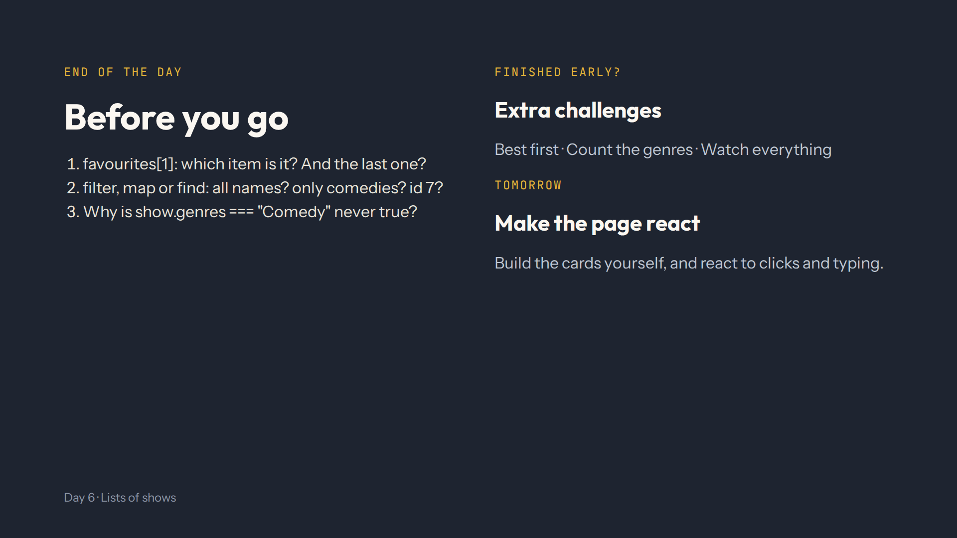
Notes:
For the afternoon teacher at the end of the day. Answers in quiz.md, End-of-day check. Ask them to type THE in the search box and explain why How I Met Your Mother appears.

