Slide 1

Notes:
Script: Mindset. The page starts to answer back today. The idea everything after builds on is state, then render (step 9). Go slowly there.

Slide 2
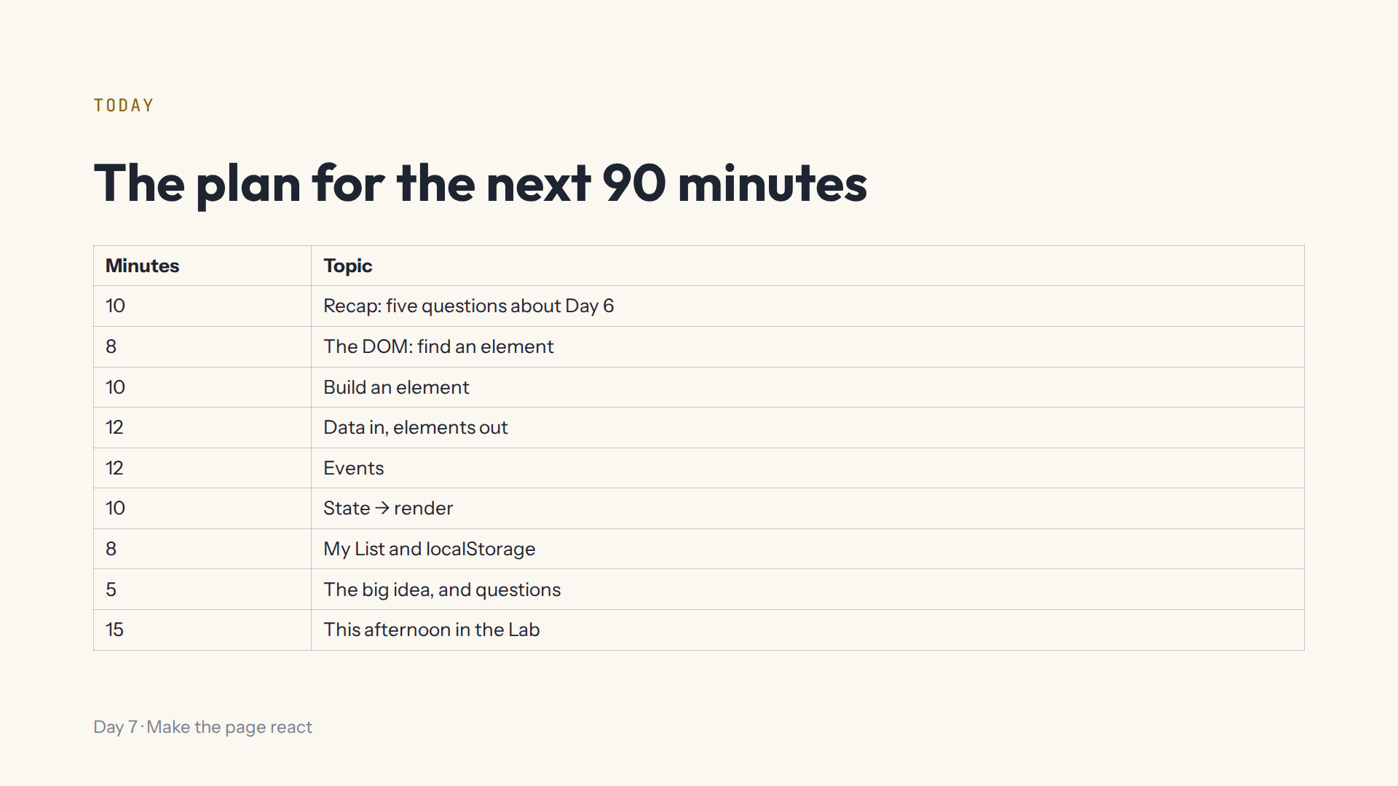
Notes:
Lab open on the projector at #/day/7: its preview shows tonight's finished page. After each demo, press Start again in that step.

Slide 3
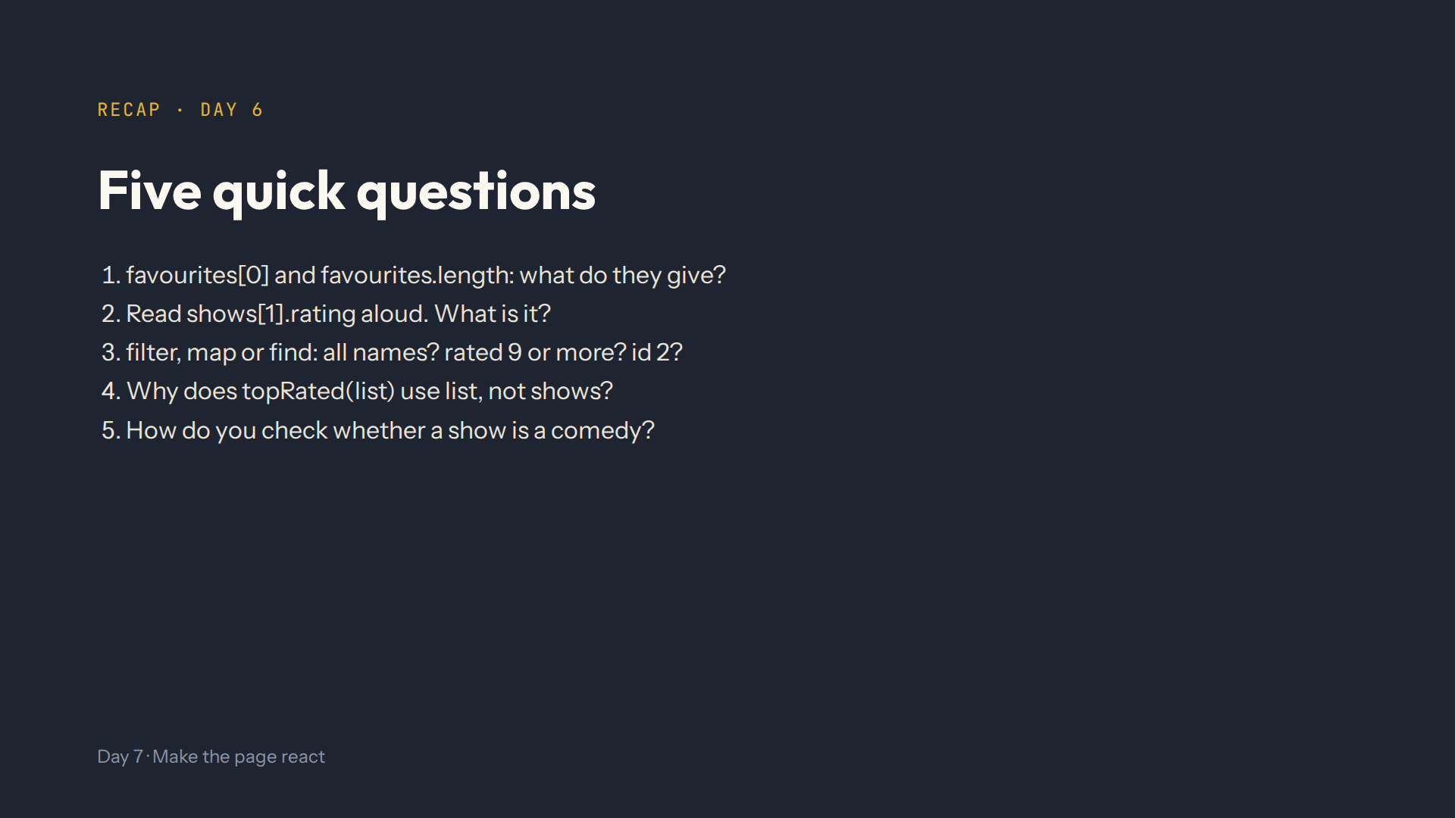
Notes:
Script 0:00. Answers: the first item, and 3. The list, the second item, its rating: 9.2. map, filter, find. So it works with any list it's given. show.genres.includes("Comedy").

Slide 4
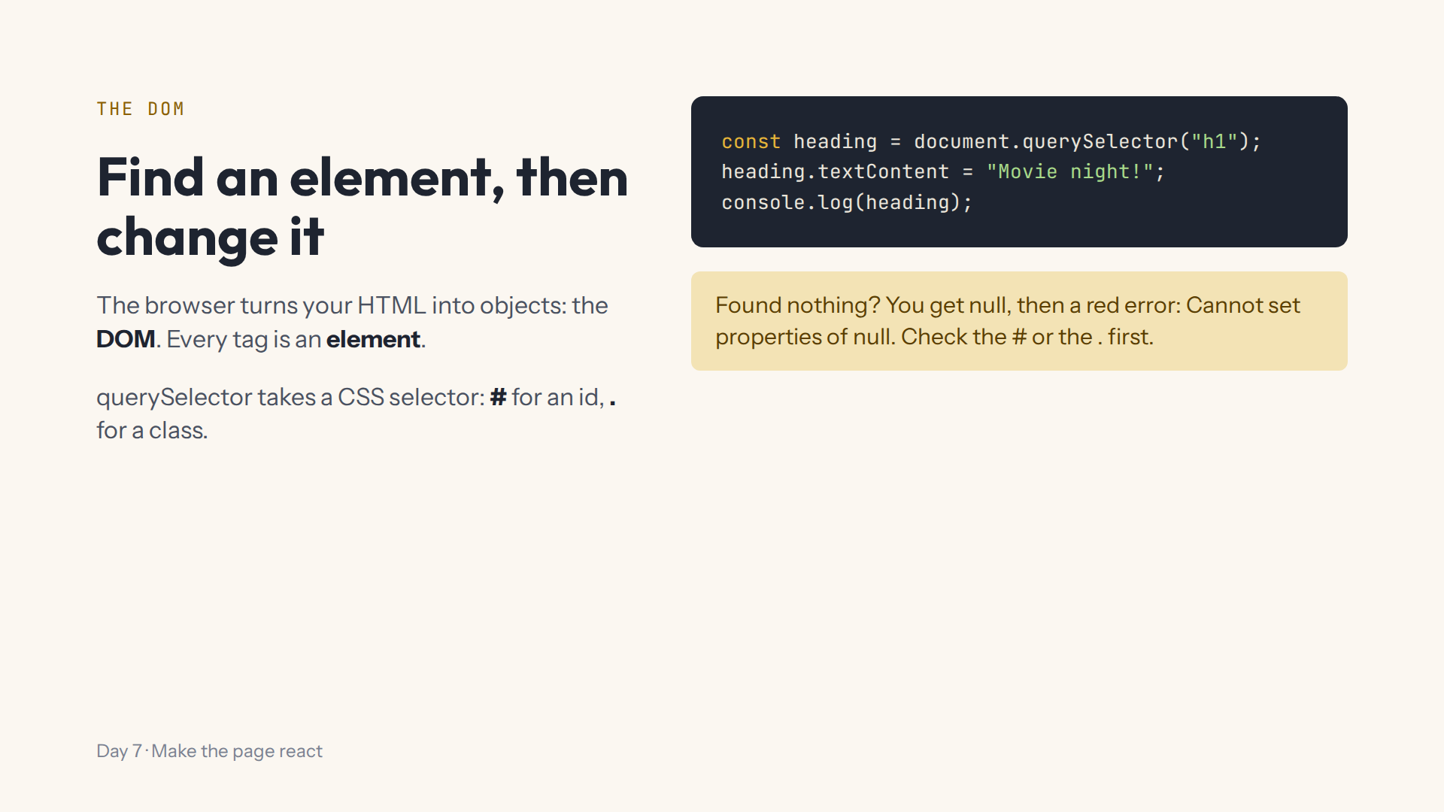
Notes:
Script 0:10, Lab step 1. Mistake on purpose: querySelector("hero") without the dot, then .textContent. Read the red error together.

Slide 5
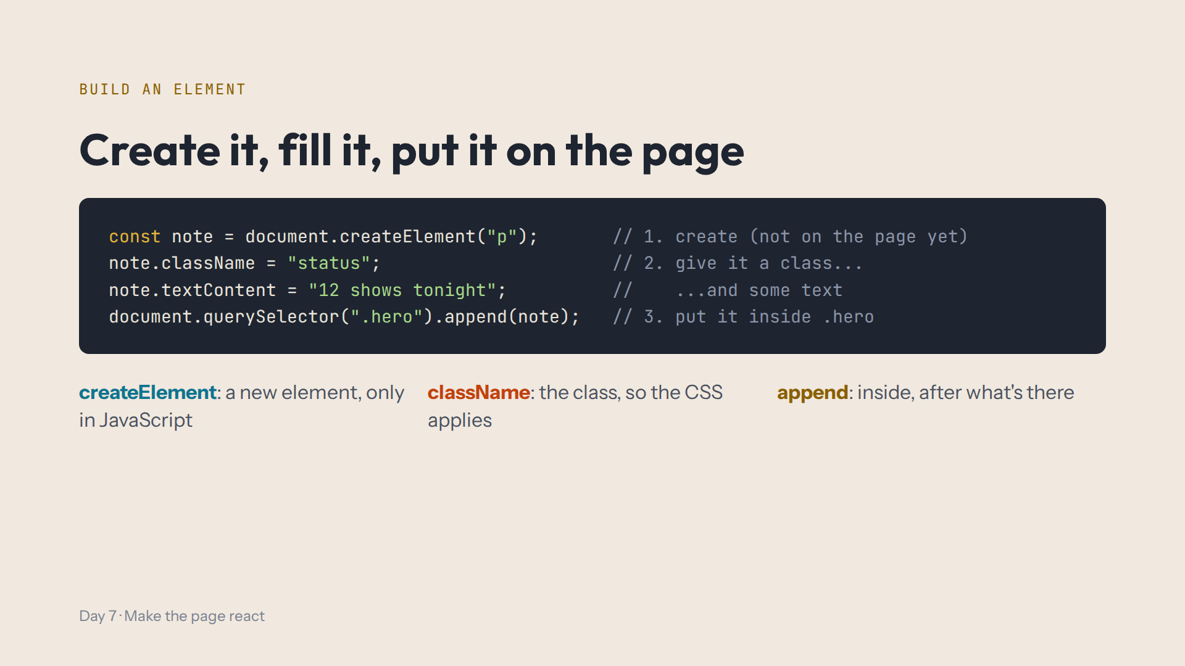
Notes:
Script 0:18, Lab step 2. Mistake on purpose: comment out the append line, and the note disappears. Ask what note.class would do: nothing, the property is className.

Slide 6
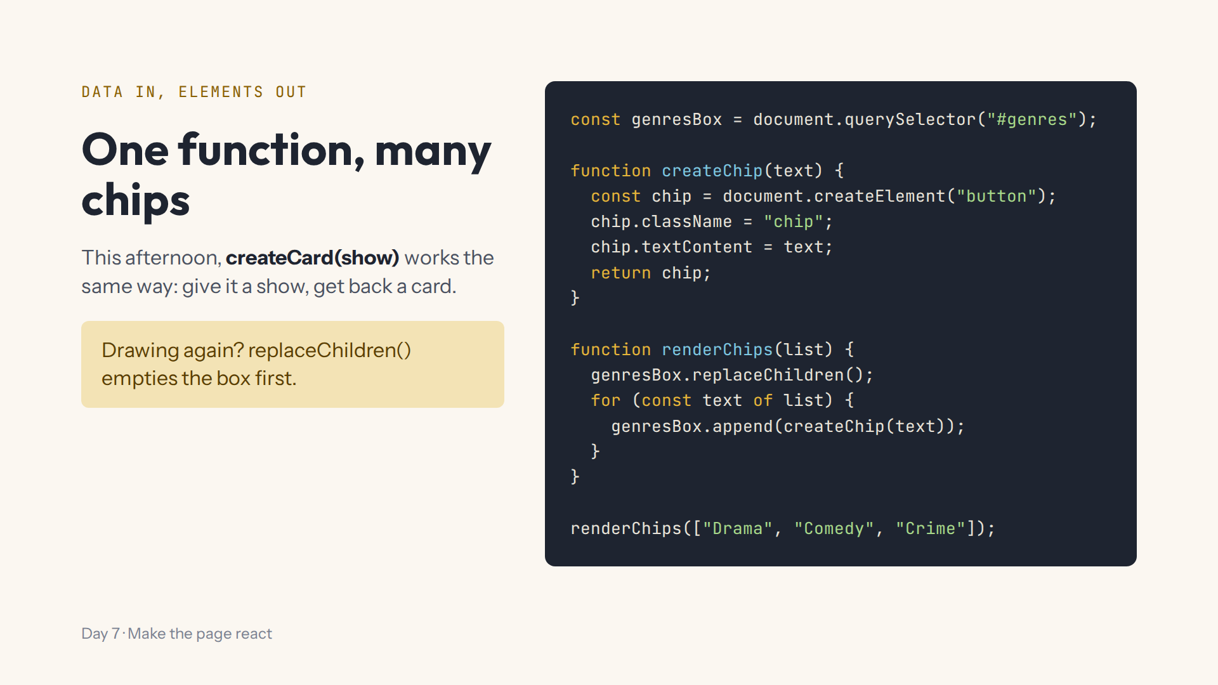
Notes:
Script 0:28, Lab steps 3 to 5. First read step 3's starter together without filling the TODOs. Mistake on purpose: call renderChips twice without replaceChildren: six chips. Render is the word for draw on the screen.

Slide 7
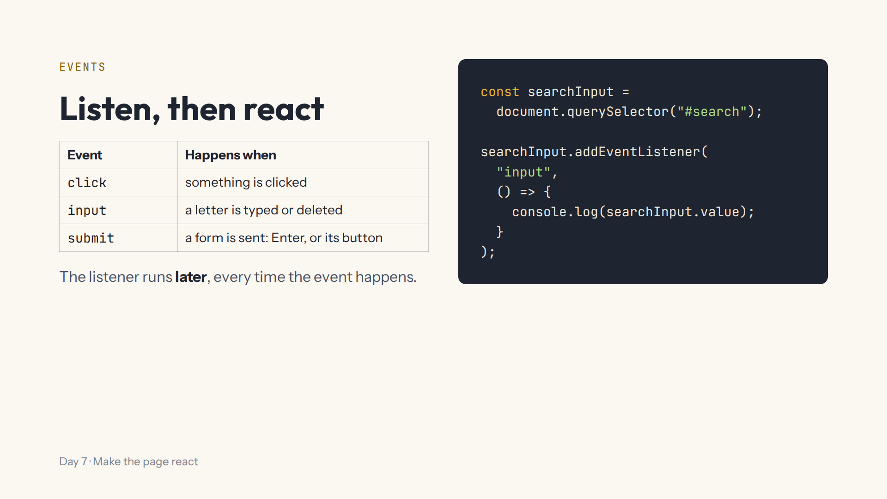
Notes:
Script 0:40, Lab step 6. Demo the heading click first, then this. Mistake on purpose: log searchInput.value outside the listener: one empty line, once, when the page loaded.

Slide 8
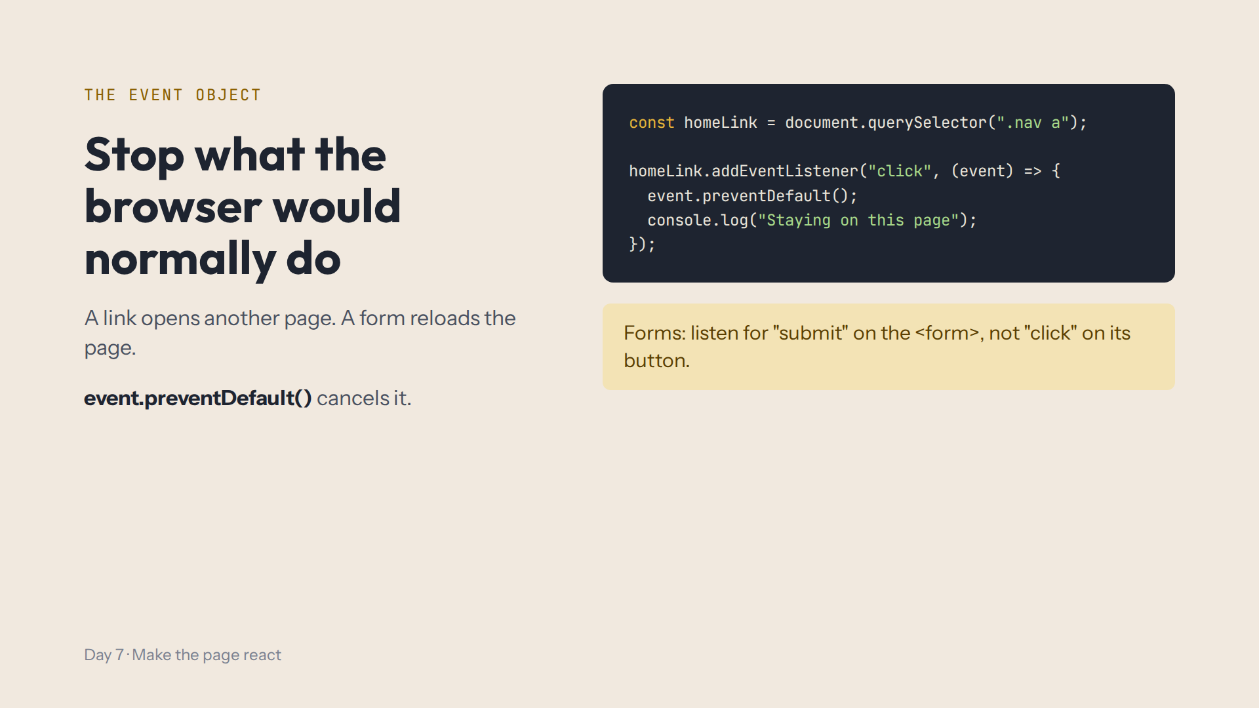
Notes:
Script 0:40, Lab step 7. Click Home first: the Lab shows a notice. Then add the listener: no notice. Press Enter in the search box to show the form reloading; they fix that this afternoon.

Slide 9
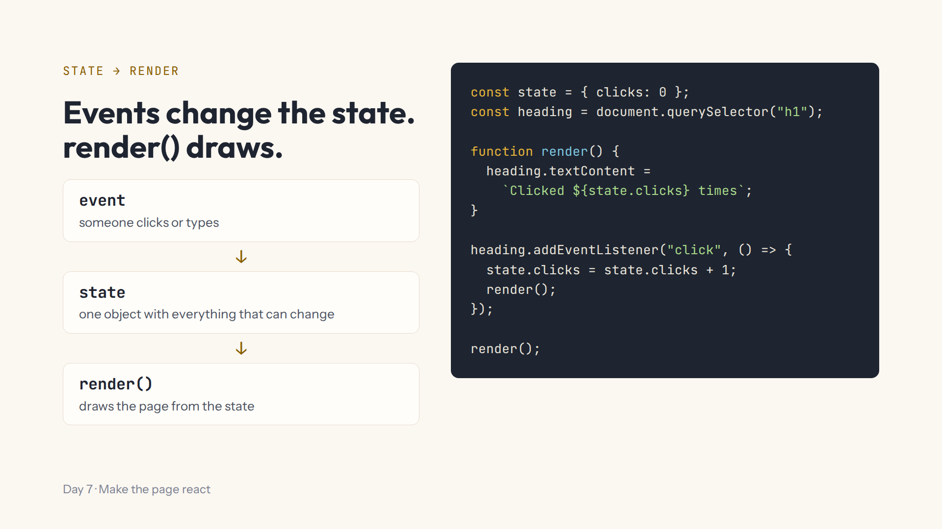
Notes:
Script 0:52, Lab steps 8 and 9. Start with hidden: #empty-message .hidden = false shows it. Then the counter. Mistake on purpose: remove render() from the listener; the state changes but nobody draws. Have the class say the order: click, state, render.

Slide 10
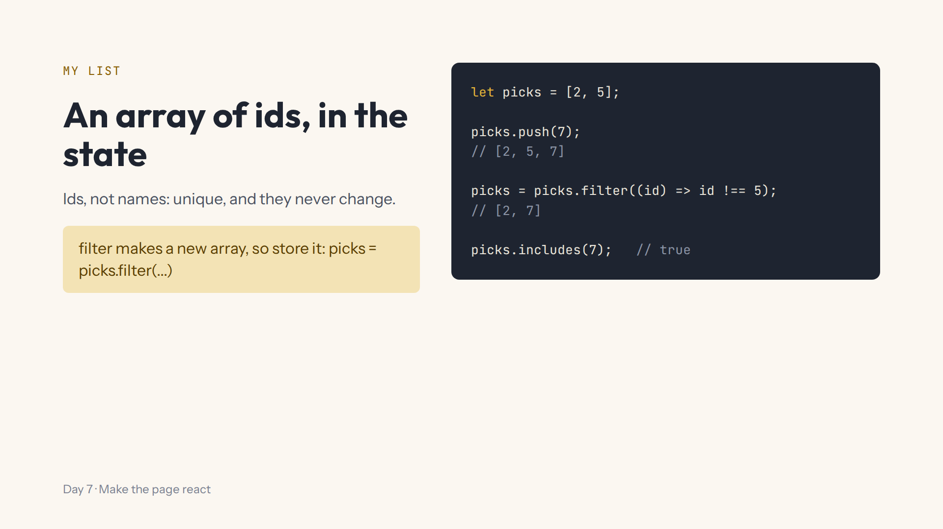
Notes:
Script 1:02, Lab step 10. push adds, filter removes, includes checks: all three from yesterday. This afternoon the + and the tick on every card are drawn from this array.

Slide 11
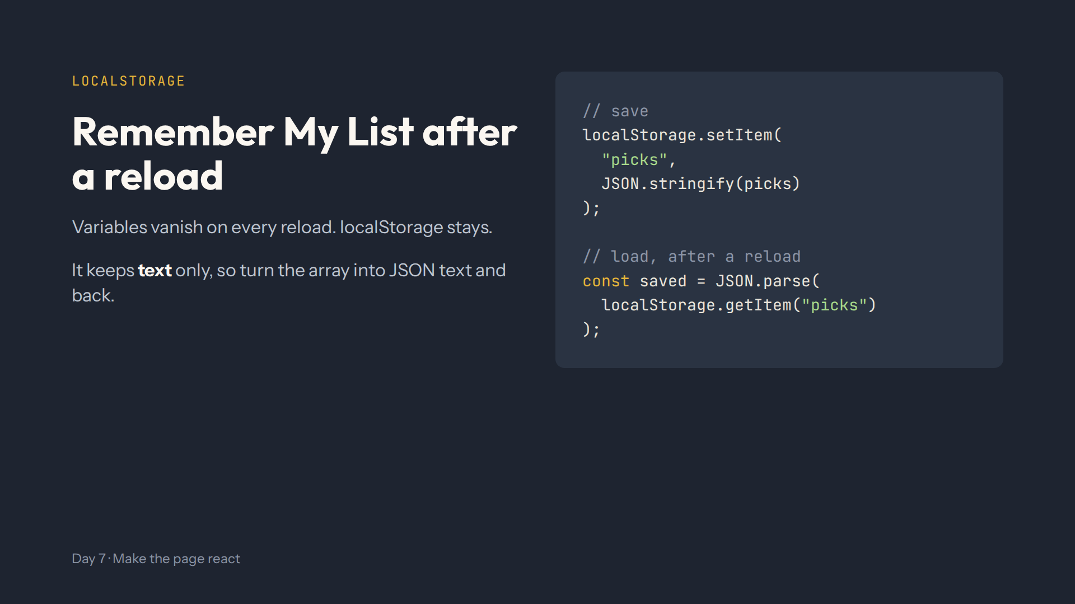
Notes:
Script 1:02, Lab step 11. Delete the setItem line and press Run again: getItem still finds [2, 7]. Mistake on purpose: setItem without JSON.stringify saves "2,7", and JSON.parse fails. This afternoon ?? [] covers the very first time, when nothing is saved.

Slide 12
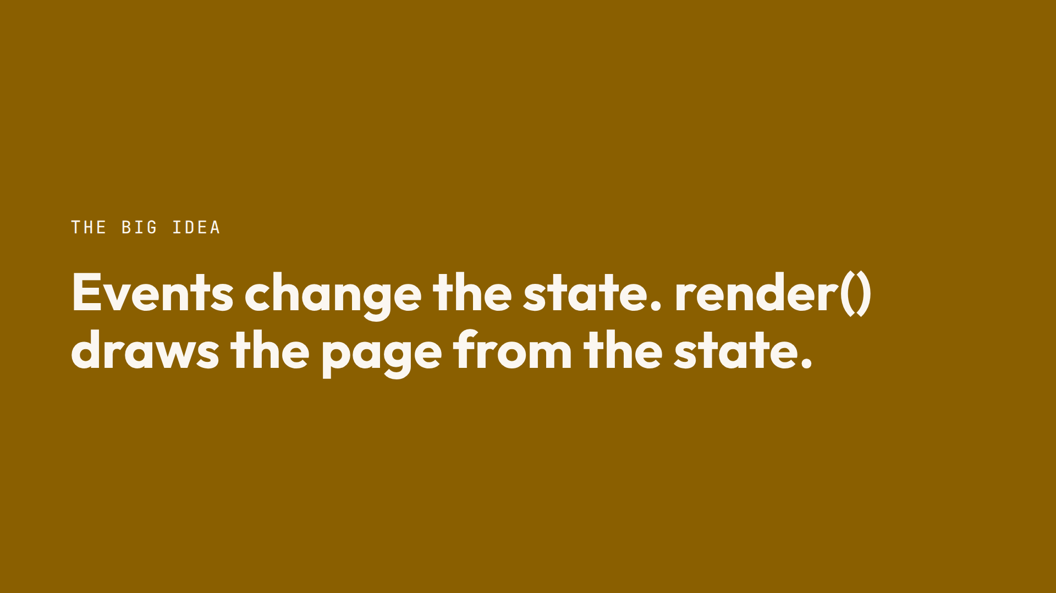
Notes:
Script 1:10. However many buttons you add, the page can't get out of step. Take questions.

Slide 13
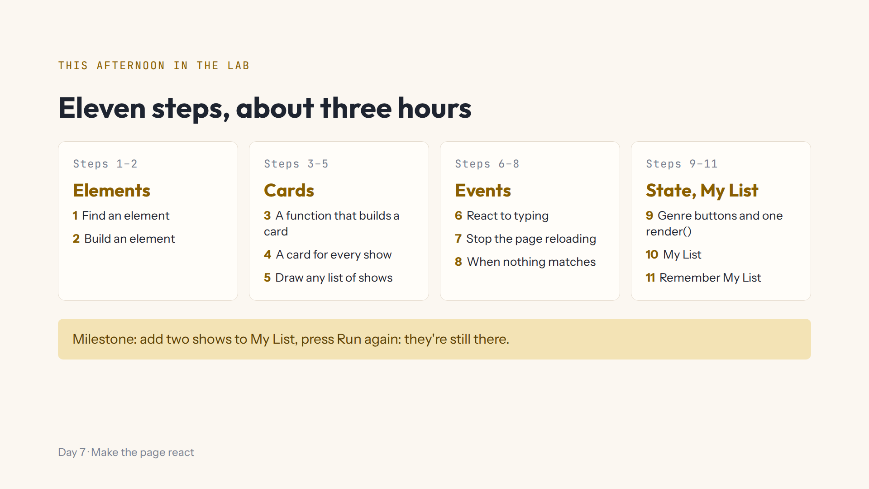
Notes:
Script 1:15. Open #/day/7, read the step list together, then do step 1 together. Show the read-only tabs, Hint, Answer, the Console and Run again. Progress saves by itself; Help, Save progress to a file to change computers.

Slide 14
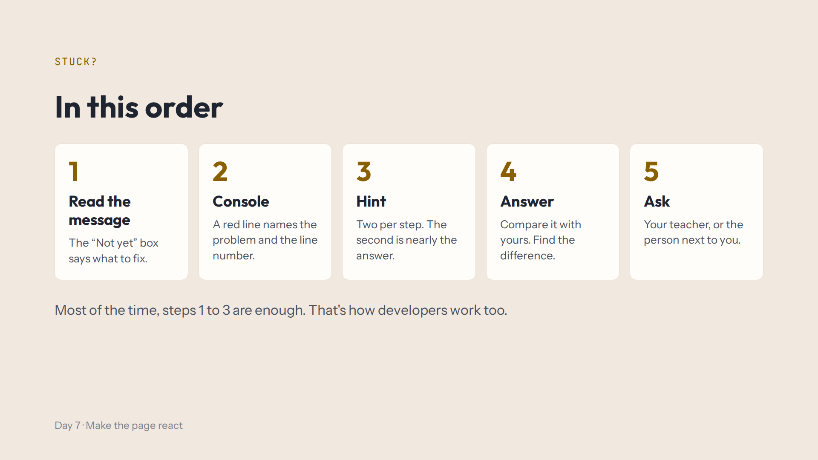
Notes:
Script 1:15. Today's most common red line is Cannot read (or set) properties of null: a selector that found nothing. Step 9 is the longest: tell them it's normal to need the hints there.

Slide 15
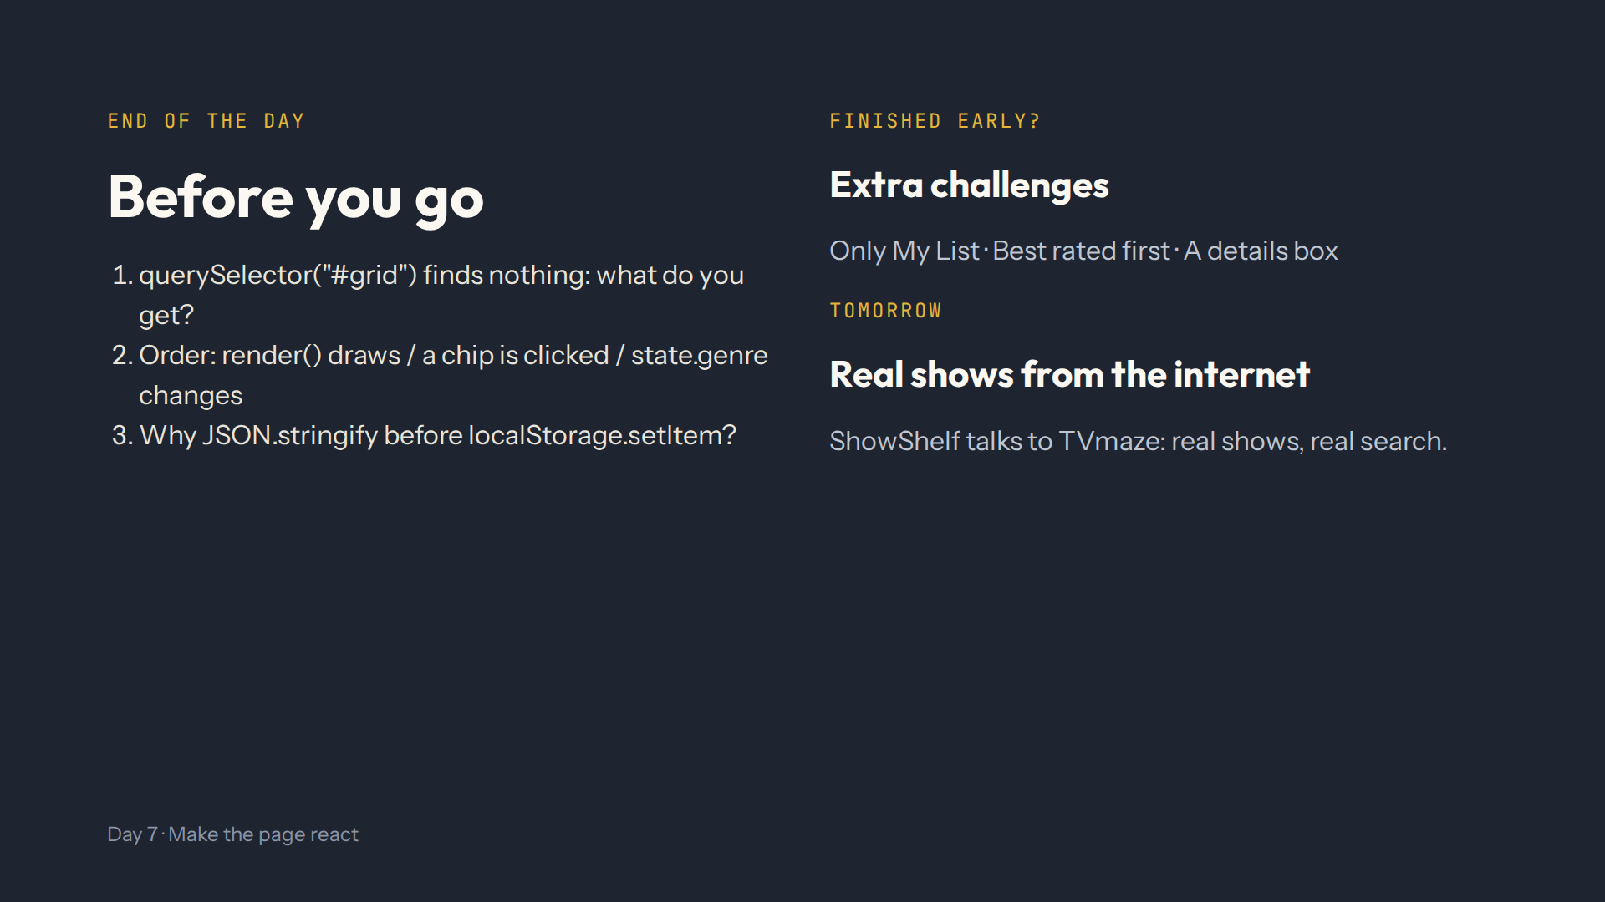
Notes:
For the afternoon teacher at the end of the day. Answers in quiz.md, End-of-day check. Ask them to add two shows, press Run again, then click Drama and type the.

