Slide 1

Notes:
Script: Before class. Check the room's internet with https://api.tvmaze.com/shows/431. No internet? Every demo still works with the Lab's saved sample data.

Slide 2
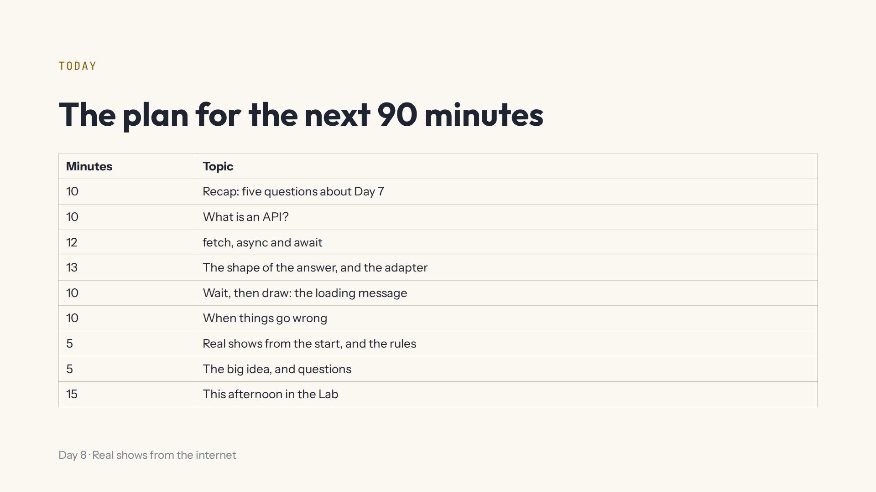
Notes:
Lab open on the projector at #/day/8. The preview runs the code at every pause in typing: type the call line of a fetch demo last. After each demo, press Start again.

Slide 3
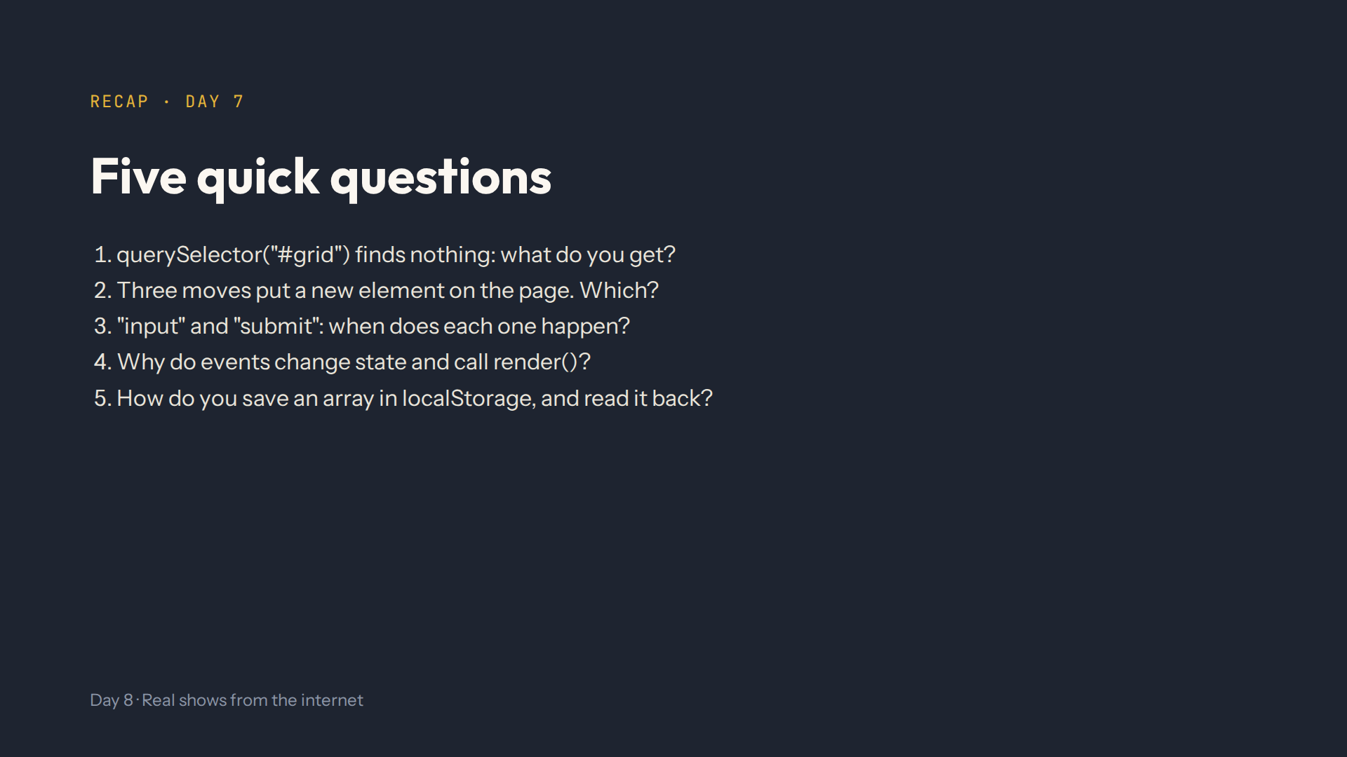
Notes:
Script 0:00. Answers: null. createElement, fill it, append it. input on every change in the box, submit when the form is sent. So search and genre don't undo each other. JSON.stringify to save, JSON.parse to read, ?? [] for the first time.

Slide 4
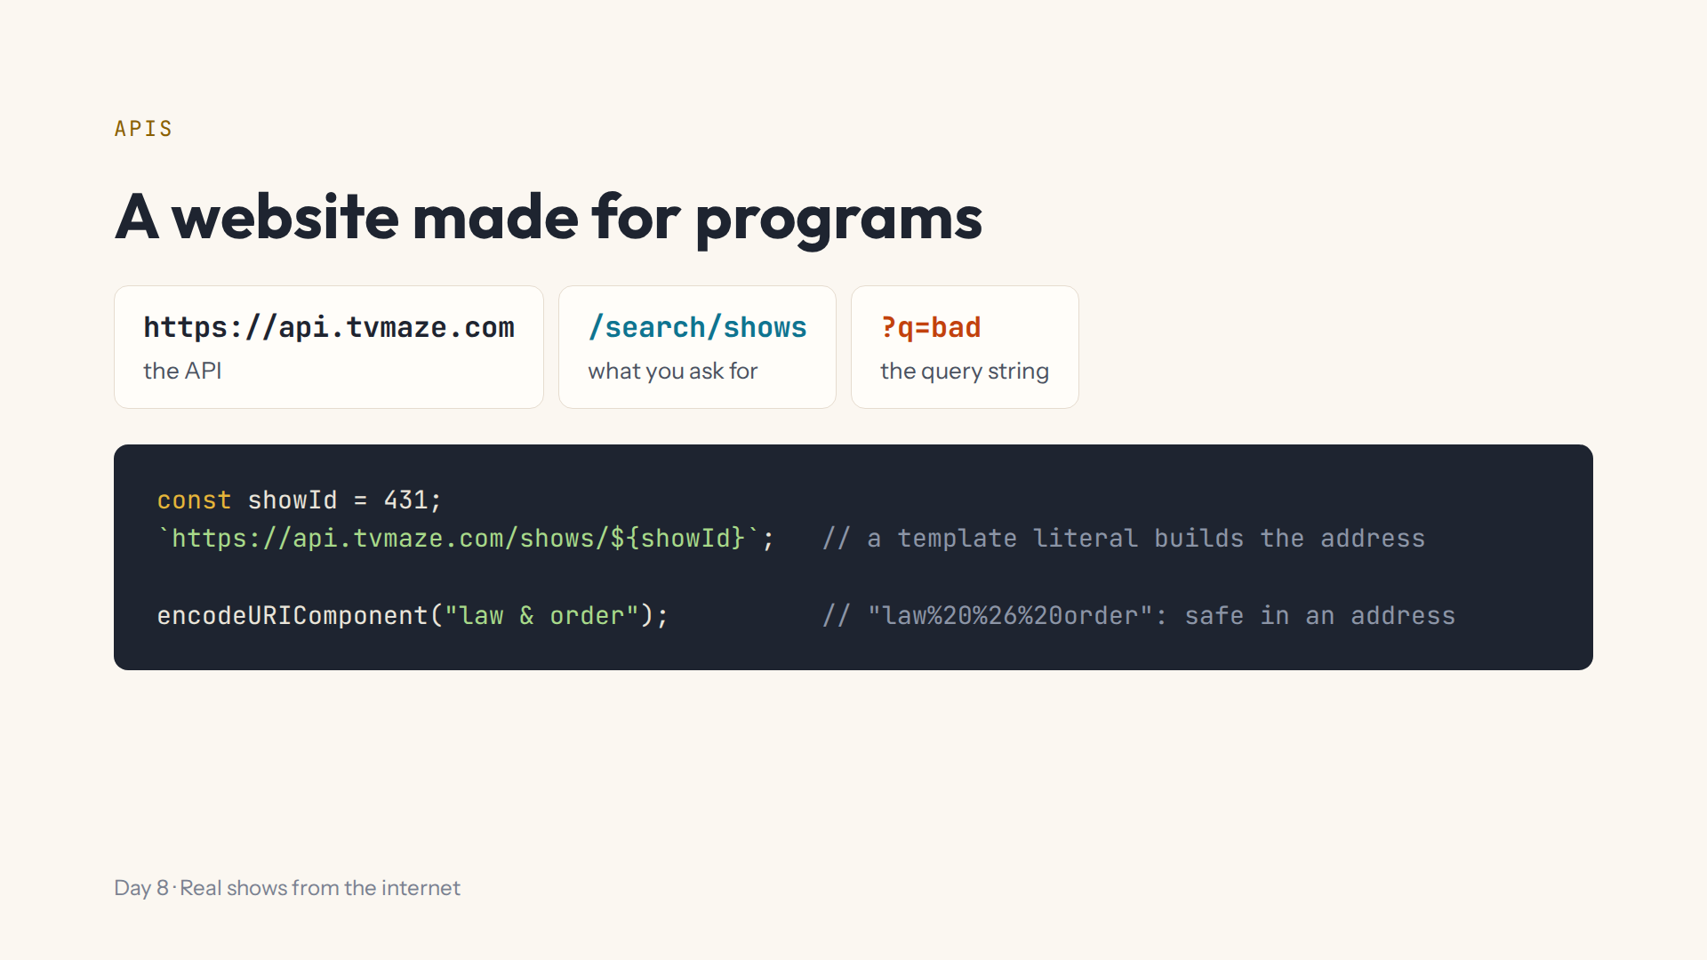
Notes:
Script 0:10, Lab step 1. Open https://api.tvmaze.com/search/shows?q=bad in a browser tab first (skip it offline). Ask what the & would do without encodeURIComponent: it starts a new part of the query string.

Slide 5
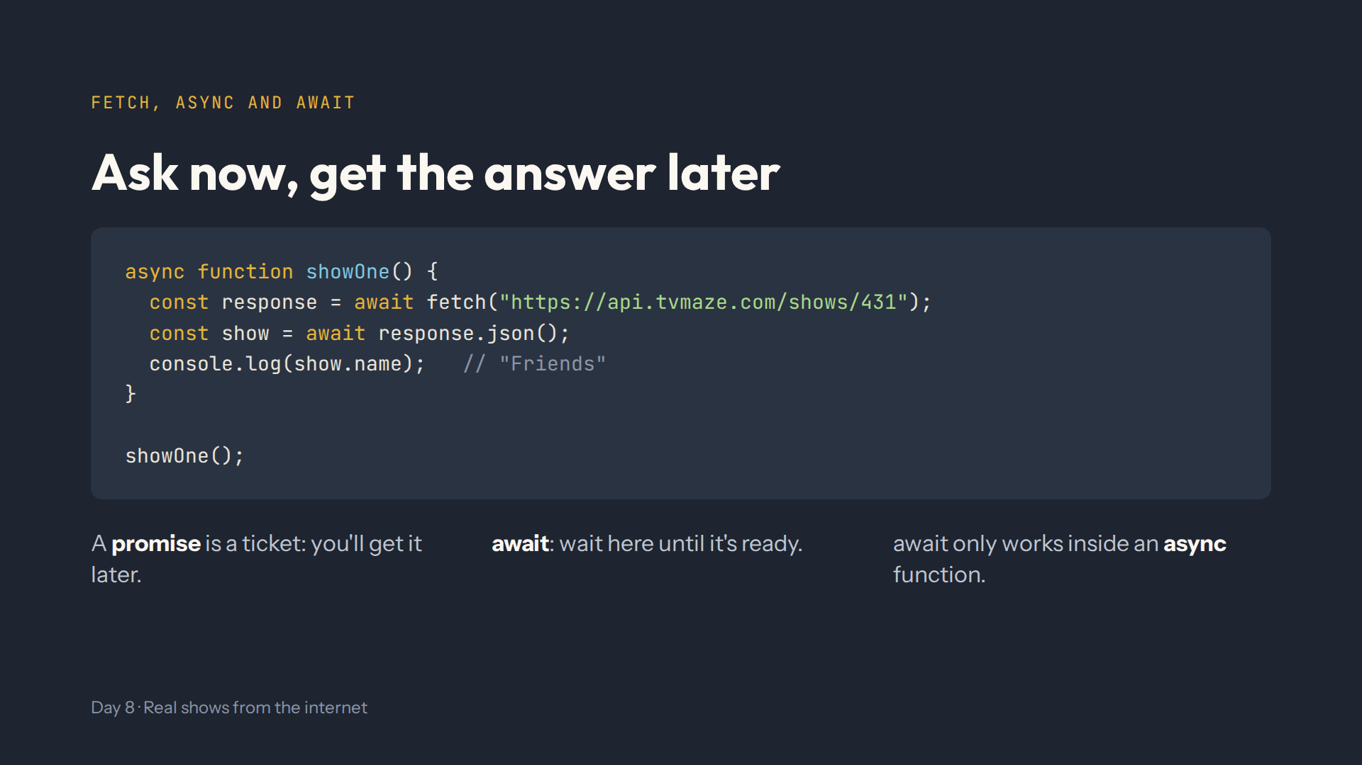
Notes:
Script 0:20, Lab step 2. Two waits: the response first, then its JSON. Mistakes on purpose: no await gives response.json is not a function; no async gives await is only valid in async functions.

Slide 6
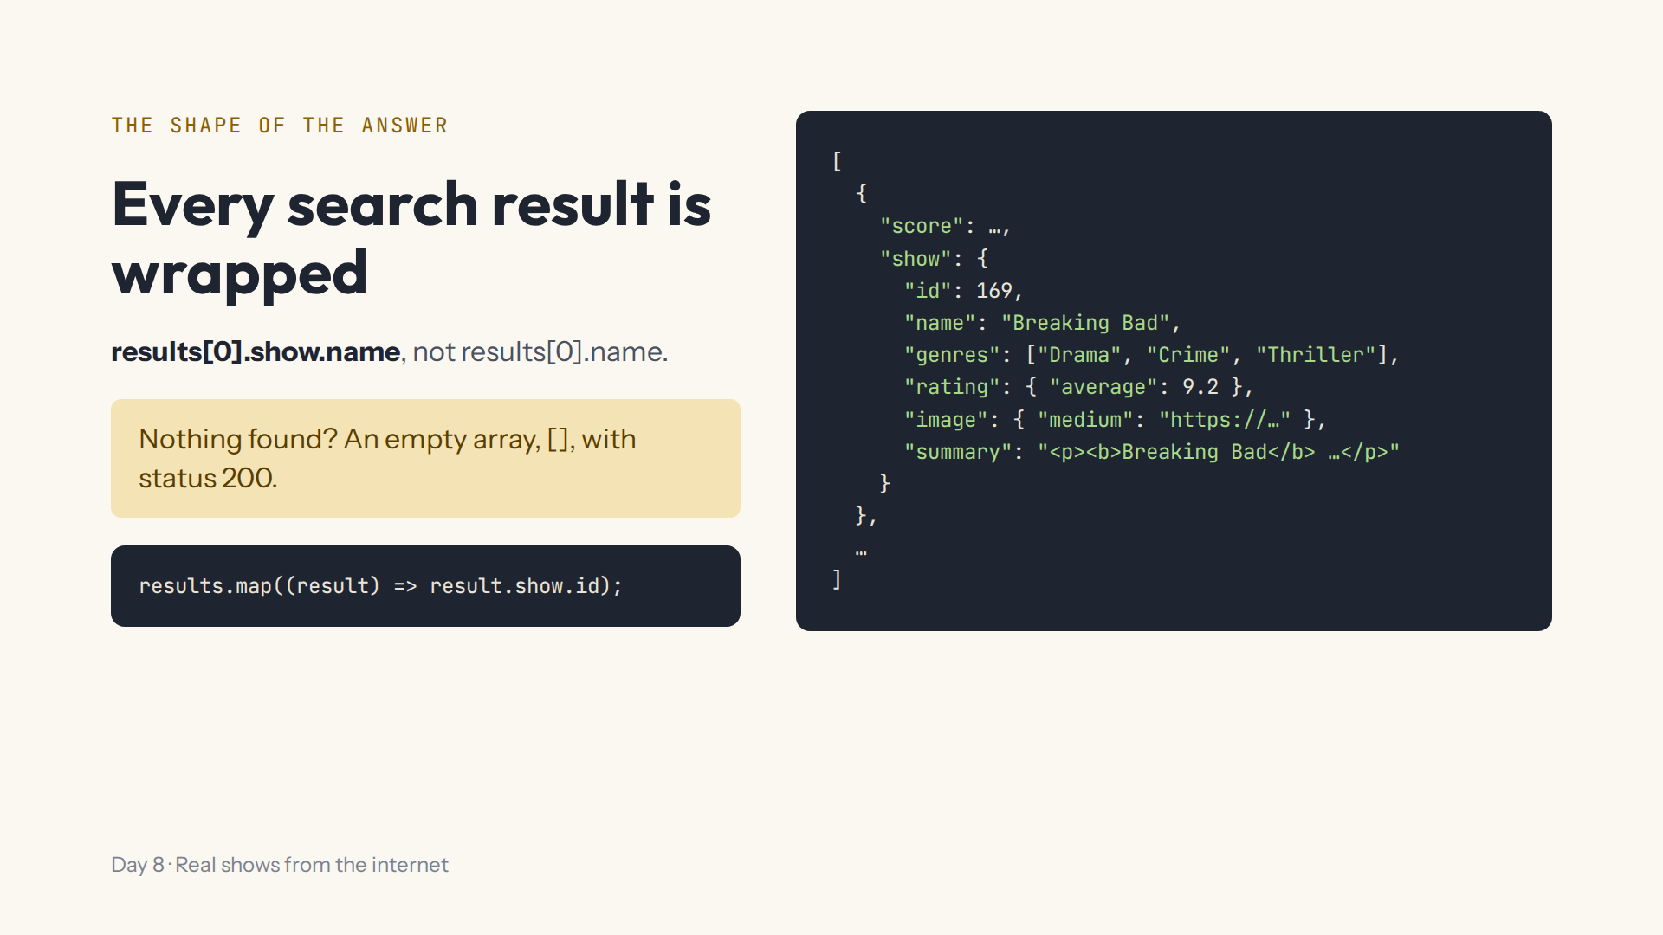
Notes:
Script 0:32, Lab step 3. Shortened: a real show has more fields. Demo with peek() in step 3's code box: log results[0].score and results[0].show.genres. Ask why result.show and not result.

Slide 7
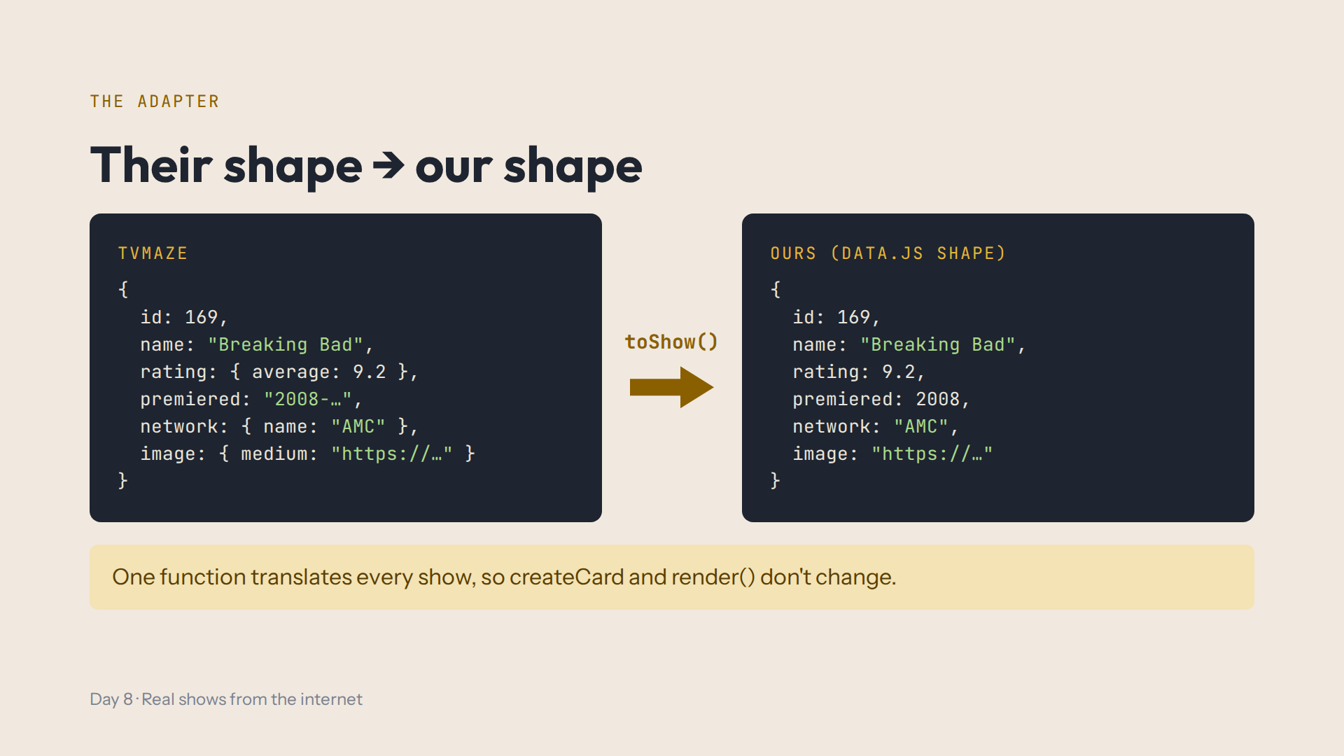
Notes:
Script 0:32, Lab step 4. Open the helpers.js tab and read toShow together. An adapter is like a travel plug. It also removes the HTML tags from the summary. Shortened here: toShow converts genres, ended and runtime too.

Slide 8
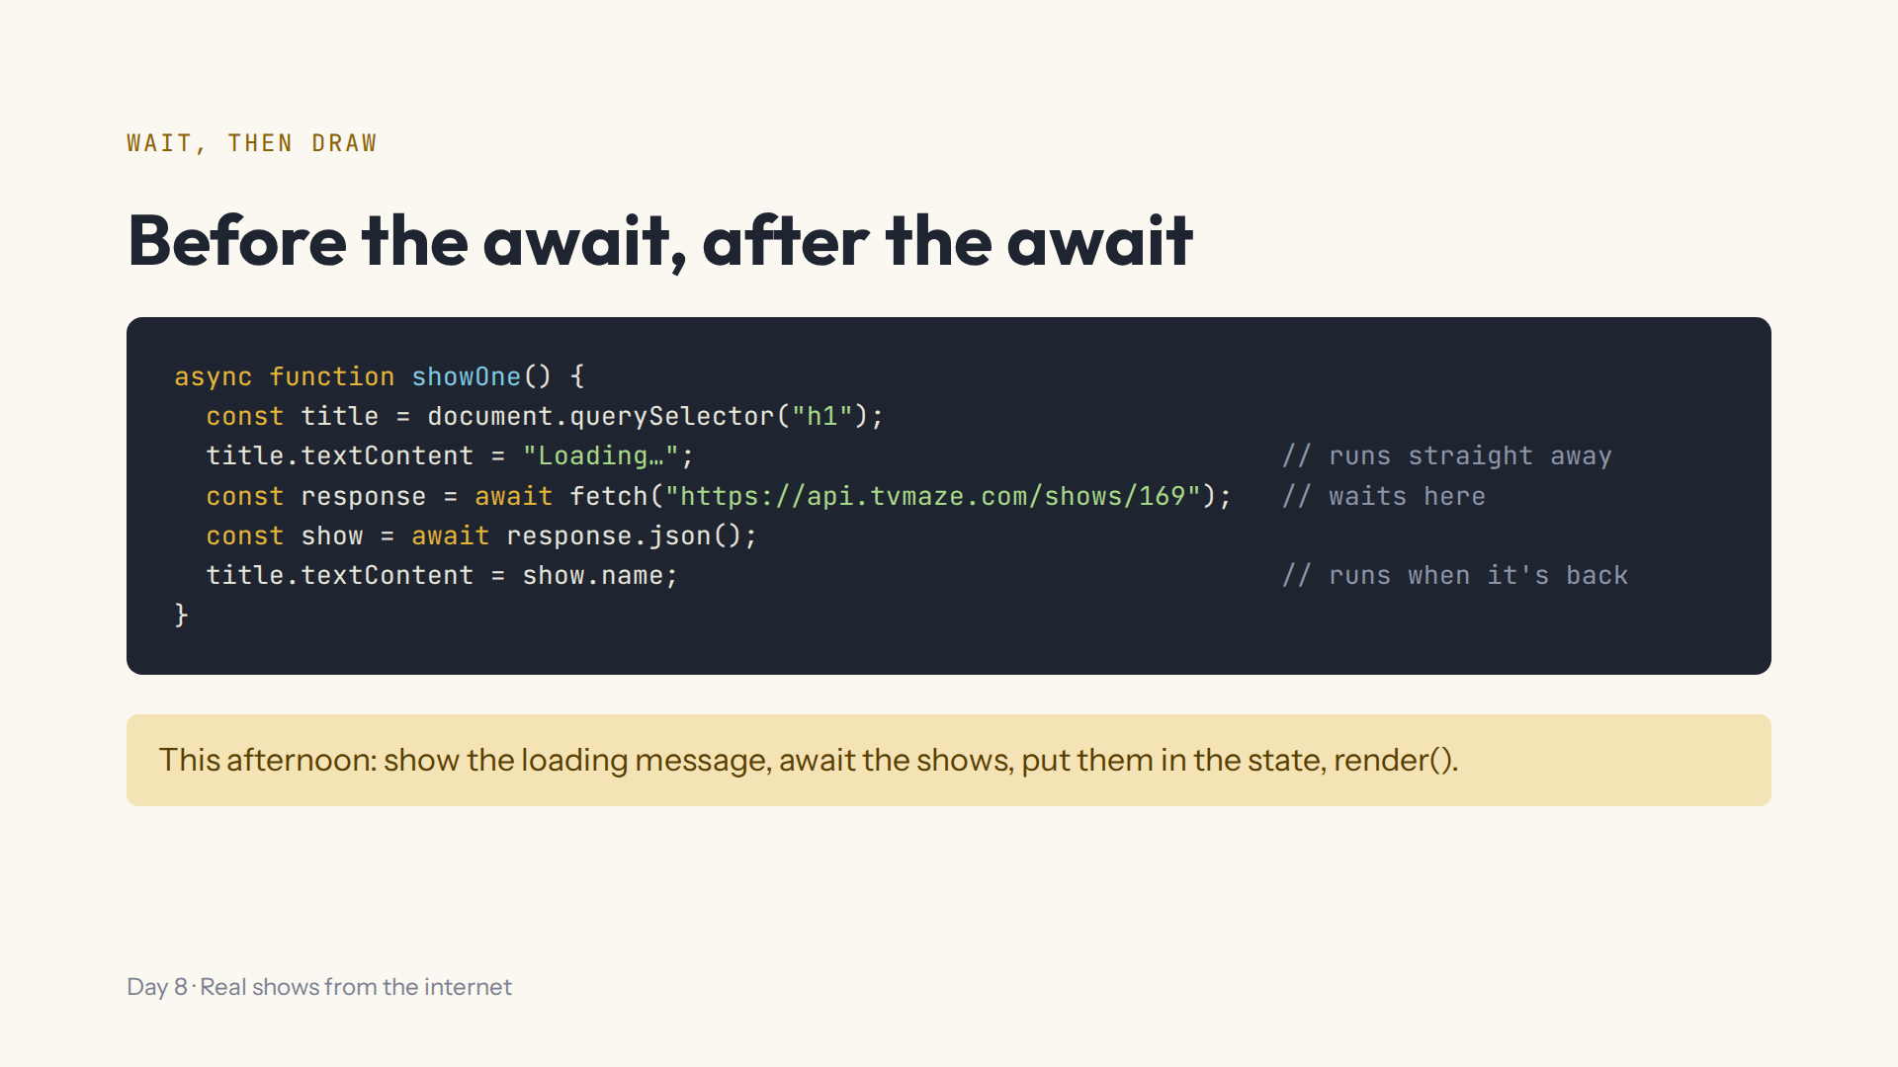
Notes:
Script 0:45, Lab steps 5 and 6. Mistake on purpose: move the Loading line below the await; it never shows. Search when the form is sent, not on every letter: TVmaze allows about 20 requests every 10 seconds.

Slide 9
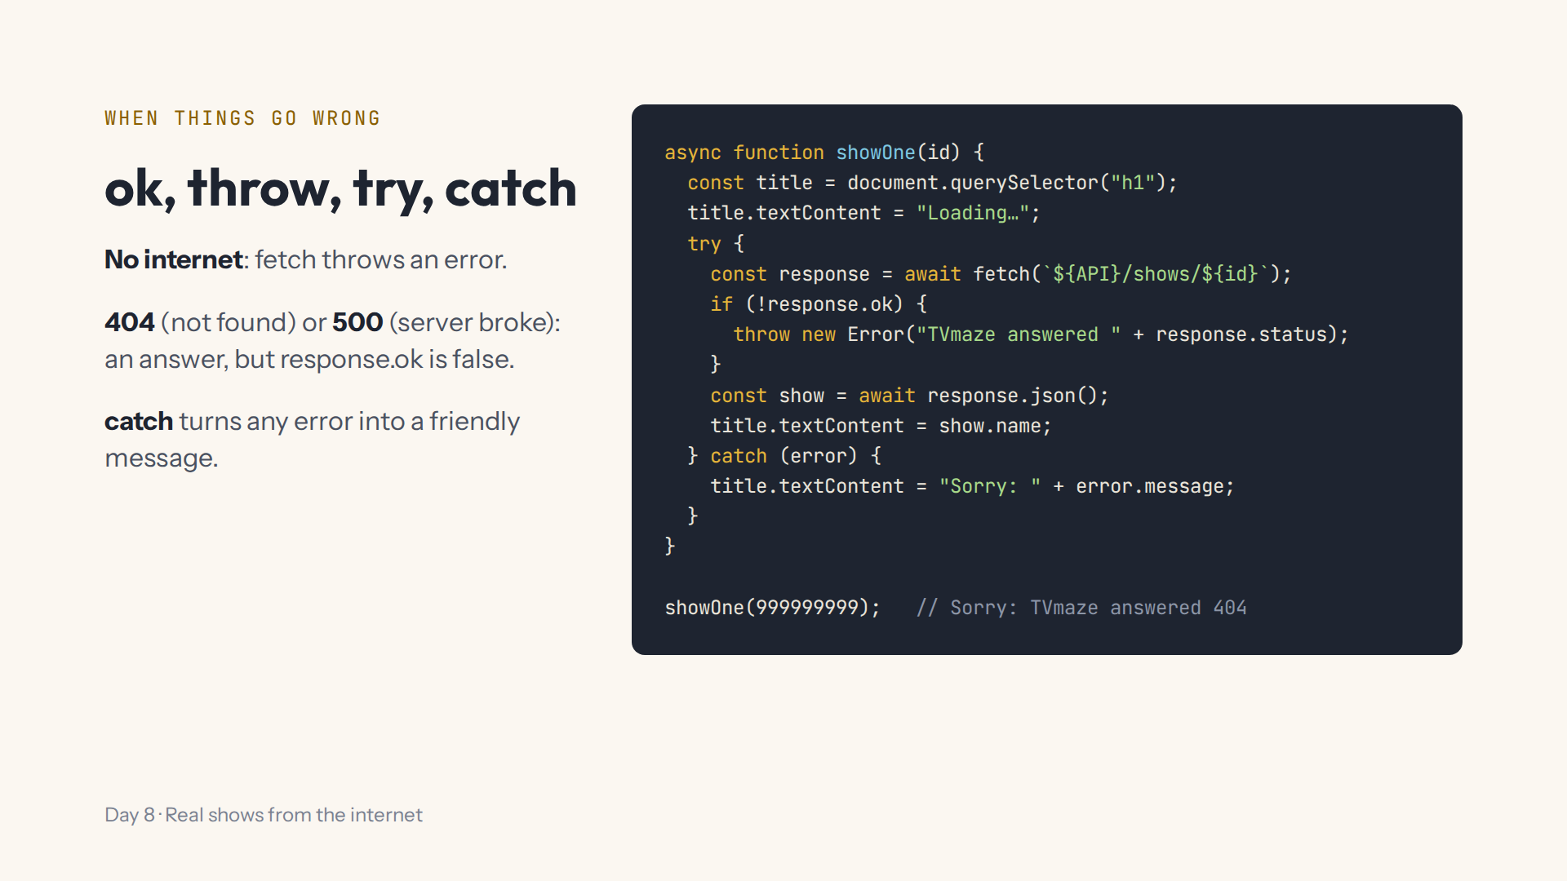
Notes:
Script 0:55, Lab step 7. API is the constant from step 1, already in the code box. Change the id to 431 to see Friends. Mistake on purpose: an empty catch block leaves the page on Loading forever.

Slide 10
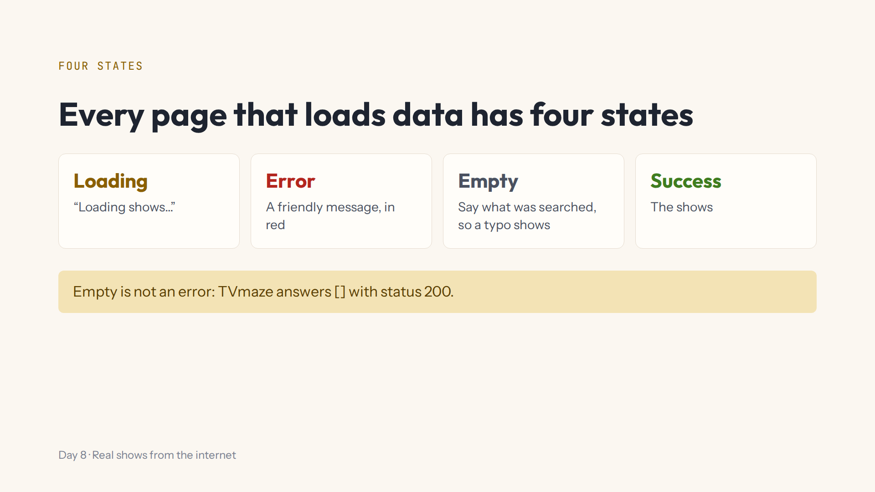
Notes:
Script 0:55, Lab step 8. Good apps show something sensible for all four. After this afternoon, ShowShelf does.

Slide 11
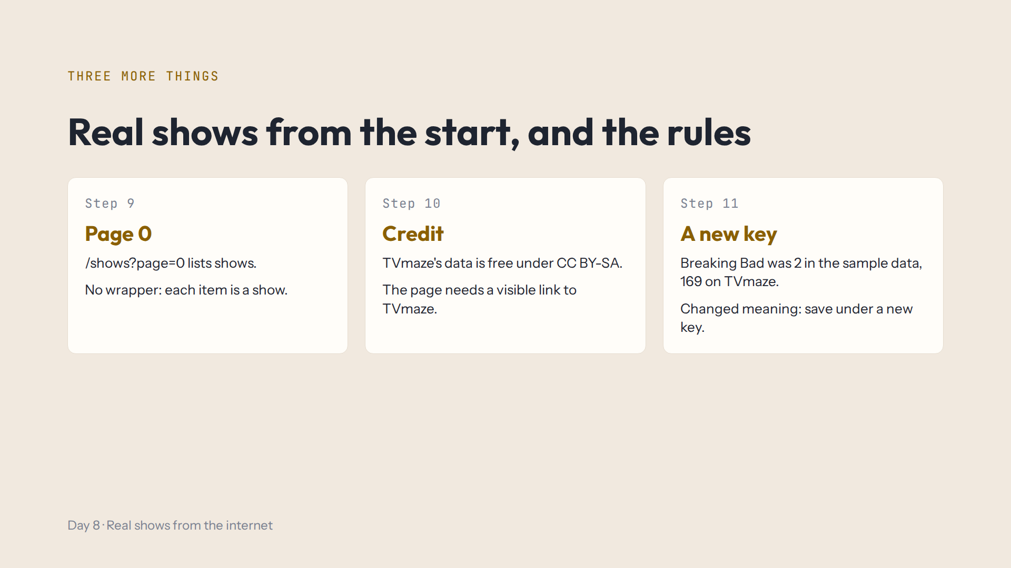
Notes:
Script 1:05, Lab steps 9 to 11. Three short points; the steps explain the details. If online, open https://api.tvmaze.com/shows?page=0 in a tab: a list of shows with no score and no show wrapper.

Slide 12

Notes:
Script 1:10. That's why createCard and render don't change today. Take questions.

Slide 13
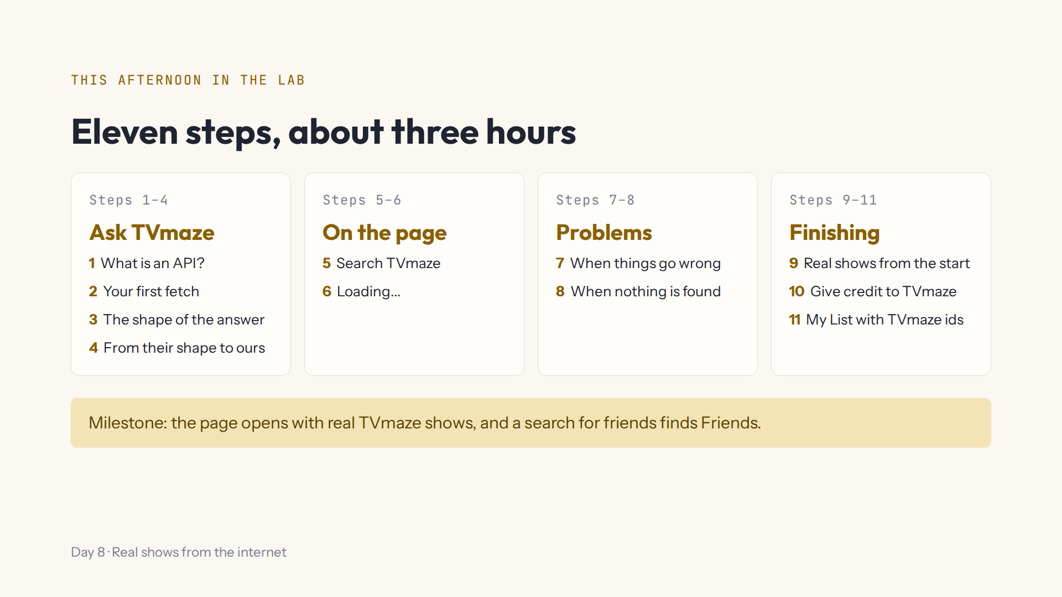
Notes:
Script 1:15. Open #/day/8, show the Day 8 comments in the code box, then do step 1 together. Show Hint, Answer, the Console and Run again. Ask them not to press Run again over and over. Help, Save progress to a file to change computers.

Slide 14
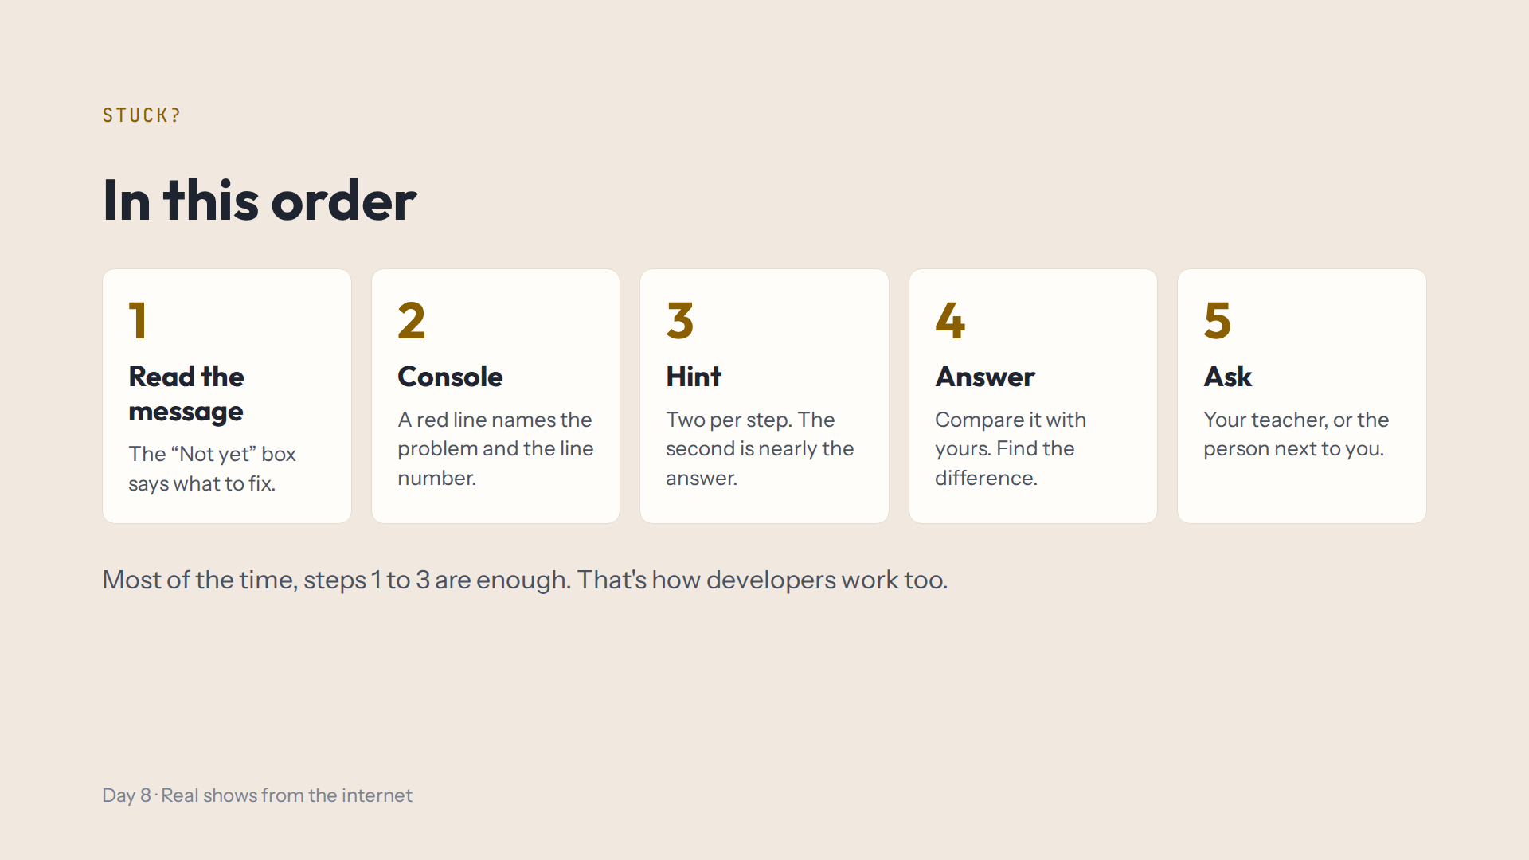
Notes:
Script 1:15. No internet is fine: the Console says when the Lab used saved sample data, and every check works offline.

Slide 15
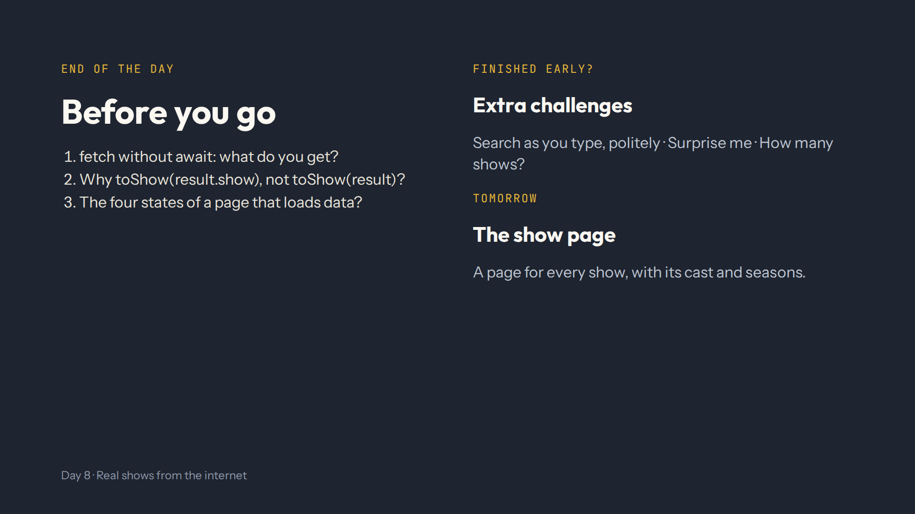
Notes:
For the afternoon teacher at the end of the day. Answers in quiz.md, End-of-day check. Ask them to search zzz, then friends, and show the Data from TVmaze link.

